Slide 1


Comparison of the Lunar Model Using the Hyper-spectral Imager Observations
Yang Wang, Xiuqing Hu，Yu Huang，Shurong Wang，Ling Chen，Lu Zhang
Ronghua Wu，and Zhanfeng Li
Changchun Institute of Optics, Fine Mehcanics and Physics, Chinese Academy of Sciences (CIOMP)
National Satellite Meteorological Center (NSMC), CMA
13-17 November, 2017, in Xian city
2017 Joint GSICS/IVOS Lunar Calibration Workshop
Notes:
Good morning, everyone! My name is Wang Yang. I am delighted to stand here and have this opportunity to share something with you. Today the subject is < Comparison of the Lunar Model Using the Hyper-spectral Imager Observations>

Slide 2
Overview
Introduction
Instrumentation and Observation
Data Processing and Result
Comparison and Analysis
Summary and Future
Notes:
My presentation will include these five parts:

Slide 3
Introduction
  The Moon as an On-orbit Calibration Target,“solar diffuser”, extremely photometrical stable(<10⁻⁸/year)（Kieffer, H. H. 1997, Icarus）
Advantages:
  +Appropriate radiance range for the most Earth-viewing instruments
  +normal Earth-observing optical path without restriction
  +Spectrally bland (from returned Apollo samples)
  +Accessible to spacecraft regardless of orbit
  +Useful as a common transfer source between spacecraft
Disadvantages
  -Spacecraft attitude maneuver
  -Non-uniform reflectance and complex photometric behavior
NASA/Jeff Williams
Lunar model
Notes:
The Moon is used as an On-orbit Calibration Target, the lunar-based calibration is very complementary to other current vicarious[vɪ'keərɪəs;] calibration methods. due to complex photometric behavior, we need a accurate [['ækjərət]] photometric model.

Slide 4
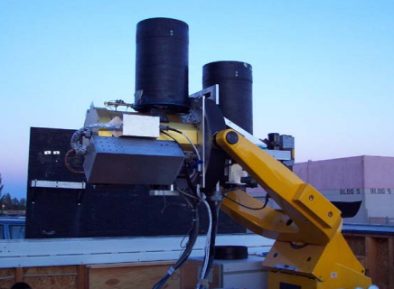
Introduction
* ROLO model （Kieffer, H. H. & T. C. Stone 2005）
A、-VNIR 23 bands, 350-950 nm - SWIR 9 bands, 950-2500 nm
B、8+ years in operation, phase angle coverage from eclipse to 90°
C、~1200 observations fitted for each band, mean absolute residual ∼1%
D、Absolute uncertainty： 5-10%，Relative uncertainty 1%（on orbit）
Application
A、On-orbit calibration：radiometric stability monitor，cross calibration ，inter-channel calibration，etc.
B、Nocturnal aerosol measurements
* MT2009 model (Miller & Turner 2009).
A、hyper-spectral irradiance, 300 to 2800 nm
B、solar source observation, lunar spectral albedo data，phase functions derived from Lane and Irvine
Application
A、Night Band Nighttime Environmental Applications
Ground-based observations：
Calibration accuracy and consistency
Notes:
There have been two lunar irradiance models using the ground-based photometric observations. To date, the most frequently used lunar photometric model is based on a data set of radiance measurements acquired by the USGSʼs Robotic Lunar Observatory., the lunar model’ is used in the calibration of Earth-observing instruments and aerosol measurements. Miller–Turner has developed a lunar hyper-spectral irradiance for quantitative nighttime applications, . we have developed a hyper-spectral observation system for lunar model improvement and validation.
The controllability of ground-based observations is much better than that of spacecraft observations, so
The data has been collected in 32 bands from 350 to 2450 nm
, and a wide range of libration angles, phase angles from near eclipse to typically 90°
especially radiometric stability monitor，cross calibration，and also for

Slide 5
Instrumentation and Observation
1. Ground-based observation system ：imaging spectrometer, equatorial mount and imaging monitor
2. Automated scanning observation：park the spectrometer as the Moon moves across the ﬁeld of view
orbit prediction of the moving Moon and time bias
YANG WANG, YU HUANG, SHURONG WANG, ZHANFENG LI, ZIHUI ZHANG, XIUQING HU, PENG ZHANG, Ground-based Observation System Development of the Moon Hyper-spectral Imaging, Publications of the Astronomical Society of the Pacific, 2017
Notes:
The ground-based observation system mainly includes an imaging spectrometer, an equatorial {ekwə'tɔːrɪəl]}mount and an imaging monitor. When the mount slews to the moon, the imaging spectrometer will be pitched ahead of the moving moon with a long slit perpendicular to the track, and the instrument can create one whole lunar image.
The observation system could accomplish automatically the observing process by adopting orbit prediction of the moving Moon and time offset.
With high SNR, an observing effort was made in the design phase to automate the observing as far as possible.

Slide 6
Instrumentation and Observation
Lunar observations in Lijiang city (3.175 km altitude)
2015.12~2016.2 (2) 2017.11~ now
Slew rate: (6.6~7.2)×10⁻⁵ rad/s
Scanning time(limb to limb): 0.9~1.7 s,
Exposure time: 0.4~1.7 s
Phase angle: -83°~ 87°
Instrument Performance : Cross-Comparison
Lunar Photometer: 280-1040 nm , 2nm
Imaging spectrometer: 400-1000 nm, 2-10nm
Notes:
A three-month observations of the Moon has been conducted at Lijiang. Cross-comparison of lunar photometer and imaging spectrometer is made in the same atmospheric path and time, the curves show a good agreement for normalized disk-integrated signals in these bands.
The moon is observed with 3-miniute spacing, and the slew rate is the angular velocity of the Moon.
Lunar observations can support cross-comparison of different instruments, using the Moon as a common target,
The atmospheric conditions were relatively stable at cloud-free night.
The lunar radiance images were obtained on these nights, spanning phase angles from −83° to 87° .
The scans of the moon pass from limb to limb at 0.9~1.7 second intervals, and the exposure time is from 0.4 to 1.7 seconds with respect to the lunar phase
The left instrument photo is the lunar photometer, and the right instrument photo is the lunar imaging

Slide 7
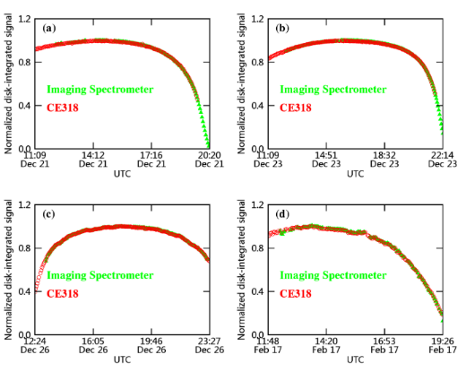
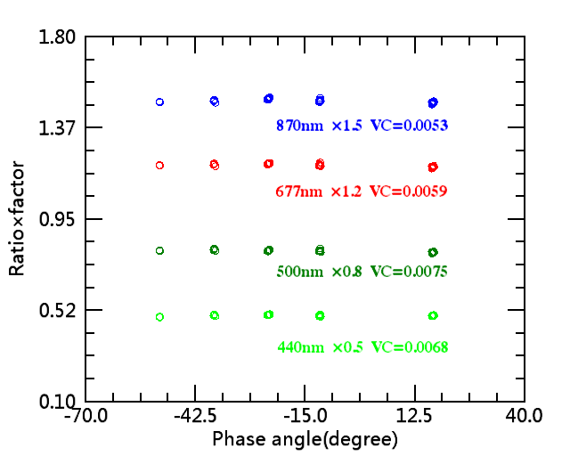
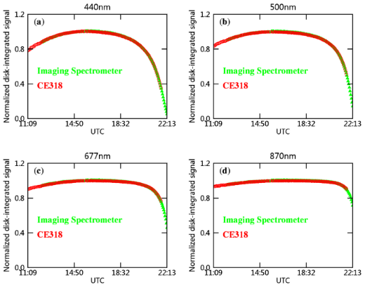
Imaging Spectrometer and lunar CE318 Cross-Comparison :
near the zenith
wavelength
VC= variable coefficient or relative standard deviations
（1）2015.12.23 : 440，500，677，870nm
（2）500nm: 2015.12.21，201512.23，2015.12.26, 2016.2.17
（3）spectrometer/CE318U ratio: normalization values*factor
Lunar Phase
consistent tendency: instrument stability
Notes:
For the spectrometer and CE318U, the curves also show a good agreement for normalized disk-integrated signals in both the wavelength and phase angle. In right Figure, there are the normalized ratios between the two instruments in different phase angle. The variable coefficients for four bands are less than 1%, and the results show a good agreement with phase angle for normalized ratio., and these results indicate that the instrument stability has been achieved.

Slide 8
Data Processing and Result
The TOA irradiance summation equation:
Notes:
The data processing began with raw data apart from a “smear and dark current” correction which includes spectral and oversampling correction. The irradiance is derived from the integration of lunar images that have been corrected for atmospheric extinction and radiometric calibration. these data are processed through the several steps as following

Slide 9
DN Signal preprocessing
(1) Dark current
DN_{dark}=(green line 1+ green line 2）/2
DN₀(λ_{k})= DN_{raw}(λ_{k})-DN_{dark}(λ_{k})
(2) Smear correction
DN_{smear}=blue line 3
DN(i)= DN₀(i)-DN_{smear}(i)
（3）Area selection
1、spatial dimension×scanning dimension
Green line: disk-integrated signal
Blue line——Green line：~0.04% ×disk-integrated signal
Red line: threshold value
2、spectral dimension
>273 channels, 400-1000nm
Notes:
For raw data, the effects of CCD readout smear and dark signal on images are inherent when using the frame-transfer type sensor for sequence acquisition. The average “dark” digital number is estimated from the area beyond the effective area of the detector. The level of the sky background brightness has zero average radiance for all bands. There is small difference between the domain using the threshold-value method and the rectangular ﬁeld of regard。
Full-disk operational images having a rectangular ﬁeld of regard which includes the deep space in the margins and corners are recorded.
The effective region of each slit image is obtained under spectral and spatial selection, and the ensemble of these 1-dimensional slit images constitutes a 2-dimensional image.
. To eliminate the above effects, these effects are subtracted from all slit image frames, Smear DN is pixel value introduced by the smear effect, related to the transfer process, dark DN is pixel value introduced by the dark effect related to wavelength k

Slide 10


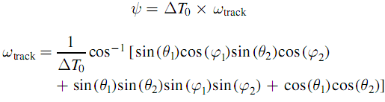
（4）Oversampling factor
The oversampling factor is defined as
SAMPA
Notes:
The Solar and Moon Position Algorithm ['ælgə'rɪðəm] can calculates the lunar zenith [zenɪθ] and azimuth ['æzəməθ] angle. The oversampling factor is be related with integration time and angular velocity which is computed by the lunar zenith and azimuth angle.
Ψ is the angle between moon position A and B, and the angular velocity with respect to the instrument coordinate system is a constant within the time ΔT₀.
, and ΔT₀ is a small value
T_{moon} is the time of one instantaneous field of view along the track direction by the apparent motion of the Moon, T_{scan} is the time of one scan, and it is equal to the sum of the integration time and CCD frame transfer time.

Slide 11
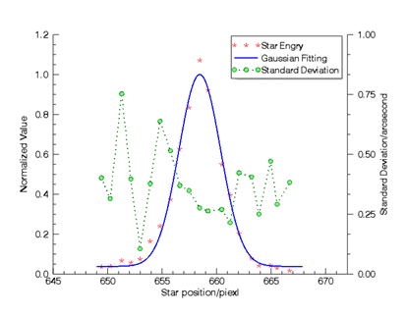
（5）Spectral correction
prism imaging spectrometer——spectrum shift
bandwidth： 2-10 nm
A：Characteristic spectrum lines: mercury lamp
B: Molecular absorption lines: water vapor, oxygen
relative drift-magnitude: <1 pixel in one night
correction： minimum integer pixels
lunar spectrum——spectral calibration,
residual error： <0.5 pixel
（6）Solid angle
Star Scanning method
Notes:
The characteristic spectrum lines of mercury [mɝkjəri]lamp and molecular absorption lines of the atmosphere were used to monitor the wavelength drift of the instrument. A minimum integer value is shifted to match the lunar spectrum with the result of the spectral calibration, There are two methods to calculate the oversampling factor. In two methods, the IFOVtrack in the solid angle and oversampling factor cancels out each other, so the lunar irradiances only rely on the IFOVcross-track. But, the star scanning method is used to measure IFOV along the track direction in the field.
and the spectrum shift correction shows the estimate of the residual error is less than 0.5 pixel.
、due to the environment temperature
Due to the environment temperature, spectrum shift can be continually changing for the prism spectrometer.
Normally, the drift-magnitude is estimated to be less than 1 pixel in the wavelength scale using a mercury lamp to monitor the spectrum lines.

Slide 12
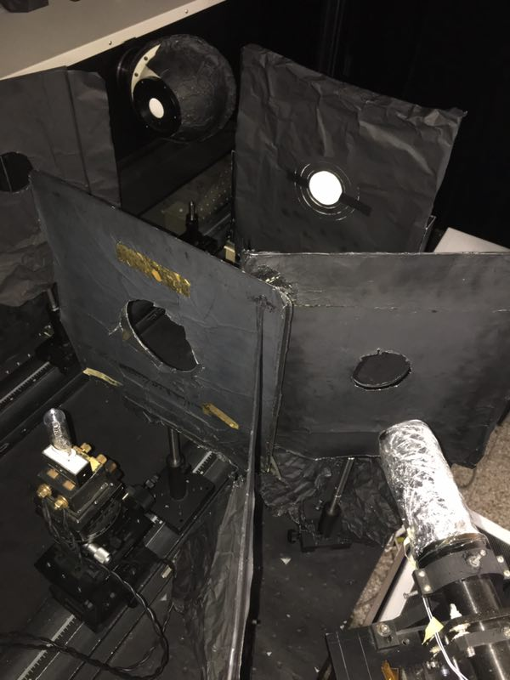
（7）Radiometric calibration
Lamp + Reference plate
To ensure low stray light level (~lunar observation)
System: Lamp + Reference plate +Aperture slot
A. Small field of view
Field angle Ψ_{aperture} of the Aperture slot with respect to the instrument
B. Fill the ﬁeld of view
approximately above 0.5°
Lunar observation ~ Linearity of CDD detector <0.5%
total uncertainty 1.5% (1 sigma)
spectral radiance
responsivity
Changchun Institute of Optics, Fine Mechanics and Physics, Chinese Academy of Sciences (CIOMP)
Anhui institute of optics and fine mechanics, Chinese Academy of Sciences (AIOFM)
National Institute of Metrology, China (NIM)
Notes:
The absolute calibration using the Lamp-Plate system was conducted based on Chinese NIM radiance standard. The low stray light level is obtained for lunar measurements. To meet the requirements of small FOV during the absolute calibration, the field angle with respect to the spectrometer should be close to lunar observation, and we need to utilize a light source large enough to ﬁll the FOV of the spectrometer.
To accurately calibrate the radiometric response,
To avoid precise pointing knowledge of the spectrometer,
The stray light outside the FOV of the instrument were measured in the laboratory.

Slide 13
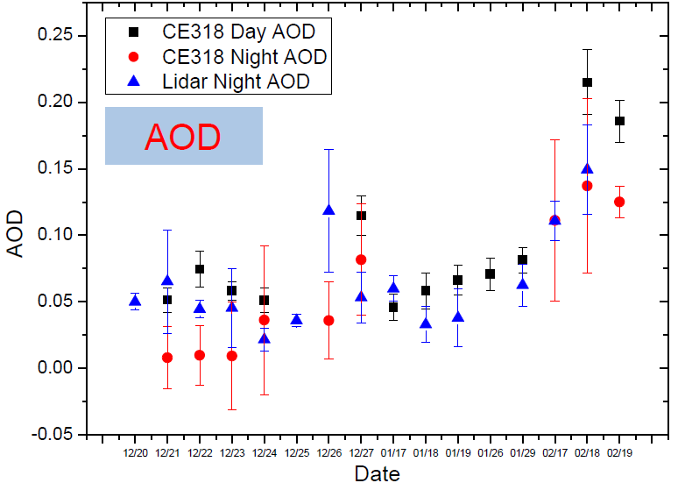
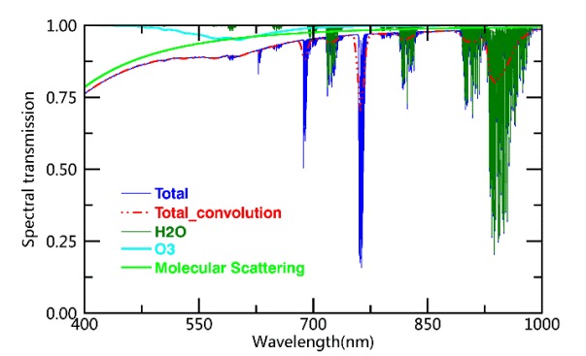
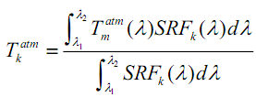
（8）Atmospheric Correction
A. Aerosol Optical Depth：
sun-photometer CE318, lunar-photometer CE318U, LIDAR
rural aerosol model
B. Water vapor :
radiosonde balloons and
C. Ozone，Rayleigh scattering, etc. :
mid-latitude winter conditions
1976 US standard atmosphere
D. Zenith angle:
ephemeris DE421 SPICE toolkit
E. Transmission spectra:
AOD～0.05 (at 550 nm)
AOD=0.03 (at 550 nm)
zenith angle of 10° .
Excellent seeing（< 1”）
Modtran Version 4.3
Notes:
For atmospheric correction, data collected on-site by radiosonde balloons, LIDAR, lunar CE-318U, Sun CE-318 were used to help with the acquisition of model parameters. The Rayleigh scattering and Atmospheric transmittance spectra for these components were calculated with MODTRAN. The atmosphere condition is excellent with about 0.05 of the AOD in the most of observational days, and excellent seeing could be as good as 1”. Lunar zenith calculations were performed with the ephemeris DE421 SPICE toolkit. The plot represents the minimum extinction in lijiang.
The transmission spectra are computed by convolving the MODTRAN transmission spectra with the SRFs.
Ozone and other gases altitude profiles adopt the 1976 US standard atmosphere and mid-latitude winter conditions.
the air of the observation site is essentially free of aerosols and we adopt the rural Aerosol model.

Slide 14
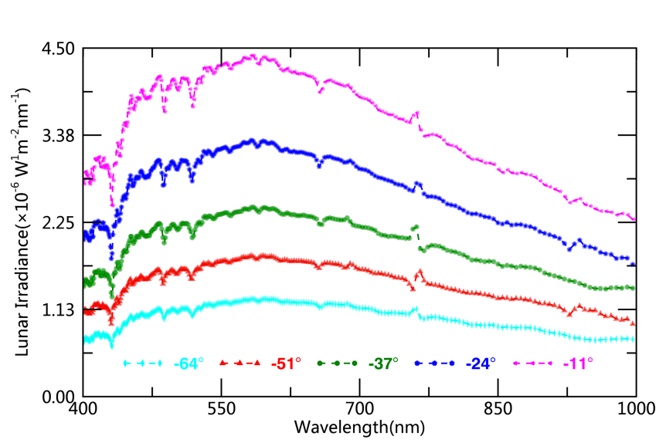
B. Radiance
Result
A. Irradiance
TOA
Atmospheric Correction
Phase angle=-11.46
Notes:
After the above processing, the lunar spectral irradiances for different phase angles and wavelengths are shown in the upper Figure. In the bottom Figure， the spectral radiances are compared in the bright spot and dark spot, and the ratio between the two varies with the wavelength.
Values near 760 and 940 nm show anomalous deviations due to atmosphere correction for strong atmosphere molecular absorption.

Slide 15

C. Typical lunar images
Raw data
①Oversampling factor: 0.75-1.45 ② Scanning lines: ~100 (0.5°) ③ Spatial resolution：20 km×20 km
Notes:
The top panel shows eight observations from different phase angles. Due to a large dynamic range of lunar brightness, an oversampling factor from 0.75 to 1.45 occurs. There are about 100 scan lines in the along-track direction. In the second row, the raw image is reduced to a full-disk image with a uniform spatial resolution, and the corresponding images of the imaging monitor are showed in the third row.
, and the result from the comparison shows that the contours of them are almost the same. , and the number of scan lines depends on the angular velocity, lunar brightness, and SNR
The ground-based observations have been performed to allow the imaging spectrometer to observe the moon at different phase angles.
using bilinear interpolation

Slide 16
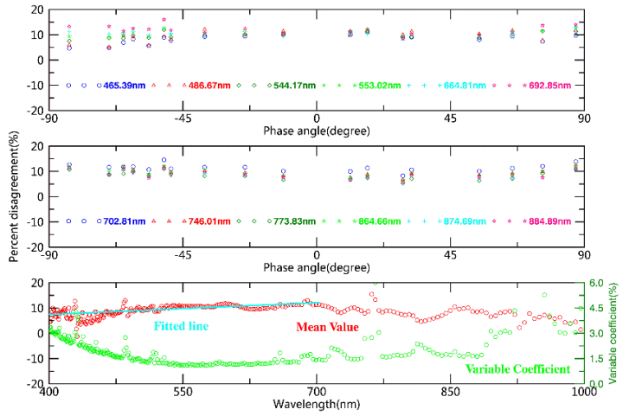
Comparison and Analysis
ROLO model
Measured/model irradiance comparisons
Percent disagreement between the imaging spectrometer and lunar model is
Difference： 5-10%（on orbit）～7%
13% in 603 nm
（Velikodsky, Y. I., et al. 2011）
Uncertainty：1%（on orbit）
Lunar observations in Lijiang：
Difference（ Mean value ）：7-12%，shape ~8.6%
Uncertainty（Variable coefficient）：1-3% ROLO Over Time
Notes:
For different wavelengths, the disagreement with phase angle between ROLO model and measured irradiance is also shown in upper panel. The bottom panel shows the mean values and variable coefficients of percent disagreement, and it shows the 18-day measurements appeared to contain a scale difference of 2% over most wavelengths of interest. The mean discrepancy between the measured irradiance and ROLO model is up to about 8.6%. The results are similar with comparison between most of the on-orbit instruments and the ROLO model, about 7%. The spectral shape of the percent disagreement are similar to that of the most spacecraft-reported observations. According to this paper，the percent disagreement between earth-based instrument and ROLO model is up to about 13% in 603 nm. It shows very good agreement in the whole spectral region from comparison, and these results confirm the results of previous comparisons.
The percent disagreement at 700 nm is the maximum, about 11.2%.
Values near 760 and 940 nm show anomalous deviations due to strong atmosphere molecular absorption.
, and may be associated with the atmospheric correction, spectrum shift or ROLO model error
there is a little scatter in the data with respect to the ﬁtting curves, with relative standard deviations of approximately 1-3% .
To compare with lunar measurements, the lunar model is interpolated in the observational time to provide the TOA irradiances at the spectrometer bands.

Slide 17
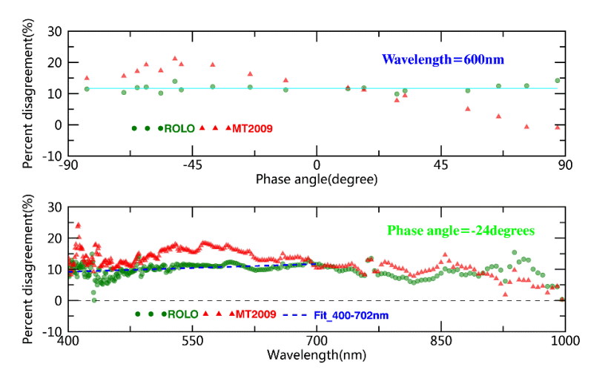
Measured/model irradiance comparisons
ROLO VS MT2009
(1) Lunar Phase : 600nm
(2) Spectrum : -24 degree
MT2009 model: 10-17%
Lunar Phase ：GIRO model >MT2009 model
Notes:
In Figure 14, results of absolute scale comparisons of measured irradiance with ROLO/MT2009 model are shown in different lunar phase and wavelength. The result indicates the ROLO model is more stable than MT2009 in a wavelength consistency of radiometric scales. Compared with the ROLO model, the MT2009 model derived from many data sources does not account for the libration and opposition effect. In the absolute and relative accuracy, the ROLO model is better than the MT2009 model, The percent disagreement is gradually increasing with wavelength before 700 nm and decreasing with wavelength after 700 nm except absorption bands. Therefore the linear regression of the scatters before 700nm is plotted in the figure
Measurement/model differences in 600nm with lunar phase angle are shown in the upper plot.
For each observation, there is a similar shape of the percent disagreement with the upper curve from the bottom panel.

Slide 18
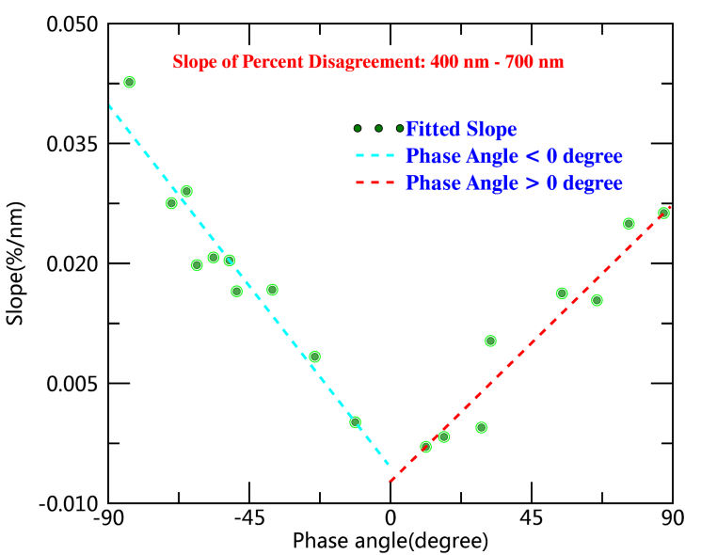

Phase dependence
The slope of fit lines（400-700nm）in different phase angle is
Fit lines of the slope with phase angle is
The phase angle is not associated with
A、transmission spectra ~ AOD
B、calibration coefficient
there is a signiﬁcant linear trend in the slope with phase angle
(negative and positive)
The tilt of the whole spectral shape of the percent disagreement increases with phase angle (absolute value).
The ratios between measured irradiance and lunar model show a signiﬁcant reddening as the phase angle increases
Notes:
For each observation, the slope of the percent disagreement ranging from 400 to 700 nm is showed in green scatter. The slopes with phase angle are irrelevant to the calibration coefficient. It doesn’t look like to be associated with the atmospheric extinction correction, because the AOD is independent of the lunar phase in different days. Therefore, the consistency of the ROLO model is relevant to the lunar phase.
There is a signiﬁcant linear trend in the slope with phase angle. From the slope with phase angle, the variation of the slopes during the waxing Moon is more than that during the waning moon. The slope is close to zero near full moon, and the agreement of the ROLO model near full moon is better than that at the other lunar phase. Therefore, the tilt of the whole spectral shape of the percent disagreement increases with phase angle (absolute value). The ratios between measured irradiance and ROLO model show a signiﬁcant reddening as the phase angle increases.
Linear trend of the percent disagreement in the wavelength with phase angle.
It is not a good linear trend for the percent disagreement from 700 to 1000 nm, but there is the same shape of the slope similar with that of the Figure 15

Slide 19
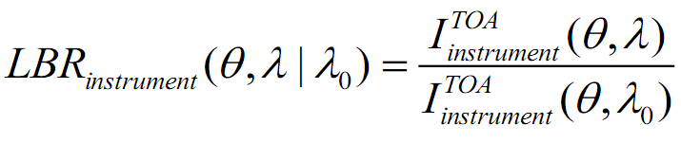
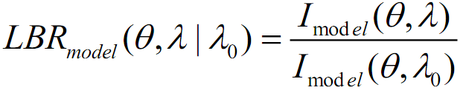
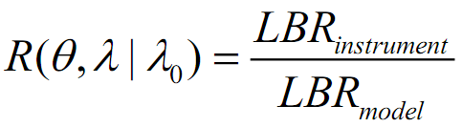
Reference band:700 nm
Lunar band ratio (LBR) comparison
The ratio between the lunar irradiance for different bands ( λ) and the reference band ( λ₀) is
LBR_{instrument} VS LBR_{model}
Lunar Phase : LBR consistency
Spectrum : R（λ）（mean value）， variable coefficient
band to band stability /spectral radiometric performance
Notes:
The Lunar Band Ratio of the lunar model between two bands is characterized by measured irradiances with phase angle. The lunar irradiances with phase angle for all the bands are scaled to absolute photometry at the wavelength λ₀ , respectively for the measurements and lunar model. In the top panel, the ratio R suggests a fundamental in consistency in the LBR of the lunar model from lunar measurements. For each band, the bottom panel gives the mean values and variable coefficients of the LBR comparison distributions from the top panel. The LBR analysis reveals that the agreement in the ratio R with respect to the standard wavelength λ₀ is less than 2% over most wavelengths.
For one reference band, the LBR trending of ROLO model agrees well with that of lunar measurements. The LBR analysis indicates this method can be used to reveal the band to band stability of the lunar model.
Lunar Band Ratio is applied to trend satellite radiometer performance, However, we use the LBR method to monitor spectral radiometric performance of the ROLO model.
LBR method also provides a useful monitoring tool to verify the relative radiometric stability of bands for the lunar model.

Slide 20
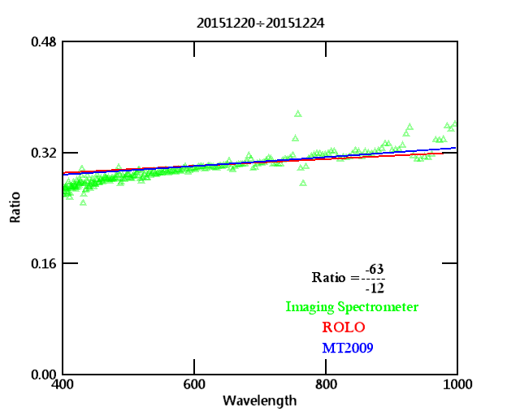
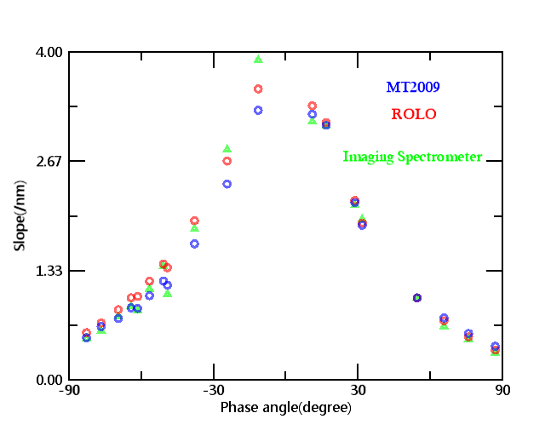
Phase Reddening
slope
The ratio between the (TOA) irradiance I(θ , λ) and the irradiance I(θ₀ , λ) is
Phase angle
Slope: ROLO VS MT2009 VS Spectrometer
atmospheric correction or lunar model
ROLO > MT2009
Notes:
In the upper plot, there is a linear trend with wavelength in the ratio between the irradiance at the phase angle θ and the irradiance at the reference phase angle θ₀ . For the 18-day observations, the slope of the ratio at the phase angle θ is showed in the bottom plot. In the same conditions, the result shows the trend of lunar models , which is the slope with the phase angle is well consistent with measured irradiance
For the measured data, the slopes is respectively fitted at the phase angle θ
, the result of the ROLO model is slightly better than that of the MT2009.
due to the atmosphere correction or lunar model, there is the inconsistency between lunar model and measured data.

Slide 21
Lunar observations
Dominant Sources
（1）Absolute Scale
Lamp-Plate system：
QTH lamp, hemispherical reflectivity and Lambertian characterization
（2）Spatial stray
Instrument calibration: systematic deviation
Lunar observation: ~0.5 °
（2）Atmospheric correction
atmospheric characterization tools:
AOD：~0.05 0.012(550 nm) zenith angle: 10°
Transmission spectra : 0.6~1.7%(400-1000nm)
（3）Spectrum Shift Correction
Spectral dimension：Maximum drift-magnitude of 0.5 pixel
Secondary sources
（1）Pixel IFOV in the cross-track direction
（2）Scanning mode（one lunar disk）: angular velocity， movement trajectory，orientation of the slit （3）Instrument：stability，linearity
（4）oversampling factor
Lunar model: ROLO
Instrument calibration: Vega
Atmospheric correction : Standard stars
Comparison and Analysis
(1) phase angle
(2) spectrum
Notes:
The dominant sources of uncertainty are derived from atmosphere extinction, absolute calibration, spatial stray and spectrum shift
For the radiometric response, the uncertainties are associated with the Lamp-Plate system and spatial stay. Since the radiance of its background is virtually zero, the low stray light level is obtained for lunar measurements and instrument calibration. For the analysis of lunar measurements, the absolute difference derives from the respective approaches to the atmosphere corrections and radiometric response calibrations. Our measurements are in agreement with independent lunar measurements by the most of spacecraft and ground-based instruments， and the results of comparison indicate the consistency of the ROLO model is related to the lunar phase and wavelength.
this term contributes 0.6-1.7% to the whole transmission spectra.
When the AOD is 0.04 at 550 nm and its variation is equal to 0.012,
at 10° zenith angle for all bands, except absorption bands.
stray also makes contribution to the radiometric response and it is systematic error.
The ROLO model is tied to the photometric star Vega for absolute scale, and a set of standard stars is observed regularly to provide atmospheric extinction correction.

Slide 22
Summary
— Stability of out-field instrument in different observation conditions
— humid, dry, temperature, attenuation, lunar polarization，etc.
— Standardization of data processing is precondition of comparison
— different sampling method, area selection，etc.
— Atmospheric corrections, calibration and instrument performance are the key contributing factors
Future
— Enables precise accounting of instrument spectral response functions
— instrument calibration in the manner of lunar observation (stay light)
— different approaches to the radiometric response calibrations
— Improves the accuracy of atmospheric corrections
— evaluation of the AOD data from different instruments
— different approaches to atmosphere corrections (Lunar-Langley method？)
— Comparison with the other data source from different instruments on orbit or on the ground
— data quality, reliability data
— Collect more lunar data in Lijiang
— validate and improve the current lunar models
Notes:
In the summary
For Lunar observation, the stability of out-field instrument in different observation conditions is very important。
Standardization of data processing is precondition of comparison
(3)The development of low-uncertainty atmospheric extinction correction and calibration are two important parts for research effort
In the future
(1）A dedicated effort is currently underway to tie the spectrometer response to the radiometric scale of the NIM and Improves the accuracy of atmospheric corrections
To check the data， comparison with the other data source from different instruments on orbit or on the ground is done
(4) We need more lunar data in Lijiang to validate and improve the current lunar models
calibration in the manner of lunar observation (stay light). different approaches to the radiometric response calibrations.

Slide 23
Thank you

