Slide 1
A Novel Hyper-spectral Lunar Irradiance Model Based on ROLO and Mean Equigonal Albedo
Lu Zhang, Peng Zhang , Xiuqing Hu, Lin Chen
National Satellite Meteorological Center （NSMC）

Slide 2
Outline
Introduction
Theory and Methodology
New lunar model
Validation

Slide 3
Introduction
The uncertainty of ROLO Model estimates are 5-10% (Kieffer & Stone, SPIE, 2005) .
The ROLO Model.
ROLO’s raw data are acquired only in 32 spectral bands between 350 nm and 2,500 nm.
The ROLO hyper-spectral lunar irradiance model was developed by making an adjustment to the ROLO model reflectance using the reflectance of Apollo samples.

Slide 4
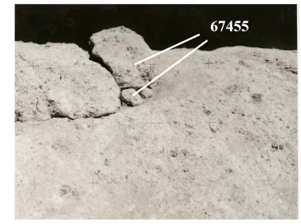
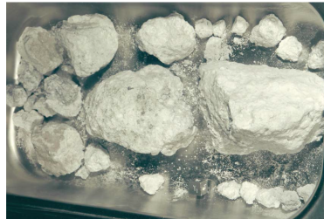
Introduction
The reflectance of returned Apollo soil samples measured in the laboratory are significantly different from that in lunar.
1. Gravitational Forces
(C.A. Dukes, R.A. Baragiola 2014)
https://www.lpi.usra.edu/lunar/samples/
Notes:
The sample’s surface is more crowed in earth than moon.
And this have some influence on reflectance.

Slide 5
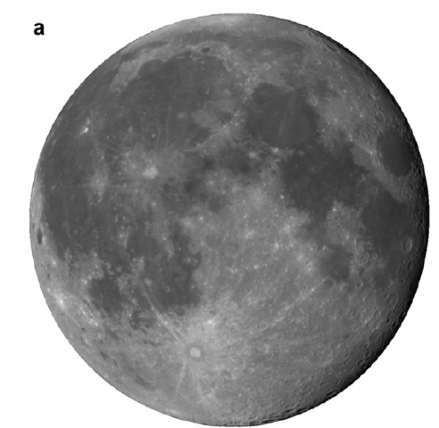
Introduction
2.Lunar Regolith
3.The ratio lunar Mare and Highland in composite spectrum is change with lunar phase angle.
(C.A. Dukes, R.A. Baragiola, Icarus, 2014)
(Velikodsky, Icarus, 2011)
Notes:
The lunar regolith covered the lunar surface, are destroyed.
The soil breccia,ROLO used a fixed ratio of 95%soil.I am not sure this ratio change with phase angle.

Slide 6
Theory and Methodology
Equigonal Albedo.
1.Spectrum of equigonal albedo of the average Lunar highlands and Mare been deduced from the catalog of C. Pieters(based on Earth ).
2.The ratio of Highlands and Maria change with phase angle.
The relationship between equigonal albedo of lunar disk and the effective disk reflectance.
:the effective disk reflectance.
:the equigonal albedo of lunar disk.
.
...
:the disk function.
.
i is the incidence angle, e is the emission angle and phase angle.
(Velikodsky, Icarus, 2011)
(Lu Zhang, Peng Zhang. Optick 2017)
Notes:
Hyper-spectral reflectance

Slide 7
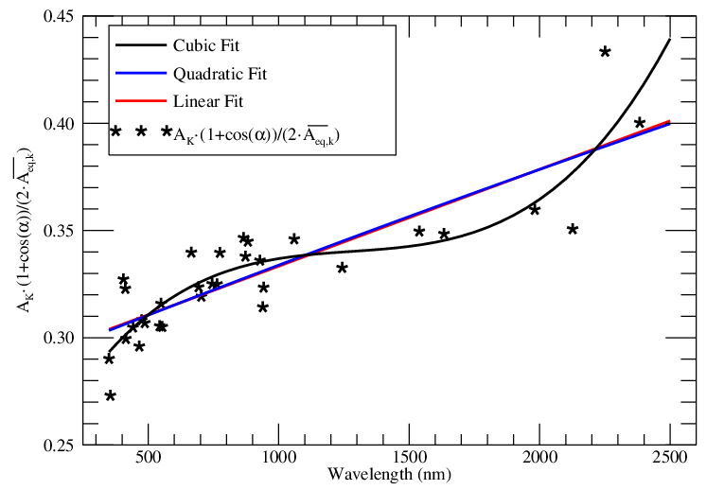
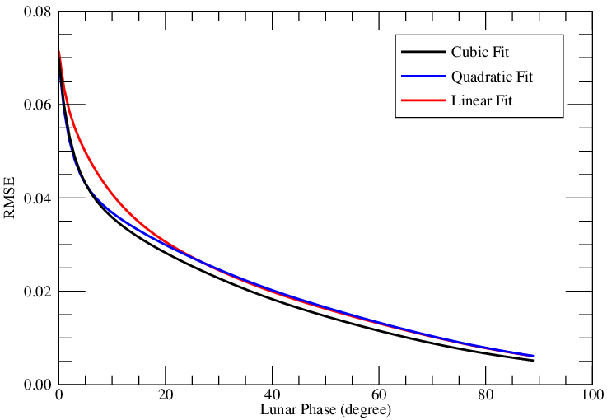
Theory and Methodology
At a fixed observation geometry, the , , are change with wavelength.
at lunar phase of 49.96º. (the black, red and blue lines respectively represent cubic fit, quadratic fit and linear fit)
The RMSE of polynomial fit for at 49.96º of lunar phase (the black, blue, and red lines respectively represent the RMSEs of cubic fit, quadratic fit, and linear fit)
(Lu Zhang, Peng Zhang Optick 2017)
Notes:
The function of wavelength.
Change breve

Slide 8
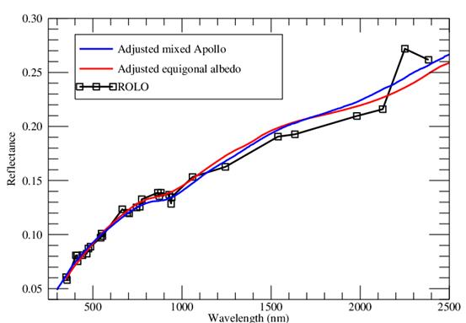
New lunar model
Adjustment to the ROLO model reflectance using equigonal albedo and mixed Apollo sample (lunar phase is 7º, selenographic longitude of the Sun is 7º, both of the selenographic latitude and longitude of the observer are 0º , the blue line is the reflectance of adjusted mixed Apollo sample, the red line is the reflectance of adjusted mean equigonal albedo, the black line with square is the effective disk reflectance of ROLO 32 bands. )
(Lu Zhang, Peng Zhang, Optick 2017)
(Kieffer, H. H.; Stone, T. C.,The Astronomical Journal, 2005, 129(6), 2887)

Slide 9
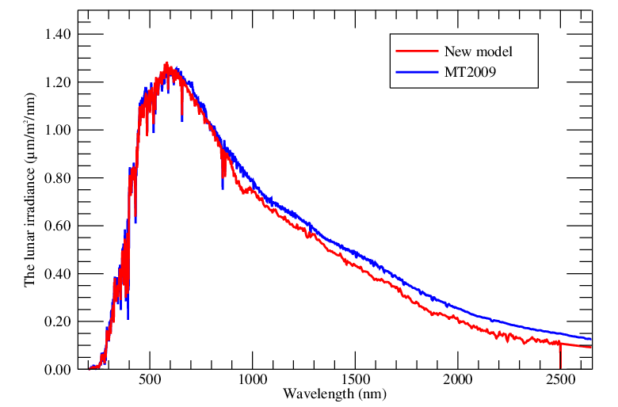
Validation
Lunar irradiances simulated by the new lunar model and MT2009. The phase angle of lunar is 49.96º, selenographic longitude of the sun is -45.59º, selenographic latitude and longitude of the observer are 4.37º and 4.12º, respectively. the Solar Spectral Irradiance is derived from the model of Wehrli (Wehrli, 1985), the red and blue lines are the lunar irradiances from the new model and the MT2009.
(Miller, S. D.; Turner, R. E.Geoscience and Remote Sensing, IEEE Transactions on, 2009, 47(7), 2316-2329)

Slide 10
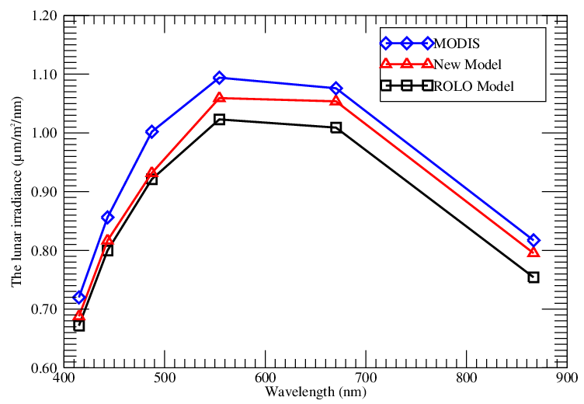
Validation
Comparison of lunar irradiances from MODIS observations at UTC 2007-01-08 06:14:21, and the ROLO model and the new model simulations.
(Lu Zhang, Peng Zhang , Optick 2017)
(Radiometric calibration stability and inter-calibration of solar-band instruments in orbit using the moon, Stone, T. C.,2008)

Slide 11
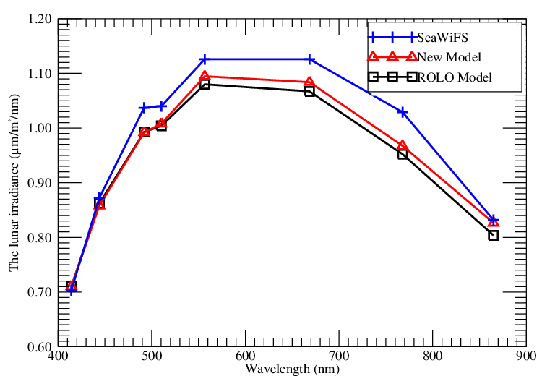
Validation
Comparison of lunar irradiances from SeaWiFS observations of UTC 2007-01-08 03:56:20, and the ROLO model and the new model simulations.
(Lu Zhang, Peng Zhang , Optick 2017)
(Radiometric calibration stability and inter-calibration of solar-band instruments in orbit using the moon, Stone, T. C.,2008)

Slide 12
Some earth-based observation lunar irradiance.
Miller model.
Notes:
Some earth-based hyoer-spectral lunar reflectance.

Slide 13
The end

