Slide 1
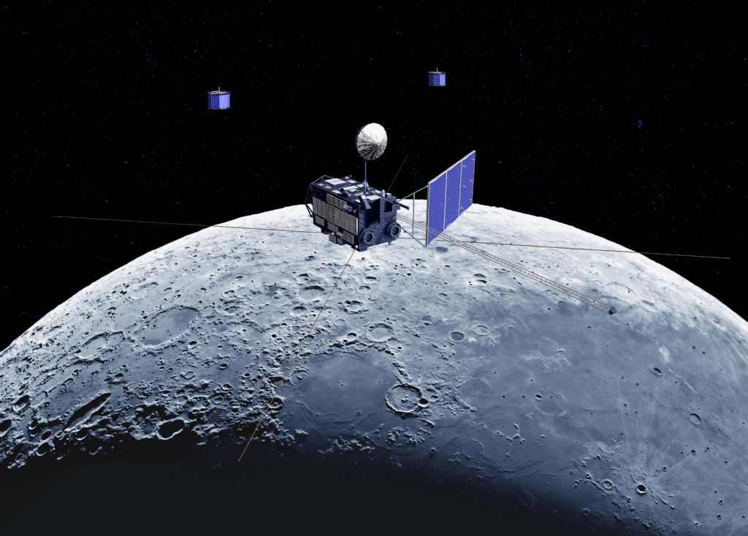
Lunar reflectance model based on SELENE/SP data
Toru Kouyama (AIST)
Matsunaga, Nakamura, Yamamoto, Yokota and Ishihara
SELENE/SP Team
Yokota et al., 2011. Lunar photometric properties at wavelengths 0.5–1.6 μm acquired by SELENE Spectral Profiler and their dependency on local albedo and latitudinal zones. Icarus215,639–660.
Kouyama et al., 2016. Development of an application scheme for the SELENE/SP lunar reflectance model for radiometric calibration of hyperspectral and multi spectral sensors, Planetary and Space Science.

Slide 2
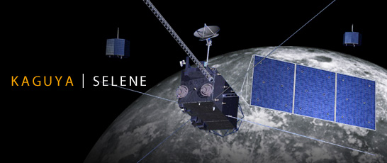
SELENE(KAGUYA) and SP
(Spectral Profiler)
SELENE:
・Size: 2 x 2 x 5m, 14 science instruments
・Orbit: Polar orbit (non sun-synchronous)
Altitude: 100 km
Ground track repeat cycle: ~ 30 days
・Mission period: 2007 – 2009 (finished)
Observing lunar surface
with various solar incident and phase angle conditions.

Slide 3
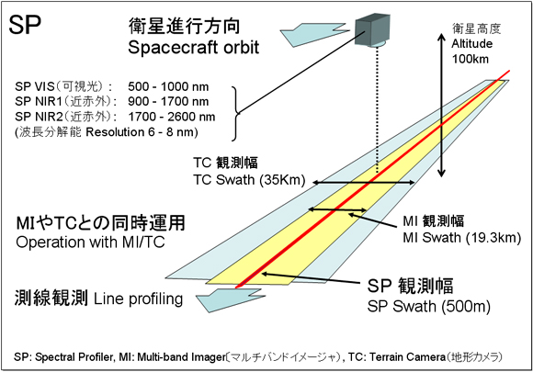
SELENE(KAGUYA) and SP
(Spectral Profiler)
Sensor type: Spectrometer
Point sensor
Spectral
Multi-band Imager
Terrain Camera
http://www.kaguya.jaxa.jp/en/equipment/tc_e.htm
Notes:
Sensor type: Spectrometer
Spectral range:
500-2600 nm
Spectral resolution:
6 nm (VNIR 520-960 nm)
8 nm (NIR-SWIR > 900 nm)
Observation swath
500 m

Slide 4
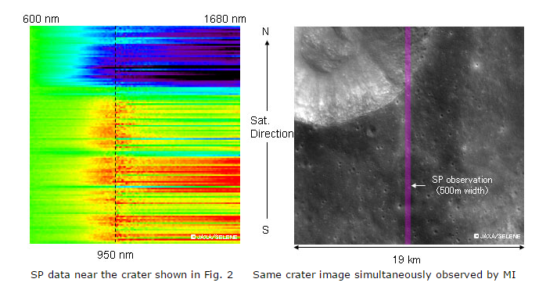
SELENE(KAGUYA) and SP
(Spectral Profiler)
SP Data
MI image and SP footprints
Wavelength
Spatial (along track)
Wavelength
http://global.jaxa.jp/press/2007/12/20071214_kaguya_e.html
Notes:
During the mission, SP obtained this kind of data globally and repeatedly.

Slide 5
SP Lunar Reflectance model (Yokota et al., 2011)
Integrating 70 million observation data covering whole lunar surface with various phase angle conditions
Reflectance map (758nm, i=30, e=0, α=30°)
Reflectance spectrum
at a reference condition
φ=30°, i = 30°, e=0°
Notes:
Including incident, emission and phase angle dependencies using empirical functions

Slide 6
SP Lunar Reflectance model (Yokota et al., 2011)
Integrating 70 million observation data covering whole lunar surface with various phase angle conditions
Reflectance map (758nm, i=30, e=0, α=30°)
Spectral range:
512 – 1650 nm (160 channels)
Δλ = 6 - 8 nm
Grid interval (Spatial resolution)
0.5˚ x 0.5˚
Including parameters for reproducing incident, emission and phase angle dependence
Notes:
Including incident, emission and phase angle dependencies using empirical functions

Slide 7
ASTER vs SELENE/SP
Observed
Simulated
[Kouyama et al., 2016, PSS]
ASTER/Band 2 (660 nm)
April 14, 2003
SP model is a radiance base model

Slide 8
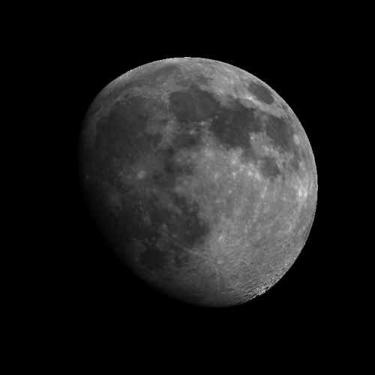
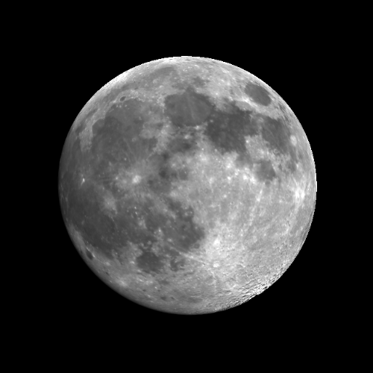
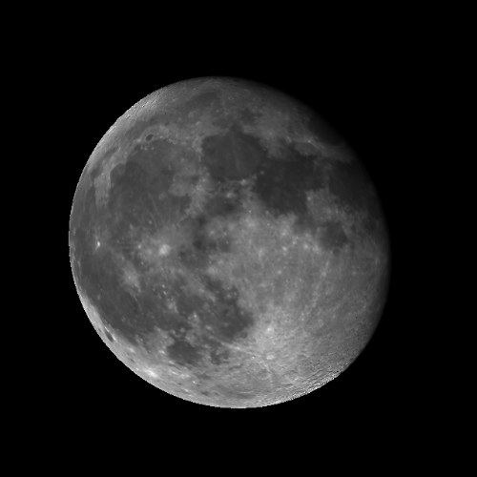
Simulating Moon observations
April 13, 2003
April 15
April 18

Slide 9
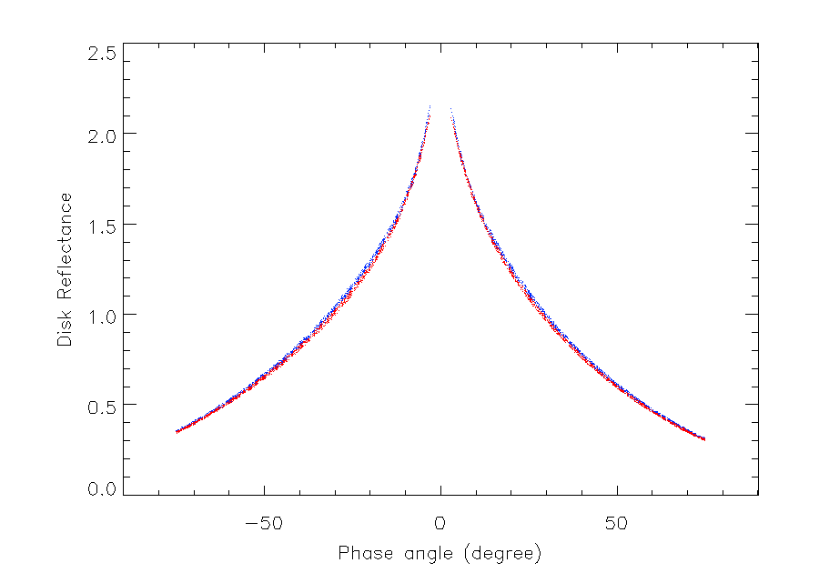
Phase angle dependence of SP model
ROLO
SP model
Disk reflectance
(Normalized by 30°)
@ 745.3 nm

Slide 10
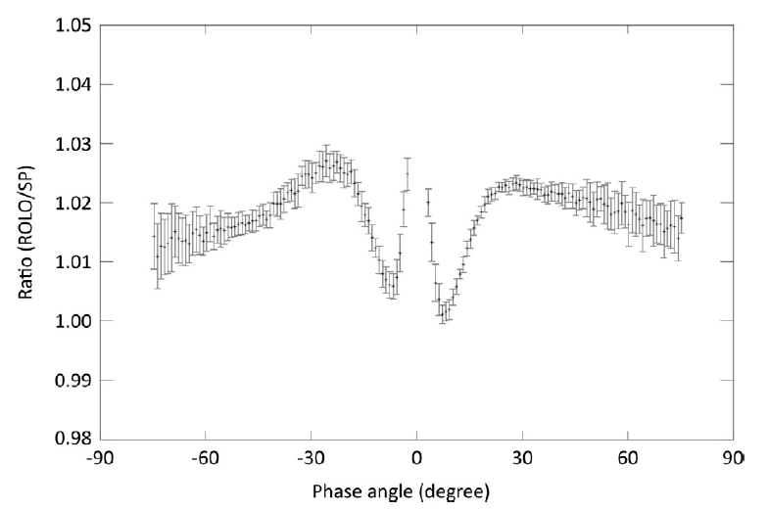
Phase angle dependence
@ 745.3 nm
*This structure is different in different wavelengths

Slide 11
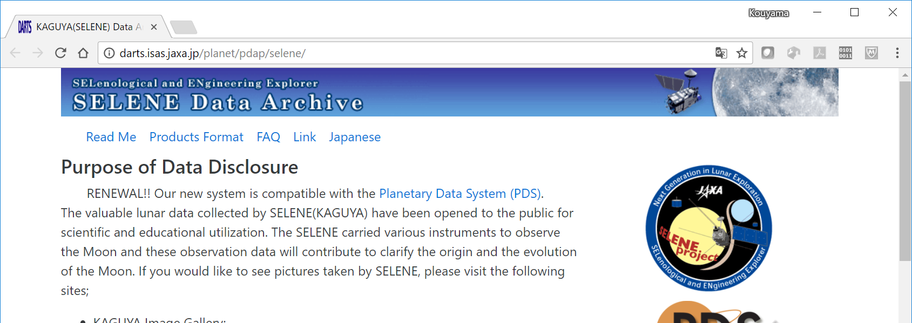
SP Model availability
Surface reflectance data (called SP Level2c), which is a source data set of the model, is available from JAXA data archive site.
http://darts.isas.jaxa.jp/planet/pdap/selene/
At this time, a “map” version of SP model has not been distributed from this archive.
(This situation has been unchanged, Sorry…)
SP team has shared the model with NOAA, JMA, and other teams in JAXA based on communication.

Slide 12
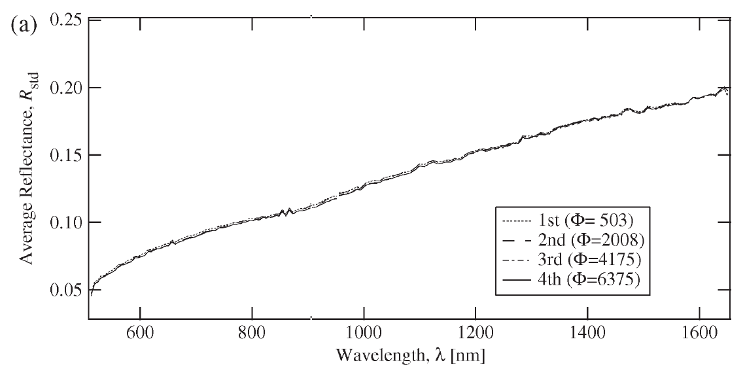
SP model accuracy
Stability of SP sensitivity during mission
Comparison of four observations of
Apollo 16 landing site [Yamamoto et al., 2011]
Nov. 19, 2007
Mar. 12, 2009
The degradation of SP was not significant over the mission period (up to 1 %).
= Good performance for measuring relative degradation.
Notes:
Sensor stability during the mission

Slide 13
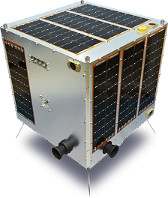
SP model accuracy
Small satellite case
Relative sensitivity
1%
2016
2017
[Kouyama et al., 2017, IGARSS]
Relative sensitivity degradation can be tracked.

Slide 14
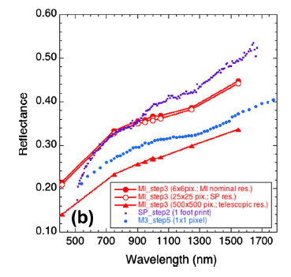
SP model accuracy
[Ohtake et al., 2013]
SP reflectance shows a “redding” trend
darker in shorter wavelength
brighter in longer wavelength.
(cf. Ohtake et al., 2010 & 2013)
SP’s reflectance
Not good absolute accuracy.
Less consistency among different wavelengths.
Notes:
This plot shows a comparison of observation results among many sensors at a same place
SP reflectance shows a steeper profile than those
As a result… In shorter wavelength region, SP tends to describe Moon reflectance darker.
感度偏差: sensitivity deviation

Slide 15
SP model accuracy
Correction with ROLO
Ratio (ASTER/SP)
Curve fitted with ROLO-SP comparison
Lunar Irradiance
[Kouyama et al., 2016, PSS]
ROLO irradiance is based on Kieffer and Stone, 2005

Slide 16
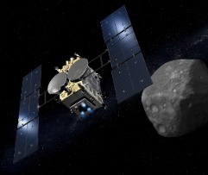
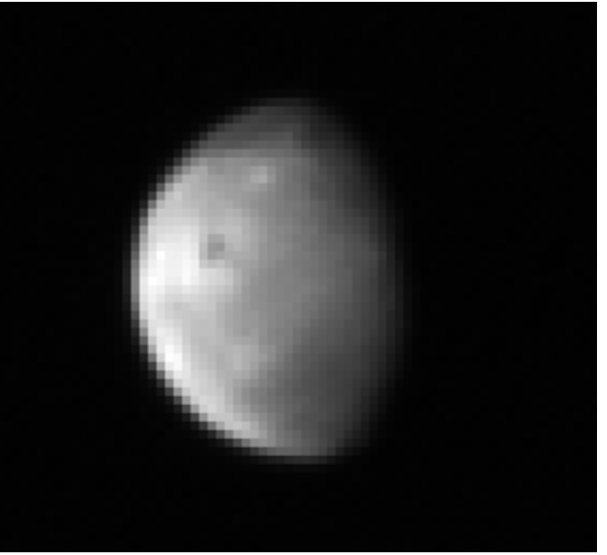
SP model accuracy
Correction with ROLO
SP: Not corrected
Hayabusa-2
SP: Corrected
Observed
Better spectral consistency
[after Suzuki et al., 2017, Icarus]

Slide 17
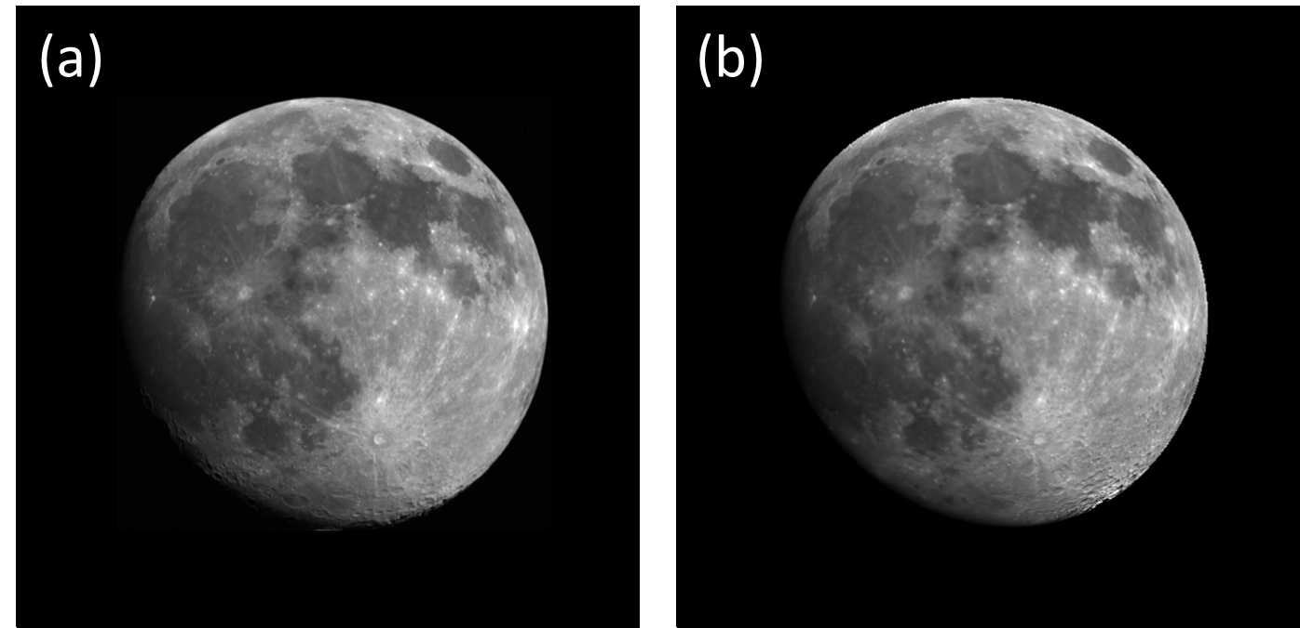
Other issues
Not good model accuracy in high emission angle and high latitude regions
ASTER
Model
Yokota’s recommendation: emission angle < 45 degrees.
SP model is a radiance model.
Accuracy of image registration may affect uncertainty.

Slide 18
Summary
A hyperspectral lunar reflectance model has been proposed based on SELENE/SP observations, and an application scheme has been also proposed.
Current SP model has not enough accurate for absolute calibration, while it can be used for relative calibration.
Radiance based model requires image registration.

Slide 19
Thank you!
Backup slides

Slide 20
ASTER vs SELENE/SP
Observed
Simulated
[Kouyama et al., 2016, PSS]
ASTER/Band 2 (660 nm)
April 14, 2003
SP model is a radiance base model

Slide 21
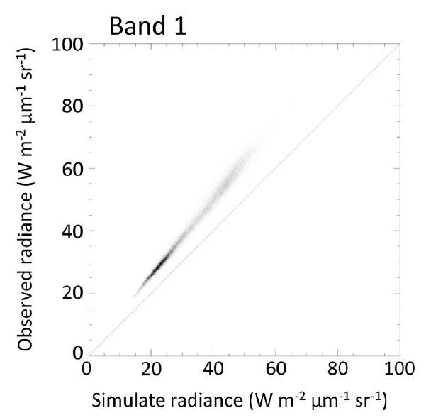
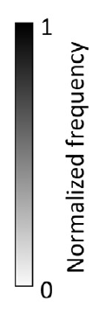
Brightness Comparison: ASTER vs SELENE/SP
 | Band 1 (520-600 nm)
Correlation Coefficient | 0.992
Mean ratio (= Bias): Observed / Simulated | 1.27
Standard deviation (= Precision of each pixel) | 0.05
Standard error | <1e-3

Slide 22
Brightness Comparison: ASTER vs SELENE/SP
 | Band 1 (520-600 nm) | Band 2 (630-690nm) | Band 3 (760-860nm)
Correlation Coefficient | 0.992 | 0.993 | 0.993
Mean ratio (= Bias): Observed / Simulated | 1.27 | 1.01 | 0.95
Standard deviation of ratio (= Precision of each pixel) | 0.05 | 0.04 | 0.04

Slide 23
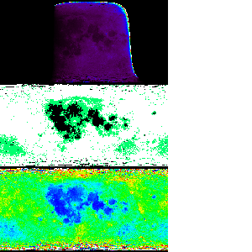
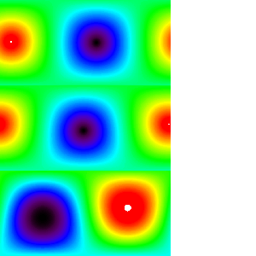
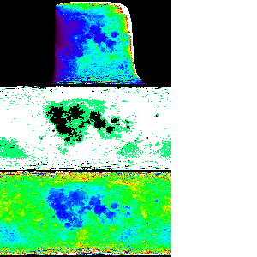
Reflectance map (i=30,e=0,α=30)
Geometry data
Incident angle
Emission angle
x Solar Irradiance
Lunar radiance map
Highland, mare and middle albedo region map
Phase angle at observation time

Slide 24
Model equations
i: incident, e: emission, α: phase anlge
F_{sun}: Sun light Flux (W/m²/um)
S: SRF
r: reflectance using i=30, e=0, α=30 as the basis condition [Yokota et al.,2011] (11)
From SP model
X_{L}: Empirical function of sun-light scattering
f: Empirical function of phase angle dependencies

Slide 25
Model equations
After Yokota et al., 2011, Eq (11)
Reflectance to be calculated
i: incident angle
e: emission angle
α: phase angle
X_{L}: Lunar lambert function
Correction terms for Limb darkening effect
f: Empirical function of phase angle dependencies
B: Shadow hiding opposition effect
P: Regolith phase function
h, c, g, B₀: Model coefficients
Notes:
c₁=-0.019, c₂=0.242x10⁻³, c₃=-1.46x10⁻⁶

Slide 26
Model equations
After Yokota et al., 2011, Eq (11)
Reflectance to be calculated
i: incident angle
e: emission angle
α: phase angle
X_{L}: Lunar lambert function
Correction terms for Limb darkening effect
f: Empirical function of phase angle dependencies
B: Shadow hiding opposition effect
P: Regolith phase function
h, c, g, B₀: Model coefficients

Slide 27
Model equations
After Yokota et al., 2011, Eq (11)
Reflectance to be calculated
i: incident angle
e: emission angle
α: phase angle
X_{L}: Lunar lambert function
Correction terms for Limb darkening effect
f: Empirical function of phase angle dependencies
B: Shadow hiding opposition effect
P: Regolith phase function
h, c, g, B₀: Model coefficients
High land, mare and medium albedo

Slide 28
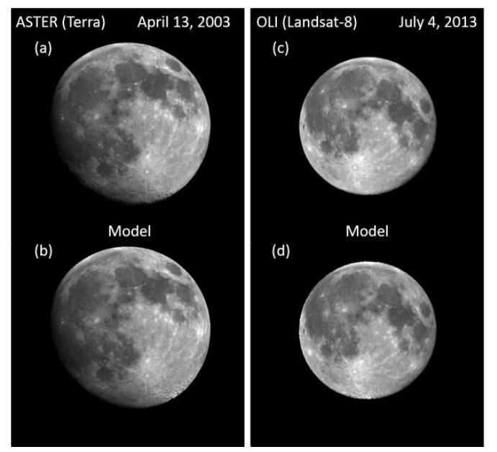
[Kouyama et al., 2014, LPSC]

Slide 29
Definition of three albedo groups of Moon surface

Slide 30
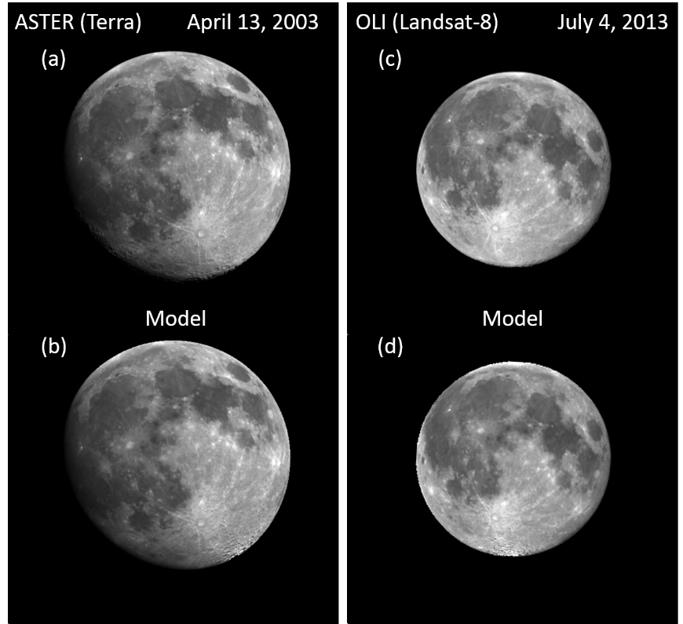
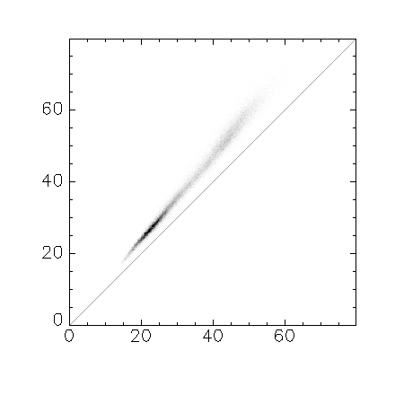
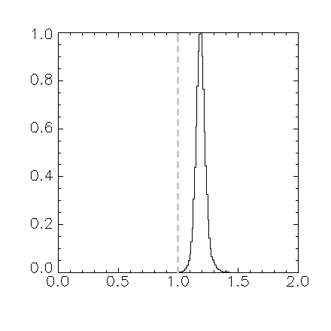
ASTER@2003.04.14 vs Model (SELENE/SP)
ASTER (Band 1) Large bias
Observed radiance (W m⁻² str⁻¹ μm⁻¹)
Relative Frequency
Modeled radiance (W m⁻² str⁻¹ μm⁻¹)
Observed / Model
Mean (Obseｒved/Model) = 1.27
SD = 0.05
SE (= SD/√Number of pixels used) = 0.0002

Slide 31
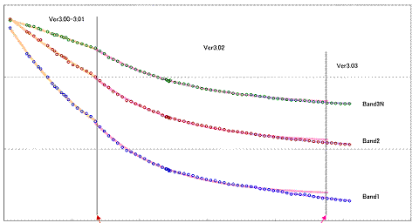
ASTER/VNIR degradation curves
1.0
0.9
Band 3
0.8
Band 2
Band 1
0.7
0
Day since launch
3000

Slide 32
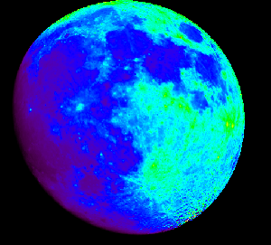
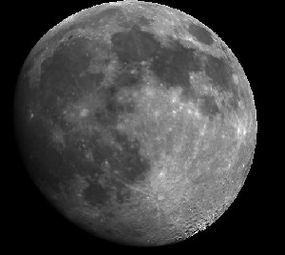
Simulated hyperspectral images
SRF convolution
Simulated band image

