Slide 1
Lunar Model Establishment based on SELENE/SP with incorporated into lunar DEM
Lu Zhang, Peng Zhang , Xiuqing Hu, Lin Chen
National Satellite Meteorological Center （NSMC）

Slide 2
Outline
Introduction
The observation geometry of SP re-calculation
Model
working

Slide 3
Introduction
The advantage of lunar calibration.
The photometric stability of lunar surface had a characteristic time of 1*10⁹ years [Kieffer, 1997].
Lunar reflectance is not strongly variegated in color.
Lunar is surrounded by a black field.

Slide 4
Introduction
Lunar model development
The data from Earth-based observation(Atmosphere).
The data from Earth orbit satellite(lack).
The data from lunar orbit satellite.
The Moon mineralogy mapper (M3) on Chandrayaan-1(geo-location, not covered entire lunar surface).
The Interference imaging spectrometer(IIM) on Chang’E-1(not covered entire lunar surface).
The Spectral Profiler(SP) on SELENE.

Slide 5
Model
Recalculating incidence angle , emission angle, phase angle.

Slide 6
Model
The Reflectance of SP
Data Screening
Classifying
The establishment of model

Slide 7
Model
Data Screening
Incidence angle (<90 ° )
Phase angle (<180 °)
Emission angle (<90 ° )
EMD (Empirical Mode Decomposition)
The data with noise is less than a threshold value

Slide 8
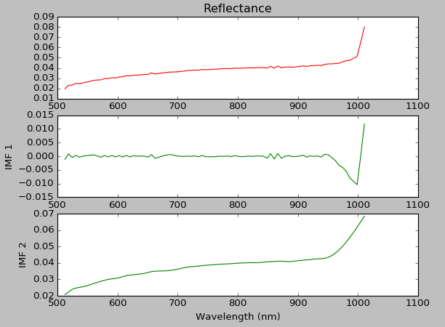
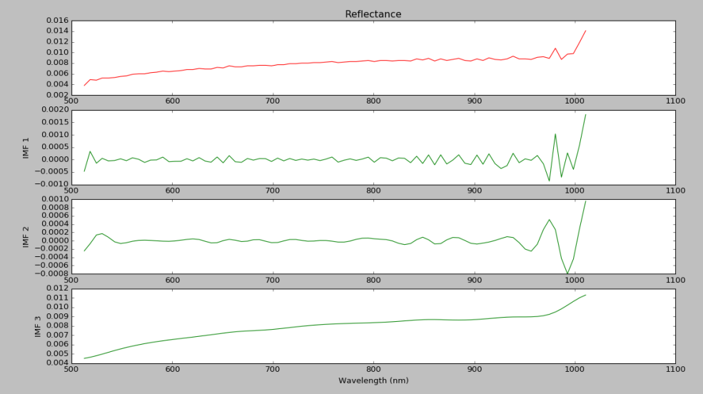
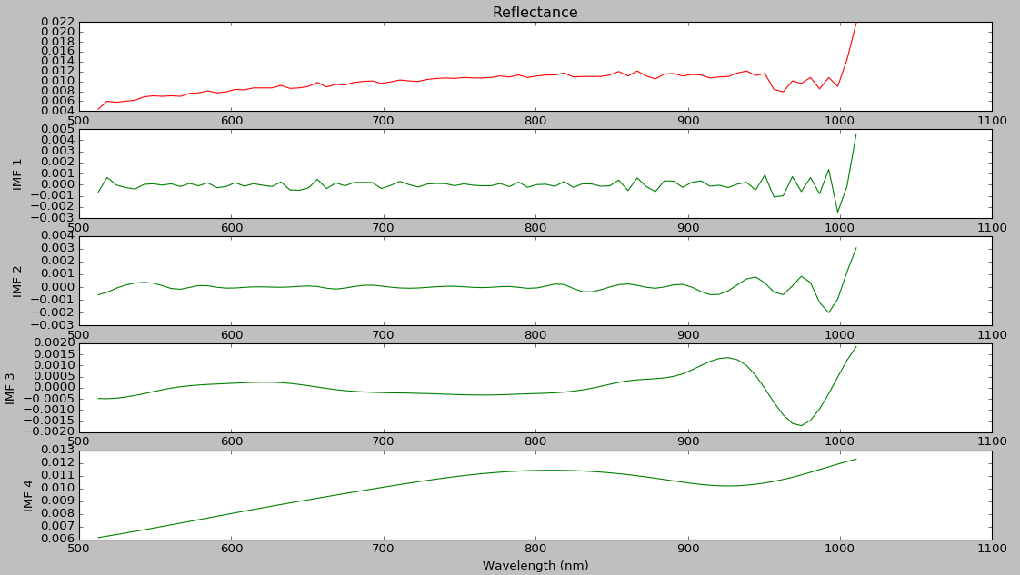
Model

Slide 9
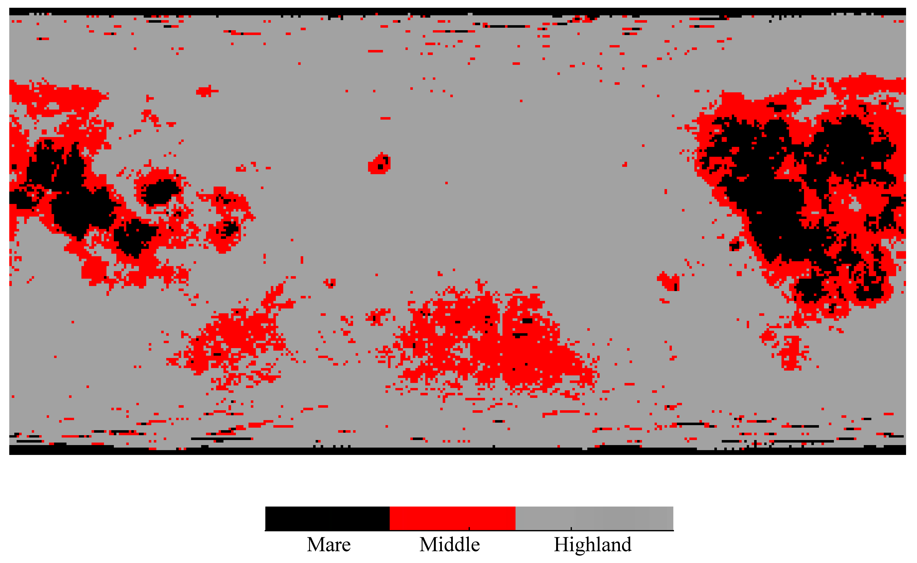
Model
Classifying：
VIS band, 512-1010nm.
Method：K-SVD( unsupervised learning method)

Slide 10
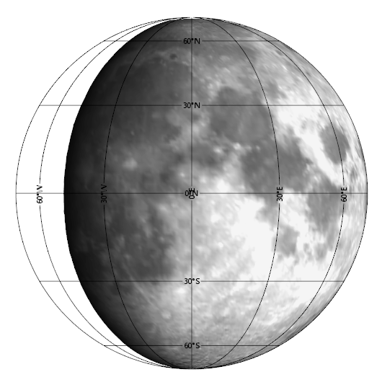
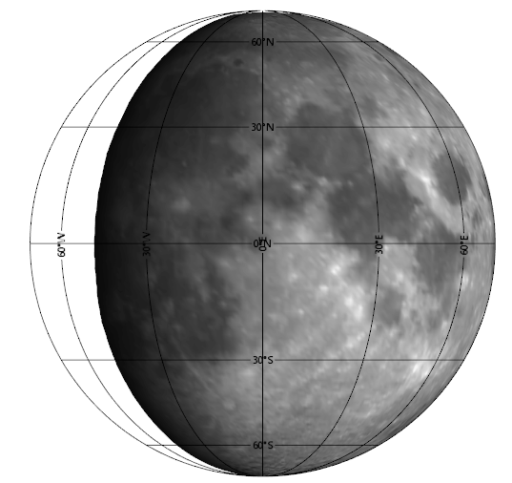
working
Lunar reflectance
512.6nm 998.5nm

Slide 11
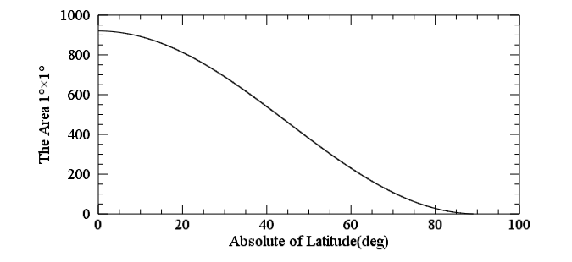
Working
1 °×1° in equator of lunar is about 900km^2
the SP’s Spatial resolution for 100 km altitude.
Along track 562 m.
Cross track 400 m.
Near the equator the data is enough.
Near the pole the data is not enough.

Slide 12
The end

