Slide 1
Progress in Radiance-Based Lunar Calibration
Fangfang Yu², Xi Shao², Xiangqian Wu¹,
Masaya Takahashi³ and Arata Okuyama³
1: NOAA/NESDIS/Center for Satellite Application and Research (STAR)
2: ERT, Inc@NOAA/NESDIS/STAR
3: Japan Meteorological Agency (JMA)/meteorological Satellite Center (MSC)
Acknowledgements: NOAA GOES-R Program for support, and
NOAA-JMA Cooperation Agreement for Himawari-8 AHI lunar data

Slide 2
Outlines
Introduction (Wu)
  Motivation
  Challenges
Image-to-image registration (Shao)
  Geometric model – Ray-tracing
  Empirical method – SIFT
  Combined method
Characterization of BRDF (Yu)
  Site selection/characterization
  Early Results
Summary

Slide 3
introduction
Wu

Slide 4
Radiometric Calibration Using the Moon
The Moon is exceptionally stable.
  A highly desirable characteristics as a calibration target.
Illumination varies greatly in the course of a month.
  Further complicated by libration, full period of 18.6 years.
Estimate the lunar irradiance semi-empirically.
  Model based on orbit dynamics
  Parameters tuned from observations
  Great progresses, which also reveal challenges.
    ROLO by USGS
    GIRO by EUMETSAT
NOAA has been exploring the use lunar radiance.

Slide 5
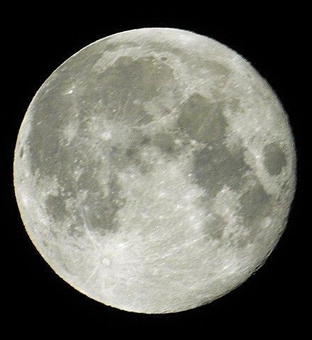
Lunar Irradiance Calibration
Jinghua Tian, Amateur Photographer
Instrument response to known signals, in this case lunar irradiance.

Slide 6
Initial Results of Lunar Calibration
Degradation rate is consistent, internally and with other methods.
Precision is less than expected.

Slide 7
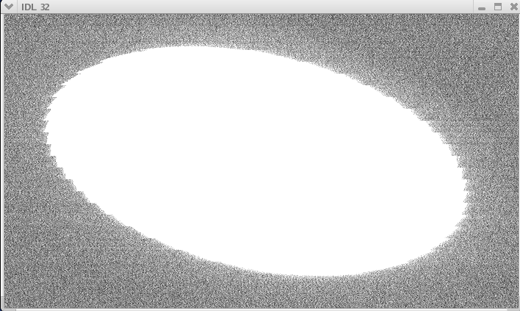
Lunar Pixel

Slide 8
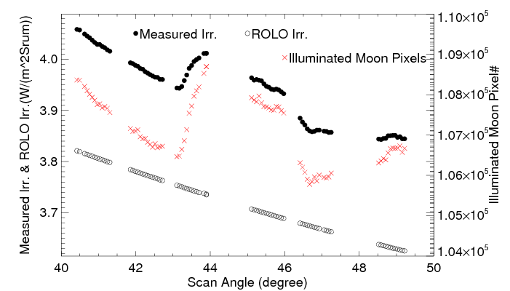
Over-Sampling
Yu et al., unpublished manuscript, showing apparently varying over-sampling rate.

Slide 9
Uncertainty in Irradiance Calibration
I_{Lunar}: Model (ROLO & GIRO) uncertainty
  Discussed extensively but separately
f_{i}: Over-Sampling
  Constant or known?
C^{i}_{M}: Count of lunar pixel
  Which pixel is/isn’t the Moon?
  Edge detection
C_{S}: Space count
  Clamp and 1/f noise

Slide 10
Uncertainty in Irradiance Calibration
I_{Lunar}: Model (ROLO & GIRO) uncertainty
  Discussed extensively but separately
f_{i}: Over-Sampling
  Constant or known?
C^{i}_{M}: Count of lunar pixel
  Which pixel is/isn’t the Moon?
  Edge detection
C_{S}: Space count
  Clamp and 1/f noise

Slide 11
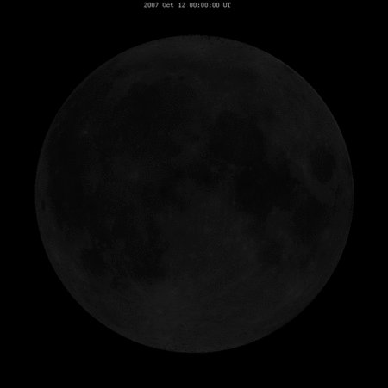
Challenges of Lunar Radiance Calibration
Same challenges, presented in different ways.
Identify ROI
  Accurate image-to-image registration
Minimize BRDF effects
  First characterize
  Empirical model later

Slide 12
Identification of ROI
Shao

Slide 13
Requirements, Challenges and Procedures
Long-term accurate measurements of high spatial resolution of lunar surface
  Himawari-8 AHI and GOES-16 ABI
    High temporal resolution from the Earth orbit
    Multiple times per month, depending on the available operation schedule
  Others
    LEO: CNES Plaiedes, Landsat TM/OLI, EOS Hyperion, etc
    GEO weather instruments: GOES Imager, MTSAT, COMS, etc.
Accurate image-to-image registration
  Automated image registration algorithm
  Region of Interest (ROI) radiance extraction
Accurate model development and validation

Slide 14
Past Efforts
Relatively spectral and spatial uniform surface selections
  Yu et al. 2015, “Photometric properties on selected lunar surface for GOES-R ABI solar reflective channels using SELENE/SP data”, EUMETSAT, Oct. 2015.
    Site selections
Automated image to image registration algorithm
  Shao et al. 2015, “Selenographic coordinate mapping of lunar observations by GOES Imager”, SPIE 9639, Sensor, Systems, and Next-Generation Satelltes XIX, 963918 doi:10.1117/12.2193914, Oct. 2015.
    Angle determination (Ray-tracing) method to assign coordinate for each lunar pixel
    Jitter, uncertain of scan positions, and possible optical distortion may cause certain uncertainty
  Yu et al. 2016, “Effort toward characterization of selected lunar sites for the radiometric calibration of solar reflective bands”, CALCON, Logan, UT, 2016.
    SIFT (Scaled Invariant Feature Transform) method to identify potential control points.
    Few matched keypoints with large phase angle difference
  Yu et al. 2017, “Improvement in ABI/AHI lunar image registration algorithm for the extraction of lunar ROI radiance”, CALCON, Logan, UT 2017
    Combined method: Ray-tracing + SIFT
    Significant improvement in the matched keypoints

Slide 15
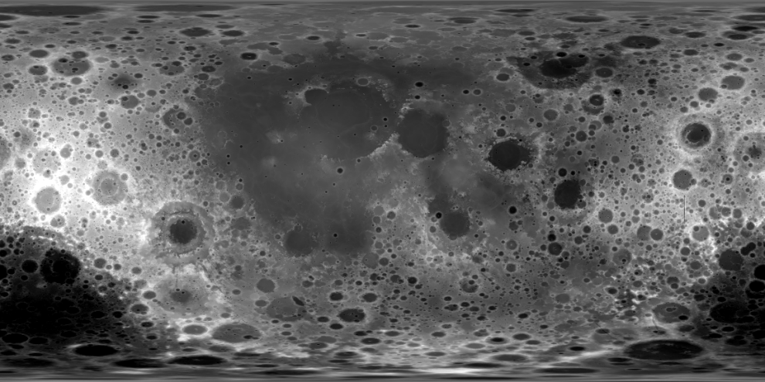
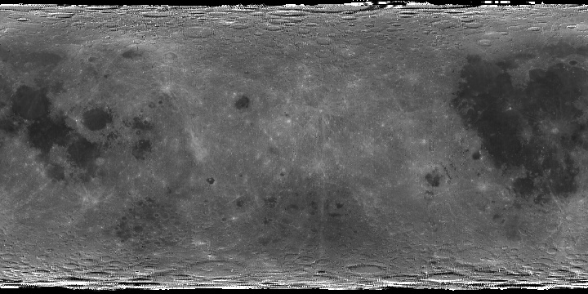
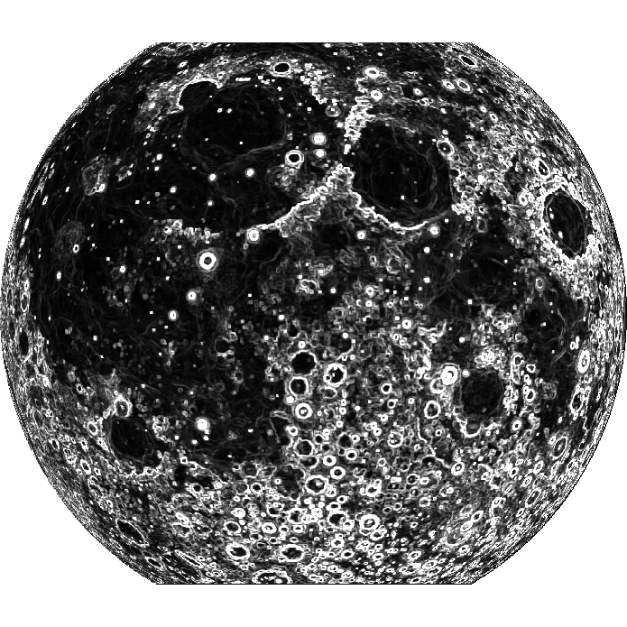
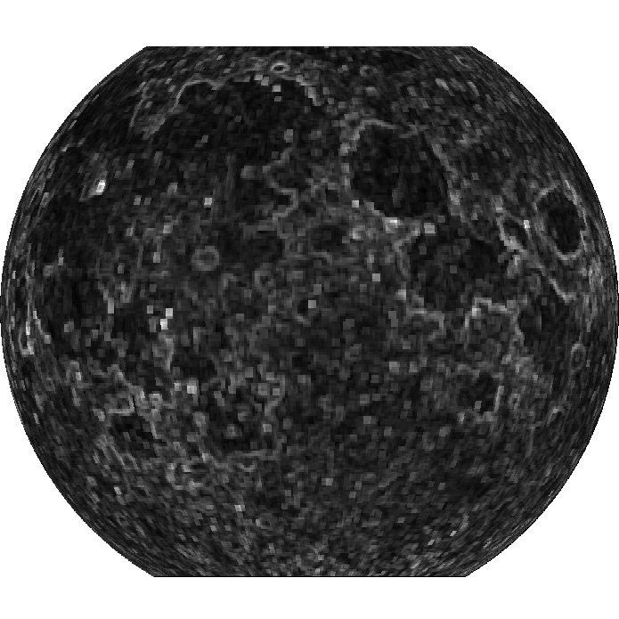
SELENE (Kaguya) Data to Select ROI
Courtesy of JAXA SELENE mission
SELENE/LALT
SELENE/SP
(-180, 90) (180, 90)
(-180,-90) (180, -90)
Re-project the near side of lunar surface products from cylindrical onto plane projection with selenographic coordinate at 5km/grid spatial resolution at Equator
Generate the Coefficient of Variation (CoV) of the topographic and radiometric products
Combine the CoV maps
Spectral convolution with ABI B2 SRF
60º
60º
60º
60º
-90º
90º
90º
-90º
Identify the Topographically and Spectrally Uniform Targets
-60º
-60º
-60º
-60º
Yu et al. 2015, “Photometric properties on selected lunar surface for GOES-R ABI solar reflective channels using SELENE/SP data”, EUMETSAT, Oct. 2015

Slide 16
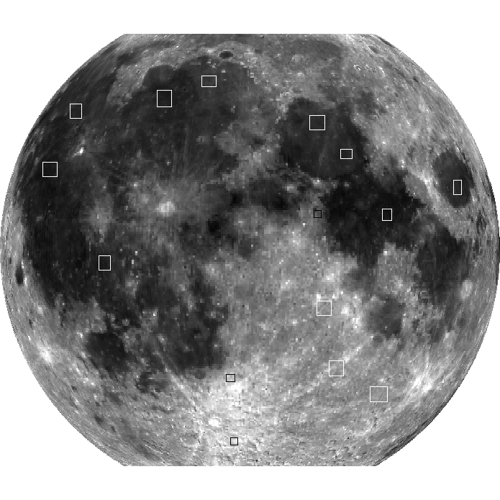
Lunar Surface Targets
Sufficiently Large – tolerant to INR uncertainty
Both dark (low elevation) and bright (high elevation) sites – bright sites to increase SNR
Closer to the center to minimize BRDF effect – viewing/illumination variations
  More data opportunity for model development
10
9
13
3
1
14
4
Apollo Site #16
12
2
15
5
6
7
11
8
Selected Lunar Target Sites
Yu et al. 2015, “Photometric properties on selected lunar surface for GOES-R ABI solar reflective channels using SELENE/SP data”, EUMETSAT, Oct. 2015

Slide 17
Exploring the Lunar Radiance Model…
One year of AHI data (June, 2015 – May, 2016)
  Provided by JMA
  No effort applied to improve the radiance quality yet
Angle determination (Ray-tracing) method is used to extract ROI radiance
  Explore the feasibility to develop the lunar radiance model
  A total of ~290 images/band

Slide 18
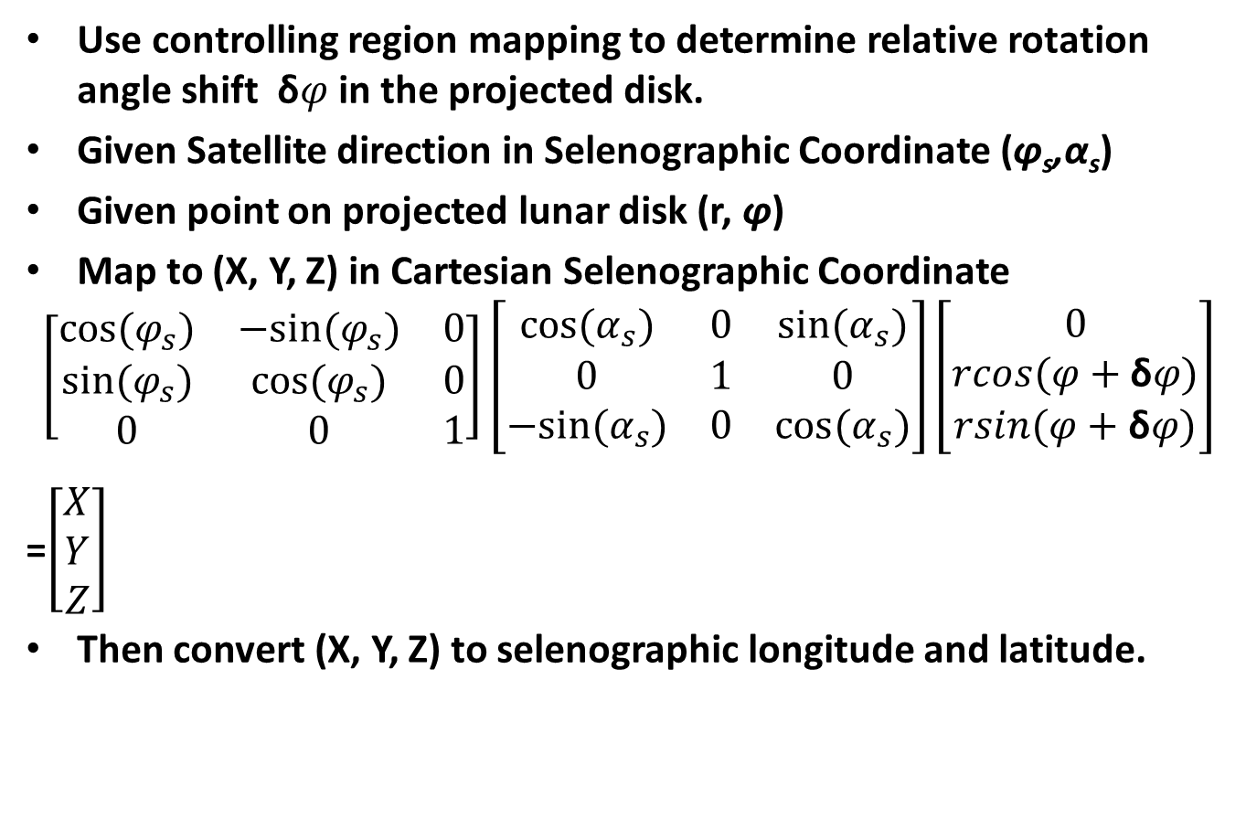
Coordinate Transformation: Three Consecutive Rotation
Use controlling region mapping to determine relative rotation angle shift δ$φ$ in the projected disk.
Given Satellite direction in Selenographic Coordinate (φ_{s},α_{s})
Given point on projected lunar disk (r, φ)
Map to (X, Y, Z) in Cartesian Selenographic Coordinate
$$\left[\begin{matrix}cos⁡(φ_{s}) & −sin⁡(φ_{s}) & 0 \\ sin⁡(φ_{s}) & cos⁡(φ_{s}) & 0 \\ 0 & 0 & 1\end{matrix}\right]\left[\begin{matrix}cos⁡(α_{s}) & 0 & sin⁡(α_{s}) \\ 0 & 1 & 0 \\ −sin⁡(α_{s}) & 0 & cos⁡(α_{s})\end{matrix}\right]\left[\begin{matrix}0 \\ rcos(φ+\text{δ}φ) \\ rsin(φ+\text{δ}φ)\end{matrix}\right]$$
=$\left[\begin{matrix}X \\ Y \\ Z\end{matrix}\right]$
Then convert (X, Y, Z) to selenographic longitude and latitude.
Shao et al. 2015, SPIE 9639, Sensor, Systems, and Next-Generation Satellites XIX, 963918 doi:10.1117/12.2193914, Toulouse, France.

Slide 19
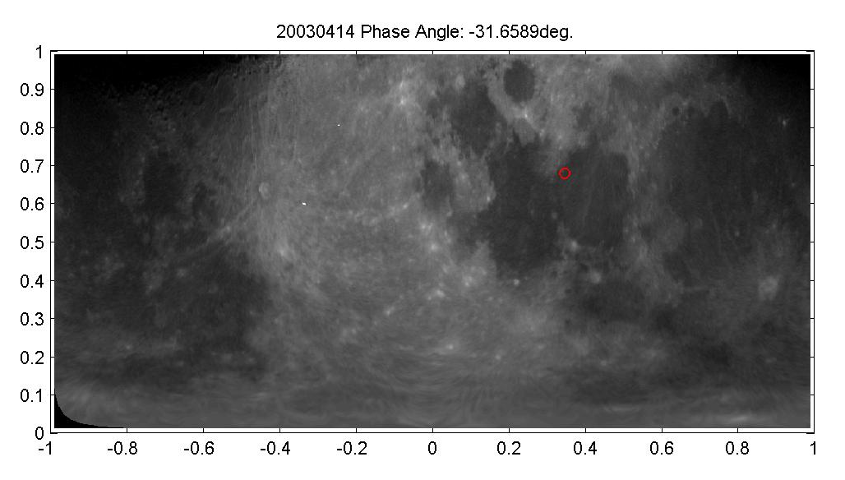
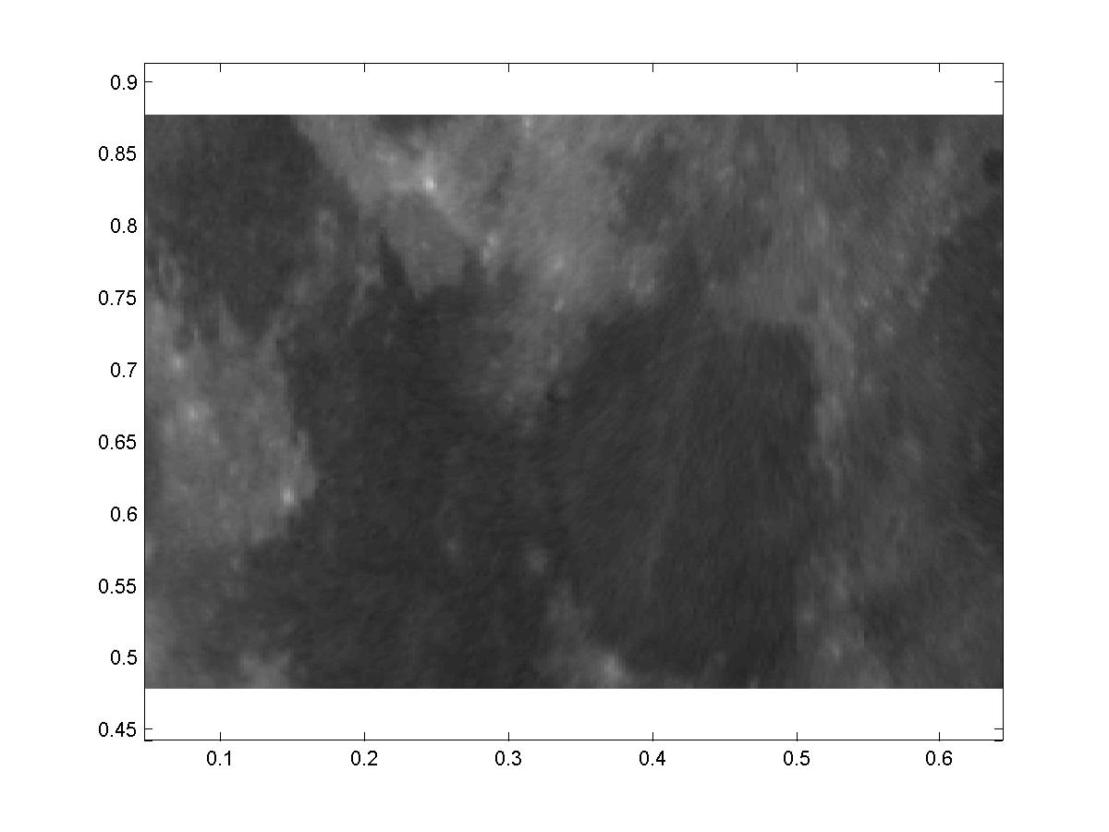
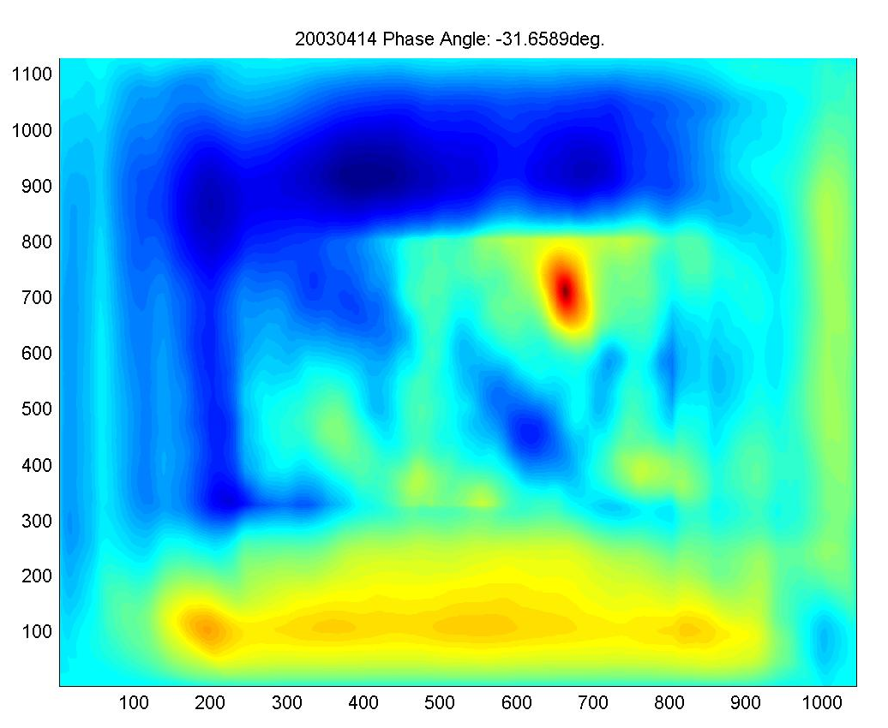
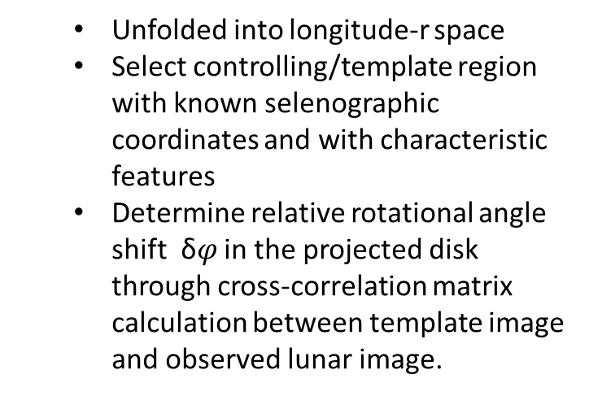
Controlling Region Matching for δ$φ$
r
Longitude/180
Cross-correlation map
  Unfolded into longitude-r space
  Select controlling/template region with known selenographic coordinates and with characteristic features
  Determine relative rotational angle shift δ$φ$ in the projected disk through cross-correlation matrix calculation between template image and observed lunar image.
Shao et al. 2015, SPIE 9639, Sensor, Systems, and Next-Generation Satellites XIX, 963918 doi:10.1117/12.2193914, Toulouse, France.

Slide 20
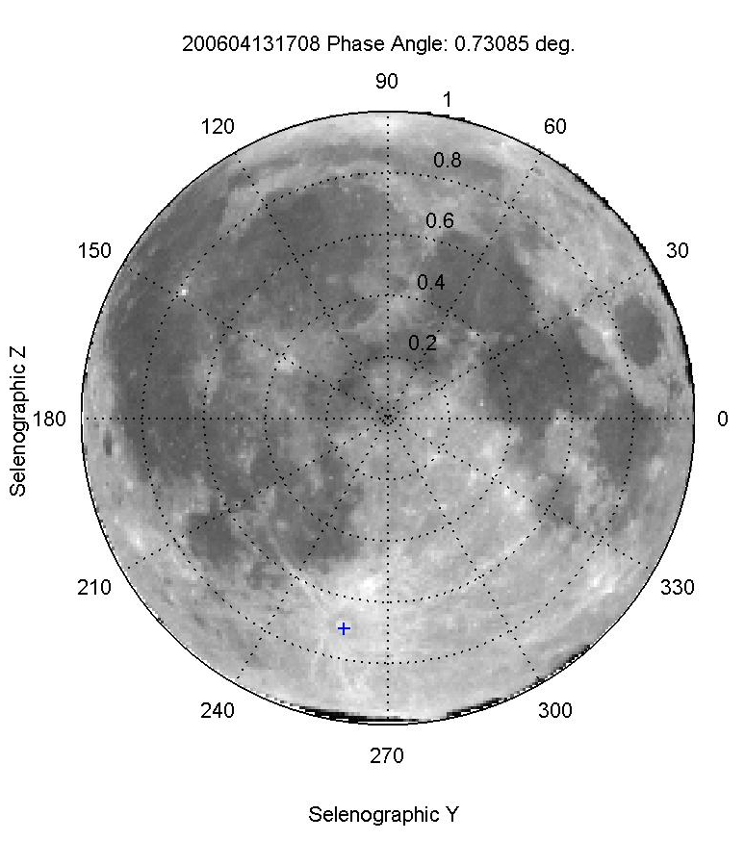
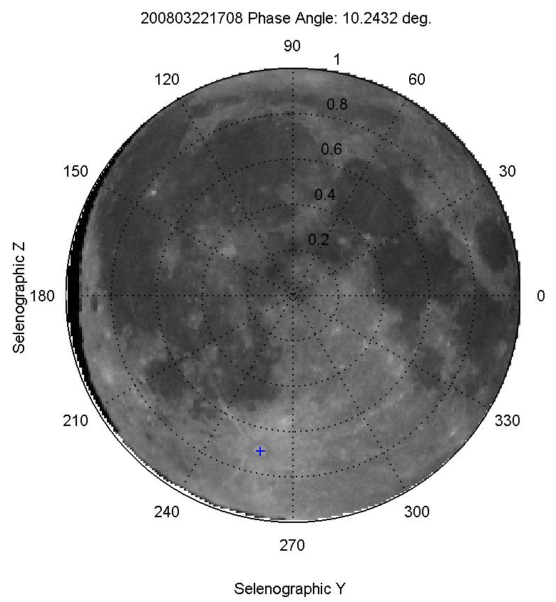
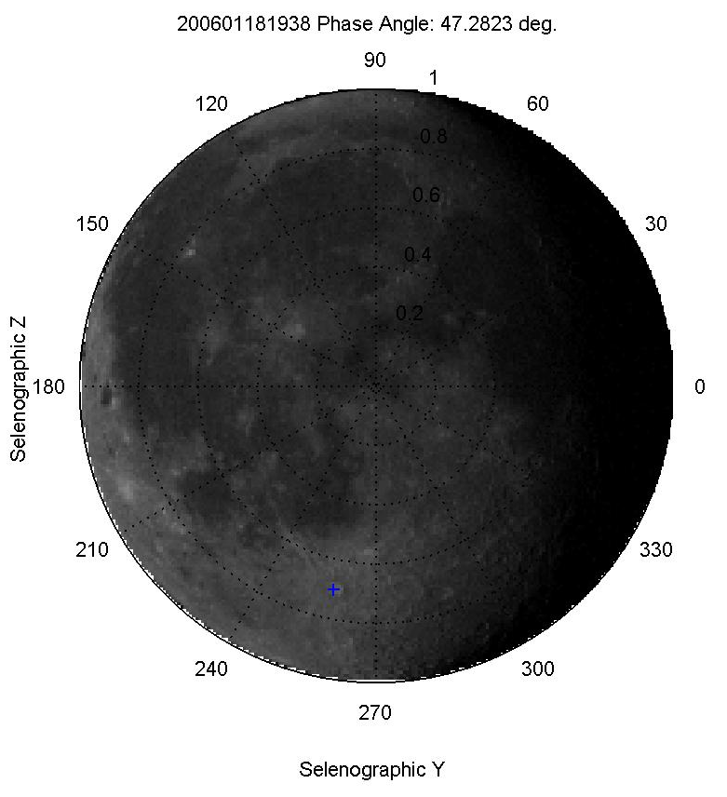
Mapped GOES-12 Lunar Observations for Different Phases
2006/04/13 φ = 0.73º
2008/03/22 φ = 10.24º
2006/01/18 φ = 47.28º

Slide 21
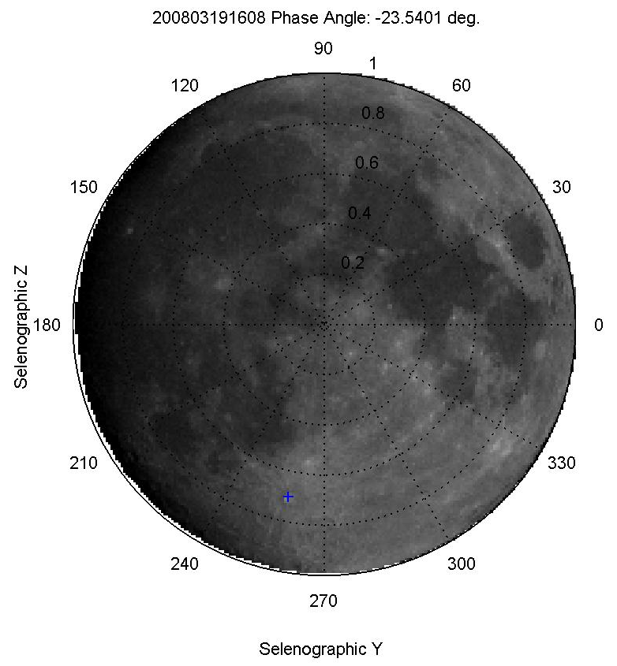
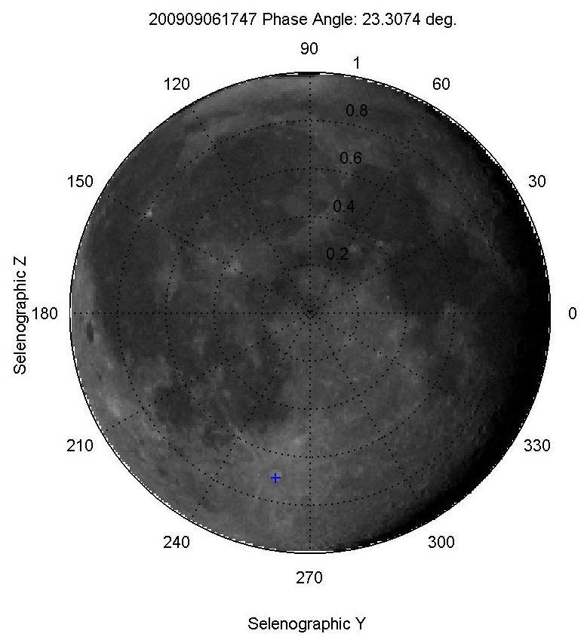
Mapped GOES-12 Lunar Observations
(Waxing vs. Waning)
2008/03/19 φ = -23.54º
2009/06/17 φ = 23.31º
Waxing
Waning
Waning moon shows more of dark maria

Slide 22
Characterization of BRDF
Yu

Slide 23
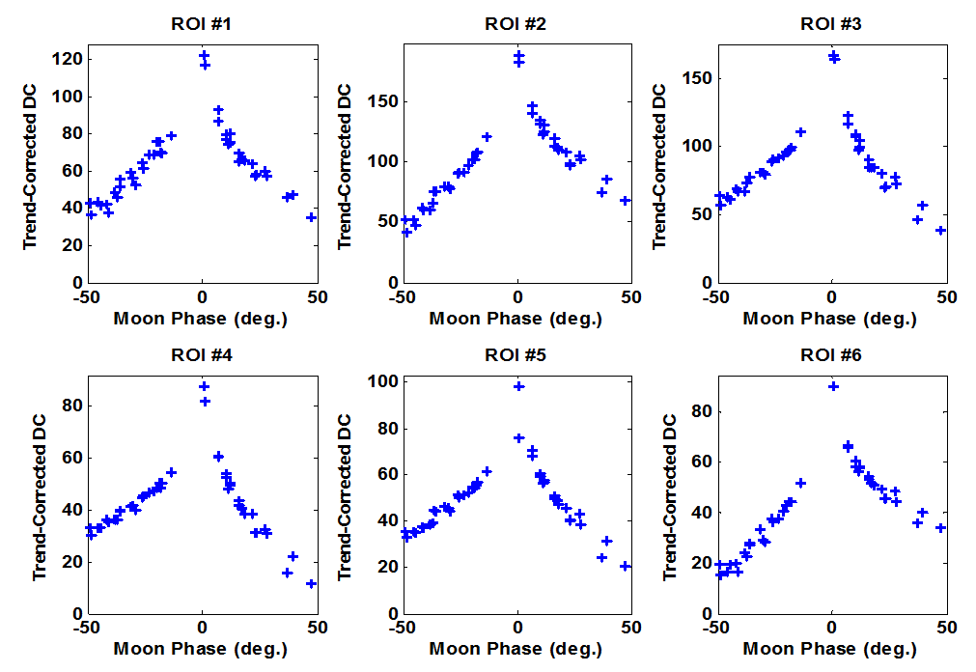
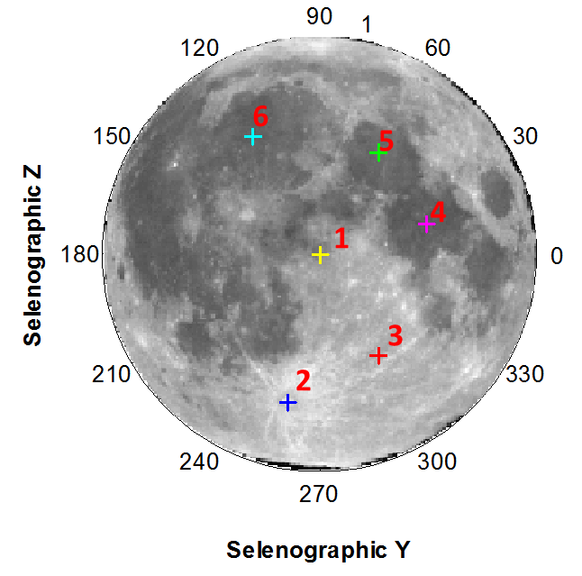
GOES-12 ROI Lunar Radiance Dependent on PA
Trend-corrected DC is well organized by lunar phase
Asymmetric between negative and positive, i.e. waxing and waning, lunar phases
BRDF of lunar surface is important
Shao et al. 2015, SPIE 9639, Sensor, Systems, and Next-Generation Satellites XIX, 963918 doi:10.1117/12.2193914, Toulouse, France.

Slide 24
Model Development ….
Band 064 as example ….
10
9
13
3
14
1
4
12
2
15
5
6
7
8
11
Target Sites

Slide 25
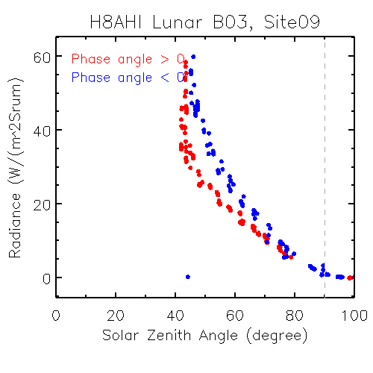
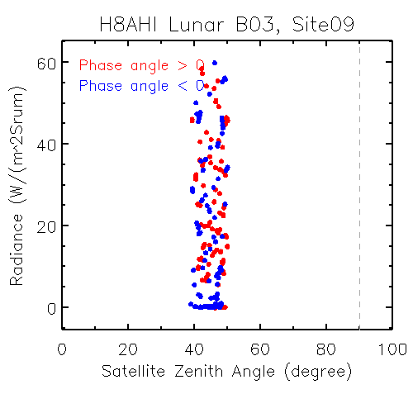
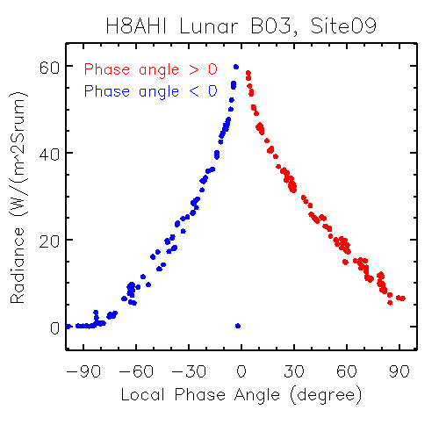
Site 9
Phase angle = -1.5
10
9
13
3
14
1
4
12
2
15
5
6
7
8
11

Slide 26
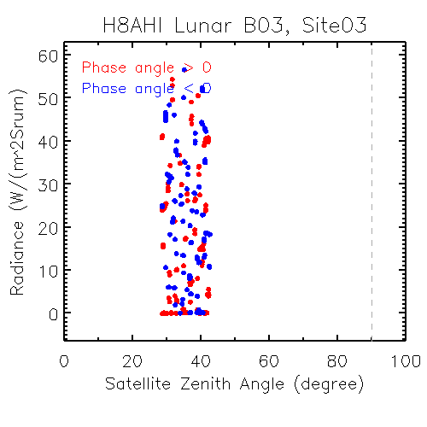
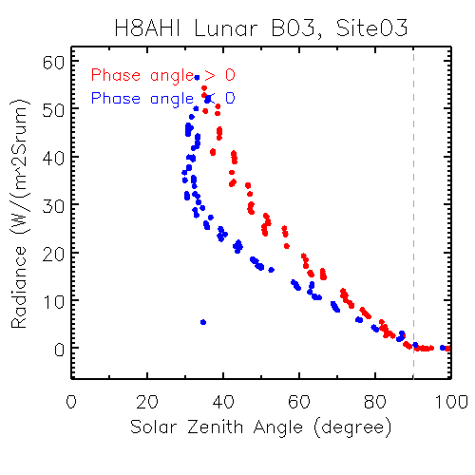
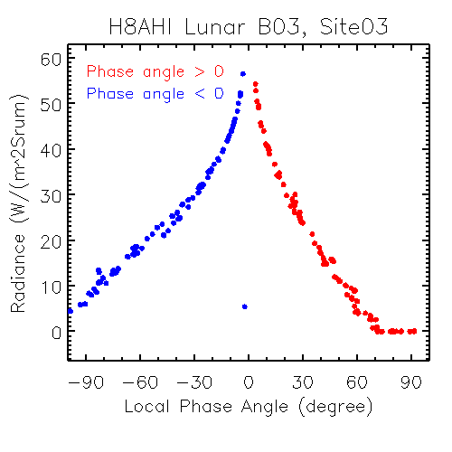
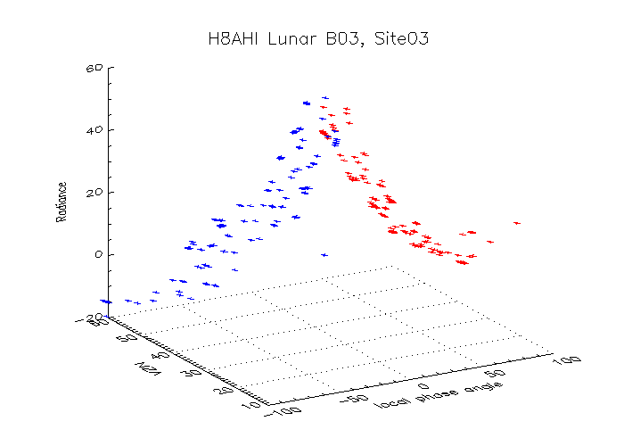
Site 3
Phase angle = -1.5
10
9
13
3
14
1
4
12
2
15
5
6
7
8
11

Slide 27
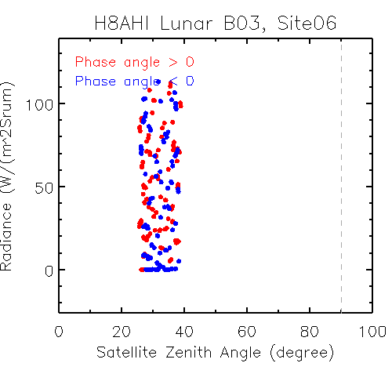
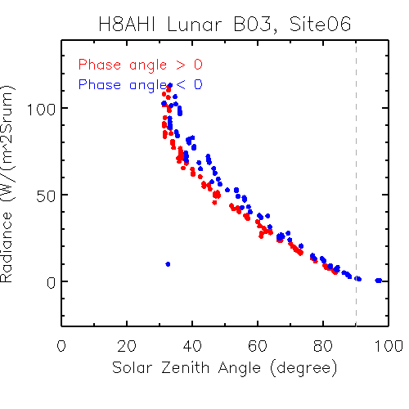
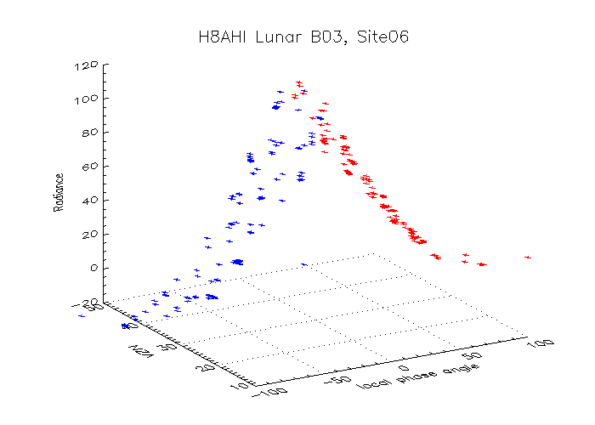
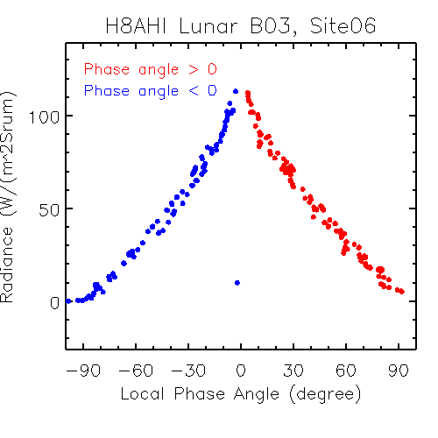
Site 6
10
9
13
3
14
1
4
12
2
15
5
6
7
8
11

Slide 28
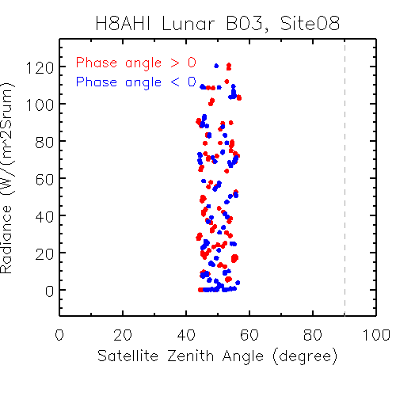
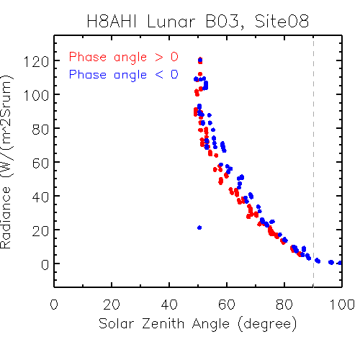
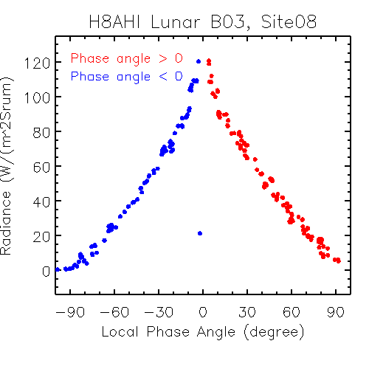
Site 8
10
9
13
3
14
1
4
12
2
15
5
6
7
8
11

Slide 29
Summary
Local phase angle is the most important angle to determine the ROI radiance. Relationship varies at different ROI.
  Confirmed with both AHI and GOES-12 data
  If the moon is considered a big pixel, this is then ROLO or other lunar irradiance observation
ROI radiance is more sensitive to solar zenith angle than satellite viewing zenith angle
Sites near the center line (Selenographic lon=0 degree) should be used to develop the radiance model
  More observations for model development and validation
  Multiple sites including both dark and bright ones should be used
Future work
  Apply combined method to improve the image registration algorithm
  Apply the improved calibration algorithm as JMA published
    New radiometric calibration algorithm
    Coherent noise correction

Slide 30
Summary
Lunar radiance calibration primarily addresses the difficulty of determining lunar irradiance from GOES Imager.
  More applicable to AHI/ABI/AMI
  Also have other benefits
Initial goal is to use it as a trending tool.
  Absolute calibration (i.e., SI traceable) and inter-calibration is possible.
Status
  Target selection has been nearly completed and presented to EUMETSAT Conference at Toulouse.
  Angle determination based on pattern recognition and coordinate rotation proves feasible and presented to SPIE at Toulouse. Expect improvement based on orbit parameters.
  BRDF determination is on-going. Expect collaboration with JMA (Visiting Scientist) and GSICS community.
This is a summary ~two years ago for your reference.

