Slide 1
Inter-band calibration using the Moon
S. Wagner, B. Fougnie, T. Hewison – EUMETSAT

Slide 2
Inter-band calibration
Inter-band calibration = way to validate/monitor the relative radiometric consistency between bands of a same instrument
A way to transfer absolute calibration from a reference band to others
➔ In particular for the calibration of absorption bands
Critical in the absence of on-board calibrators
An efficient monitoring method for on-boards calibrators
More and more important with the use of multi-spectral information to derive Level-2 products: ocean colour, aerosols, clouds properties, etc.
➔ Not only Low-Earth Orbit instruments, but new generations of GEO imagers with more reflective solar bands

Slide 3
Using the Moon for inter-band calibration
Lunar reflectance spectrum is smooth, with only wide, shallow absorption features
Many different spectral response functions of instruments can be accommodated
Out-of-Atmosphere Smooth Reference spectrum:
➔ Convenient for inter-band calibration
➔ Convenient for the calibration of absorption bands

Slide 4
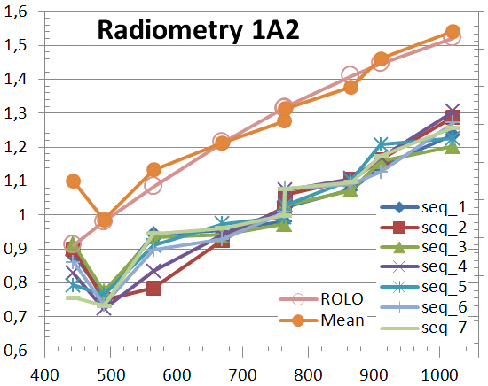
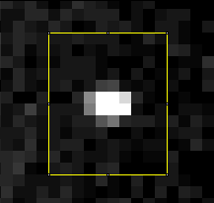
Inter-band radiometric calibration
Tested on PARASOL (IFOV: 6.5 km)
Interband normalization
Full image
Region of
interest
B. Fougnie,
Pers. Comm., 2014

Slide 5
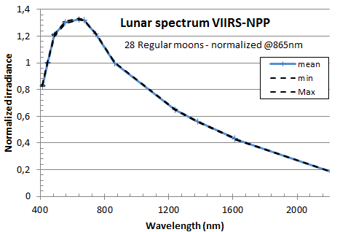
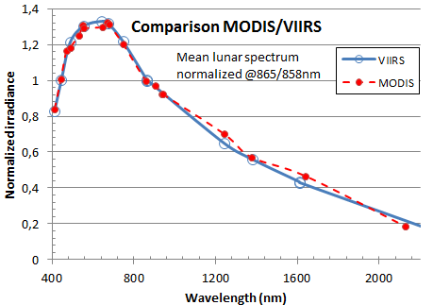
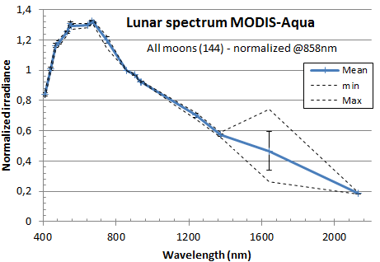
Inter-band radiometric calibration
Applied successfully to MODIS and VIIRS
B. Fougnie,
GSICS annual meeting, 2016
Inter-comparison with other instruments

Slide 6
Inter-band calibration using the GLOD…
The GLOD includes data from many LEO instruments + a few GEO instruments with more Reflective Solar Bands
Next slides = an abrupt inter-band comparison with 2 reference bands:
0.6 µm
0.865 µm
Based on data as provided to EUMETSAT. May not reflect the latest version
Results still to be refined and discussed with data owners + LC Community
But potential is there!
➔ Please, do not take those results as end results. It is a base for discussion.

Slide 7
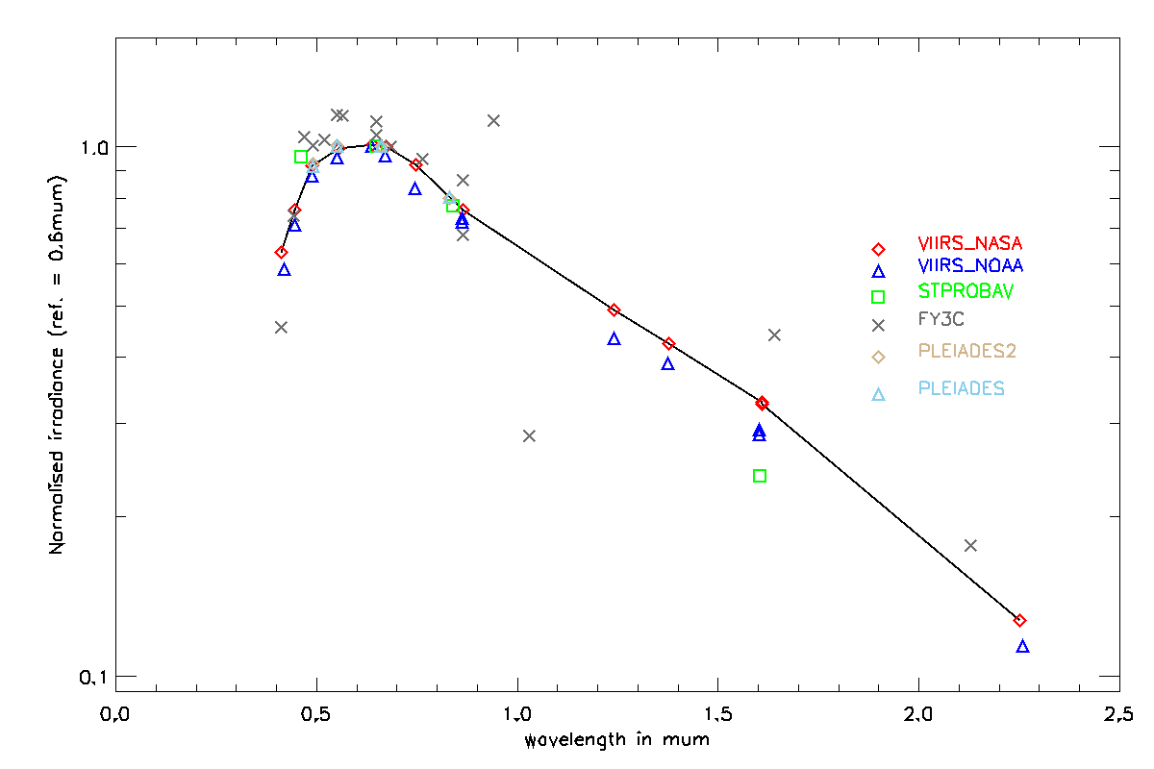
An example using the data GLOD – 0.6 µm
VIIRS NASA
Results for FY3C are not correct due to the wrong selection of the reference channel

Slide 8
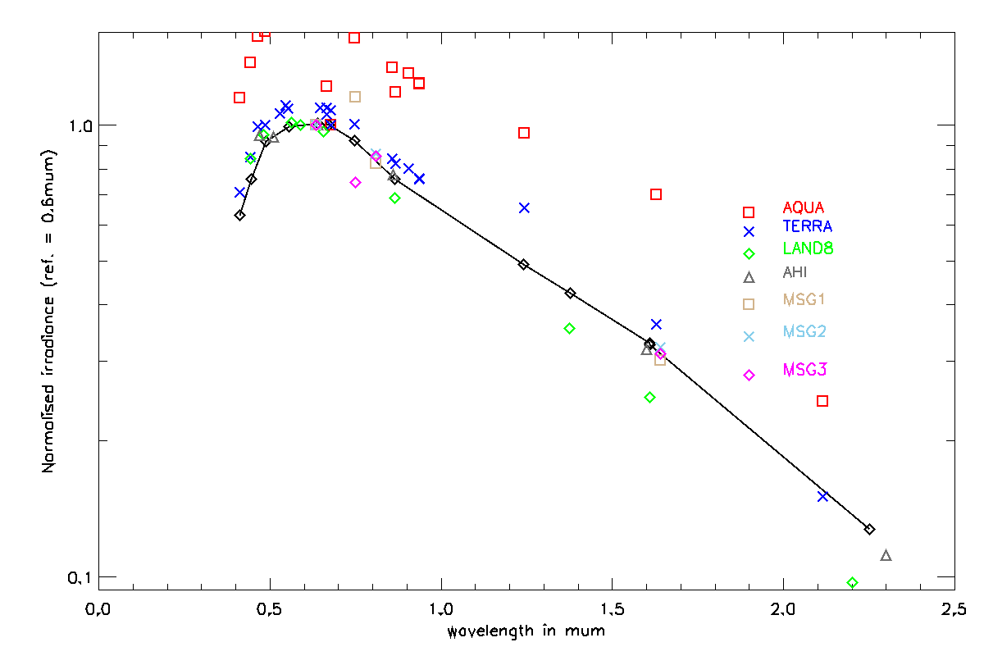
An example using the data GLOD – 0.6 µm
VIIRS NASA
Results for FY3C are not correct due to the wrong selection of the reference channel

Slide 9
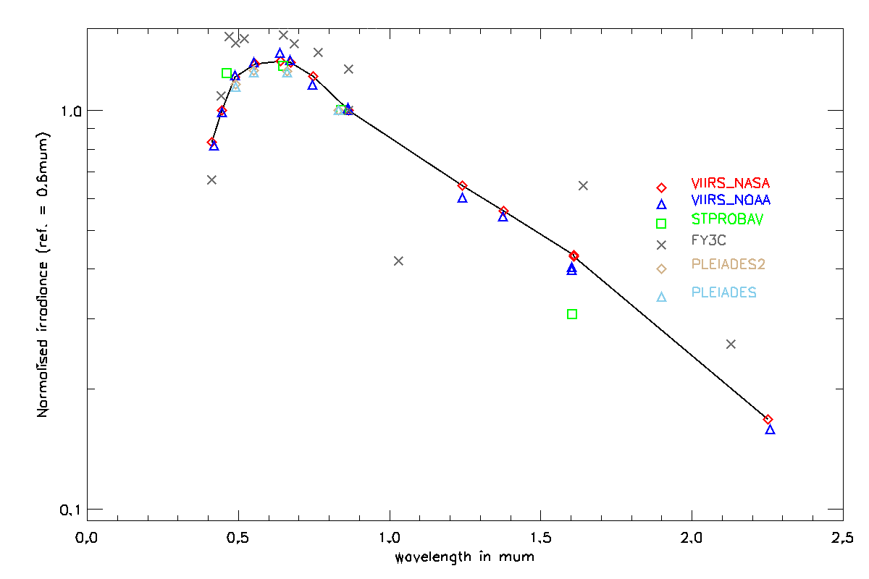
An example using the data GLOD – 0.8 µm
VIIRS NASA
Results for FY3C are not correct due to the wrong selection of the reference channel

Slide 10
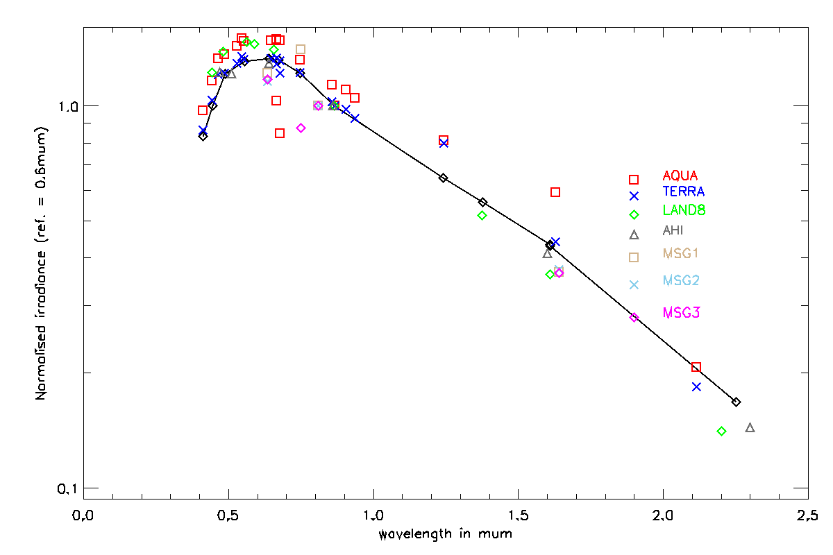
An example using the data GLOD – 0.8 µm
VIIRS NASA

Slide 11
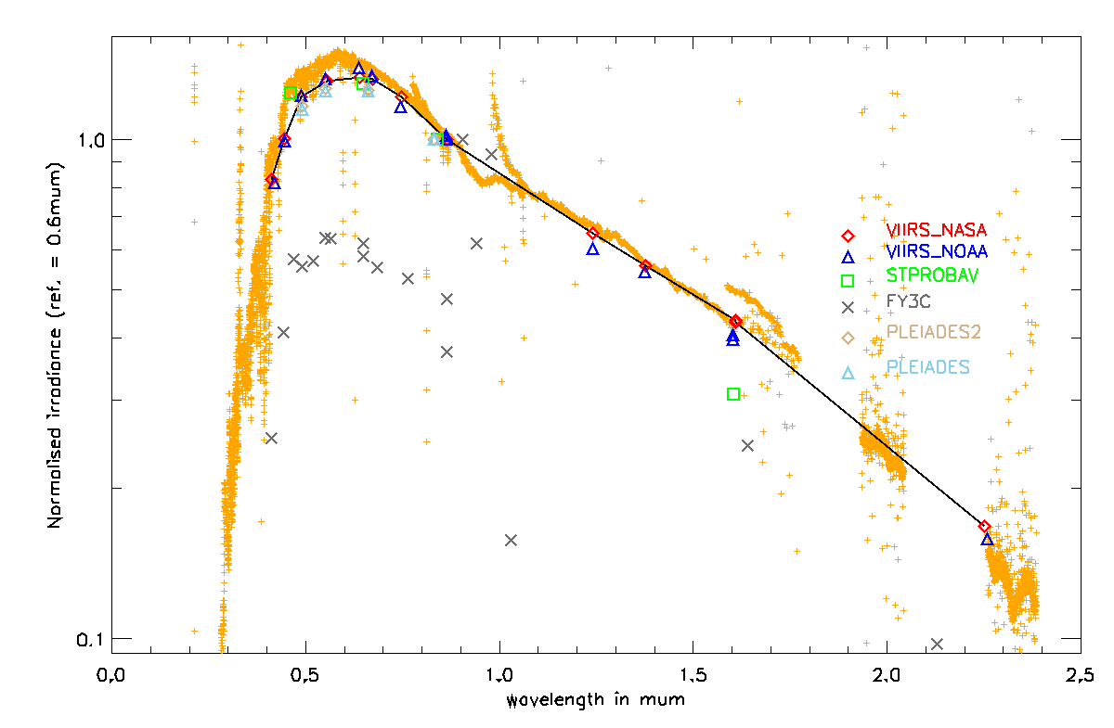
An example using the data GLOD – 0.865 µm
VIIRS NASA
SCIAMACHY at 50° phase
Results for FY3C are not correct due to the wrong selection of the reference channel

Slide 12
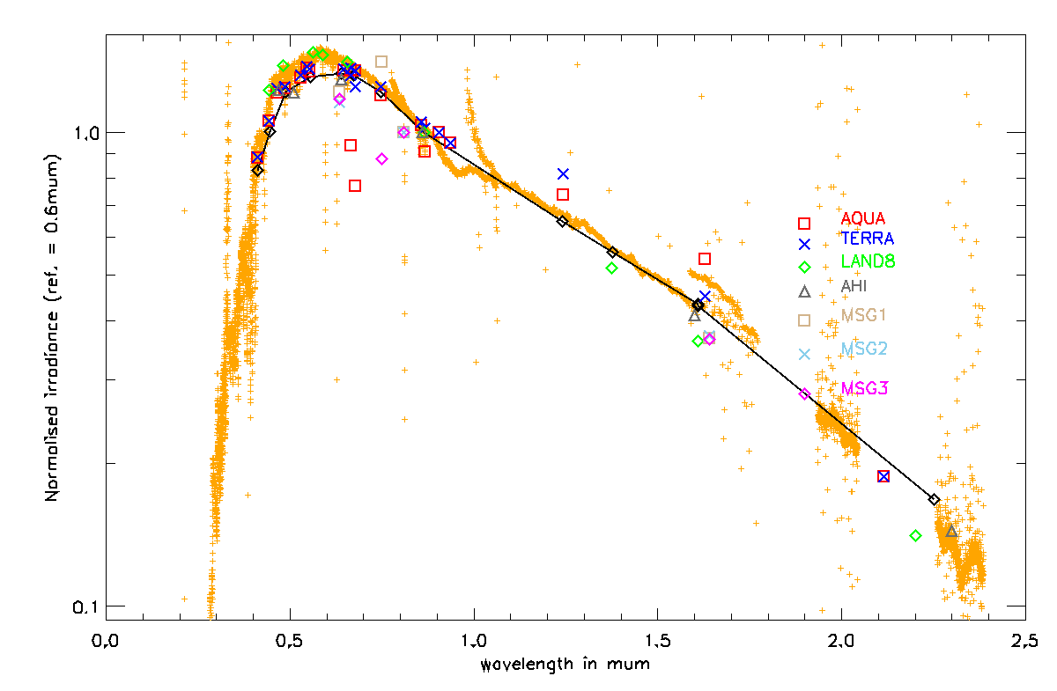
An example using the data GLOD – 0.865 µm
VIIRS NASA
SCIAMACHY at 50° phase

Slide 13
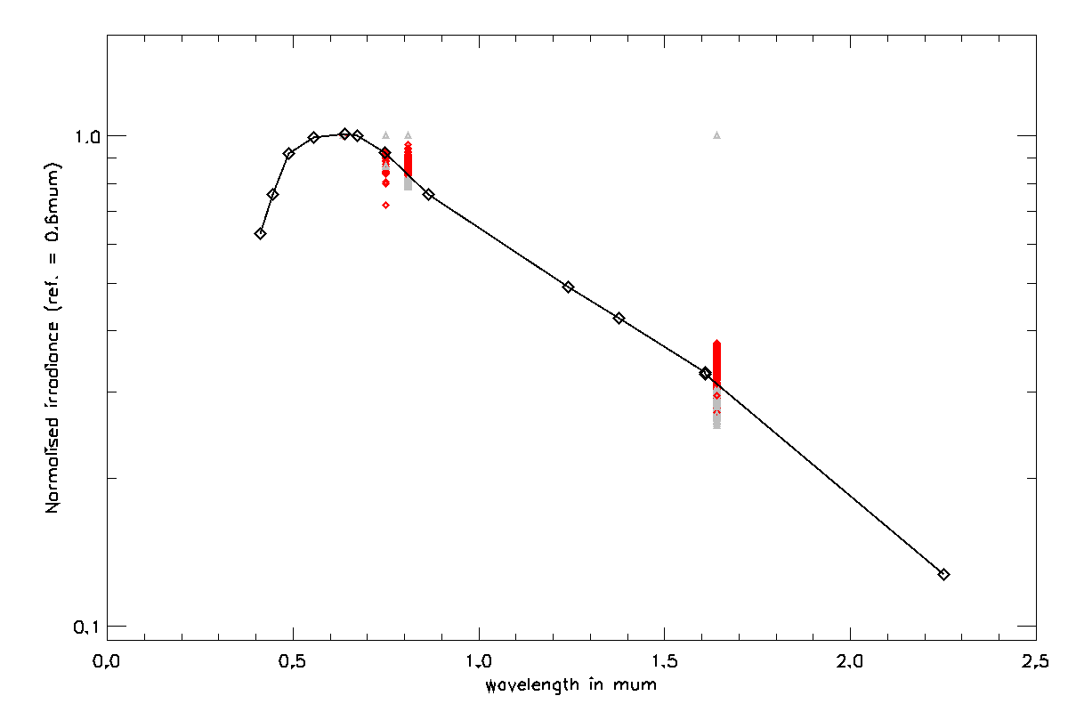
Meteosat-10 - SEVIRI inter-band – 0.6 µm
VIIRS NASA
GIRO
Variability due to the changing illumination conditions

Slide 14
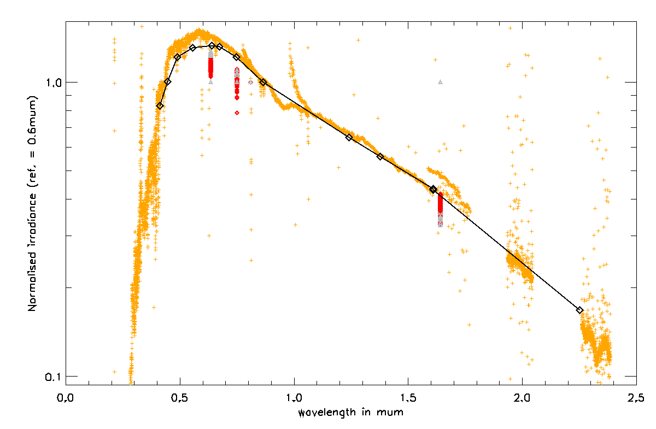
Meteosat-10 - SEVIRI inter-band – 0.865 µm
VIIRS NASA
GIRO

Slide 15
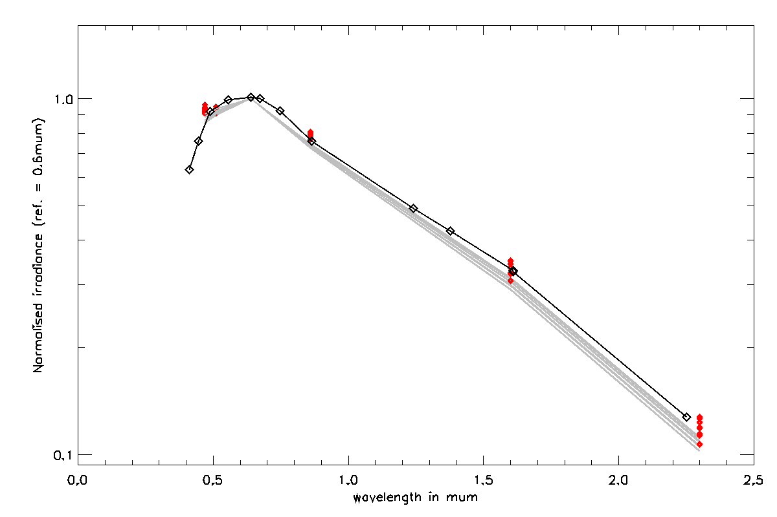
Himawari-8 - AHI inter-band – 0.6 µm
VIIRS NASA
GIRO

Slide 16
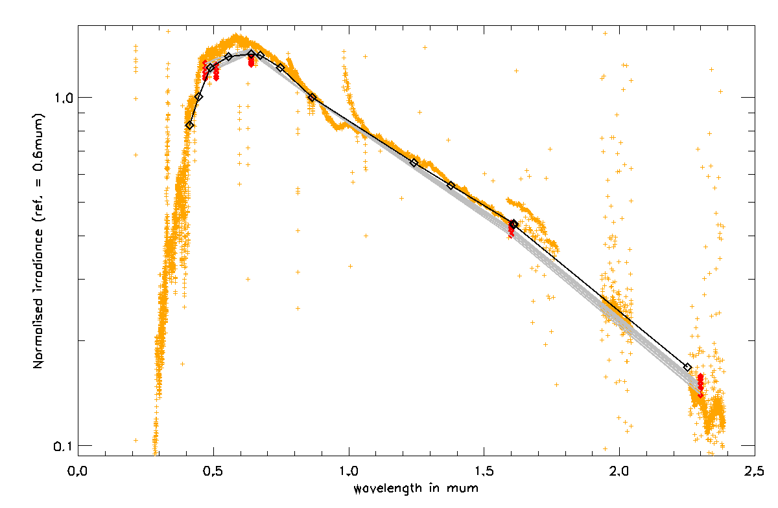
Himawari-8 - AHI inter-band – 0.865 µm
VIIRS NASA
GIRO

Slide 17
Conclusion
More work required on the current results (SBAFs, reference bands selection, etc.)
However, it is an efficient method to investigate the consistency between:
Inter-band calibration methods
Absolute calibration
Consistency between instruments
A way to check the Moon irradiance calculation when comparing with other methods???
Would need the teams interested to provide more data (up-to-date data processing)
Interactions needed with the instrument experts and data owners to define the reference band(s)

