Slide 1
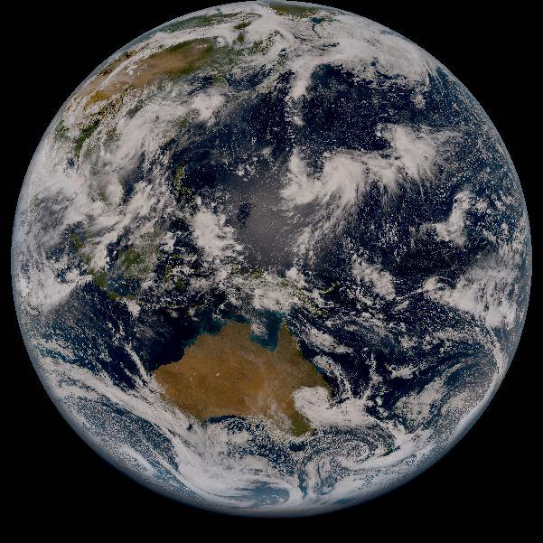
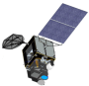
Lunar INTER-CALIBRAION of
AHI with MODIS
Masaya Takahashi (JMA)
in collaboration with Sebastien Wagner (EUMETSAT)
1
2nd GSICS/CEOS Lunar Calibration Workshop, 13-16 November, Xi’an, China

Slide 2
Contents
Himawari-8/AHI Lunar Inter-calibration Method
Preliminary Inter-calibration Results w.r.t. Aqua/MODIS
Future Plans
  Inter-calibration w/ S-NPP/VIIRS
  Inter-calibration w/ GEO Imagers
  Summary

Slide 3


Lunar Inter-calibration
(proposed by S. Wagner at 2016 GSICS Annual Meeting in Tukuba, Japan)
Compute lunar irradiances using:
Monitored instrument SRF (i.e. AHI)
Observation time and satellite position of reference instrument (i.e. Aqua/MODIS)
and compare with Aqua/MODIS lunar irradiance (SBAF is also taken into account)
2. Take an average of the results of step-1
Assumption : reference sensor is well calibrated, no phase angle dependence
3. Take difference between monitored/reference instruments and derive inter-calibration result

Slide 4
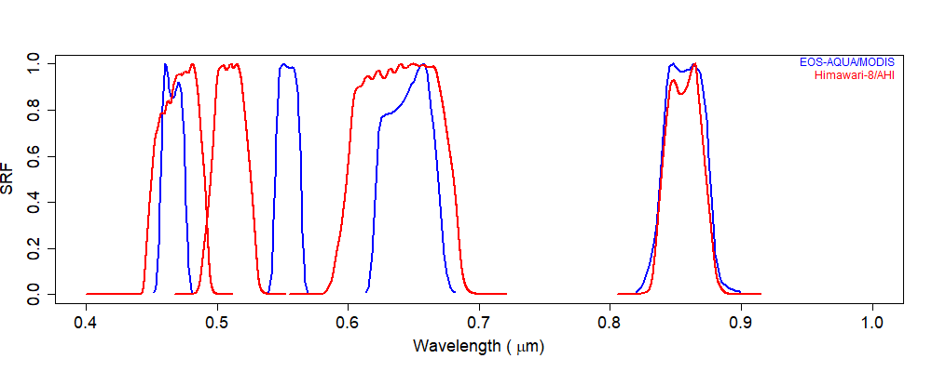
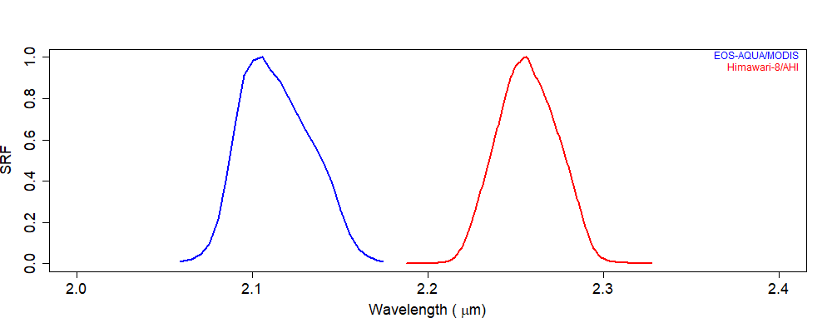
Himawari-8/AHI Lunar Inter-Calibration
Reference data
Aqua/MODIS (many thanks to MCST for approving the data usage)
Average of 24 irradiance (2002-10-16 to 2014-10-04)
SBAF: currently not considered
AHI | Band1 (0.47) | Band2 (0.51) | Band3 (0.64) | Band4 (0.86) | Band6 (2.3)
Aqua/MODIS | Ch3 (0.449) | Ch4 (0.555) | Ch1 (0.645) | Ch2 (0.858) | Ch7 (2.130)
Ch3 Ch4 Ch1 Ch2 Ch7
Band1 Band2 Band3 Band4 Band6

Slide 5
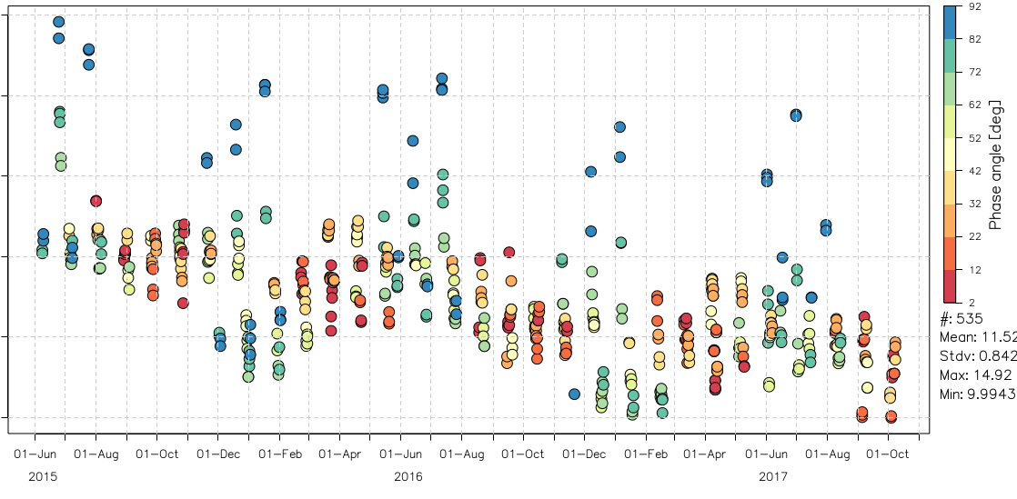
ΔIrr of Himawari-8/AHI Band4 (0.86 μm)
Relative difference of AHI lunar irradiance vs. GIRO: ~12% +/- ~2%
Calibration slope from solar diffuser obs. (mean of Mar-May 2015 results) is used for all the lunar obs.
10 11 12 13 14 15 [%]
AHI vs. GIRO [%]

Slide 6

Inter-calibrated ΔIrr of Himawari-8/AHI Band4 (0.86 μm)
with reference to Aqua/MODIS Ch2 (0.858 μm)
ΔIrr: shifted from 12 (+/- 2) [%] to ~4 [%]
3 4 5 6 7 [%]
AHI vs. Aqua/MODIS [%]

Slide 7
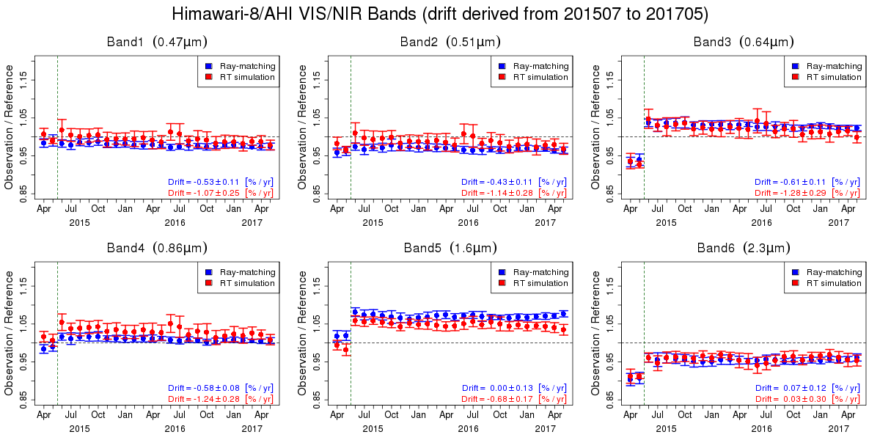
Comparison w/ other validation results
Lunar inter-calibration: roughly in agreement w/ vicarious calibration
Need for revisiting oversampling factor and pixel IFoV
SBAF also needs to be considered
Vicarious calibration using Aqua/MODIS as inputs to radiative transfer calculation
Ray-matching (Quasi-SNO) w/ S-NPP/VIIRS
Himawari-8/AHI Band4 (0.86 μ m) vs. Aqua/MODIS Ch2 (0.858 μm)
Himawari-8/AHI
Band4 (0.86 μ m)
3 4 5 6 7 [%]
Updates of Cal. Slope from pre-launch determined value to Solar diffuser obs.

Slide 8
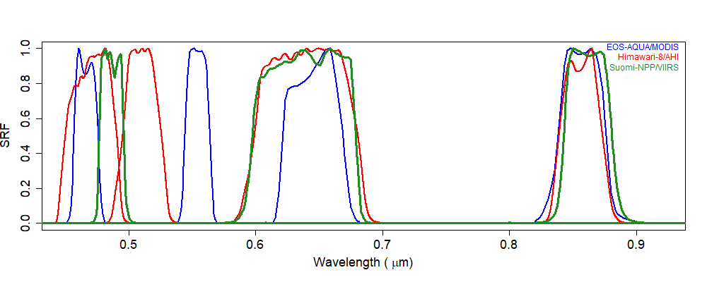
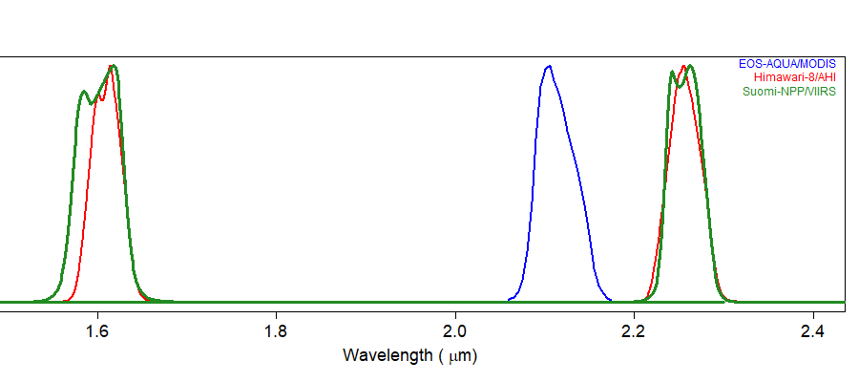
Future Plan 1: Use of S-NPP/VIIRS as a Reference
Needs of inter-calibration for AHI all 6 VNIR bands incl. Band5 (1.6 μm)
Use of S-NPP/VIIRS is planned (looking forward to be in a part of GLOD!)
MODIS Ch3 Ch4 Ch1 Ch2 Ch7
AHI Band1 Band2 Band3 Band4 Band5 Band6
VIIRS M03 I01 M07 M10 M11

Slide 9
Future Plan 2: Inter-calibration w/ GEO Imagers
How to deal with GIRO phase angle dependence in inter-calibration? Correction of the dependence would be the best way, but alternatively….
a
1. Limiting AHI’s phase angles to be compared with MODIS/VIIRS
Smaller # of AHI samples, but could still be OK
a
2. Inter-calibration w/ GEO imagers (e.g. SEVIRI, ABI)
No need for the phase angle dependence correction
Could be useful for checking the calculation of observed lunar irradiance (e.g. calibration, oversampling factor, pixel IFoV)
Potential to be inter-calibrated “GEO-Ring” L1 products?

Slide 10
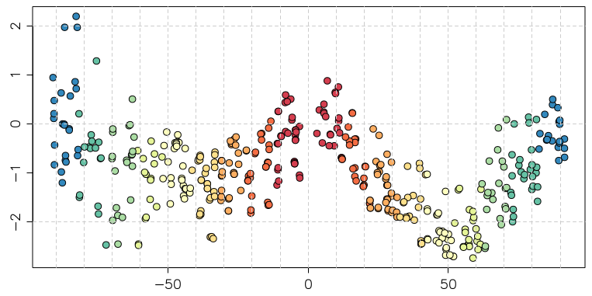
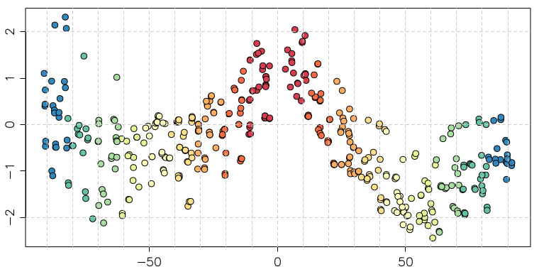
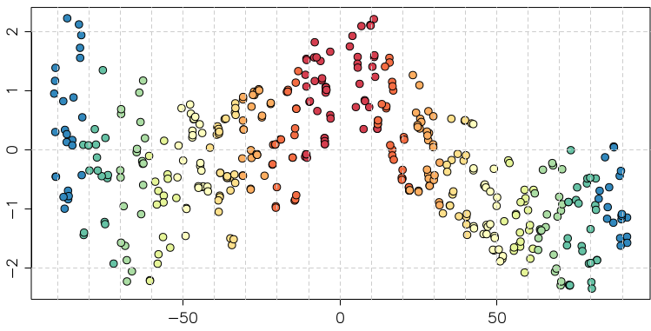
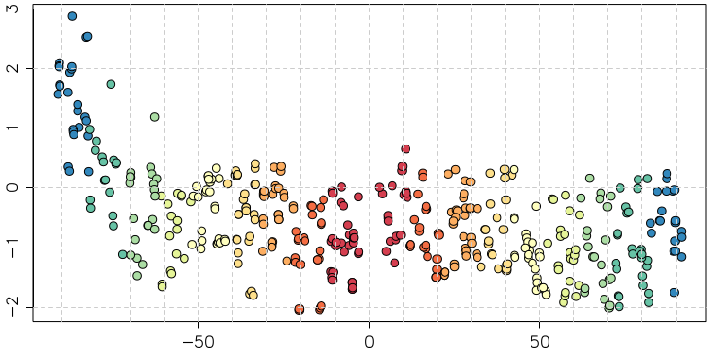
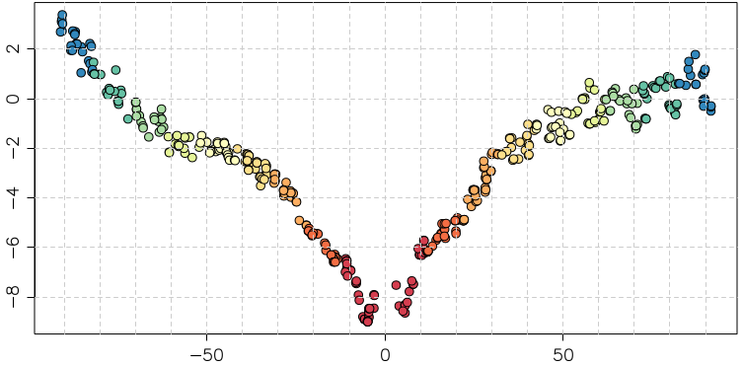
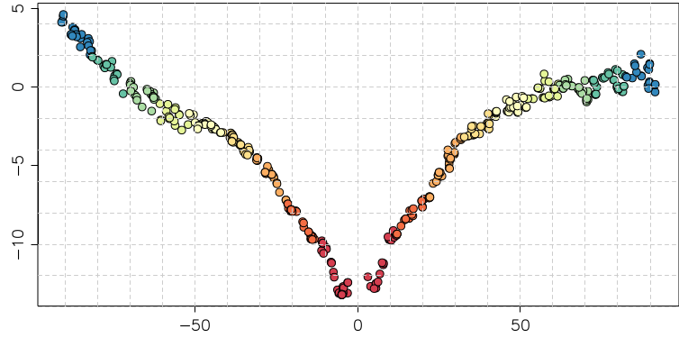

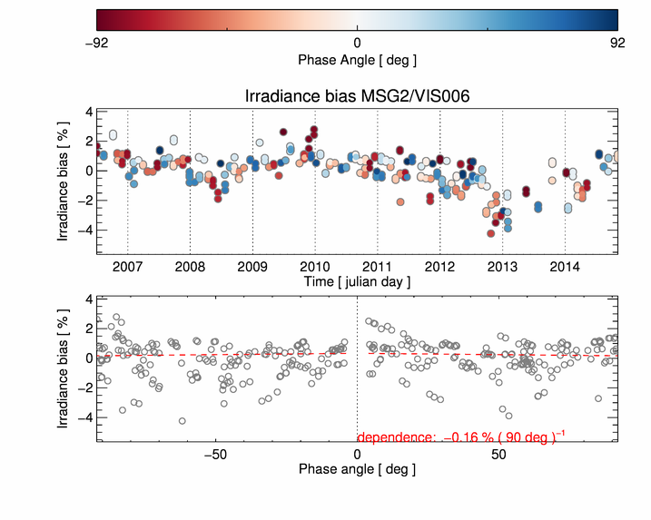
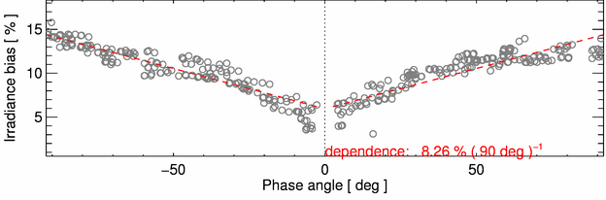
Himawari-8/AHI lunar phase angle dependence in ΔIrr
Good agreement with SEVIRI NIR1.6, but not with SEVIRI VIS 0.6
Moon pixel selection w/ lower DC threshold (=25) + Connected-component labeling
Band1 Band2 Band3
(0.47μm) (0.51μm) (0.64μm)
ΔIrr (%)
Band4 (0.86μm) Band5 (1.6μm) Band6 (2.3μm)
ΔIrr (%)
Lunar phase angle [deg]
Lunar phase angle [deg]
Lunar phase angle [deg]
MSG1/SEVIRI VIS 0.6
MSG1/SEVIRI NIR1.6
Difference of lunar irradiance between the observation and GIRO [%]
SEVIRI results from B. Viticchie at the Lunar Calibration Workshop in Dec. 2014

Slide 11
Summary
Himawari-8/AHI was inter-calibrated w.r.t. Aqua/MODIS
Roughly in agreement w/ AHI vicarious calibration results, but need for further improvements to derive more reliable results
Future plans
Revisits of AHI oversampling factor and pixel IFoV
Consideration of SBAF
Inter-calibration w/ S-NPP/VIIRS
Inter-calibration w/ SEVIRI, ABI

Slide 12
Thanks for your attention!

Slide 13
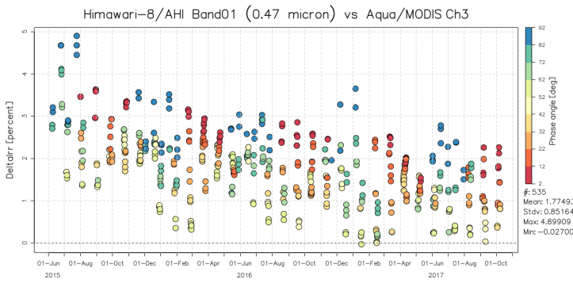
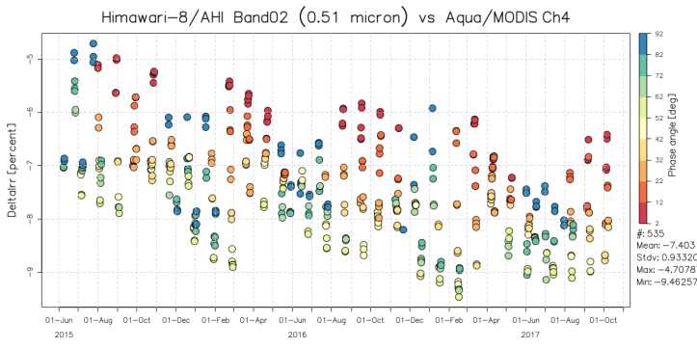
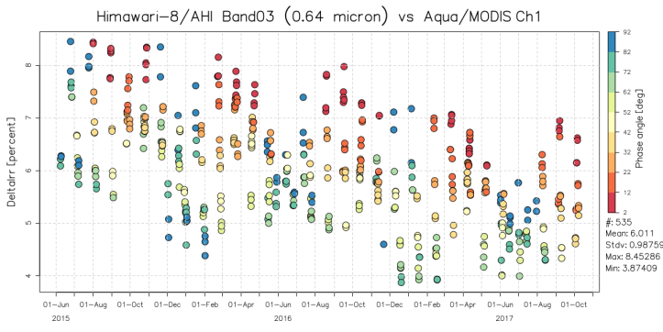

Himawari-8/AHI vs. GIRO
AHI Band1 (0.47μm) AHI Band2 (0.51μm)
AHI Band3 (0.64μm) AHI Band4 (0.86μm)

Slide 14
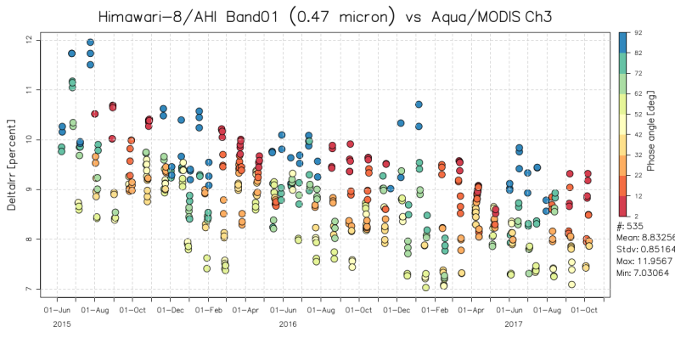
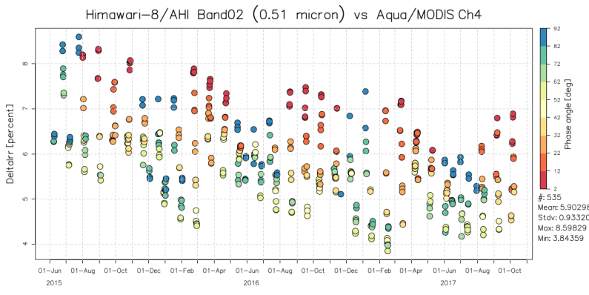


AHI Lunar Inter-calibration Results vs. other Validation Results
AHI Band1 (0.47μm) vs. MODIS Ch3 AHI Band2 (0.51μm) vs. MODIS Ch4
AHI Band3 (0.64μm) vs. MODIS Ch1 AHI Band4 (0.86μm) vs. MODIS Ch2

Slide 15
AHI Lunar Inter-calibration Results vs. other Validation Results
AHI Band1 (0.47μm) vs. MODIS Ch3
AHI Band2 (0.51μm) vs. MODIS Ch4

Slide 16
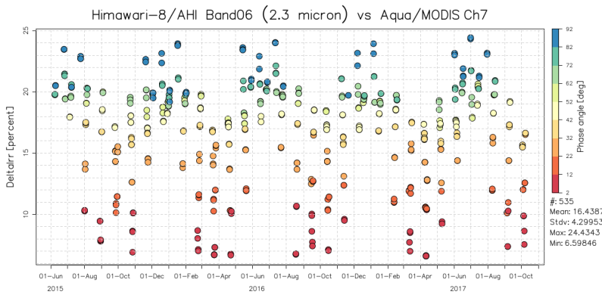
Himawari-8/AHI vs. Aqua/MODIS
AHI Band3 (0.64 μm) vs. MODIS Ch1
AHI Band6 (2.3 μm) vs. MODIS Ch7

Slide 17
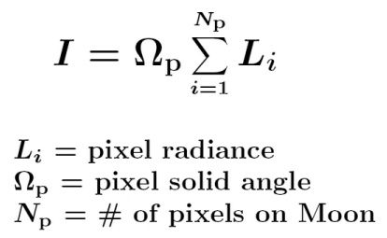
Oversampling, Pixel Solid Angle
Oversampling factor
N-S IFoV / N-S Sampling Distance
No E-W oversampling is assumed because E-W IFoV < E-W Sampling Distance
Pixel solid angle
E-W Sampling Distance * N-S IFoV
Both oversampling/Pixel IFoV: assumed to be constant
Future plans
Revisit of the definition of oversampling factor and pixel solid angle
Under-discussion within NOAA-JMA bilateral collaboration on ABI/AHI Cal/INR
Calculation of alternative factor (e.g. effective moon solid angle (Choi et al. 2016))
Validation of the pre-launch determined IFoV using on-orbit observation data

Slide 18
Radiance
Level of image processing
Level 1A equivalent data
Calibration used to convert DN to radiance
Quadratic calibration equation
Quadratic term: pre-launch determined value
Slope: solar diffuser / pre-launch determined value
Offset: deep space observation (updated at each full-disk swath / each lunar obs.)
Handling extraneous signals
Out-of-Filed Anomalous Response (OFAR, Griffith 2017)
Appears in Band 1 -3 (0.47, 0.51 and 0.64 μm)
P. Griffith, 2017: Himawari08 Out-of-Field Anomalous Response (OFAR), 8th Asia/Oceania Meteorological Satellite Users’ Conference, 18 - 20 October 2017, Vladivostok, Russia.

Slide 19
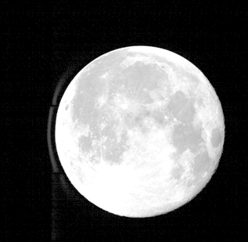
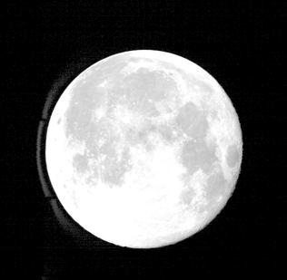
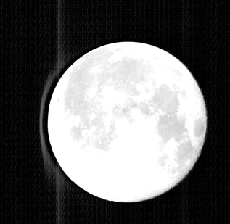
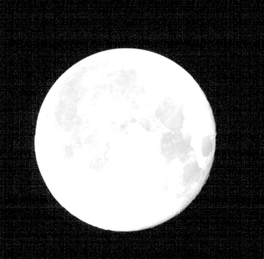
Moon Pixel Selection
Based on DC thresholds
Needs to discriminate the Moon and Out-of-Field Anomalous Response (Griffith 2017)
OFAR: blurring occurs in Bands 1-3 (0.47, 0.51, 0.64 μm) which use silicon detectors
No effect in other bands which use HgCdTe detectors
Appears west of the Moon under the current observation configuration
GOES-R/ABI and GK-2A/AMI are unaffected by OFAR
Enhanced Himawari-8/AHI lunar observation image (color scale: 0.1 – 30 % of reflectivity)
Band1 (0.47 μm) Band2 (0.51 μm) Band3 (0.64 μm) Band4 (0.86 μm)
19 August 2016

Slide 20
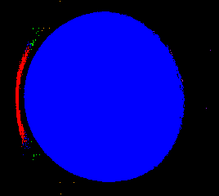
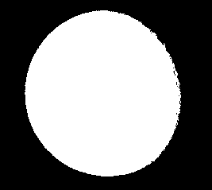
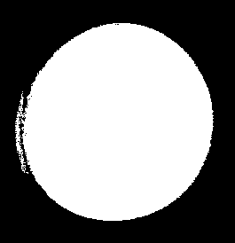
Moon Pixel Selection using Connected-component Labeling
Lower DC threshold (~25) w/ Connected-component Labeling method is used
Assign the same number (label) to adjacent DCs which exceed the threshold
Choose the label w/ the biggest # of pixels as the Moon pixels
Effectively distinct OFAR for positive lunar phase angles, but difficult for negative phase angles
Labelled pixels
Selected Moon pixels
Phase angle: -28.2 deg.

Slide 21
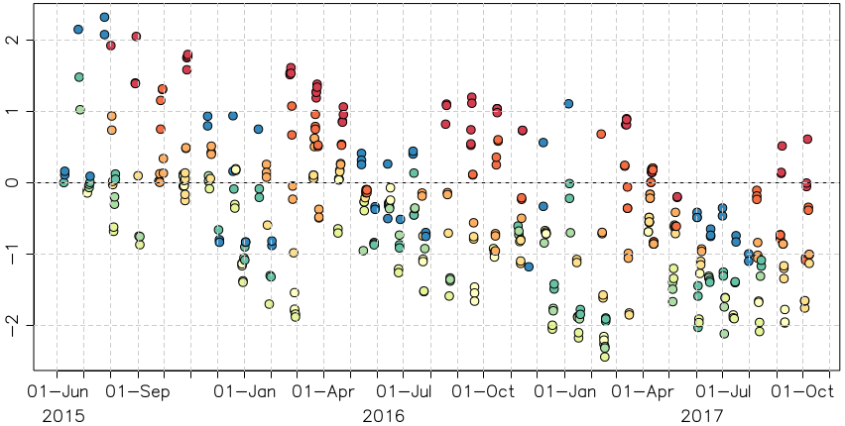
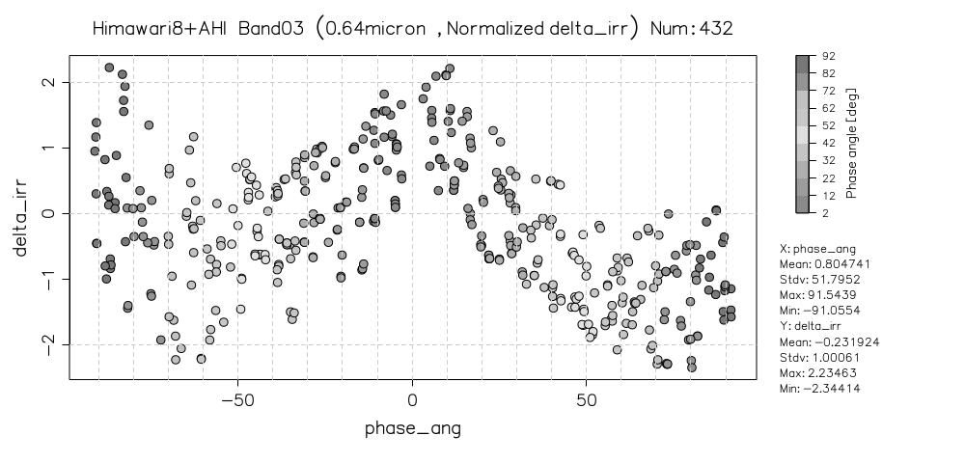
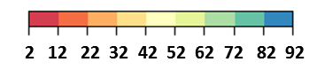
Impacts of Moon-masking DC Threshold on Lunar Calibration
Difference of lunar irradiance between the observation and GIRO [%]
Lower DC threshold (=25) w/ Connected-component Labeling approach is used
Phase angle dependence is reduced, but still exists
Further lower DC threshold (~20) should be ideally used
Nonlinearity in AHI ? - to be investigated
Band3 (0.64 μm)
Band3 (0.64 μm)
ΔIrr (%)
ΔIrr (%)
Color: lunar phase angle [deg]
Lunar phase angle [deg]

Slide 22
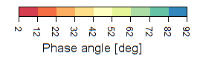
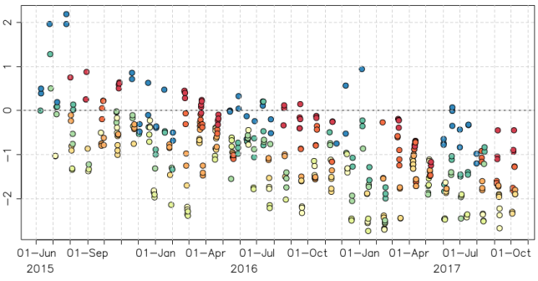

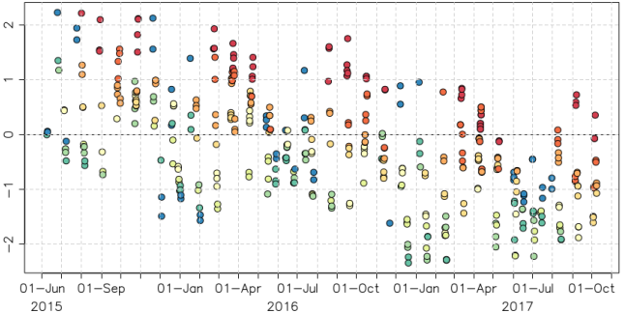
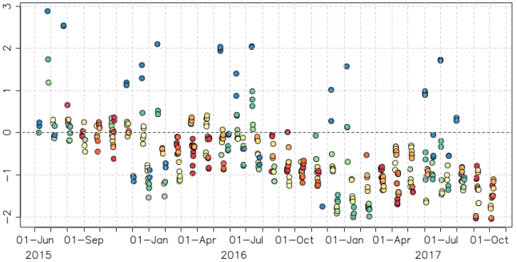
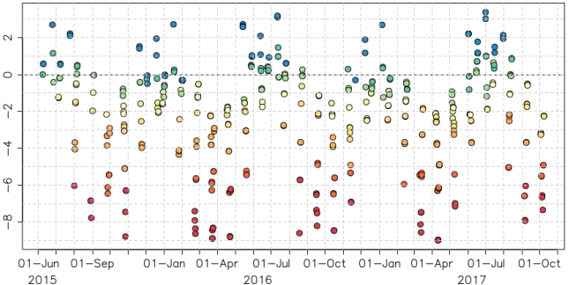
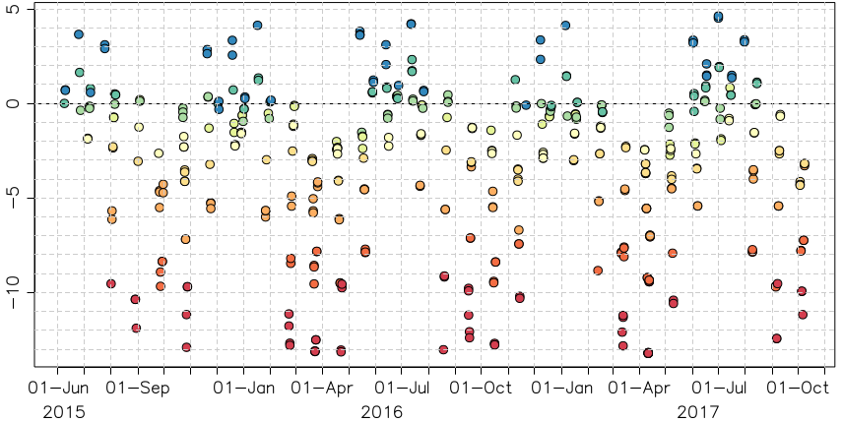
Time Series of ΔIrr of Himawari-8/AHI
Difference of lunar irradiance between the observation and GIRO [%]
Moon pixel selection
Lower DC threshold (=25) + Connected-component labeling
Sensor degradation trend
Good agreements with other Cal/Val approaches
2 12 22 32 42 52 62 72 82 92
Phase angle [deg]
Band1 (0.47μm) Band2 (0.51μm) Band3 (0.64μm)
ΔIrr (%)
Band4 (0.86μm) Band5 (1.6μm) Band6 (2.3μm)
ΔIrr (%)

Slide 23
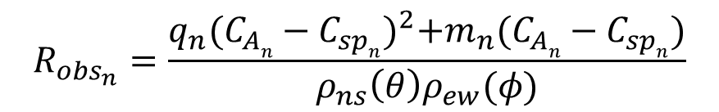
VIS/NIR on-board Calibration using Solar Diffuser (SD)
Quadratic calibration equation in “L1A (L1.0) equivalent data” processing
$$R_{{obs}_{n}}=\frac{q_{n}{(C_{An}−C_{spn})}^{2}+m_{n}(C_{An}−C_{spn})}{ρ_{ns}{\left(θ\right)ρ}_{ew}(φ)}$$
R_{obsn}: Observed radiance
C_{An}: Raw digital count
C_{spn}: Deep space raw digital count
q_{n}, m_{n}: Coefficients
n: Detector ID
ρ : Scan mirror reflection coef.
θ, φ : Incidence angle to SM
q_{n}: pre-launch test value
m_{n}:
Pre-launch test value (until 7 June 2015)
Values based on solar diffuser (SD) observations (since 8 June 2015). SD observation is performed every 2 weeks
C_{sp}: updated by deep space observation at each Full-disk swath
aa

Slide 24
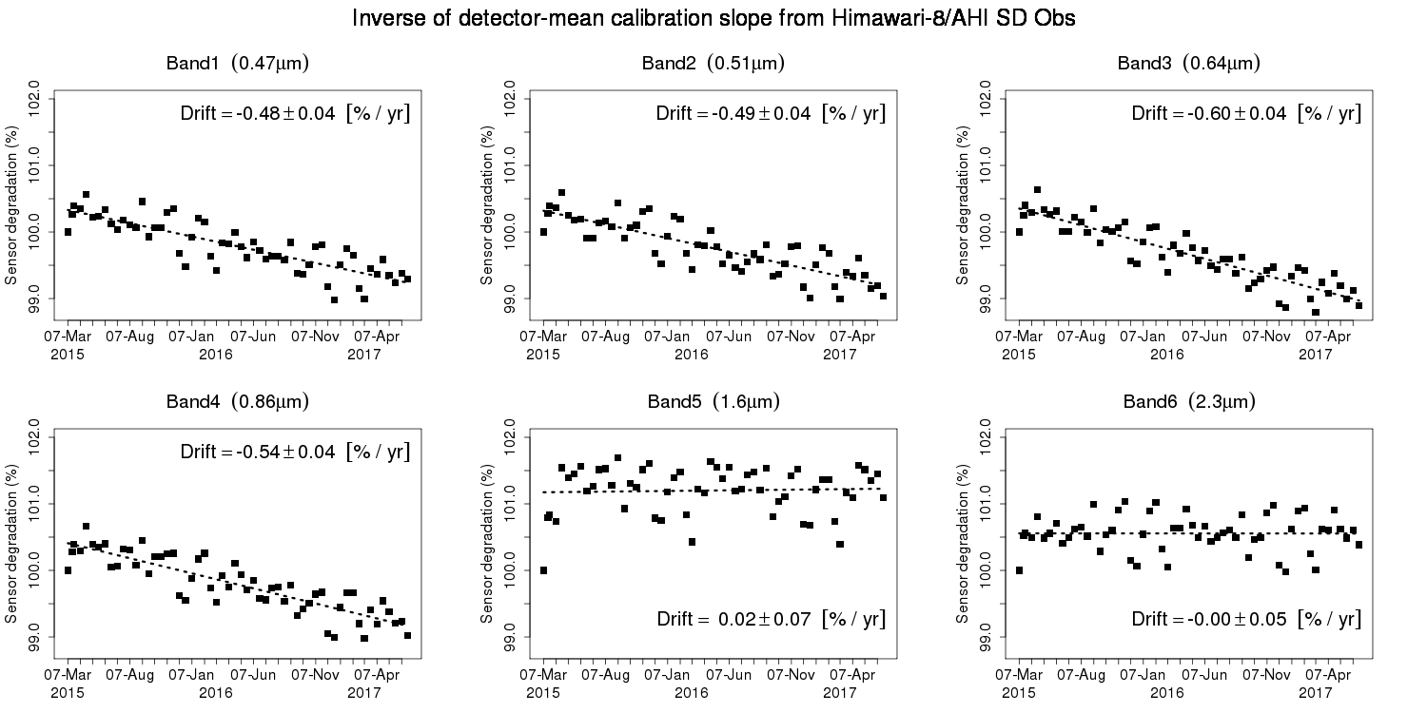
VNIR Calibration Slopes derived from Solar Diffuser (SD) observations
SD observation: performed twice / month
June 2015: VNIR calibration slopes in L1 data were updated using Mar-May 2015 SD obs.
~0.5% degradation trends in Band1-4 (no SD degradation is assumed)
Time series of inverse of detector-averaged calibration slope from SD observations
Band1 Band2 Band3
(0.47μm) (0.51μm) (0.64μm)
Band4 Band6
(0.86μm) (2.3μm)
Band5
(1.6μm)

Slide 25
Validation of On-board Calibration Slope
~0.5%/year of degradation trends in Band1-4
~6% bias for Band5, ~4 % bias for Band6 based on ray-matching validation
Time series of ratios between Himawari-8/AHI observations and reference values
Band1 (0.47μm) Band2 (0.51μm) Band3 (0.64μm)
Updates of Cal. slope
Band4 (0.86μm) Band5 (1.6μm) Band6 (2.3μm)
Error bar: stdv. of slopes

Slide 26
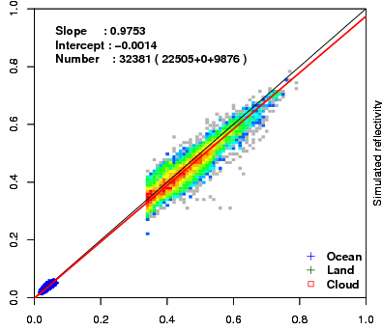
Validation of On-board Calibration
Method 1) Vicarious Calibration using RT Simulation
Comparison of observed and simulated radiance for multiple targets (collaboration research with the University of Tokyo and JAXA/EORC [Prof. Nakajima])
Targets:
Cloud-free ocean (rayleigh scattering) , liquid water cloud, *cloud-free land and *deep convective cloud
Radiative transfer calculation:
RSTAR (Nakajima and Tanaka [1986,1988])
Input data: Independent from GEO data
JMA Re-Analysis atmos. profiles (JRA-55/JCDAS)
Aerosol/Cloud optical thickness retrieved from MODIS L1B (M[O,Y]D02SSH)
MODIS BRDF (MCD43C2) for land target
Aura/OMI total column ozone, …
August 2015
Simulated reflectivity
Observed reflectivity
*Not implemented for Himawari-8/-9 AHI as of June 2017

Slide 27
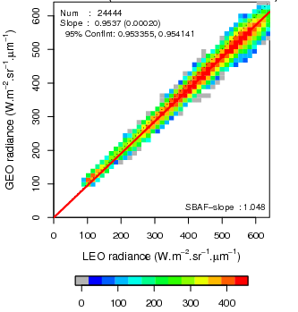
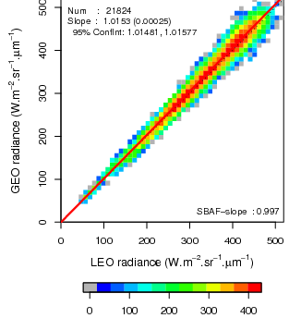
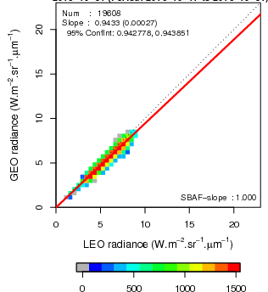
Validation of On-board Calibration
Method 2) Ray-matching with S-NPP/VIIRS
Inter-calibration based on AHI-VIIRS collocation (Quasi-SNO)
Calibration target: cloud pixels
Low radiance scene (e.g. cloud-free ocean) : not used
Spectral Band Adjustment Factor (SBAF) accounting for the spectral mismatch
Band1-5: from NASA Langley SBAF based on SCHIAMACHY (http://cloudsgate2.larc.nasa.gov/SBAF)
Band6: computed using RSTAR simulation
Band1 Band3 Band5
(0.47 μm) (0.64 μm) (1.6 μm)
Stats from 17 to 31 Oct. 2016

Slide 28
Comparison of VNIR Calibration between AHI-8/-9
Results for AHI-8/-9 vicarious calibration, ray-matching and GEO-GEO comparison
Converted to (AHI-9/AHI-8 – 1) x 100 [%]
Good agreements among the three validation methods
Band1: AHI-9 is 4-6% brighter than AHI-8
Band2-4, 6: AHI-8/-9 diffs. are within 2%
Band5: AHI-9 is ~6% darker than AHI-8
Notes on calibration slope
AHI-8: derived from solar diffuser obs. in Mar-May 2015
AHI-9: pre-launch determined value
Could cause AHI-8/-9 discrepancies in the validation
(AHI-9/AHI-8-1) x 100 [%]
0.47 0.51 0.64 0.86 1.6 2.3 [μm]
Observation data: 14-28 Feb. 2017

Slide 29
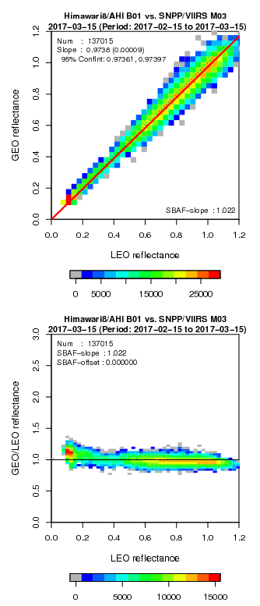
AHI-8 vs. VIIRS direct comparison (ray-matching)
AHI Band 1 (0.47 µm)
Brighter VIIRS at dark scenes
AHI-8 Band1 (0.47 μm) vs. VIIRS M03 (0.46 µm)

