Slide 1
Inter-calibration Using the Moon to Bridge Instruments with Different Relative Spectral Responses in RSB
Lu Zhang, Peng Zhang , Xiuqing Hu, Lin Chen
National Satellite Meteorological Center （NSMC）

Slide 2
Outline
Introduction
Methodology
Validation
Summary

Slide 3
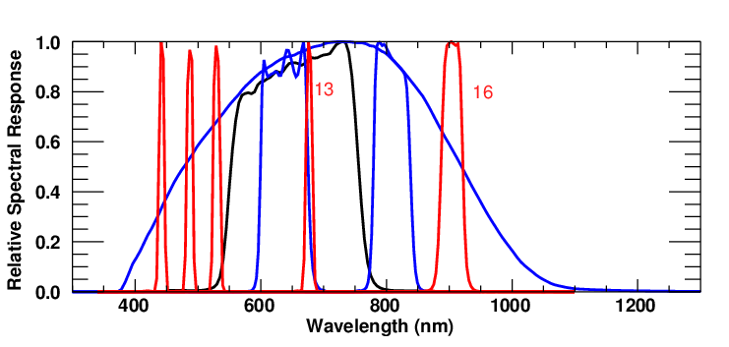
Introduction
Using lunar as a target for inter-calibration
Different relative spectral responses , Inter-band calibration
2. Different observation geometry of lunar
.
...
.

Slide 4
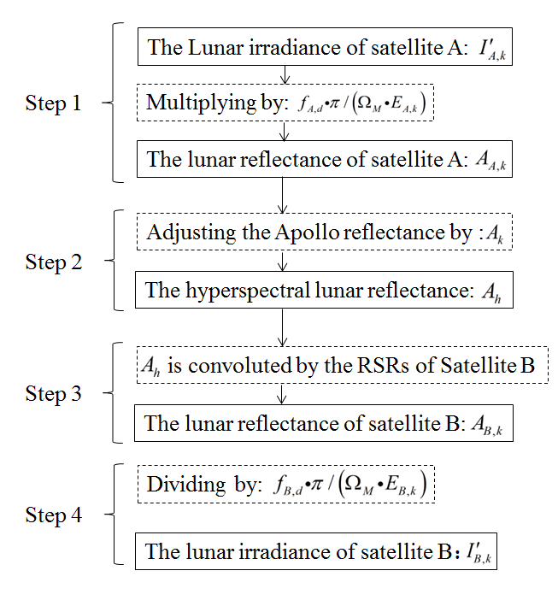
Methodology
Different relative spectral responses
The Spectral Band Adjustment of RSRs by Apollo sample reflectance
Flowchart for spectral band adjustment of RSRs by Apollo sample reflectance

Slide 5
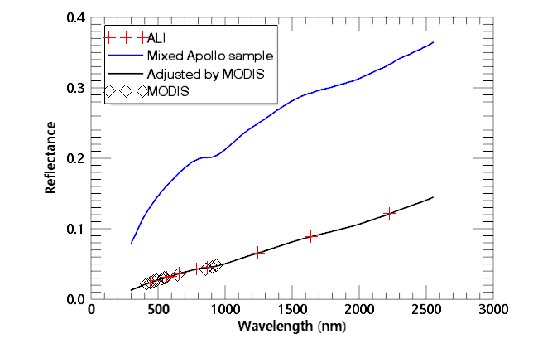
Methodology

Slide 6
Methodology
Using Model of Lunar Irradiance as a Bridge to inter-calibrate Sensors
Double-difference：
Double-ratio：

Slide 7
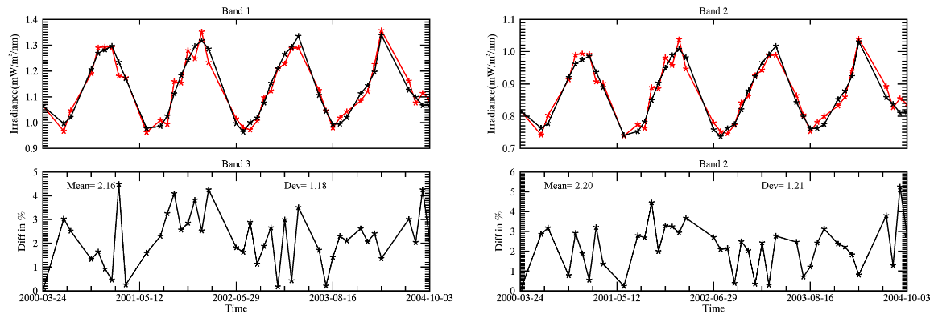
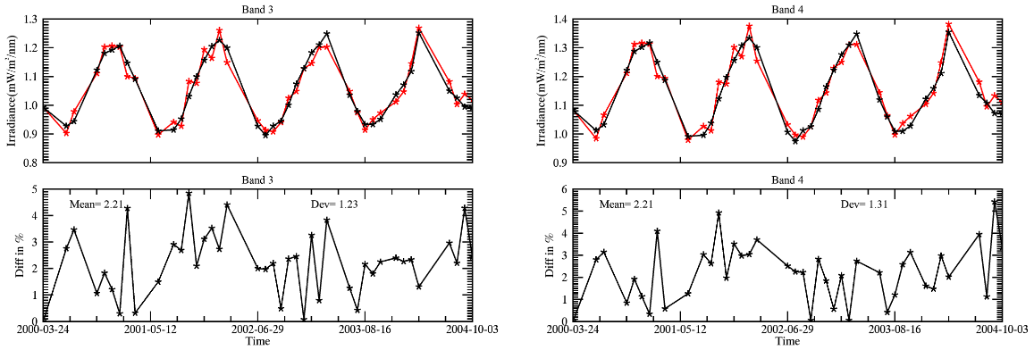
Methodology
MODIS long stability

Slide 8
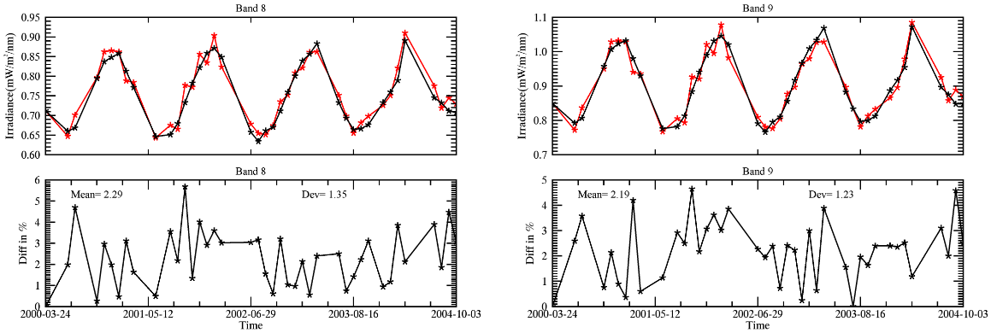
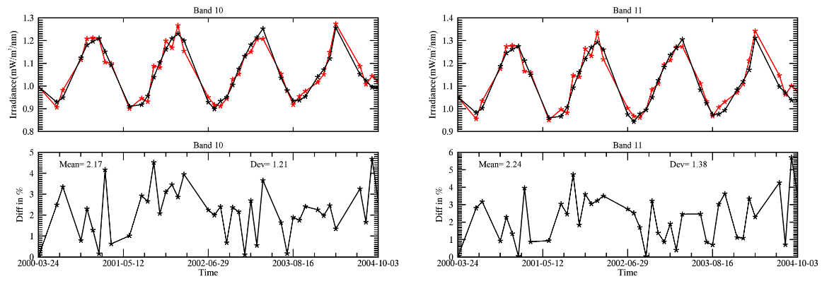
Methodology
MODIS long stability

Slide 9
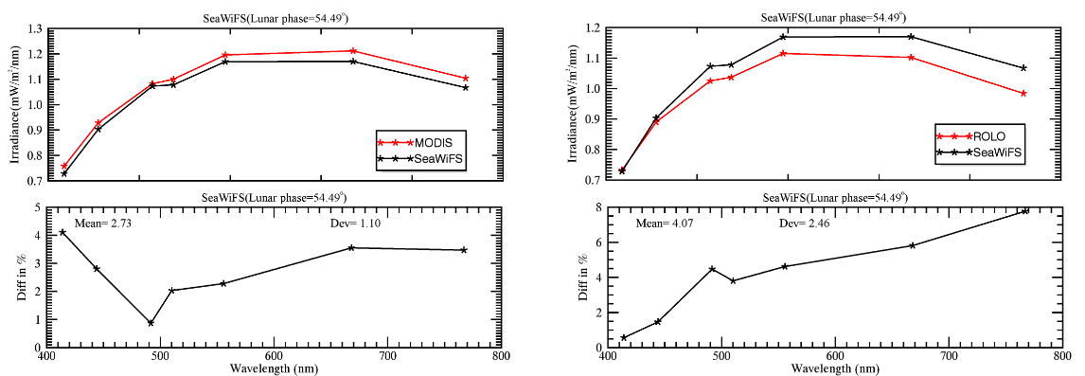
Validation
SeaWiFS between MODIS
Use of the Moon for calibration and characterization of MODIS, SeaWiFS, and VIRS,Barnes, W,2006, 98-119

Slide 10
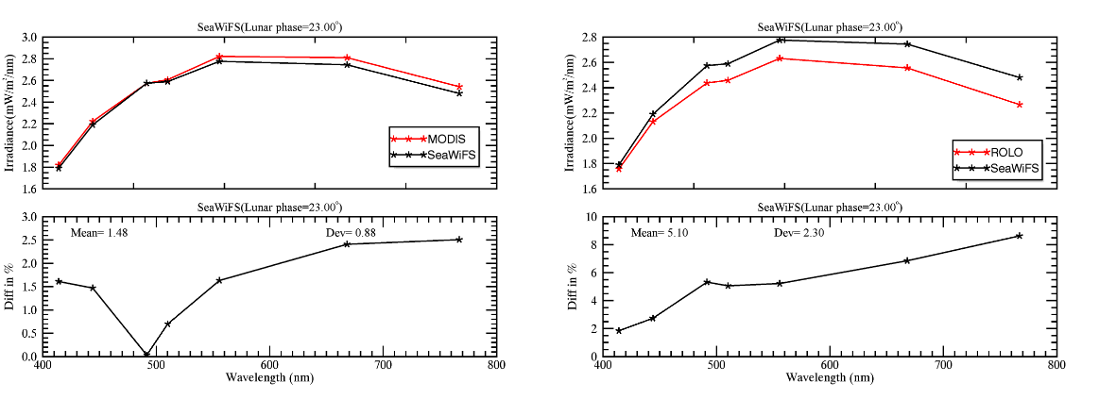
Validation
SeaWiFS between MODIS
Use of the Moon for calibration and characterization of MODIS, SeaWiFS, and VIRS,Barnes, W,2006, 98-119

Slide 11
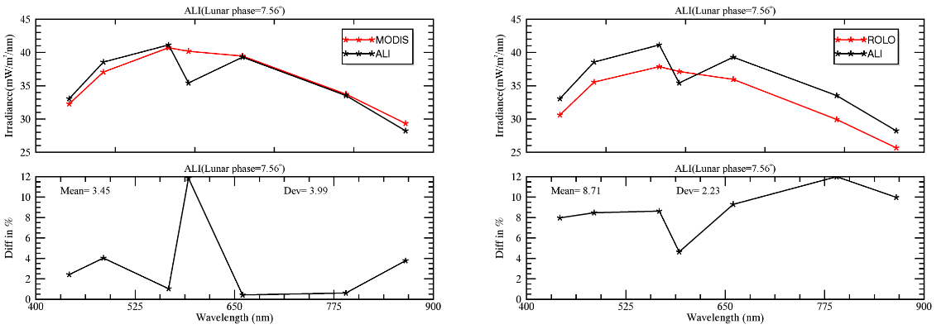
Validation
ALI between MODIS
https://www.moon-cal.org/facility/observatory.php

Slide 12
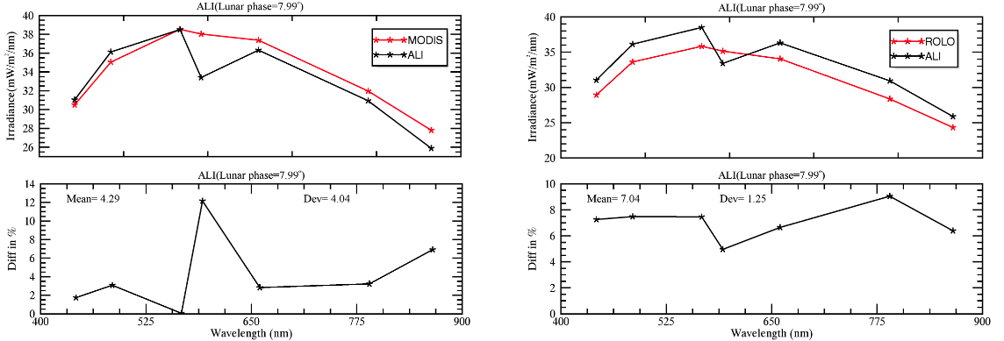
Validation
ALI between MODIS
https://www.moon-cal.org/facility/observatory.php

Slide 13
Summary
Which satellite’s lunar observation are used as a benchmark?
The satellite’s lunar observation in many observation geometry.
The more bands of satellite have are better.
How large the different of observation geometry is appropriate?
The threshold value is testing.

Slide 14
The end

