Slide 1
Towards a Community Best Practice of
Using Lunar Image for On-Orbit Evaluation of Modulation Transfer Function (MTF)
Xi (Sean) Shao¹, Xiangqian Wu², Fangfang Yu¹
1. ERT, Inc. @ NOAA/NESDIS/STAR
2. NOAA/NESDIS/STAR
Acknowledgement: J. Choi, H. Qian, Agencies contributing lunar data

Slide 2
Outline
Introduction – why this effort?
What is MTF and how do we know?
NOAA results:
  What is new now?
  Assessment for six GEO instruments.
Discussions
Summary

Slide 3
Motivation
There is a need to evaluate the spatial quality of an imaging instrument.
  In addition to radiometric, geometric, and spectral calibration.
  From users, instrument vendors, calibration specialists, satellite operators, program managers, among others.
Modulation Transfer Function (MTF) of the sharp edge of lunar image is a nearly ideal and widely available target for such evaluation.

Slide 4
Issues
Standardize the procedure to make the results comparable.
  There can be variations of deriving MTF from lunar image.
    For example deriving Line Spread Function (LSF) from Edge Spread Function (ESF).
  There can also be instrument-specific idiosyncrasy.
    For example pixel overlapping.
Hence the need for a community best practice of using lunar image for on-orbit evaluation of MTF.
  And to outline its limitations.

Slide 5
Approach
NOAA, in collaboration with the GSICS, initiated a project to research these issues.
The first step is to make available lunar images by six GEO instruments:
  ABI on GOES-16, AHI on Himawari-8, Imager on GOES-15, MI on COMS, Imager on FY-2, SEVIRI on MSG.
  To establish a reference to evaluate various methods.
One method for all instruments
  NOAA will report the results of this effort.
  Are Imager and MI similar? ABI and AHI? Better than Imager/MI?
Different methods for the same instrument
  Each agency evaluate MTF of its own satellite.
  Compare the differences in methods, tradeoffs, and results.

Slide 6
Expected Outcomes
Review the various methods and results.
Identify major obstacles or opportunities.
  Is it feasible?
  Are there better ways?
Summarize key questions for further investigation.
Plan for future – interim goals and schedule.
Commit to assignment.

Slide 7
Outline
Introduction – why this effort?
What is MTF and how do we know?
NOAA results:
  What is new now?
  Assessment for six GEO instruments.
Discussions
Summary

Slide 8
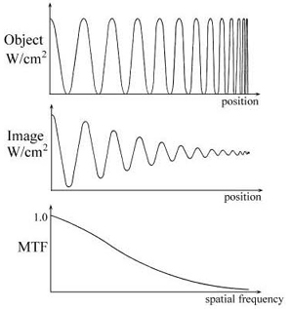
What Is MTF – Intuitively
Modulation transfer function is the decrease of modulation depth with increasing frequency.
https://spie.org/publications/tt52_131_modulation_transfer_function?SSO=1
Ideal (diffraction-limited)

Slide 9
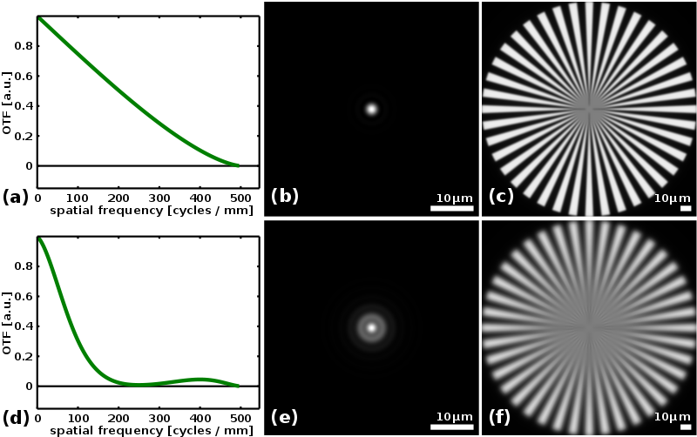
What Is MTF – Formally
Formally, the Optical Transfer Function (OTF) is the Fourier Transform of the Point Spread Function (PSF). The MTF is the magnitude (absolute value) of the complex OTF.
https://en.wikipedia.org/wiki/Optical_transfer_function
Ideal (diffraction-limited)

Slide 10
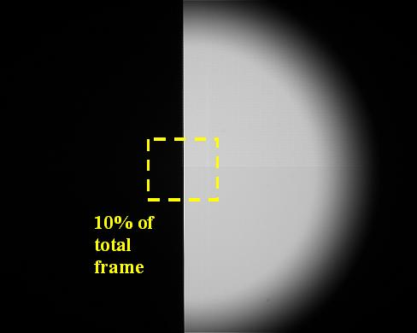
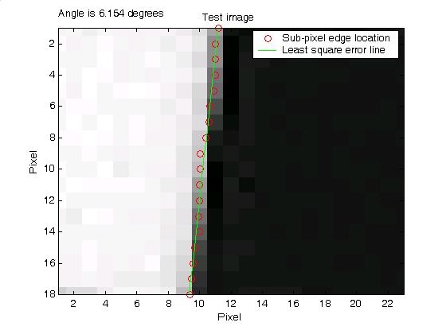
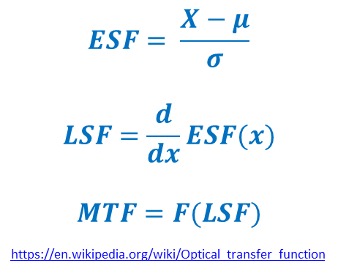
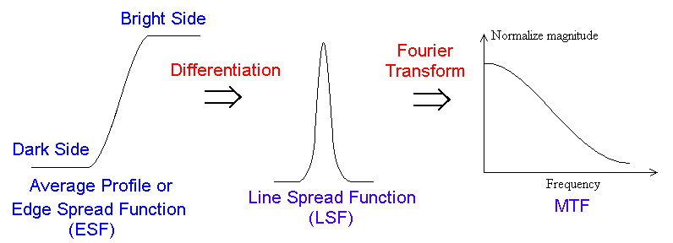
Assess MTF Prelaunch
$$ESF= \frac{X−μ}{σ}$$
$$LSF=\frac{d}{dx}ESF(x)$$
$$MTF=F(LSF)$$
https://en.wikipedia.org/wiki/Optical_transfer_function
Courtesy of Jason Choi

Slide 11
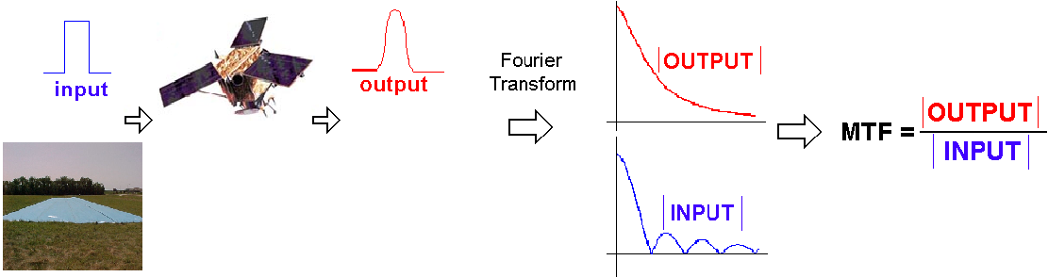
Assess MTF Post-Launch – Pulse
A pulse input is given to the imaging system.
Output of the system is the resulting image.
Edge detection and mSG filtering was applied to obtain output profile.
Take Fourier transform of the input and output.
MTF is calculated by dividing output by input and normalizing DC component to unity.
Pulse method
Courtesy of Jason Choi

Slide 12
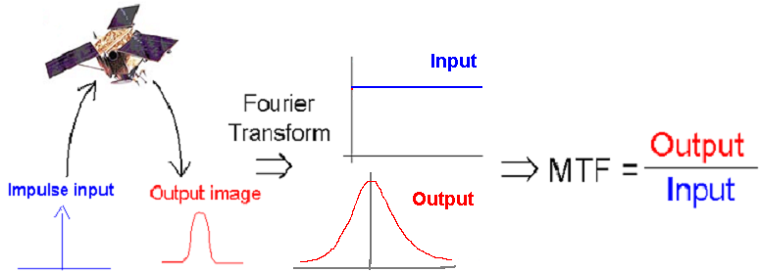
Assess MTF Post-Launch - Mirror
16 - 20 convex mirrors formed ground impulse inputs on a uniform grassy background.
A Sub-pixel peak location was found by fitting the Gaussian function for each mirror.
Final 2D Gaussian function was found by fitting aligned data points from all the mirrors.
Cross and along track direction LSF and MTF were calculated by applying Fourier transformation.
Courtesy of Jason Choi

Slide 13
Assess MTF Post-Launch – Edge (Lunar)
Shea, James J. "Lunar limb knife-edge optical transfer function measurements." Journal of electronic imaging 8.2 (1999): 196-208.
  Among the first attempt.
M. Grotenhuis, X. Wu, C. Cao, and G. Sindic-Rancic, “On-Orbit Determination of GOES-15 Imager Visible Channel Modulation Transfer Function.” CALCON 2011
  Multiple cross sections.
Choi, Taeyoung, Xiaoxiong Xiong, and Zhipeng Wang. "On-Orbit Lunar Modulation Transfer Function Measurements for the Moderate Resolution Imaging Spectroradiometer." Geoscience and Remote Sensing, IEEE Transactions on 52.1 (2014): 270-277.
  Applied to polar instrument.
  Limited pixel resolution
C. Rollins, SPIE.
  Applied to ABI.

Slide 14
Outline
Introduction – why this effort?
What is MTF and how do we know?
NOAA results:
  What is new now?
  Assessment for six GEO instruments.
Discussions
Summary

Slide 15
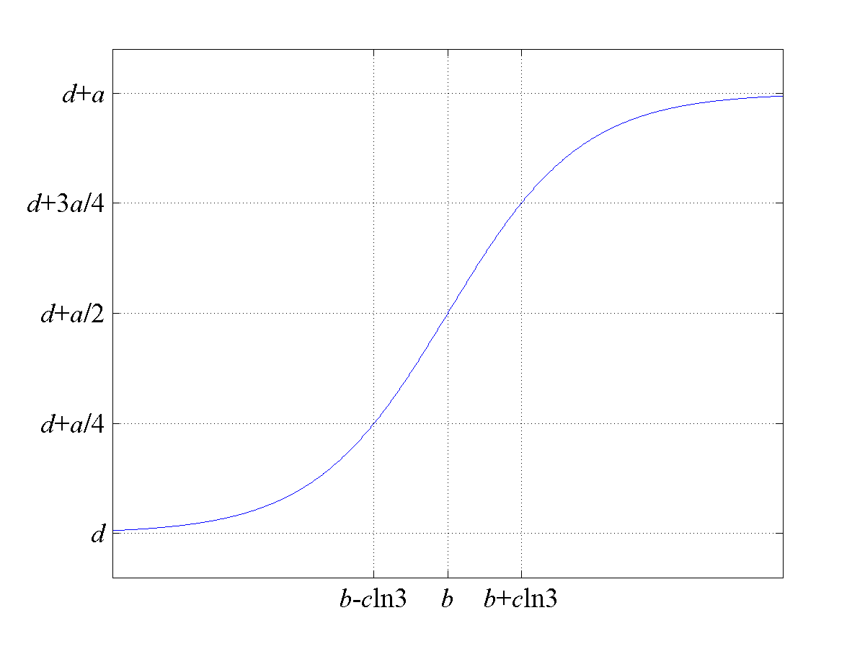
  Algorithm:
  Parametric Edge Detection by Fermi Distribution Function
Fitting function:
A Fermi function-based parametric method was applied to estimate edge location to sub-pixel accuracy.
Parameter ‘b’ is the sub-pixel edge location estimate.
A. P. Tzannes and J. M. Mooney, 1995; Choi et al., 2014

Slide 16
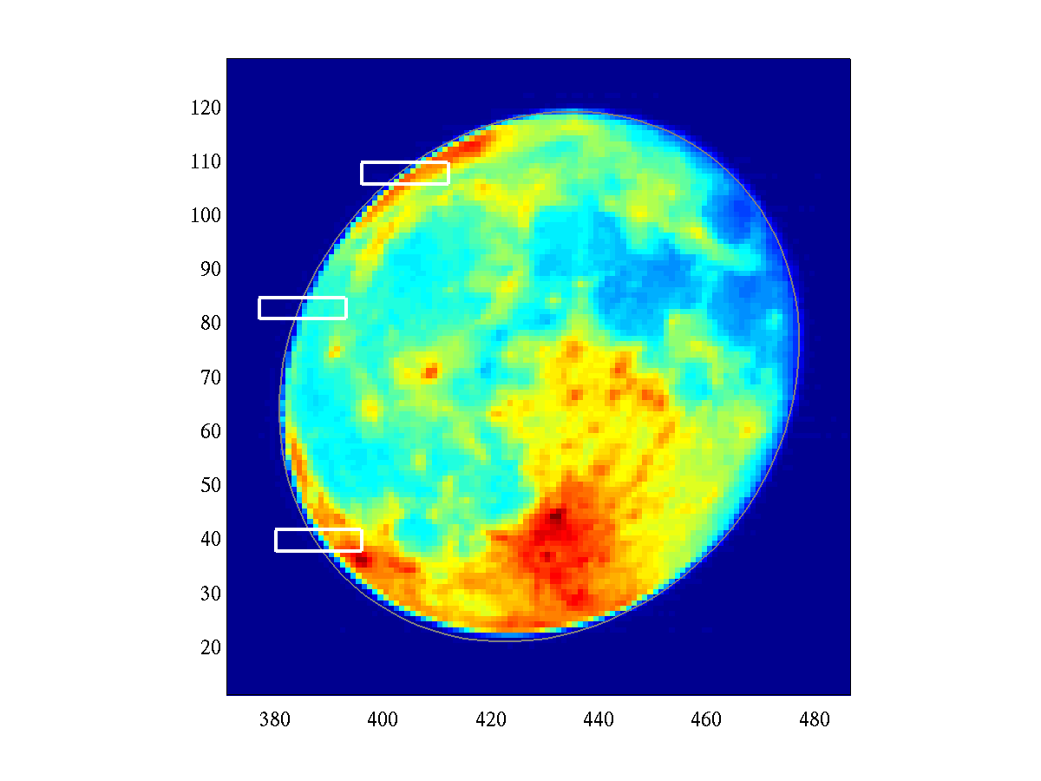
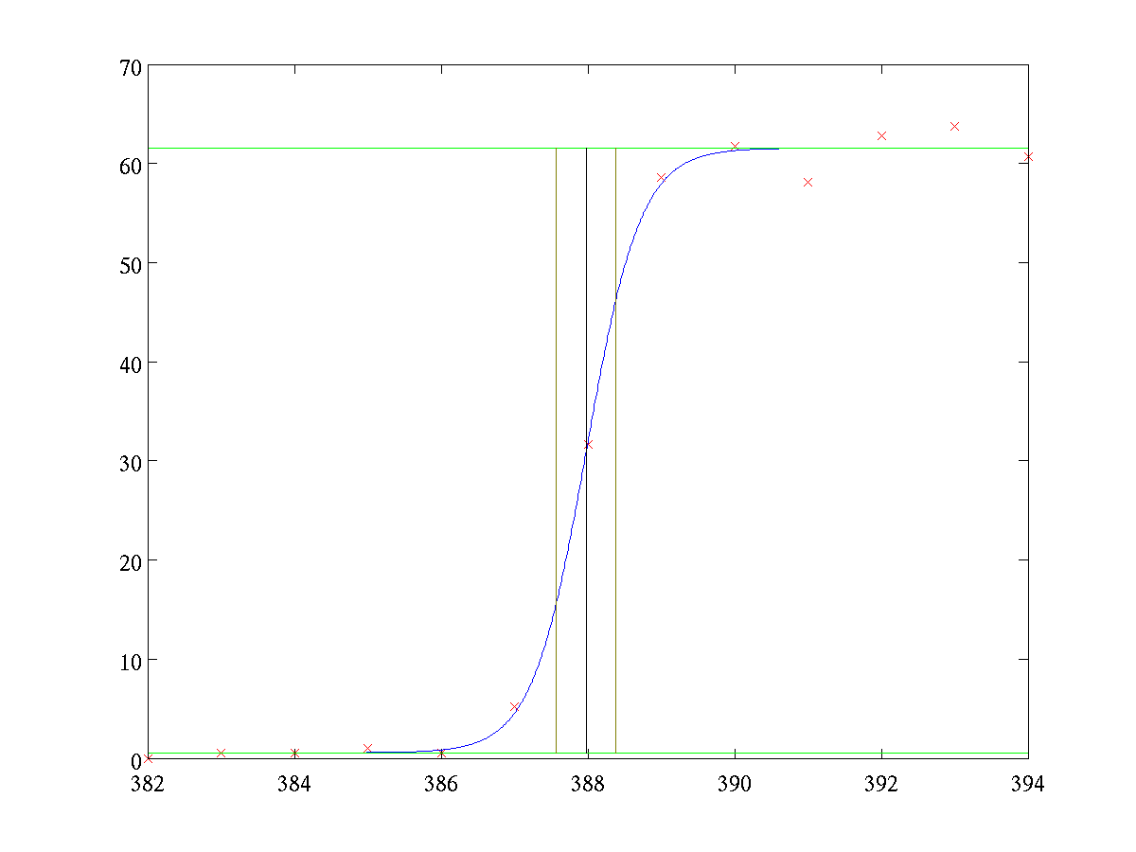
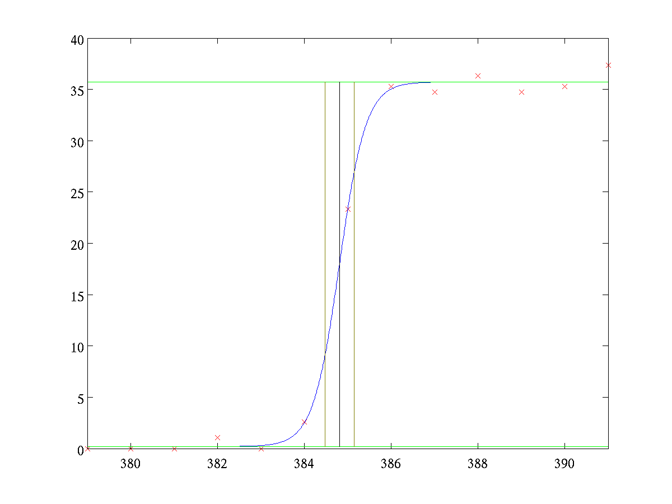
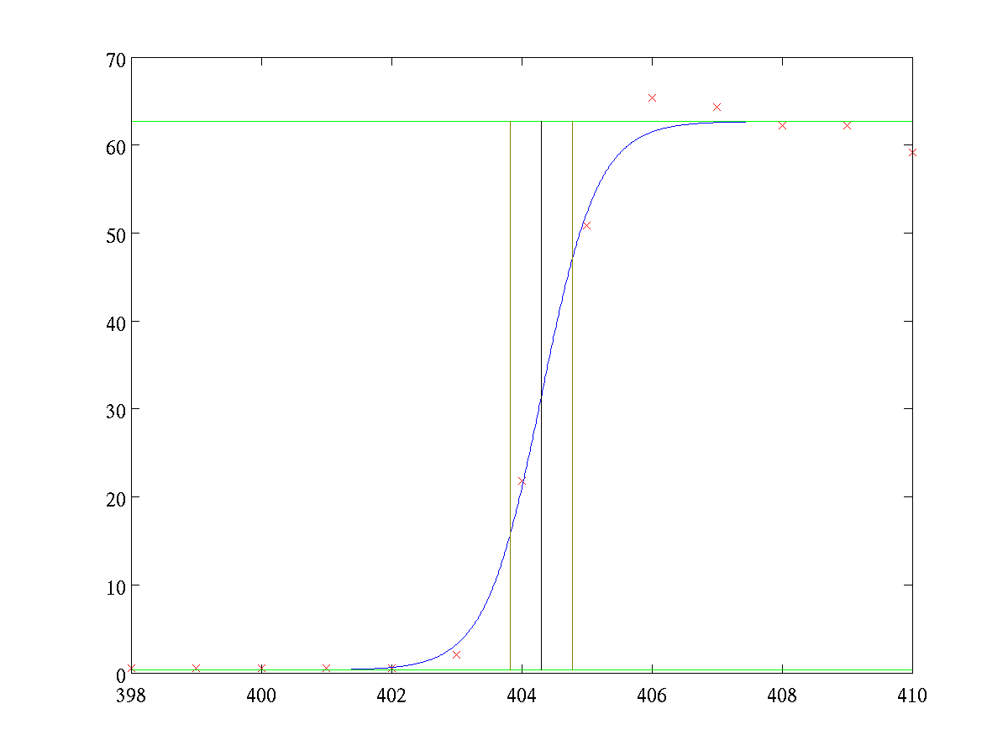
Example: Edge Detection by Fermi Distribution Function

Slide 17
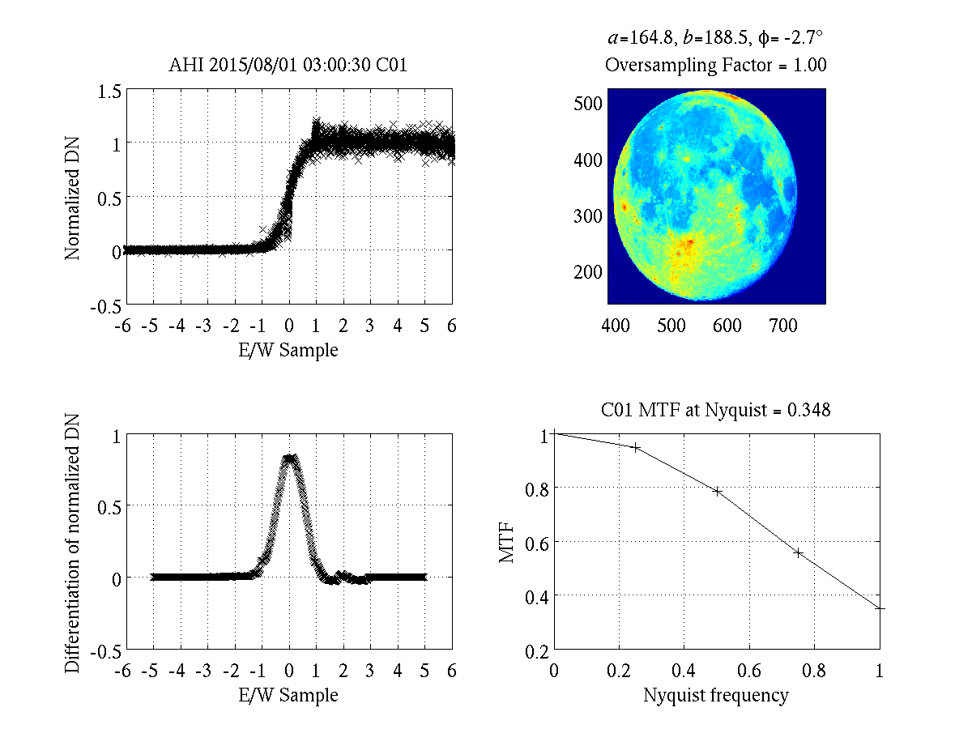
Lunar MTF Method
Normalization
Align the multiple background-to-Moon transition proﬁles at sub-pixel level along the scan-direction.
Sliding piecewise 2nd order polynomial filtering applied to ensemble of edge data
Differentiated to form the line spread function.
Apply Fourier transformation to the line spread function to derive MTF.
MTF at sub-Nyquist frequencies for imaging sensors (taking into account of Sensor specific oversampling factor)

Slide 18
Challenges
Oversampling Factor Determination
  Instrument specific
  Channel specific
ABI and AHI
  ABI: Resampling factor from detector to fixed grid conversion is involved
  Together with the oversampling factor due to scanning speed.

Slide 19
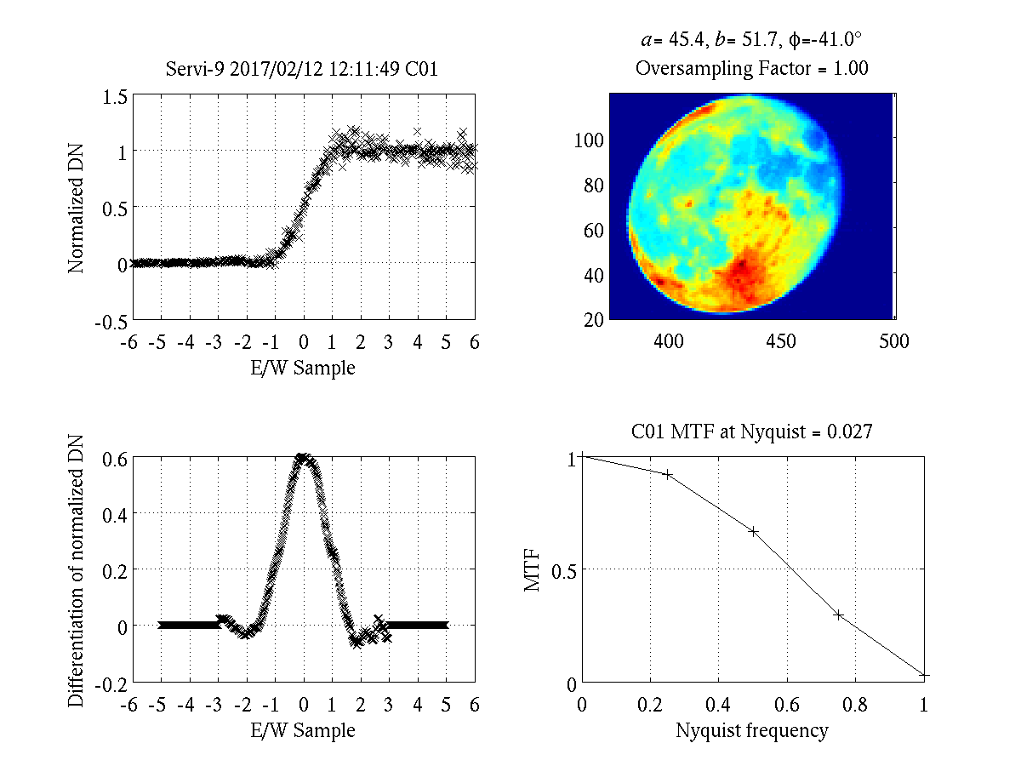

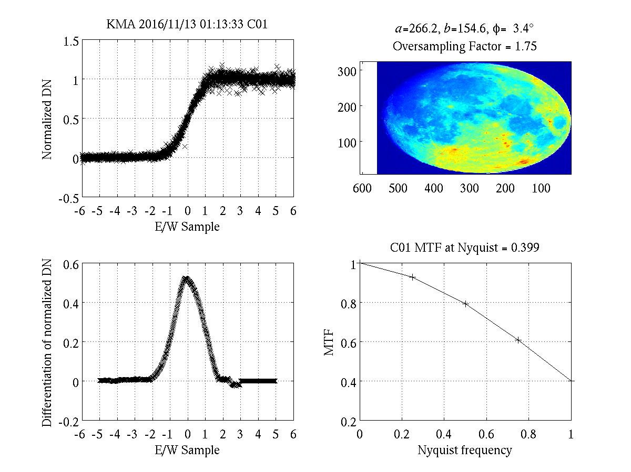
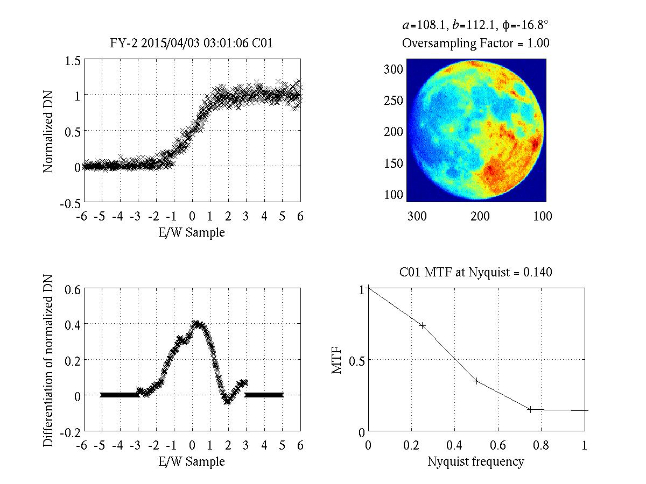
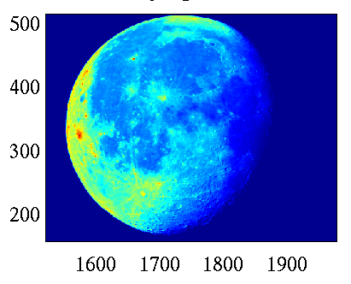
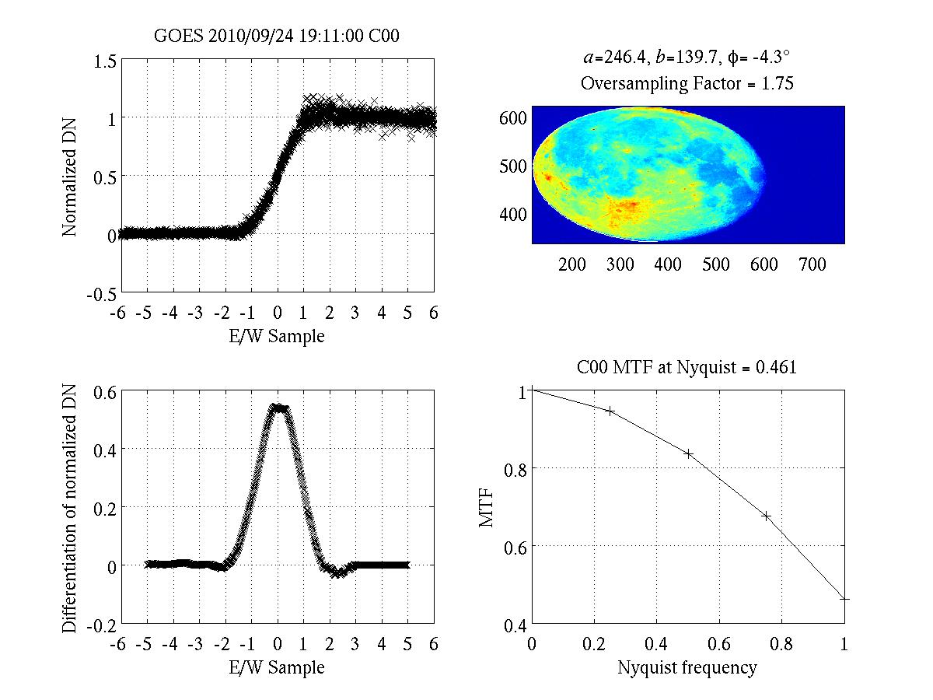
How good does the spatial quality of different imagers perform under one standard metrics?
SEVIRI-9
HIMAWARI-8 AHI
KMA COMS MI
FY-2G
GOES-16 ABI
GOES-15

Slide 20
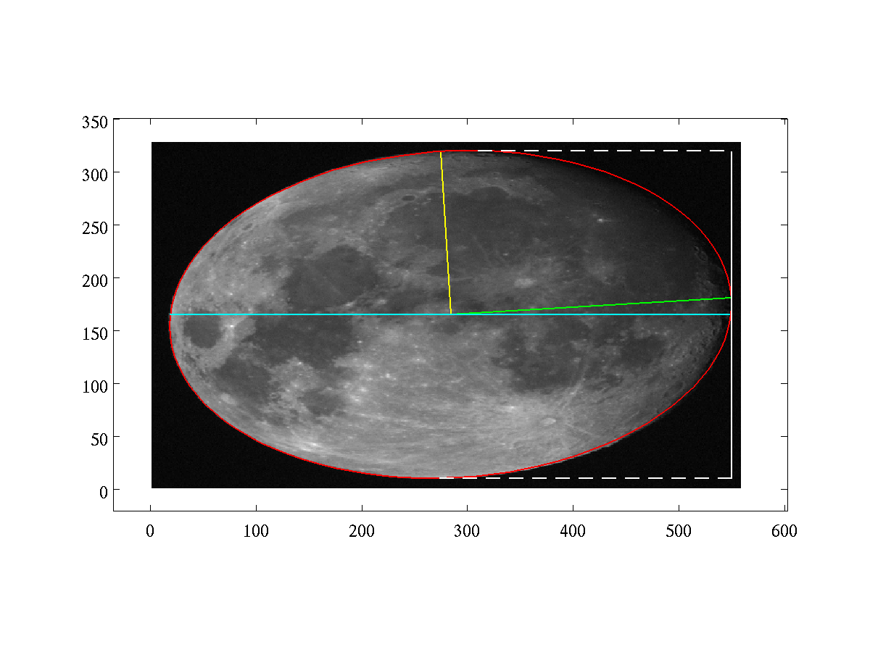
EXAMPLE: KMA COMS MI
KMA-Provided Oversampling Factor= 1.75
From elliptical fitting
  Moon EW span = 530.6
  Moon NS span = 310.3
Estimated OF from EW/NS Span Ratio = 1.71
NS
b
EW
a

Slide 21
KMA MI Instrument
 | MTF
 | P1 | P2 | P3 | P4
KMA | 0.926 | 0.791 | 0.607 | 0.399

Slide 22
GOES-15
 | MTF
 | P1 | P2 | P3 | P4
GOES-15 | 0.945 | 0.835 | 0.675 | 0.461

Slide 23
EUMETSAT SEVIRI-9 CH01 （0.6 um）
 | MTF
 | P1 | P2 | P3 | P4
SEVIRI-9 | 0.919 | 0.664 | 0.297 | 0.027

Slide 24
CMA FY-2G
Use this side
 | MTF
 | P1 | P2 | P3 | P4
FY-2G | 0.734 | 0.348 | 0.148 | 0.140
Expecting improved performance for FY-4

Slide 25
MTF Performance Comparison
Instrument | CH | Time | Center λ(um) | Lunar Phase (deg.) | EW Span # of Pixel | NS Span # of Pixel | EW/NS Ratio | OS Factor Used | MTF
 |  |  |  |  |  |  |  |  | P1 | P2 | P3 | P4
KMA MI | 1 | 2016-11-13 01:13:33 | 0.675 | -22.09 | 530.6 | 310.3 | 1.71 | 1.75 | 0.926 | 0.791 | 0.607 | 0.399
GOES-15 | 1 | 2010-09-24 19:11:00 | 0.63 | 16.49 | 492.8 | 279.4 | 1.76 | 1.75 | 0.945 | 0.835 | 0.675 | 0.461
EUMETSAT SEVIRI | 1 | 2017-02-12 12:11:49 | 0.6 | 18.45 | 95.57 | 98.16 | 0.974 | 1.0 | 0.919 | 0.664 | 0.297 | 0.027
CMA FY-2G | 1 | 2015-04-03 03:01:06 | 0.5-0.75 | -15.10 | 216.8 | 223.5 | 0.969 | 1.0 | 0.734 | 0.348 | 0.148 | 0.140
Using EW-Span/NS-Span Ratio is an effective way to estimate the oversampling factor

Slide 26
VNIR Band of HIMAWARI-8 AHI and GOES-16 ABI
GOES-16 ABI
Wavelength (um) | CH # | Resolution Km | N/S IFOV (urad) | E/W IFOV (urad) | Detector #
0.64 | 2 | 0.5 | 10.5 | 12.4 | 1460
0.47,0.87, 1.61 | 1, 3, 5 | 1 | 22.9 | 22.9 | 676
1.38,2.26 | 4, 6 | 2 | 42 | 51.5 | 372
HIMAWARI-8 AHI
Wavelength (um) | CH # | Resolution Km | N/S IFOV (urad) | E/W IFOV (urad) | Detector #
0.64 | 3 | 0.5 | 10.5 | 12.4 | 1460
0.47, 0.51,0.87 | 1,2, 4 | 1 | 22.9 | 22.9 | 676
1.61, 2.26 | 5, 6 | 2 | 42 | 51.5 | 372

Slide 27
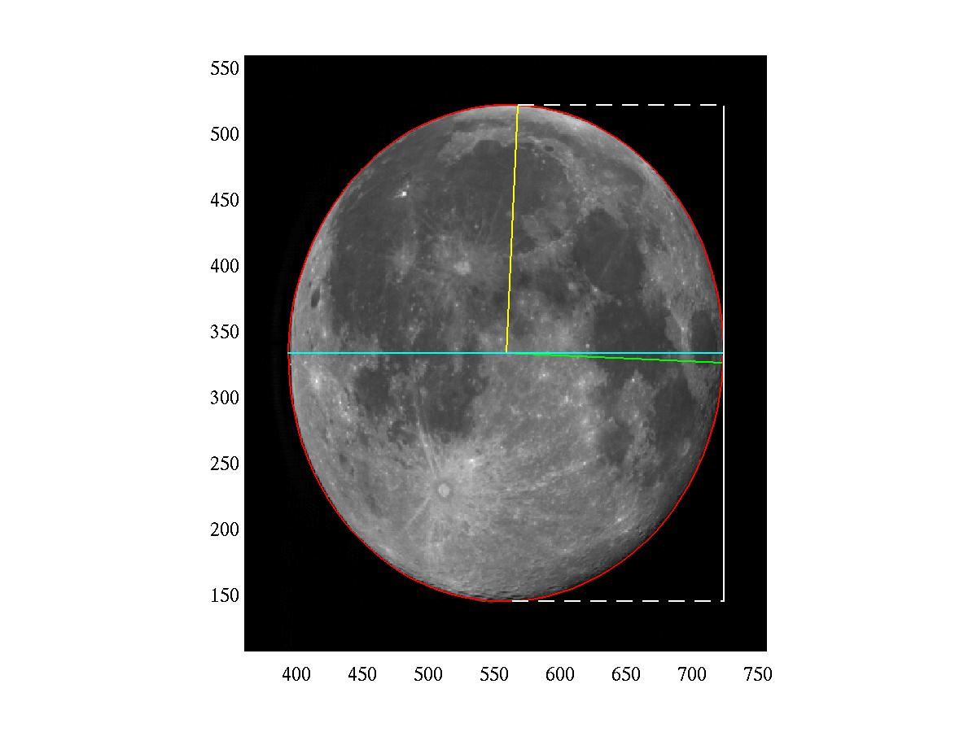
HIMAWARI-8 AHI Lunar Image CH01
Lunar Phase = 9.85 deg.
EW span = 329.64
NS span = 376.97
Ratio: EW/NS =0.8744
Under-sampling?
CH01
  E/W IFOV = 22.9 urad
  N/S IFOV = 22.9 urad
NS
b
EW
a

Slide 28
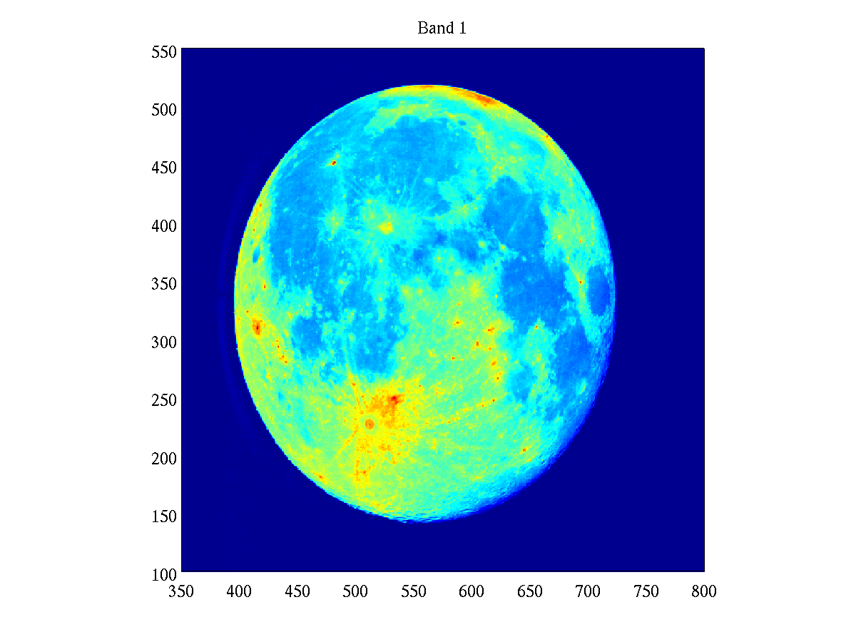
HIMAWARI AHI CH01
Oversampling or Under-sampling?
Solid angle ratio
  Solid Angle from Pixel calc. /Estimated Solid Angle= 1.088
Axis Ratio (EW/NS) = 0.873 (Under-sample?)
Direct readout from AHI data = 1.075 (Oversampling)

Slide 29
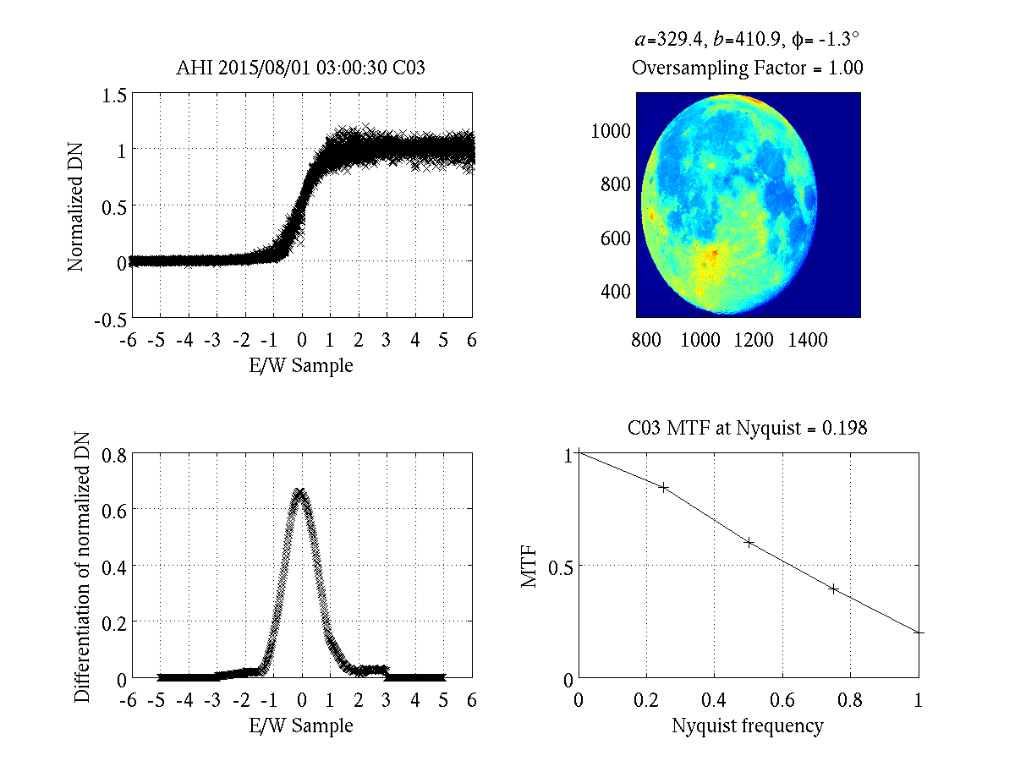
AHI B03 (Oversampling Factor = 1)
 | MTF
 | P1 | P2 | P3 | P4
AHI | 0.845 | 0.600 | 0.393 | 0.198

Slide 30
HIMAWARI-8 AHI MTF Performance
2015-08-01 03:00:30
CH | Center λ(um) | Lunar Phase (deg.) | EW Span # of Pixel | NS Span # of Pixel | EW/NS Ratio | RE-SAMP Factor Used | MTF
 |  |  |  |  |  |  | P1 | P2 | P3 | P4
1 | 0.47 | 9.85 | 329.6 | 377.0 | 0.874 | 1 | 0.947 | 0.785 | 0.555 | 0.348
2 | 0.51 | 9.85 | 329.7 | 377.0 | 0.874 | 1 | 0.922 | 0.725 | 0.476 | 0.273
3 | 0.64 | 9.85 | 658.8 | 821.8 | 0.802 | 1 | 0.845 | 0.600 | 0.393 | 0.198
4 | 0.865 | 9.85 | 329.9 | 377.2 | 0.874 | 1 | 0.930 | 0.742 | 0.497 | 0.285
5 | 1.61 | 9.85 | 165.4 | 206.4 | 0.801 | 1 | 0.953 | 0.820 | 0.621 | 0.412
6 | 2.26 | 9.85 | 165.6 | 206.3 | 0.802 | 1 | 0.930 | 0.759 | 0.527 | 0.298

Slide 31
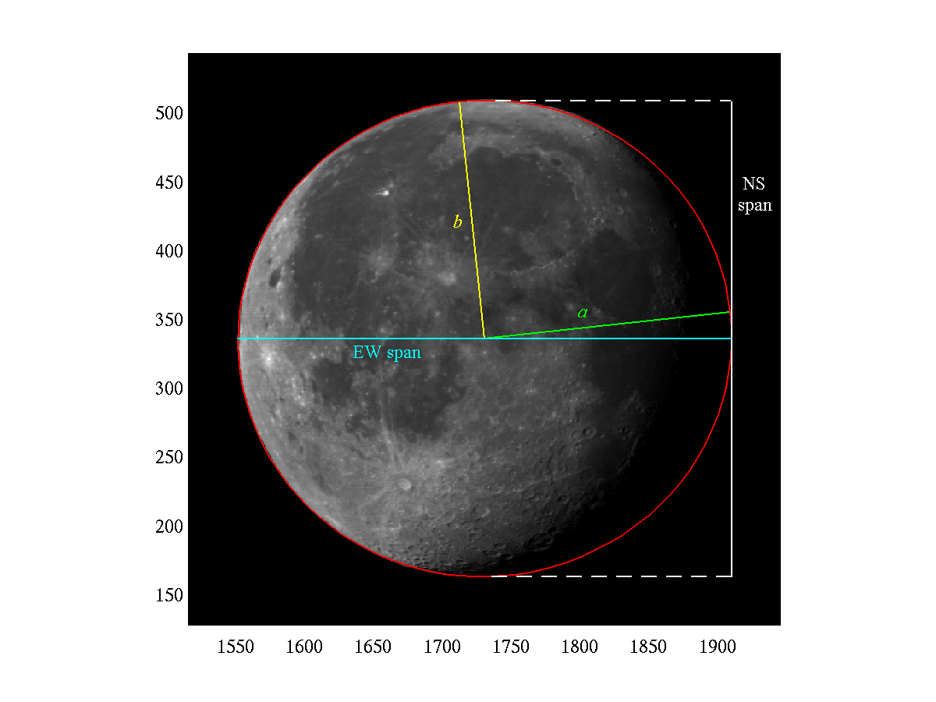
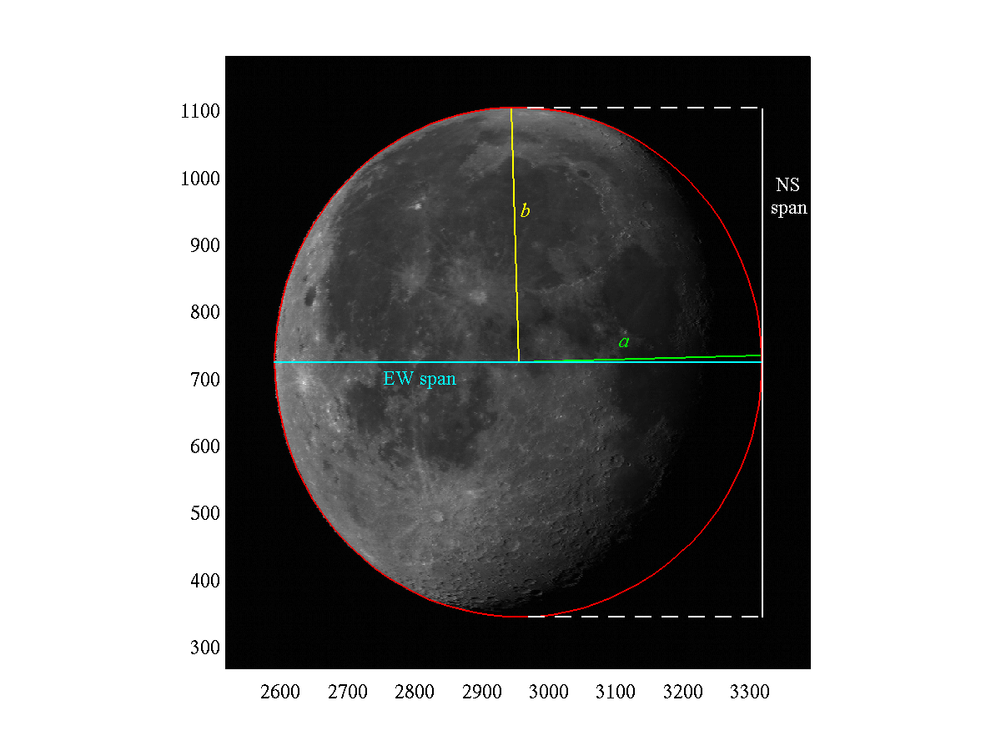
GOES-16 ABI
ABI CH01
ABI CH02
 | EW Span # of Pixel | NS Span # of Pixel | EW/NS Ratio
CH01 | 371.49 | 358.69 | 1.035685
Ch02 | 741.96 | 771.56 | 0.961636
GOES-16 is not declared operational. The ABI data are currently experimental and still undergoing testing.

Slide 32
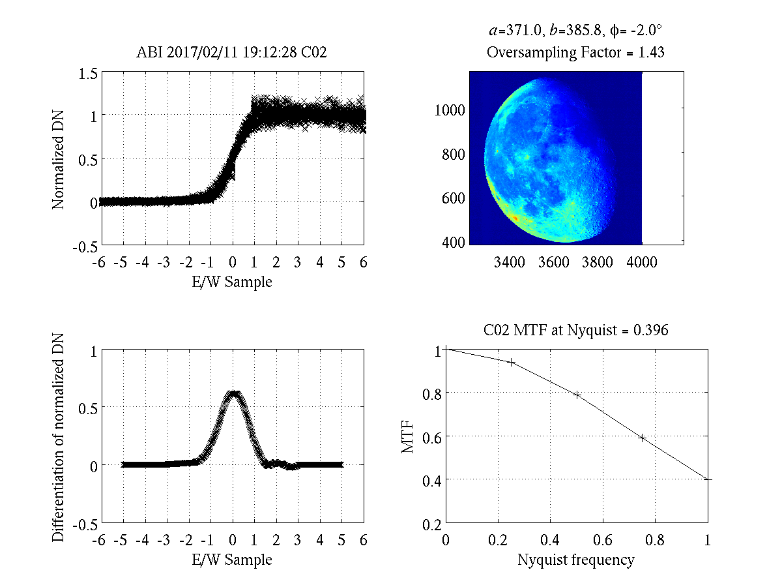
ABI CH02 (2017-02-11)
 | MTF
 | P1 | P2 | P3 | P4
ABI | 0.939 | 0.788 | 0.590 | 0.396

Slide 33
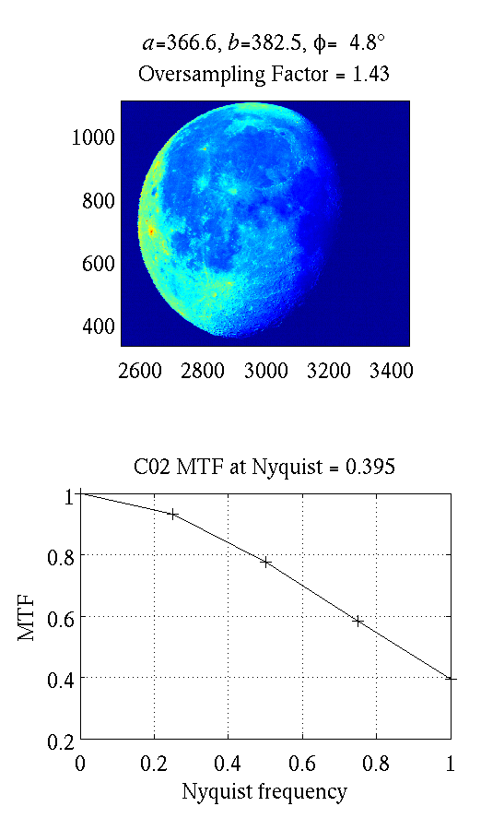
GOES-16 CH01
2017/07/12
2017/02/11

Slide 34
Comparison for ABI VNIR
2017-02-11 (lunar Phase = 9.75)
2017-07-12 (lunar Phase = 41.96)
EW/NS Ratio | RE-SAMP Factor Used | MTF
 |  | P1 | P2 | P3 | P4
1.035685 | 1.32 | 0.953 | 0.827 | 0.647 | 0.454
0.961636 | 1.43 | 0.939 | 0.788 | 0.590 | 0.396
1.035892 | 1.32 | 0.941 | 0.800 | 0.624 | 0.443
0.949052 | 1.49 | 0.960 | 0.860 | 0.712 | 0.538
1.034969 | 1.32 | 0.923 | 0.739 | 0.520 | 0.320
0.957086 | 1.49 | 0.948 | 0.826 | 0.662 | 0.485
EW/NS Ratio | RE-SAMP Factor Used | MTF
 |  | P1 | P2 | P3 | P4
1.046474 | 1.32 | 0.959 | 0.836 | 0.647 | 0.445
0.958908 | 1.43 | 0.932 | 0.776 | 0.583 | 0.395
1.046704 | 1.32 | 0.946 | 0.805 | 0.618 | 0.430
0.952383 | 1.49 | 0.974 | 0.889 | 0.743 | 0.559
1.042841 | 1.32 | 0.927 | 0.741 | 0.509 | 0.306
0.958314 | 1.49 | 0.966 | 0.867 | 0.710 | 0.523
MTF analysis of two cases show consistent MTF performance for ABI VNIR channel
Lunar EW/NS Span ratio are also consistent for two cases with different lunar phases, which is encouraging.

Slide 35
Overall MTF Comparison
Instrument | CH | Date | Center λ(um) | Lunar Phase (deg.) | MTF |  |  |  | Note
 |  |  |  |  | P1 | P2 | P3 | P4
AHI | 3 | 2015-08-01 03:00:30 | 0.64 | 9.85 | 0.845 | 0.600 | 0.393 | 0.198 | O-F?
ABI | 2 | 2017-02-11 19:12:28 | 0.64 | 9.75 | 0.939 | 0.788 | 0.590 | 0.396
KMA MI | 1 | 2016-11-13 01:13:33 | 0.675 | -22.09 | 0.926 | 0.791 | 0.607 | 0.399
GOES-15 | 1 | 2010-09-24 19:11:00 | 0.63 | 16.49 | 0.945 | 0.835 | 0.675 | 0.461
EUMETSAT SEVIRI-9 | 1 | 2017-02-12 12:11:49 | 0.6 | 18.45 | 0.919 | 0.664 | 0.297 | 0.027
CMA FY-2G | 1 | 2015-04-03 03:01:06 | 0.5-0.75 | -15.10 | 0.734 | 0.348 | 0.148 | 0.140

Slide 36
Summary
COMS MI and GOES-15
  Oversampling factor is known and consistent with EW/NS lunar span ratio
  Similar MTF performance
SEVIRI-9 lunar image is tilted and EW/NS lunar span ratio is ~1
  MTF performance drops after ¾ Nyquist Frequency
FY-2G MTF performance is not as good at ½ Nyquist Frequency
HIMAWARI-8 AHI and GOES-16 ABI
  AHI: Need to reconcile under-sampling factor from EW/NS lunar span ratio together with EW/NS pixel size ratio (if there is any?)
  Resampling factor needs to be taken into account

Slide 37
Discussion/Question I (MTF Method)
MTF Evaluation with edge function
  Recommendation: Fermi-function as used in this evaluation
  Other methods?
N/S Portion of lunar image for evaluation
  Recommendation: Focus on 80% of pixel at the center N/S
Sliding piecewise 2nd order polynomial filtering applied to ensemble of edge data
  ±20% around mean screening applied
  other filtering and screening method?
Differentiated to form the line spread function.
  Padded 0 for pixels # > 3 or pixel # <-3
Apply Fourier transformation to the line spread function to derive MTF.

Slide 38
Discussion II (Impact of Oversampling Factor)
KMA and GOES-15 Oversampling factor can be clearly identified from EW/NS Elliptical fitting axis ratio
SEVIRI and FY-2 seem to have oversampling factor ~1
AHI lunar image needs to be investigated further
  EW/NS is ~ 0.8 to 0.87 (under-sampling?)
  From pixel solid angle ratio suggests oversampling ~ 1.08
  Resampled or not (Need reconciliation)
ABI: need to take into account of resampling factor
Action: agencies need to provide the oversampling/resampling factor for evaluation

Slide 39
Discussion III (Evaluation with MTF at Nyquist Frequency )
MTF at quarter, half, ¾ of Nyquist frequency performs better as metrics for evaluation of MTF performance
MTF at full Nyquist frequency has large uncertainties and does not serve as a good metrics.
Some agency uses 0.9 Nyquist frequency for evaluation.
Recommendation:
  Evaluate at 0.25, 0.5, 0.75, 0.9 Nyquist
  Cross-Comparison at 0.5 Nyquist

Slide 40
Questions / Discussions
Name:
  Community Best Practice?
  GSICS Standard Method?
  GSICS Endorsed Method?
  ??
Limited to GEO only? Initially?
Agency POC:
  NOAA: Xi Shao
  EUMETSAT: Claude Ledez
  CMA: Lin Chen
  JMA
  KMA
  ??

Slide 41
Action Items
Prepare a report summarizing current session on “Community Best Practice of Using Lunar Image for On-Orbit Evaluation of Modulation Transfer Function (MTF)” (Lead： Fred Wu (NOAA); Draft and POC: Sean Shao)
  Analysis from NOAA and results by other agencies
Send out survey and collect inputs on standardizing lunar MTF evaluation method
Seek inputs from agencies on determination of over-sampling and resampling factor for the lunar data they provided.
Collect and compare MTF evaluation from agencies

Slide 42
Lunar MTF Results from Others
Discussion

Slide 43
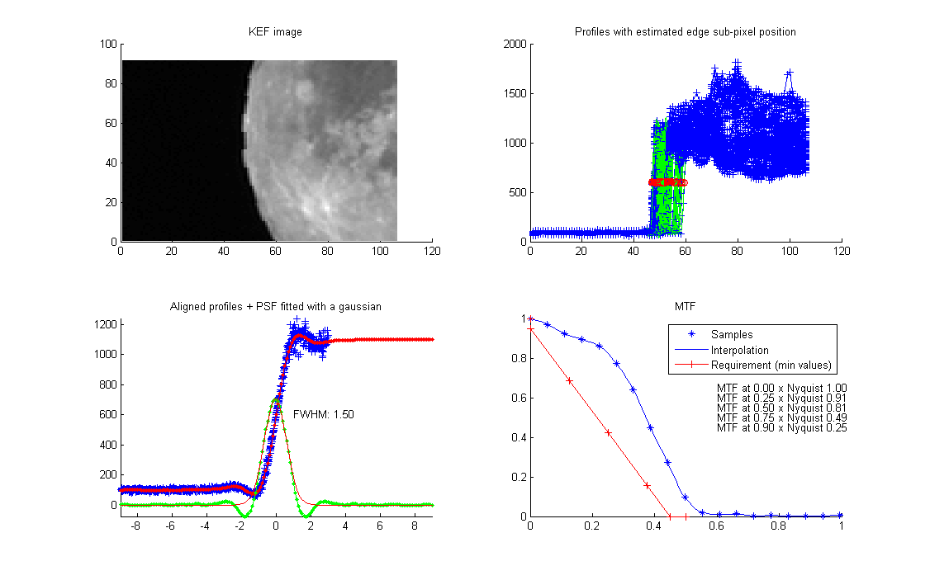
MSG-1 SEVIRI HRV in EW - One Measurement (Calculation by EUMETSAT)

Slide 44
EUMETSAT SEVIRI-9 CH01 （0.6 um）
 | MTF
 | P1 | P2 | P3 | P4
KMA | 0.919 | 0.664 | 0.297 | 0.027

Slide 45
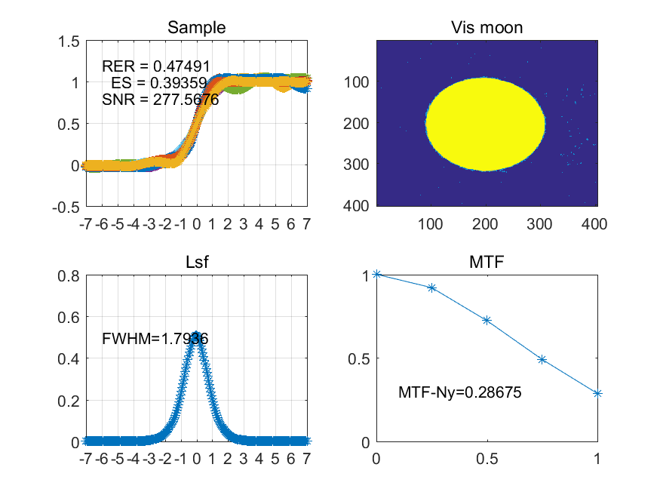
CMA Calculation on FY-2G
Courtesy of Lin Chen

Slide 46
CMA FY-2G
Use this side
 | MTF
 | P1 | P2 | P3 | P4
KMA | 0.734 | 0.348 | 0.148 | 0.140

Slide 47
Comparison with MTF Calculation by Different Agency
Inst. | CH | Calculation | Time | Center λ(um) | Lunar Phase (deg.) | OS Factor Used | MTF
 |  |  |  |  |  |  | P1 | P2 | P3 | P4
EUMETSAT SEVIRI | 1 | NOAA | 2017-02-12 12:11:49 | 0.6 | 18.45 | 1.0 | 0.919 | 0.664 | 0.297 | 0.027
EUMETSAT SEVIRI |  | EUMETSAT |  |  |  |  | 0.91 | 0.81 | 0.49
CMA FY-2G | 1 | NOAA | 2015-04-03 03:01:06 | 0.5-0.75 | -15.10 | 1.0 | 0.734 | 0.348 | 0.148 | 0.140
CMA FY-2G | 1 | CMA | 2015-04-03 03:01:06 | 0.5-0.75 | -15.10 |  |  |  |  | 0.28675

