Slide 1
Estimating MTF post-launch using lunar imagery – the case of SEVIRI
S. Wagner, on behalf of C. Ledez

Slide 2
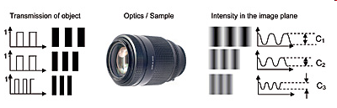
What is a MTF?
Modulation Transfer Function (MTF) = response of a system to an array of contrasted elements with varying separation.
MTF is typically an imaging system requirement: e.g. for SEVIRI, a MTF template specifies the minimal and maximal normalized contrast as a function of spatial frequency.
For low spatial frequencies, MTF is close to 1 and generally falls as the spatial frequency increases until it reaches zero. This is the limit of resolution for a given optical system or the so-called cut off frequency.
Sampling matters: above Nyquist frequency, signal is folded; this creates unwanted image artefacts.
Nyquist freq.

Slide 3

What is a MTF?
As spatial separation decreases, the “good” system maintains clear separation of point source images, while the “poor” system eventually can no longer distinguish them.
MTF quantifies this phenomenon in terms of contrast between the center peak intensities versus intensity at their midpoint across a scale of separation distances.
Noise also limits the resolution: if noise level is higher than the contrast, the points cannot be distinguished.
Good (sharp)
Poor (fuzzy)

Slide 4
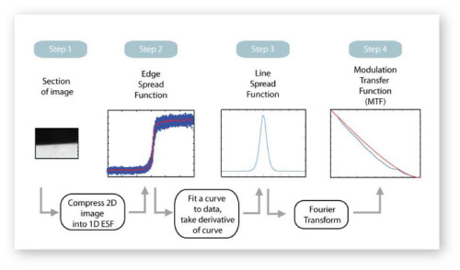
MTF measurement
The image of a point source is blurred and degraded due to noise by an imaging system.
MTF = magnitude of the complex Optical Transfer Function (OTF).
OTF = Fourier transform of the Point Spread Function (PSF) in 2D or
Line Spread Function (LSF) in 1D.
LSF can be obtained by differentiating the Edge Spread Function (ESF).
The use of a slanted-edge (ISO 12233 standard) allows oversampling the ESF and, consequently, measuring MTF above the Nyquist frequency. This method is relatively insensitive to noise.

Slide 5
Procedure – basic concept
Step 1
Step 2
Step 3
Step 4

Slide 6
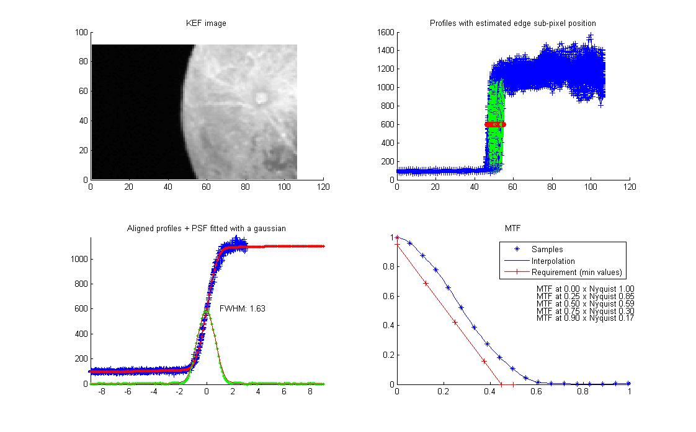
Procedure – basic concept
Step 1: Extract the portion of image to be processed
One image = One MTF measurement

Slide 7
Procedure – basic concept
One image = One MTF measurement
Step 2a: derive the edge spread function:
Extract all transients - blue curves
Estimation of the edge subpixel position (spline interpolation) – red points

Slide 8
Procedure – basic concept
One image = One MTF measurement
Step 2b: derive the edge spread function:
Realignment of the profiles + rescaling of the count levels
Truncation after a few Moon pixels (1-3 pixels)
Averaging ➔ blue curve

Slide 9
Procedure – basic concept
One image = One MTF measurement
Step 3: derive the line spread function:
Resampling through a fit to have a regular sampling (required for the Fourier transform) + symmetrisation of the fit ➔ red curve
Derivative estimate ➔ green curve
Adjustments to avoid noisy derivative ➔ underlying red curve
➔ Fourier Transf. = MTF

Slide 10
Procedure – basic concept
One image = One MTF measurement

Slide 11
Post-launch characterisation - MTF
Some examples - SEVIRI
Courtesy C. Ledez - Eumetsat
Meteosat-8 SEVIRI HRV MTF North-South

Slide 12
Post-launch characterisation - MTF
Results MSG-2 SEVIRI - Channel 01 (VIS 0.6)
Courtesy C. Ledez - Eumetsat
More images = uncertainties on the MTF measurement
Average MTF EW
Average MTF NS
Nyquist frequency
Nyquist frequency

Slide 13
Post-launch characterisation - MTF
Results MSG-2 SEVIRI - Channel 02 (VIS 0.8)
Courtesy C. Ledez - Eumetsat
Average MTF EW
Average MTF NS
Nyquist frequency
Nyquist frequency

Slide 14
Post-launch characterisation - MTF
Results MSG-2 SEVIRI - Channel 03 (NIR 1.6)
Courtesy C. Ledez - Eumetsat
Average MTF EW
Average MTF NS
Nyquist frequency
Nyquist frequency

Slide 15
Known limitations and mitigation – 1/2
  Moon ≠ slanted edge
    selection of ROI on brightest edge E/W or N/S with limited moon edge slope variation
    estimation of moon shape via polynomial fitting for local edge slope estimation
    correction of sampling irregularity (e.g. due to pixel position on focal plane)
  Moon ≠ flat radiance field
    exclusion of moon image with strong illumination gradient, e.g. crescent
    estimation of local moon radiance near edge: 1 per radiometric profile EW or NS
    limitation of profile length inwards: up to edge position + 1 pixel (no limit over deep space)

Slide 16
Known limitations and mitigation – 2/2
  Deep space radiance ≠ 0
    filtering of stars
    filtering of ghost image (e.g. AHI)
  High uncertainty in edge position with aliasing
    fitting individual radiometric profile with sigmoid / parameters estimated via Kalman type filtering
  High noise on individual profile
    merging of all profiles from all detectors, aligned with respect to moon edge position
    profile averaging via local polynomial smoothing
    making average profile symmetric
    visual checking of average profile: no under or over-fitting, good filtering of spurious profiles

Slide 17
Post-launch characterisation - MTF
Areas of improvement
  Proper validation with simulated moon image from HR data
    planned by EUMETSAT for MTG
    study of phase dependence
    effect of craters
  Moon radiance flat fielding
    VIS: use of moon radiance model and selenographic coordinates
    IR: ?
  MTF estimation at detector level
    use of swath/detector information

Slide 18
Post-launch characterisation - MTF
Results HIMAWARI-8 AHI - Channel 01
Courtesy C. Ledez - Eumetsat
X 23 images =
Average MTF EW
Nyquist frequency

Slide 19
Post-launch characterisation - MTF
Results HIMAWARI-8 AHI - Channel 02
Courtesy C. Ledez - Eumetsat
X 23 images =
Average MTF EW
Nyquist frequency

Slide 20
Post-launch characterisation - MTF
Results HIMAWARI-8 AHI - Channel 03
Courtesy C. Ledez - Eumetsat
X 23 images =
Average MTF EW
Nyquist frequency

Slide 21
Post-launch characterisation - MTF
Results HIMAWARI-8 AHI - Channel 04
Courtesy C. Ledez - Eumetsat
X 23 images =
Average MTF EW
Nyquist frequency

Slide 22
Post-launch characterisation - MTF
Results HIMAWARI-8 AHI - Channel 05
Courtesy C. Ledez - Eumetsat
X 23 images =
Average MTF EW
Nyquist frequency

Slide 23
Post-launch characterisation - MTF
Results HIMAWARI-8 AHI - Channel 06
Courtesy C. Ledez - Eumetsat
X 23 images =
Average MTF EW
Nyquist frequency

Slide 24
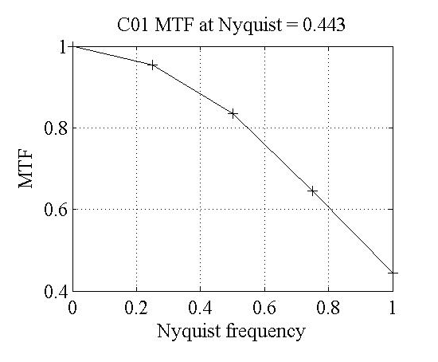
Post-launch characterisation - MTF
Results GOES-16 ABI - Channel 01
Courtesy C. Ledez - Eumetsat
X 1 image =
To be compared with:
Nyquist frequency

Slide 25
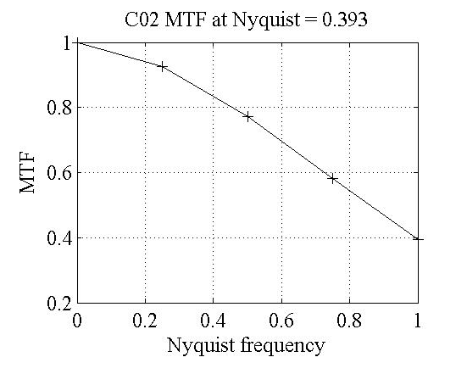
Post-launch characterisation - MTF
Results GOES-16 ABI - Channel 02
Courtesy C. Ledez - Eumetsat
X 1 image =
To be compared with:
Nyquist frequency

Slide 26
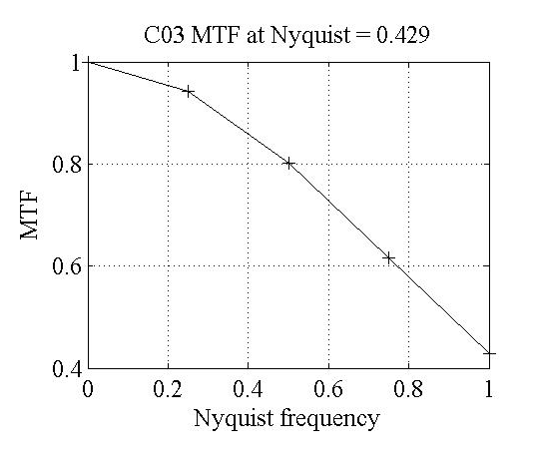
Post-launch characterisation - MTF
Results GOES-16 ABI - Channel 03
Courtesy C. Ledez - Eumetsat
X 1 image =
To be compared with:
Nyquist frequency

Slide 27
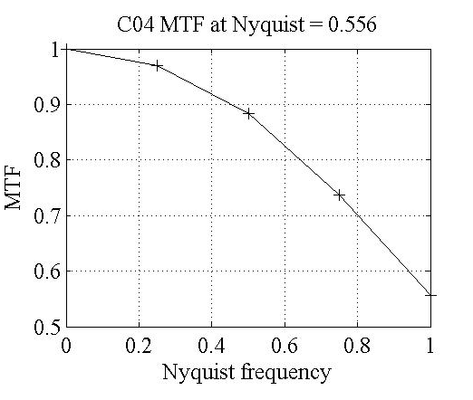
Post-launch characterisation - MTF
Results GOES-16 ABI - Channel 04
Courtesy C. Ledez - Eumetsat
X 1 image =
To be compared with:
Nyquist frequency

Slide 28
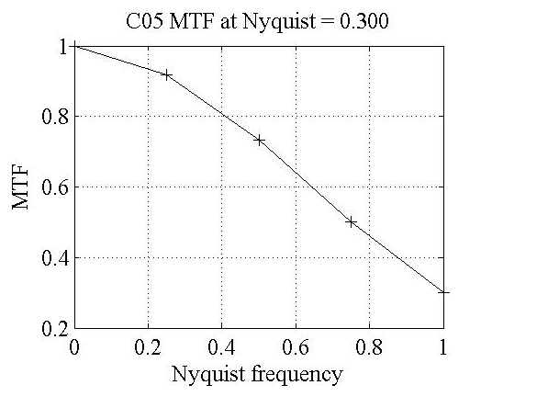
Post-launch characterisation - MTF
Results GOES-16 ABI - Channel 05
Courtesy C. Ledez - Eumetsat
X 1 image =
To be compared with:
Nyquist frequency

Slide 29
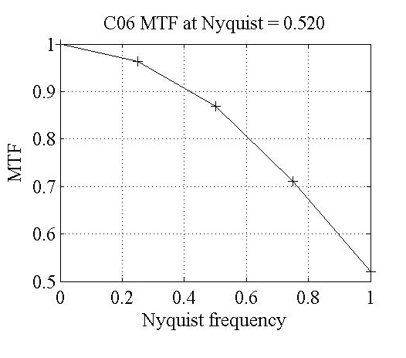
Post-launch characterisation - MTF
Results GOES-16 ABI - Channel 06
Courtesy C. Ledez - Eumetsat
X 1 image =
To be compared with:
Nyquist frequency

Slide 30
Recommendation - questions
MTF curves more useful if provided up to x2 Nyquist ➔ aliasing
Can we agree about a frequency range to estimate the MTF? ([0, Nyquist] or [0, 2xNyquist])
What about using a consistent sampling for the MTF?
What about agencies sharing the details of their algorithms for estimating MTF post-launch?
Do we target a GSICS-recommended approach? What are the next steps for this MTF exercise?
Exchange with JMA on the data processing ➔ for the exercise, GIRO imagettes (=“processed” data) were used
Exchange with NOAA ➔ was the stretching properly applied?
What about

