Slide 1
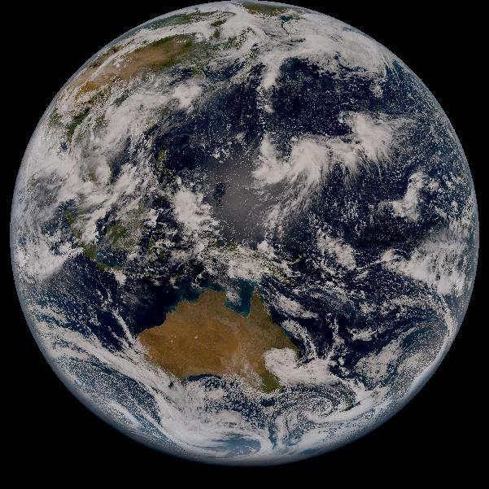
MTF Evaluation of Himawari-8/AHI using Lunar Observations
Ryuichiro Nakayama and Masaya Takahashi
Meteorological Satellite Center
Japan Meteorological Agency
GSICS/CEOS 2nd Lunar Calibration Workshop, Xi'an, China, 13-16 November 2017

Slide 2
Contents
Overview
Lunar Observation Data for MTF Calculation
MTF Calculation Method
E-W Intensity Profiles
E-W AHI MTFs
Summary and Future Plans

Slide 3
Overview of AHI MTF Calculation
Lunar Observation Data for MTF Calculation
4 observations on 15 January 2017
05:00:30Z, 05:01:30Z, 05:02:30Z, 05:03:30Z
Calibrated L1A/L1.0 equivalent data (w/o resampling)
Relative detector position differences are corrected
MTF Calculation Method
E-W intensity profile -> LSF -> MTF
AHI-17-023 (Harris Corporation) is referred
Validation domain: 10 x 6 pixels
No-oversampling for deriving edge spreading function
E-W MTFs are only calculated
Average of 24 MTFs (6 lines x 4 obs. times) for each band
Validation domain for Band 5 (1.6 μm)

Slide 4
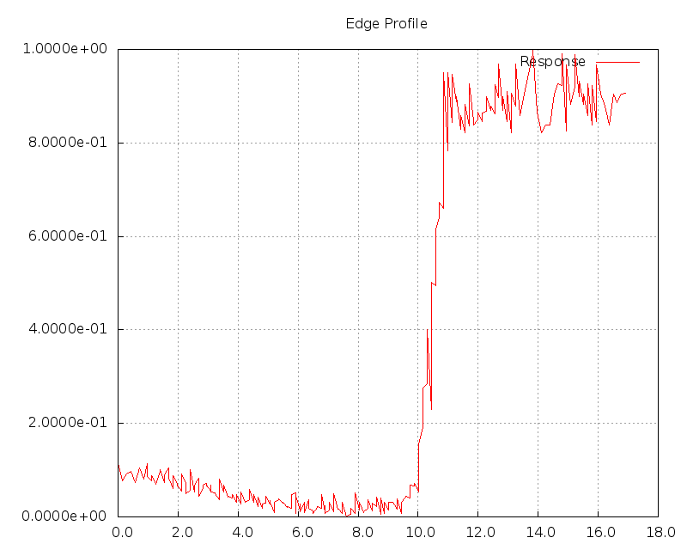
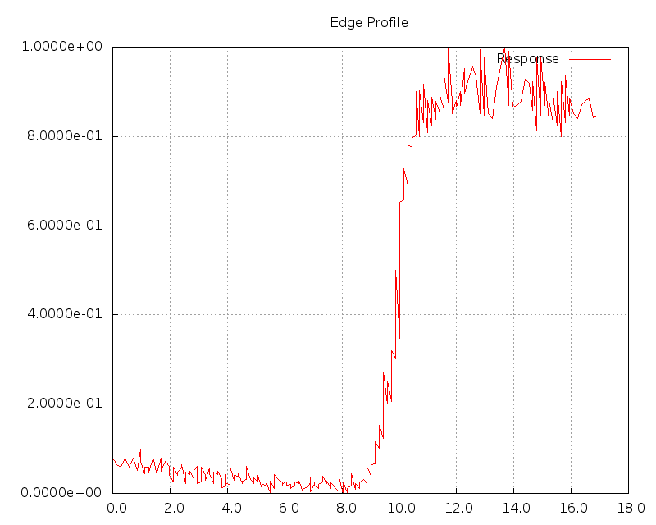
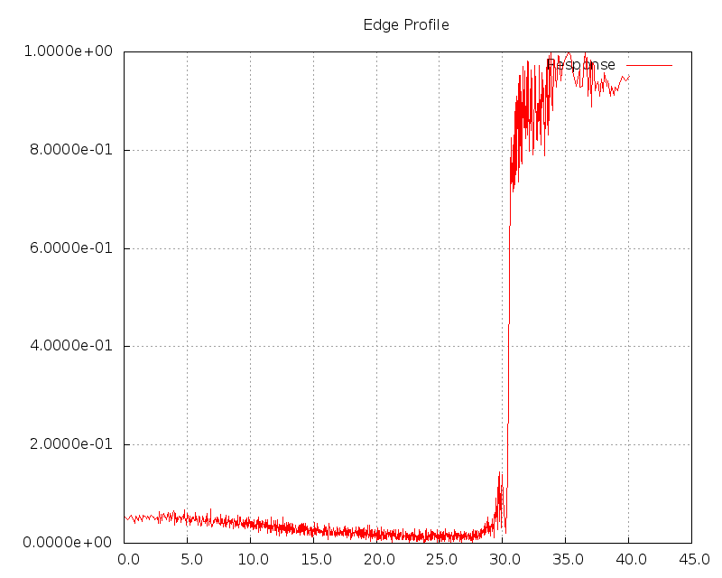
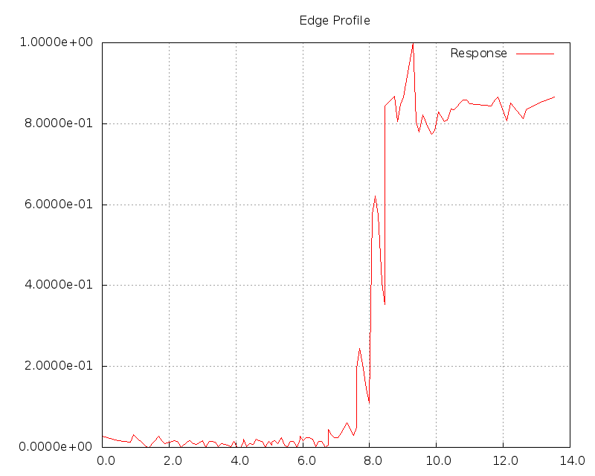
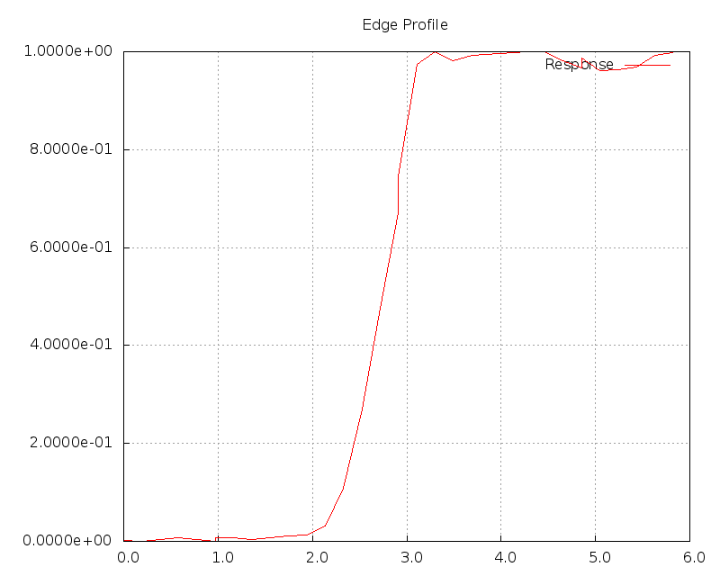
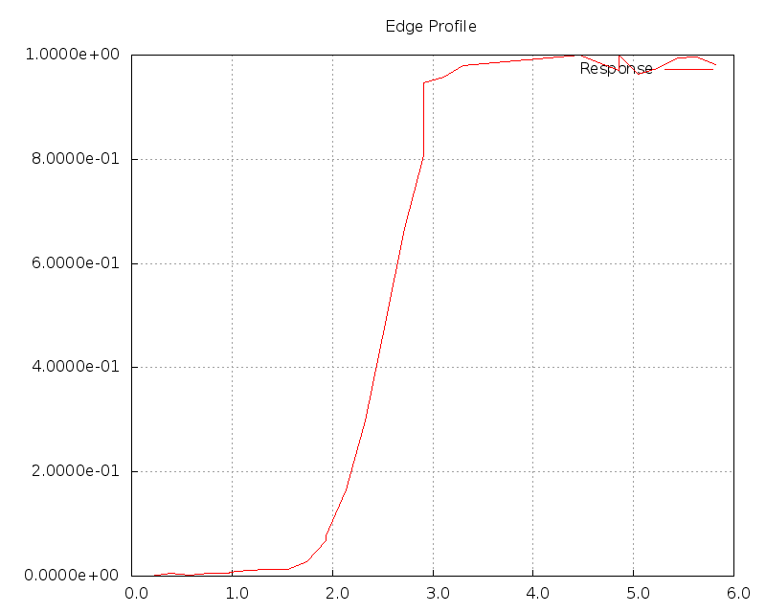
E-W Intensity Profiles
Band 1
0.47 μm
1 km-reso.
Band 2
0.51 μm
1 km-reso.
Band 3
0.64 μm
0.5 km-reso.
Band 4
0.86 μm
1 km-reso.
Band 5
1.6 μm
2 km-reso.
Band 6
2.3 μm
2 km-reso.
(Samples when we tried to oversample the lunar images)

Slide 5
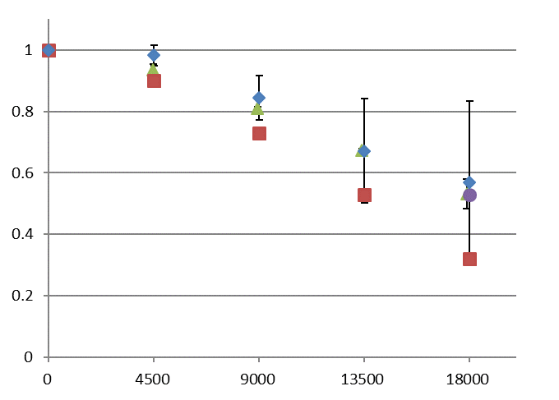
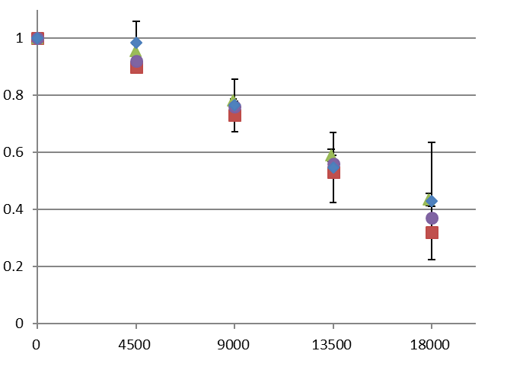
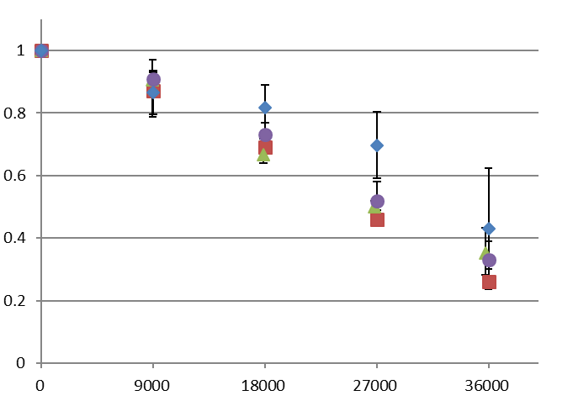
E-W MTFs for VIS Bands
Lunar
Smaller E-W sampling distance (26, 26, 13 μrad for Bands 1-3) than other cases (28, 28, 14 μrad)
In-Orbit Test
Calculated using earth observation data w/o resampling (Mitsubishi Electric Corporation)
Ground Test (worst case of the test)
AHI-17-024 (Harris Corporation)
Requirement
Normalized MTF
Band 1
0.47 μm
1 km-reso.
(cycle/rad)
Normalized MTF
Normalized MTF
Band 2
0.51 μm
1 km-reso.
Band 3
0.64 μm
0.5 km-reso.
(cycle/rad)
(cycle/rad)

Slide 6
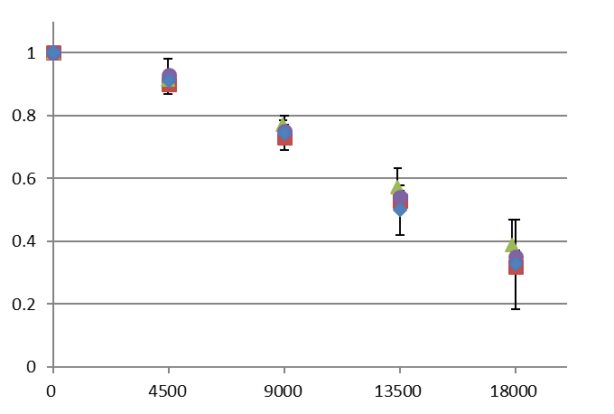
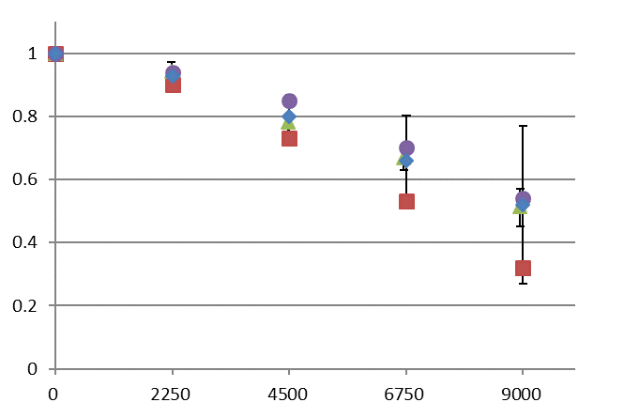
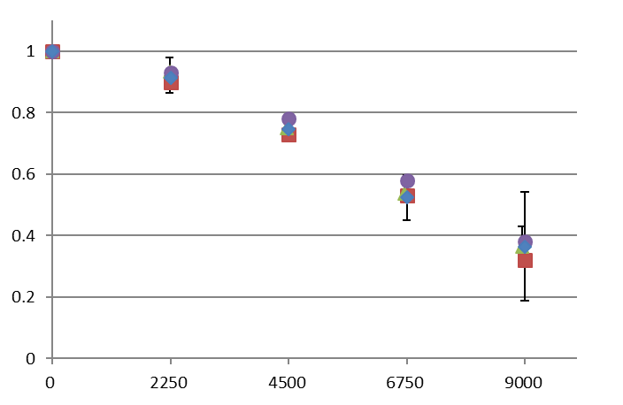
E-W MTFs for VNIR Bands
Lunar
Smaller E-W sampling distance (26, 52, 52 μrad for Bands 4-6) than other cases (28, 56, 56 μrad)
In-Orbit Test
Calculated using earth observation data w/o resampling (Mitsubishi Electric Corporation)
Ground Test (worst case of the test)
AHI-17-024 (Harris Corporation)
Requirement
Normalized MTF
Band 4
0.86 μm
1 km-reso.
(cycle/rad)
Normalized MTF
Normalized MTF
Band 5
1.6 μm
2 km-reso.
Band 6
2.3 μm
2 km-reso.
(cycle/rad)
(cycle/rad)

Slide 7
E-W MTFs for VNIR Bands
 | Band1 (0.47 μm) |  |  |  |  | Band2 (0.51 μm) |  |  |  |  | Band3 (0.64 μm)
F/F_{Nyquist} | Requirement | Ground Test | In-Orbit Test | Lunar |  | Requirement | Ground Test | In-Orbit Test | Lunar |  | Requirement | Ground Test | In-Orbit Test | Lunar
0.25 | 0.90 | 0.95 | 0.94 | 0.98 |  | 0.90 | 0.92 | 0.95 | 0.98 |  | 0.87 | 0.91 | 0.90 | 0.87
0.50 | 0.73 | 0.84 | 0.81 | 0.84 |  | 0.73 | 0.76 | 0.78 | 0.77 |  | 0.69 | 0.73 | 0.67 | 0.82
0.75 | 0.53 | 0.70 | 0.67 | 0.67 |  | 0.53 | 0.56 | 0.59 | 0.55 |  | 0.46 | 0.52 | 0.50 | 0.70
1.00 | 0.32 | 0.53 | 0.53 | 0.57 |  | 0.32 | 0.37 | 0.44 | 0.43 |  | 0.26 | 0.33 | 0.35 | 0.43
 | Band4 (0.86 μm) |  |  |  |  | Band5 (1.6 μm) |  |  |  |  | Band6 (2.3 μm)
F/F_{Nyquist} | Requirement | Ground Test | In-Orbit Test | Lunar |  | Requirement | Ground Test | In-Orbit Test | Lunar |  | Requirement | Ground Test | In-Orbit Test | Lunar
0.25 | 0.90 | 0.93 | 0.92 | 0.91 |  | 0.90 | 0.94 | 0.94 | 0.93 |  | 0.90 | 0.93 | 0.93 | 0.91
0.50 | 0.73 | 0.75 | 0.77 | 0.74 |  | 0.73 | 0.85 | 0.78 | 0.80 |  | 0.73 | 0.78 | 0.75 | 0.75
0.75 | 0.53 | 0.54 | 0.57 | 0.50 |  | 0.53 | 0.70 | 0.67 | 0.66 |  | 0.53 | 0.58 | 0.54 | 0.52
1.00 | 0.32 | 0.35 | 0.39 | 0.33 |  | 0.32 | 0.54 | 0.51 | 0.52 |  | 0.32 | 0.38 | 0.36 | 0.36
In-Orbit Test: Calculated using earth observation data (Mitsubishi Electric Corporation)
Ground Test: AHI-17-024 (Harris Corporation)

Slide 8
Summary and Future Plans
Himawari-8/AHI MTFs for 6 VNIR bands¹ were calculated using L1A equivalent lunar observation data
All the MTFs derived from lunar observations are within the specifications, good agreement with pre-launch ground test and In-Orbit Test during the commissioning phase
Future plans
Expansion of analysis domain using more reliable intensity profiles (edge spread function)
Validation of N-S MTF
Comparison of MTFs among L1A/L1B lunar observation data
Application to IR bands
¹ 0.47, 0.51, 0.64, 0.86, 1.6, and 2.3 μm

Slide 9
Contents
Thanks for your attention!

Slide 10
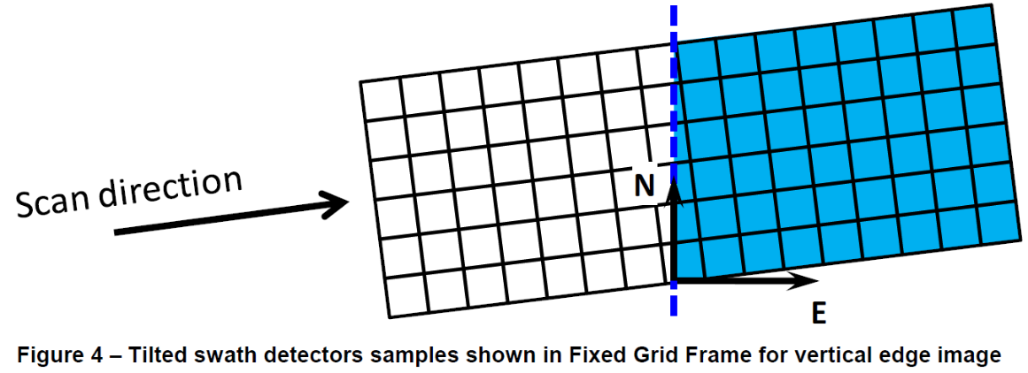
MTF Calculation Algorithm for Resampled Image
(AHI-17-023 by Harris Corporation)
Resample the first swath of the vertical edge target using the standard NS & EW pixel spacing
Repeat for all 10 pixel-to-edge distances
Differentiate each row of each image:
For each differentiated row, pad both sides with enough zeros to obtain a row length of 4096 pixels.
a
5. Calculate the magnitude of the discrete Fourier transform for each row of each image in the set
Note that the spatial frequencies are
, where n is an integer from -2048 to +2047.
6.
6. Average the MTF across all rows of all images
a
7. Scale the MTF at the ¼, ½, ¾, and Nyquist frequencies by the factors in the following table.
8. Report the MTF at the ¼, ½, ¾, and Nyquist frequencies by the factors in the following table.
i and j: vertical/horizontal pixel index
k: index of pixel-to-edge distances
$$∆p_{λ,k}\left(i,j\right)=p_{λ,k}\left(i,j+1\right)−p_{λ,k}(i,j)$$
$$Δq_{λ,k}\left(i,l\right)=\left\{\begin{aligned}0 l=0…2046−\frac{N−1}{2} \\ Δp_{λ,k}\left(i\right) l=2047−\frac{N−1}{2}…2047+\frac{N−1}{2} \\ 0 l=2048+\frac{N−1}{2}…4095\end{aligned}\right.$$
$${MTF}_{λ,i,k}\left(f\right)={FFT}_{l=0}^{l=4095}(Δq_{λ,k}(i,l))$$
$$f_{n}=\frac{n}{4096{pixel}_{size}}$$
$$\overline{{MTF}_{λ}}\left(f\right)=\frac{1}{10M}\sum_{k=1}^{10}{\sum_{i=i_{0}}^{i_{0}+M−1}{{MTF}_{λ,i}(f)}}$$
Frequency | 0.25 Nyquist | 0.5 Nyquist | 0.75 Nyquist | Nyquist
MTF Scale Factor | 1.0262 | 1.1107 | 1.2752 | 1.5708

Slide 11
Himawari-8/-9 AHI
AHI Band Configuration
 | B01 | B02 | B03 | B04 | B05 | B06 | B07 | B08 | B09 | B10 | B11 | B12 | B13 | B14 | B15 | B16
Central Wlen [μm] | 0.47 | 0.51 | 0.64 | 0.86 | 1.6 | 2.3 | 3.9 | 6.2 | 6.9 | 7.3 | 8.6 | 9.6 | 10.4 | 11.2 | 12.4 | 13.3
Spatial Reso. [km] | 1 | 1 | 0.5 | 1 | 2 | 2 | 2 | 2 | 2 | 2 | 2 | 2 | 2 | 2 | 2 | 2
# of detectors | 676 | 676 | 1460 | 676 | 372 | 327 | 332 | 332 | 332 | 332 | 332 | 332 | 408 | 408 | 408 | 408
Spectral Response Functions of AHI-8 and AHI-9
Wavelength [μm]
Wavelength [μm]
VIS
MWIR
MWIR
Wavelength [μm]
NIR
LWIR

Slide 12
AHI Performance in Pre-launch Ground Test
http://www.data.jma.go.jp/mscweb/en/himawari89/space_segment/doc/AHI8_performance_test_en.pdf

