Slide 1
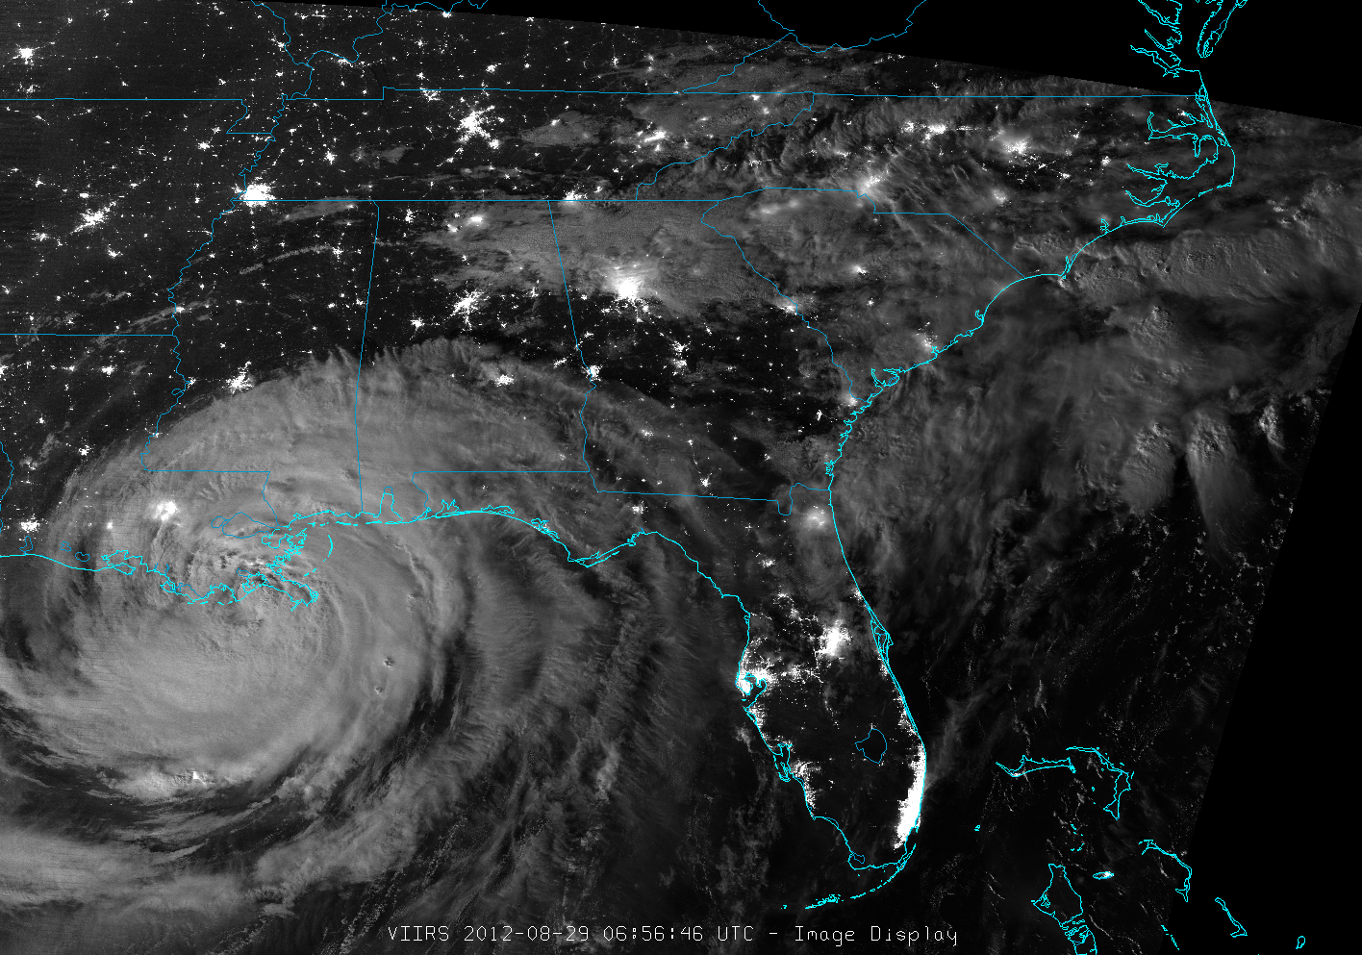


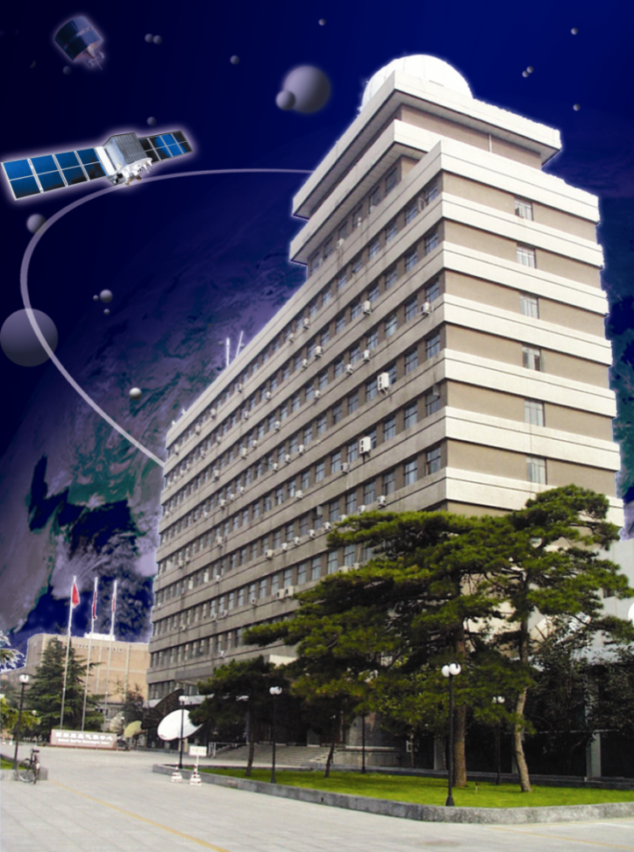
MTF Evaluation of FY-3C/MERSI using Lunar Observation
Min Min, Lin Chen, Ronghua Wu, Xiuqing Hu
National Satellite Meteorological Center, CMA
E-mail: minmin@cma.gov.cn

Slide 2
Outline
What is MTF or Spatial Quality?
FY-3C/MERSI Introduction
MTF results using polar ice block edge
MTF results using lunar image
Summary

Slide 3
Outline
What is MTF or Spatial Quality?
FY-3C/MERSI Introduction
MTF results using polar ice block edge
MTF results using lunar image
Summary

Slide 4
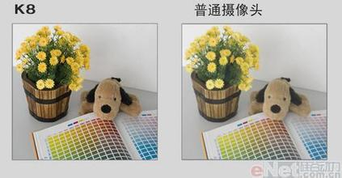
MTF（or spatial quality）
Image Sharpness
MTF@Nyquist = 0.10
MTF@Nyquist = 0.30
1.0
1.0
MTF
MTF
0.3
0.1
0.0
0.5
0.0
Frequency
0.5
Frequency

Slide 5
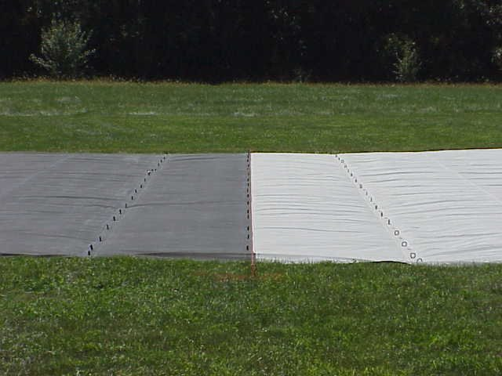

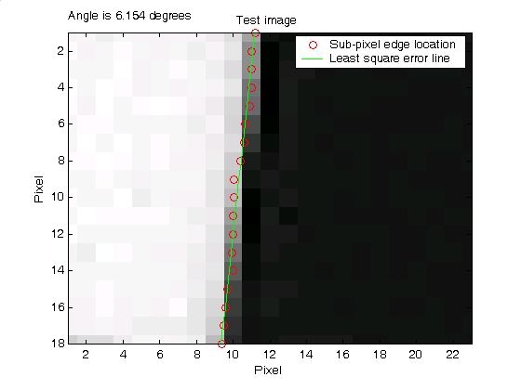
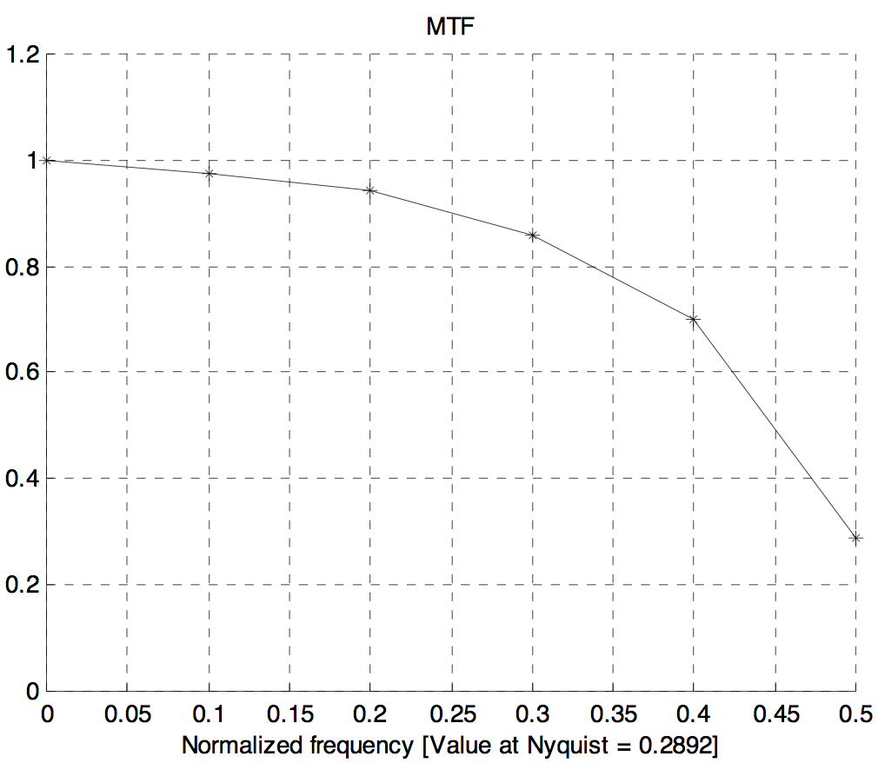
Traditional Edge and Pulse Methods
Choi 2002
Nyquist frequency
Notes:
Spot, IKONOS, Fabric 布

Slide 6
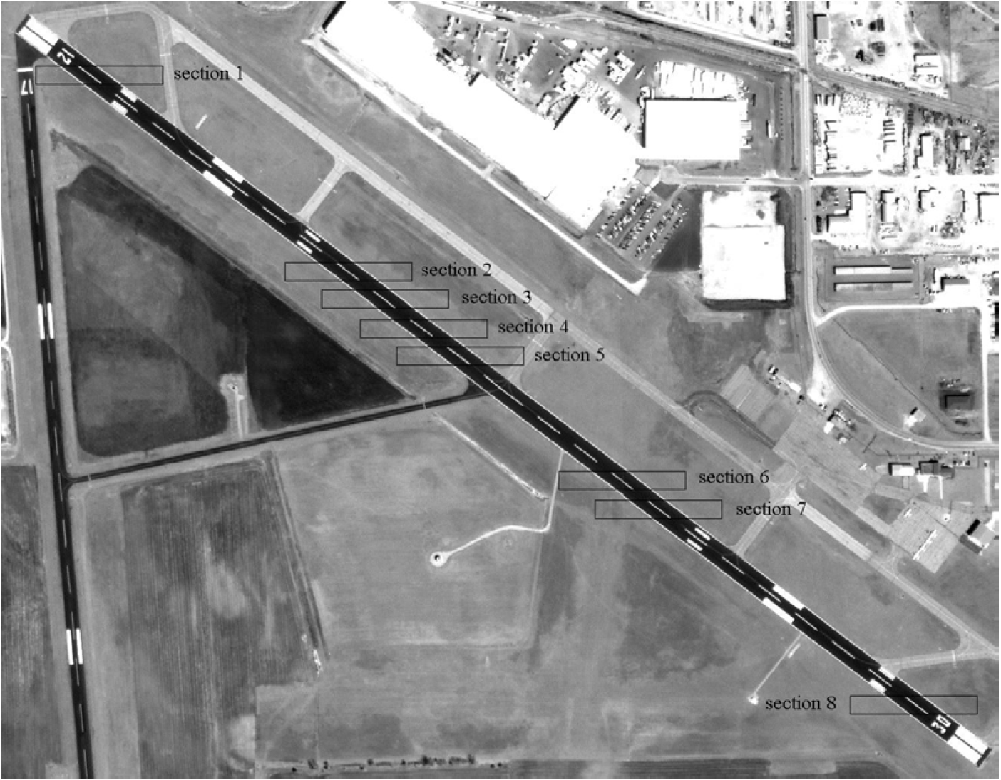
Airport NW-SE runway
Choi 2002

Slide 7
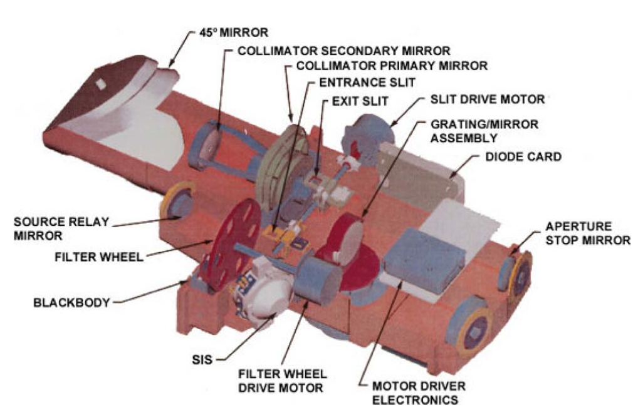
MODIS SpectroRadiometric Calibration Assembly (SRCA)
Achieve on-orbit MTF test for MODIS imaging system
Choi et al., 2014
Notes:
It is heavy and cost a lot.

Slide 8
Outline
What is MTF or Spatial Quality?
FY-3C/MERSI Introduction
MTF results using polar ice block edge
MTF results using lunar image
Summary

Slide 9
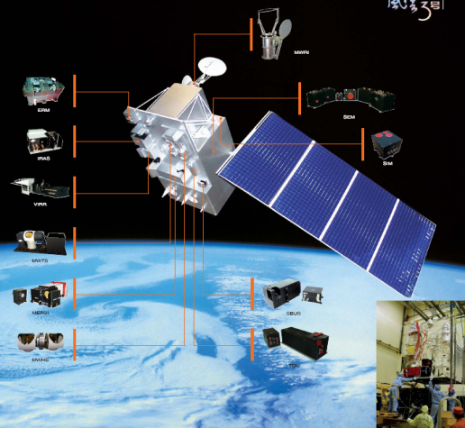
FY-3C/MERSI
ok
FY-3C is a polar-orbit meteorological satellite. The MERSI sensor on FY-3C have 20 bands from visible to infrared bands.
The onboard blackbody calibration are performed for all infrared bands of FY-3C.
Inter-calibration and drifter track method are used to validate FY-3 IR channels.
MERSI

Slide 10
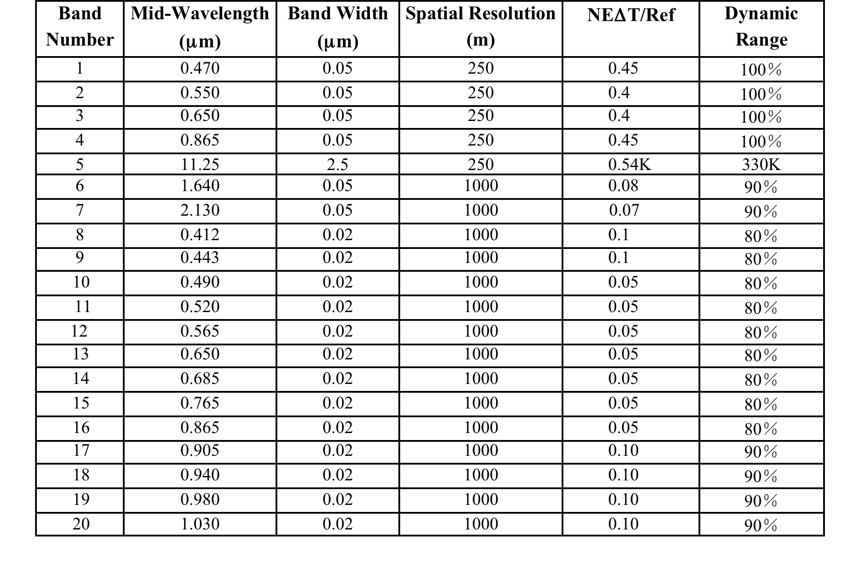
FY-3C/MERSI Bands
Notes:
serious stripe effect

Slide 11
Outline
What is MTF or Spatial Quality?
FY-3C/MERSI Introduction
MTF results using polar ice block edge
MTF results using lunar image
Summary

Slide 12
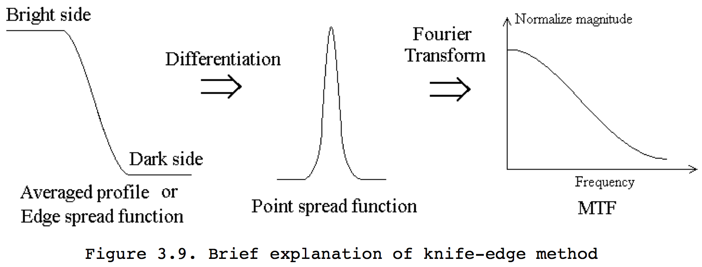
MTF theory using edge

Slide 13
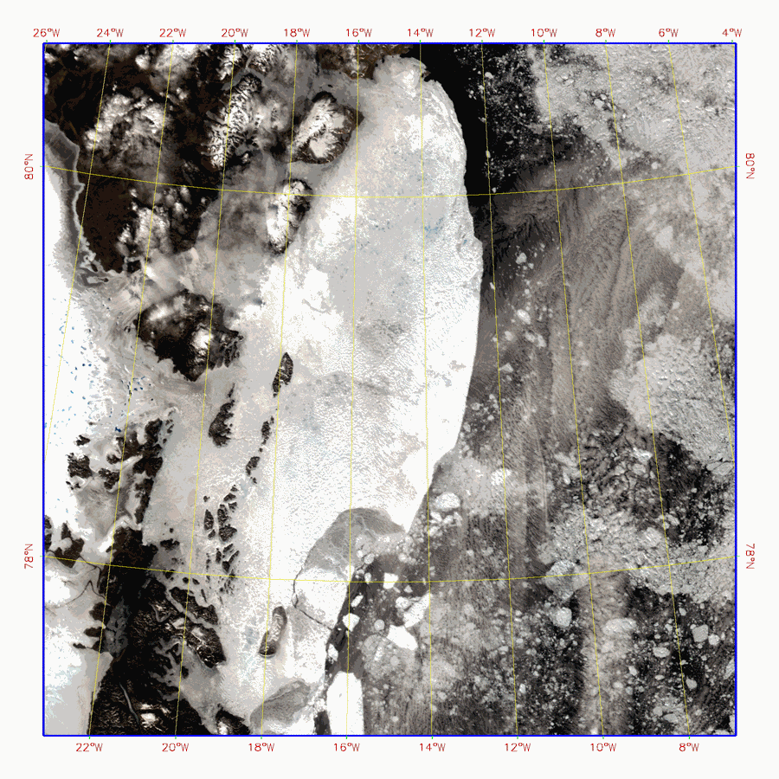
Ice block in the Polar Region
Low Spatial Resolution
(250m/1000m)
It is impossible to make
or find an artificial target
to do MTF test for MERSI.
We use Ice block in
the polar region as a Sharp
Edge to do the MTF test.
Notes:
It is very hard to find some valuable works about MTF test for FY-3C/MERSI from intelnet. Spatial Quality of MERSI is still lacking or unclear.

Slide 14
FY-3C/MERSI SRF

Slide 16
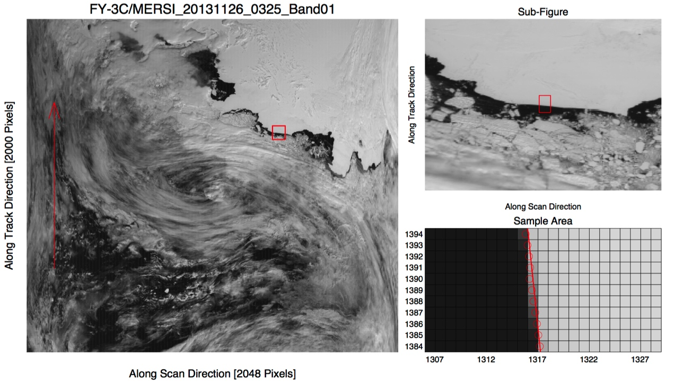
Selection of polar ice block edge for MTF test
Cited from Min Min, Cao Guangzhen, Xu Na et al, 2016. On-orbit spatial quality evaluation and image restoration of FengYun-3C/MERSI [J]. IEEE Transactions on Geoscience and Remote Sensing. 54(12): 6847-6858

Slide 17
Long-term FY-3C/MERSI MTF results

Slide 18
Averaged MTF result
Cited from Min Min, Cao Guangzhen, Xu Na et al, 2016. On-orbit spatial quality evaluation and image restoration of FengYun-3C/MERSI [J]. IEEE Transactions on Geoscience and Remote Sensing. 54(12): 6847-6858

Slide 19
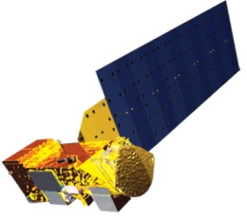
27% Overlapped between two adjacent pixels at cross-track (Scan) direction
Scan Direction
…………..
27% overlap

Slide 20
Outline
What is MTF or Spatial Quality?
FY-3C/MERSI Introduction
MTF results using polar ice block edge
MTF results using lunar image
Summary

Slide 21
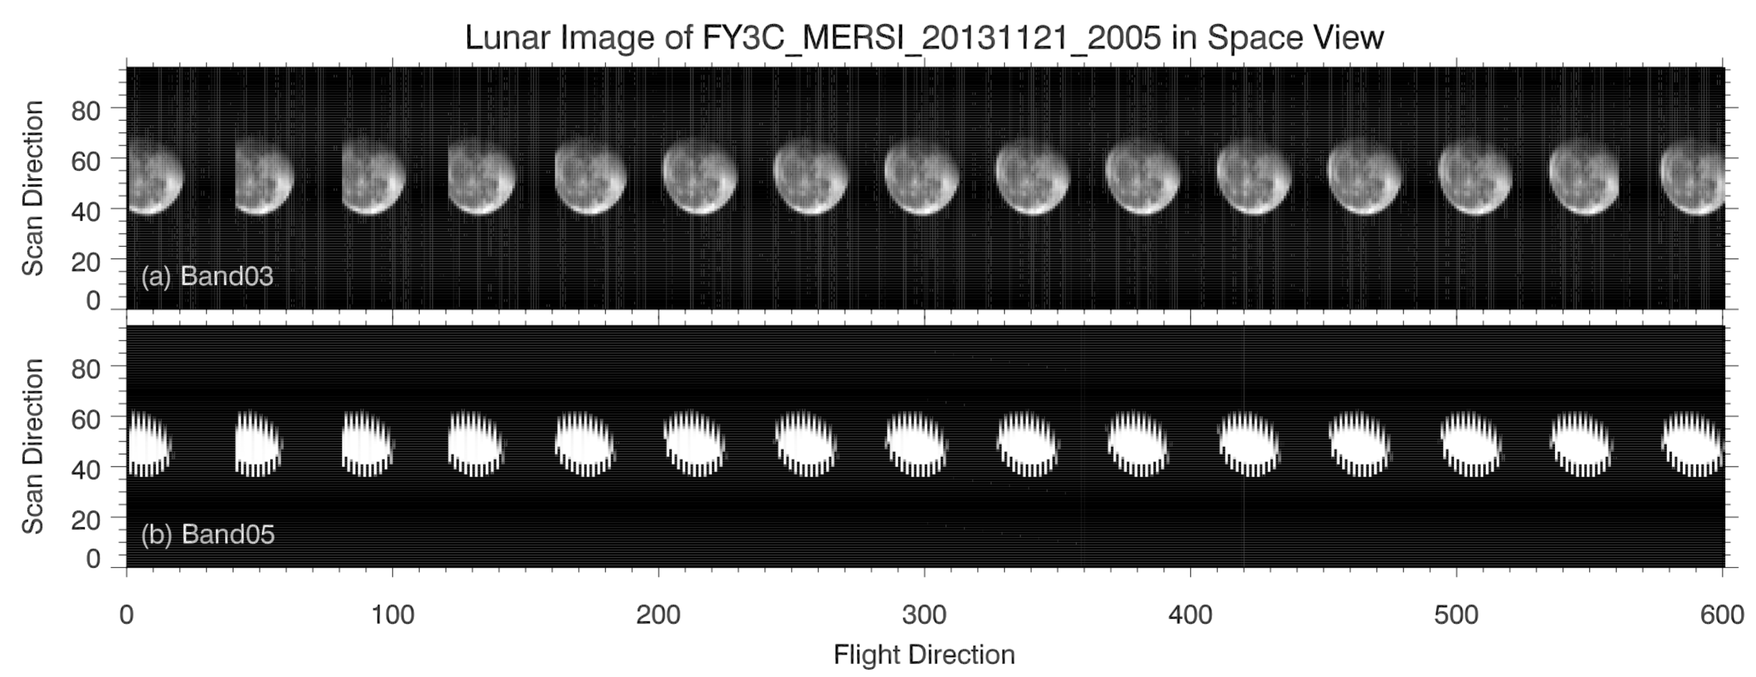
Lunar image in FY-3C/MERSI space view
Fig. 1. Lunar images of FY-3C/MERSI (a) Band03 and (b) Band05 in space view with 250 m resolution at 20:05 UTC on 21 November 2013.

Slide 22
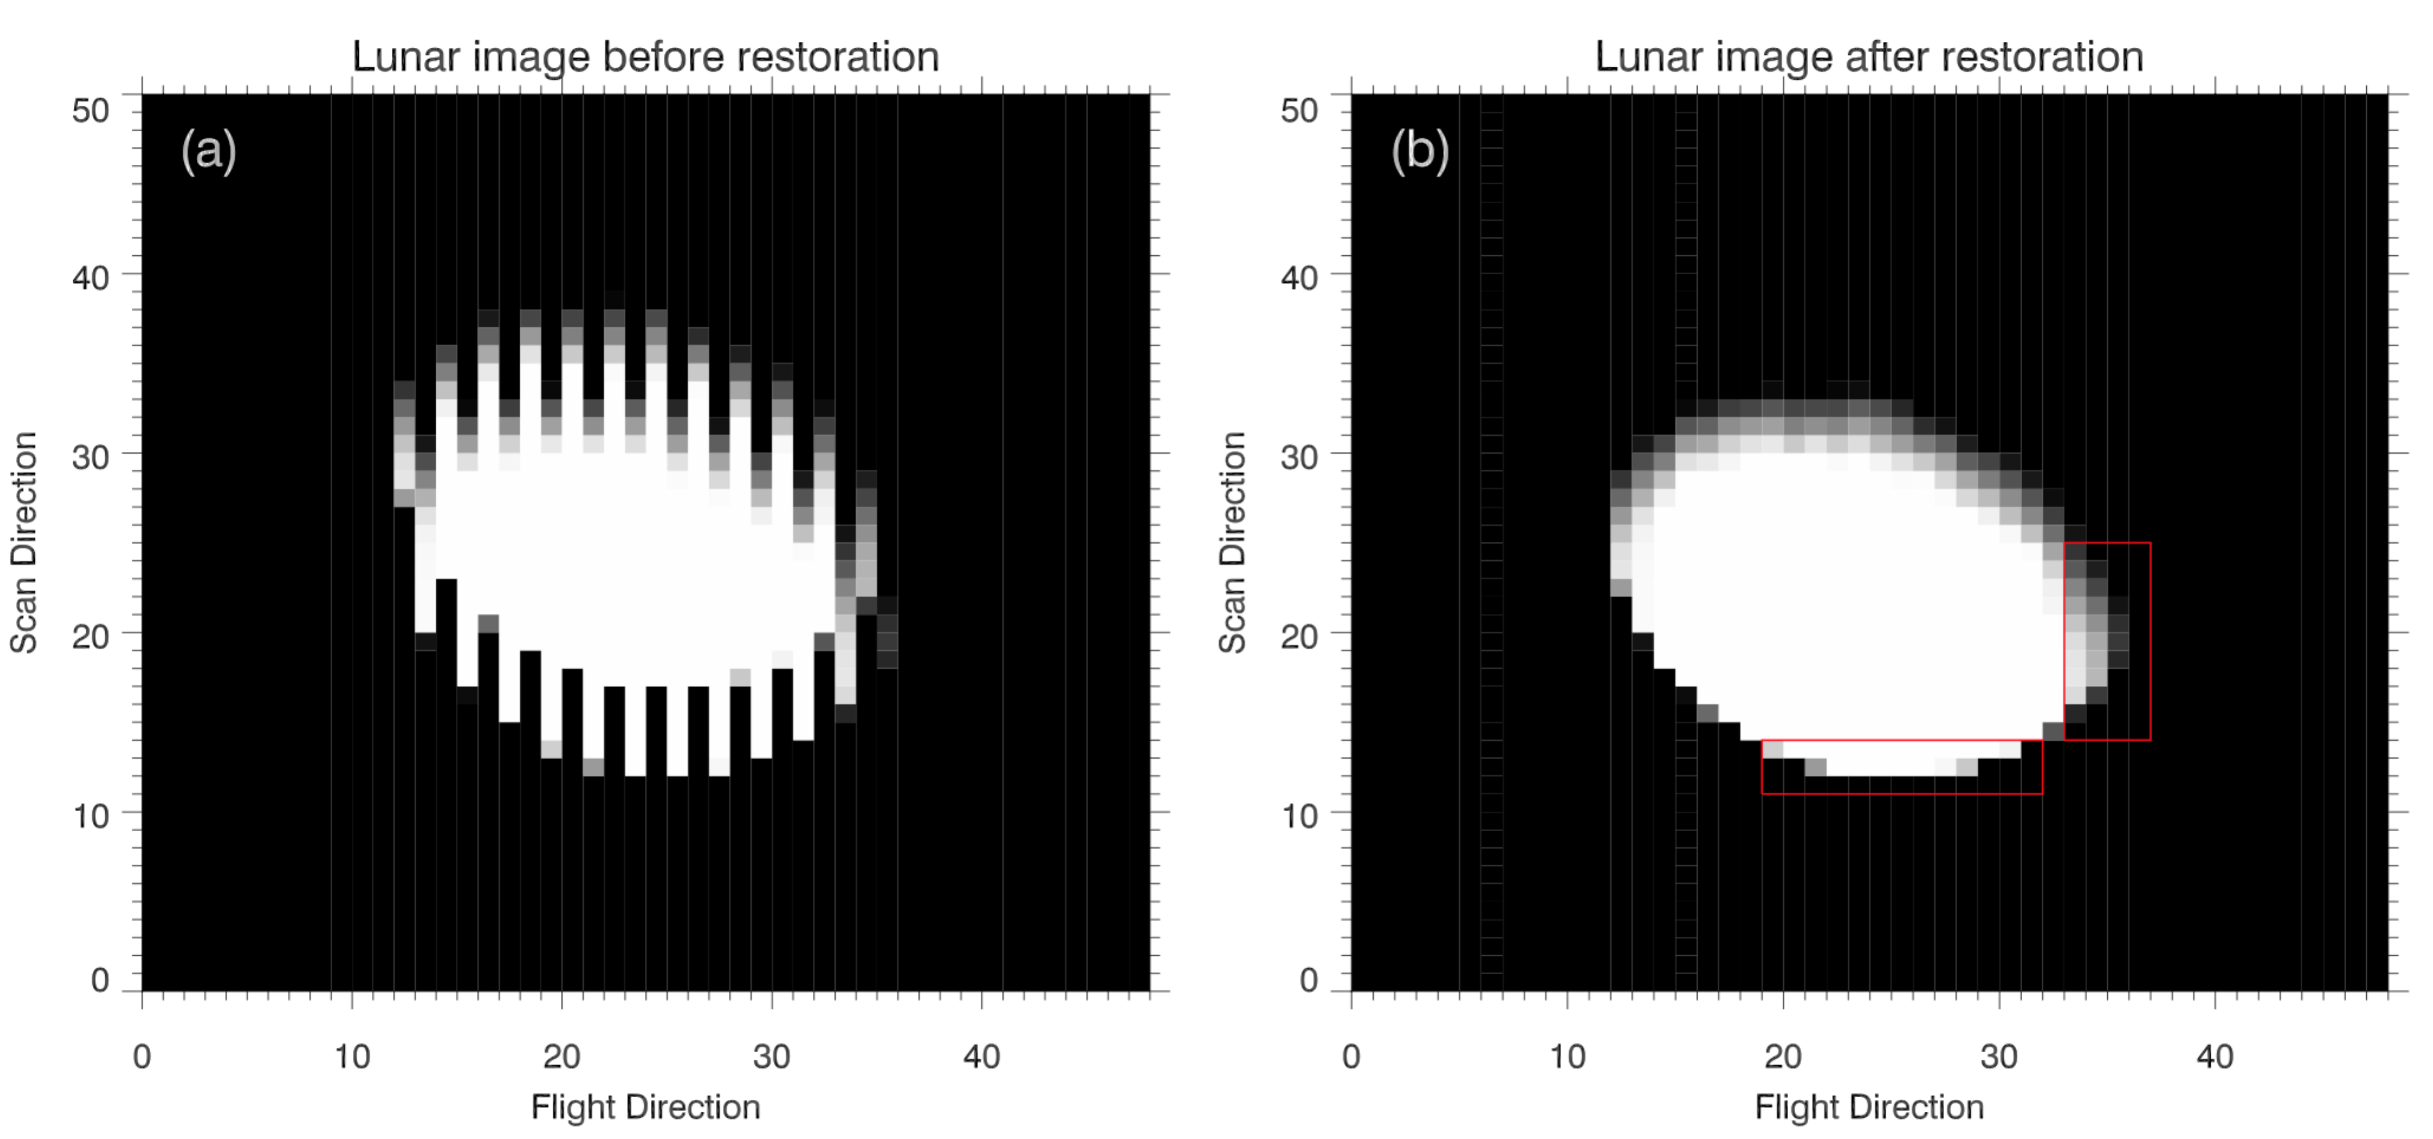
Lunar image restoration
Fig. 2. Lunar images of FY-3C/MERSI in space view (a) before and (b) after restoration. The red boxes represent the moon edge zones we use for calculating ESF.

Slide 23
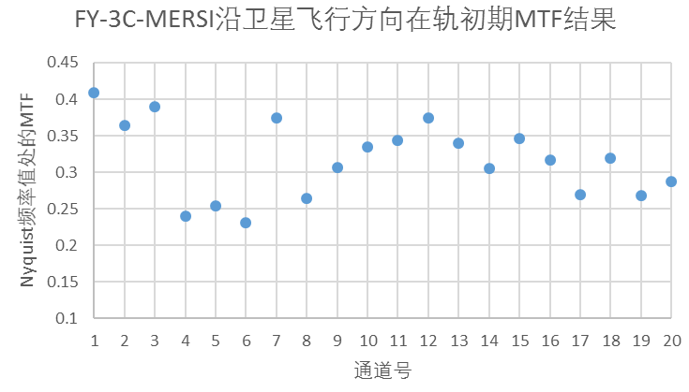
MTF result comparison along flight direction
Using polar ice block
The results are a litter bit higher than those using polar ice block
atmospheric extinction effect
Using lunar image
Early Result on orbit

Slide 24
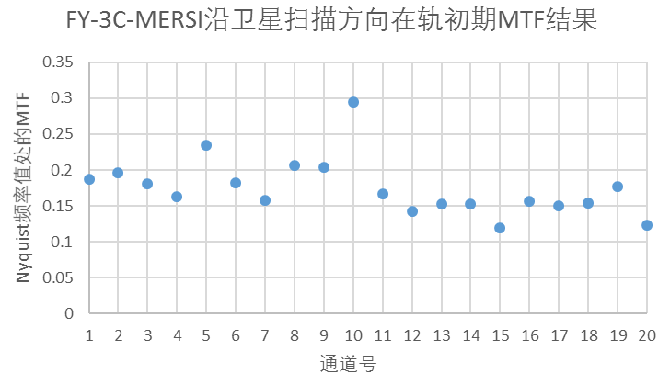
MTF result comparison along scan direction
Using polar ice block
Using lunar image
The results are a litter bit higher than those using polar ice block
Early Result on orbit

Slide 25
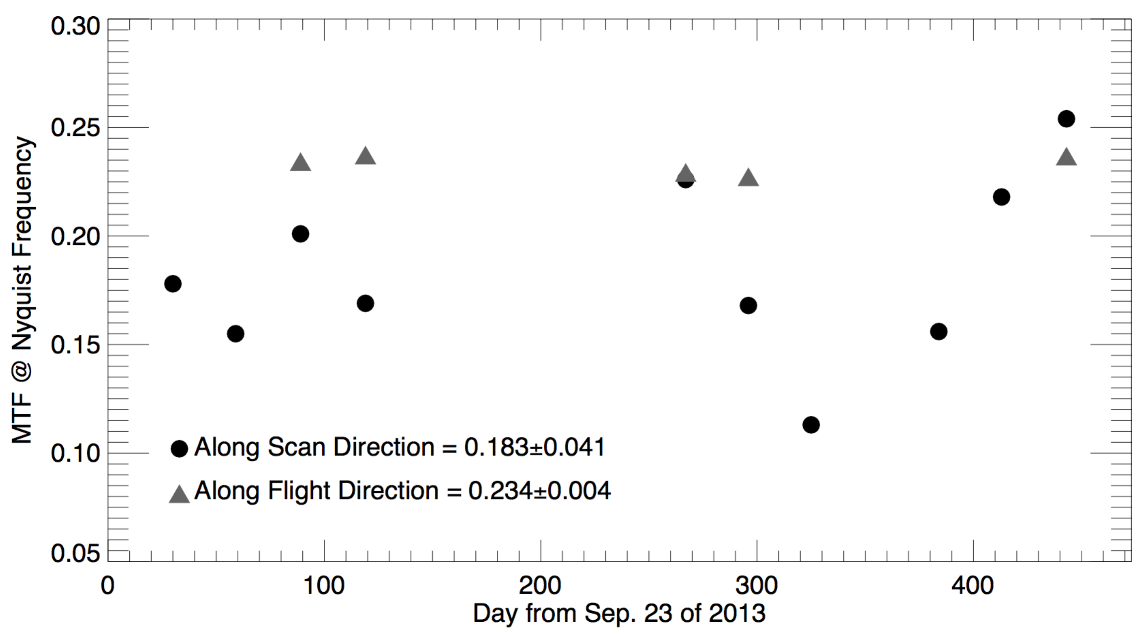
MTF results for IR band
Dates and UTC times of the lunar observations in SV and phase angles
Number | Date | UTC Time | Lunar Phase Angle
1 | 2013-10-23 | 05:30 | 48.21
2 | 2013-11-21 | 20:05 | 45.71
3 | 2013-12-21 | 10:30 | 43.18
4 | 2014-01-20 | 09:25 | 44.42
5 | 2014-06-17 | 08:10 | 57.08
6 | 2014-07-16 | 00:50 | 49.15
7 | 2014-08-14 | 05:20 | 47.39
8 | 2014-10-12 | 10:35 | 49.58
9 | 2014-11-10 | 23:25 | 48.45
10 | 2014-12-10 | 12:10 | 45.30
Fig. 3. MTF values at the Nyquist frequency for TEB of FY-3C/MERSI from October 2013 to December 2014. The solid gray triangle and black circle respectively represent the MTF values sampled along flight and scan directions.

Slide 26
Outline
What is MTF or Spatial Quality?
FY-3C/MERSI Introduction
MTF results using polar ice block edge
MTF results using lunar image
Summary

Slide 27
Summary
Early MTF test results from polar ice block and lunar image show the same variation trend
MTF results using lunar image are a little bit higher than those using polar ice block due to atmospheric extinction effect.
Inherent Overlapped scan mode of FY-3C/MERSI induces the reduction of MTF or spatial quality, which are proved by both ice and lunar methods.

Slide 28

Thank you
Q&A

