Slide 1
On-orbit Modulation Transfer Function Characterization of
PROBA-V Using the Moon
Work done by : Ignacio Torralba Elipe (ESA-ESTEC)
Presentation : Stefan Adriaensen (VITO)
2nd GSICS/CEOS Lunar Calibration Workshop, Xi’an, China 13/11/20117 – 16/11/20117

Slide 2
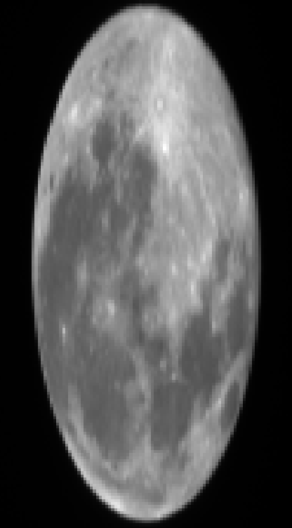
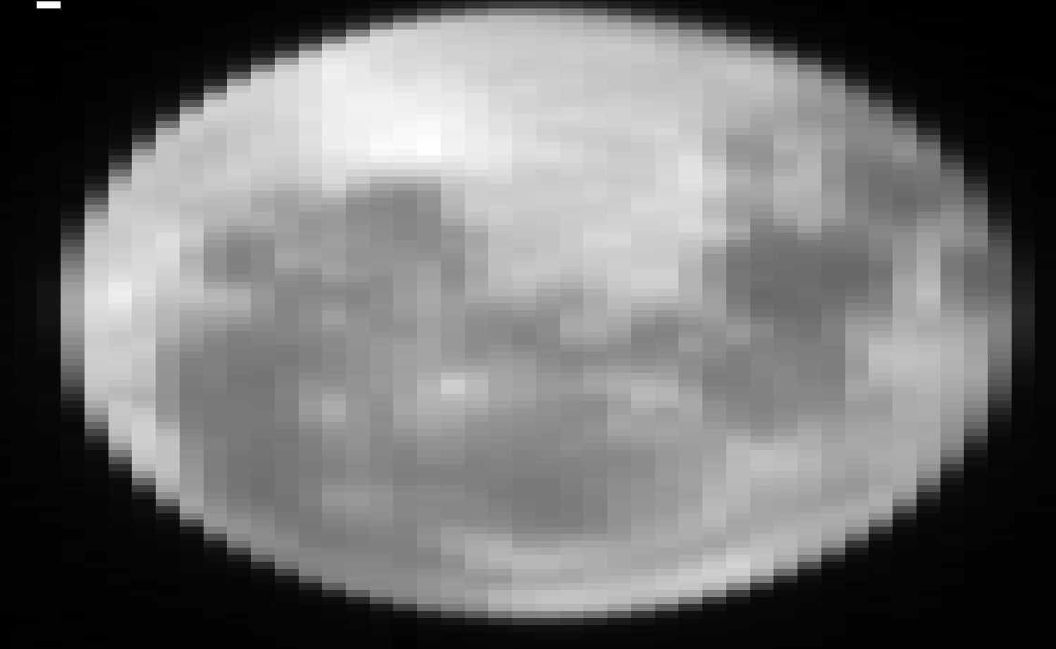
In orbit verification of PROBA-V MTF
MTF is a measure for the spatial imaging quality of a sensor
PROBA-V is a pushbroom line-sensor, so the MTF is derived from the line spread function.
This is done using lunar acquisitions near full Moon (7degrees phase)
radiance values are used

Slide 3
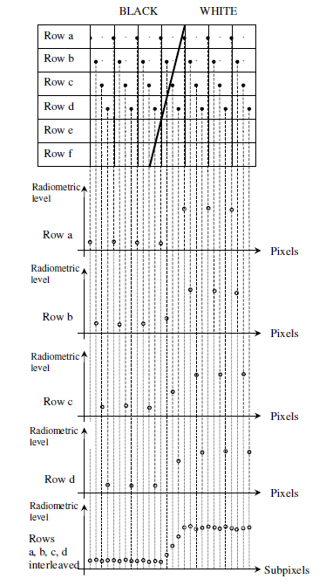
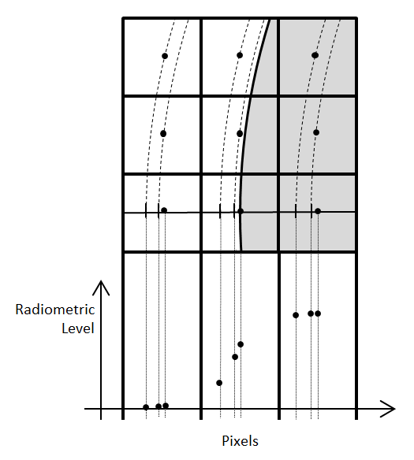
ESF edge spread function
The method is based on the method by Françoise Viallefont-Robinet [2010]
Based on the selection of multiple lines in the lunar image, an edge spread function can be constructed with a resolution higher than the pixel resolution
edge spread function needs resampling for the fourrier transform (equidistant points) by means of Fermi-Dirac fitting

Slide 4
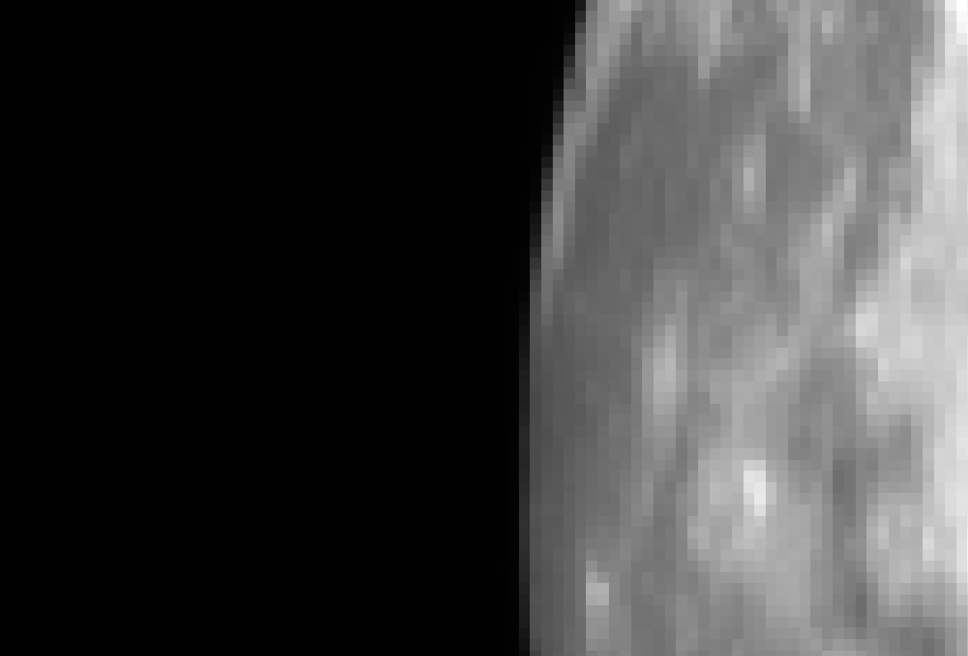
ESF : PROBA-V moon edge selection
The position of the edge start line selection is done by hand as a starting point

Slide 5
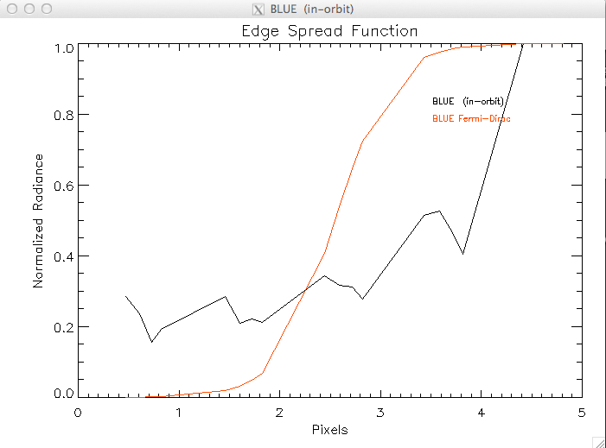
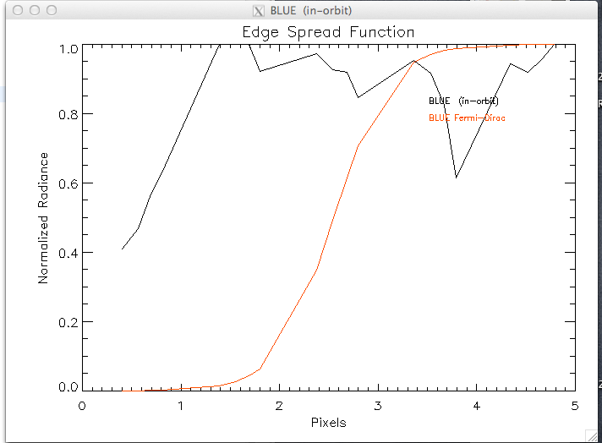
ESF : mismatch in selection

Slide 6
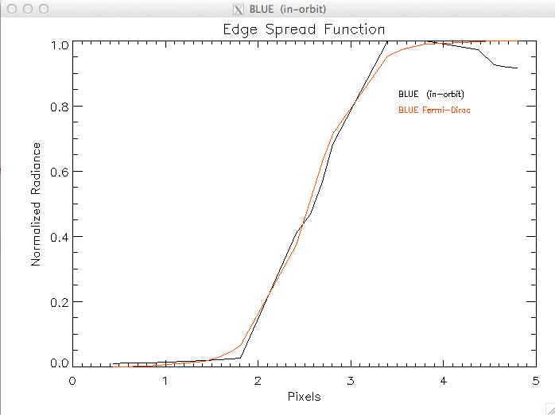
Edge Spread Function

Slide 7
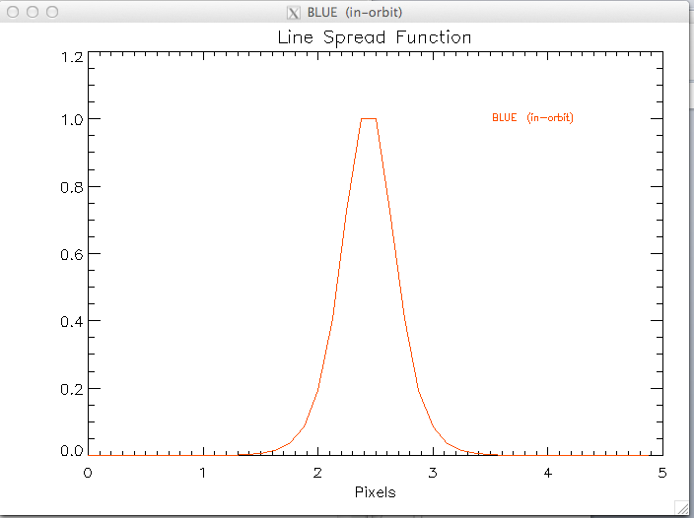
Line Spread Function
The Line Spread Function essentially is the derivative of the ESF
The LSF is first normalised and then the Fourrier Transform is is calculated, resulting in MTF

Slide 8
MTF : Results for PROBA-V
Results for 4 bands (BLUE, RED, NIR, SWIR)
Comparison with on ground measured MTF is shown
Results of 2 assessments are shown : 23062013 and 24072013

Slide 9
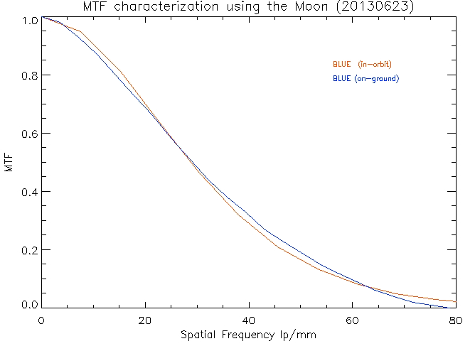
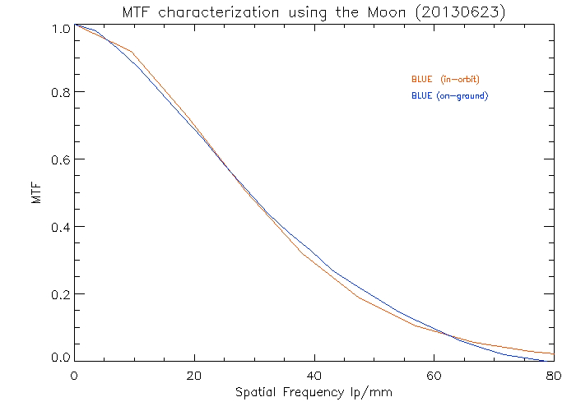
MTF BLUE

Slide 10
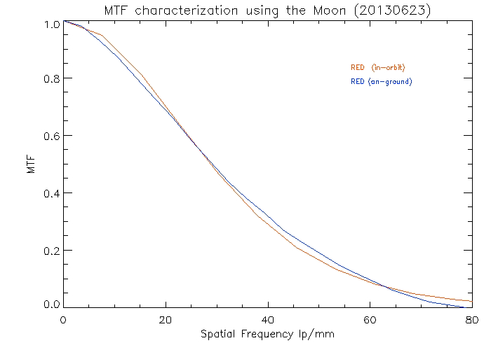
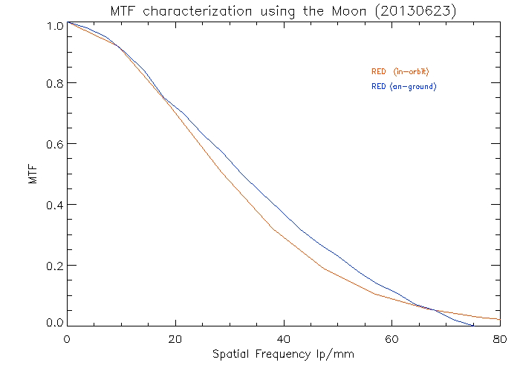
MTF RED

Slide 11
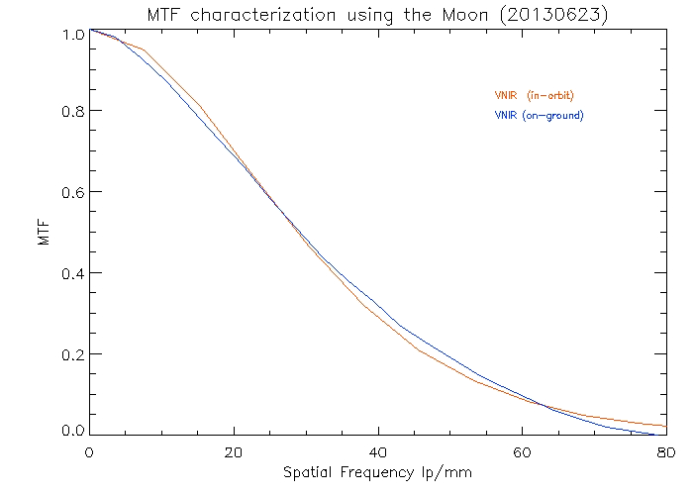
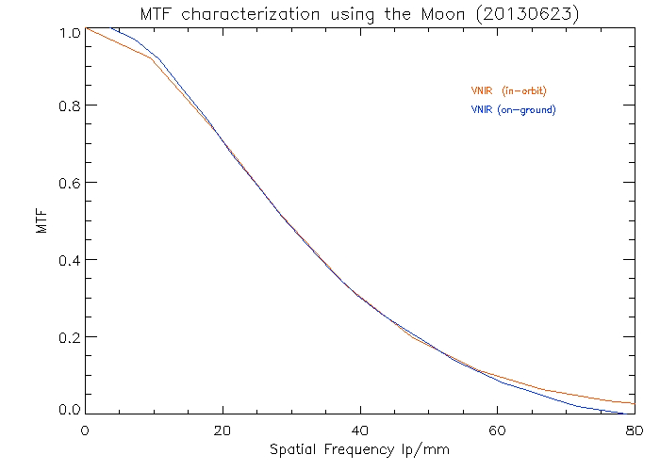
PROBA-V MTF NIR

Slide 12
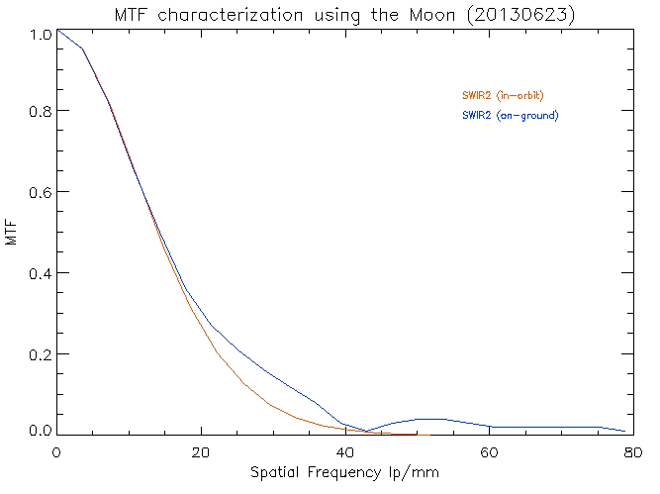
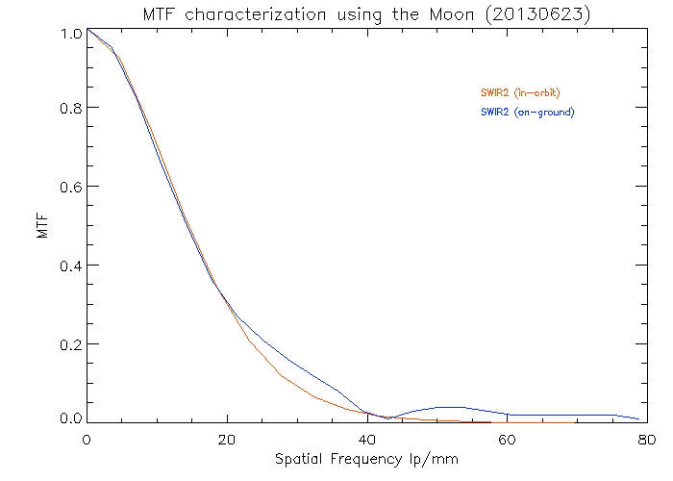
PROBA-V MTF SWIR2

Slide 13
Conclusion
MTF is verified in orbit for PROBA-V using lunar images
Proccessing could be done semi automatically
The retrieved MTF curves match well with the measured ones
Thanks to Ignacio Torralba Elipe (ESA)

