Slide 1
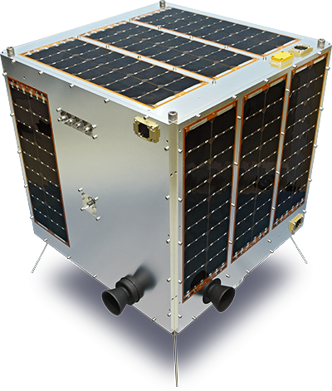
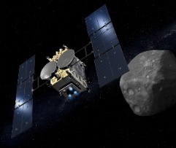
Lunar Observation Activities with a Small Satellite and a Planetary Exploration Satellite.
Hodoyoshi-1
Hayabusa-2
Toru Kouyama, AIST
2017.10.05

Slide 2
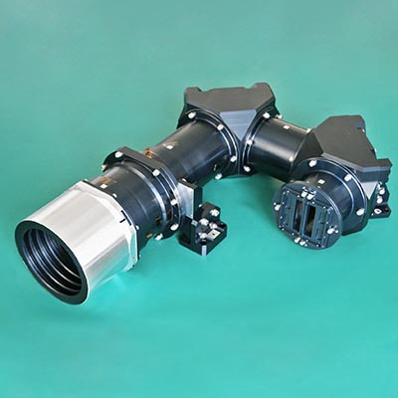
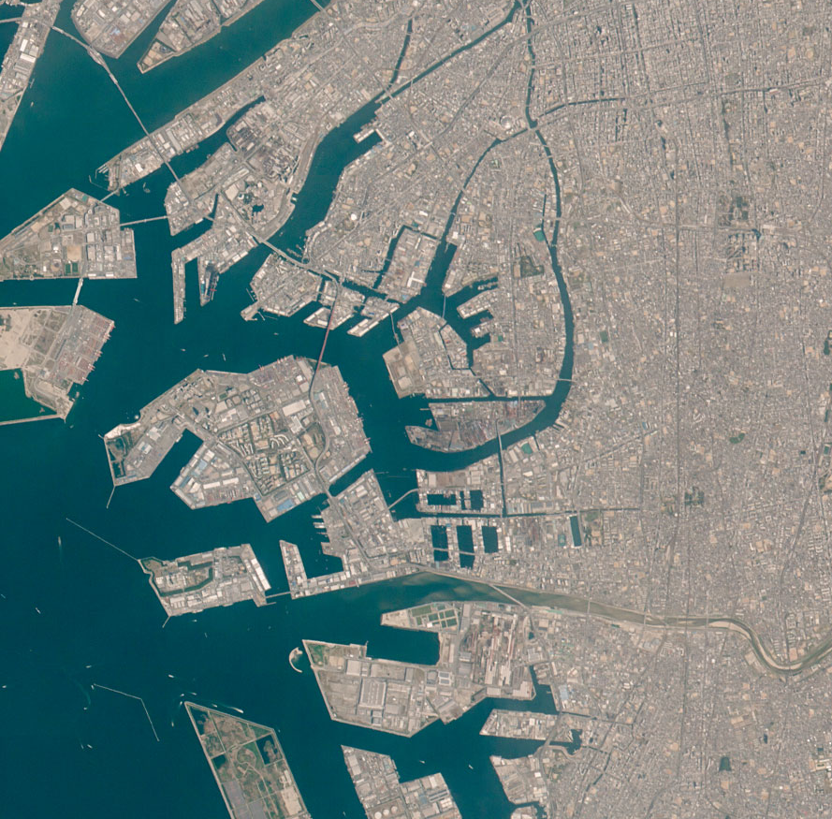
50cm
Hodoyoshi-1 (2014-)
A small satellite developed and operated by Axelspace corporation
(Japanese venture company)
50kg
Osaka, Japan
Image Acquisition Mode | Push-broom
Ground Resolution | 6.7 m
Spectral bands | Blue | 450-520 nm
 | Green | 520-600 nm
 | Red | 630-690 nm
 | Near Infrared | 780-890 nm
Notes:
Oversampling
Stray-light
Dark signal bias

Slide 3
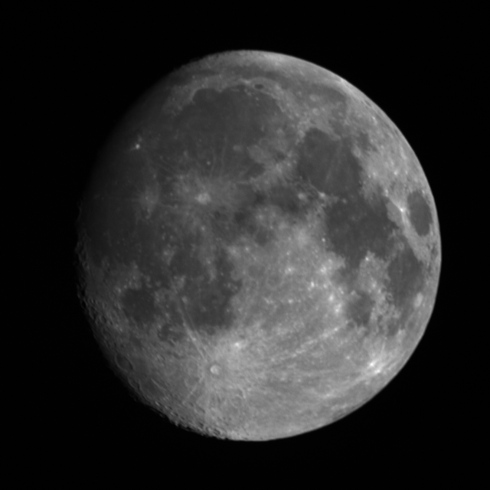
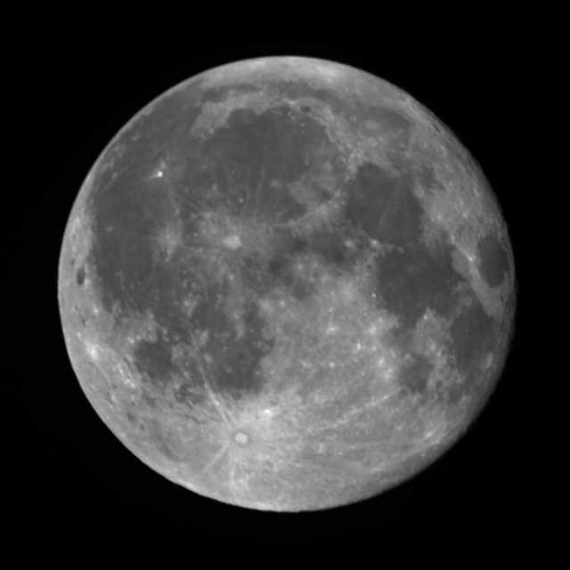
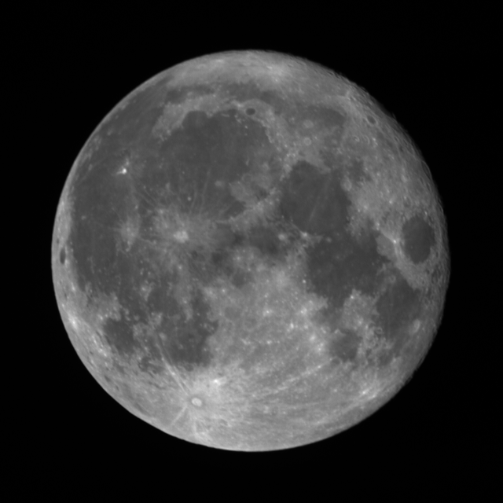
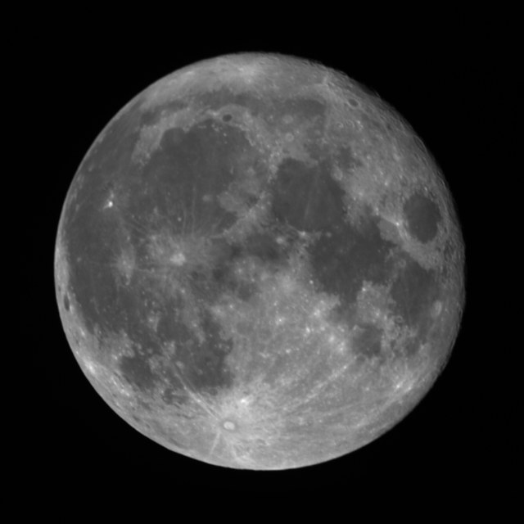
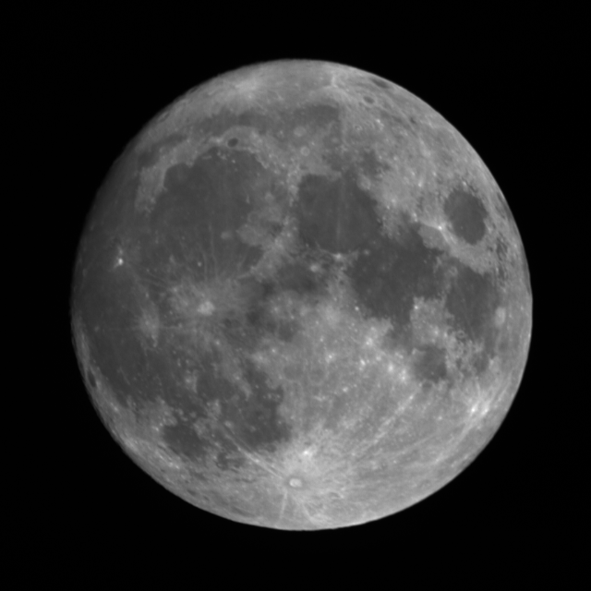
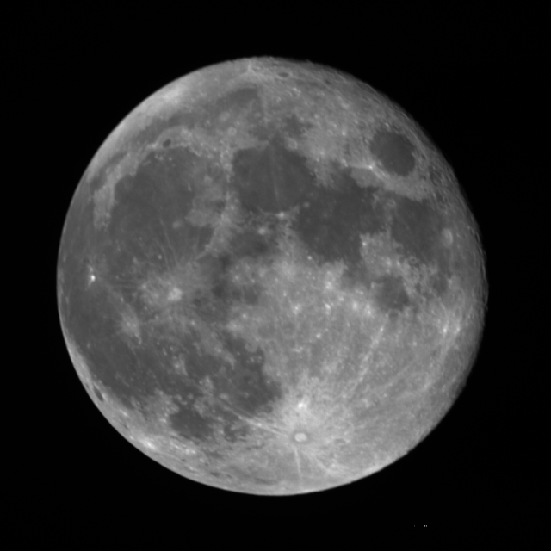
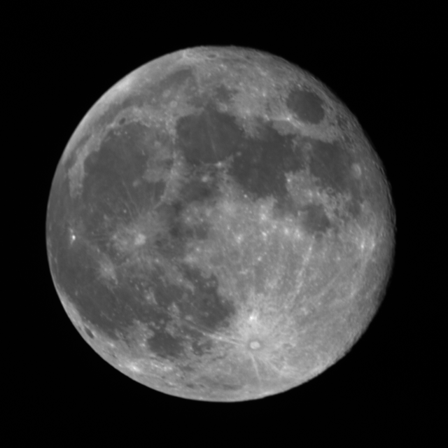
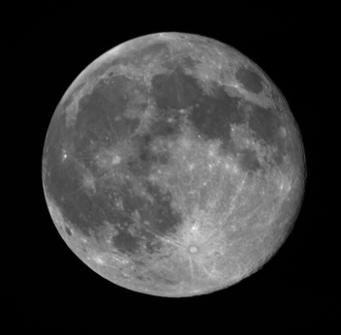
50cm
Hodoyoshi-1’s moon observations
(2016.8 – 2017.5)
α: Phase angle
*after correcting oversampling effect
2016.08.16
2016.08.19
2016.11.15
2016.12.14
α = -29 °
α = +10°
α = +10°
α = +10°
2017.01.12
2017.02.11
2017.03.13
2017.05.11
α = -10°
α = +10°
α = +10°
α = +10°
Notes:
Oversampling
Stray-light
Dark signal bias

Slide 4
Lunar calibration results
Using SP model, and normalized with 8/19 result
1%
Dashed line: Expected sensitivity variation
[Kouyama et al., 2017, IGARSS]
Lunar calibration for Hodoyoshi-1 can detect very small degradation (less than 1 %)!
1 % is enough for science use.

Slide 5
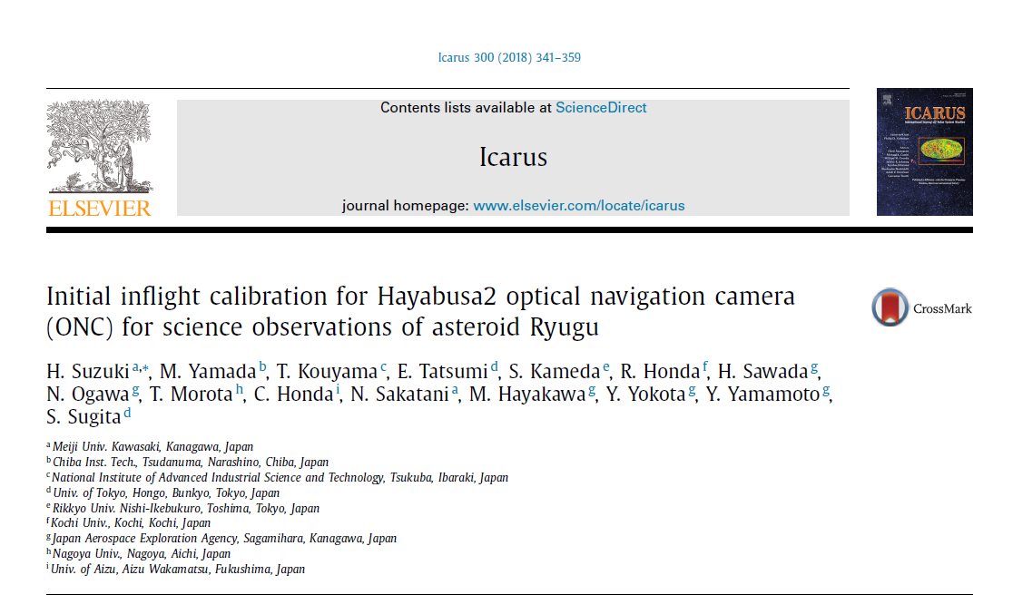
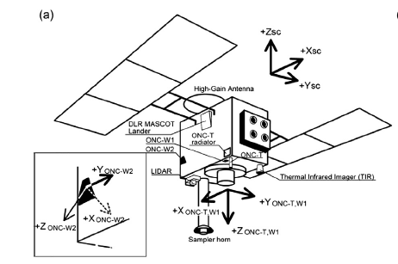
Lunar calibration for Hayabusa-2
Observation
Simulation

Slide 6
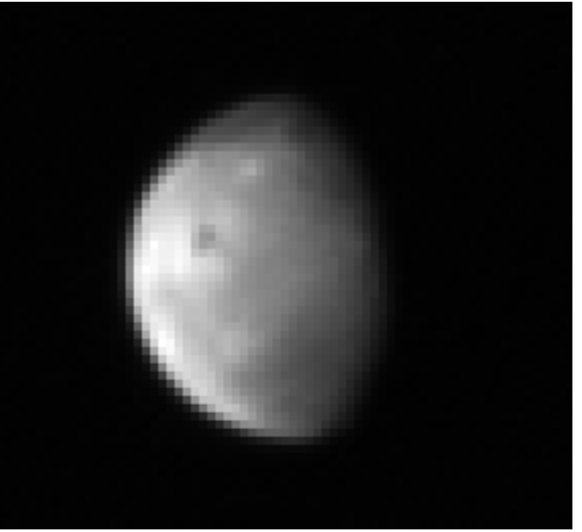
Consistency between bands
SP: Not corrected
Hayabusa-2
SP: Corrected
Observed
Better spectral consistency
[after Suzuki et al., 2017, Icarus]

Slide 7
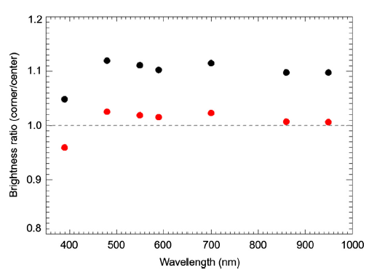
Checking flat correction
Brightness ratio between Moons located at image center and at image corner
Center
Without additional correction
10%
Corner
With additional correction
[after Suzuki et al., 2017, Icarus]

Slide 8
Summary
We (AIST) have collaborated with two small satellite missions and several planetary missions.
Discussion of importance of calibration and how we can achieve the calibration with a commercial company.
-> I want to notice the importance of calibration in Japanese small satellite community.
Lunar calibration can be used for checking homogeneous of sensitivity in a 2D image sensor. (validating flat correction)

Slide 9
Thank you !
Backup slides…

Slide 10
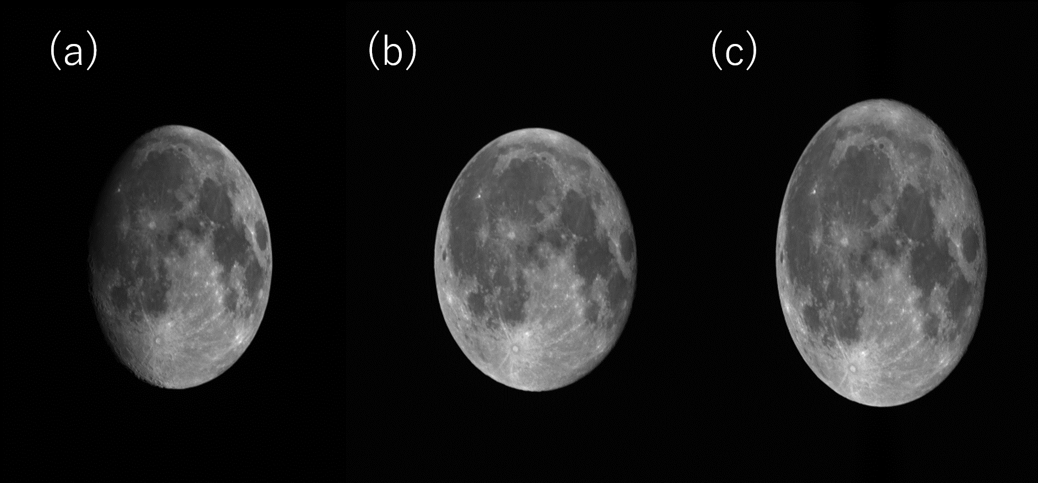
Raw images

Slide 11
ASTER/VNIR Lunar calibration results
(r = Observed brightness / Simulated brightness)
Degradation ratio from 2003 to 2017
Current
official
Vicarious
+ Cross
Our results
 | RCC(Ver 4) | Obata et al (2015) | Lunar Calibration
Band 1 | 0.972 | (0.972) | 0.970
Band 2 | 0.986 | 0.949 | 0.948
Band 3N | 0.923 | 0.942 | 0.943

Slide 12
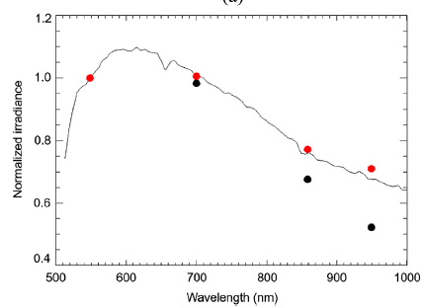
Sensor performance of Hayabusa-2
Consistency of sensitivity among different bands
Expected Moon brightness
Observed brightness
Keep good performance

Slide 13
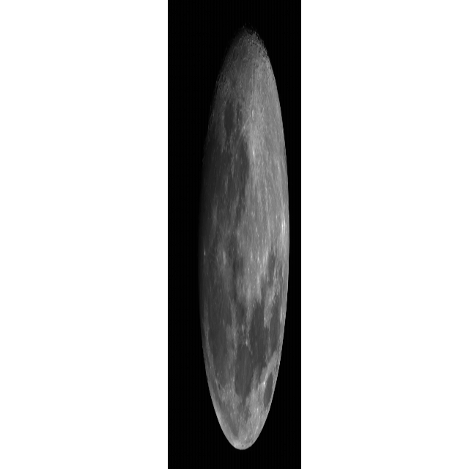
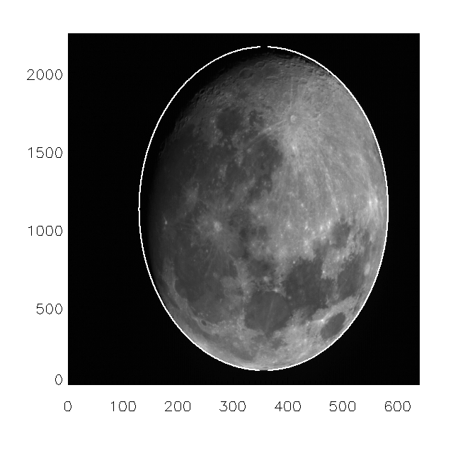
Lunar calibration procedure
① Correcting oversampling effect
Image analysis
Obtaining
Oversampling factor
Correction

Slide 14
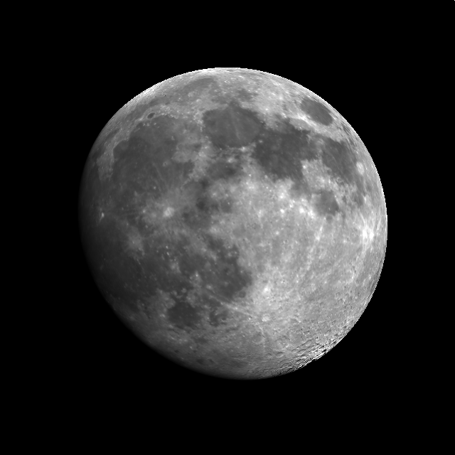
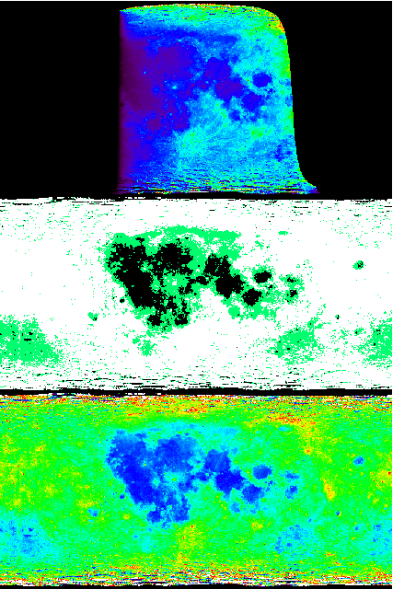
Lunar calibration procedure
② Simulating lunar observation
Input:
Observation date
Observation geometry
Model calculation
③ Comparing observation and simulation

Slide 15
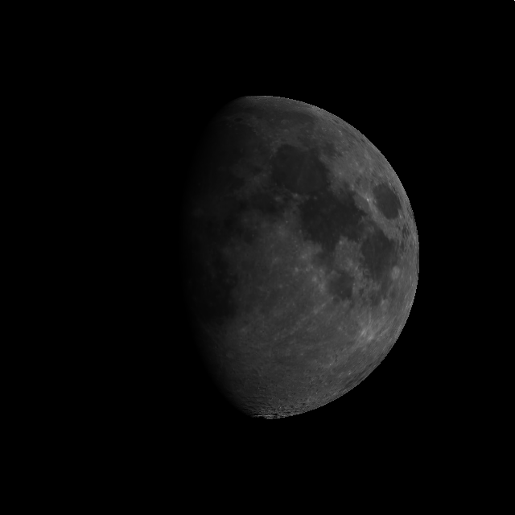
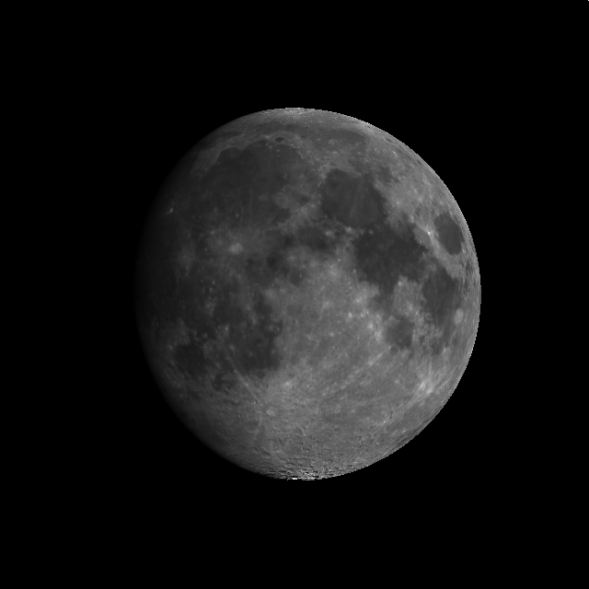
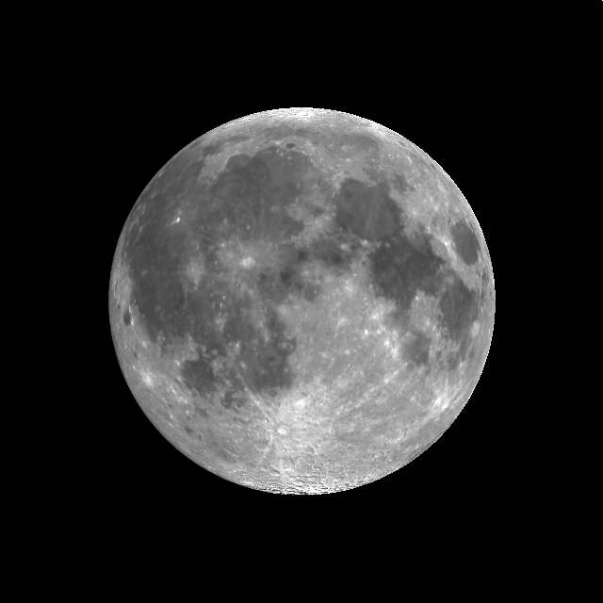
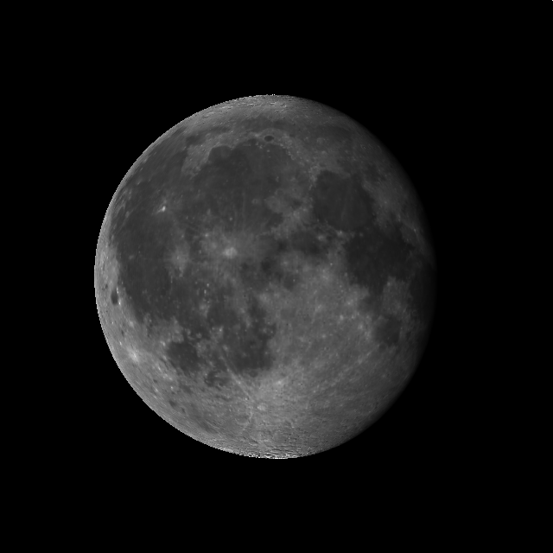
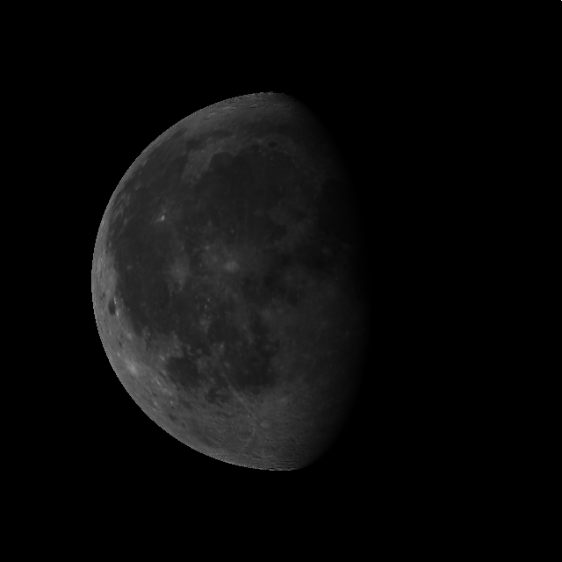
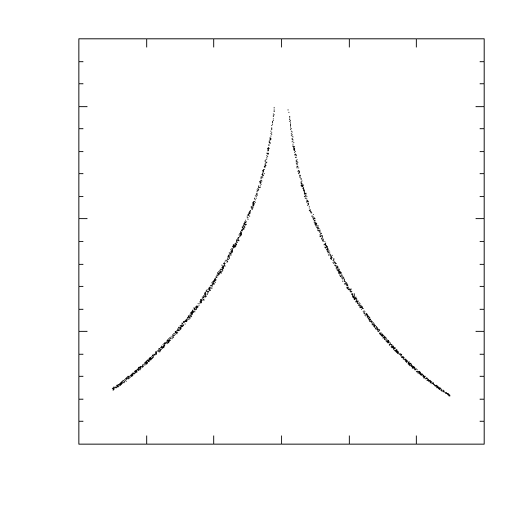
Lunar brightness characteristics
Dependency on phase angle
1.5
Normalized brightness
(Disk integrated)
1
0.5
Waxing
Waning
0
-90
-60
-30
0
30
60
90
Phase angle (degrees)

Slide 16
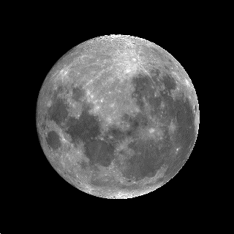
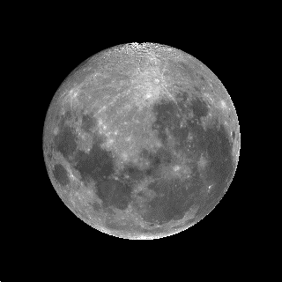
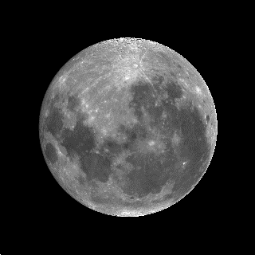
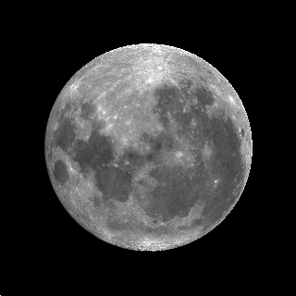
Lunar brightness characteristics
Dependency on Libration effect
Phase angle = -7°
Brightness Deviation (%)
Month in 2017

Slide 17
Lunar calibration results
Using SP model, and normalized with 8/19 result
1%
Discrepancy = Uncertainty
Note: Lunar brightness model (SP model) does not cover Blue band wavelength range.
Blue band sensitivity is deduced from comparison with Green and Red bands.

