Slide 1
Evaluation of ABI Radiometric Characteristics Using Lunar Measurements
Fangfang Yu¹, Xi Shao¹ , and Xiangqian Wu²
1: ERT, Inc@NOAA/NESDIS/STAR
2: NOAA/NESDIS/Center for Satellite Application and Research (STAR)
GOES-16 is not declared operational. The ABI data are currently experimental and still undergoing testing.

Slide 2
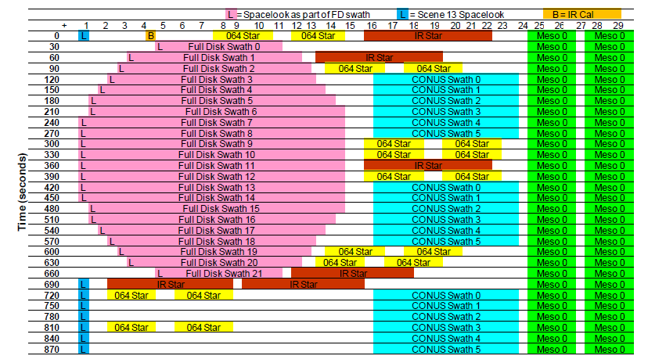
Normal Lunar Scans
MESO scan in mode 3 is used to collect the Moon data. Each MESO scan consists of two swaths
The Moon is scanned with one of the two swaths
ABI Moon data is in Level1Alpha format – calibrated but not navigated data
G16 ABI uses Side2 FPMs
ABI Mode 3 timeline
Band name | Central Wavelength (µm) | EW ASD (µrad) | NS ASD (µrad) | Columns | Row
B01 | 0.47 | 22 | 22.7 | 3 | 676
B02 | 0.64 | 11 | 10.4 | 3 | 1460
B03 | 0.87 | 22 | 22.7 | 3 | 676
B04 | 1.38 | 44 | 41.6 | 6 | 372
B05 | 1.61 | 22 | 22.7 | 6 | 676
B06 | 2.25 | 44 | 41.6 | 6 | 372

Slide 3
Normal Lunar Scans: Chasing and Trending
Chasing:
ABI consecutively scans the Moon as it transits across the space within the Field of Regard (FOR).
The data is mainly used for the Response vs. Scan-angle (RVS) study, as well as trending analysis.
Only conducted during the PLT/PLPT periods.
Trending:
ABI scans the Moon within one meso-scan time window which is ~2 minutes.
The data is used for the monitoring of VNIR solar calibration degradation.
Will be conducted 2-3 times per month through the operational mission life.

Slide 4
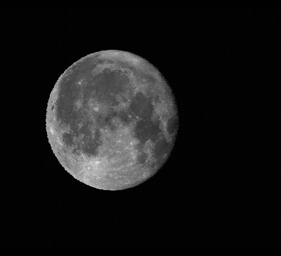
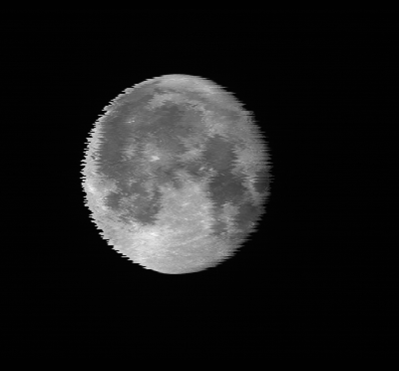
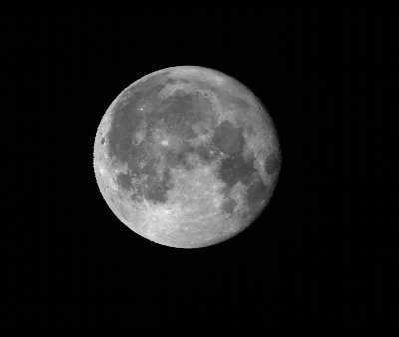
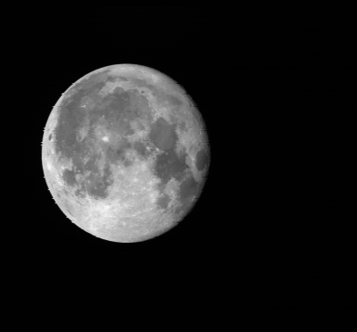
GOES-16 ABI Lunar Images
B01
B02
B03
B04
B05
B06
Phase angle ≈ 15 degree

Slide 5
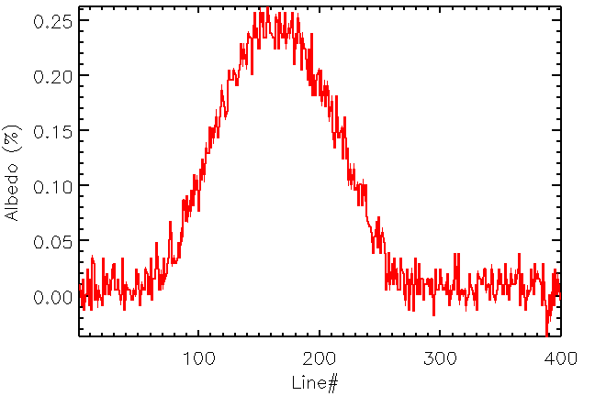
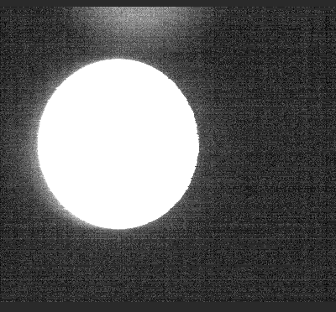
Enhanced Lunar Image Display
Albedo: [-0.1%, 0.5%]
Band01 Band02 Band03
Ghosting/xtalking?
Ongoing effect to identify the source to accurately calculate the irradiance
Band04 Band05 Band06
Coherent noise at each band meets the specification

Slide 6
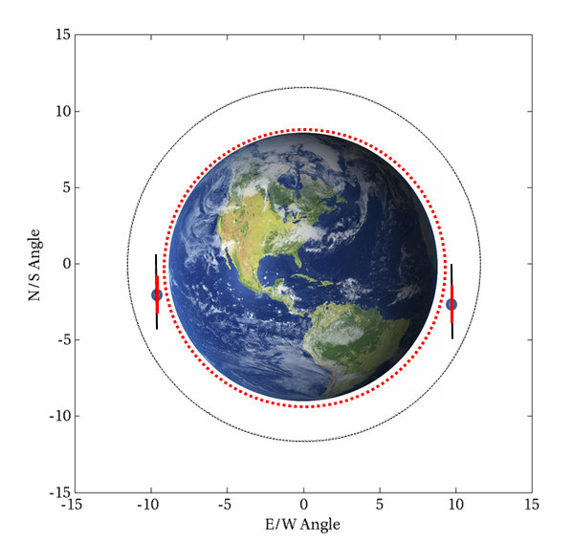
ABI Lunar North-South Scan (NSS)
ABI conducted series of North-South Scan (NSS) over the Moon
All the detectors of the all 16 bands across the illuminated lunar edges from north to south
Used to examine the crossing talk effect in between detectors and bands
Effort is still ongoing

Slide 7
Band 1
Examples of Lunar NSS Images
Band 2
Band 3
Band 4
Band 5
Band 6

Slide 8
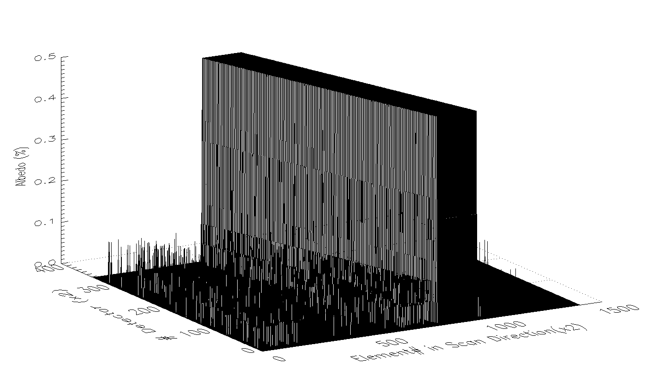
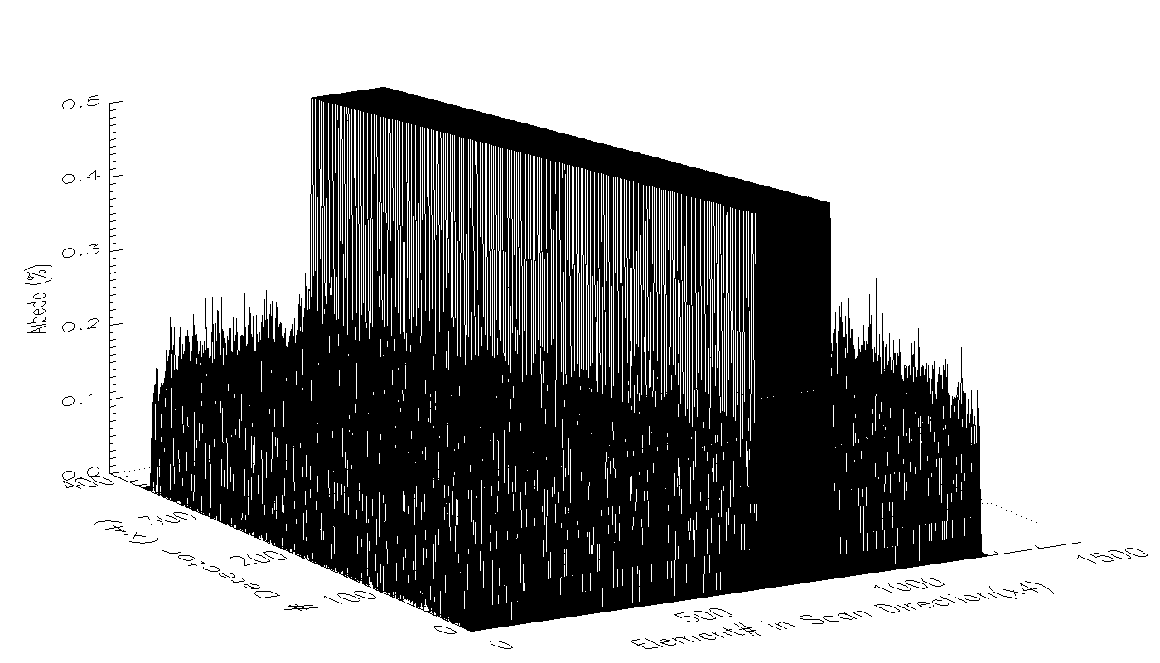
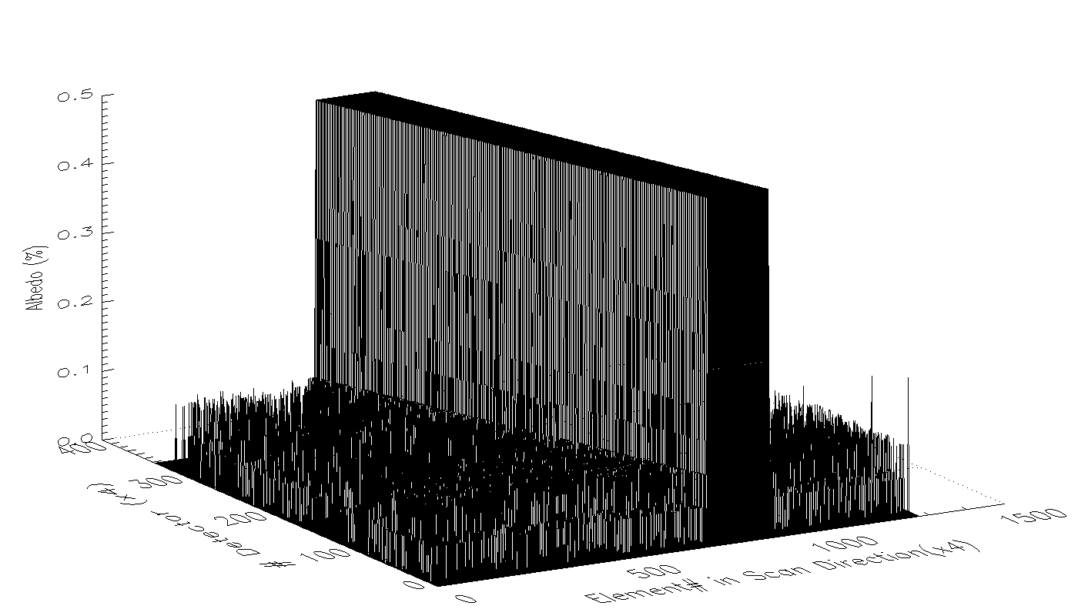
Lunar NSS Radiance in 3D Demonstration: B1-3
Band 1
Band 2
Band 3
The lunar NSS radiance is generated with an off-line soft package which currently does not fully function yet

Slide 9
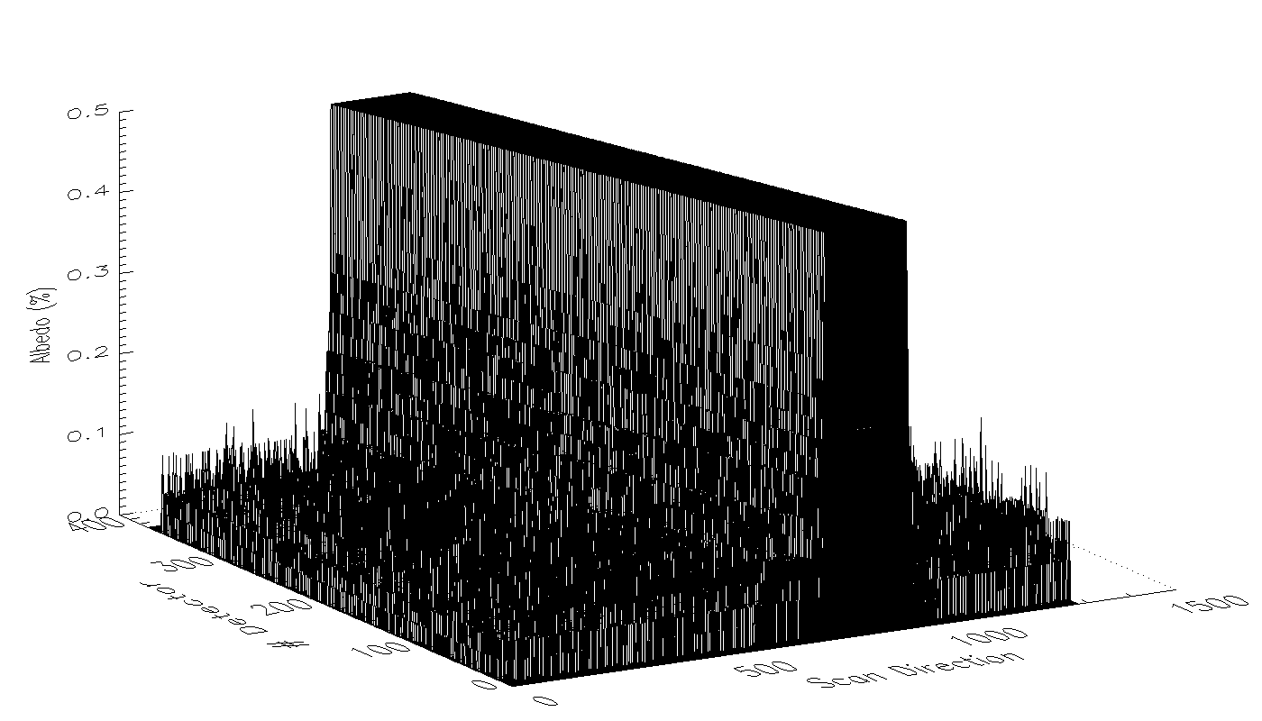
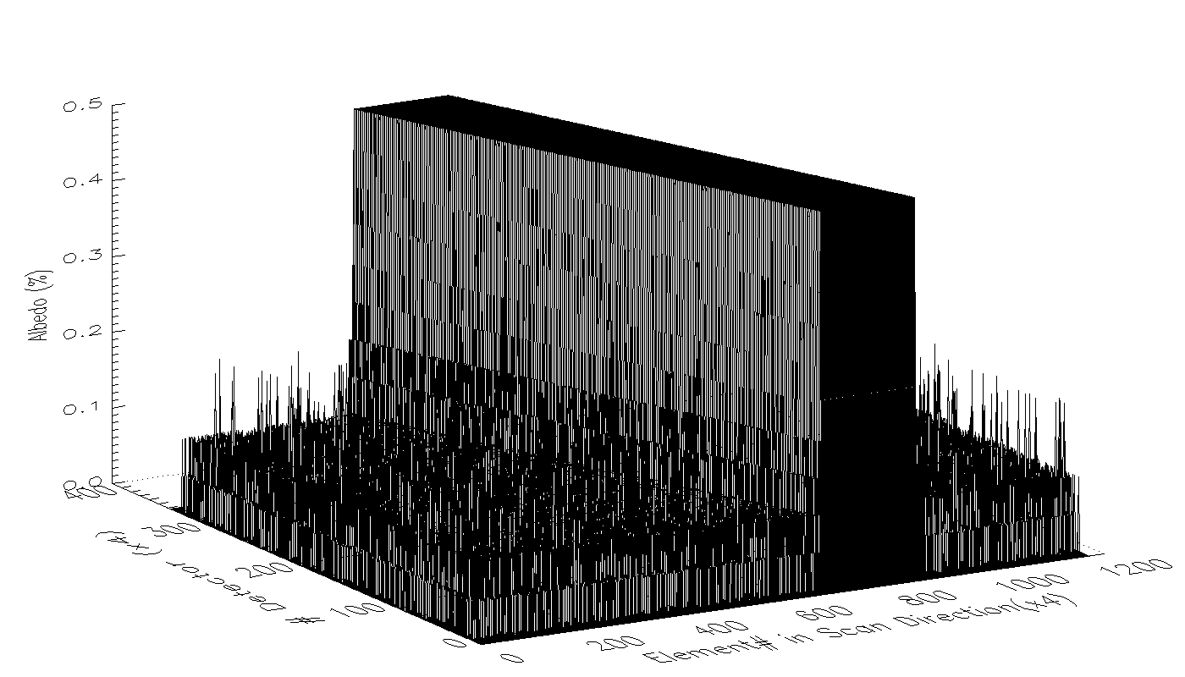
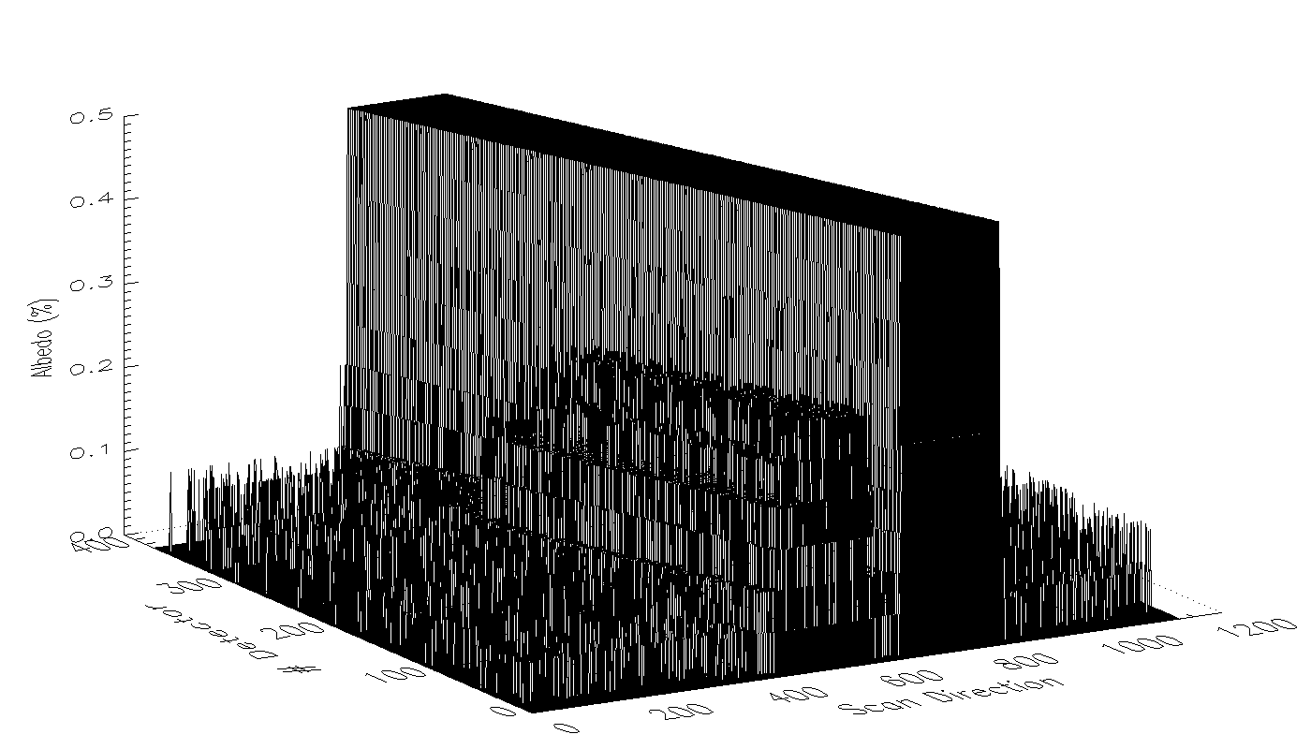
Lunar NSS Radiance in 3D Demonstration: B4-6
Band 4
Band 5
Band 6
O/E Xtalking?
On-going effect to identify the source
The lunar NSS radiance is generated with an off-line soft package which currently does not fully function yet

Slide 10
Discussion of the terms
OOF (Out Of Field) energy
= OFAR (Out of Field Anomalous Response)
Blooming – detector problem (esp. old CCD)
Optical/e-xtalking?
Ringing – usually detector issue. Possible (but unlikely) resample.
e-xtalking
Ghosting – internal reflection (optical)
optical xtalking (e.g. band-to-band xtalking)
Overshooting/Undershooting - probably another name of ringing.
E-xtalking
Xtalking
Optical xtalking
Electronic xtalking
Often out-of-band (OOB), in addition to OOF

Slide 11
Conclusions
The moon image is unique to detect and assess the out-of-field (OOF) energy
Source and target of the cross-talking energy
GOES-16 ABI lunar images do not show apparent out-of-field energy except at B06
Accurate calculation of lunar irradiance need to understand the source of OOF energy
More accurate assessment of xtalking will be examined with the ABI lunar NSS data
Detector-to-detector xtalking
Band-to-band xtalking

