Slide 1
GitHub for GSICS GDWG 2017.11.8.
Jin Woo, KMA
CMA, CNES, EUMETSAT, ISRO, IMD, JMA, KMA, NASA, NIST, NOAA, ROSHYDROMET, USGS, WMO

Slide 2
Contents
■ Operational Policy of GDWG GitHub
■ Status of GitHub Activities
■ Plotting tool Project
■ KMA’s GitLab for contributing plotting tool

Slide 3
Operational Policy of GitHub [Decisions made at 2017 GDWG meeting]
■ Goals
▷ Configuration management(codes, tools), issue tracking(GDWG action)
■ Who
▷ User(All developers(#) or Agency representatives in GDWG group)
▷ Administrator ⇒ KMA
■ What
▷ Operational code, s/w, tools, action items, etc.
▷ Copyright ?
■ Activation plan
▷ Collaboration project ⇒ Plotting tool

Slide 4
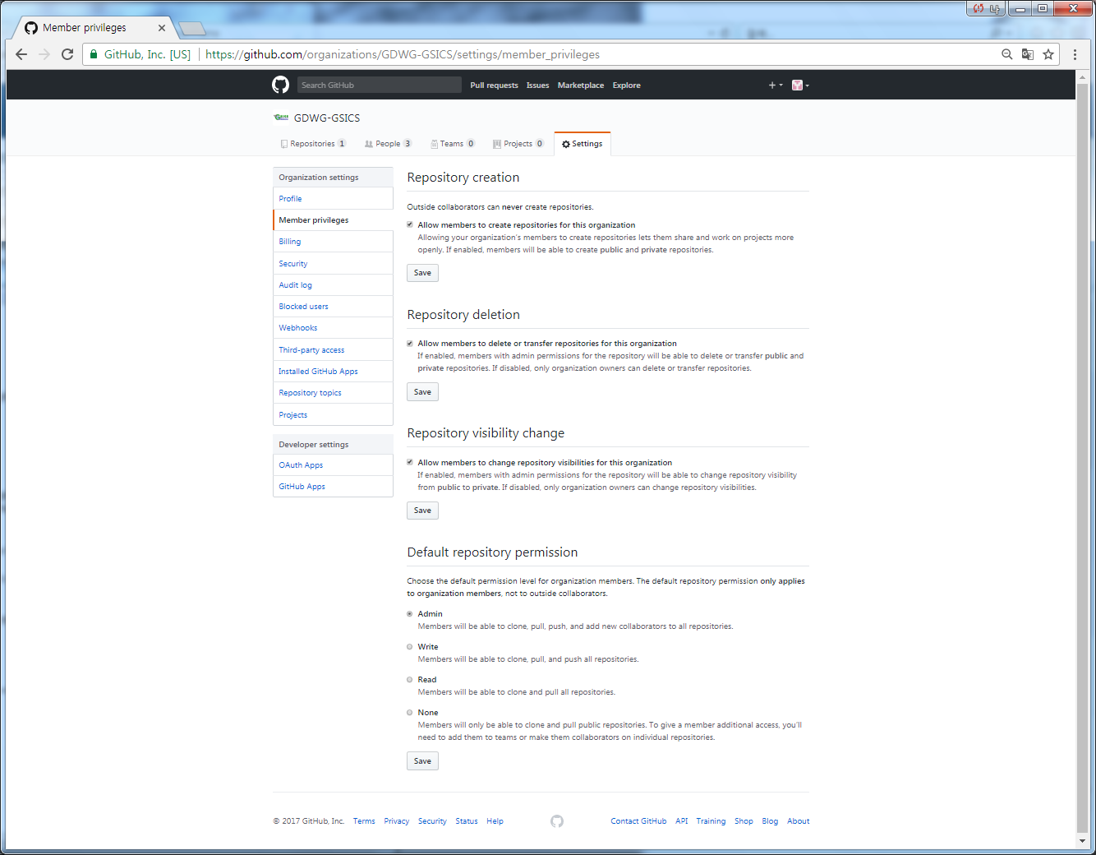
Operational Policy of GitHub [Decisions made at 2017 GDWG meeting]
Notes:
All of GDWG member Admin 권한

Slide 5
Status of GitHub Activities [History]
■ Group account registration in GitHub [April 27, 2017]
▷ https://github.com/GDWG-GSICS
■ Registration request to GDWG members [May 4, 2017]
■ Naming convention for account [May 30, 2017]
▷ Account name : "${personal name}-${Agency's name}“ (e.g. JWOO-KMA)
▷ Profile name : "${Agency's name}-GDWG" (e.g. KMA-GDWG)
■ Registration Plotting tool Project [June 8, 2017]
▷ By EUMETSAT(Pablo Benedicto)

Slide 6
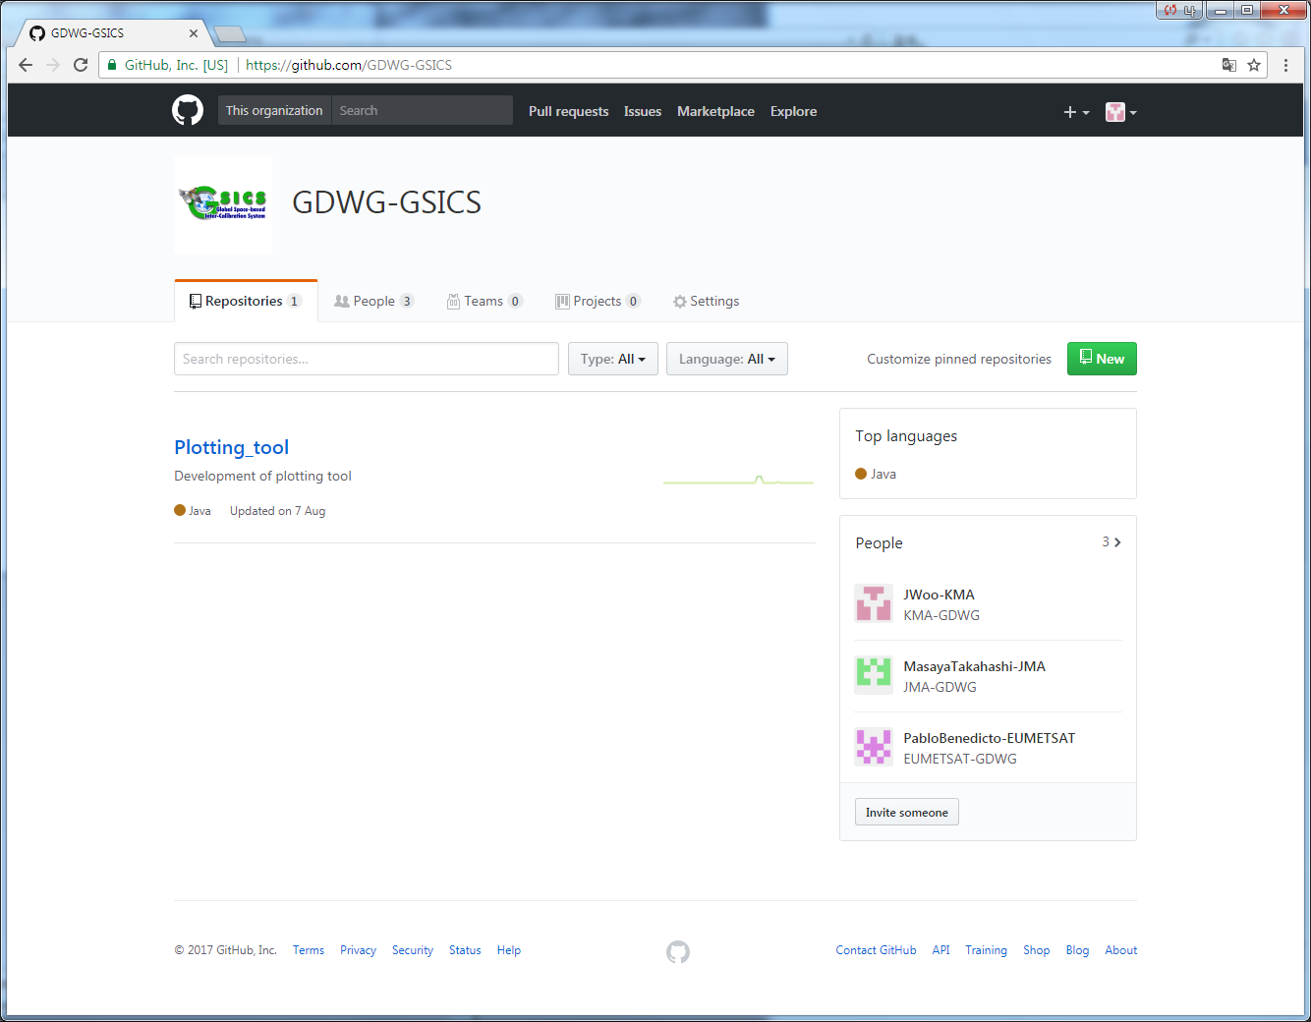
Status of GitHub Activities [Members]

Slide 7
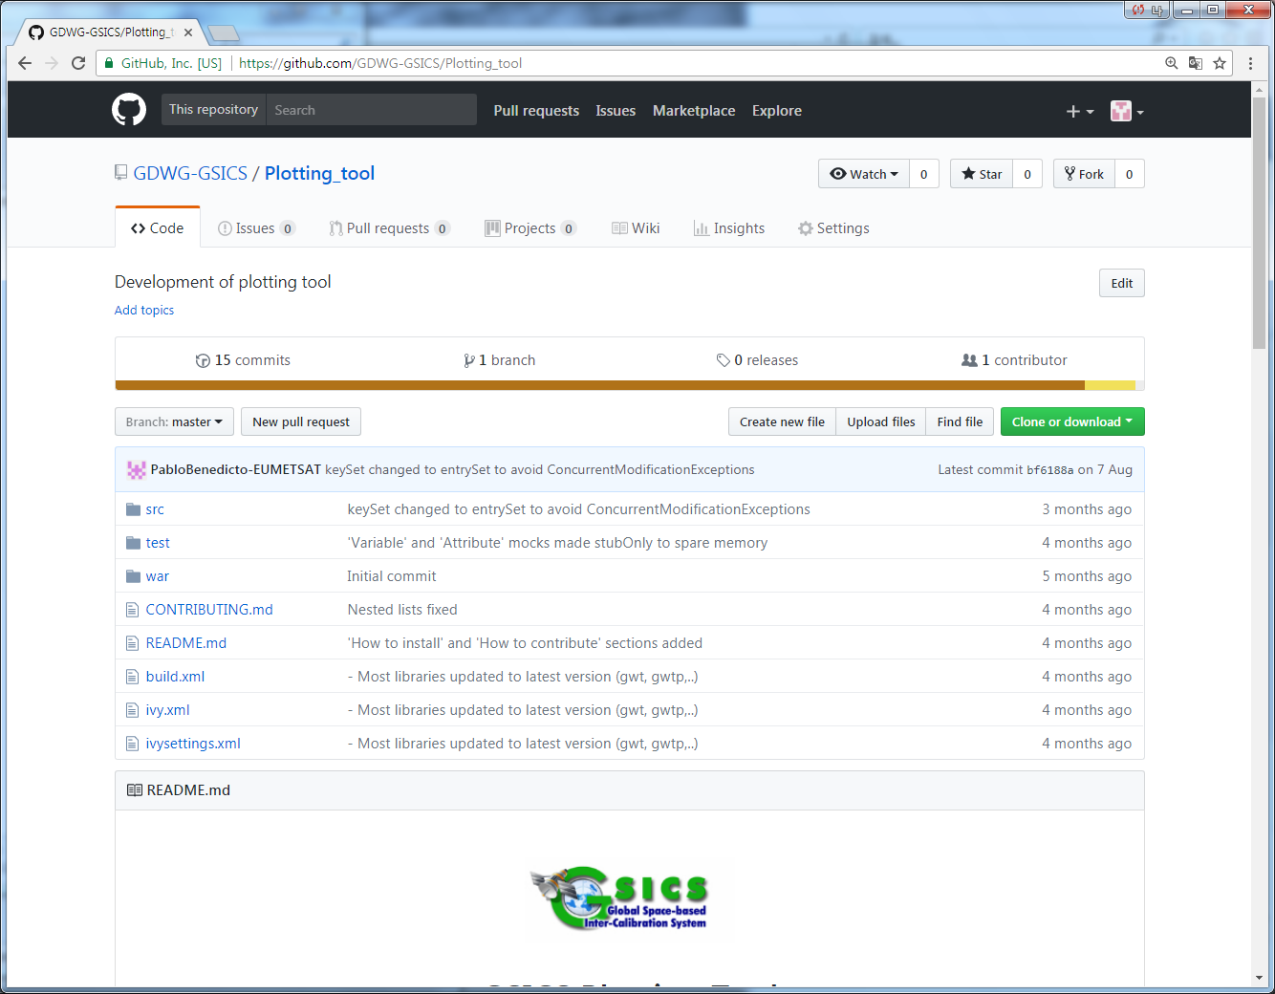
Plotting Tool Project [Repository]

Slide 8
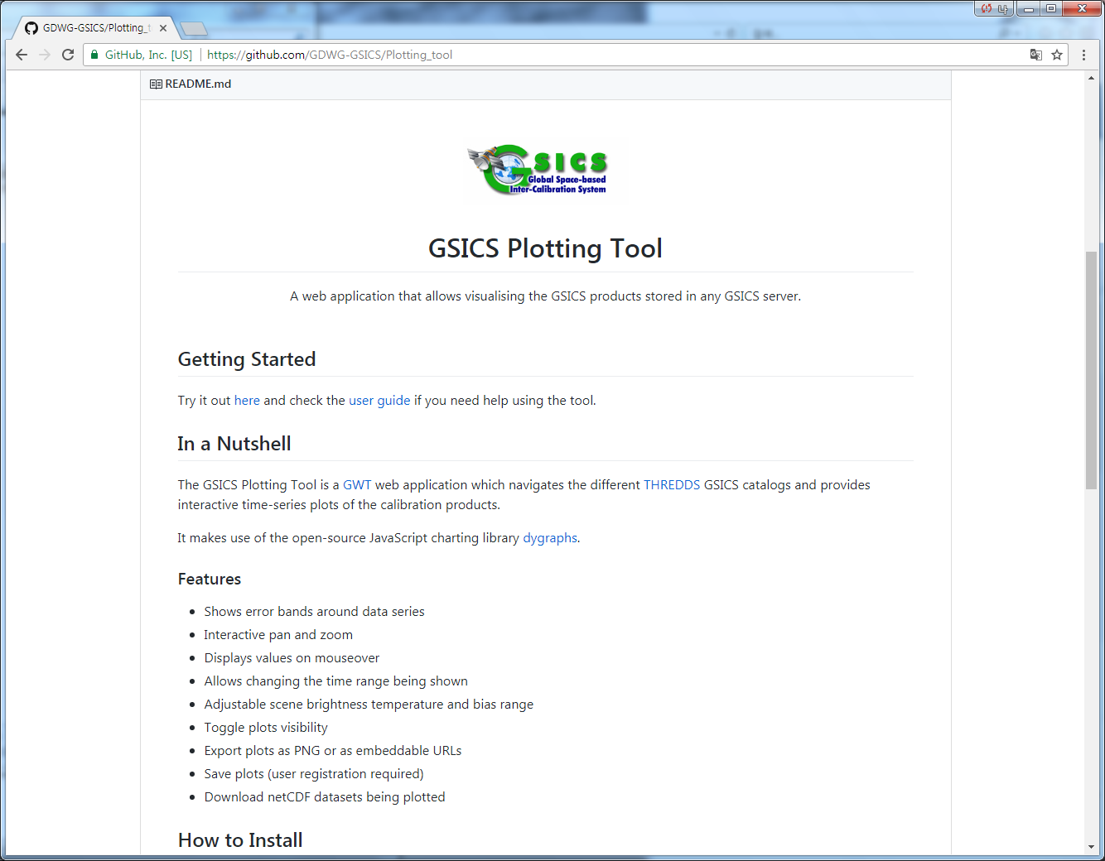
Plotting Tool Project [Readme]

Slide 9
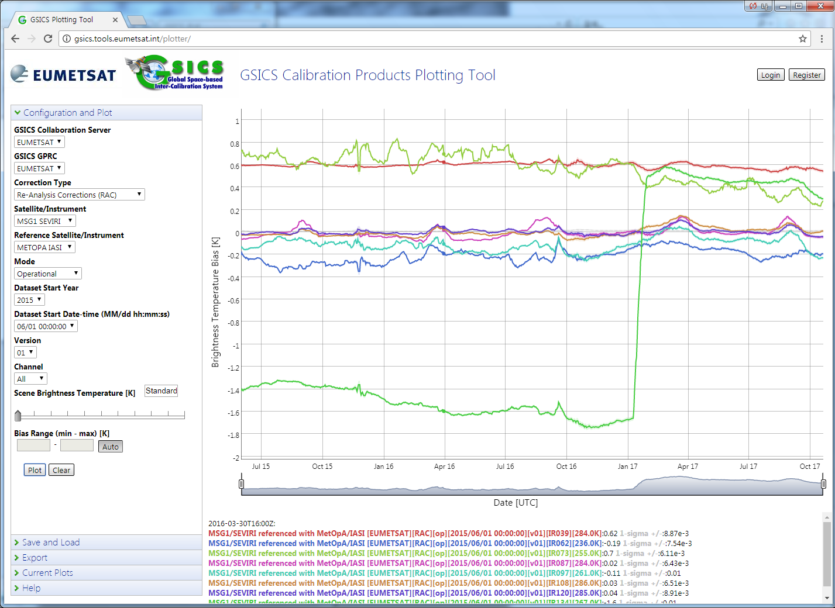
Plotting Tool Project [Try it out]

Slide 10
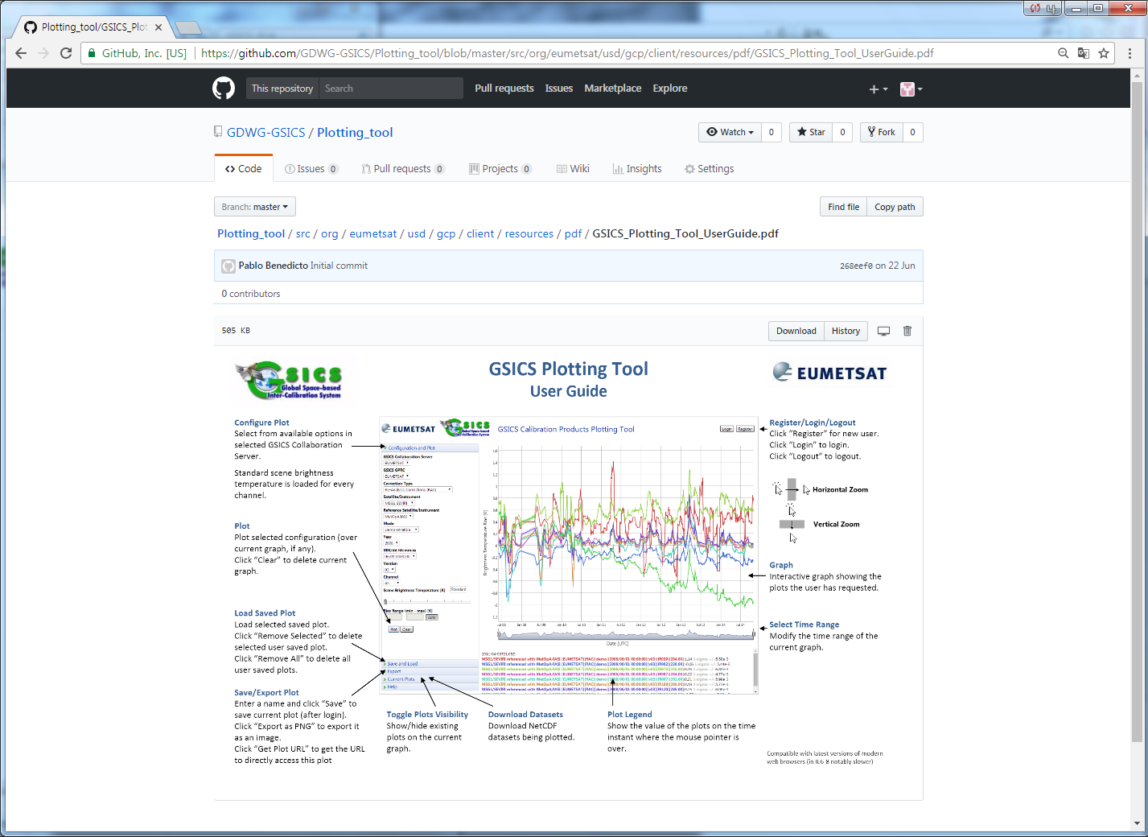
Plotting Tool Project [User Guide]

Slide 11
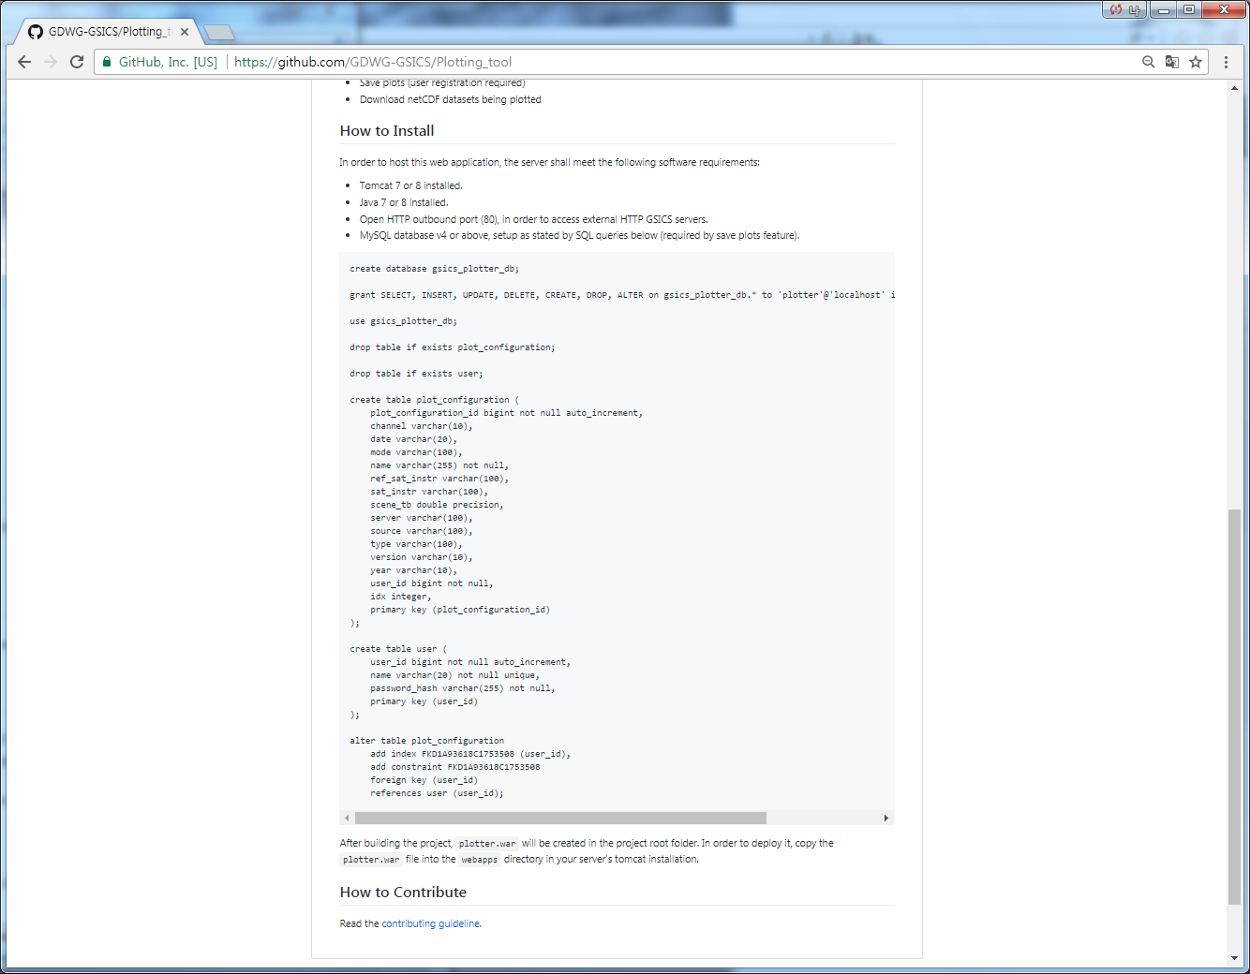
Plotting Tool Project [Readme]

Slide 12
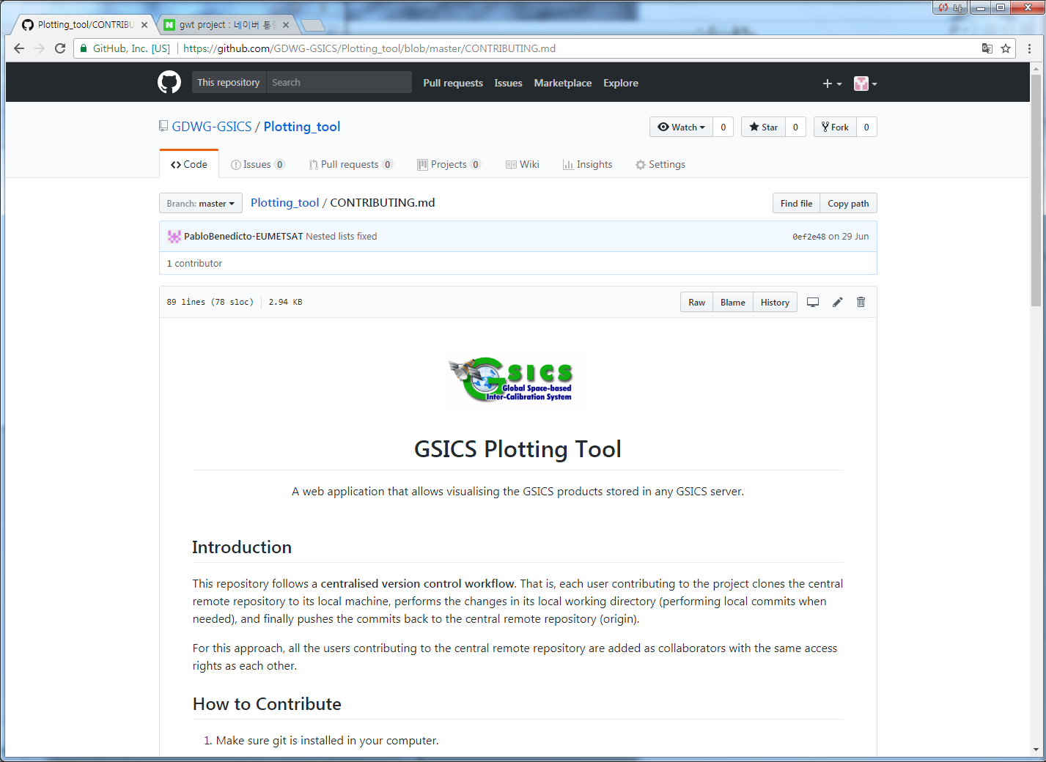
Plotting Tool Project [Contributing Guideline1]

Slide 13
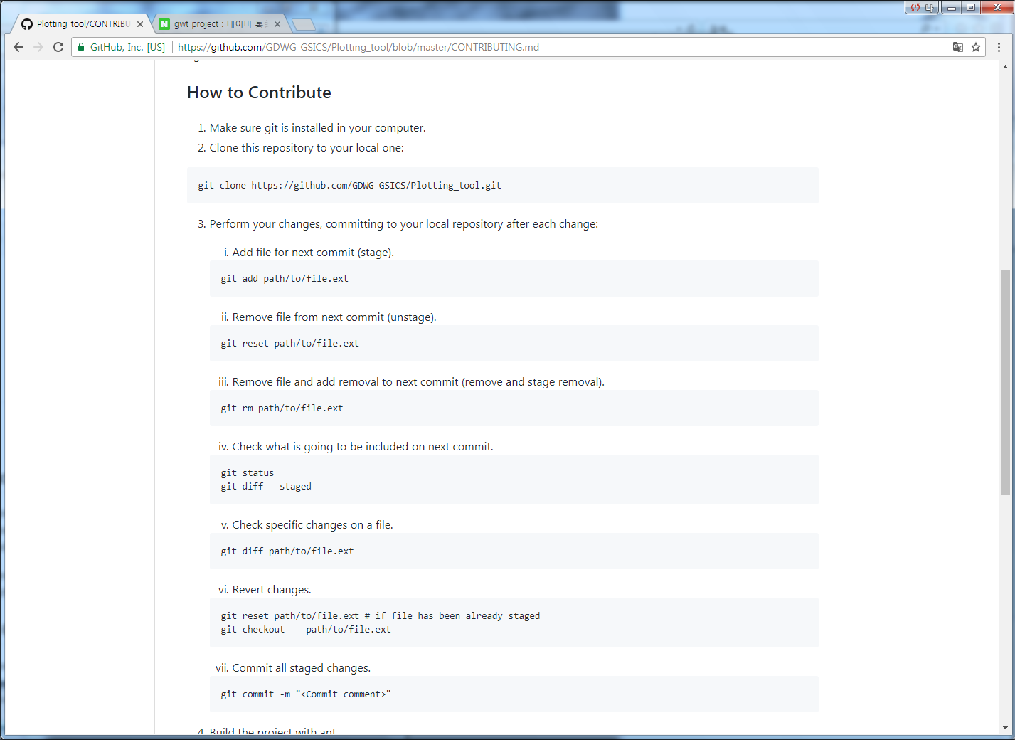
Plotting Tool Project [Contributing Guideline2]

Slide 14
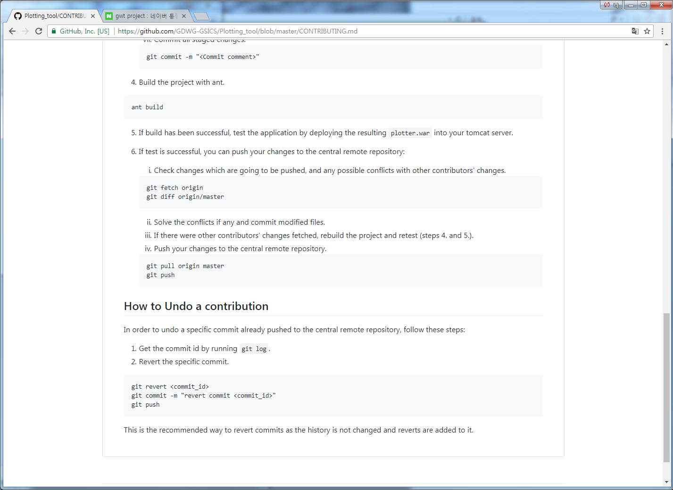
Plotting Tool Project [Contributing Guideline3]

Slide 15
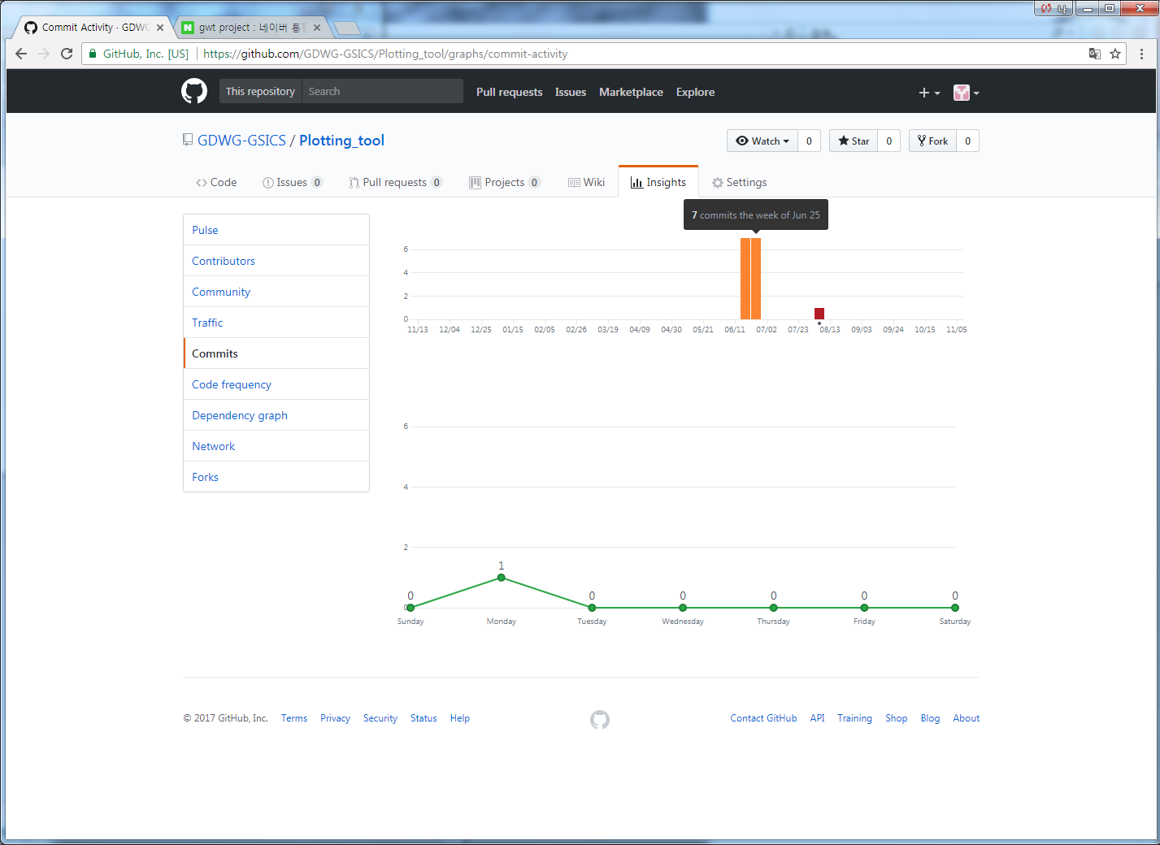
Plotting Tool Project [Statistics of Activity]

Slide 16
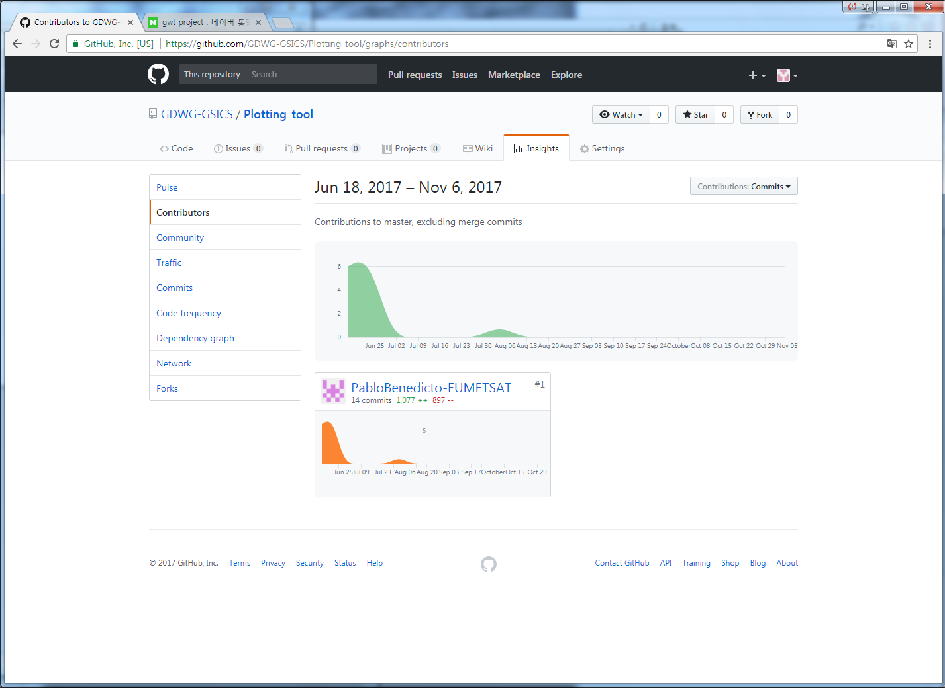
Plotting Tool Project [Statistics of Activity]

Slide 17
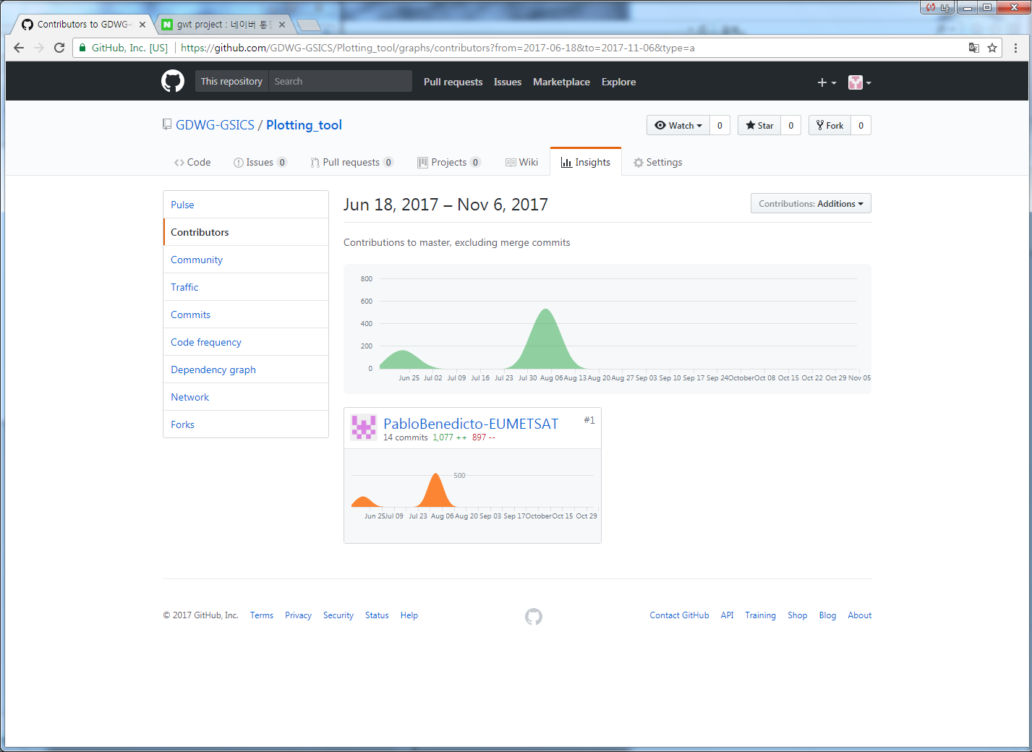
Plotting Tool Project [Statistics of Activity]

Slide 18
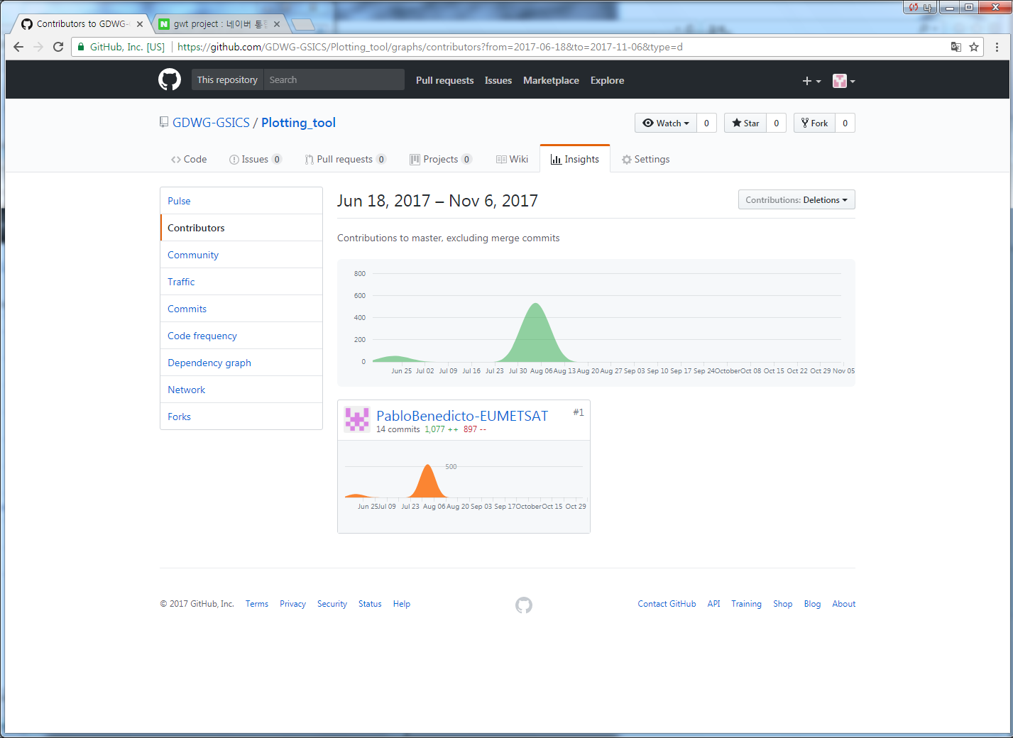
Plotting Tool Project [Statistics of Activity]

Slide 19
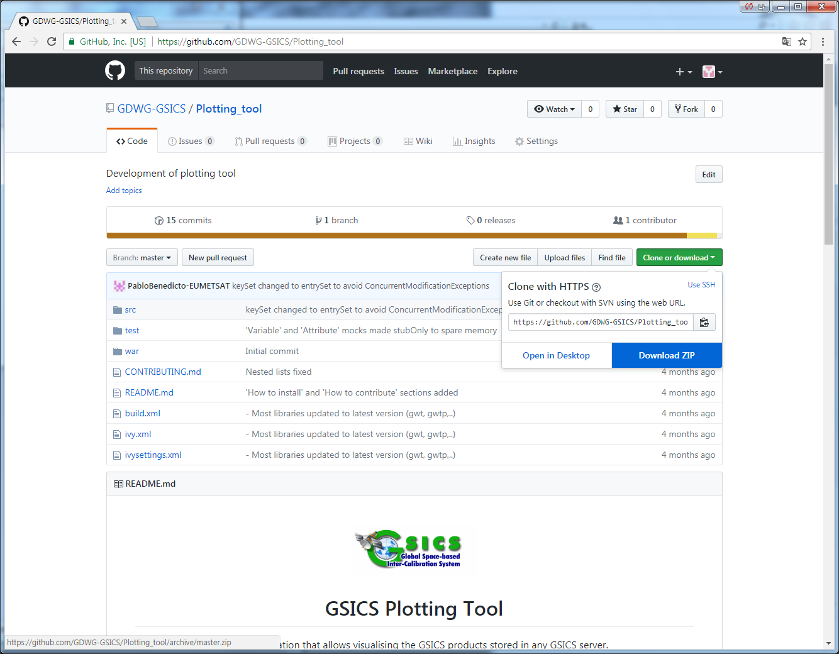
KMA’s GitLab for contributing plotting tool

Slide 20
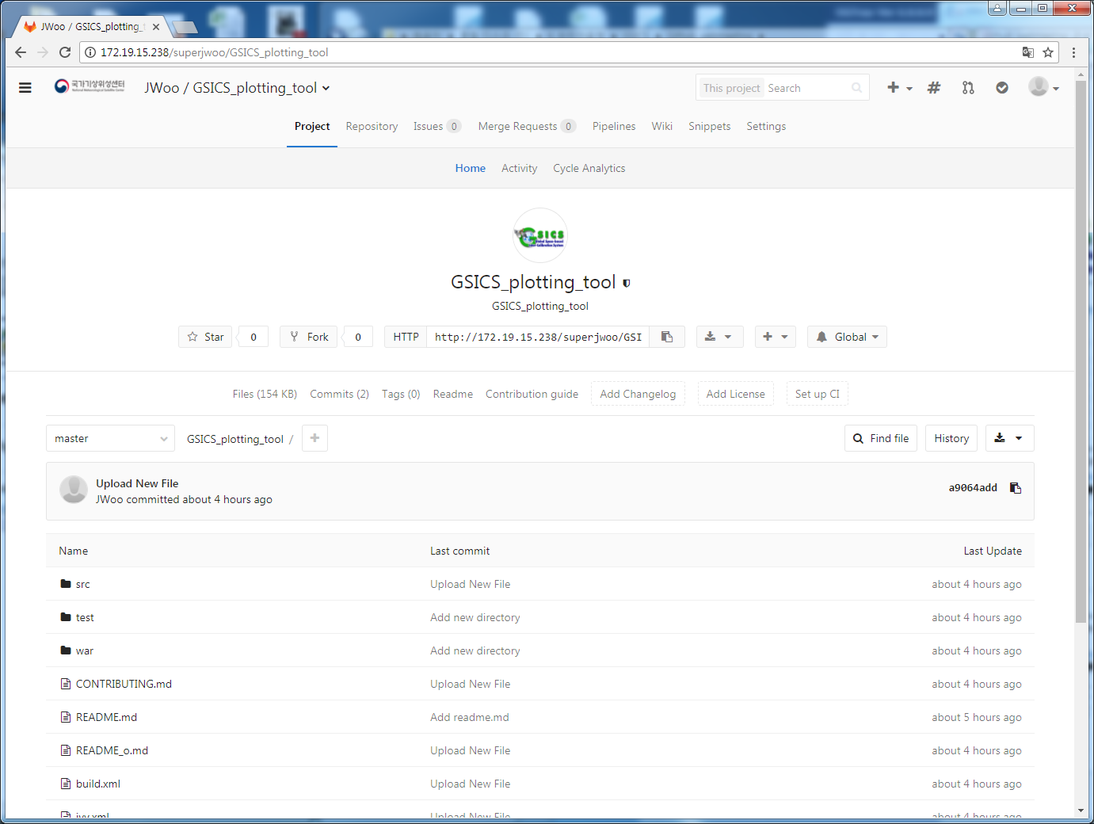
KMA’s GitLab for contributing plotting tool

Slide 21
KMA’s GitLab for contributing plotting tool
■ GSICS project registration in GitLab [November 7, 2017]
▷ http://xxx.xxx.15.238/superjwoo/GSICS_plotting_tool
■ Building Development Env. [~ing]
▷ Checking library dependency
▷ Notice to internal user(in November)

Slide 22
Thank You~

