Slide 1
Current Status of CMA GSICS Collaboration Server
XU Zhe
CMA GDWG

Slide 2
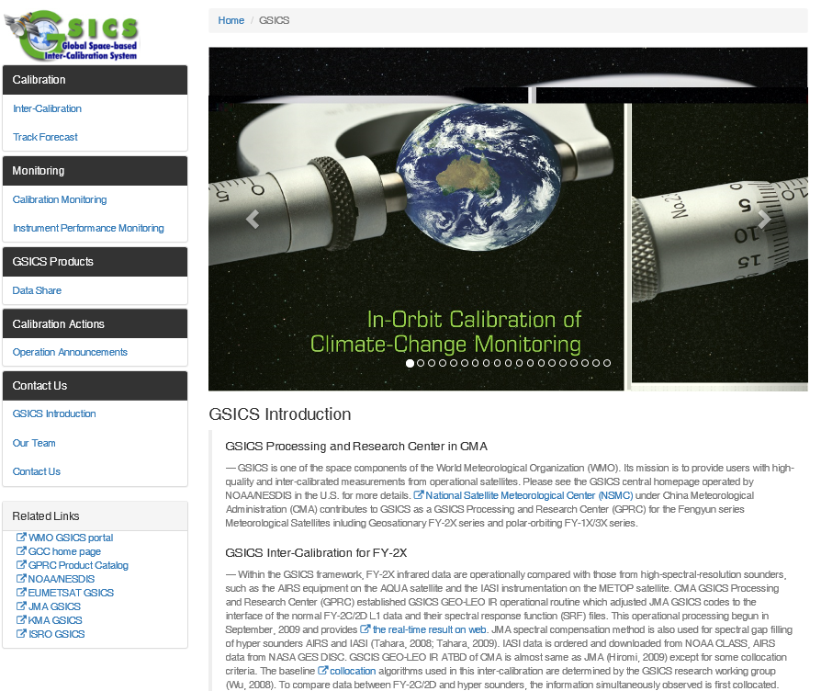
CMA GPRC Website Update
Reviewed by GDWG co-chairs, last annual meeting
Fix error links, new webpage online http://gsics.nsmc.org.cn
CMA GRWG: Content provider
CMA GDWG: Website construction and operation
Integrated into NSMC Web Portal, Servers operated by NSMC IT Dep.
Notes:
GSICS Processing and Research Centres (GPRC)

Slide 3
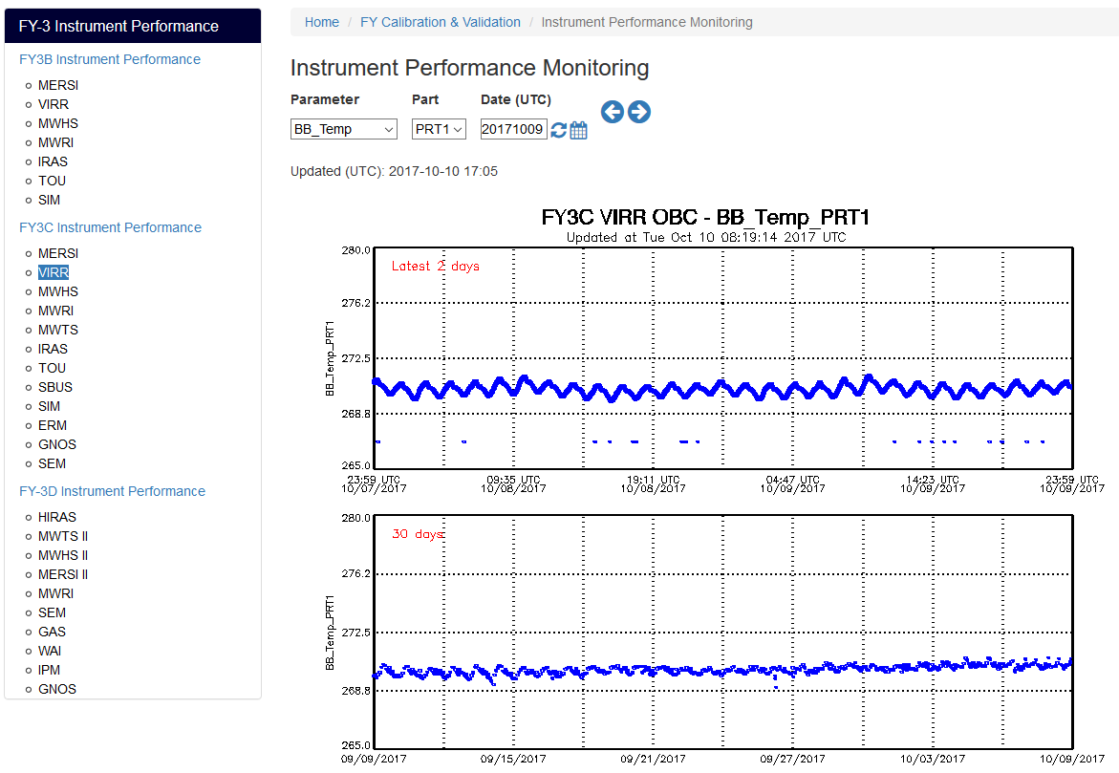
CMA GPRC Website Update
Instrument Performance Monitoring

Slide 4
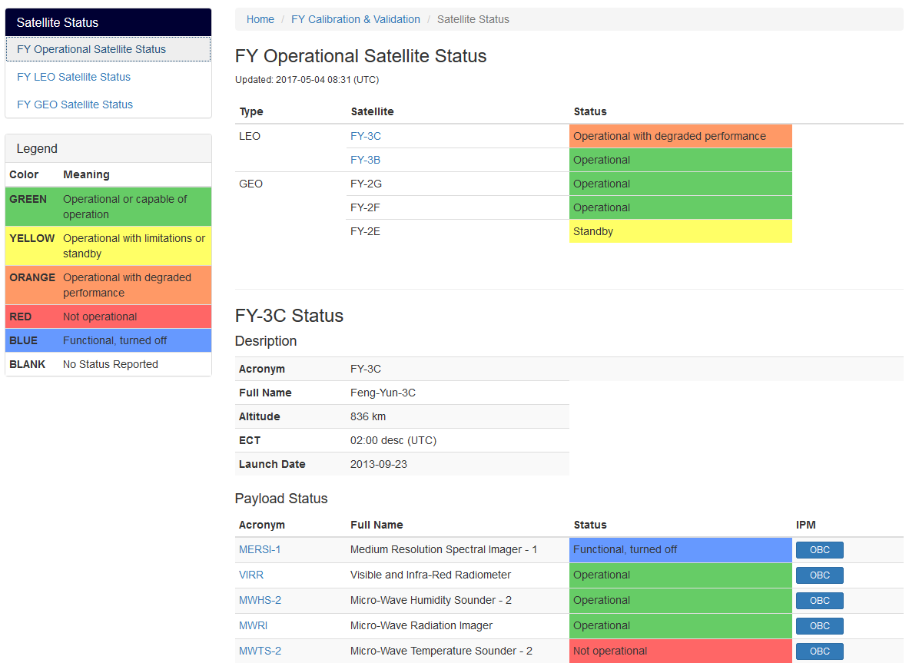
CMA GPRC Website Update
Instrument Status

Slide 5
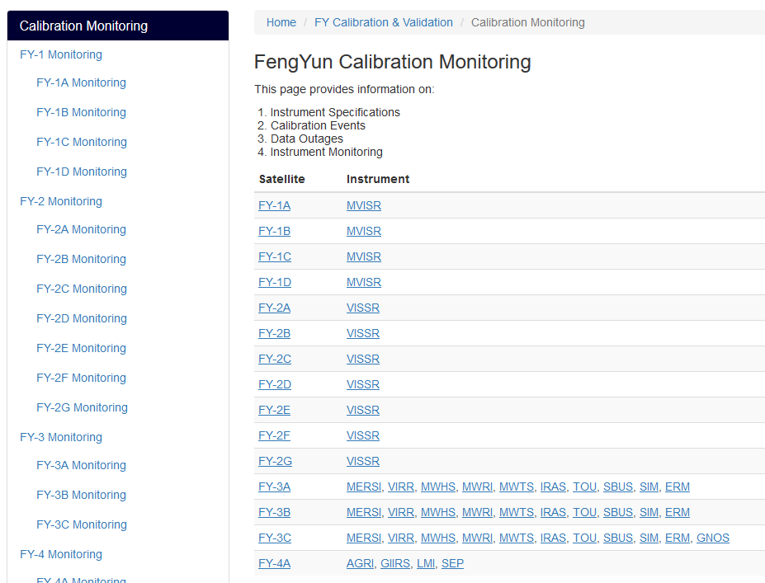
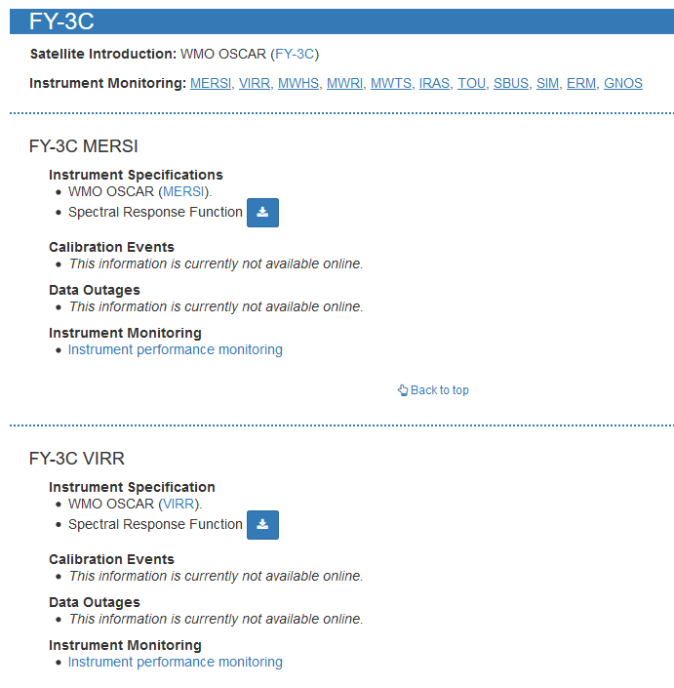
CMA GPRC Website Update
Landing Page (Li Yuan)

Slide 6
Server Synchronisation
Data flow: GET and PUT
GET：Data collecting server, download file from EUMETSAT Thredds
PUT：Tamper-resistant server, a back up for all static content on Web sever.
Scheduled routine job, 1/day
For backup, no timeliness requirement
Collecting server: Shell script and a configuration file
DMZ
Data Collecting
EUMETSAT Thredds
Tamper-resistant
CMA GPRC Server

Slide 7
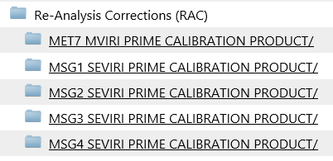
Server Synchronisation
“Operational”, but no monitoring
Notes:
GSICS Processing and Research Centres (GPRC)

Slide 8
Thank you for your attention
WMO GSICS Portal
http://gsics.wmo.int
GSICS Coordination Centre http://www.star.nesdis.noaa.gov/smcd/GCC/index.php
GSICS Product Catalog https://www.star.nesdis.noaa.gov/smcd/GCC/ProductCatalog.php
GSICS Wiki
http://gsics.atmos.umd.edu/wiki/Home

