Slide 1
The GSICS Actions Page Updates
Manik Bali, Lori Brown and Lawrence E. Flynn
Web Meeting 11/08/2017

Slide 2
Outline
Introduction
Requirements
Google Cloud Solution
How to Use Action Tracker
Demo of New Features Added to the Action Tracker
Summary and Discussion

Slide 3
Introduction
Each year actions are generated in GSICS community.
These actions were previously monitored on the GSICS Wiki Page
Over the years activity in GSICS has increased as has the number of Actions generated in GSICS Annual, EP, UW and group and subgroup meetings.
GRWG placed a request to GCC-NOAA-GDWG to provide an alternative to the wiki actions page. Features that were requested.
Fast search.
Easy Action writing.
Easy updating.
Easy to understand layout.
New Category of actions ( For example, Lunar, Recommendation, Decision)
Some level of automation.

Slide 4
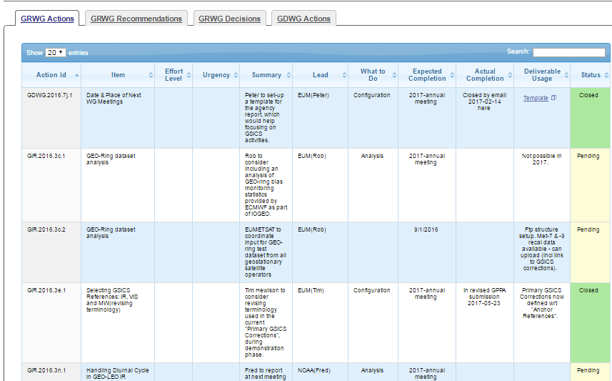
Approach - Google Cloud + Web
Actions are input into GOOGLE Sheet
API communicates with Sheet. Fetches a CSV format file
Start
Finish

Slide 5
How to Use the Action Tracker
GCC creates a google Sheet for each type of action being tracked. The Sheet link is shared among GSICS members.
The actions are grouped into pages by year, each different type viewable on a separate tab. The content of the tables on the tabs are sortable and searchable.
If users need to add hyperlinks to any action sheet, users should use the ‘Activate Hyperlink’ button to activate it on the GCC Action Tracker website.
When users’ changes are saved, they are dynamically updated onto the correct Action Tracker page.

Slide 6
Demo of New Features added to the Action Tracker
Summary of additions
Added new buttons. Each GSICS Meeting has a button
Added new Tabs on the Excel Sheet
Added the ability to import actions from Wiki Page and Webpages
Demo
https://docs.google.com/spreadsheets/d/11-U2XDE7J5cHYjksRsZ5WGFVXMyw_hgEz5XG1RG4BoY/edit#gid=1779096712

Slide 7
Conclusion
A new Google based Action Tracker has been setup at NOAA.
The action tracker utilizes key features of the google sheets ( versioning, projects)
Tracker is fast and efficient
New features have been added to the tracker that streamline generated actions.
Utilizes the new Action naming convention.
New categories of actions have been created ( such as lunar, EP, Recommendation, Decisions)

