Slide 1
Mirroring of GSICS Products
Manik Bali, NOAA

Slide 2
Introduction
Action: NOAA to investigate the mirroring of EUMETSAT products on the NOAA server

Slide 3
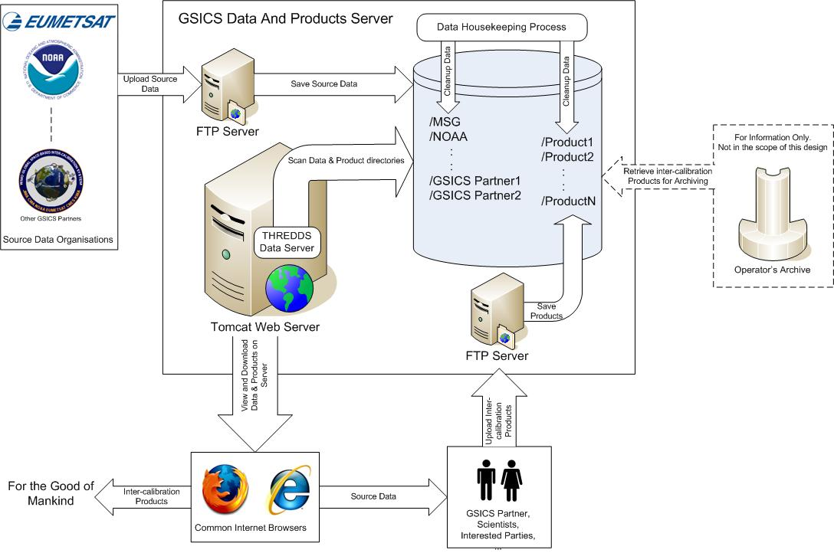
Collaboration Network

Slide 4
Collaboration Network

Slide 5
FTP Server
NOAA has a robust FTP Server.
Directory structure was created on a disk mounted on FTP Server.
GSICS Products are downloaded via wget onto this directory structure once each month.
Currently NOAA has approved enough disk area to copy entire time length of GSICS data files and update them monthly.
Access to mirror click here
NOAA is sorting out security issues. Most likely system would be up in January, 2018

Slide 6
THANK YOU

