Slide 1
Double differencing of IASI-A/B (+ AIRS and CrIS) against Himawari-8/AHI IR Channels
Masaya Takahashi
Meteorological Satellite Center,
Japan Meteorological Agency

Slide 2
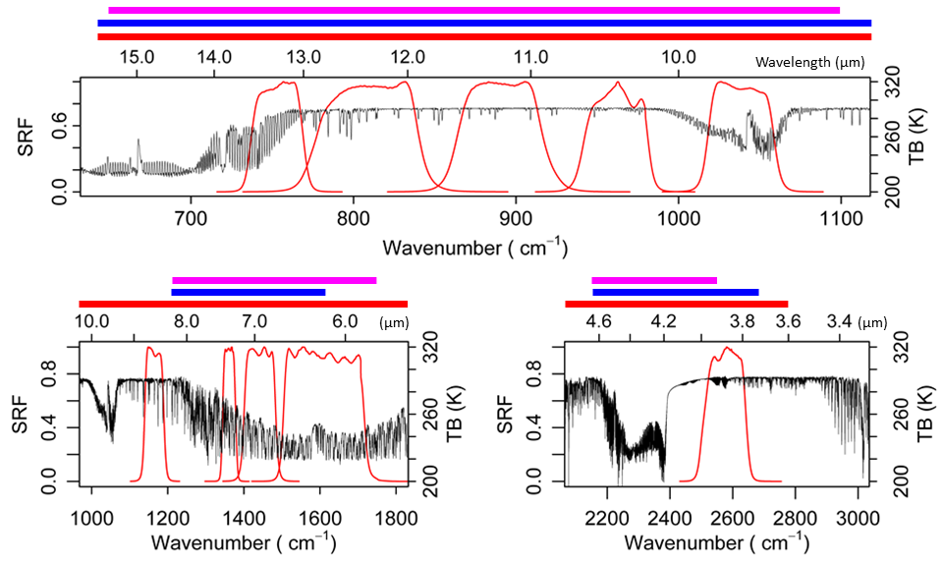
Spectral Coverage of Reference Instruments vs. Himawari-8/AHI IR Bands
IASI covers almost all the AHI spectra
CrIS/AIRS do not fully cover several AHI bands
CrIS
AIRS
IASI
#16 #15 #14 #13 #12
#10
#9 #8
#11
#7

Slide 3
Time Series of Double Difference (IASI-B – IASI-A) using Himawari-8/AHI GEO-LEO-IR
IASI-B – IASI-A [K]
IASI-B – IASI-A [K]
3.9 μm@286 K
6.2 μm@235 K
Consistent double difference result that was validated using SEVIRI GEO-LEO-IR
IASI-B – IASI-A [K]
IASI-B – IASI-A [K]
6.9 μm@244 K
7.3 μm@255 K
IASI-B – IASI-A [K]
IASI-B – IASI-A [K]
8.6 μm@284 K
9.6 μm@259 K
IASI-B – IASI-A [K]
IASI-B – IASI-A [K]
10.4 μm@286 K
11.2 μm@286 K
IASI-B – IASI-A [K]
IASI-B – IASI-A [K]
12.4 μm@284 K
13.3 μm@270 K

Slide 4
IASI-B – IASI-A for Himawari-8/AHI 13.3 μm Band
TB bias at standard scene
~0.1 K
Jump
IASI-B – IASI-A [K]
TB bias at various brightness temperatures
IASI-B – IASI-A [K]
~0.5 K Jump at cold scenes

Slide 5
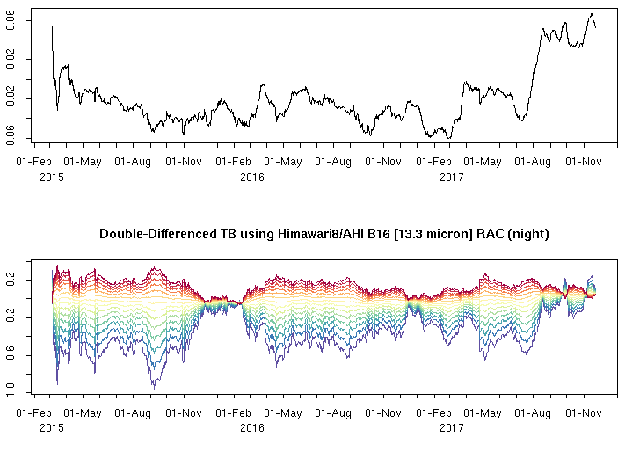
IASI-B – AIRS for Himawari-8/AHI 13.3 μm Band
~0.1 K
Jump
IASI-B – AIRS [K]
IASI-B – AIRS [K]
~0.5 K Jump at cold scenes

Slide 6
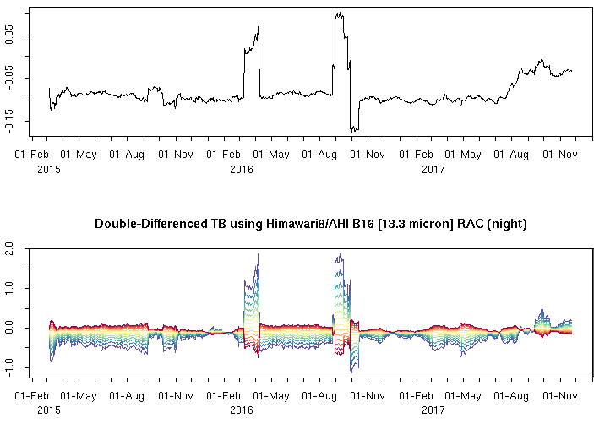
IASI-B – CrIS for Himawari-8/AHI 13.3 μm Band
IASI-B – CrIS [K]
Outliers are probably contained in the stats, need to be reprocessed
Systematic change of TB biases from negative to positive
IASI-B – CrIS [K]

Slide 7
IASI-B – IASI-A Stats – Inter-comparison between AHI and SEVIRI
Mean Difference dTb [K]
Color: Spectral Bands of AHI and SEVIRI
Himawari-8/AHI
(2015-07-01 – 2017-06-30)
Meteosat-10/SEVIRI
(2013-03-01 – 2017-03-01)
Uncertainty on Mean Difference u(dTb) [K], k=1
Himawari-8/AHI
(2015-07-01 – 2017-06-30)
Meteosat-10/SEVIRI
(2013-03-01 – 2017-03-01)

Slide 8
Summary
TB biases of GSICS reference instruments were validated based on double difference approach, using Himawari-8/AHI GEO-LEO-IR
IASI-B – IASI-A, IASI-B – AIRS, IASI-B – CrIS, …
Double differences detected IASI-B on-board processing change on 2017-08-02
Larger impacts on cold scenes (~0.5 K jump@200 K)
Himawari-8/AHI double difference statistics generally shows good agreement with that of Meteosat-10/SEVIRI

Slide 9
Thank You!

Slide 10
IASI-A – IASI-B for Himawari-8/AHI 6.2 μm Band

Slide 11
IASI-A – IASI-B for Himawari-8/AHI 6.9 μm Band

Slide 12
IASI-A – IASI-B for Himawari-8/AHI 7.3 μm Band

Slide 13
IASI-A – IASI-B for Himawari-8/AHI 8.6 μm Band

Slide 14
IASI-A – IASI-B for Himawari-8/AHI 9.6 μm Band

Slide 15
IASI-A – IASI-B for Himawari-8/AHI 10.4 μm Band

Slide 16
IASI-A – IASI-B for Himawari-8/AHI 11.2 μm Band

Slide 17
IASI-A – IASI-B for Himawari-8/AHI 12.4 μm Band

