Slide 1
Detections of Radiometric Calibration Update/Anomaly with ABI vs. CrIS/IASI IR Inter-Calibration
Fangfang Yu¹ and Xiangqian Wu²
1: ERT, Inc@NOAA/NESDIS/STAR
2: NOAA/NESDIS/Center for Satellite Application and Research (STAR)
GOES-16 is not declared operational. The ABI data are currently experimental and still undergoing testing.

Slide 2
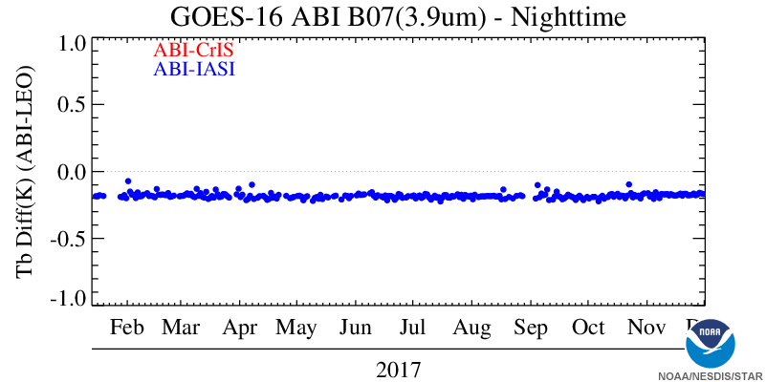
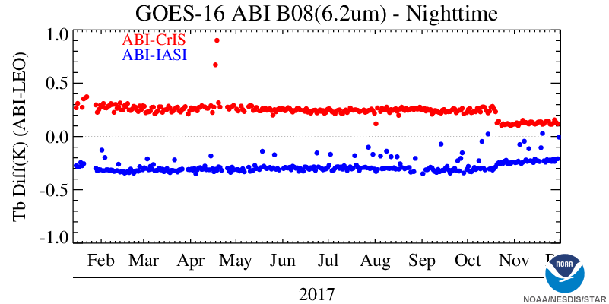
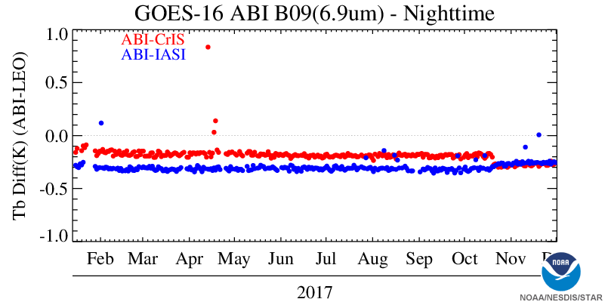
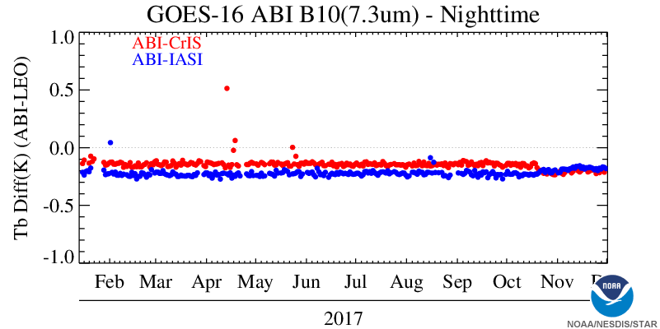
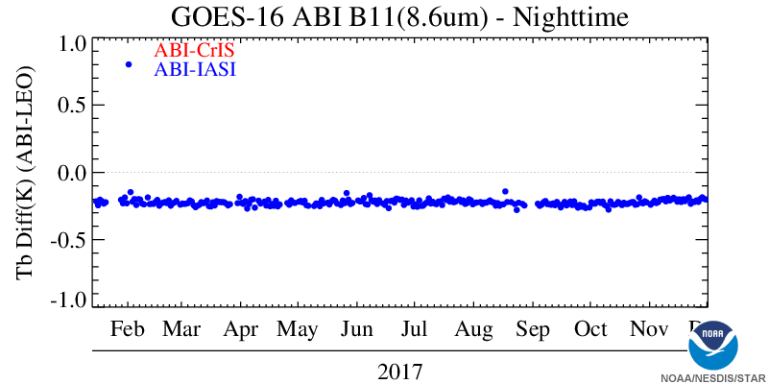
GEO-LEO Inter-Calibration for ABI MIR Bands
10/19/2017: updates of ABI Scan mirror Emissivity LUTs

Slide 3
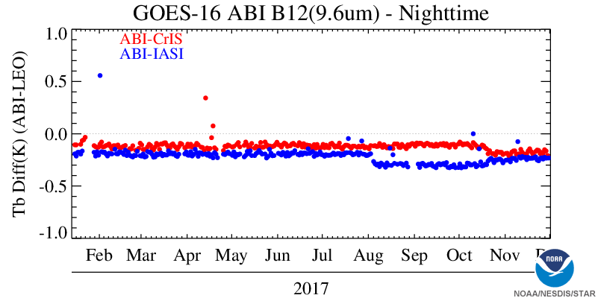
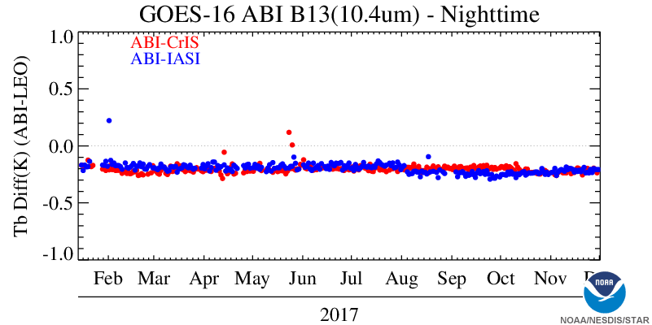
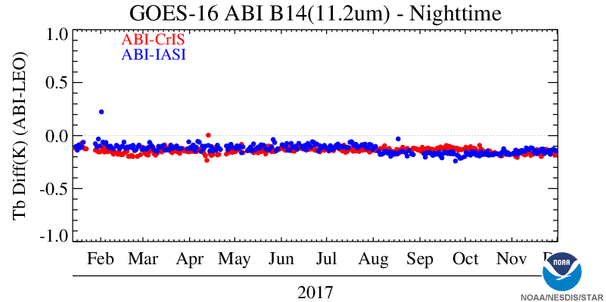
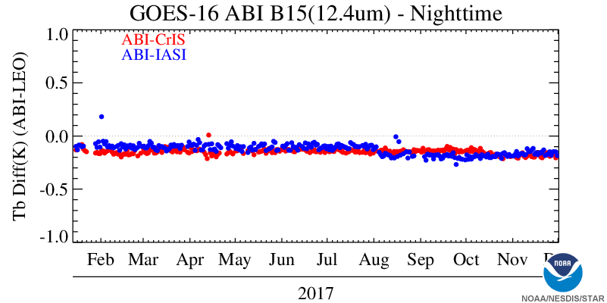
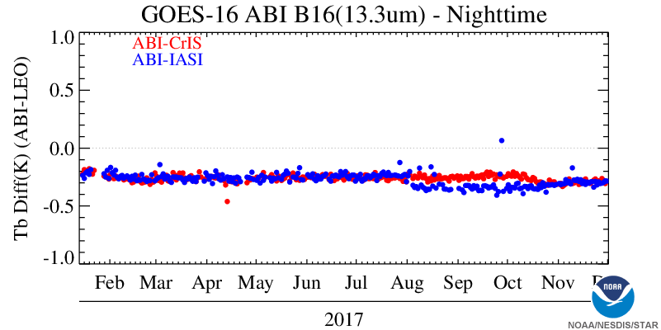
GEO-LEO Inter-Calibration for ABI LIR Bands
?
08/02/2017: Metop-B IASI non-linearity correction
10/19/2017: updates of ABI Scan mirror Emissivity LUTs

Slide 4
Summary
The update of Metop-B IASI ground processing can be detected at the ABI LWIR bands using the daily mean Tb bias
Both ABI and IASI are very stable
Magnitude of the Tb bias jump is channel dependent
The residual of ABI scan mirror spatial uniformity corrections amplify the impact
Observed from August 1 – Oct. 19, 2017
Update of the ABI scan mirror emissivity LUTs reduced the ABI Tb bias to CrIS and IASI, as expected
Need more study on B12 (9.6um) as Tb bias to CrIS and IASI is slightly larger than the other bands

