Slide 1
Preparation for GSICS 2018 Annual Meeting
CMA and SITP

Slide 2
Preparation items
Agenda drafting (CMA and SITP presentations)
Mini-conference presentations
Arrange Subgroup talks from CMA GPRC
Microwave breakout session (Advice from Ralph and Manik)
Participants List (Foreigner and Chinese)
Foreigner more than 22
Chinese about 25 to 28
Total 50 persons
Hotel room reservation and Meeting room
Package room rate including Buffee Launch (RMB 800~1000)
NSMC Webex account application (ongoing)
Excellent interface to Internet
Transportation Information
SITP Tour and Reception Banquet (Date/Time and Location)
Action and Recommendation review from 2017 meeting and EP
Action by CMA
Recommendation for CMA
Invitation speaker: Hank Revercomb for discussion about CLARREO-like worshop
CMA presentation will be inner reviewed in earlier March 2018
SITP hope to be GSICS member or observer (Peng Zhang nominate to EP)

Slide 3
Foreigner/Outside China Participants
no. | Family name | first & middle name | gender | nationality | arrival | days of stay | orgnazition
1 | Takahashi | Masaya | male | Japan | 2018/3/18 | 7 | JMA
2 | Yogo | Yusuke | male | Japan | 2018/3/18 | 7 | JMA
3 | FLYNN | LAWRENCE EDMUND | male | USA | 2018/3/17 | 12 | noaa
4 | Bali | Manik | male | Indian | 2018/3/17 | 9 | noaa
5 | Doelling | David Robert | male | USA | 2018/3/18 | 7 | NASA
6 | Scarino | Benjamin Raymond | male | USA | 2018/3/18 | 7 | NASA
7 | Ferraro JR | Ralph Rocco | male | USA | 2018/3/18 | 7 | noaa
8 | WOO | JIN | female | KOR | 2018/3/18 | 7 | KMA
9 | Ahn | Myoung Hwan | male | KOR | 2018/3/18 | 7 | Ewha Womans University
10 | Kang | Mina | female | KOR | 2018/3/18 | 7 | Ewha Womans University
11 | GU | MINJU | female | KOR | 2018/3/18 | 7 | nmsc/kma
12 | AHN | Kibeom | male | KOR | 2018/3/18 | 7 | KIOST
13 | Hewison | Timothy James | male | UK/Germany | 2018/3/17 | 8 | EUMESAT
14 | WAGNER | Sébastien | male | French | 2018/3/17 | 8 | EUMESAT
15 | MIU | PETER THOMAS | male | UK | 2018/3/17 | 8 | EUMESAT
16 | Coppens | Dorothée Marie Suzanne | female | French | 2018/3/18 | 6 | EUMESAT
17 | Goryl | Philippe | male | French | 2018/3/18 | 7 | ESA
18 | Xiong | Xiaoxiong | Male | USA |  |  | NASA
19 | Kim | Dohyeong | Male | Korea |  |  | KMA
20 | Stone | Tome | Male | USA |  |  | USGS
21 | Zou | Xiaolei | Female | USA |  |  | UMD
22 | Lin | Lin | Female | China |  |  | NOAA/UMD
23 | Sun | Ninghai | Male | USA |  |  | NOAA/ERT
 | TBD
23 | Revercomb | Hank | Male | USA |  |  | UWS
24 | Wang | Likun | Male | USA |  |  | UMD
25 | Xu | Hui | Male | China |  |  | UMD

Slide 4
Chinese Participants
CMA has more than 15 persons
SITP has about 10 persons
NSCC has 3~4 persons
Others 2~3 persons

Slide 5
Presentation title update from China
Mini Conference
Peng Zhang/CMA：Latest progress of CMA FY-3D and FY-4 satellite
Lei Din/SITP：Development of SI-traceable Hyperspectral FTIR instrument
Zhiqing Zhang/CMA：FY-4A calibration and validation (update)
Xiuqing Hu/CMA：Post-launch test progress of FY-3D (update)
Cao Changyong/Lin lin/NOAA: NOAA-20 Imager/Sounder SDR Maturity and Collaboration with FY3D through GSICS
Feng Jiang/SITP：Solar band SI-traceable demonstration instrument
Yanmeng Bi/Zhongdong Yang/CMA：Tansat/ACGS inflight calibration and validation
Dekui Yin/Yipeng Zhang/SITP: TG-2 Multi-Angle Polarization Imager Calibration and evaluation
Plenary and Subgroup session
Xiuqing Hu/CMA： CMA GPRC Annual report
IR subgroup:
Chengli Qi/CMA：HIRAS calibration algorithm and uncertainty buget
Hanlie Xu/CMA： Hyperspectral instrument evaluation for FY-4A/GIIRS and FY-3D/HIRAS；
Na Xu/CMA： Inflight SRF retrieval based on hyperspectral reference instrument
Chunqiang Wu/CMA：Non-linear calibration of HIRAS
VIS-NIR subgroup:
Ronghua Wu/CMA：Tansat/CAPI calibration and evaluation
Ling Wang/CMA：Consistent calibration of VIRRs onboard on FY-3A to 3C
Hanlie Xu/CMA：Interband calibration development using Sunglint
Na Xu/CMA：FY-3D/MERSI-II calibration/validation
Ling Wang/CMA: Calibration monitoring based on Tibet glaciers
Yuan Li/CMA: New BRDF Model in Dunhuang field campaign for Vicarious calibration/validation

Slide 6
Presentation from China (Continued)
Lunar subgroup:
Ronghua Wu/CMA：Interband calibration for atmosphere absorption bands based on Lunar observation
Yang Wang/CMA：Lunar model validation using ground-based hyperspectral measurement
Lu Zhang/CMA：Lunar Simultaneous observation intercomparison from FY-3D and ground-based
UV subgroup:
Houmao Wang/NSSC: FY-3/TOU intercalibration with GOME-2 and OMPS for solar diffuser correction (The inter-comparison of radiance between TOU, OMPS and GOME-2 (MetopA/B) for TOU diffuse board data correction)
Weihe wang/CMA: In-orbit calibration for FY-3C/TOU
Microwave subgroup:
Shenli Wu/CMA: Development of FY-3/MWRI Calibration on warm/cold targets and reflector emissivity
Yang Guo/CMA: Calibration and Validation of Microwave Humidity Sounder onboard FY-3D Satellite
Xiaolei/UMD: Mutual Validations of Observations between lifetime S-NPP ATMS and GPS ROs from COSMIC, MetOp and KOMPSAT
Xiaolong Dong/NSSC: ???
…….

Slide 7
Microwave Breakout Session
Manik email: Ralph Ferraro, Chair of MW subgroup is planning told a special breakout session on microwave calibration in the GSICS Annual Meeting. Since we are in Shanghai this time, this breakout session can be an excellent platform to showcase the immense thrust in the Microwave Space program in China and the lead it can provide to the GSICS community.
Response from Peng Zhang: It is great. It is very important for MW activity within GSICS. I forward your email to Scott, you can discuss details with him.
Current Status: we are coordinate with NSCC for more presentations about Chinese other Microwave sensor plan as well as Fengyun sensors.

Slide 8
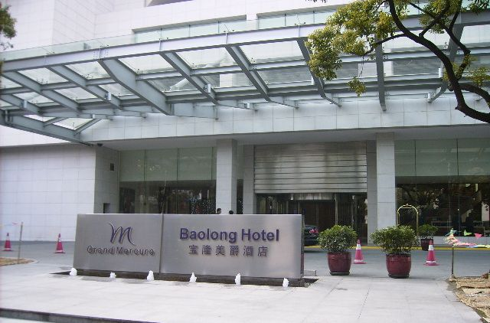
Hotel and Information
Baolong Hotel:
180 Yixian Road Shanghai 200434, P. R. China
Tel: +86 (21) 3505 9666
E-mail: info@baolonghotel.com
Website: www.baolonghotel.com
Room Rate
Package price (about RMB ¥800--1000)including breakfast and launch
All participant rooms are reserved by us
Don’t need your reservation with credit card by yourself
Participants name list will provided to Hotel in advance
Remaining enough rooms for temporary participants or family members as the same package price

Slide 9
Transportation
Best Transportation way: Taxi and Metro
Nearest Dabaishu station (0.8 Km to hotel) of No.3 Metro line (Yellow line)
Hongqiao airport (or Train station) to hotel (27Km) : No.2 transfer to No.3 at Zhongshan Park station
Pudong international airport to hotel (48Km): No.2 east extending line to No. 3 at Zhongshan Park station
Taxi: The starting fee is: 16 yuan /3 km; Unit price: 2.5yuan/km; The extra distance is 15 kilometers, and the low speed is the unit price of 4 minutes per kilometer. The price rises 30% at night.

Slide 10
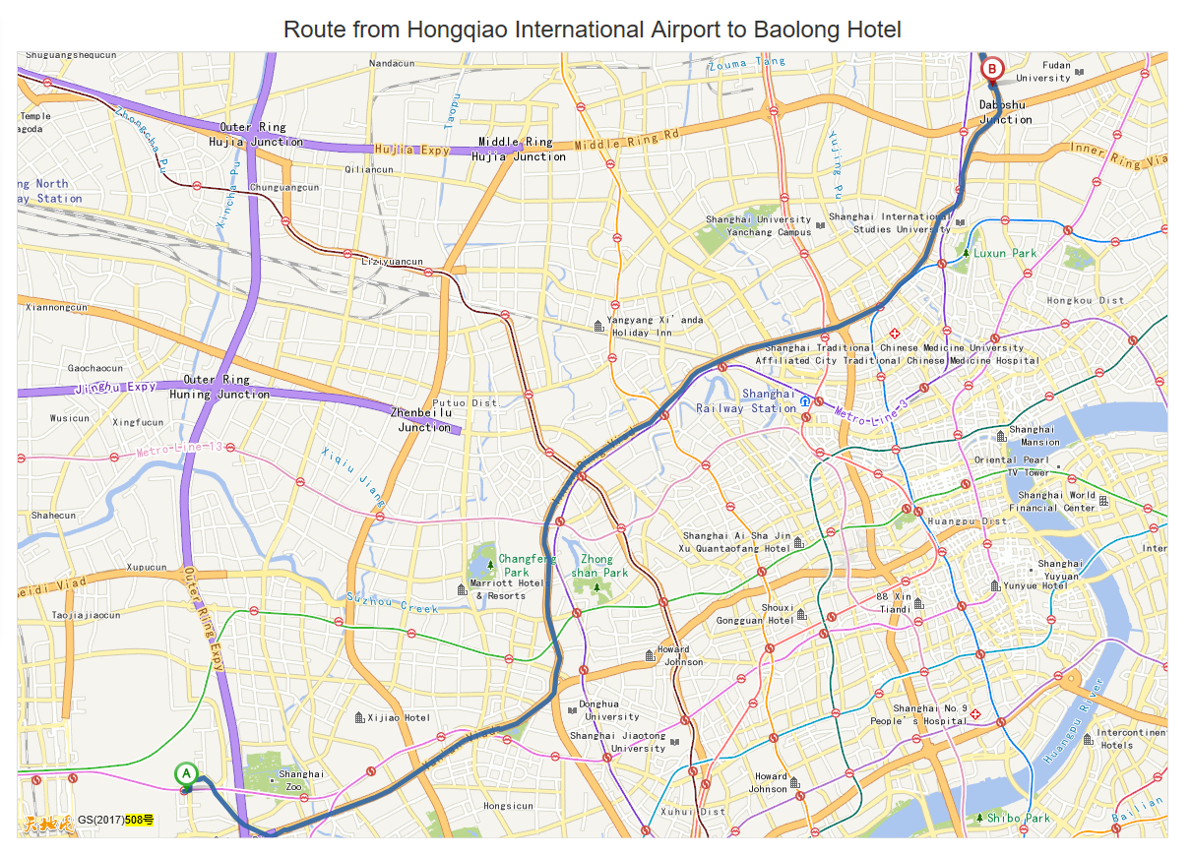

Slide 11
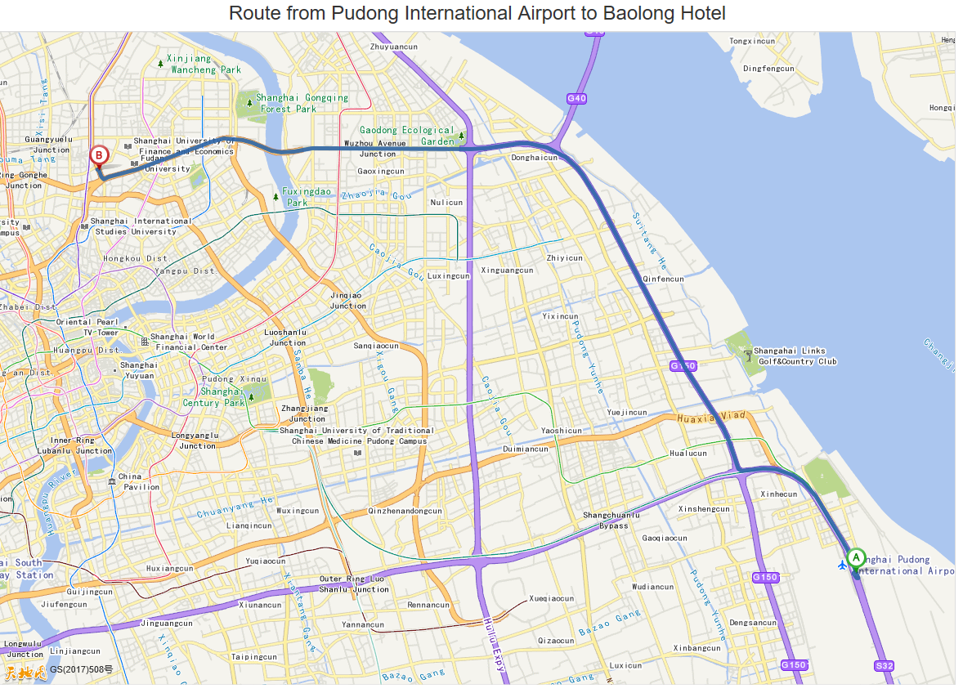

Slide 12
Tourist in Shanghai
Shanghai CBD and Waitan
Yuyuan
Chinese Typical Traditional town around Shanghai

Slide 13
Thanks

