Slide 1
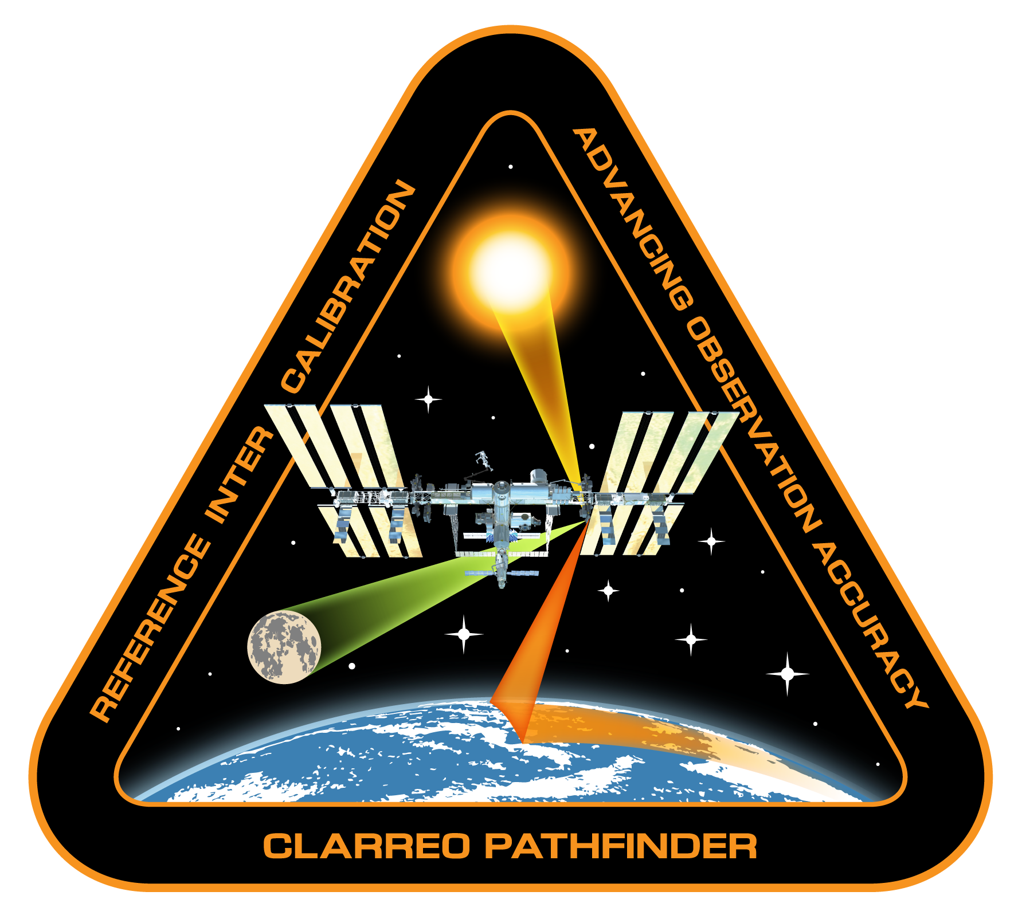
CLARREO Pathfinder Inter-calibration:
Requirements and Objectives
CLARREO Pathfinder Inter-Calibration Team
Presented by Tom Stone, USGS

Slide 2
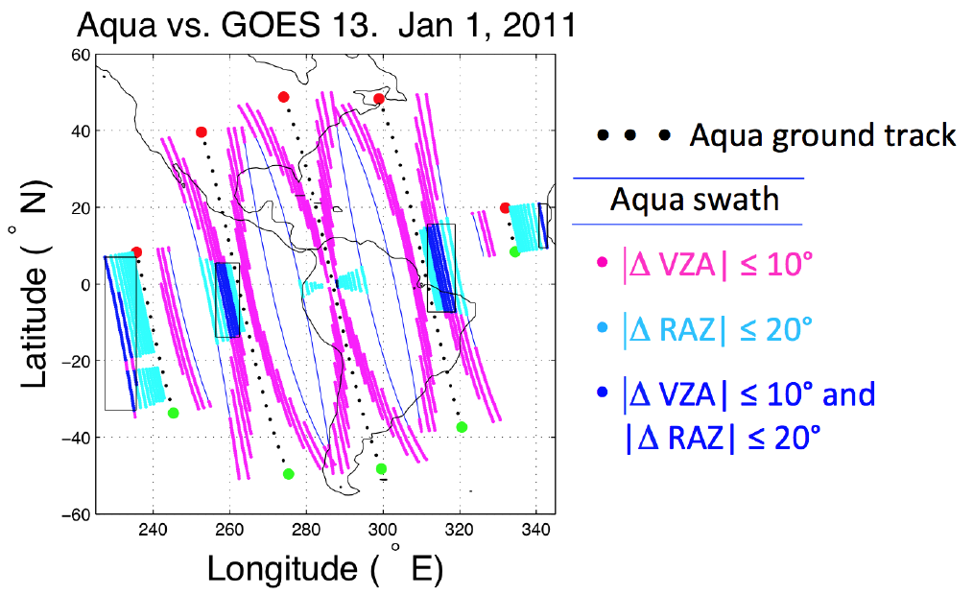
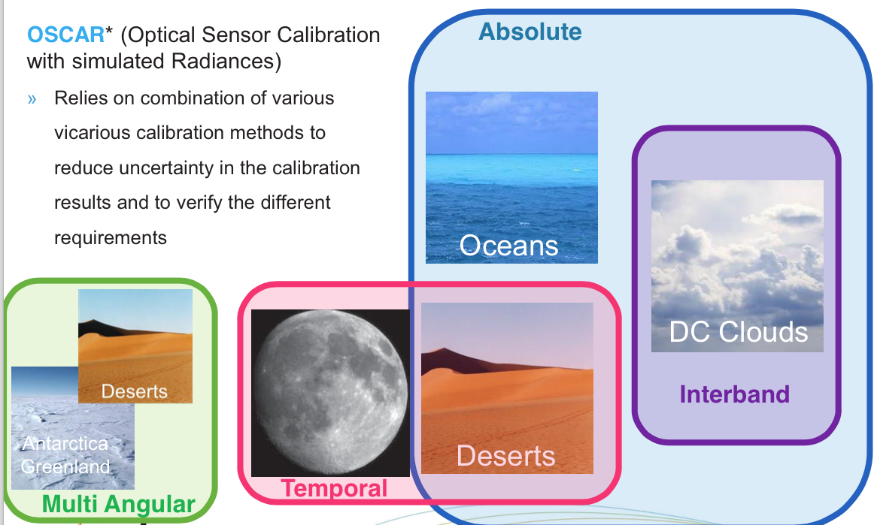
Inter-Calibration of Sensors in RS: Current
Results from C. Roithmayr
Temporal matching: 30 minutes
LEO and GEO data matching when available (e.g. MODIS and GOES-13).
Uniform and stable surface sites.
Instrument stability by observing the Moon (e.g. SeaWIFS).
Deep Convective Clouds, clear ocean & deserts: involve RT modeling.

Slide 3
Inter-Calibration of Sensors in Reflected Solar: Current
Results from the GSICS Report
Fundamental limitation
of current approach
Inter-calibration of gain:
Type A uncertainty (random) is 5.11% (k=1): due to data matching.
Type B uncertainty (not random) is defined by the MODIS accuracy of 2% (k=1) [pre-launch].
Spectral Type B uncertainty: due to difference in spectral response.

Slide 4
Inter-Calibration Requirements & Objectives
Baseline Science Objectives:
The CLARREO Pathfinder objective is to demonstrate the ability to use
the reflected solar spectrometer as an in-orbit transfer standard for inter-calibration of the reflectance bands of the VIIRS instrument and the CERES instrument's shortwave channel. The uncertainty contribution
from inter-calibration approach should be limited to 0.3% (k=1)
Ability to perform:
- Inter-calibration of imagers in GEO;
- Surface site characterization (e.g. deserts);
- Calibration of Lunar Spectral Reflectance.
Threshold Science Requirements:
The CLARREO Pathfinder shall demonstrate the ability to use the
reflected solar spectrometer as an in-orbit transfer standard for inter-calibration of the reflectance bands of the VIIRS instrument and the
CERES instrument's shortwave channel. The uncertainty contribution
from inter-calibration approach should be limited to 0.6% (k=1)*
* This is sampling uncertainty in addition to other uncertainties

Slide 5
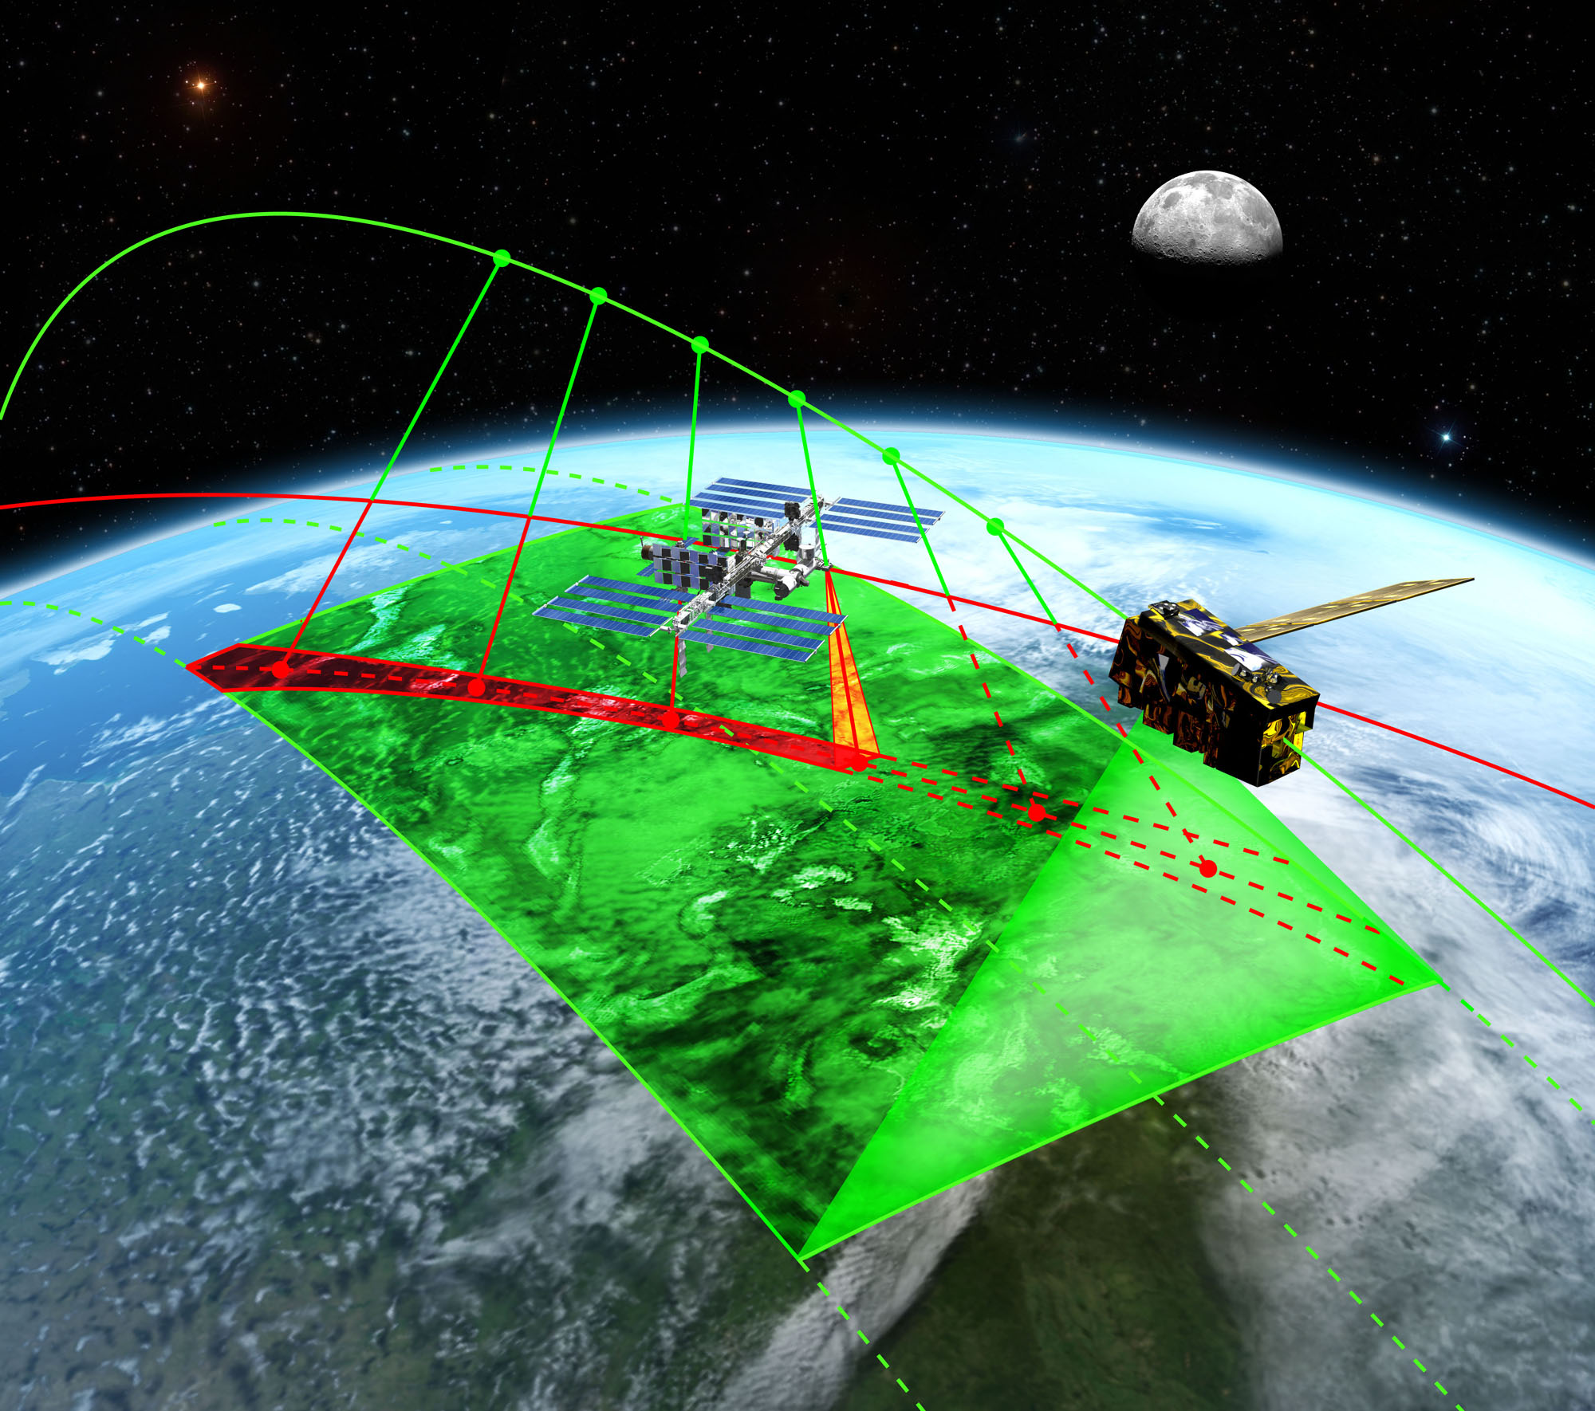
Inter-Calibration Concept: CERES & VIIRS
A simplified visualization of
Inter-calibration event with
CERES and VIIRS on JPSS-1
Approach: inter-calibration by real time pointing off-nadir
Inter-calibration on-orbit operations are planned ahead of time
CLARREO Pathfinder Instrument provides high-accuracy reference on orbit
CLARREO Pathfinder Instrument has 2D pointing ability (pitch-roll)
CLARREO Pathfinder data matching with CERES and VIIRS on JPSS:
temporal matching within 10 minutes, on-orbit angular/spatial matching
Inter-calibration event prediction/planning ahead of time
CLARREO Pathfinder location on ISS: ELC-1 Site 3

Slide 6
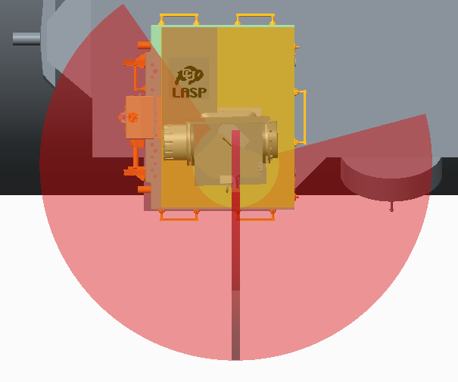
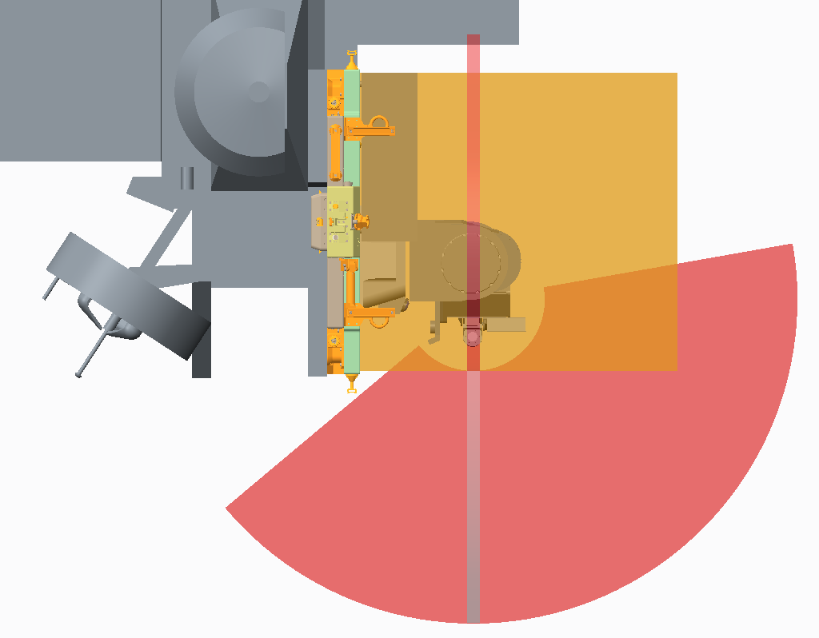
RS Instrument Field-of-Regard from ELC-1 Site 3
Pitch
145º
Wake
Roll
-105º
Ram
Port
100º
100º
Starboard
+x
0º
+z
-50º
Accommodation studies by the CPF team
0º
+y
+z
Gimbal configuration: pitch - roll
Approximate gimbal range of motion at ISS ELC-1 Site 3.
Some FOR obscuration due to ISS accommodation.

Slide 7
Inter-Calibration Events: Geolocation
Results from C. Roithmayr
Geolocation of the ISS ground track during each opportunity to take measurements for inter-calibrating JPSS cross-track sensors (CERES and VIIRS).
Instrument FOV = 10º
Time matching +/- 10 minutes
1356 inter-calibration opportunities over 1 year

Slide 8
Inter-Calibration: Sampling & Margin
Simulation ISS ELC-1 Site 3:
10 minutes time matching
Instrument field-of-regard
Instrument FOV = 10º
No Instrument FOV obscuration
Event duration > 30 seconds
SZA < 75º
N good events = 1208
VIIRS:
100 samples every 5 seconds
(imager re-sampling)
CERES:
3 FOVs every 5 seconds
(large FOV)
Margin at about 55% for operations
not-available on average !

Slide 9
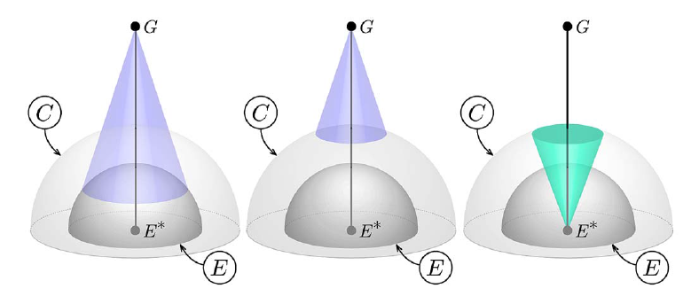
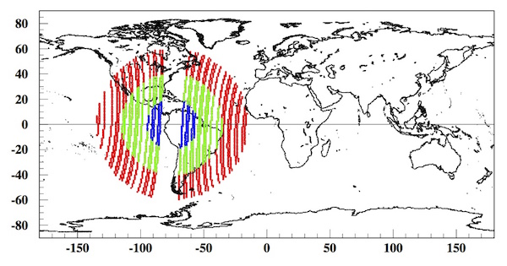
Inter-Calibration Objectives: GEO imagers
Roithmayr et al., 2014
SENSORS:
GEO imagers:
NOAA ABI on GOES-16
EUMETSAT
ESA GERB
Sampling example:
10 days for GOES 75 W
(from P90 600 km orbit)
No sampling in the center due to singularity for the yaw motion. No such thing for the CPF pitch-roll configuration !
Latitude will be limited to 51.6º

Slide 10
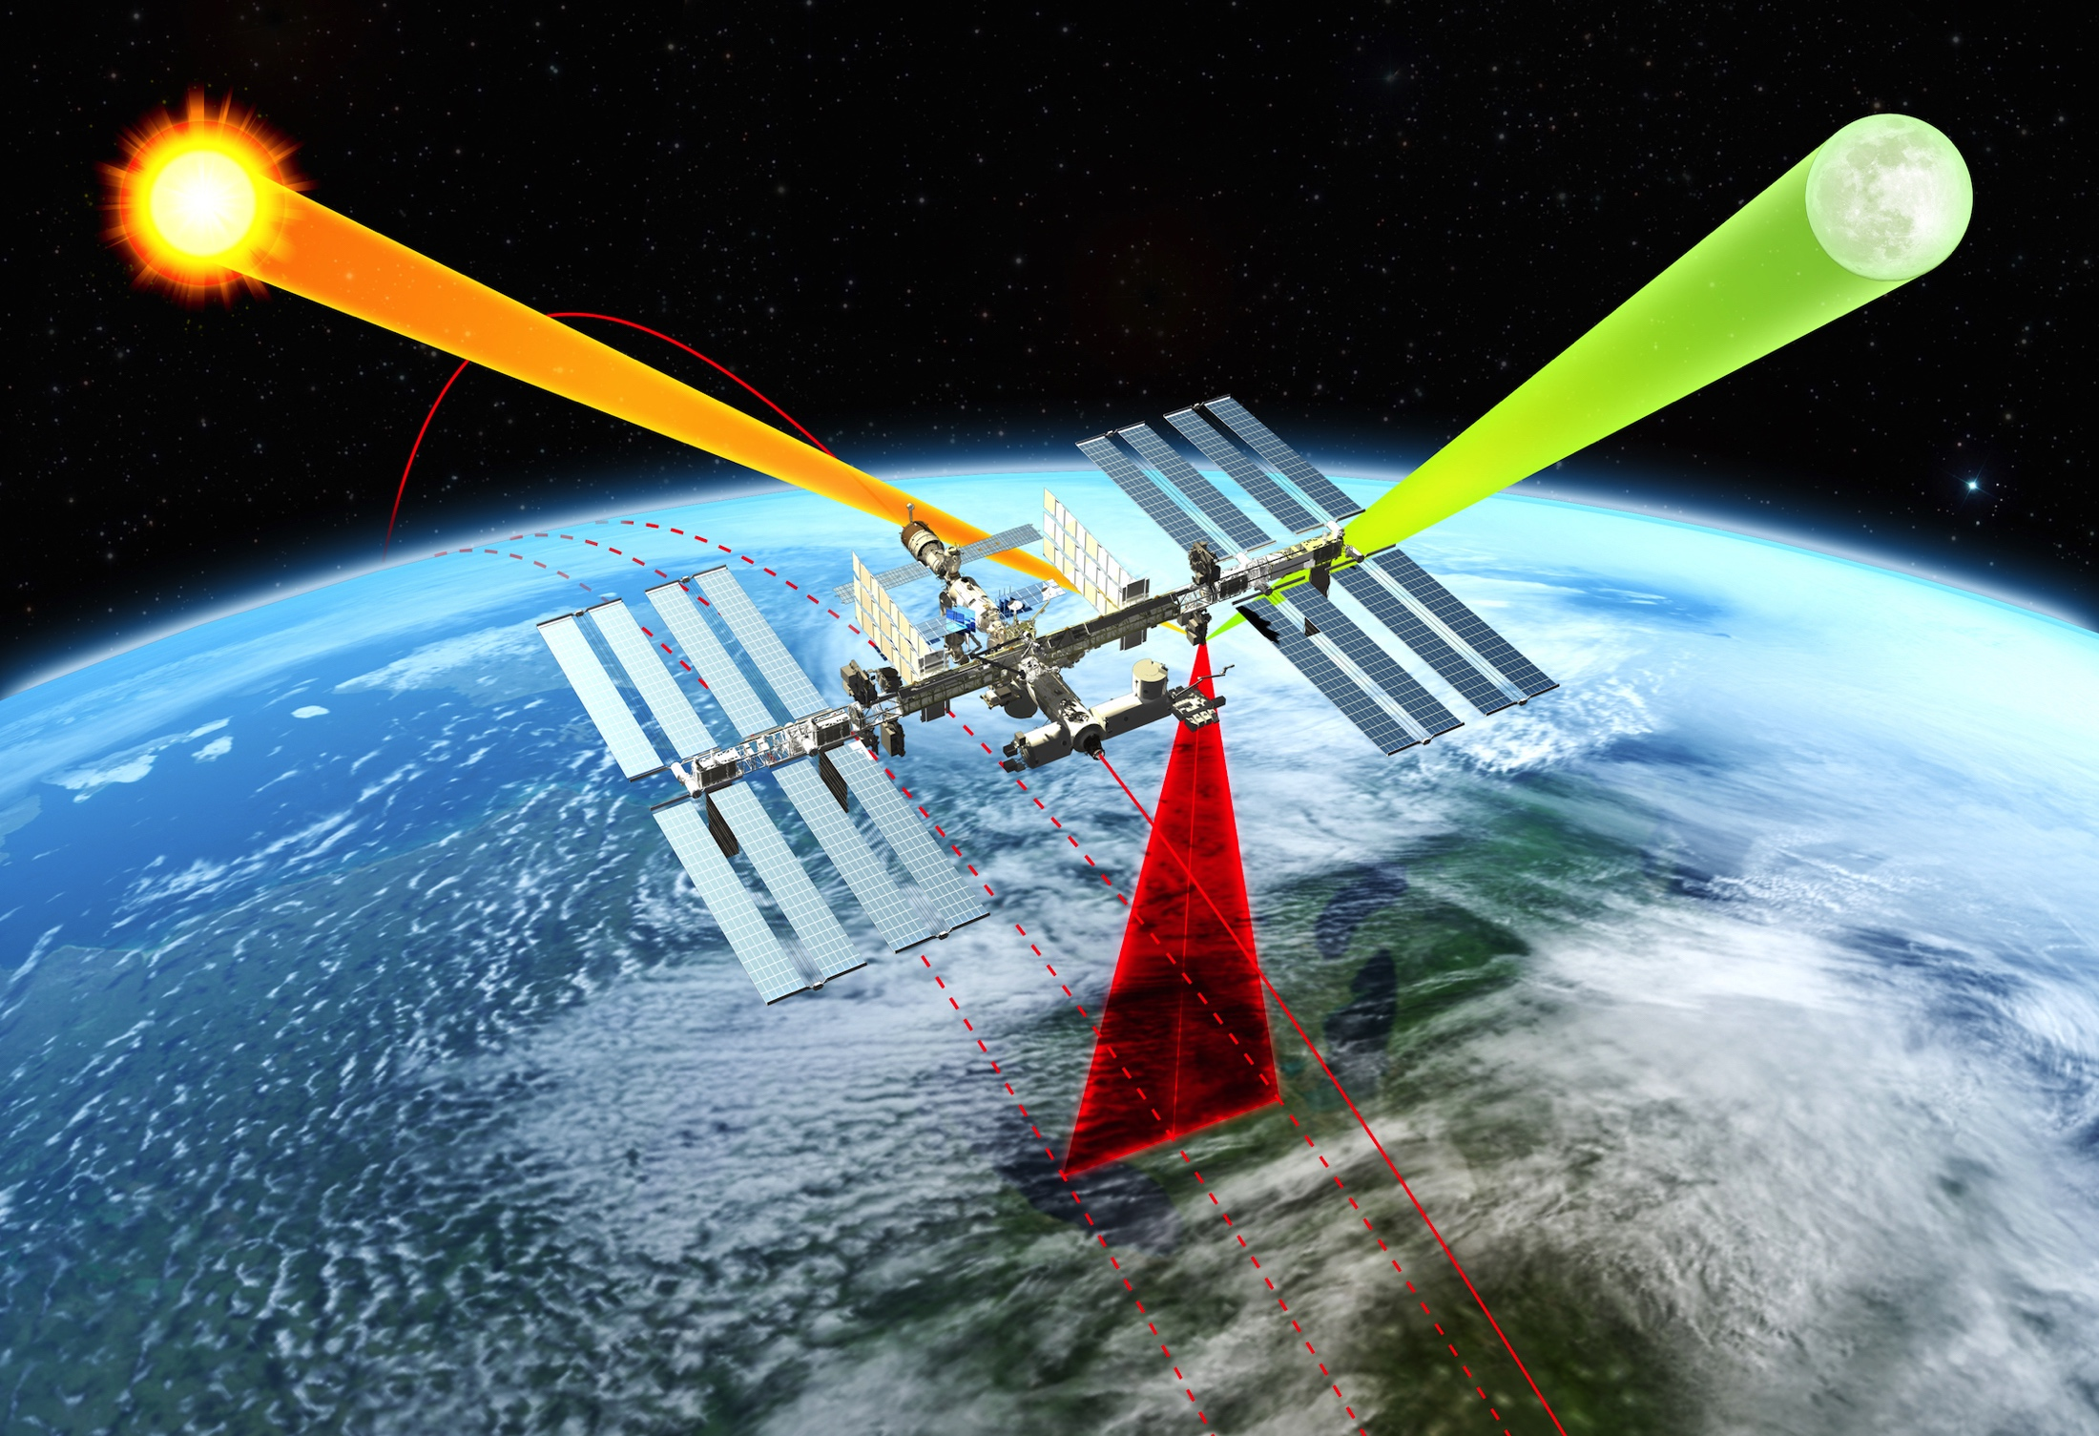
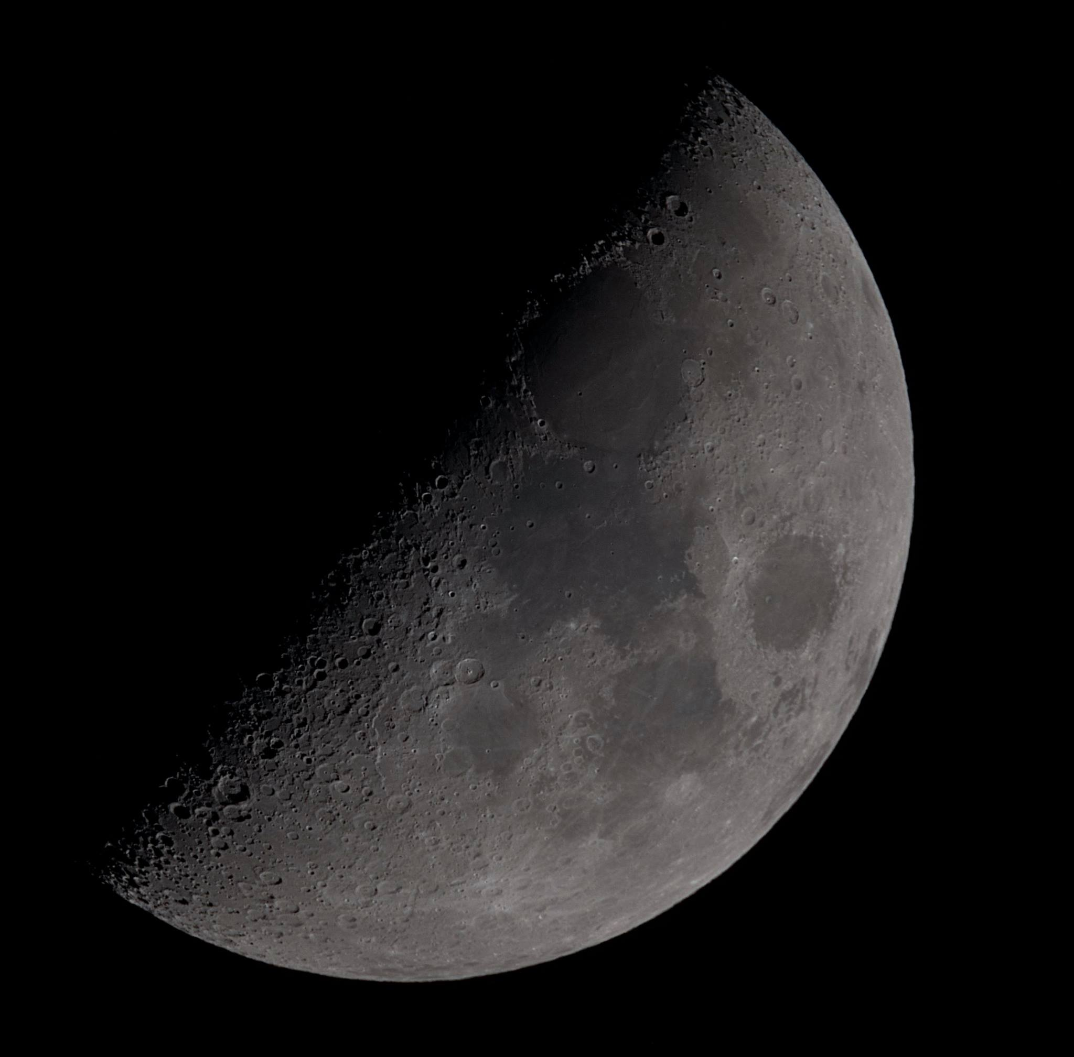
Inter-Calibration Objectives: Lunar Reflectance
CALIBRATION TARGET:
Moon: improve accuracy of lunar spectral reflectance
Reflectance of Lunar surface stable to < 10⁻⁸
NOTE:
ARCSTONE is a parallel project funded by the NASA ESTO to calibrate Lunar spectral reflectance from space with cubesat implementation.
Currently at TRL3
Expected TRL5 in September 2019
© 2017, C. Lukashin

Slide 11
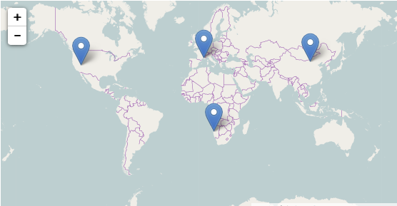
Inter-Calibration Objectives: Surface Sites
CALIBRATION TARGET:
Instrumented and not-instrumented Surface Sites (e.g. deserts)
Currently considered Surface Sites:
Railroad Valley Playa
  Lat: 38.497º
  Long: -115.690º
Baotou
  Lat: 40.851659º
  Long: 109.628904º
La Crau
  Lat: 43.55885º
  Long: 4.868872º
Gobabeb
  No data yet available?
Source: RadCalNet Quick Start Guide: https://www.radcalnet.org/resources/RadCalNetQuickstartGuide_20160915.pdf

Slide 12
Inter-Calibration Data Products
Product | Contents | Resolution | Granule
Level-1 Products for VIIRS CERES GEO (NOAA, ESA, etc.) Surface Sites Moon | Calibrated and geo-located CPF observations. | Full spectral and spatial resolution of the CPF RS Instrument. | Each granule contains single CPF inter-calibration event.
Level-4 Products for VIIRS CERES | Collections of CPF (Level-1), VIIRS, and CERES matched data (Level-1 & Level-2). | CLARREO (Level-1B) and VIIRS (Level-1 & Level-2, Clouds and Aerosols) data spatially convolved over IC sample. CLARREO Spectral re-sampling. CLARREO (Level-1) spatially convolved over CERES FOV’s PSF. CLARREO conversion to broadband reflectance. Scene ID from the CERES SSF. | Data processed by the CPF inter-calibration events.
Data Analysis VIIRS CERES | Inter-calibration results: Constraints on effective offset, gain, non-linearity, sensitivity to polarization, and spectral degradation. | Format is TBD | Format is TBD
Nadir observations will be processed into Level-1B data product
Additional data analysis – by a separately funded science team

Slide 13
Inter-Calibration: Current Work
CLARREO Pathfinder mission is extended Phase-A study period:
Refining inter-calibration planning and sampling:
- Orbital prediction and pointing
- ISS-related algorithms, obscuration, impact on pointing
- Definition of event priority and planning cycle
- Continue inter-calibration sampling studies
Definition of data products
PCRTM-based algorithms for angular and broadband modeling
Data product simulation for selected inter-calibration events
ATBD draft including:
- Required data inputs and interfaces
- Uncertainty budget for VIIRS inter-calibration
- Uncertainty budget for CERES inter-calibration
Theoretical and empirical PDM development and validation
PDM application software prototype
Coordination with DMT on algorithms implementation

Slide 14
CLARREO Inter-Calibration: Key Publications
Roithmayr, C.M., and P.W. Speth, 2012: “Analysis of opportunities for intercalibration between
two spacecraft,” Advances in Engineering Research Vol. 1, Chapter 13, Edited: V.M.
Petrova, Nova Science Publishers, Hauppauge, NY, pp. 409 - 436.
Lukashin, C., B. A. Wielicki, D. F. Young, K. Thome, Z. Jin, and W. Sun, 2013: “Uncertainty
estimates for imager reference inter-calibration with CLARREO reflected solar spectrometer,”
IEEE Trans. on Geo. and Rem. Sensing, special issue on Intercalibration of satellite instruments,
51, n. 3, pp. 1425 – 1436.
Roithmayr, C. M., C. Lukashin, P. W. Speth, G. Kopp, K. Thome, B. A. Wielicki, and D.F. Young,
2014a: “CLARREO Approach for Reference Inter-Calibration of Reflected Solar Sensors:
On-Orbit Data Matching and Sampling," IEEE TGRS, v. 52, 10, pp. 6762 - 6774.
Roithmayr, C. M., C. Lukashin, P. W. Speth, D.F. Young, B.A. Wielicki, K. J. Thome, and G.
Kopp, 2014b, “Opportunities to Intercalibrate Radiometric Sensors from International Space
Station,” J. of Atm. and Oce. Tech., DOI: 10.1175/JTECH-D-13-00163.1.
Wu, A., X. Xiong, Z. Jin, C. Lukashin, B.N. Wenny, J.J. Butler, 2015: “Sensitivity of Intercalibration
Uncertainty of the CLARREO Reflected Solar Spectrometer Features,” IEEE TGRS, v. 53, 4741 - 4751,
10.1109/TGRS.2015.2409030
Sun W., C. Lukashin, and D. Goldin, 2015: “Modeling polarized solar radiation for CLARREO
inter-calibration applications: Validation with PARASOL data," J. Quant. Spectrosc. Radiat.,
v. 150, pp. 121 - 133.
Sun, W., R.R. Baize, C. Lukashin, and Y. Hu, 2015: “Deriving polarization properties of
desert-reflected solar spectra with PARASOL data,” Atmos. Chem. Phys., 15, 7725 - 7734,
doi: 10.5194/acp-15-7725-2015.

