Slide 1
Proposal of SI-traceable IR and VIS Hyperspetral reference Workshop by GSICS/IVOS
Scott
NSMC/CMA

Slide 2
Implementation of Action GRWG.2016.3s.2
GRWG Chair Dohyeong Sending Email
Ask for your interest in participating in a proposed workshop on the use of hyperspectral instruments as inter-calibration references.
At the 2016 GSICS Research Working Group meeting it was suggested that a workshop could be set-up to bring together calibration and instrument experts with those working to develop inter-calibration algorithms to explore how the observations could be tied to international (SI) standards. It may be possible to run such a workshop close to the next year’s GRWG meeting, which is expected to take place in China around March 2018.
Email List: h gsics-dev@googlegroups.com , Nigel Fox, Dave Doelling, Bruce Wilwiki, Likun Wang, Dave Tobin, Rose Munro, Kei Shiomi, Masakatsu Nakajima
GRWG_14.39: CMA to investigate hosting a joint GSICS/CEOS-IVOS workshop to promote SI traceable measurements in orbit.
GRWG.2016.3s.2 | CLARREO preparations | GRWG Chair to check the interest and availability of key representatives for a workshop on hyperspectral instruments as inter-calibration references. | GRWG Chair | Configuration | 2017-annual meeting

Slide 3
CLARREO-like Workshop Motivation
Current GSICS inter-calibration references(AIRS,IASI,CrIS, MODIS, VIIRS,GOME-2) are not specific designed instruments for inter-comparison benchmark as international space earth observation.
There are three programs TRUTH, CLARREO and Chinese Space-based Benchmark Project in the past and present.
Requirement and traceability chain of Space-based Benchmark , technical possibility, Risk/Cost are paid attention by the scientists and high level decision-makers.
International CLARREO-like workshop may be useful to push this concept into quicker implementation within WMO/GSICS and CEOS/WGCV members

Slide 4
Proposed topics of CLARREO-like Workshop
Science/Technology Requirement and specification for CLARREO-like sensor
Current hyperspectral instruments as GSICS inter-calibration references were usually operational instruments and have no specific design for benchmark usage. What kind of shortage is the current reference instruments.
Is there some specific consideration for benchmark goal and climate observation
Satellite Platform specific specification for meeting the requirement as reference instrument and if small satellite can do that?
Current status of being carried or planning on programs
TRUTH mission
Program CLARREO pathfinder
Chinese Demonstration instrument development
CLARREO Pathfinder preparation
Candidate Reference sites
Observation mode determination
Possibility of international collaboration within GSICS community for CPF implementation into intercalibration
Post-launch test and commissioning
Evaluation and usage of Current GSICS Reference instrument
AIRS for reference
IASI for reference
CrIS for reference
MODIS/VIIRS for reference
Potential reference instruments such as GOME-2 ….
Transition to future reference instrument

Slide 5
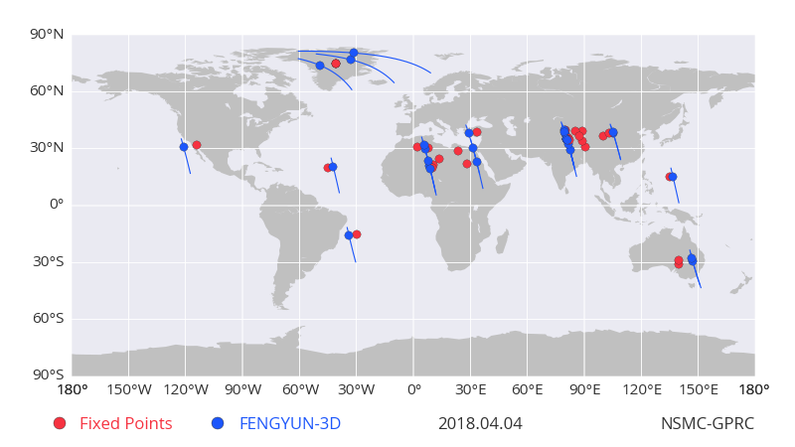
Global reference sites CMA selected

Slide 6
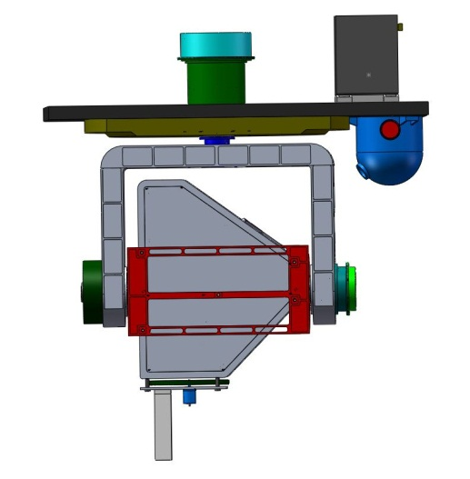
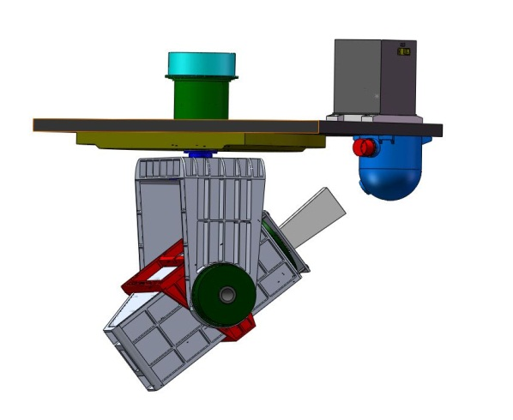
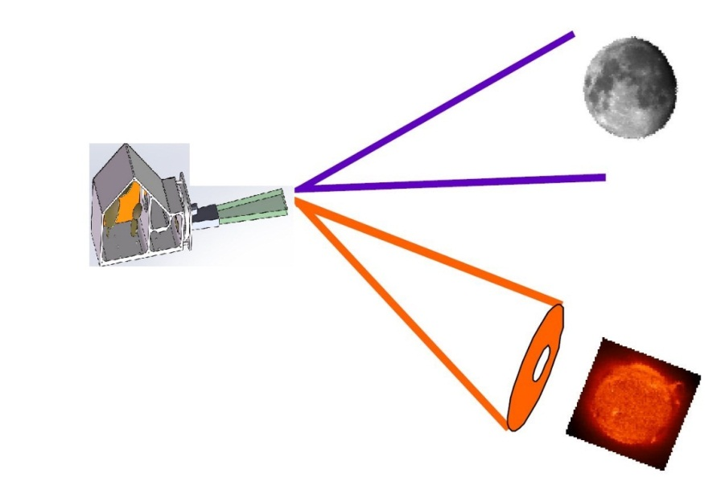
Chinese SI-traceable demo instrument development on FY-3RM rainfall mission (2021)
LeSIRB-Lunar and Earth Spectral Imager Radiometry Benchmark
Mission Goal: Demonstration of SI traceability instrument and experiment for inter-calibration between all FY optical imagers to improve calibration accuracy
Parameter items | Specification
Ground spatial resolution | 250m
Spectral resolution | 4nm
Spectral range | 400nm~1060nm
Ground Swath width | 50Km
S/N Ratio | >150
Radiance Dynamic | Similar to MERSI-3
MTF | >0.2@f/f_nyq=1.0
Radiometric uncertainty | 2%
Spectral calibration | 2nm
Polarization sensitivity | <1%
Observation Model | Earth/Lunar/Sun/Calibrator
Earth Model
Onboard Calibration
Moon/Sun Model

Slide 7
Future Preparation for CLARREO-like Workshop
A webmeeting for discussing workshop preparation after annul meeting
Potential participants invitation
Proposal Topics determination (session Chairs)
Determination of workshop venue: Europe, China?
Workshop Duration and Timing: 2~3 days

