Slide 1
NOAA Agency Report 2018
Xiangqian WU and Fangfang YU
with contributions from
Changyong CAO, Manik BALI, Ralpha FERRARO, Lawrence FLYNN, Lin LIN, Ninghai SUN, Likun WANG, and many scientists at
NOAA/NESDIS/STAR

Slide 2
Presentation Overview
Agency’s support to GDWG Activities
Agency’s support to GRWG Activities
UV/VNIR/IR/MW
Visiting scientist program
GCC Activities
Agency’s Instruments Updates & Recent Satellite launch
Agency’s Personnel supporting GSICS
Summary

Slide 3
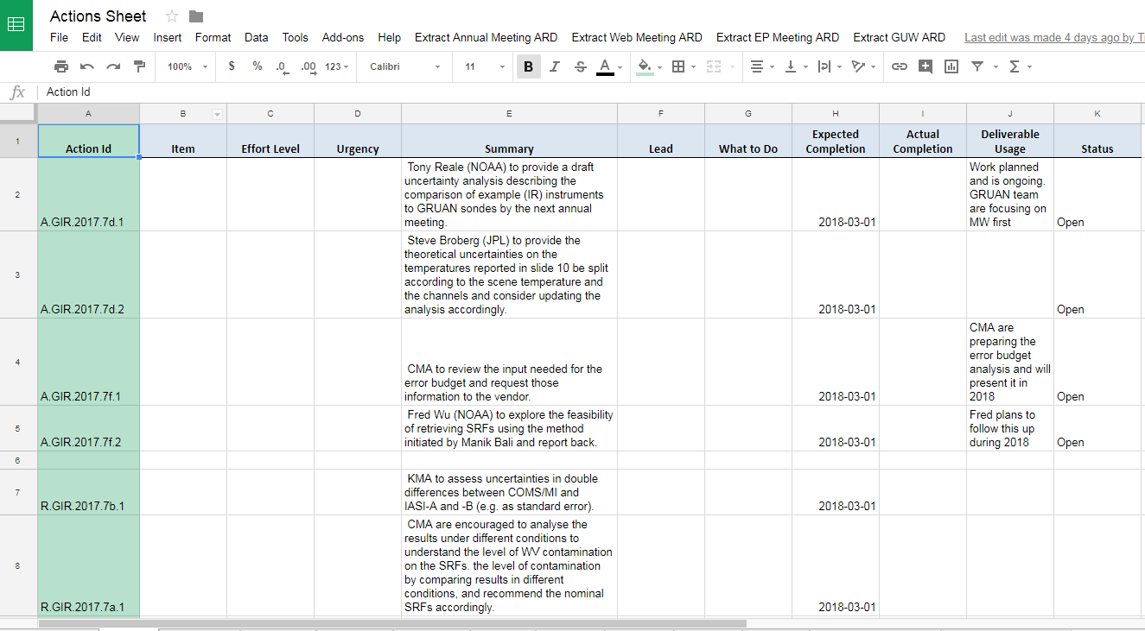
NOAA Support to GDWG Activities
NOAA GDWG focused on
Building the GSICS Action Tracker on the Google Cloud. ( Talk on this in 10d )
Maintaining the GSICS Wiki on the AOSC Webserver (http://gsics.atmos.umd.edu/wiki/Home by Yuanzheng Yao )
Develop script that download GSICS Products from THREDDS Server ( provided to Masaya)
Proposing GSICS metadata standards for Microwave Products ( working with MW on products)
Proposing Meta Data for GSICS Microwave Reference Records
Support review process
Future work
Migrating wiki to ESSIC
Developing Action Tracker
See talk 5e, 8a

Slide 4
UV Activities
Working on NOAA-20 OMPS in-orbit test
Completed SNPP/OMPS Reprocessing
Best Practices on the UV projects
Continue the UV Solar Reference project at NOAA
Continue monitoring the SBUV/2 and OMPS initial measurement residuals
Working with NASA to Reconcile the initial measurement residuals for SBUV(/2) and OMPS measurements to create a more homogeneous measurement data set for ozone profile retrievals.
Working on the time series of reflectivity and aerosol index statistics for a latitude/longitude box in the Pacific for the S-NPP & NOAA-20 OMPS and the Metop (-A, -B & -C) GOME-2.
See talk 6e and 6g

Slide 5
IR Activities
GOES-16 ABI post-launch test and post-launch product test completed
Working on the NOAA-20 CrIS early in-orbit test
SNPP CrIS SDR Reprocessing completed.
Leading on the best practice for Hyperspectral IR Sounder SDR ground processing
See talks 1g, 3j, 4d, 4f, 4r

Slide 6
VNIR Activities
NOAA-20 VIIRS in-orbit testing
SNPP VIIRS SDR Reprocessed Version 1.0 completed (2012-2017)
Data are ready to the public soon
SNPP VIIRS SDR Reprocessing Version 2.0 is in the planning stage
Exploring the GSICS community best method of using the lunar image for on-orbit evaluation of Modulation Transfer Function (MTF)
High spatial lunar images
See talks 1i, 4x, and 7h

Slide 7
MW Activities
SNPP VIIRS ATMS Reprocessing completed
Organized & convened 3 telecons over past year
Made good progress on several action items assigned from last year
GPSRO/Reference
MW sensor data base/linkages to OSCAR
Exploiting CDR’s to serve as GSCIS best practices
Expanded/Enhanced membership to more agencies and affiliates
Organized MW focus set of articles for newsletter
Organized MW session at current GRWG/GDWG
Some key technical activities include:
Exploiting GRUAN
Lunar calibration
NIST calibration reference
Exploitation of ATMS
See talks 3g, 9a, 9f, 9g, 9h, 9k, and 9m

Slide 8
GCC Activities
Continue providing coordination supports to EP, GRWG and GDWG
Attended and supported the EP meeting, and GRWG and GDWG webmeetings
Published four2017 GSICS Quarterly Newsletters
Organized the users’ workshop in the 2017 AOMUC meeting in Russia
Hosted the visiting scientist from CMA on the UV instrument inter-calibration
Jan. 2017 – Jan. 2018
See talk 3a

Slide 9
Visiting Scientist Programs
Between NOAA and CMA
CMA (Yuan Li) visited NOAA affiliated at University of Maryland from Jan 2017 to Jan 2018
Between NOAA and EUMETSAT
Short-term visits invited by EUMETSAT on the collaboration of the next-generation of GEO weather instrument calibration
Two scientists from the NOAA ABI calibration working group (CWG), Drs. Bob Iacovazzi and Fangfang Yu visited EUMETSAT for one and two weeks in 2017, respectively
Planning another two short-term visiting programs (Drs. Vladimir Krondratovich and Xiangqian Wu) in 2018

Slide 10
GOES-16 and NOAA-20
GOES-16
ABI L1B data became operational at the GOES-East position on 18 December 2017
NOAA-20 ATMS, CrIS, OMPS and VIIRS
Level 1 (Sensor Data Records) products from all four instruments will soon be declared to be at Provisional Maturity and released to the public. Maturity Presentations and ReadMe files are available at
https://www.star.nesdis.noaa.gov/jpss/AlgorithmMaturity.php
The Integrated Calibration Validation System pages are currently password protected at
https://www.star.nesdis.noaa.gov/icvs-beta/, but will soon drop the “-beta” and become publicly available.
ATBDs and other documents can be found at
https://www.star.nesdis.noaa.gov/jpss/Docs.php
See talks 1g and 1i

Slide 11
GOES-S is now GOES-17
GOES-S was launched on 1 March 2018
The second new-generation geostationary satellite operated by NOAA
Reached the geostationary orbit and became GOES-17 on 12 March 2018
Check-out position: 89.5W
NOAA’s next GOES-West satellite

Slide 12
Personnal supporting GSICS
EP: Mitch Goldberg (GSICS Chair)
GCC: Lawrence Flynn (director) and Manik Bali (deputy)
GDWG: Manik Bali (NOAA GDWG member)
GRWG: Ralph Ferraro (WM chair), Lawrence Flynn (NOAA UV sub-group member), Likun Wang (IR sub-group coming chair), Xiangqian Wu (NOAA GPRC chair), Fangfang Yu (Deputy of NOAA GPRC chair) and many many other scientists at NOAA/STAR

Slide 13
Summary
NOAA/STAR continue the strong and active supports to GSICS
Dedicated efforts on the instrument in-orbit calibration
Reprocessing the SDR data to provide better quality of satellite data to the community
Continue leading, exploring and supporting the new best practice methods
Enhanced the agency collaborations

Slide 14
Thank you for your attention
WMO GSICS Portal
http://gsics.wmo.int
GSICS Coordination Centre http://www.star.nesdis.noaa.gov/smcd/GCC/index.php
GSICS Product Catalog https://www.star.nesdis.noaa.gov/smcd/GCC/ProductCatalog.php
GSICS Wiki
http://gsics.atmos.umd.edu/wiki/Home

