Slide 1
GRWG Microwave Sub-Group Briefing
Ralph Ferraro (and entire MW Subgroup)
NOAA/NESDIS

Slide 2
Outline
Scope of MW Subgroup
Membership
Focus for past/upcoming year
Status of Action Items
Quarterly Meetings/Highlights
MW Parallel Sessions – 2017 & 2018
Summary of Accomplishments & Ongoing Endeavors

Slide 3
Scope of Microwave Sub-Group
Understanding the users’ requirements for inter-calibration products for microwave instruments
Imagers + sounders – passive only (initially, but eventually consider active if there is a need…)
Retrospective calibration (CDR’s and their components like geolocation, scan biases, inter-satellite)
Forward looking calibration (near-real time uses)
Identifying existing products that could meet those requirements, but first….
Need to define criteria…Reference standards (sensor(s), models, calibration methodologies….)
And then a process that adheres to GSICS principles
We should also focus on tools/algorithms like SNO, Double Difference, RTM, etc.
Might be something more feasible in near term?
Define data standards (jointly with GDWG)
Encourage the creators of those products to submit them to the GSICS Procedure for Product Acceptance (GPPA), once its defined for MW
Candidates include Cheng-Zhi Zou (MSU-AMSU), Karsten Fennig (SSMI), GPM X-Cal LUT’s
Coordination with other groups (e.g., CEOS WGCV MW, GPM X-Cal) would also be required to generate standards and best practices

Slide 4
Members Signed up as of January 2018
Over 50 members!
NOAA (and affiliates) - Ralph Ferraro (Chair), Huan Meng, Cheng-Zhi Zou, Tony Reale, Mark Liu, Manik Bali (Univ. Maryland), Isaac Moradi (Univ. Maryland), Hu (“Tiger) Yang (Univ. Maryland), Wenze Yang (Univ. Maryland), Johnny Luo (City College New York), Xailei Zou (Univ. Maryland), Lin Lin (Univ. Maryland), John Yang (Univ. Maryland)
EUMETSAT (and affiliates) – Tim Hewison, Karsten Fennig, Viju John, Jörg Ackermann, Sabatino DiMichele, Sante Laviola, Vinia Mattoli, Sreerekha Thonipparambil, Christophe Accadia, Martin Burgdorf (Hamburg Univ.), Imke Hans (Hamburg), Ralf Bennartz (Vanderbilt Univ.)
NASA (and affiliates) – Ed Kim (GSFC), Tanvir Islam (JPL), Linwood Jones (Univ. of Central Florida), Rachael Kroodsma (Univ. of Maryland), Wes Berg (Colorado State Univ.), Thomas Holmes (GSFC)
NIST – Derek Houtz, David Walker, Dazhen Gu
ECMWF – Steve English, Heather Lawrence
CMA (and affiliates) – Songyan Gu, Qifeng Lu, Lin Chen, Hu Yang, Xiaolong Dong, Shengli Wu, Xiuqing Hu
KMA (and affiliates) – Jun Park, Dong-Bin Shin (Yonsei University, South Korea), Dohyeong Kim, Minju Gu
JAXA (and affiliates) - Misako Kachi, Takashi Maeda
IISC – Ram Ratan

Slide 5
Focus Topics for 2017-2018
Defining CLEAR PATH for GSICS MW products and algorithms
Methodologies (Jun Park, Rachel Kroodsma)
SNO, Double difference, etc.
Reference Standards (Manik Bali, Isaac Moradi, Derek Houtz)
A particular sensor? Likely to be wavelength dependent (e.g., window, O₂, H₂0); A RTM?
LUT/Correction Tables (Karsten Fennig, Cheng-Zhi Zou, Viju John)
Near real-time and climate; they will be different
Tying together other groups/opportunities
GPM X-Cal (Wes Berg, Rachel Kroodsma)
CEOS MW subgroup (Cheng-Zhi, Xiaolong Dong)
Expanding active participation (Manik Bali, Ralph Ferraro)
GRUAN (Tony Reale, Cheng-Zhi Zou)
FIDUCEO (Martin Burgdorf)
GAIA-CLIM (Heather Lawrence/Steve English)
Continued participation by subgroup at meetings of relevance:
GSICS; CEOS;CALCON, Microrad, AMS Sat. Met, EUMESAT Satellite, etc.

Slide 6
Action Items Details in backup slides in presented Thurs MW session
Action Id | Item | Summary | Lead | What to Do | Expected Completion | Actual Completion | Deliverable Usage | Status
A.GMW.2017.6b.1 | ATMS on JPSS-1 | Priovide an update on the status after launch (currently Sept 2017) | Ed Kim | Information | 2017-12-01 | 2018-01-12 | Information | CLOSED
A.GMW.2017.6c.1 | Microwave imager CDR | Determine feasibility of extracting the inter-calibration algorithms and coefficients from the FCDR and making them a GSICS product. | Karsten Fennig | Analysis | 2018-03-01 | 2018-03-01 |  | CLOSED (see A.GMW.20170725.2)
A.GMW.2017.6d.1 | Microwave sounder CDR | Determine feasibility of extracting the inter-calibration algorithms and coefficients from the FCDR and making them a GSICS product. | Cheng-Zhi Zou | Analysis | 2018-03-01 | 2018-03-01 |  | CLOSED (see A.GMW.20170725.2)
A.GMW.2017.6f.1 | MW Sensor inventory | MW Subgroup chair to develop candidate satellite/sensor (inventory), perhaps in the form of a graphical aid, as in orbit references for specific channels (based on some predetermined set of parameters that Manik has outlined...) and note pros and cons, other attributes (publications, etc.)? It should include timelines of sensors and overlap periods. | Jun Park | Information | 2018-03-01 | 2018-03-01 | Information | CLOSED
A.GMW.2017.6f.2 | GRUAN Study | Tony Reale (NOAA) to provide a draft uncertainty analysis describing the comparison of example (microwave) instruments to GRUAN sondes. | Tony Reale | Analysis | 2018-03-01 |  |  | Open?
A.GMW.2017.6g.1 | MW RTM comparison | MW co-chair to develop set of specific tasks to be performed by the Subgroup to intercompare RTM output over static references and surface models. Tasks to be identified within 6 months (Sep. 2017). | Isaac Moradi | Information | 2018-08-01 |  |  | Open
A.GMW.2017.5g.1 | MW Naming Convention/Metadata | MW subgroup would contact NOAA GDWG to get support for product creation if needed. | Ralph Ferraro | Tech Support | 2018-03-01 |  |  | Open
R.GMW.2017.6a.1 | MW Lunar Calibration | Get an update from Martin in approx. 6 months. | Martin Burgdorf | Information | 2017-09-30 | 2017-10-12 | Information | CLOSED
R.GMW.2017.6e.1 | NIST calibration reference | Get an update from Derek in approx. 6 months. | Derek Houtz | Information | 2017-09-30 | 2018-01-12 | Information | CLOSED
[EP-18.02] GRWG to assess the utilization RO for microwave instrument monitoring purposes
We have held several meetings and developed a white paper to close out this action
This will be a specific topic at the Thurs/MW subgroup meeting

Slide 7
Recent Meetings of Microwave Sub-Group
Mostly web meetings
Max 2.5hr; try to hold in the 1100 – 1400 UTC timeframe
Materials and minutes always posted on Wiki
22 June 2017
12 October 2017
12 January 2018
Some side-bar meetings:
GSICS/CDR Products and best practices
GRUAN
GPSRO
Sensor database/OSCAR

Slide 8
Meeting Highlights (1/3)
Mark Liu/Ed Kim, 12 Jan 2018
Misako Kachi/Takashi Maeda, 12 Oct 2017
NOAA-20 ATMS On-Orbit NEΔT Status
AMSR-2 Cross Calibration V2

Slide 9
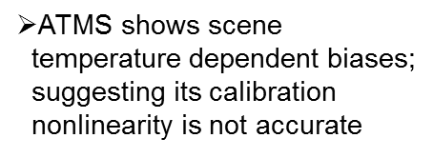
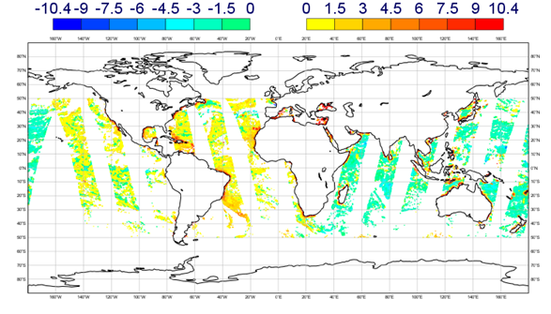
Meeting Highlights (2/3)
Cheng-Zhi Zou/Manik Bali, 12 Jan 2018
Heather Lawrence/Steve English, 22 Jun 2017
Use of MSU/AMSU CDR as Calibration Reference
ECMWF O – B minus global average – 10 H GHz

Slide 10
Meeting Highlights (3/3)
Derek Houtz, 12 Jan 2018
Tony Reale, 12 Oct 2017
NIST MW Calibration Reference for ATMS (JPSS-2)
Instrument noises can be used to determine the distance criteria when collecting collocated datasets between GRUAN and MW Sensors
Minimum STD = √2 *0.3K=0.42K
Maximum distance for collocated datasets ~40Km

Slide 11
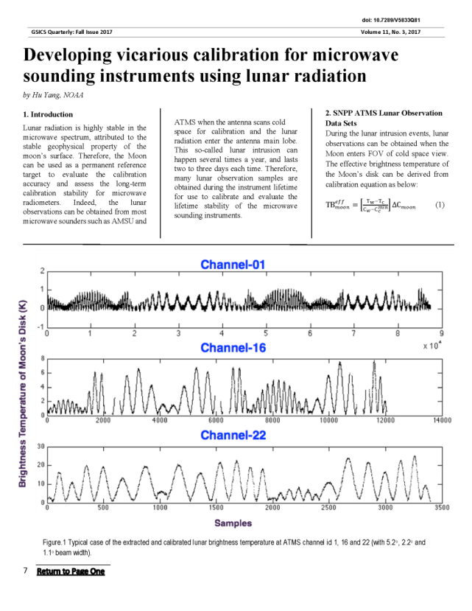
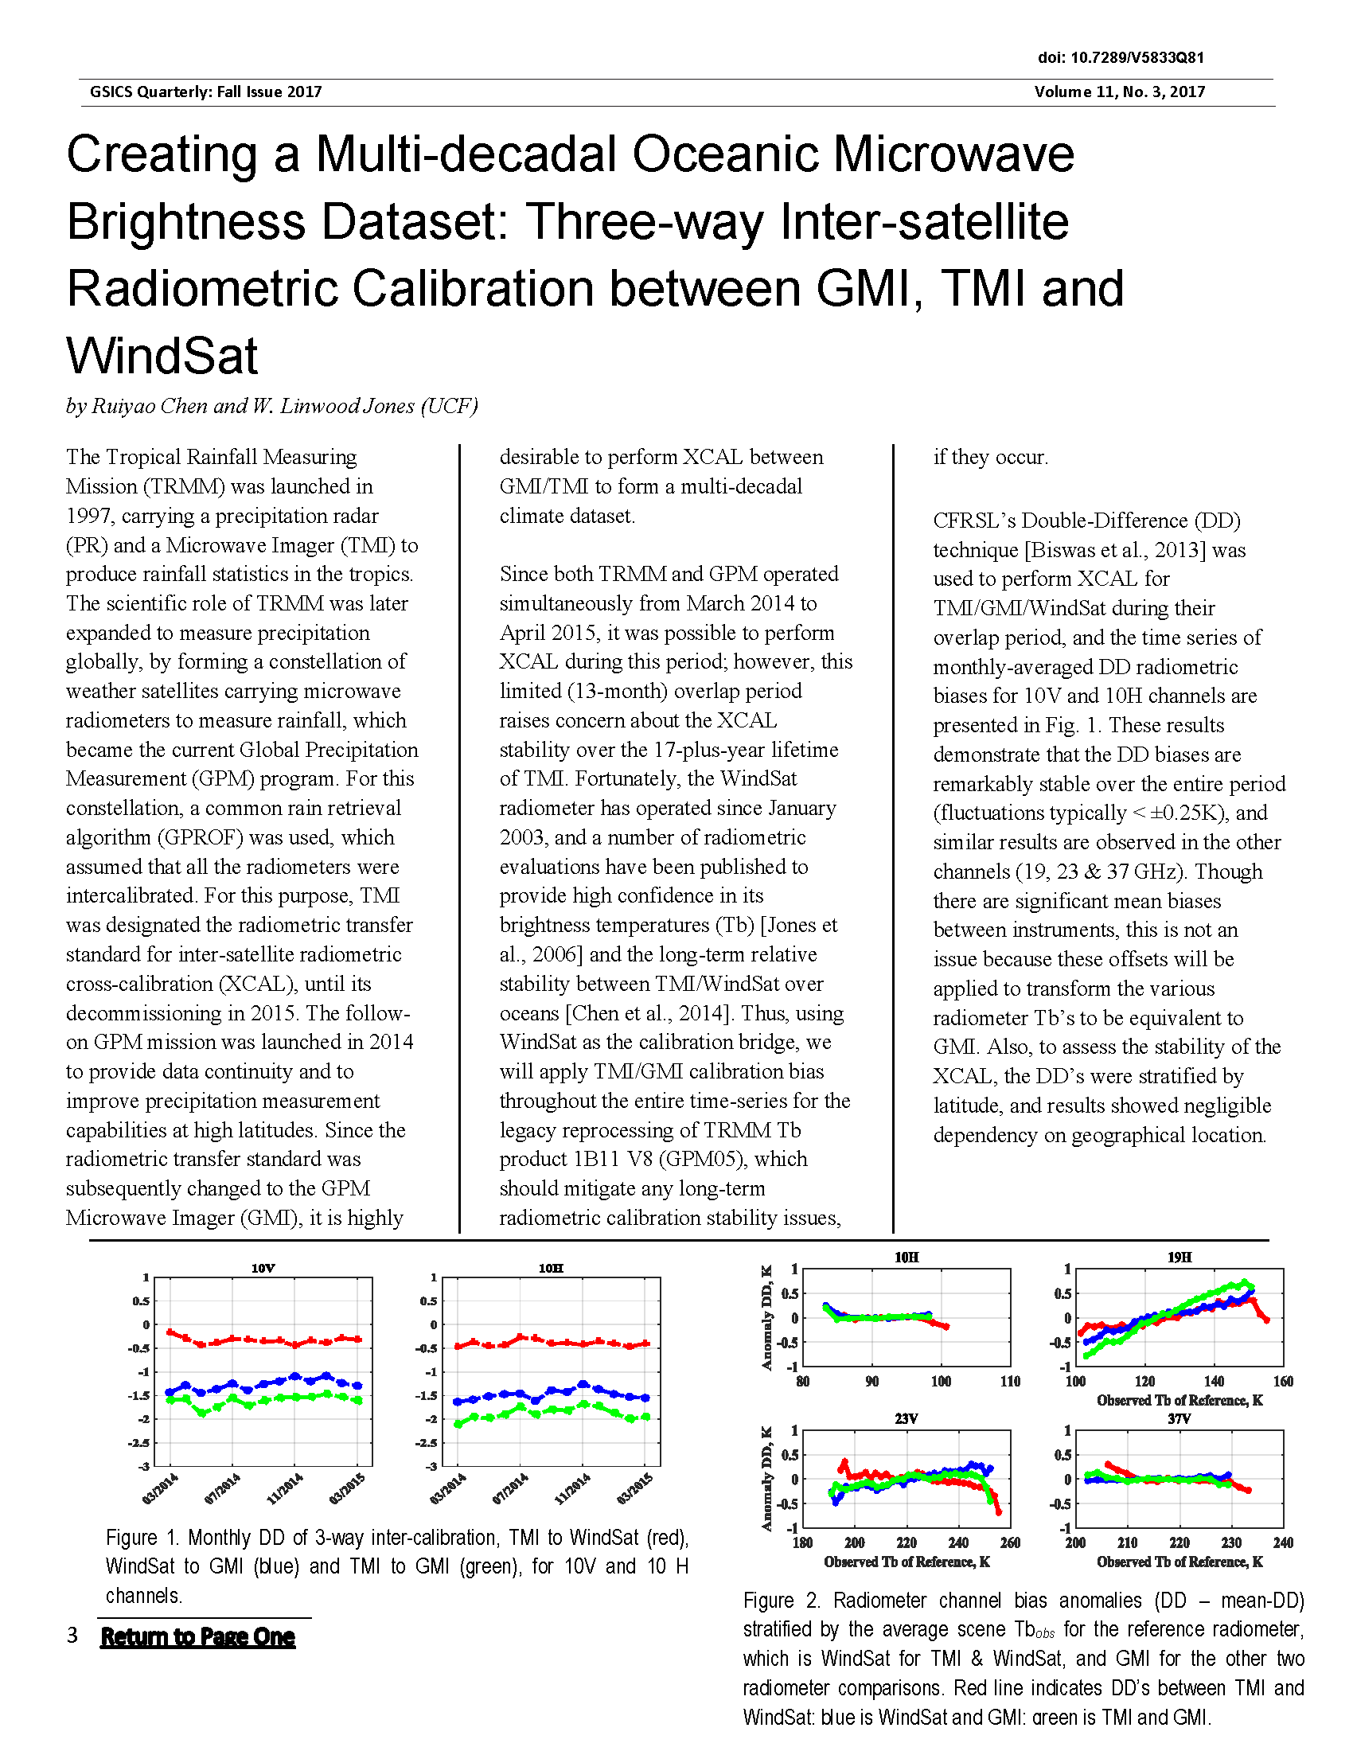
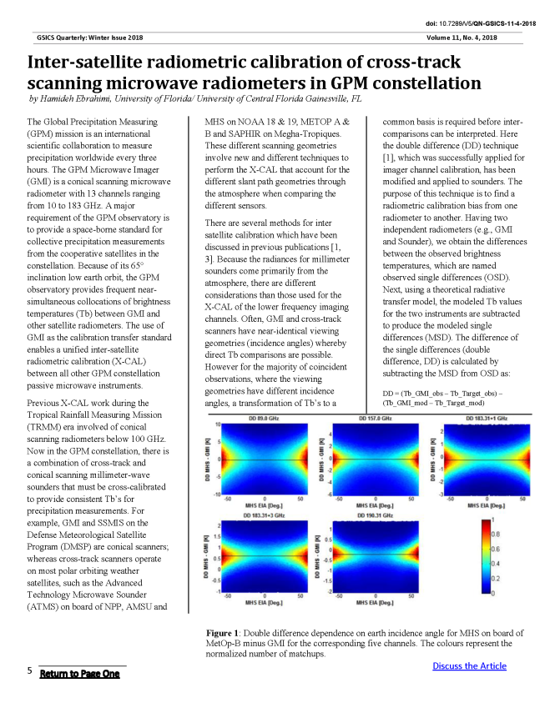
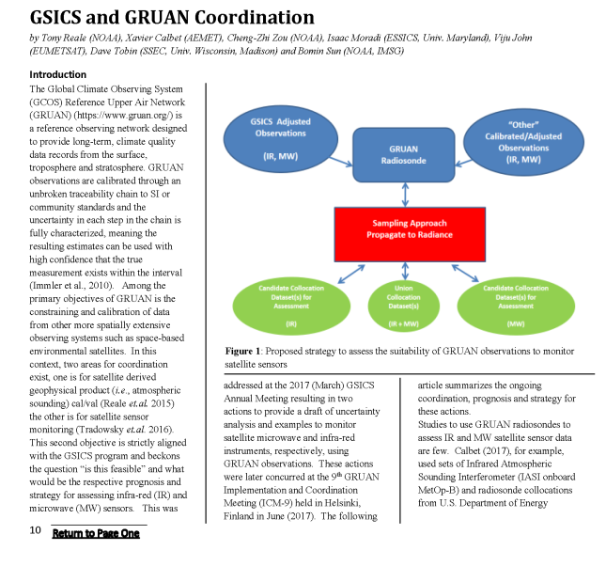
Newsletters – MW Topics

Slide 12
2017 MW Session
There were some logistical, remote participation matters that were “good lessons learned”
Were able to have some in person participation from U.S. members
Helped stimulate closer interactions this past year
We came up with our first set of actions!

Slide 13
2018 MW Session
Thu pm | GRWG: MW Sub-Group
 | Chair : Ralph Ferraro
13:00 | Ralph Ferraro | NOAA | Introduction and Action Item/Discussion | 9a | 0:30
13:30 | Shenli Wu | CMA | Development of FY-3/MWRI Calibration on warm/cold targets and reflector emissivity | 9b | 0:20
13:50 | Yang Guo | CMA | Calibration and validation of Microwave Humidity Sounder onboard FY-3D satellite | 9c | 0:20
14:10 | Hao Liu | NSSC | Consideration of the on-board calibration of interferometric synthetic aperture microwave radiometer, | 9d | 0:20
14:30 | Xiaolong Dong | NSSC | Development and Standardization of the Guidelines for Prelaunch Calibration of Microwave Sensors - Activities of the CEOS WGCV | 9e | 0:20
14:50 | Ninghai Sun | NOAA Affiliate | ATMS SDR NOAA-20 and NPP ATMS calibration update | 9f | 0:20
15:10 | Coffee break |  |  |  | 0:20
15:30 | Ralph Ferraro | NOAA | Introduction: Radio Occultation as a MW standard/calibration source | 9g | 0:10
15:40 | Lin Lin | NOAA Affiliate | Mutual Validations of Observations between lifetime S-NPP ATMS and GPS ROs from COSMIC, MetOp and KOMPSAT (Provided by Xiaolei Zou) | 9h | 0:15
15:55 | All |  | RO Discussion | 9i | 0:30
16:25 | Scott Hu | CMA | ATMS Cal/Val evaluation using FY-3C/GNOS profile standard | 9j | 0:15
16:40 | Manik Bali | NOAA Affiliate | Proposed Best Practices | 9k | 0:30
17:10 | Ralph Ferraro | NOAA | NASA GPM X-Cal Updates (provided by Wes Berg and Rachel Kroodsma) | 9l | 0:20
17:30 | Manik Bali | NOAA Affiliate | GRUAN (Provided by Tony Reale) | 9m | 0:30

Slide 14
Summary and ongoing endeavors
Continued expansion of group
More ideas, new collaborations, exploit other ongoing activities of relevance to GSICS
Planning an evening session at IPWG-9 to engage precipitation community
Sub-topical leads/formation
Develop tasks, move forward with them
References, Methods, Correction Tables….
Taking a little longer than I had hoped…
Contributions to GSICS Newsletters
Parallel MW sessions are maturing
Can help determine action items and paths forward
Chairmanship
Been leading for 3+ years…have made it to 2 out of 4 annual meetings
Never had a vice-chair…

Slide 15
Backup material

Slide 16
GRWG Microwave Session
Ralph Ferraro
NOAA/NESDIS

Slide 17
Action Items
Action Id | Item | Summary | Lead | What to Do | Expected Completion | Actual Completion | Deliverable Usage | Status
A.GMW.2017.6b.1 | ATMS on JPSS-1 | Priovide an update on the status after launch (currently Sept 2017) | Ed Kim | Information | 2017-12-01 | 2018-01-12 | Information | CLOSED
A.GMW.2017.6c.1 | Microwave imager CDR | Determine feasibility of extracting the inter-calibration algorithms and coefficients from the FCDR and making them a GSICS product. | Karsten Fennig | Analysis | 2018-03-01 | 2018-03-01 |  | CLOSED
A.GMW.2017.6d.1 | Microwave sounder CDR | Determine feasibility of extracting the inter-calibration algorithms and coefficients from the FCDR and making them a GSICS product. | Cheng-Zhi Zou | Analysis | 2018-03-01 | 2018-03-01 |  | CLOSED
A.GMW.2017.6f.1 | MW Sensor inventory | MW Subgroup chair to develop candidate satellite/sensor (inventory), perhaps in the form of a graphical aid, as in orbit references for specific channels (based on some predetermined set of parameters that Manik has outlined...) and note pros and cons, other attributes (publications, etc.)? It should include timelines of sensors and overlap periods. | Jun Park | Information | 2018-03-01 | 2018-03-01 | Information | CLOSED
A.GMW.2017.6f.2 | GRUAN Study | Tony Reale (NOAA) to provide a draft uncertainty analysis describing the comparison of example (microwave) instruments to GRUAN sondes. | Tony Reale | Analysis | 2018-03-01 |  |  | Open?
A.GMW.2017.6g.1 | MW RTM comparison | MW co-chair to develop set of specific tasks to be performed by the Subgroup to intercompare RTM output over static references and surface models. Tasks to be identified within 6 months (Sep. 2017). | Isaac Moradi | Information | 2018-08-01 |  |  | Open
A.GMW.2017.5g.1 | MW Naming Convention/Metadata | MW subgroup would contact NOAA GDWG to get support for product creation if needed. | Ralph Ferraro | Tech Support | 2018-03-01 |  |  | Open
R.GMW.2017.6a.1 | MW Lunar Calibration | Get an update from Martin in approx. 6 months. | Martin Burgdorf | Information | 2017-09-30 | 2017-10-12 | Information | CLOSED
R.GMW.2017.6e.1 | NIST calibration reference | Get an update from Derek in approx. 6 months. | Derek Houtz | Information | 2017-09-30 | 2018-01-12 | Information | CLOSED
[EP-18.02] GRWG to assess the utilization RO for microwave instrument monitoring purposes
We have held several meetings and developed a white paper to close out this action
But there is still more to discuss today!

Slide 18
ATMS Updates for S-NPP and NOAA-20
Provided by Q. Liu/E. Kim – N. Sun will provide more updates in this session
A.GMW.2017.6b.1
ATMS SDR performance is better than the requirement in J1RD.
ATMS calibration using radiance has been operational since March 08, 2017 (block 2).
Suomi NPP
ATMS is healthy.
Scan drive main motor current had been dropped down to a “normal” level.
ATMS SDR has reached “long-term monitoring validated maturity”.
NOAA-20
ATMS is good in operational normal.
ATMS TDR has reached beta maturity and pending on approval for provisional maturity.
PCT 006 converting TDR to SDR is scheduled for this January 2018.

Slide 19
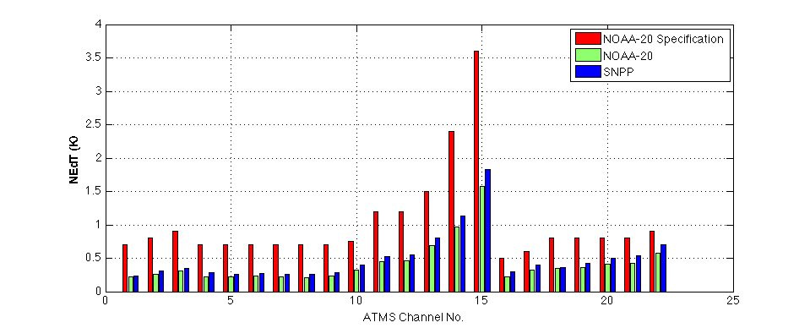
NOAA-20 ATMS Performance Summary
In comparison to S-NPP ATMS TVAC data, NOAA-20 ATMS data has been demonstrated better performance.
Consistent performance between pre- (TVAC) and post-launch (onboard):
Smaller sidelobes (i.e. higher antenna efficiency)
Lower noise (i.e. NEdT)
Much smaller inter-channel noise correlation (better independent information)
Smaller ΔG/G (less striping)
Larger non-linearity. After correction, residual NL is smaller and meet requirement.
NOAA-20 ATMS On-Orbit NEΔT Status

Slide 20
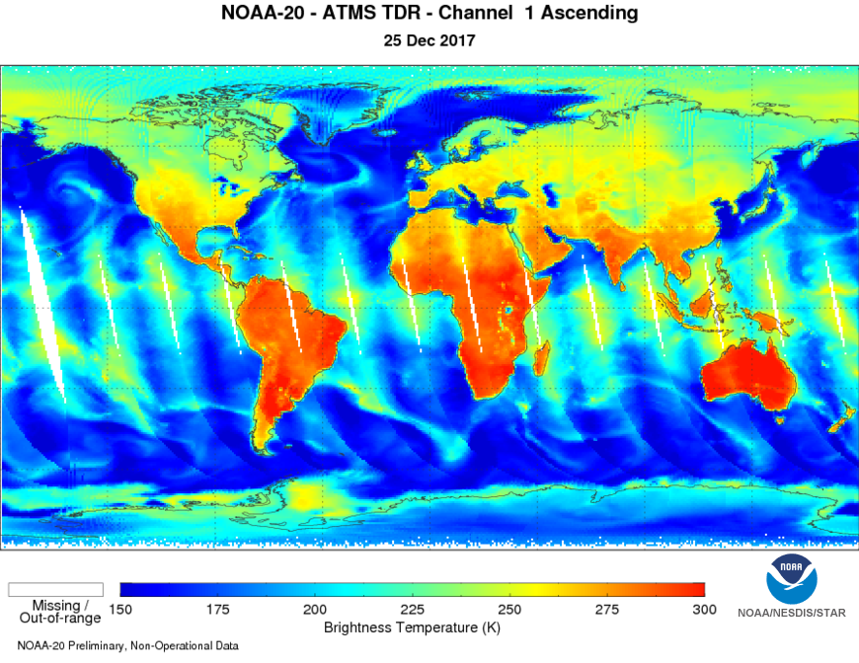
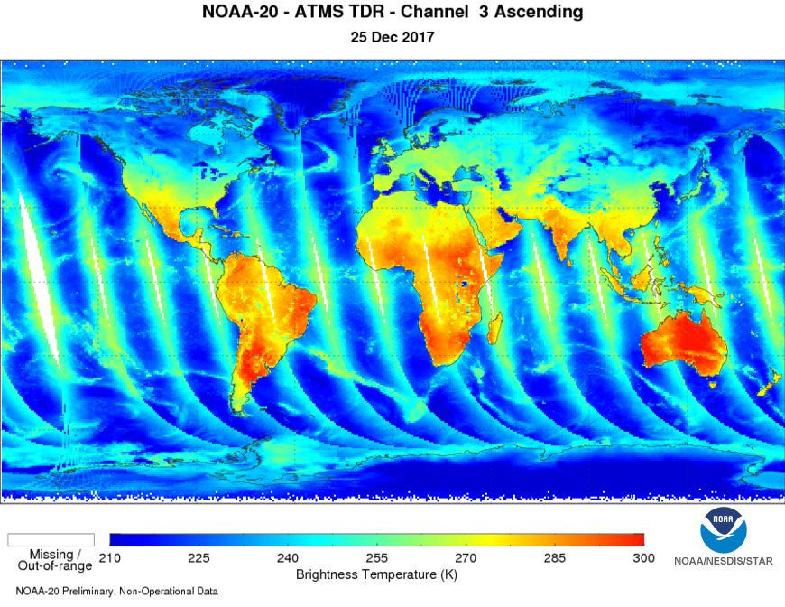
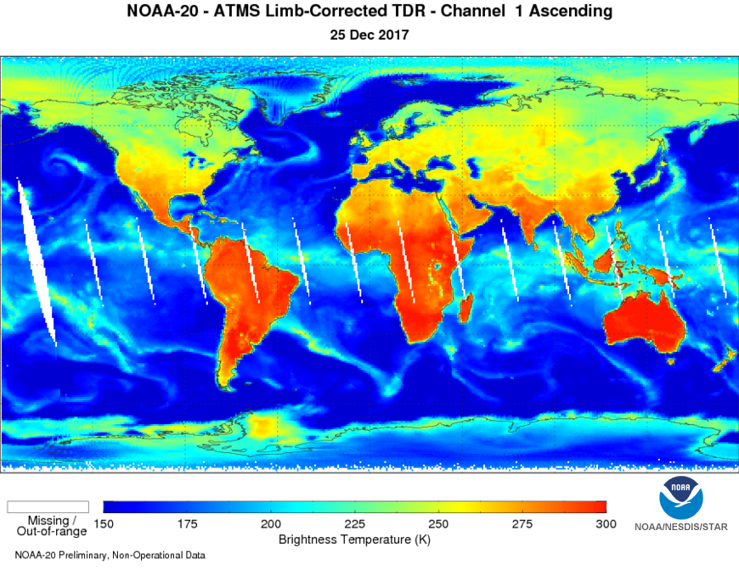
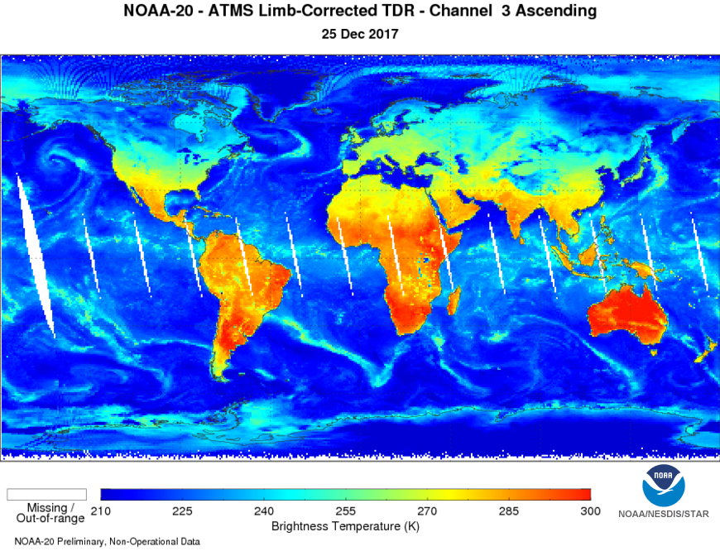
NOAA-20 ATMS TDR (upper) and limb-corrected (bottom)

Slide 21
Determine feasibility of extracting the inter-calibration algorithms and coefficients from the FCDR and making them a GSICS product.
Provided by C. Zou, K. Fennig, M Bali
A.GMW.2017.6c.1 and …6d.1
Decided to look at both of these together – MW/Imager and MW/Oxygen FCDR – many common threads
An ad-hoc team was formed and first met on 25 July 2017, with several email activity, primarily with
Ferraro, Bali, Fennig, Zou, Takahashi (GDWG)
Issues we struggled with:
No MW standard – where do we start?
Different channel classes that can be treated differently
Sounders and imagers – incidence angles, polarization, …
What EXACTLY do users want and need?
Climate type corrections cannot necessarily be unraveled into near real time type of corrections
ICDR’s are now being generated…will 1-2 month lag suffice? Things don’t change that quickly, esp. for “mature” sensors

Slide 22
Determine feasibility of extracting the inter-calibration algorithms and coefficients from the FCDR and making them a GSICS product.
Let’s recall some basic GSICS principles
Instrument monitoring
Standardized tools/methodologies/best methods for all agencies to adopt
Things that were further considered
Get clarification on user needs (Ralph, Manik)
Earlier input was not perhaps as broad as it could be
However, after thinking closer, felt this was not needed at this time
Define short term (~1 year) and long term (~3 year) goals
Standardize tools (Karsten, Cheng-Zhi, Tony, …)
SNO, use of GRUAN, use of GPSRO, etc.
Use CDR (ICDR?) as references?

Slide 23
Take away points….
MSU CDR
SSMI CDR
One set of non-linear calibration coefficients for all beam positions via SNO
MSU – N10 is reference
AMSU- N19 is reference
Published results, others are updated on web page
Uncertainties are available
Corrections can only be used if ‘starting point’ is the same
APC
Sensor specific issues
Might just be easier to use the FCDR’s (but they contain original SDR)
F11 is reference
Use vicarious type calibration along with double difference
Methods published
Corrections mature, don’t change quickly, could be a GSICS product even if
not calibrated against true reference
Notes:
Mitch provided long time support for project from the program side, such as leveraging funding.
And Fuzhong also provides program support and coordinate the CRTM team to work with our product development team. You may notice that most of my SDS science team members are from his Branch.
I also want to thank Changyong for his long time support from scince side. I can always count on his support when I need a discussion on science. even when I need support from his team members.

Slide 24
Provided by J. Park, E. Kim and R. Ferraro
A.GMW.2017.6f.1
MW Subgroup chair to develop candidate satellite/sensor (inventory), perhaps in the form of a graphical aid, as in orbit references for specific channels (based on some predetermined set of parameters that Manik has outlined...) and note pros and cons, other attributes (publications, etc.)? It should include timelines of sensors and overlap periods.
Goal – develop a useful matrix of sensor information that ultimately, could be in a query type format for easy use for comparison
Useful information supplied by:
Wes Berg (X-CAL), Thomas Holmes (internal) use, WMO/OSCAR (wound up being our best resource)
Ralph developed a draft matrix; Jun took over and completed for passive MW
We vetted through our team
We learned that OSCAR (or a future version) could do mostly what we wanted
Our next step is to provide some specific details to WMO on this….

Slide 25
Sample Matrix

Slide 26
Properties of ICI Sensor via OSCAR

Slide 27
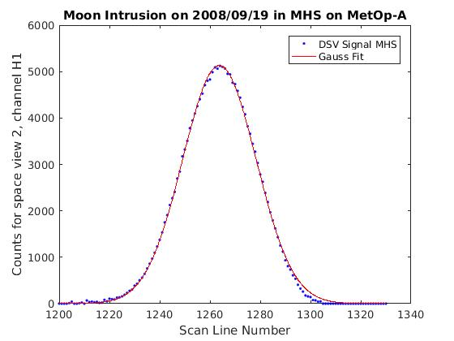
MW Lunar Calibration
Provided by M. Burgdorf and recently, H. Yang
A.GMW.2017.6a.1
Advantages of using the
Moon for MW
“Light” Curve from Moon Intrusion
has Shape of Gaussian
Radiance from Moon the same for all sounding channels
Accessible for all satellites in typical polar constellation
Check uniformity with Moon intrusions
Highly stable in MW
We know where the moon will be!
There is a bias in ch. 20 of AMSU-B on N-16, but only with Earth scenes (SNOs)
Moon flux << Earth flux
DSV correct. factor is more prominent with Moon obs.
Rule out wrong DSV correction as reason for bias => RFI more likely

Slide 28
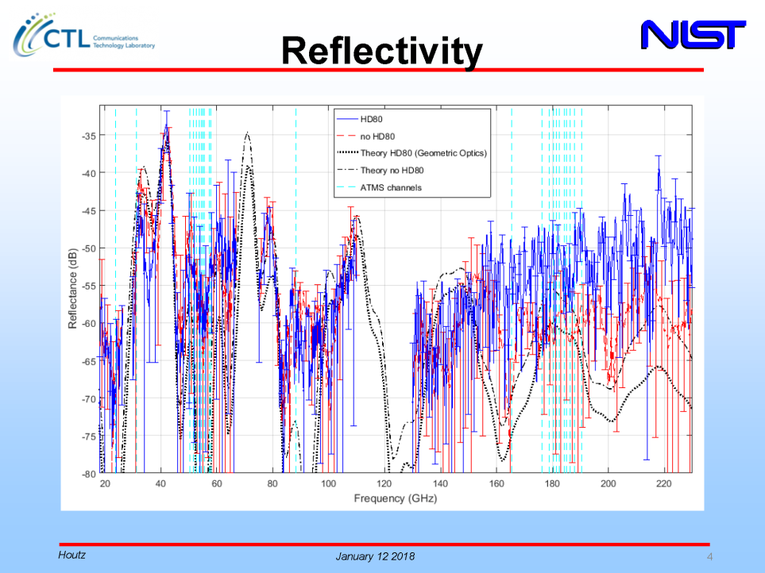
NIST Calibration Targets
Provided by D. Houtz
A.GMW.2017.6e.1

Slide 29
MW co-chair to develop set of specific tasks to be performed by the Subgroup to intercompare RTM output over static references and surface models. Tasks to be identified within 6 months (Sep. 2017).
Provided by I. Moradi
A.GMW.2017.6g.1
Co-chair did not get very far on this…
I. Moradi (Univ. of Maryland) volunteered to lead this as it fits within some ongoing work he is doing to support GSICS
This action is thus just starting…we can discuss these if we have time
Otherwise, Isaac can present at future meeting

Slide 30
GSICS MW Subgroup Task to Inter-compare RTMs in MW region
Collocate GRUAN and ATMS observations – include other MW instruments if necessary. Consider GRUAN uncertainties (GRUAN team?)
Run RTTOV using Collocated Datasets (EUMETSAT, UK-MetOffice?)
Run CRTM using Collocated Datasets (NOAA?)
Select an LBL model and simulate MW radiances using collocated dataset. The results would be more reliable if more than one LBLM is selected. Any suggestion for the LBL models?
Analyze the differences among the RTMs based on surface and atmospheric variables
Analyze the ATMS biases vs. GRUAN observations taking into accounts the findings from the previous step

Slide 31
Inter-comparison of CRTM, RTTOV and a LBL Model
Era Profiles
(P, T, q, O3, Surface Variables)
Collocate Era and Satellite Observations
CRTM/RTTOV/LBL Models’ Interfaces
ATMS/CRiS observations (time, location)
Analyze the differences between model with respect to surface and atmospheric variables
Simulate ATMS/CrIS Observations Using RT Models

Slide 32
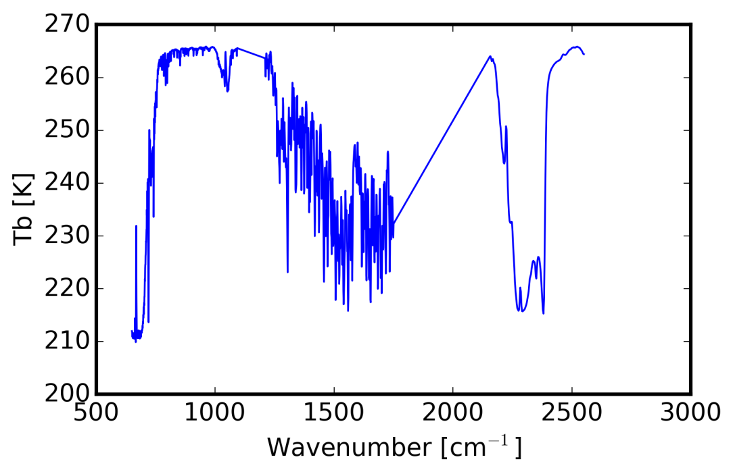
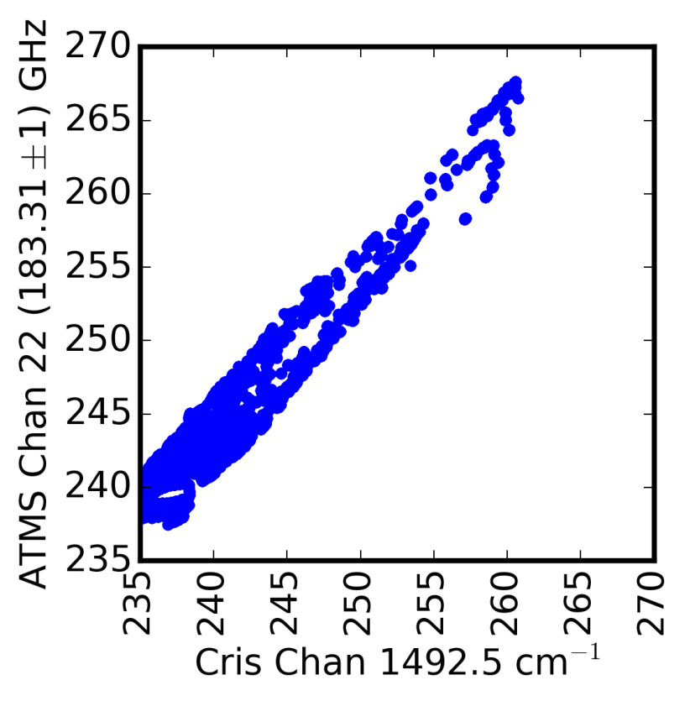
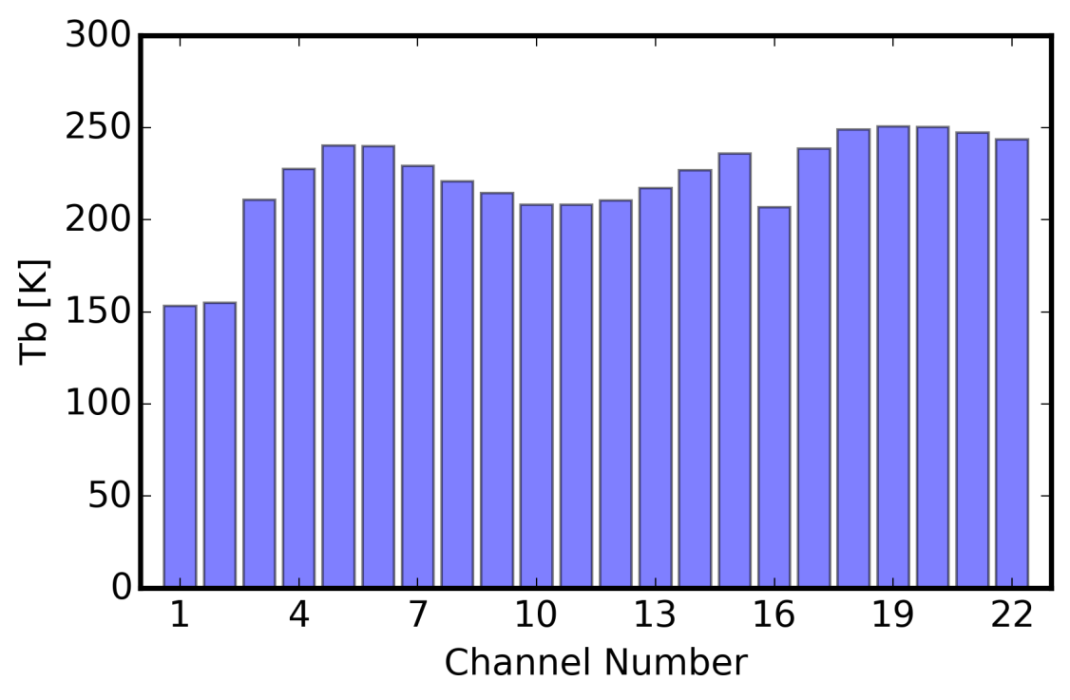
Ultimate Goal: Generating ATMS Pseudo-Observations from CrIS data

Slide 33
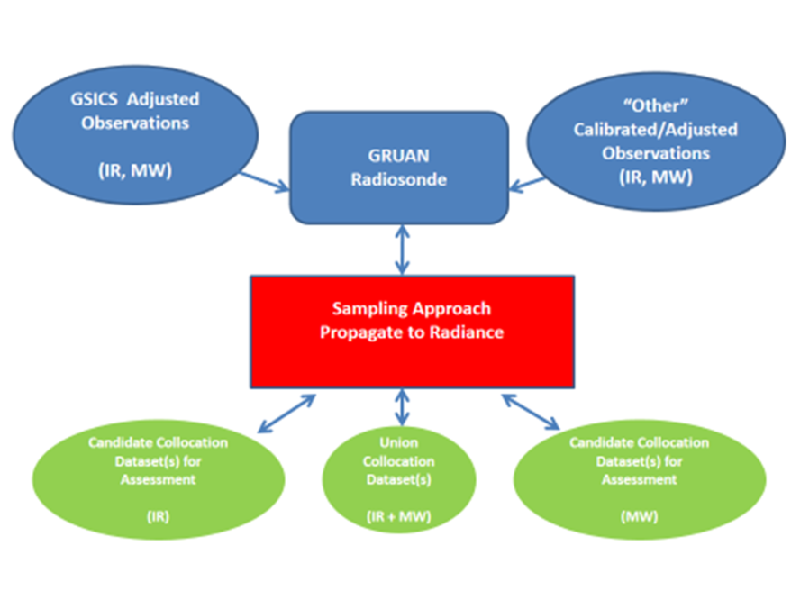
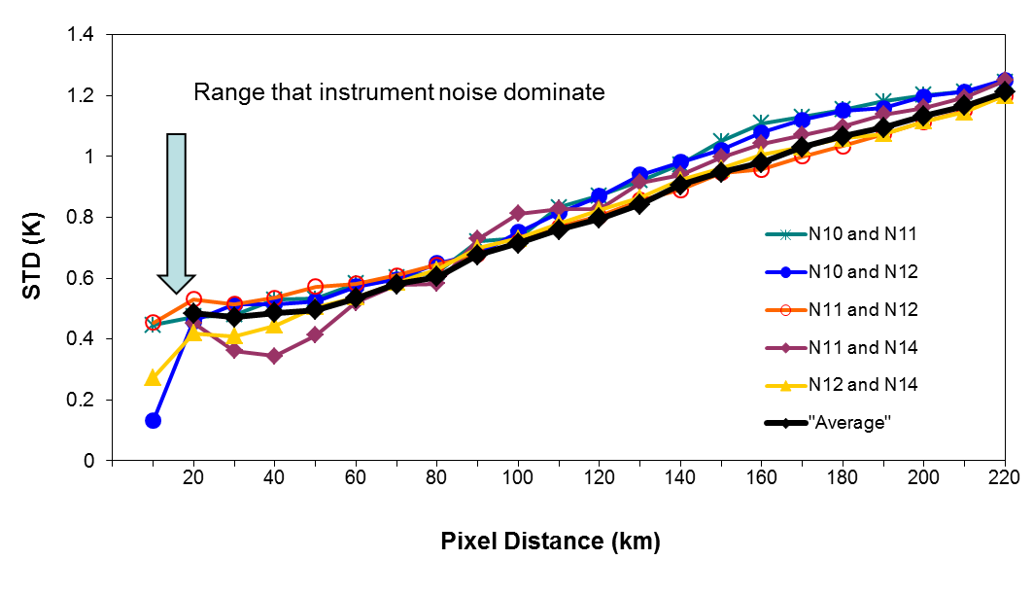
Provided by T. Reale, C-Z. Zou, B. Sun, et al.
A.GMW.2017.6f.2
Tony Reale (NOAA) to provide a draft of uncertainty analysis examples to determine feasibility of monitoring satellite microwave instruments using GRUAN observations (radiosonde). Note this is also linked to GIR.2017.7d.1 - IR
Article published in GSICS Newsletter (Winter 2018) – “GSICS and GRUAN Coordination” – Reale, Calbet, Zou, Moradi, John, Tobin and Sun
Instrument noises can be used to determine the distance criteria when collecting collocated datasets between GRUAN and MW Sensors
Minimum STD = √2 *0.3K=0.42K
Maximum distance for collocated datasets ~40Km

