Slide 1
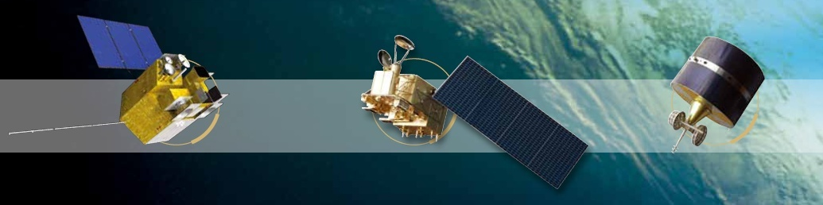
The improved calibration results of FY-4A/AGRI and some recommendations to GSICS GEO-LEO IR baseline algorithm
2018 GSICS Data & Research Working Groups Annual Meeting
Qiang Guo, Xuan Feng, Boyang Chen, and Ling Sun
guoqiang@cma.gov.cn
National Satellite Meteorological Center, CMA
19-23 March 2018, Shanghai, China

Slide 2
Outline
Background
Early results and improvements of FY-4A/AGRI
Recommendations to GSICS baseline algorithm
Conclusion

Slide 3
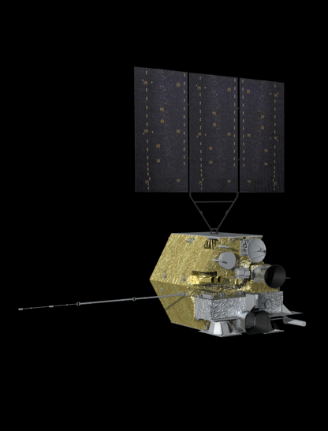
FY-4A: New Era of GEO Satellite together with GOES-R, MTG, Himawari-8/9.
Spacecraft:
Launch Weight: approx 5300kg
Stabilization: Three-axis
Attitude accuracy: 3″
Bus: 1553B+Spacewire
Raw data transmission : X band
Output power: >= 3200W
Design life: over 7 years
GIIRS: Geo. Interferometric Infrared Sounder
AGRI: Advanced Geosynchronous Radiation Imager
LMI: Lightning Mapping Imager
SEP: Space Environment Package

Slide 4
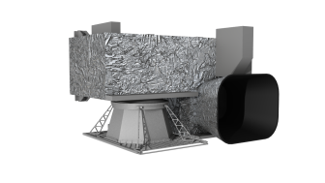
Characteristics of AGRI (Specification & Main Usage)
Spectral Coverage | Spectral Band (µm) | Spatial Resolution (Km) | Sensitivity | Main Applications
VIS/NIR | 0.45～0.49 | 1 | S/N≥90 (ρ=100%) | Aerosol
 | 0.55～0.75 | 0.5～1 | S/N≥200 (ρ=100%) | Fog, Clouds
 | 0.75～0.90 | 1 | S/N≥5(ρ=1%)@0.5Km | Vegetation
 | 1.36～1.39 | 2 | S/N≥200 (ρ=100%) | Cirrus
 | 1.58～1.64 | 2 |  | Cloud,Snow
 | 2.10～2.35 | 2～4 |  | Cirrus,Aerosol
Middle-wave IR | 3.50～4.00 | 2 | NEΔT≤0.7K(300K) | Fire
 | 3.50～4.00 | 4 | NEΔT≤0.2K(300K) | Land surface
 | 5.80～6.70 | 4 | NEΔT≤0.3K(260K) | WV
 | 6.90～7.30 | 4 | NEΔT≤0.3K(260K) | WV
Long-wave Infrared | 8.00～9.00 | 4 | NEΔT≤0.2K(300K) | WV,Clouds
 | 10.3～11.3 | 4 | NEΔT≤0.2K(300K) | SST
 | 11.5～12.5 | 4 | NEΔT≤0.2K(300K) | SST
 | 13.2～13.8 | 4 | NEΔT≤0.5K(300K) | Clouds,WV
AGRI’s Main Usage:
Acquire multiple band, high temporal resolution, high radiation accuracy images of Earth’s surface, atmosphere and cloud

Slide 5
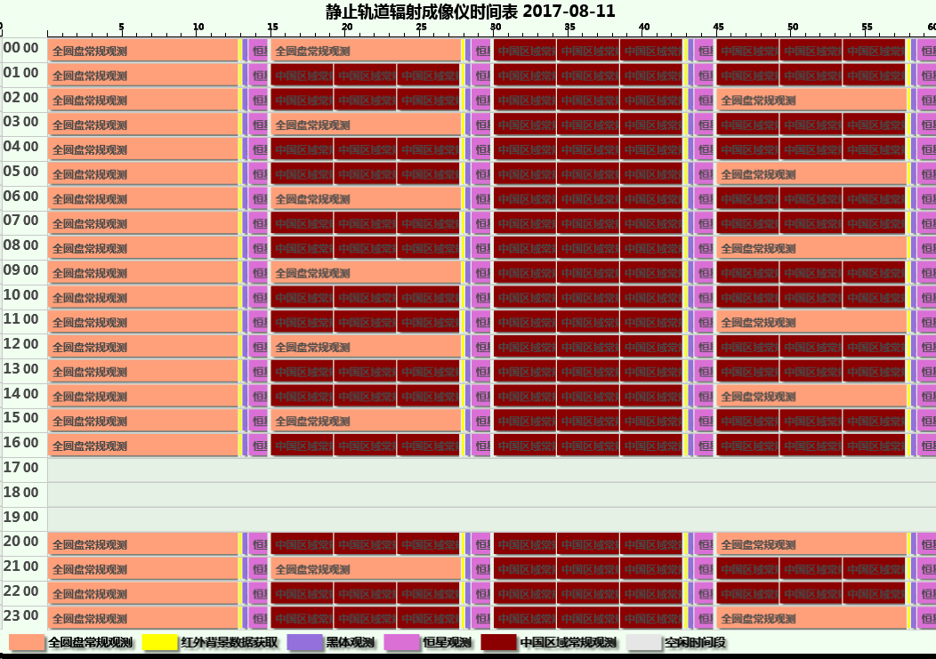
AGRI Mission/Time Table
Full disc observation can be finished within 15 min at one hour interval;
Local area (China and its surrounding) observation is restricted within 5 min;
A complete auxiliary observations (i.e. blackbody, space and star views) is performed every 15 min;
Every 3 hours, a combination of 3 full-disc images is done to support AMV product generation;
During 17-19 at local time, AGRI is suspended to ensure its safety.

Slide 6
Outline
Background
Early results and improvements of FY-4A/AGRI
Recommendations to GSICS baseline algorithm
Conclusion

Slide 7
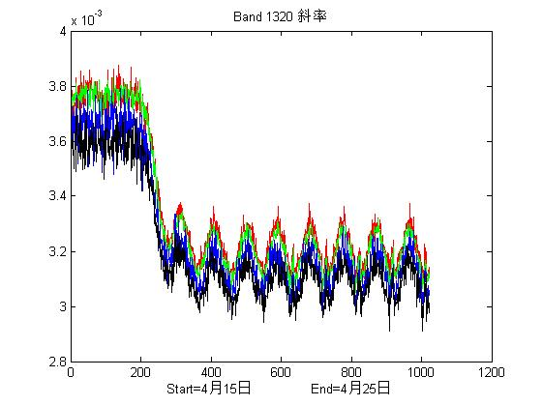
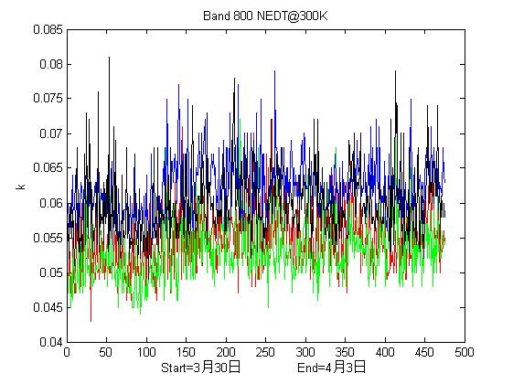
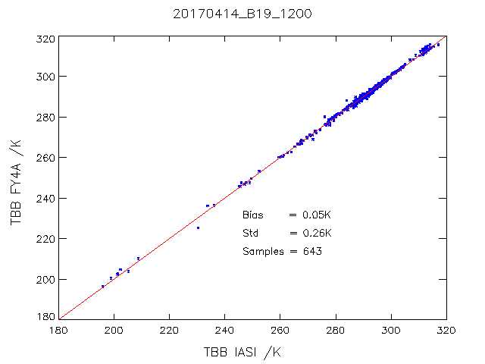
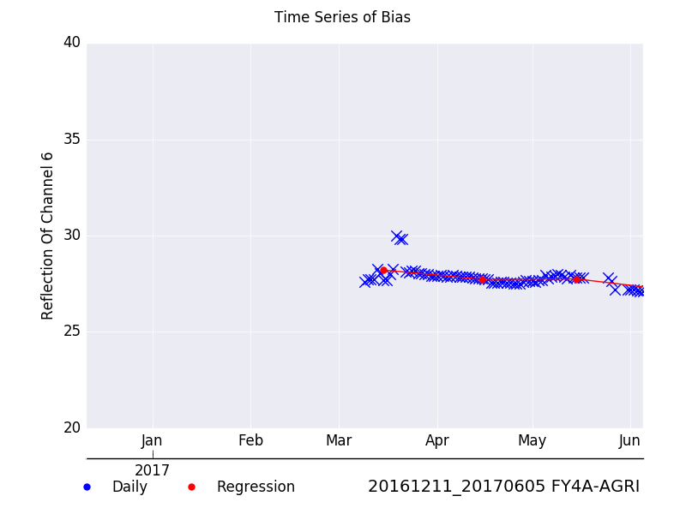
Main performance monitoring for AGRI
NEDT@300K(B11:8.5μm)
B14:13.5μm
Sensitivity
CAL Slope
Daily Variation: 84~85K
88K
Time: 30 March ~ 3 April, 2017
Time: 15-25 April, 2017
CAL Bias Monitoring for TEB
CAL Performance Monitoring for RSB

Slide 8
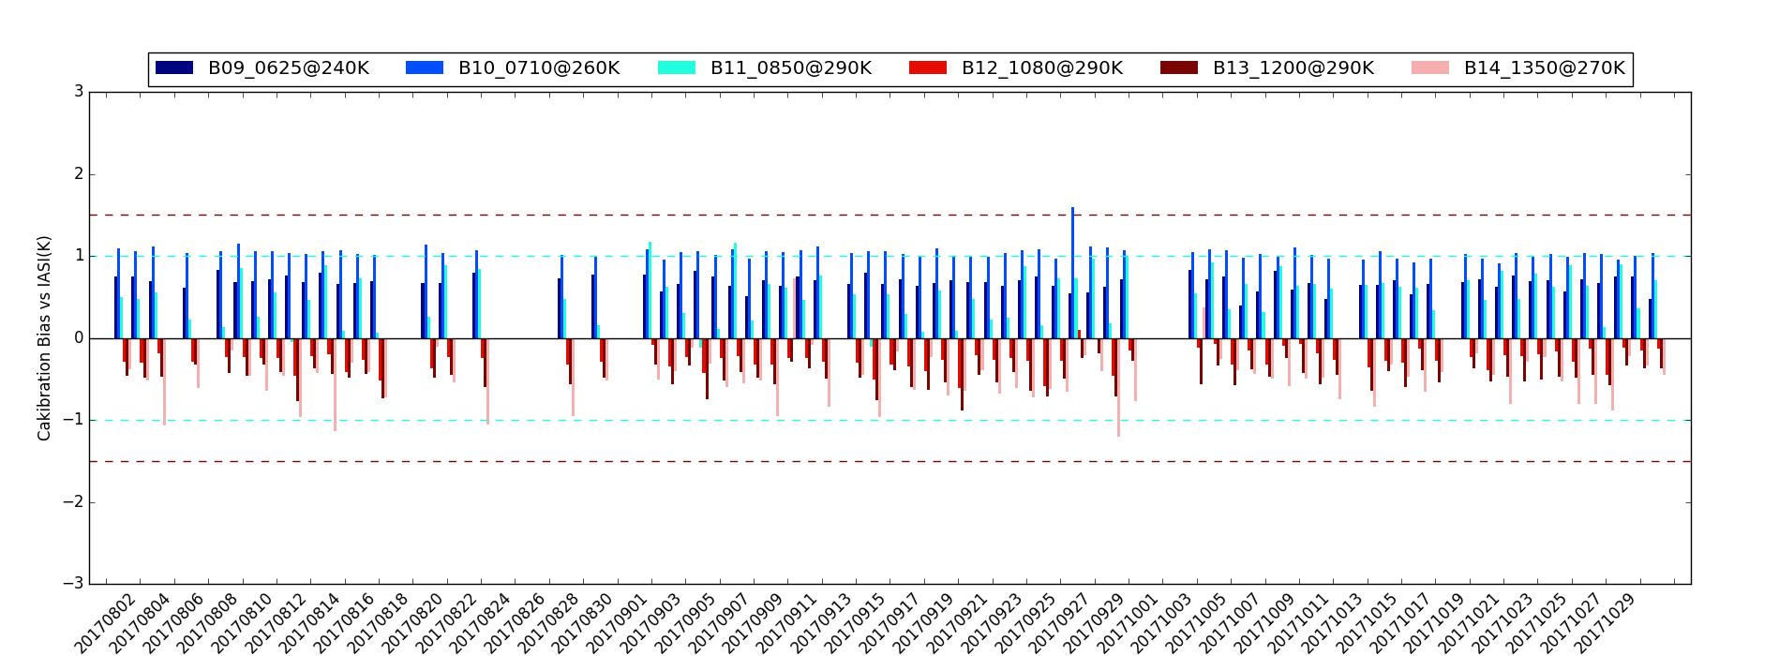
Early CAL bias monitoring for AGRI thermal IR bands
Period: 20170801~20171031; Ref: METOP-A/IASI
Band(μm) | Calibration Bias (vs.-IASI)
B09: 5.8~6.7 | 0.7K@240K
B10: 6.9~7.3 | 0.9K@260K
B11: 8.0~9.0 | 1.0K@290K
B12: 10.3~11.3 | 0.3K@290K
B13: 11.5~12.5 | 0.6K@290K
B14: 13.2~13.8 | 0.7K@270K
Other thermal IR bands (B09/10/11/13/14) appear some systematic bias in nature and should be improved!

Slide 9
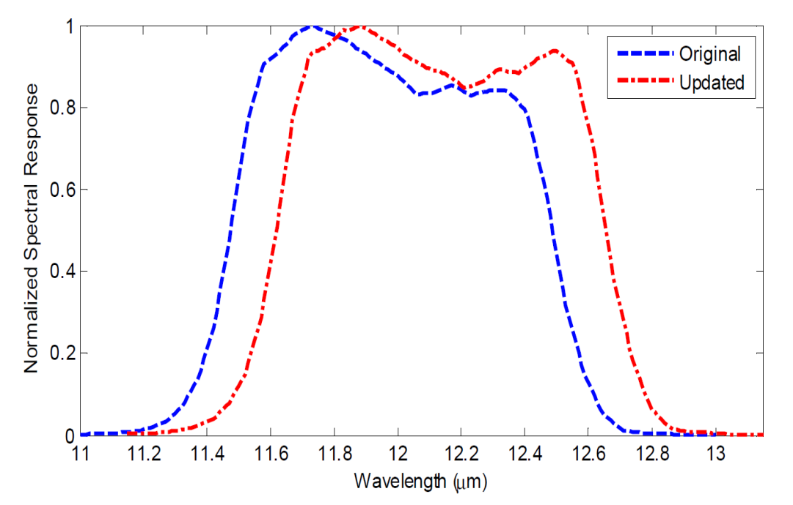
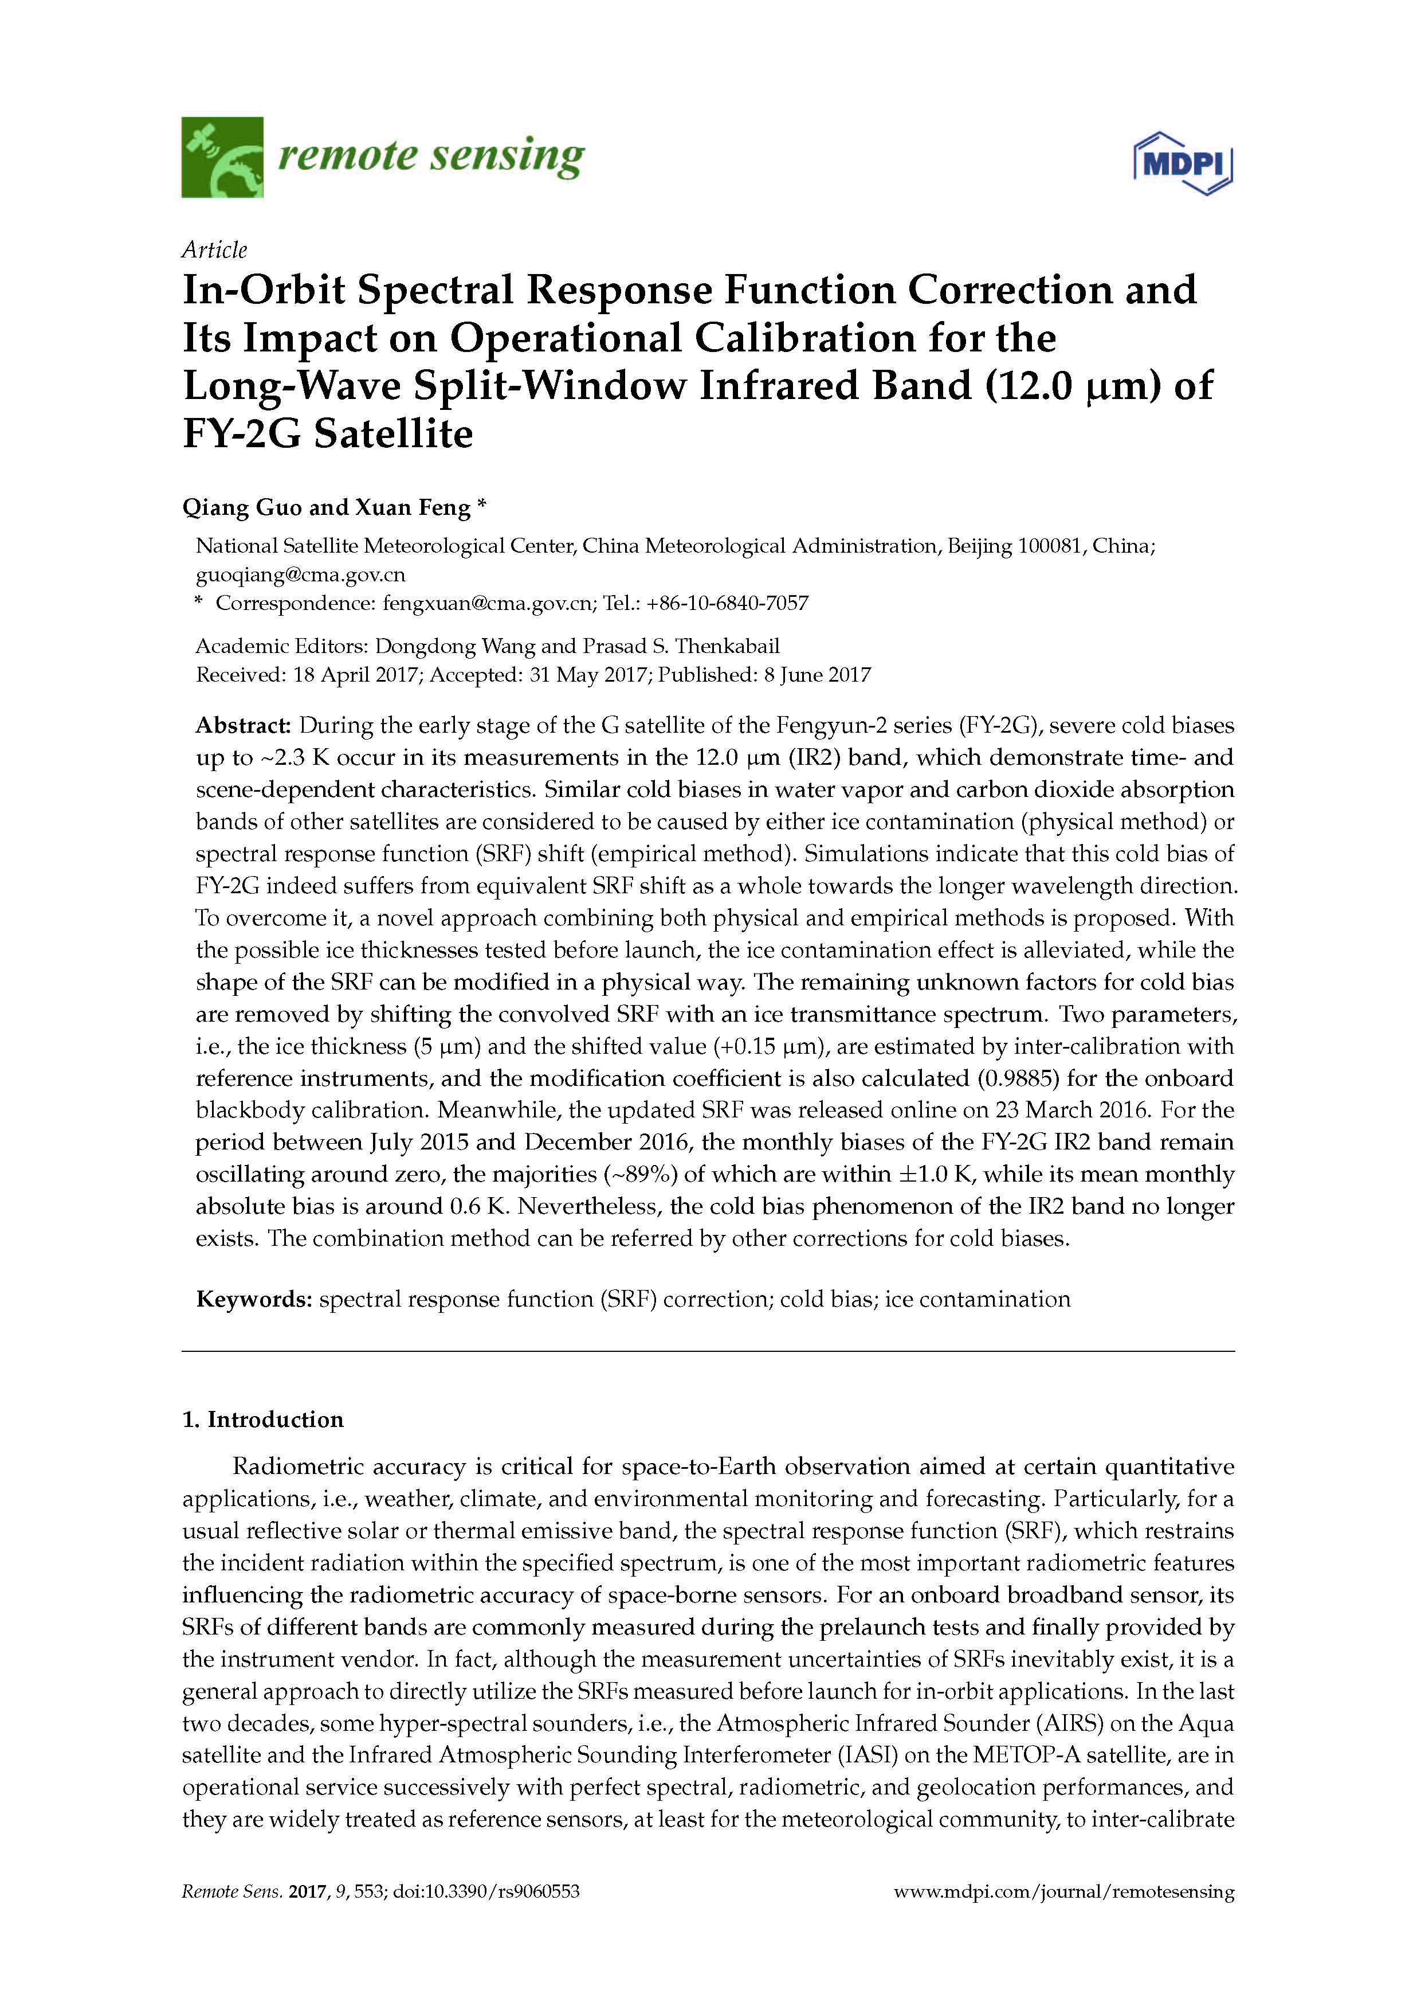
On-orbit SRF modification: FY-2G/VISSR IR2(11.5-12.5μm)
Physical (i.e. ice contamination) + Empirical (equivalent shift) method
Tim J. Hewison, et.al., 2013
Xiangqian Wu & Fangfang Yu, 2013
Monthly biases of main infrared bands of FY-2G/VISSR satellite between July 2015 and December 2016 against METOP-A/IASI.

Slide 10
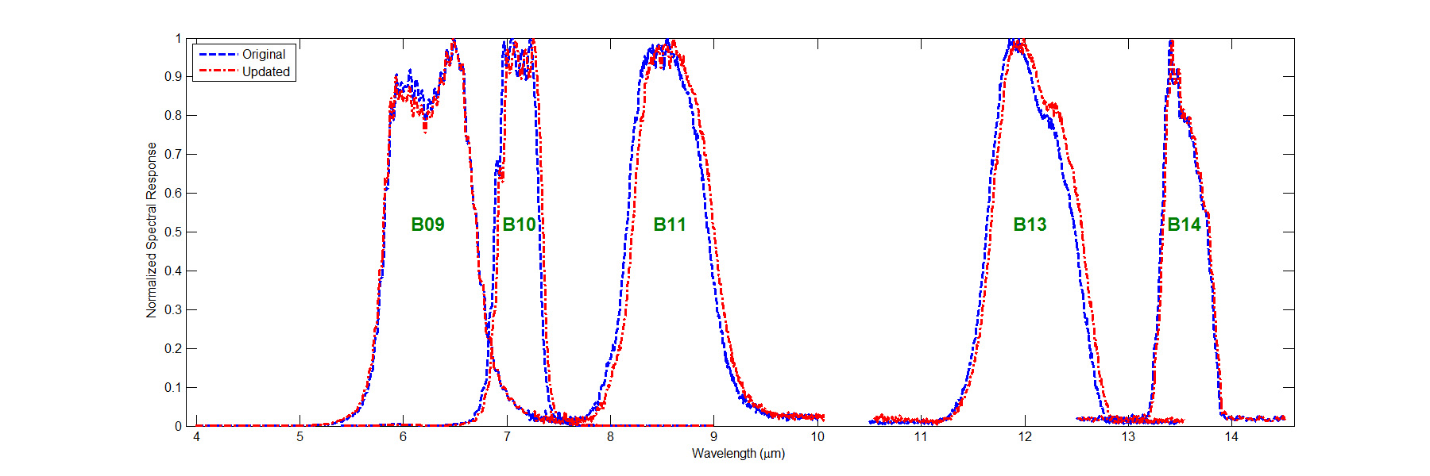
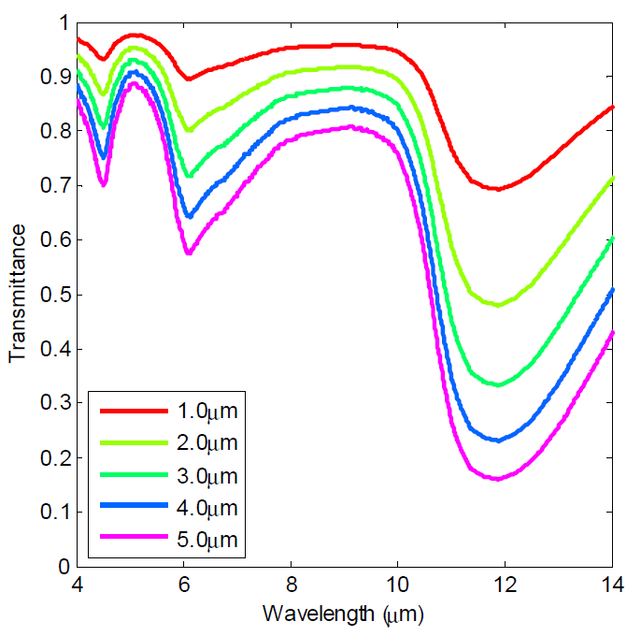
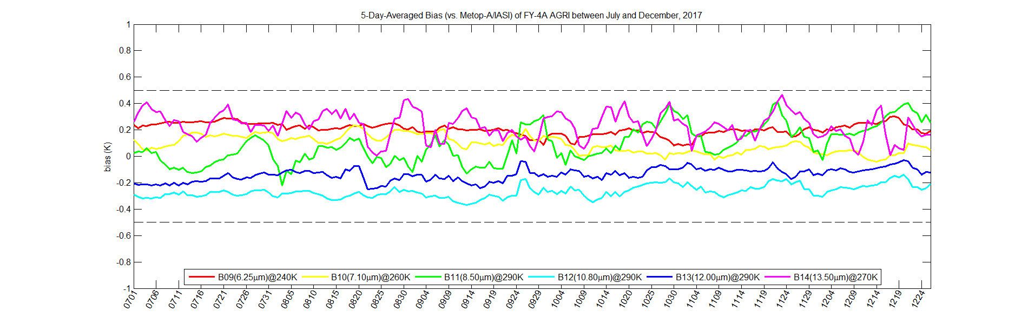
On-orbit SRF modification: FY-4A/AGRI B09/10/11/13/14
ice transmission spectrum with different ice-layer thickness
SRF comparison between before and after adjustment
B09
B10
B11
B13
B14
Re-assessed CAL biases of 6 TIR bands with new SRFs between July and December, 2017

Slide 11
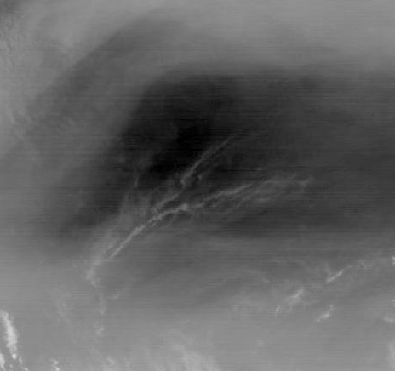
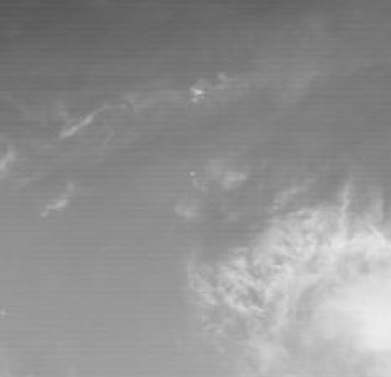
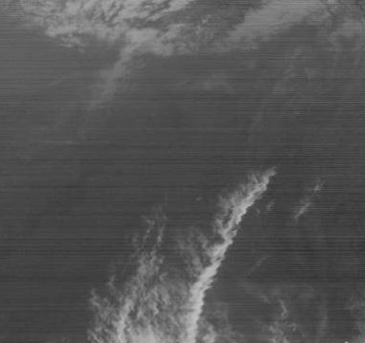
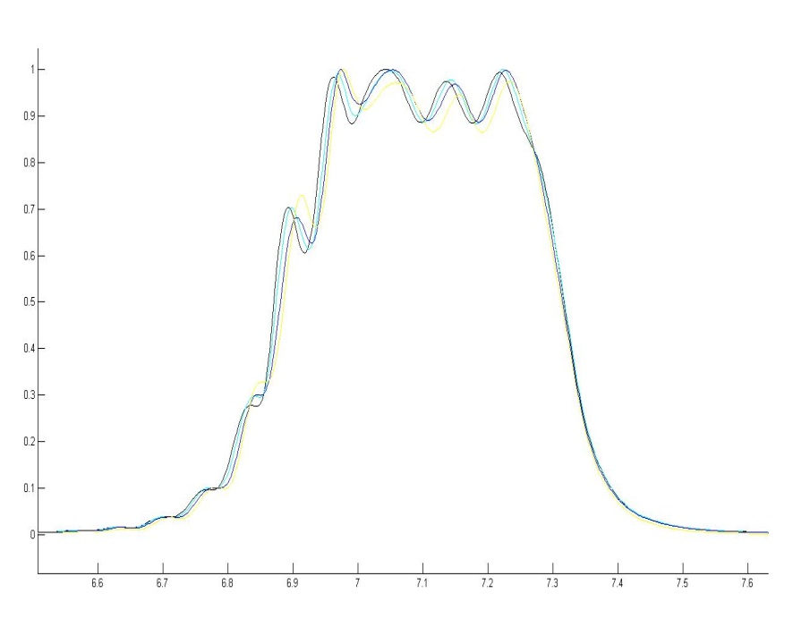
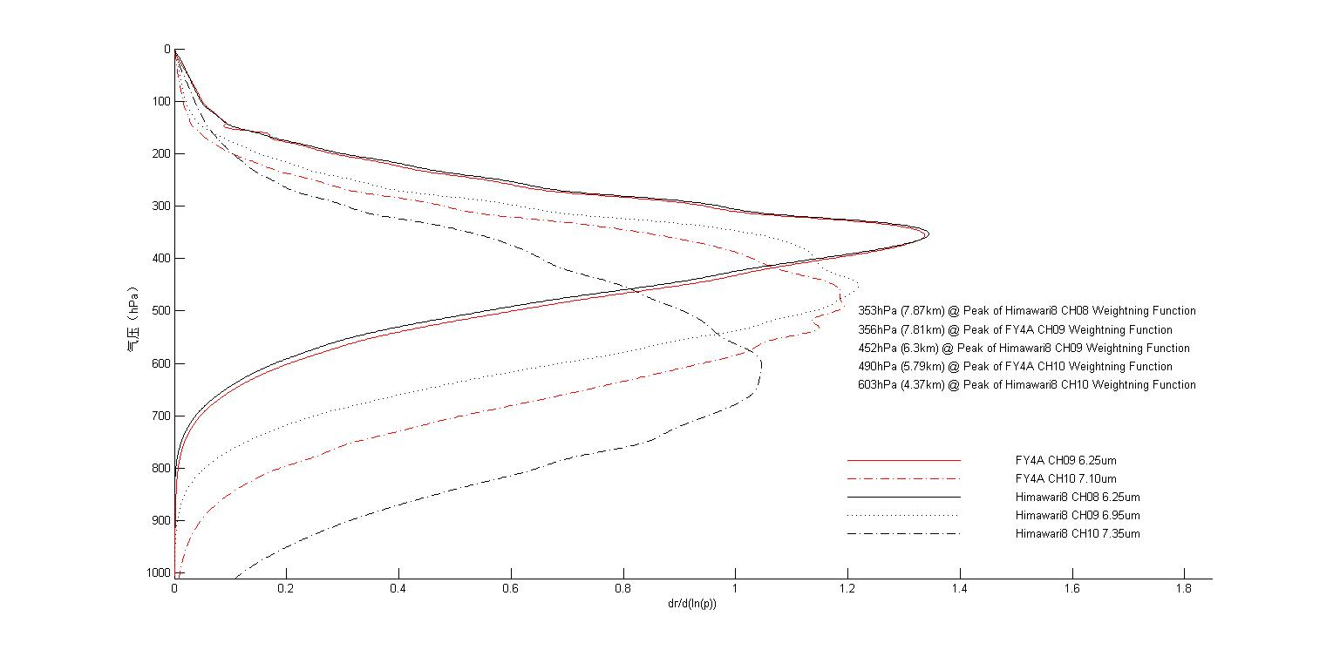
Stripe restrain in atmospheric absorption bands: B09/10/14
B09: 6.25μm
B10: 7.10μm
B14: 13.5μm
SRF
Weights Profile
Normalized SRF
Pressure (hPa)
Wavelength (μm)
dr/d(ln(p))

Slide 12
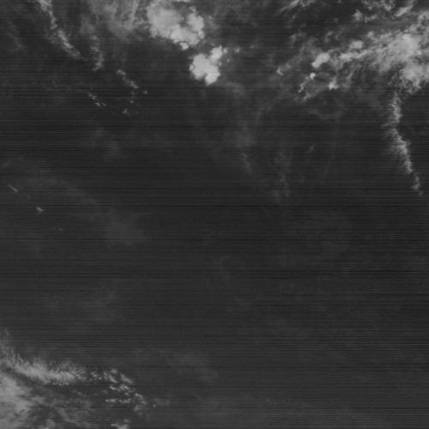
B14: 13.5μm
Comparison between with and without stripe restrain (wavelet processing)

Slide 13
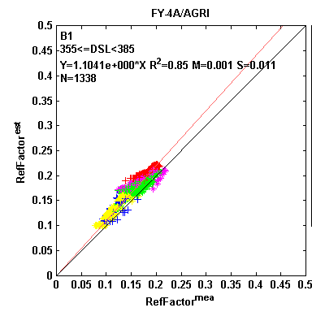
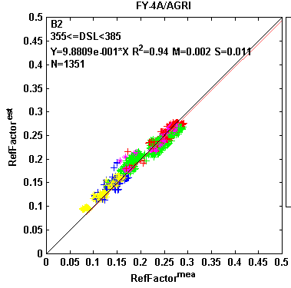
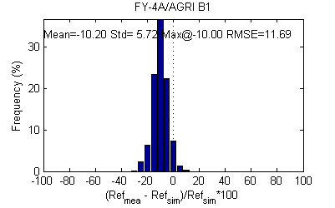
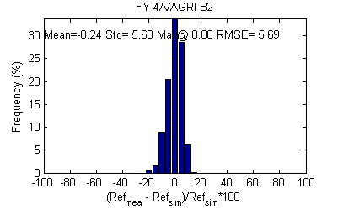
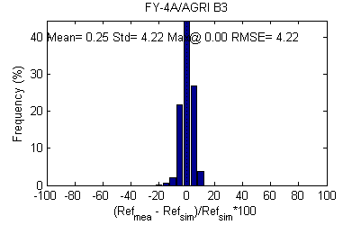
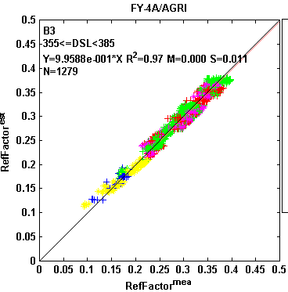
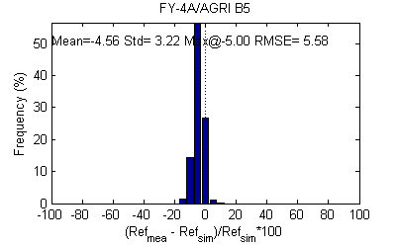
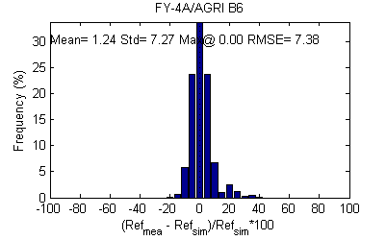
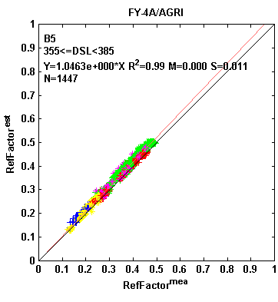
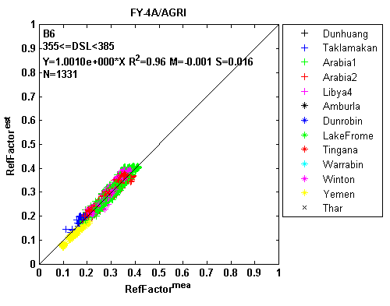
Reflective Solar Band (RSB) Calibration and Update
B1_{bias}: -10%
B5_{bias}: -4%
Monitoring results from
multiple (13) sites in coverage area for one month (Dec. 2017)
Difference histogram between operational CAL and simulation (Dec. 2017)

Slide 14
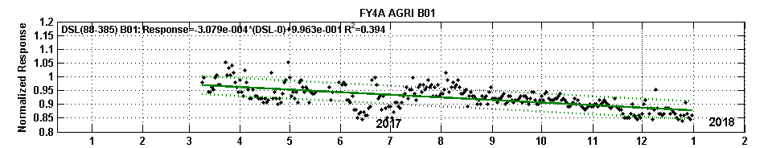
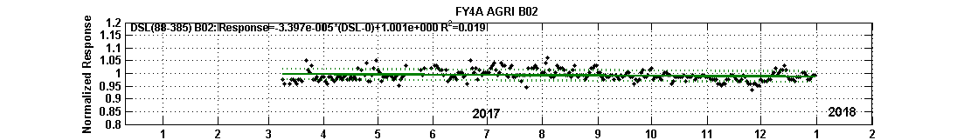
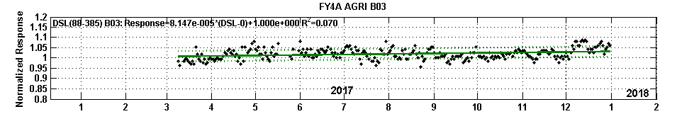
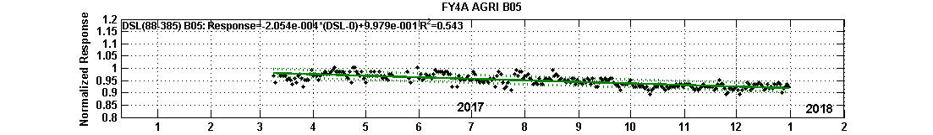
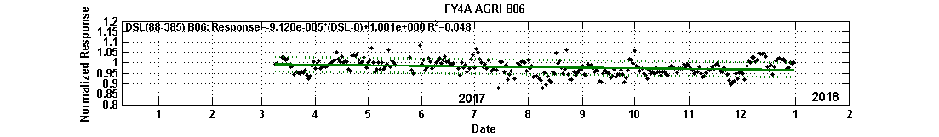
Band | TotalDecay(%) | AnnualDecay (%) | Sigma/ Mean (%)
1 | 11.88 | 11.24 | 3.54
2 | 1.31 | 1.24 | 2.10
3 | -3.14 | -2.97 | 2.51
5 | 7.93 | 7.50 | 1.72
6 | 3.52 | 3.33 | 3.57
Calibration coefficients of B1 and B5 have been updated in 15 March, 2018

Slide 15
Outline
Background
Early results and improvements of FY-4A/AGRI
Recommendations to GSICS baseline algorithm
Conclusion

Slide 16
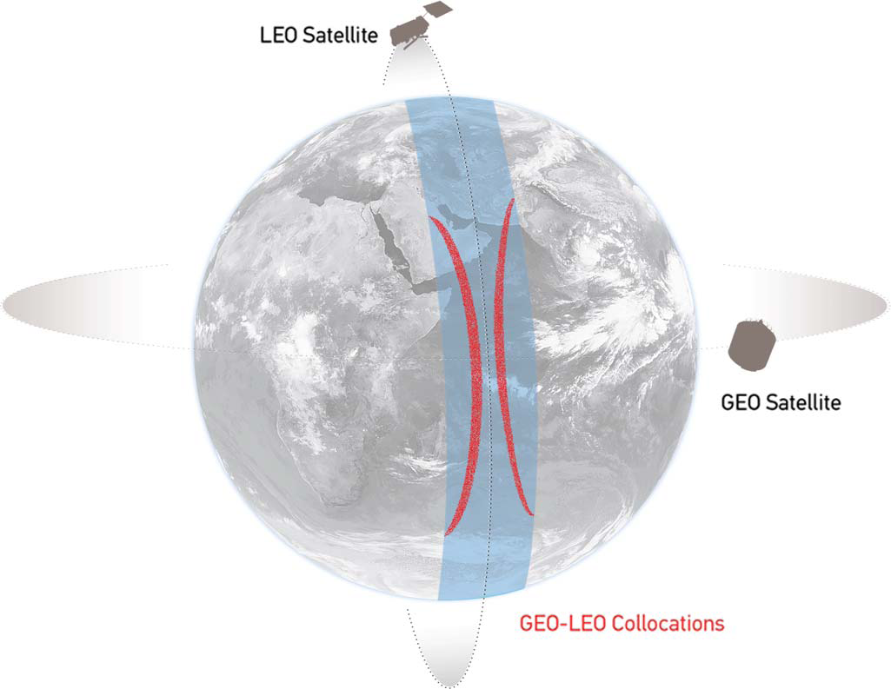
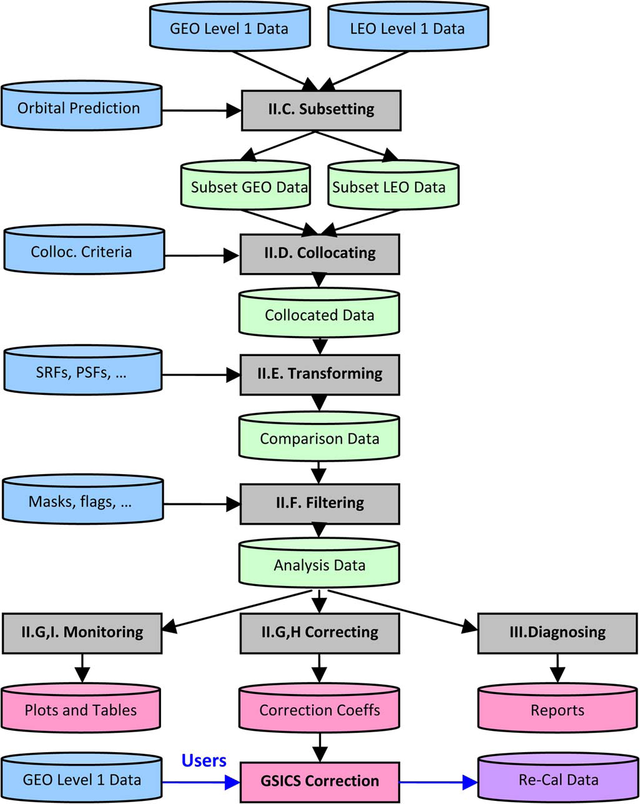
GSICS framework for SNO GEO-LEO intercalibration
Two issues needs to be considered more carefully:
Accurate spatial collocation or matching particularly for GEO-LEO matched pairs far away for satellite’s nadir;
Necessity parallax correction for cloud targets for intercalibration at some low BT region (i.e.<220K)
Cited from Tim J. Hewison, et.al., 2013

Slide 17
Necessity of accurate spatial collocation for GEO-LEO Intercalibration
● Overlap pattern for GEO-LEO intercalibration varies with satellite zenith;
● Overlap pattern should be calculated accurately according to the relative positional and pointing information between satellite and targets
GSICS recommended overlap pattern
Overlap pattern far away from nadir

Slide 18
Examples of overlap pattern for real GEO-LEO intercalibration
(a) (b) (c)
Real spatial collocations of intercalibration between FY-2G VISSR and METOP-A IASI at UTC0300 April 24, 2015
(a) Collocated map in slant hourglass pattern; (b) Real spatial collocation examples near nadir; (c) Real spatial collocation examples far away from nadir
Weights distribution in the newly defined target area (5 by 5 GEO pixels) for three typical cases
Case 1: (94.566971, 0.048508) |  |  |  |  | Case 2: (94.409821, 0.082732) |  |  |  |  | Case 3: (107.867203, 33.345127)
0.000000 | 0.000000 | 0.000000 | 0.000000 | 0.000000 | 0.000000 | 0.000000 | 0.000000 | 0.000000 | 0.000000 | 0.000000 | 0.000000 | 0.000000 | 0.000000 | 0.000000
0.000000 | 0.037073 | 0.193131 | 0.065738 | 0.000000 | 0.000000 | 0.061248 | 0.097010 | 0.000000 | 0.000000 | 0.000580 | 0.072261 | 0.072596 | 0.005496 | 0.000000
0.000000 | 0.118072 | 0.202203 | 0.177856 | 0.000000 | 0.000000 | 0.277795 | 0.213222 | 0.044326 | 0.000000 | 0.065868 | 0.152944 | 0.152961 | 0.165959 | 0.000000
0.000000 | 0.019351 | 0.153254 | 0.033321 | 0.000000 | 0.000000 | 0.129960 | 0.170167 | 0.006272 | 0.000000 | 0.000128 | 0.117286 | 0.119667 | 0.074255 | 0.000000
0.000000 | 0.000000 | 0.000000 | 0.000000 | 0.000000 | 0.000000 | 0.000000 | 0.000000 | 0.000000 | 0.000000 | 0.000000 | 0.000000 | 0.000000 | 0.000000 | 0.000000
The uniform weighting (UW) recommended by GSICS should be replaced by the proposed variable weighting (VW) one!

Slide 19
How the proposed VW method benefits intercalibration results?
Intercalibration results of typical observation at UTC 0430 Jan.1, 2016 for FY-2E at different target’s nonuniformity (ρ) and spatial collocation method (UW or VW)

Slide 20
Necessity of parallax correction (PC) for GEO-LEO Intercalibration
The sketch of basic viewing geometry for space-to-Earth observation when satellite’s nadir is on the Earth equator

Slide 21
Simulated parallax corrections for GEO & LEO for clouds with different heights
Parallax effect error (e_{PE}) against satellite zenith angle (δ) under different cloud heights between 10 and 20 km for both GEO (VISSR) and LEO (IASI) sensors

Slide 22
How the proposed PC method benefits intercalibration results?
Scatter diagrams of typical observation at UTC 0300 Apr.6, 2016 for FY-2G IR1-IR3 bands with/without PC

Slide 23
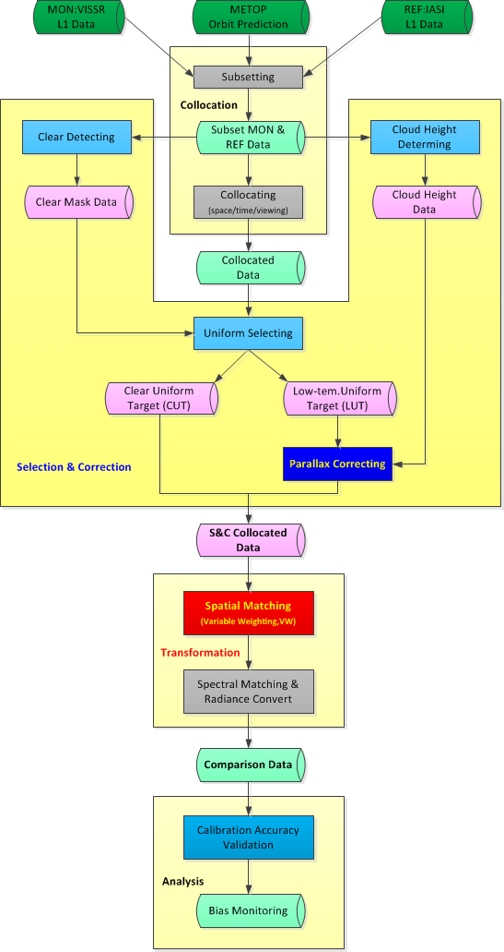
Independent developed calibration accuracy validation system for GEO satellites (GeoCAVS) under GSICS
Calibration bias of FY-2E main TEBs (IR1-IR3) between January 2014 and December 2016 validated by GeoCAVS
NEW
GeoCAVS
Flowing chart
Calibration bias of FY-2G main TEBs (IR1-IR3) between June 2015 and December 2016 validated by GeoCAVS

Slide 24
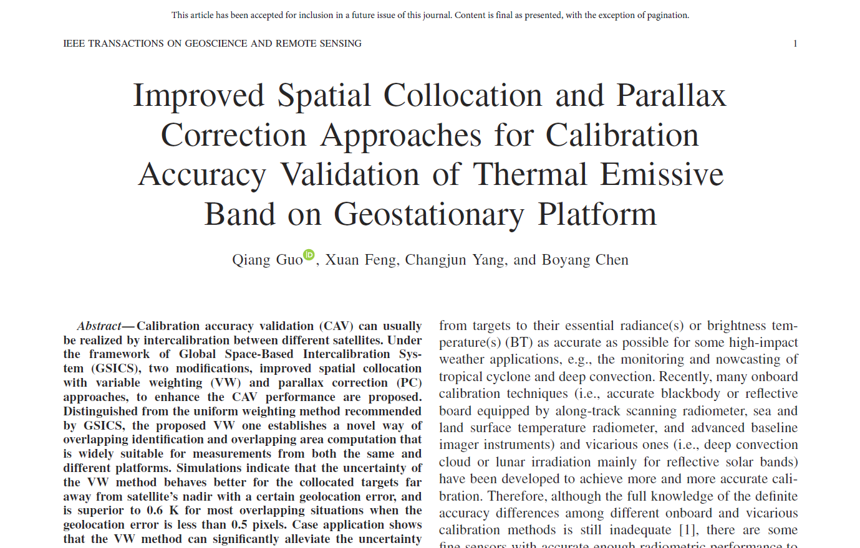
Reference: recommendations for GSICS baseline algorithm
This article (DOI:10.1109/TGRS.2017.2778744) has been online published on IEEE TGRS in March 6, 2018

Slide 25
Outline
Background
Early results and improvements of FY-4A/AGRI
Recommendations to GSICS baseline algorithm
Conclusion

Slide 26
The GEO imager (AGRI) with high accuracy in temporal, spatial & radiometric aspects on FY-4A satellite is available and believed to be comparable with GOES-16/ABI & H8/AHI
  Full-disc observation can be finished within15 min and local area (China and its surrounding area) is restricted within 5 min;
  Using wavelet processing, the stripes in B09/10/14 have been removed completely;
  With a comprehensive on-orbit SRF adjustment for most (B09/10/11/13/14) TIR bands of AGRI, the daily biases of all the 6 TIR bands are entirely lower than 0.5K.
About recommendations to GSICS GEO-LEO IR baseline algorithm
  Compared with the uniform weighting (UW) method recommended by GSICS for spatial collocation, the proposed variable weighting (VW) one is theoretically more accurate when the paired observations are far away from satellite’s nadir, where the dynamic identifying the overlapping relationship also benefits the intercalibration between hyperspectral sensors with comparable spatial resolutions.
  The proposed parallax correction (PC) method is suitable for intercalibration with cloud targets with a certain height to achieve more reliable outcomes.
  Therefore, both VW and PC methods are recommended for GSICS utilization at least in GEO-LEO IR intercalibration. Relevant documents and prototype software are willing to share in GSICS community if required.

Slide 27


Thanks for your attention

