Slide 1
Progress on COMS IR inter-calibration
Minju Gu and Dohyeong Kim
KMA
2018 GSICS Annual Meeting, 19-23 March 2018, Shanghai, China

Slide 2
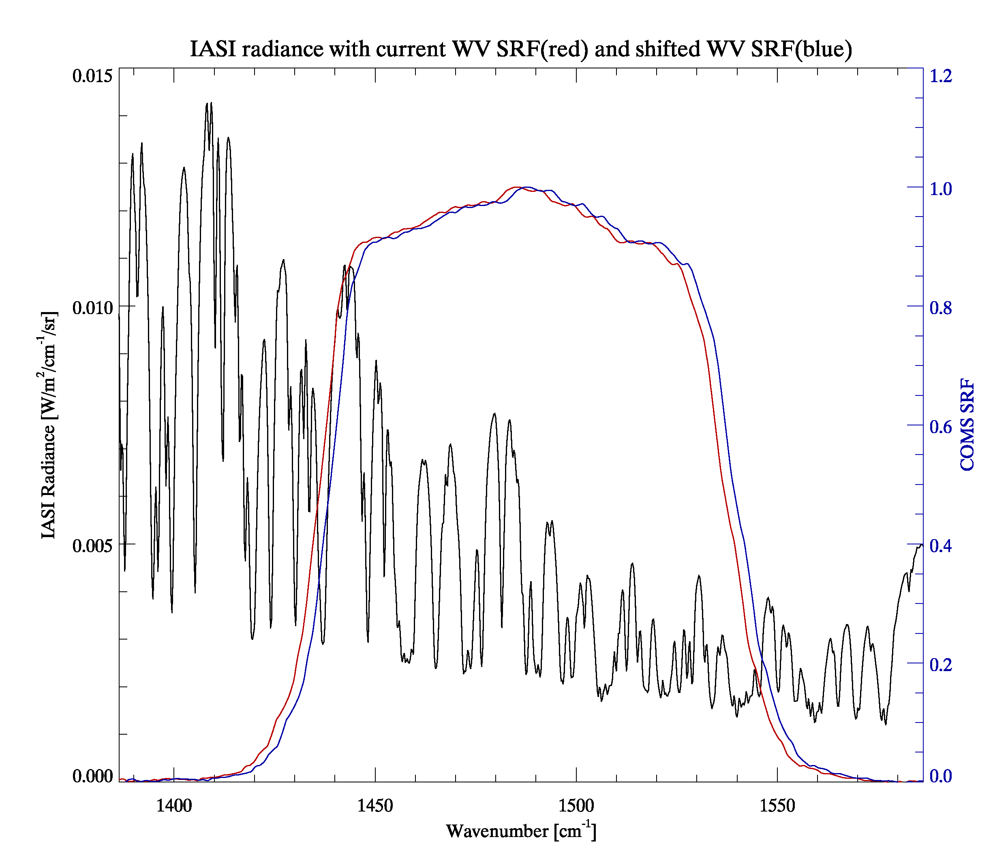
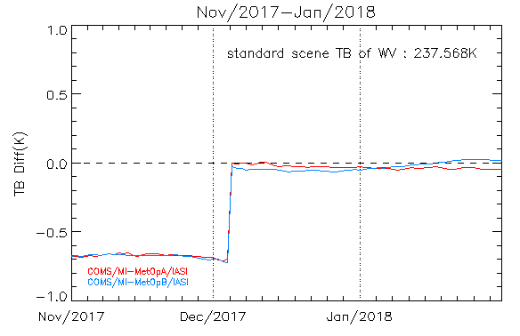
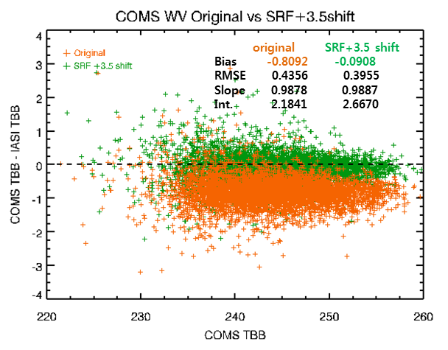
Operation with shifted SRF of WV
Remove the consistent biases in WV inter-calibration with IASI by adopting the SRF shift
Operation with shifted WV SRF 3.5cm⁻¹ since Dec.5. 2017 shows the small TB bias(COMS-IASI/A,B) close to zero
3.5 cm⁻¹
Test Operation

Slide 3
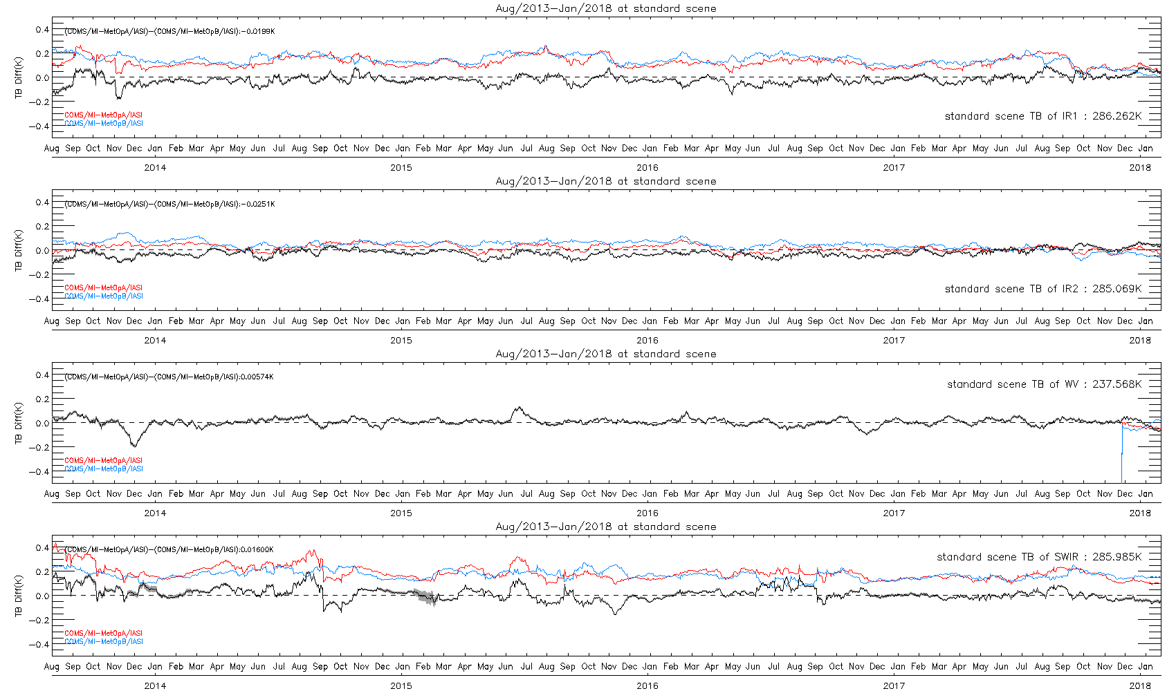
Double Difference (IASI)
Time series of Double Difference
Period: Aug/2013-Jan/2018
COMS/MI-MetOpA/IASI, COMS/MI-MetOpB/IASI and (COMS/MI-MetOpA/IASI)-(COMS/MI-MetOpB/IASI) at standard scene TB
IR1(10.8μm)
IR2(12.0μm)
WV(6.8μm)
SWIR(3.8μm)

Slide 4
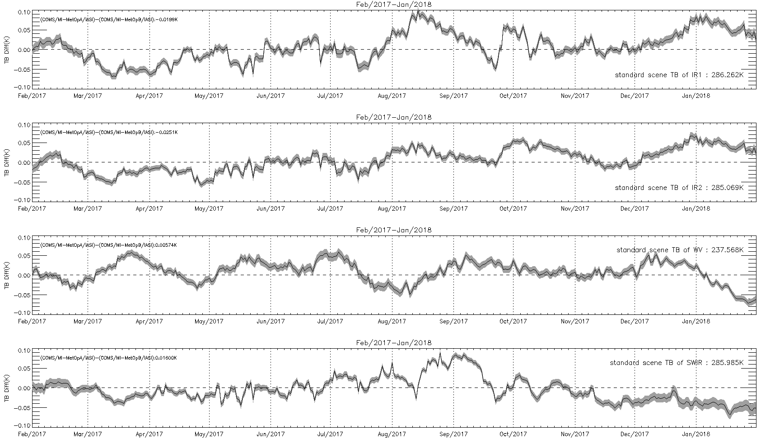
Double Difference Zoom(IASI)
IR1(10.8μm)
IR2(12.0μm)
WV(6.8μm)
SWIR(3.8μm)

Slide 5
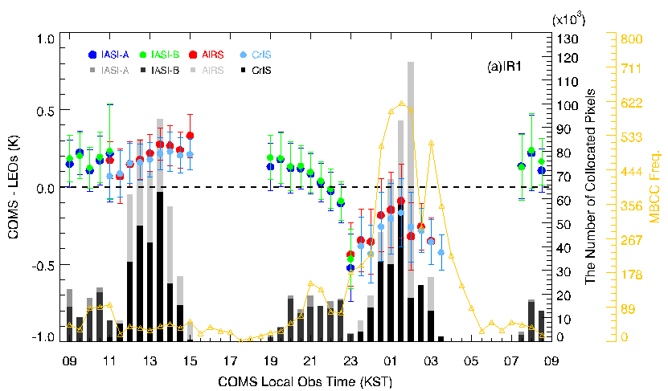
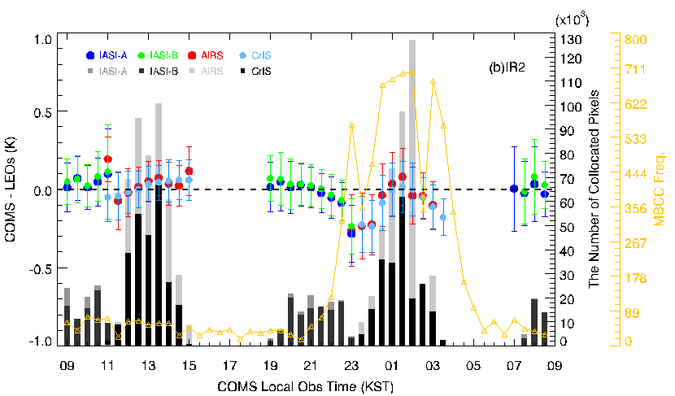
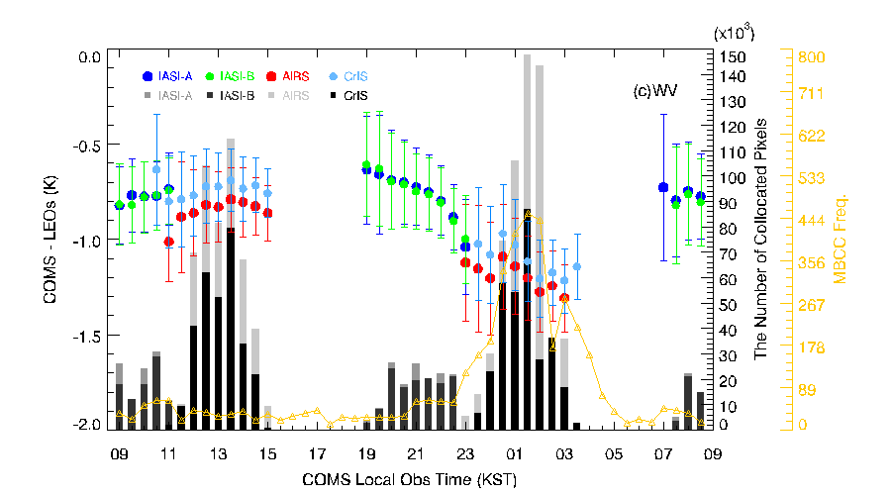
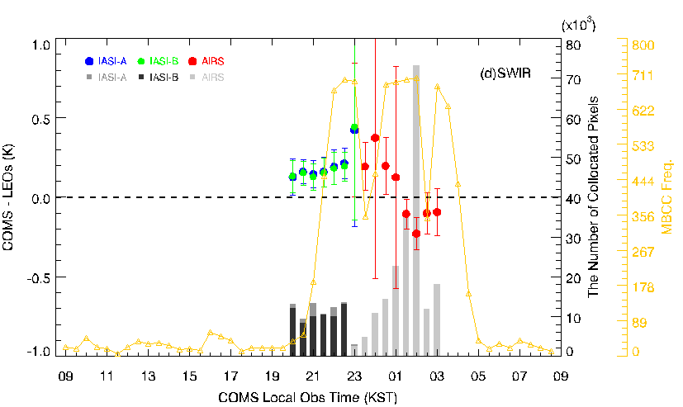
Diurnal variation at standard scene
Diurnal variation for TB bias of IASI-A, IASI-B, AIRS and CrIS at standard scene,
KMA-NOAA collaboration about Diurnal variation

Slide 6
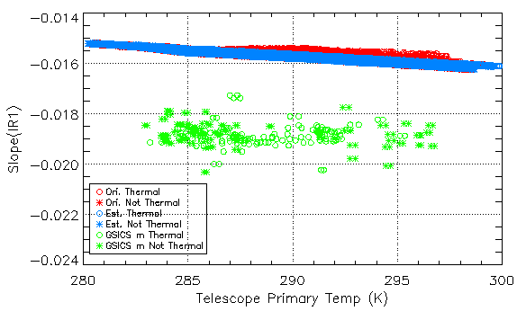
KMA-NOAA collaboration
GSICS Slope to replace Estimated slope(MBCC application)
Period : March, June, September, December 2016
GSICS Slope : $m_{GSICS}=b_{g}=\frac{b_{c}}{b_{r}}$ $I_{GEO}=a_{c}+b_{c}C_{GEO} , I_{GEO}=a_{r}+b_{r}I_{LEO}$ ⇒ $I_{LEO}=a_{g}+b_{g}C_{GEO}$ , where $a_{g}=\frac{a_{c}−a_{r}}{b_{r}}$, $b_{g}=\frac{b_{c}}{b_{r}}$
Original Slope : $m_{org}=\frac{r_{BB}−q×({{\overline{X}}_{BB}}^{2}−{{\overline{X}}_{SP−BB}}^{2})}{{\overline{X}}_{BB}−{\overline{X}}_{SP−BB}}$
Estimated slope : $m_{est}=C_{0}+C_{1}×T_{optics}+C_{2}×{T_{optics}}^{2}$ where $T_{optics}$ : “predicting” temperature
m_{org}
Summary
GSICS slope is systematically smaller than the original/estimated slope
Current GSICS slope couldn’t be the replacement of original/estimated slope
IR1
m_{est}(MBCC)
m_{GSICS}
NEWLY propose by NOAA : MICA(Midnight IR Calibration Anomaly)
$R_{BB}=\left\{\left[ε_{SM}B\left(T_{SM}\right)\left(1−ε_{BB}\right)+ε_{BB}B\left(T_{BB}\right)\right]Ω_{SM}+ε_{BB}B\left(T_{BB}\right)\left(1−Ω_{SM}\right)\right\}\left(1−ε_{SM}\right)+R_{SP}$ ⇒ $\frac{R_{BB}}{B(T_{BB})}=a+b\frac{{B(T}_{SM})}{B(T_{BB})}$ , where $R_{BB}$ : radiance from GSICS
On-going project

Slide 7
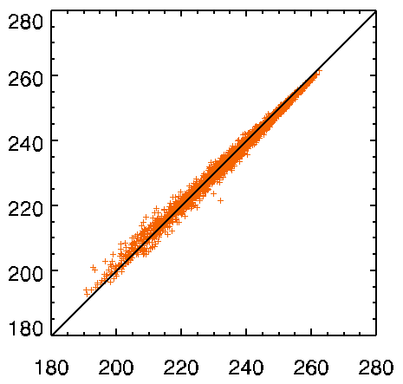
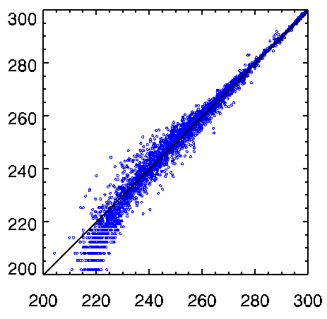
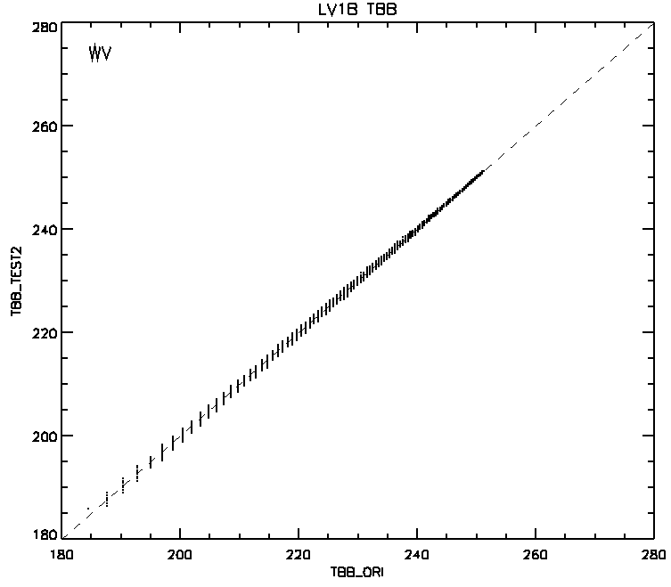
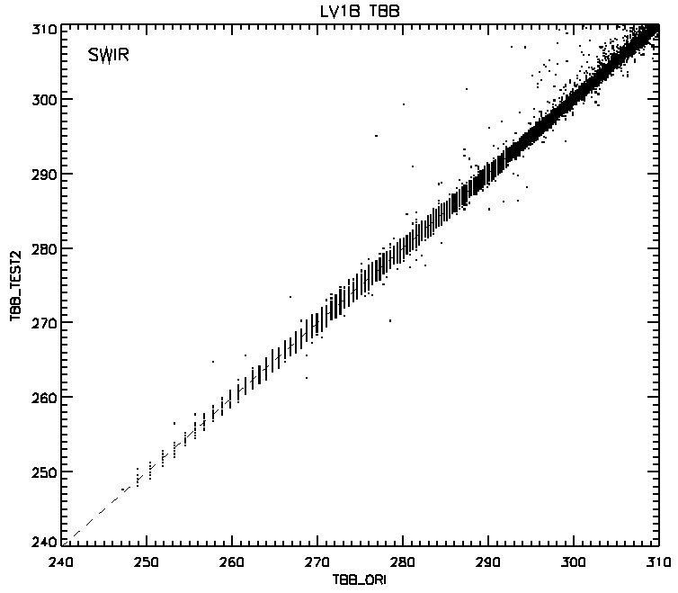
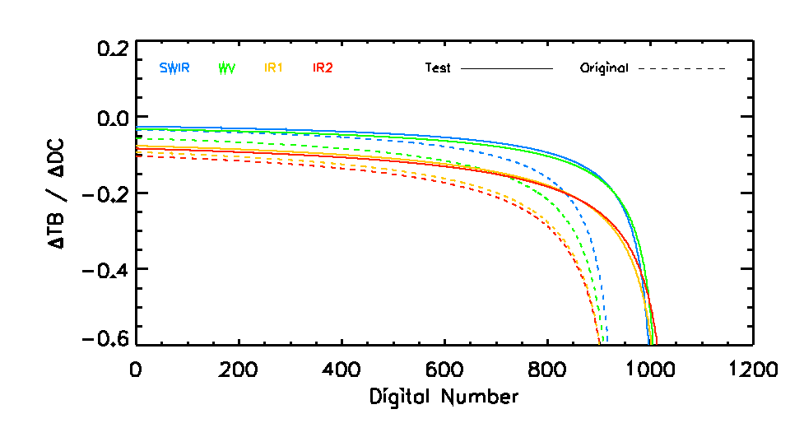
Dynamic Range of MI for Infrared channel
TB inter-comparison with IASI appears large differences in low temperature, especially for SWIR, WV channels
Need to update dynamic range(DN to Radiance conversion table) of COMS MI
WV
SWIR
Adjusted dynamic range to increase radiometric resolution
Max TBB of SWIR : 350 K → 320K
COMS TB(K)
SWIR
WV
IASI TB(K)
IASI TB(K)
Test TBB
Increasing resolution
Original TBB
Original TBB
Will update pre-processing system with adjusted dynamic range by the first half of 2018

Slide 8
Thank you

