Slide 1
Himawari-8/9 AHI GEO-GEO Comparisons
Hidehiko Murata, Yusuke Yogo and Masaya Takahashi
Meteorological Satellite Center
Japan Meteorological Agency
Notes:
I'm gonna talk about Himawari89 AHI GEO-GEO comparisons

Slide 2
Use of GEO-GEO and
GEO-LEO Approach for AHIs
Purpose : to check the consistency of 1) AHI-8/-9 calibration performance and 2) multiple validation approaches
GEO-LEO approach
IR : 10 bands from 3.9 to 13.3 μm
Quasi-SNO w/ hyperspectral IR sounders (IASI, AIRS and CrIS)
(VNIR : 6 bands from 0.47 to 2.3 μm)
Vicarious cal. using RTM + MODIS, Ray-matching w/ S-NPP/VIIRS
GEO-GEO approach
Direct comparison of AHI-8/9 full-disk radiances
A few times / year, during ~2 weeks of Himawari-9 “Health Check” operation
Himawari-8/-9 SSPs : within 0.1 degrees at 140.7 E
Averaged radiances over 19x19 pixels are used
Notes:
first of all, JMA has utilized both GEO-GEO and GEO-LEO approaches
the purpose of doing these approaches is to check the consistency of Himawari8 and 9 AHI calibration performance and multiple validation approaches
we apply the QuasiSNO method using hyperspectral sounders as the GEO-LEO approach for IR bands,
and vicarious calibration using radiative transfer model and raymatching with VIIRS for visible and NIR bands
because SSPs of Himawari8 and 9 are almost same around 140.7 deg E, we can directly apply GEO-GEO between Himawari8 and 9, but only when Himawari9 is under health checkup
Averaged radiances over 19x19 pixels are used for comparison

Slide 3
AHI-8/-9 TB Differences
(2018-02-16 14:30 UTC, Full-Disk)
Need for Spectral Band Adjustment Factor (SBAF) to validate calibration performance
Band 7
3.9 μm
Band 8
6.2 μm
+0.05 K
Band 9
6.9 μm
+0.5 K
Band 10
7.3 μm
Band 11
8.6 μm
+0.10 K
AHI9 – AHI8 [K]
+0.1 K
+3 K
+0.2 K
-0.10 K
-0.1 K
+1 K
-0.15 K
Band 12
9.6 μm
Band 13
10.4 μm
Band 14
11.2 μm
Band 15
12.4 μm
Band 16
13.3 μm
AHI9 – AHI8 [K]
+0.1 K
+0.1 K
+0.1 K
+0.1 K
-1 K
-0.1 K
-0.2 K
-0.2 K
-0.2 K
-2 K
AHI8 [K] AHI8 [K] AHI8 [K] AHI8 [K] AHI8 [K]
Notes:
the results of direct comparisons are here
but nothing can be said from these, because differences of response functions of each bands are not considered yet
so we need SBAF for validating GEO-GEO performance

Slide 4
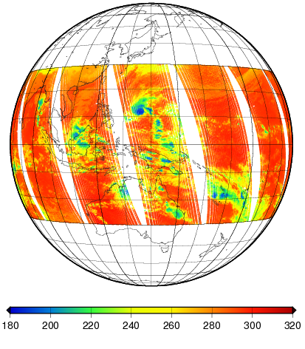
AHI-8/-9 Pseudo Radiances for Deriving SBAFs
Input data: Metop-A/IASI L1C
Ascending/Descending data on 2015-01-04
Band 7 (3.9 μm): ascending (nighttime) data are only used
Domain: 30 S – 30 N, 50 E – 130 W
No need to apply gap-filling method because spectral mismatches are negligible
Pseudo AHI-8 TB derived from Metop-A/IASI
IASI Spectral Coverage
AHI-8
AHI-9
Notes:
to derive SBAF from Himawari9 to 8, we made pseudo radiances using IASI L1C (ascending and descending) data
latitude from 30S to 30N and all longitude that AHI can see
There is a slight mismatch between the coverage of IASI and the response function of AHI9, but it's negligible so no need to apply gap-filling
---
Lat30: 極付近にデータが偏るのを防ぐため

Slide 5
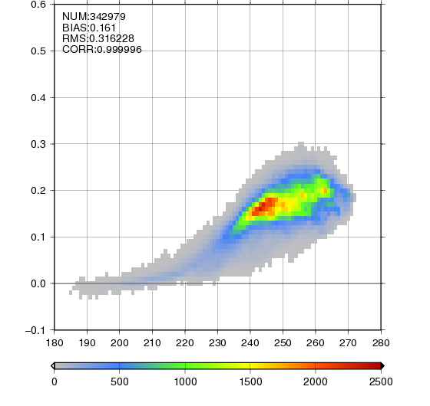
Computation of AHI-8/-9 SBAFs
- Case for Standard Scenes
AHI-8 std. TB
(243.85 [K])
1. Defining reference TB
e.g. AHI-8 standard radiance calculated by RTTOV-11.2
2. Extracting pseudo radiances:
AHI-8 TB < ±1.0 K of reference TB
3. Averaging the samples of TB differences (i.e. AHI9 – AHI8)
-> SBAF in TB
Band 9 (6.9 μm)
AHI9 – AHI8 [K]
AHI-8 [K]
5
Notes:
I'm gonna explain the procedure of SBAF computation
first, defining reference brightness temps
they are calculated by RTTOV, under US standard atmosphere and GSICS standard conditions
second, extracting pseudo radiances
scenes within 1 K plus or minus reference brightness temp are used
next, calculating brightness temp differences between AHI9 and 8, and averaging it

Slide 6
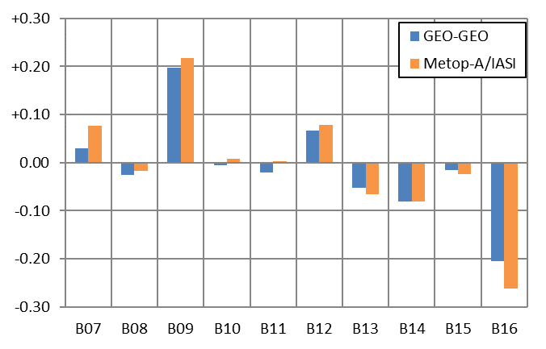
Comparison of AHI Calibration Biases b/w GEO-GEO and GEO-LEO
GEO-GEO: SBAF TBs are subtracted to see calibration bias differences
Good agreements b/w GEO-GEO and GEO-LEO
AHI-9 -> 8 SBAFs (TB differences)
Band (μm) | SBAF @stdRad [K] | stdRad [K]
B07 (3.9) | 0.15 | 286
B08 (6.2) | -0.03 | 235
B09 (6.9) | 0.16 | 244
B10 (7.3) | -0.03 | 255
B11 (8.6) | -0.01 | 284
B12 (9.6) | -0.14 | 259
B13 (10.4) | 0.00 | 286
B14 (11.2) | 0.03 | 286
B15 (12.4) | 0.05 | 284
B16 (13.3) | -1.36 | 270
AHI9 – AHI8 [K] @ std. TB
Period of time for stats: 3-12 Feb. 2018
Notes:
then, I'm gonna compare results by GEO-LEO and GEO-GEO approaches
now SBAF has been subtracted from GEO-GEO, to see calibration bias differences
seeing the graph, in each band, GEO-GEO and GEO-LEO show good agreements

Slide 7
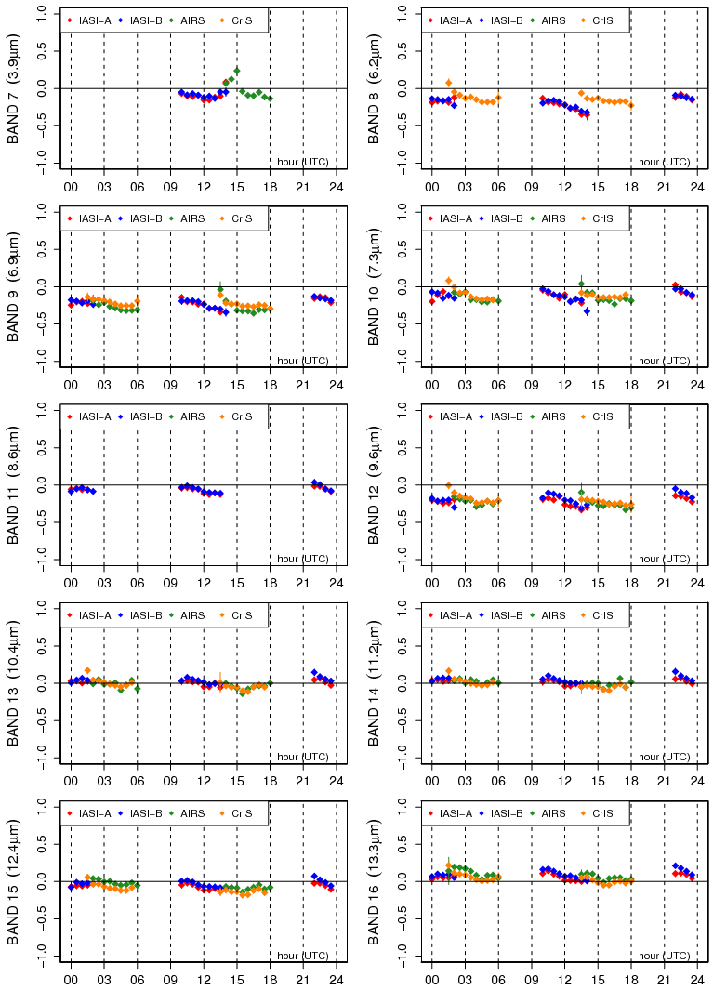
Reference
Metop-A/IASI
Metop-B/IASI
Aqua/AIRS
S-NPP/CrIS
Next Step: Validation of Diurnal Calibration Variation
Stats from 14-28 Feb. 2017
@ std. TB
1.0 [K]
3.9 μm
6.2 μm
-1.0 [K]
6.9 μm
7.3 μm
8.6 μm
9.6 μm
Can we complement the temporal gaps using GEO-GEO results?
(Practically) Yes!
Proper estimation of uncertainties in GEO-GEO SBAFs would be a key
10.4 μm
11.2 μm
12.4 μm
13.3 μm
[UTC]
Notes:
these figure show AHI GEO-LEO IR results using IASI-A, IASI-B, AIRS, CrIS
IASI-A,B and AIRS-CrIS go through the equator different time, so temporal coverage of GEO-LEO result can be expand by using their results
but even if we use all of them, there are still gaps about 4 hour per half day
then, we think we may be able to complement these gaps, by using GEO-GEO approach with an adjacent GEO satellite
properly estimating SBAFs between GEOs would be important thing

Slide 8
Use of GEO-GEO results as Calibration Transfers
t1: GEO1 – LEO
t1 (GEO1 can collocate with LEO)
East
GEO1
GEO2
GEO3
[Start, End]
Time range of collocation
with LEO Descending
[Start, End]
Time range of collocation
with LEO Ascending
Time
West
Notes:
during t1, the time when GEO1 can collocate with LEO, of course GEO-LEO approach can be applied
# but rest of the time we can't acquire GEO1-LEO result

Slide 9
Use of GEO-GEO results as Calibration Transfers
t1: GEO1 – LEO
t2: (GEO2 – LEO)^{t2} – (GEO2 – GEO1)^{t2} – SBAF(GEO2/GEO1) = (GEO1 – LEO)^{t2}
t1 (GEO1 can collocate with LEO)
t2 (GEO1 can't collocate, GEO2 can)
East
GEO1
GEO2
GEO3
[Start, End]
Time range of collocation
with LEO Descending
[Start, End]
Time range of collocation
with LEO Ascending
Time
West
Notes:
Now, consider the method to extend GEO1-LEO results, using an adjacent GEO satellite
during the time t2, applying GEO-LEO between GEO2 and LEO and GEO-GEO between GEO1 and GEO2
and then, considering GEO2-LEO, GEO1-GEO2 and SBAF between GEO1 and GEO2,
GEO2 impact would be cancelled out and we acquire GEO1-LEO

Slide 10
Use of GEO-GEO results as Calibration Transfers
t1: GEO1 – LEO
t2: (GEO2 – LEO)^{t2} – (GEO2 – GEO1)^{t2} – SBAF(GEO2/GEO1) = (GEO1 – LEO)^{t2}
t3: (GEO3 – LEO)^{t3} – (GEO3 – GEO2)^{t3} – SBAF(GEO3/GEO2) = (GEO2 – LEO)^{t3} (GEO2 – LEO)^{t3} – (GEO2 – GEO1)^{t3} – SBAF(GEO2/GEO1) = (GEO1 – LEO)^{t3}
t1 (GEO1 can collocate with LEO)
t2 (GEO1 can't collocate, GEO2 can)
East
t3 (GEO1/2 can't collocate, GEO3 can)
GEO1
GEO2
GEO3
[Start, End]
Time range of collocation
with LEO Descending
[Start, End]
Time range of collocation
with LEO Ascending
Time
West
Notes:
This method can be connected to a farther GEO satellite
first, during the time t3, GEO2-LEO is acquired by using GEO3-LEO and GEO2-GEO3
next, using GEO2-LEO and GEO1-GEO2, we can get GEO1-LEO during t3
but it should have more uncertainty

Slide 11
Summary and Future Plans
AHI-8/9 GEO-GEO comparison has been performed, to check the consistency of AHI-8/9 calibration performance and multiple validation approaches.
Spectral mismatches between AHI-8 and -9 are compensated by applying SBAF derived from Metop-A/IASI.
GEO-LEO-IR and GEO-GEO-IR results show good agreements.
Current temporal coverage of LEO IR reference instruments (i.e. IASI, AIRS, and CrIS) is not perfect. Use of GEO-GEO inter-comparison would be a solution to fill the temporal gaps.
Proper estimation of GEO-GEO SBAF is very important.
JMA plans to investigate the feasibility of blending GEO-GEO / GEO-LEO results to validate AHI's diurnal calibration variation.
Notes:
finally I summarize this talk
AHI-8/9 GEO-GEO comparison has been performed, to check the consistency of AHI-8/9 calibration performance and multiple validation approaches
Spectral mismatches are compensated by applying SBAF derived from Metop-A/IASI
in IR bands, GEO-LEO and GEO-GEO results show good agreement
Current temporal coverage of LEO IR reference instruments is not perfect. Use of GEO-GEO inter-comparison would be a solution to fill the temporal gaps
is this method, GEO-GEO SBAF affects biases and uncertainties, so it is very important.
JMA plans to investigate the feasibility of blending GEO-GEO / GEO-LEO results to validate AHI’s diurnal calibration variation.

Slide 12
Thank you for your attention!

Slide 13
Himawari-8/-9 AHI SBAFs [K] at various scenes using Metop-A/IASI
Band (μm) | 190 | 200 | 210 | 220 | 230 | 240 | 250 | 260 | 270 | 280 | 290 | 300 | 310 | @stdRad | stdRad [K]
B07 (3.9) | - | - | 3.99 | 1.87 | 1.42 | 0.72 | 0.48 | 0.40 | 0.30 | 0.18 | 0.11 | -0.02 | - | 0.15 | 286
B08 (6.2) | 0.00 | 0.00 | -0.01 | -0.01 | -0.02 | -0.03 | -0.03 | -0.04 | - | - | - | - | - | -0.03 | 235
B09 (6.9) | -0.01 | 0.00 | 0.01 | 0.04 | 0.09 | 0.14 | 0.17 | 0.19 | 0.19 | - | - | - | - | 0.16 | 244
B10 (7.3) | -0.03 | -0.01 | 0.00 | 0.01 | 0.01 | -0.01 | -0.03 | -0.02 | 0.02 | - | - | - | - | -0.03 | 255
B11 (8.6) | 0.00 | 0.00 | 0.00 | 0.00 | 0.00 | 0.00 | 0.00 | -0.01 | -0.01 | -0.01 | -0.01 | -0.01 | -0.01 | -0.01 | 284
B12 (9.6) | - | - | 0.10 | 0.04 | -0.01 | -0.06 | -0.10 | -0.14 | -0.16 | -0.22 | - | - | - | -0.14 | 259
B13 (10.4) | 0.00 | 0.00 | 0.00 | 0.00 | 0.00 | 0.00 | 0.00 | 0.00 | 0.00 | 0.00 | 0.00 | 0.00 | 0.00 | 0.00 | 286
B14 (11.2) | 0.01 | 0.02 | 0.03 | 0.04 | 0.04 | 0.05 | 0.06 | 0.07 | 0.06 | 0.03 | 0.04 | 0.02 | 0.02 | 0.03 | 286
B15 (12.4) | 0.00 | 0.00 | 0.00 | 0.01 | 0.02 | 0.03 | 0.03 | 0.04 | 0.04 | 0.04 | 0.06 | 0.10 | 0.10 | 0.05 | 284
B16 (13.3) | 0.16 | 0.09 | -0.01 | -0.13 | -0.30 | -0.52 | -0.74 | -1.01 | -1.36 | -1.58 | -2.25 | - | - | -1.36 | 270
Shaded in light blue: | SBAF | >= 0.10 K

Slide 14
Himawari-8/9 AHI
AHI Band Configuration
 | B01 | B02 | B03 | B04 | B05 | B06 | B07 | B08 | B09 | B10 | B11 | B12 | B13 | B14 | B15 | B16
Central Wlen [μm] | 0.47 | 0.51 | 0.64 | 0.86 | 1.6 | 2.3 | 3.9 | 6.2 | 6.9 | 7.3 | 8.6 | 9.6 | 10.4 | 11.2 | 12.4 | 13.3
Spatial Reso. [km] | 1 | 1 | 0.5 | 1 | 2 | 2 | 2 | 2 | 2 | 2 | 2 | 2 | 2 | 2 | 2 | 2
# of detectors | 676 | 676 | 1460 | 676 | 372 | 327 | 332 | 332 | 332 | 332 | 332 | 332 | 408 | 408 | 408 | 408
Spectral Response Functions of AHI-8 and AHI-9
Wavelength [μm]
Wavelength [μm]
VIS
MWIR
SWIR
Wavelength [μm]
NIR
LWIR

Slide 15
Current Status of GEO-LEO-IR Inter-Calibration for JMA GEO Imagers
AHI on Himawari-8/9
Reference: IASI, AIRS, CrIS
Dec. 2017: Entered GSICS Demonstration Phase
Continuous collaboration w/ NOAA
JAMI on MTSAT-1R and Imager on MTSAT-2
Reference: IASI, AIRS
GSICS Demonstration Phase since July 2010
VISSR on GMS to GMS-5
Reference: HIRS/2
Implemented within SCOPE-CM/IOGEO project (special thanks to EUMETSAT Climate Group)
Satellite | Operation Period (incl. plan)
Himawari-9 | 2022 – 2029
Himawari-8 | 2015 – 2022
MTSAT-2 | 2010 – 2015
MTSAT-1R | 2005 – 2010
GOES-9 | 2003 – 2005
GMS-5 | 1995 – 2003
GMS-4 | 1989 – 1995
GMS-3 | 1984 – 1989
GMS-2 | 1981 – 1984
GMS | 1978 – 1981

Slide 16
Ongoing/Future Activities for Himawari-8/9 AHI Inter-calibration
Preparation of products’ submission to Pre-Operational Phase
Type-B uncertainty analysis (next slide)
Use of S-NPP/CrIS Full Spectral Resolution SDR and NOAA-20/CrIS
External user review: need for finding users!
Implementation of Prime GSICS Correction
Calculation of Double Differences for reference instruments (agenda 4p)
Investigation for known issues: diurnal calibration variation
(Probably) related to angular dependence of AHI scan mirror emissivity
NOAA updated ABI scan mirror emissivity LUTs in Oct 2017
Blending GEO-GEO and GEO-LEO results to clarify AHI diurnal calibration biases (agenda 4c)

Slide 17
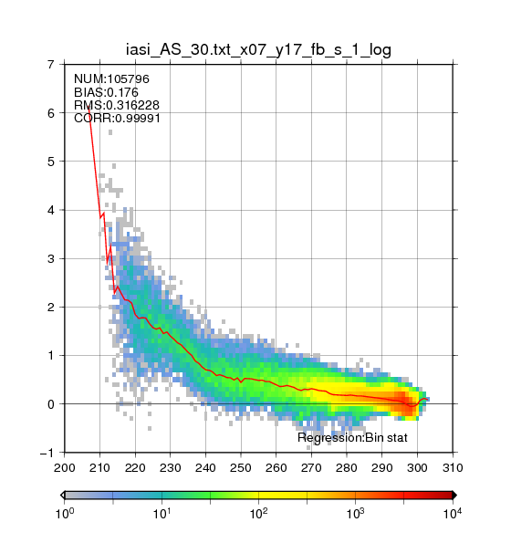
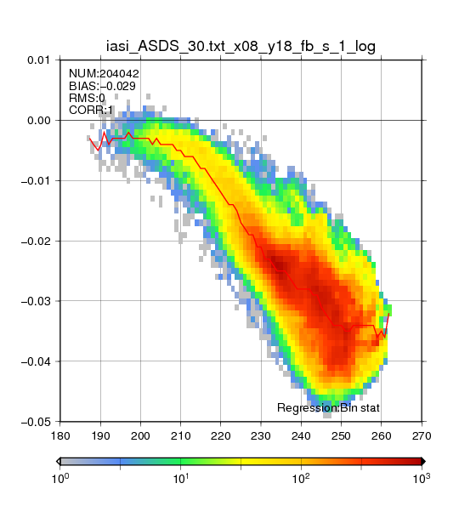
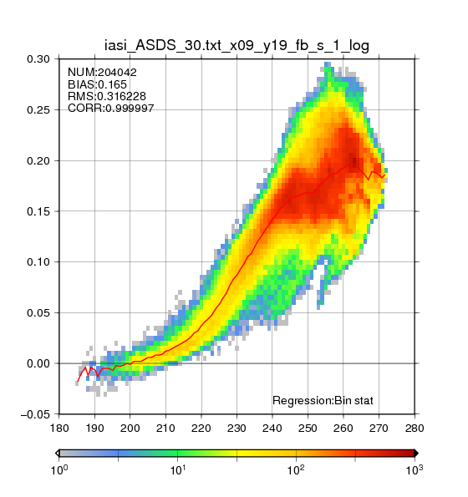
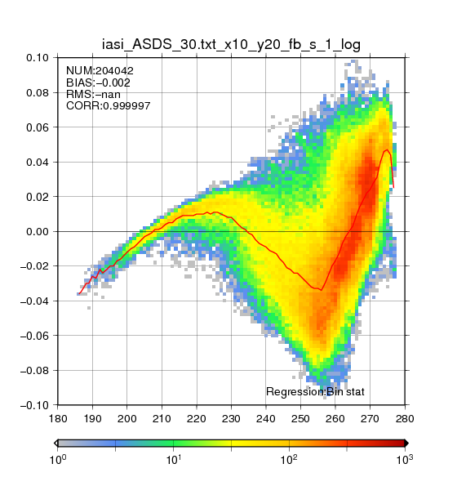
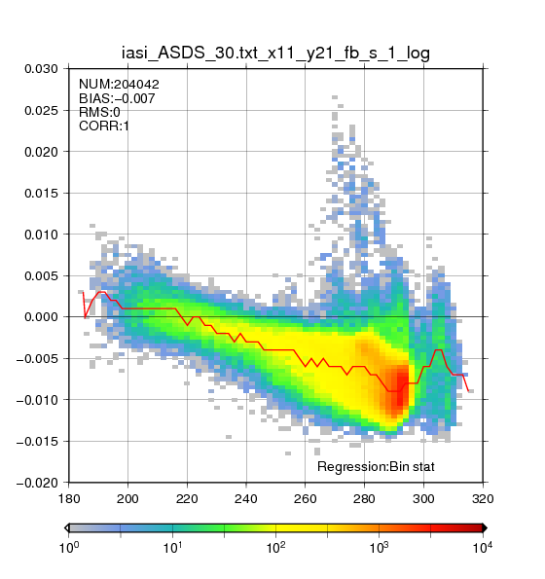
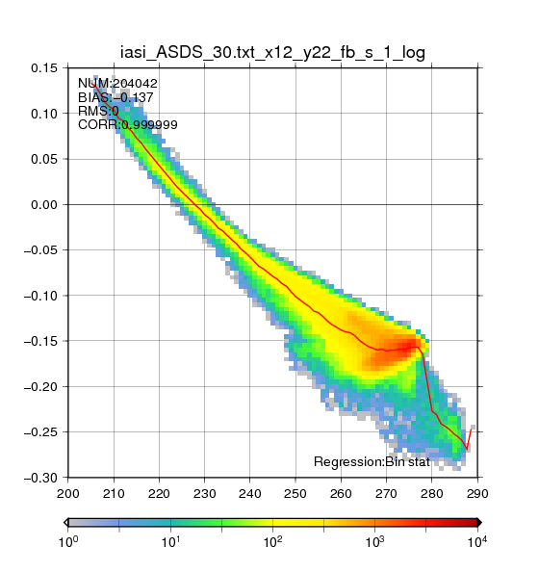
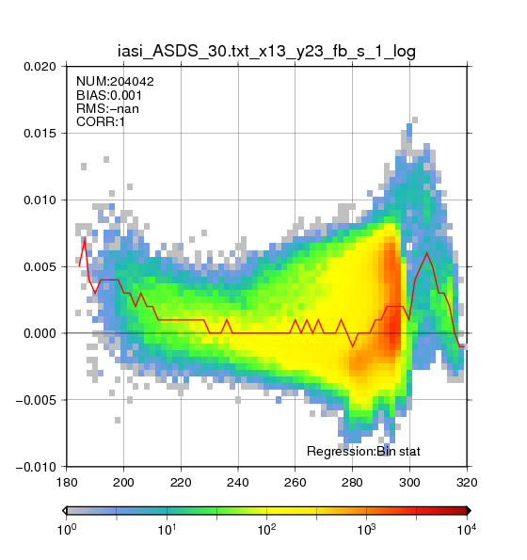
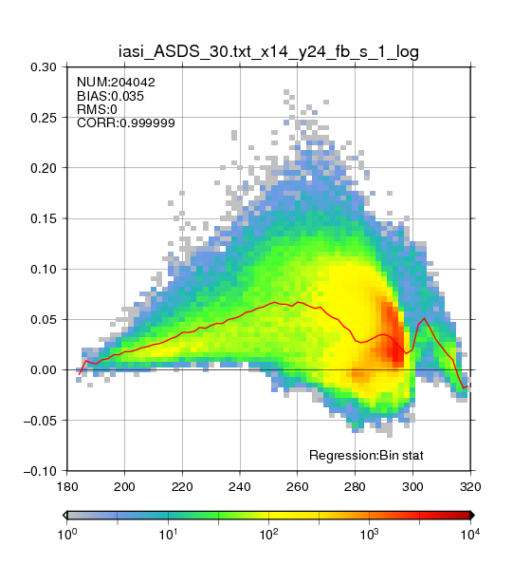
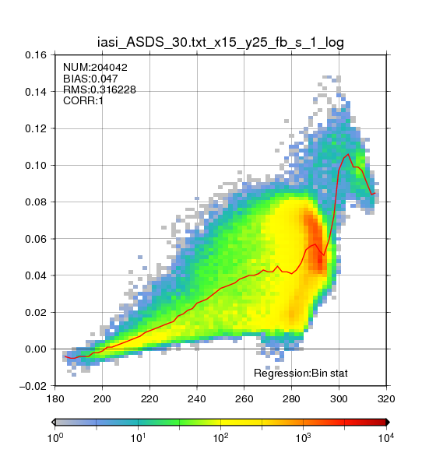
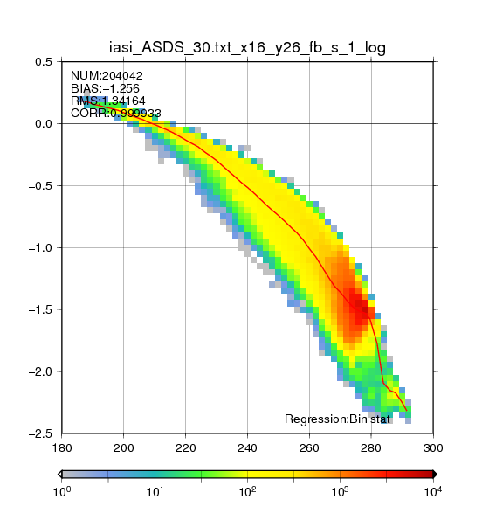
AHI-8/-9 Simulated-TB Differences using Metop-A/IASI
Band 7
3.9 μm
Band 8
6.2 μm
Band 9
6.9 μm
Band 10
7.3 μm
Band 11
8.6 μm
4 K
0.01 K
AHI9 – AHI8 [K]
-0.02 K
2 K
0.1 K
-0.04 K
-0.06 K
Band 12
9.6 μm
Band 13
10.4 μm
Band 14
11.2 μm
Band 15
12.4 μm
Band 16
13.3 μm
AHI9 – AHI8 [K]
0.1 K
0.1 K
-0.1 K
0.1 K
-1 K
-0.2 K
-2 K
AHI8 [K] AHI8 [K] AHI8 [K] AHI8 [K] AHI8 [K]

Slide 18
Blending GEO-GEO/GEO-LEO Results: would be very useful for Heritage Imagers
Himawari-8/AHI MTSAT-2/Imager
B07
IR4
B08
IR3
B13
IR1
B15
IR2

Slide 19
Use of GEO-GEO results as Calibration Transfers
P1: GEO1 – LEO
P2: (GEO2 – LEO) – (GEO2 – GEO1) – SBAF(GEO2/GEO1) = GEO1 – LEO
P3: (GEO3 – LEO) – (GEO3 – GEO2) – SBAF(GEO3/GEO2) = GEO2 – LEO
(GEO2 – LEO)^{t=P3} – (GEO2 – GEO1)^{t=P3} – SBAF(GEO2/GEO1)^{t=P3} = (GEO1 – LEO)^{t=P3}
P1 P1 P1
[Deg. East]
P2 P2
GEO1
GEO2
P3 P3
GEO3
[UTC]
LEO Descending
[Start, End]
LEO Ascending
[Start, End]

Slide 20
Use of GEO-GEO results as Calibration Transfers
t1: GEO1 – LEO
t2: (GEO2 – LEO) – (GEO2 – GEO1) – SBAF(GEO2/GEO1) = (GEO1 – LEO)^{t2}
t3: (GEO3 – LEO) – (GEO3 – GEO2) – SBAF(GEO3/GEO2) = (GEO2 – LEO)^{t3} (GEO2 – LEO)^{t3} – (GEO2 – GEO1)^{t3} – SBAF(GEO2/GEO1) = (GEO1 – LEO)^{t3}
t1 (GEO1 can collocate with LEO)
t2 (GEO1 can't collocate, GEO2 can)
East
t3 (GEO1/2 can't collocate, GEO3 can)
GEO1
GEO2
GEO3
[Start, End]
Time range of collocation
with LEO Descending
[Start, End]
Time range of collocation
with LEO Ascending
Time
West

