Slide 1
Detections of Radiometric Calibration Update/Anomaly with ABI vs. CrIS/IASI IR Inter-Calibration
Fangfang Yu¹ and Xiangqian Wu²
1: ERT, Inc@NOAA/NESDIS/STAR
2: NOAA/NESDIS/Center for Satellite Application and Research (STAR)

Slide 2
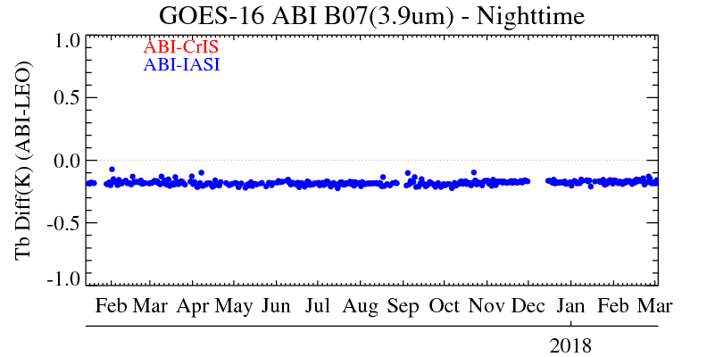
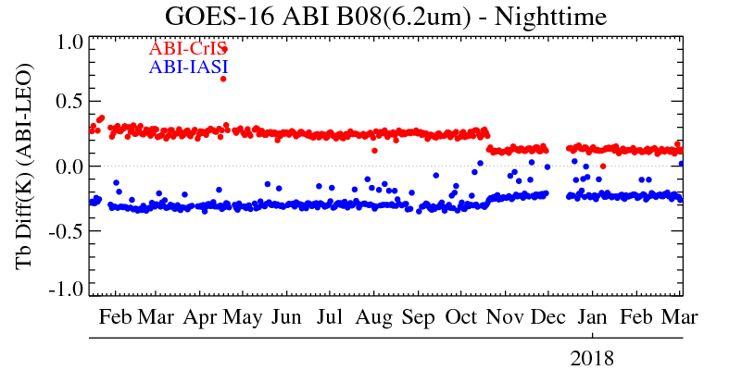
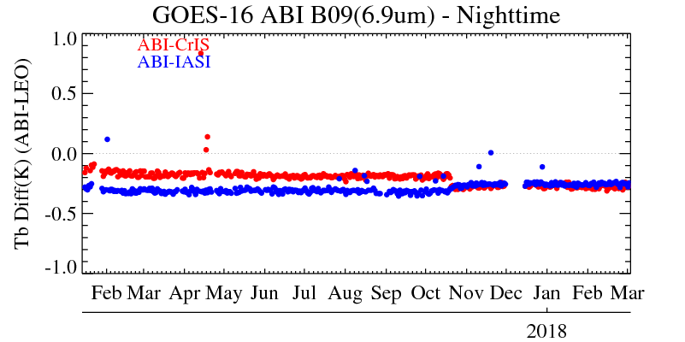
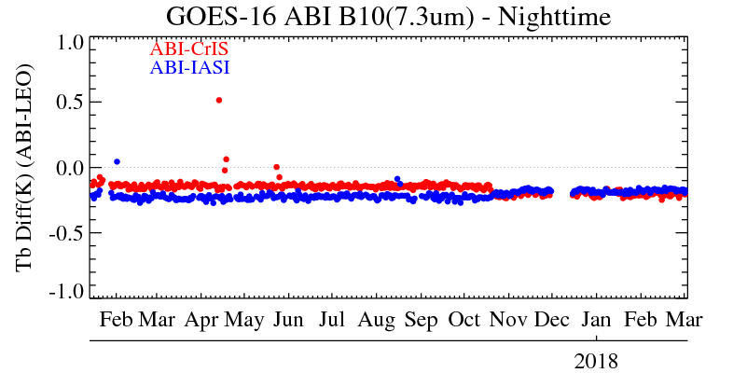
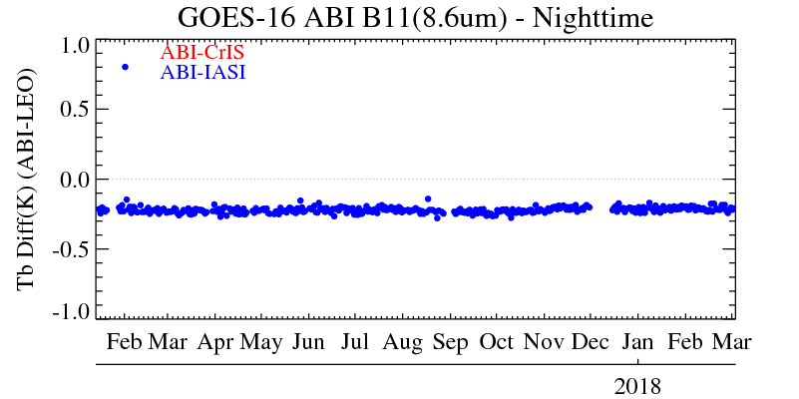
10/19/2017: updates of ABI Scan mirror Emissivity LUTs

Slide 3
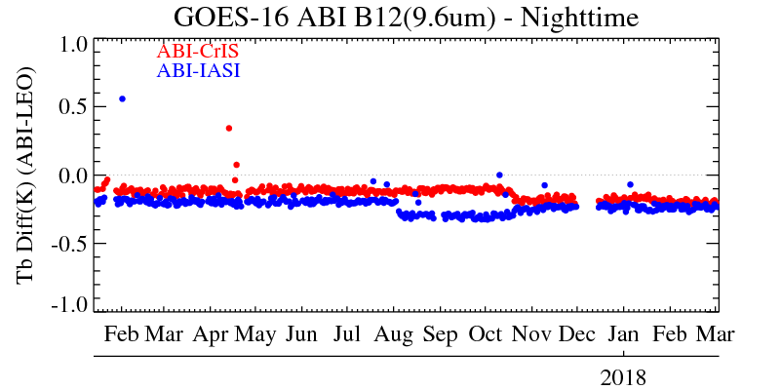
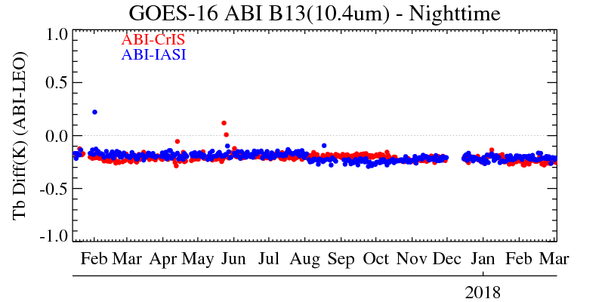
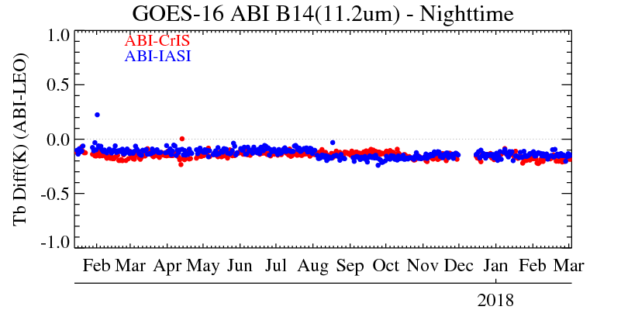
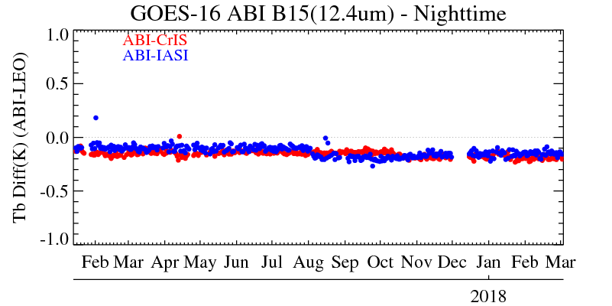
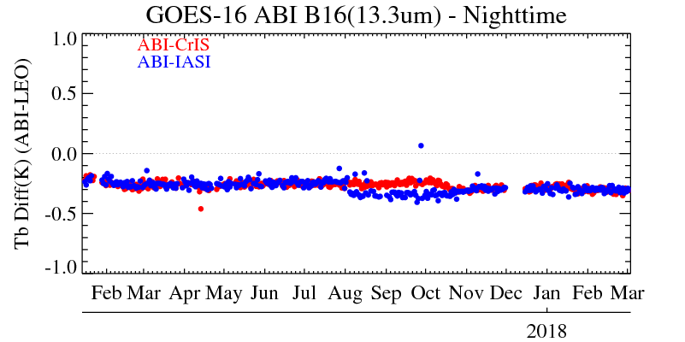
08/02/2017: Metop-B IASI non-linearity correction update for its long-wavelength band
10/19/2017: updates of ABI Scan mirror Emissivity LUTs

Slide 4
Summary
Double difference method is very valuable to detect and validate possible change in instrument calibration
The update of Metop-B IASI and ABI ground processing can be detected with the daily mean Tb bias
Both ABI and IASI are very stable
Double difference results can be affected with uncertainty in the transfer instrument measurement
The residual of ABI scan mirror spatial uniformity corrections amplify the impact
Observed from August 1 – Oct. 19, 2017
Update of the ABI scan mirror emissivity LUTs reduced the ABI Tb bias to CrIS and IASI, as expected

