Slide 2
Scoring Reference Instruments
Scoring with Oscar

Slide 3
Do we need to keep score?
Previously, proposed [2014-07-23]…
Selecting Anchor Reference
Scoring all potential reference sensors
Based on performance against requirements
Based on contribution to uncertainty
Still needed? If so, …
Could use WMO OSCAR to keep score
But not all parameters included in database
Could define scores offline & enter manually
Visualise available references over long time series

Slide 4
Application of OSCAR Gap Analysis
It is not practical to maintain all the factors of uncertainty and systematically derive the « score » in OSCAR
GSICS can compute the « score » outside of OSCAR,
using its weighted combination of normalized criteria
The GSICS score is entered in OSCAR as instrument « property » for candidate reference sensors
«Intercalibration Reference» mission is created in OSCAR
Instruments are rated (from 1 to 5) for this mission according to their GSICS score (from 1 to 0)
GSICS owns the scoring algorithm and provides updates

Slide 5
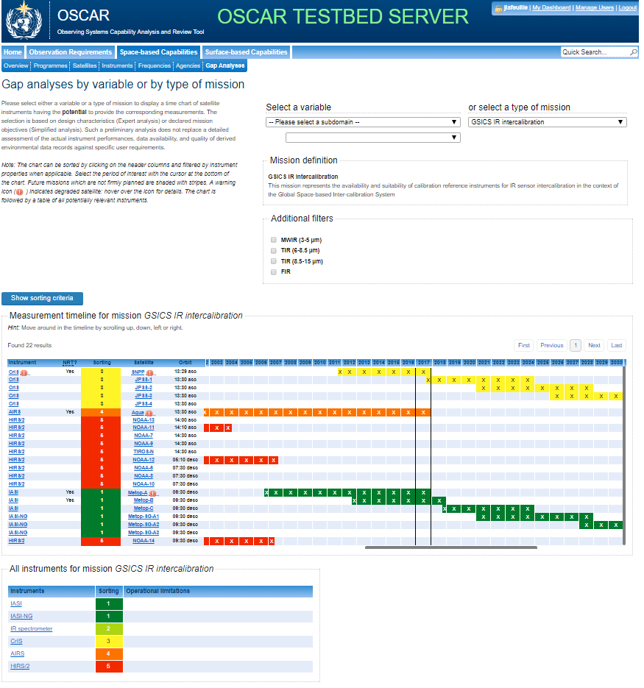
This allows drawing a Gap Analysis for GSICS Inter-calibration References
The advantage of using OSCAR is to link the scoring information, provided by GSICS, with the OSCAR information about instrument launch plans and status.
The advantage of using OSCAR is to link the scoring information, provided by GSICS, with the OSCAR information about instrument launch plans and status.
Notes:
The advantage of using OSCAR is to link the scoring information, provided by GSICS, with the OSCAR information about instrument launch plans and status.

Slide 6
Notes:
Among the « gap Analysies by type of mission » we can select « GSICS IR Intercalibration » mission, which is defined in a short sentence, with a possibility to filter the result to only some of the spectral bands of the relevant instruments.

Slide 7
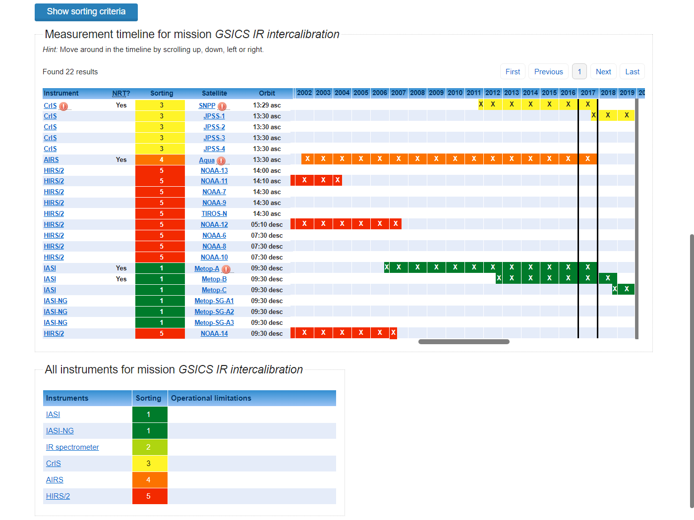
Actual or firmly planned availability of sensors contributing to « GSICS IR Intercalibration » mission.
Notes:
The instruments which have a positive score appear on the Gap Analysis chart, with the colour code corresponding to their GSICS score.
The grey bar at the bottom enables shifting the chart time window . Scrolling to the left will display early years where only HIRS data are available, while scrolling to the right will show future sensors of JPSS/CrIS and METOP/IASI-NG.
The time chart shows the actual or firmly planned availability of sensors contributing to « GSICS IR Intercalibration » mission.
Non-functional sensors or future sensors with no confirmed launch plan are thus excluded.

Slide 8
A table displays all sensors specified to contribute to the mission, including non-functional ones or future sensors with no confirmed launch plan (e.g. CLARREO/Infrared spectrometer )
Notes:
The CLARREO-1A Infrared spectrometer cannot be shown on the time chart since there is no confirmed operating period, but is listed in the table below the chart.
In spite of its excellent performance in the 5 -8 and 8 – 15 µm it is rated only 2 because the 3-5 µm is missing.

Slide 9
Discussion
Previously, proposed [2014-07-23]…
Selecting Anchor Reference
Scoring all potential reference sensors
Based on performance against requirements
Based on contribution to uncertainty
Still needed? If so, …
Could use WMO OSCAR to keep score
But not all parameters included in database
Could define scores offline & enter manually
Visualise available references over long time series
How to pursue this offer?

Slide 10
Dealing with Multiple References
IR Sub-Group Discussion:
Dealing with Change
(IR Reference Sensors)

Slide 11
IR Sub-Group Discussion
Multiple hyperspectral reference sensors:
IASI on Metop-A, -B,
CrIS on SNPP, NOAA20
AIRS on Aqua
HIRAS?

Slide 12
GEO-LEO IR Update - CrIS
Accept CrIS as GSICS Reference?
Is its calibration „in family“?
(wrt IASI-A/B)
Is its calibration stable?
(wrt IASI-A/B)
Is its data freely available?
With sufficient latency?
What other questions should we ask?

Slide 13
IR Sub-Group Discussion
What to do for GEO-LEO IR Products?
NRTC
Just switch RefA->RefB
Switch RefA->RefB+∆
Just average all* Refs (within limits)
Full Prime GSICS Corrections
RAC
Useful for case studies?
Re-processing, Re-calibration, FCDR, …?

Slide 14
Dealing with Multiple References for FCDR Generation
Define ∆ Corrections
Based on stable overlaps
Apply to all* references
* at least all with stable references
Merge together
Applying delta corrections
“Prime GSICS Correction”
Version changes:
Or Split time series
When reprocessing impossible (e.g. onboard changes)
Reprocess whole dataset
Where possible
Need to regenerate FCDR
When any component changes
Introduce review cycles
RefAv1
RefAv2
∆A1B1
∆A2B2
RefBv1
RefBv2
Time

Slide 15
Dealing with Change
IASI on-board processing change
Step change in Reference sensor record
Split before/after change
Treat as separate sensors?
Automatically check for step changes
But what about drifts?

