Slide 1
Best Practice for Hyperspectral IR Sounder SDR Ground Processing
- Lessons learned from CrIS
Likun Wang & Hank Revercomb
University of Maryland &

Slide 2
Background
More hyperspectral instruments are available from GSICS member agents
  AIRS, IASI(3), CrIS(2), HIRAS, GIIRS …
Differences exist among these IR instrument measurements
  Instrument-related calibration parameters
  Data processing are different
In the past years, lessons have been learned from each instrument
  IASI: non-linearity adjustment, …
  CrIS: non-circular filter, algorithms order, polarization correction, …
In this group, do we need to jointly develop a to document to define best practice for the processing of IR sounders?
  Discussion for preparation
  Bring up issues
  Understanding differences

Slide 3
What are discussed
Grating spectrometer vs Interferometer:
  most operational IR Sounders are designed as interferometer
Pre-launch characterization is not discussed here and we only focus on SDR data processing
  Space segment processing
  Ground segment processing
IASI vs CrIS
  Each instrument is different only ca/val team has best knowledge
  Space segment processing is different
  Mainly focused on CrIS

Slide 4
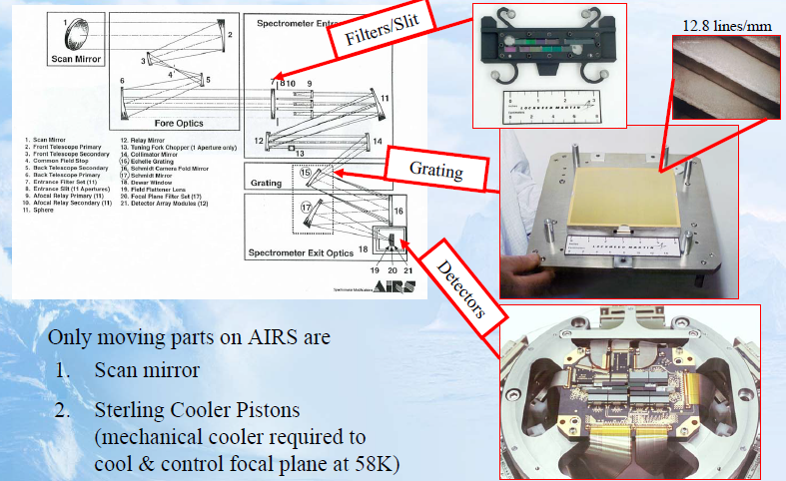
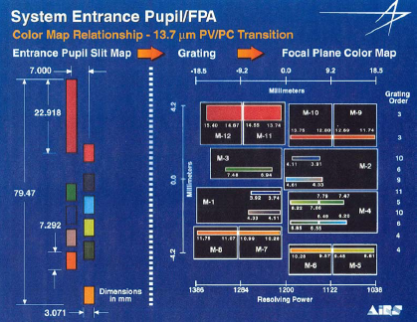
AIRS: Grating Spectrometer
From Christ Barnet

Slide 5
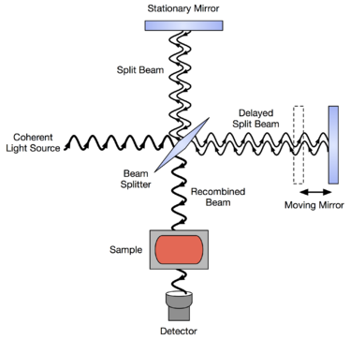
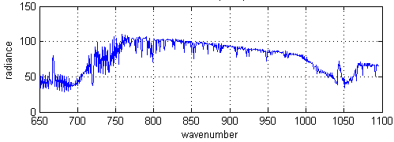
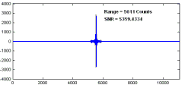
IASI, CrIS, and other: Interferometer
CrIS optical system
Han et al. 2013
Fourier
Transform
IR spectrum
Interferogram

Slide 6
Data Processing Flow
From CrIS ATBD

Slide 7
Space Segment Processing
Objectives: Reducing the transmission data rate in order to downlink the RDR to ground system
Choices:
  Option 1: Onboard FFT and then clip spectra ➔ Real spectra (IASI)
    Spike detection
    Non-linearity correction
    NZPD
    FFT
    Calibration
  Option 2: Filter and decimate ➔ complex interferogram (CrIS)
    Spike detection
    Filter
    Decimate
    Bit Trim Mask
This is why IASI data can’t be re-processed once non-linear correction coefficients were updated.
From Dan Mooney/MIT

Slide 8
CrIS Space Segment Processing
FTS Optical & Electrical Responsivity Modifies Shape of Scene Spectrum Prior to Downlinking
From J. Predina et al. 2015

Slide 9
CrIS Ground Processing
Main Goal: The CrIS SDR algorithms should process the signal as a “Truth Spectrum” that is defined by an Earth scene filtered by the sensor optical responsivity function which is then convolved with an Ideal Sinc ILS.
Reference:
  Team work: CrIS SDR Science team members for their contributions in SDR algorithm development and validations. The science team includes the groups of University of Wisconsin-Madison, led by H. Revercomb, University of Maryland at Baltimore County, led by L. Strow, Space Dynamics Laboratory, led by D. Scott, Massachusetts Institute of Technology, Lincoln Laboratory, led by D. Mooney, Exelis Inc., led by L. Suwinski, Northrop Grumman Aerospace Systems, led by D. Gu, NASA Langley Research Center, Led by D. Johnson, and members from NOAA/NESDIS/STAR.
  J. Predina, Y. Han, D. Mooney, S. Atre, and L. Suwinski, "Future JPSS Cross-track Infrared Sounder (CrIS) Ground Calibration Algorithm Improvements," in Fourier Transform Spectroscopy and Hyperspectral Imaging and Sounding of the Environment, OSA Technical Digest (online) (Optical Society of America, 2015), paper JM1A.1.
  Y. Han and Y. Chen, "Calibration Algorithm for Cross-Track Infrared Sounder Full Spectral Resolution Measurements," in IEEE Transactions on Geoscience and Remote Sensing, vol. 56, no. 2, pp. 1008-1016, Feb. 2018. doi: 10.1109/TGRS.2017.2757940

Slide 10
Radiometric Calibration before Spectral Calibration
(CrIS NSR algorithms)
From J. Predina et al. 2015

Slide 11
Different Algorithm
From J. Predina et al. 2015

Slide 12
Improved Level 1b Algorithm Performs
Spectral Correction Prior to Radiometric Calibration
From J. Predina et al. 2015

Slide 13
Optimizing Calibration Equation
Current algorithm:
FIR filter removal
Spectral calibration
New algorithm:
The new algorithm applies spectral calibration to raw spectra to take into account the effect of instrument responsivity and allow a wider bandpass post-filter f
S_{e} , S_{DS}, S_{ict} – raw spectra of earth scene, deep space & internal calibration target
B_{ICT} – calculated ICT spectrum
SA, SA⁻¹ – self-apodization and self-apodization correction matrices
F – spectral resampling matrix
f – bandpass post-calibration filter
From Han and Chen 2018

Slide 14
Radiometric calibration
From David Tobin/UW
See Hank’s Talk

Slide 15
Lessons Learned from CrIS
The on-orbit processing should considering the re-processing capability, downlink enough information to ground.
Ground processing should reverse the on-orbit processing, making calibrated Earth spectra close to the “Truth”
  Nonlinearity correction
  Phase removing
  Non-circular filter effects correction
  Self-apodization correction
  Spectral resampling
  Radiometric calibration
  Polarization correction
Radiomtric calibration play important role and should be carefully characterized.
  ICT model
  Non-linearity correction
  Polarization correction

