Slide 1
In-orbit Calibration for FY-3C/TOU
Weihe Wang¹，Zhuo Zhang², Yuan Li¹
National Satellite Meteorological Center，CMA
National Space Science Center, CAS
2018 GSICS Annual Meet, March 18~23, 2018, Shanghai ,China

Slide 2
Introduction for FY-3C/TOU calibration problems
After FY-3C being launched in Sep 2013, the Solar irradiance (after BRDF correction) of FY-3C/TOU has a large difference compared to that of FY-3B/TOU which is consistent with other UV instruments such as SBUS. By analyzing the observed irradiance (before BRDF correction) among the three instruments, we find that the variation rules between the observed irradiance and wavelength is consistent for FY-3C/TOU and FY-3B/TOU, although the actual irradiance (after BRDF correction) of FY-3C/TOU is very different from that of FY-3B.
Further analysis of FY-3C/TOU irradiance data shows that the sun-satellite vector in satellite coordinate is in-correct: there exists non-unit transformation matrix from satellite coordinate system to instrument coordinate system and an algorithm has been designed to estimate this non-zero matrix, after correction, the irradiance results were improved but didn’t meet the requirement for ozone retrieval.
This work used a vicarious calibration method: cross-calibration based on measurements of satellite and RTM simulation.

Slide 3
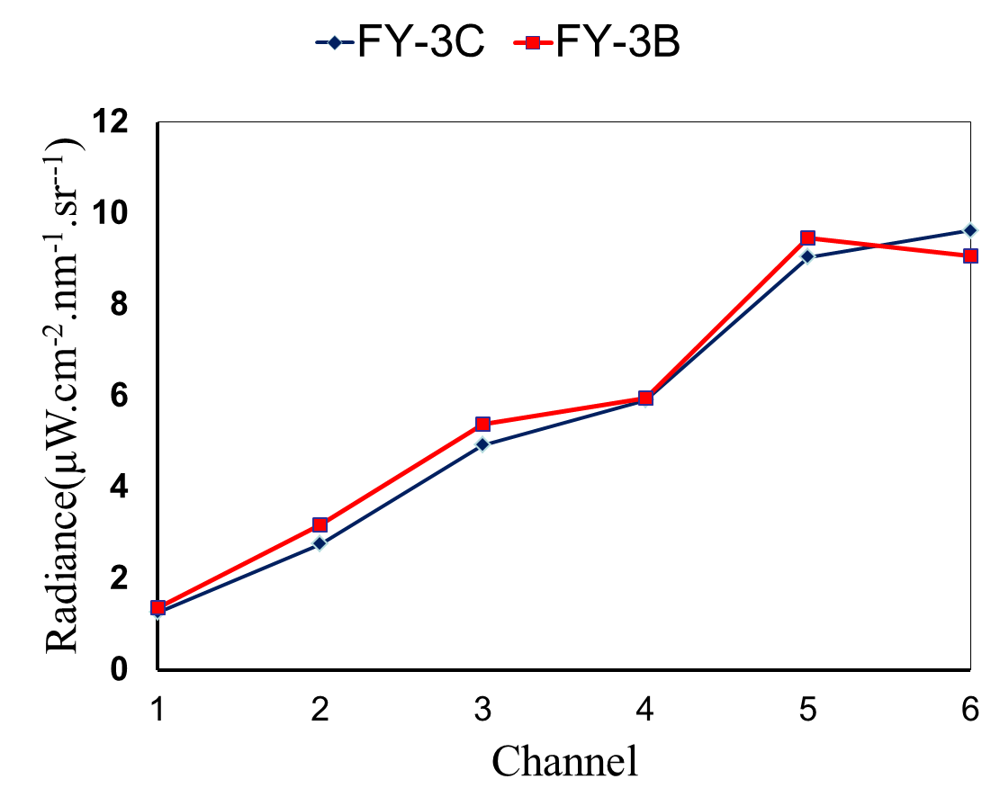
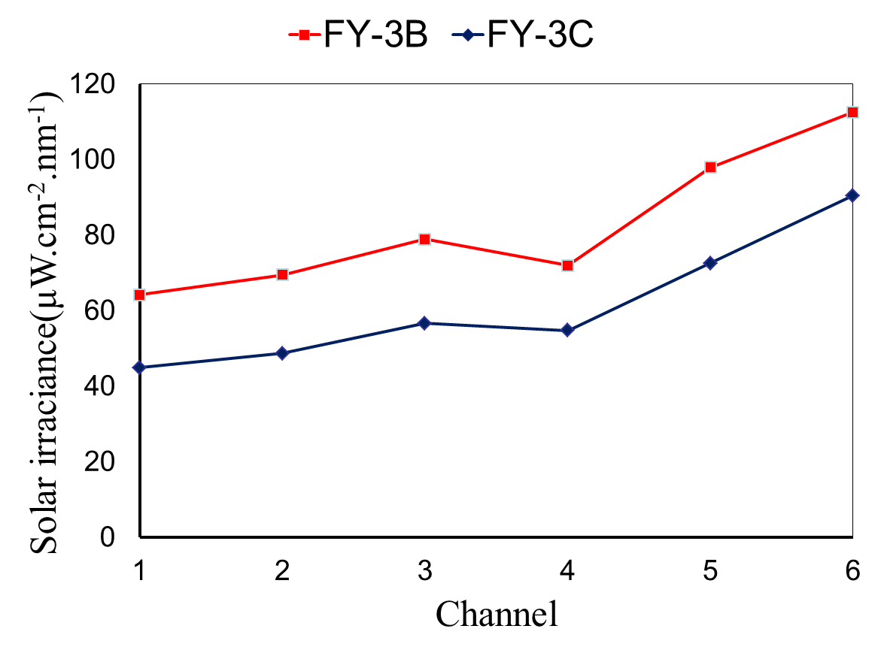
Comparisons for irradiance and clear-sky radiance between FY-3B/TOU and FY-3C/TOU
The solar irradiance
The earth’s radiance over sea
Comparisons for solar irradiance and clear sky earth’s radiance for FY-3B/C, the irradiance measured by FY-3C/TOU is different from FY-3B/TOU which has been validated, the radiance (nadir) for clear-sky is consisitent with FY-3B/TOU, the problem should be in the diffuser system.

Slide 4
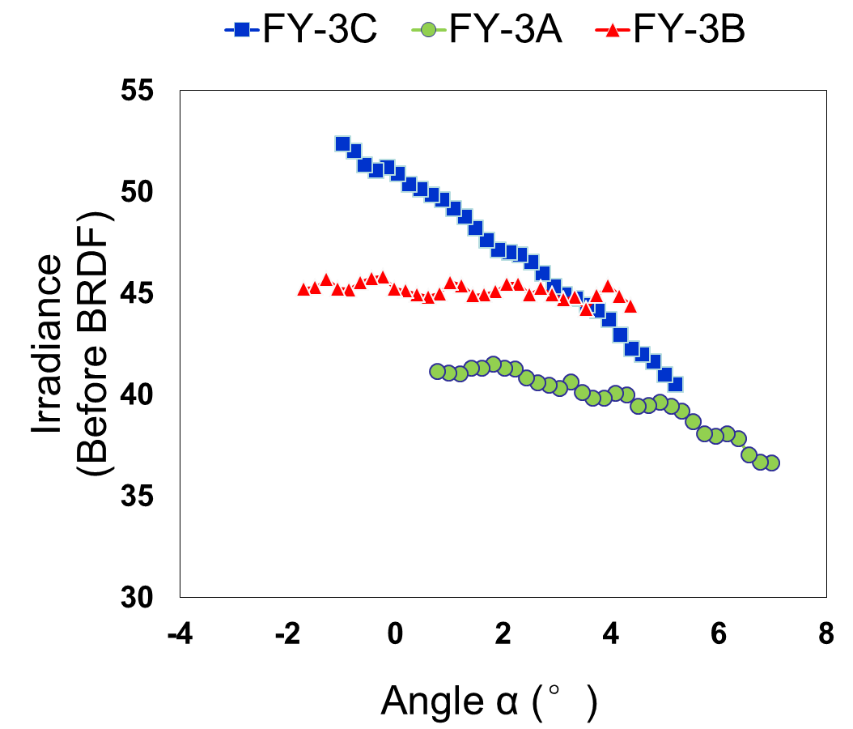
Variation for solar irradiance (before BRDF correction) with sun-satellite vector(α).

Slide 5
Method
Solar irradiance can not be used to calculate the degradation rate because the correction is not stable with time. Four years’ degradation rate of FY-3C/ TOU was estimated by comparing the measured radiance (nadir)and RTM simulation for clear-sky pixels over tropical pacific ocean(30°S～30°N, 161°E～120°W) . FY-3B/TOU irradiance measurements show that the degradation rates for 6 channels don’t have much difference so only radiance of channel 6 for FY-3C is used to estimate the degradation rates for all channels. Validation results show that the rms error is less than 5%(2013.9～2017.9).

Slide 6
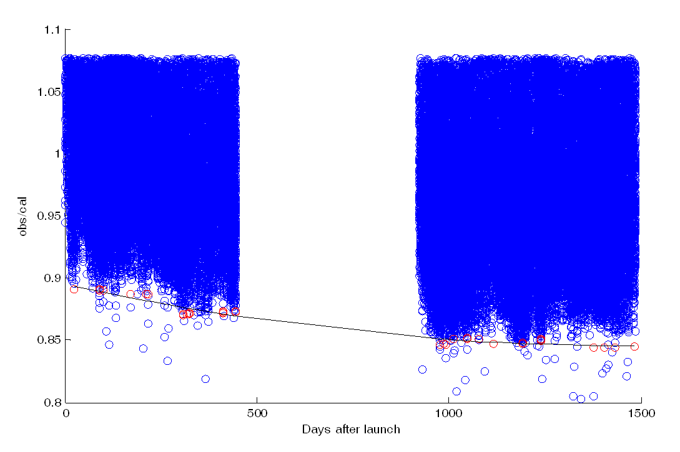
Ratio of measured radiance of channel 6 for FY-3C/TOU over tropical pacific ocean, ocean(30°S～30°N, 161°E～120°W ), the data were removed around the turn-off period of FY-3C/TOU (the battery system didn’t work well) . The degradation rate is estimated from the lowest part of the data which were considered to be clear-sky, the degradation rate is about 5%.

Slide 7
Retrieval sample: Global
FY-3C/TOU global total ozone of October 7, 2017, after calibration(Dobson Units)

Slide 8
Retrieval sample: Antarctic
FY-3C/TOU Antarctic area total ozone of October 7th 2017 after calibration(Dobson Units)

Slide 9
Validation
Comparison result of FY-3C/TOU total ozone amount after calibration and KAUNAS site data
Comparison result of FY-3C/TOU total ozone amount after calibration and VALENTIA site data

Slide 10
Validation
Comparison result of FY-3C/TOU total ozone amount after calibration and MANCHESTER site data
Comparison result of FY-3C/TOU total ozone amount after calibration and NORRKOEPING site data

Slide 11
WOUDC staion information
Station | Country | Latitude | Longitude
NORRKOEPING | SWE | 58.58 | 16.15
KAUNAS | LTU | 54.52 | 23.54
VALENTIA | IRL | 51.93 | -10.25
MANCHESTER | GBR | 53.48 | -2.23

Slide 12

Thanks

