Slide 1
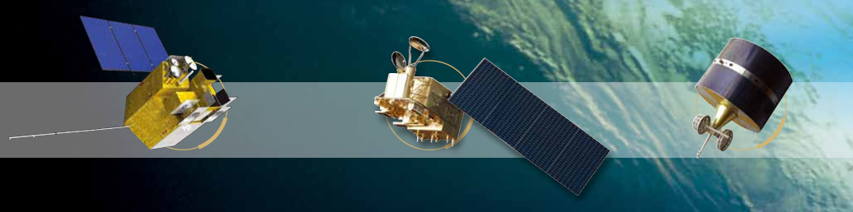


Inter-band calibration for atmosphere
Absorption bands based on Lunar observation
Wu Ronghua,
Zhang Peng, Yang Zhongdong, Hu Xiuqing, Xu Na, Zhang Lu, Ding Lei
National Satellite Meteorological Centre
Notes:
早上好，
我叫吴荣华
下面介绍MERSI-II的月亮定标情况。
Morning,
Next I will introduce 2 sensors lunar calibration
One is FY-3C/MERSI which is a MODIS like instrunment.
The other one is TanSat is Chinese CO2 monitoring satellite and CAPI is one of its payload which can provide aerosol information.

Slide 2
  content
  MERSI-II Bands setting
  Improvement of Lunar observation performance
  Inter-band calibration
  Product improvement
Notes:
主要内容：
MERSI-II对月观测性能提升
月亮图像
吸收通道困难
月亮光谱和GIRO模型
观测辐照度计算
定标公式
传递结果（单次）
序列情况
在3C的试验
结论和未来工作

Slide 3
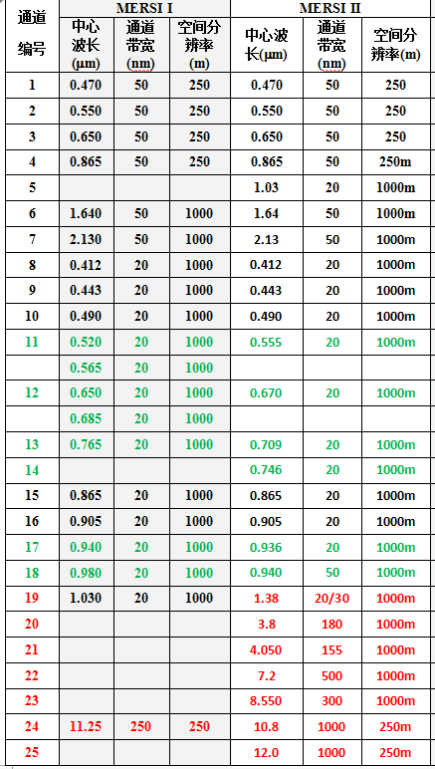
MERSI-II Bands setting
25 Bands vs 20 Bands
19 Vis-NIR Bands + 6 IR Bands
2 split window bands with 250m resolution
Adjust some bands’ center wave length and dynamic range
Notes:
MERSI的通道变化了
补通道光谱响应的图
另单独放大940水汽吸收线的SRF

Slide 4
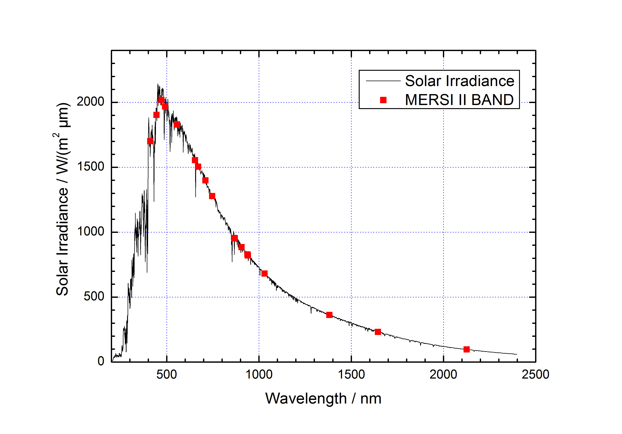
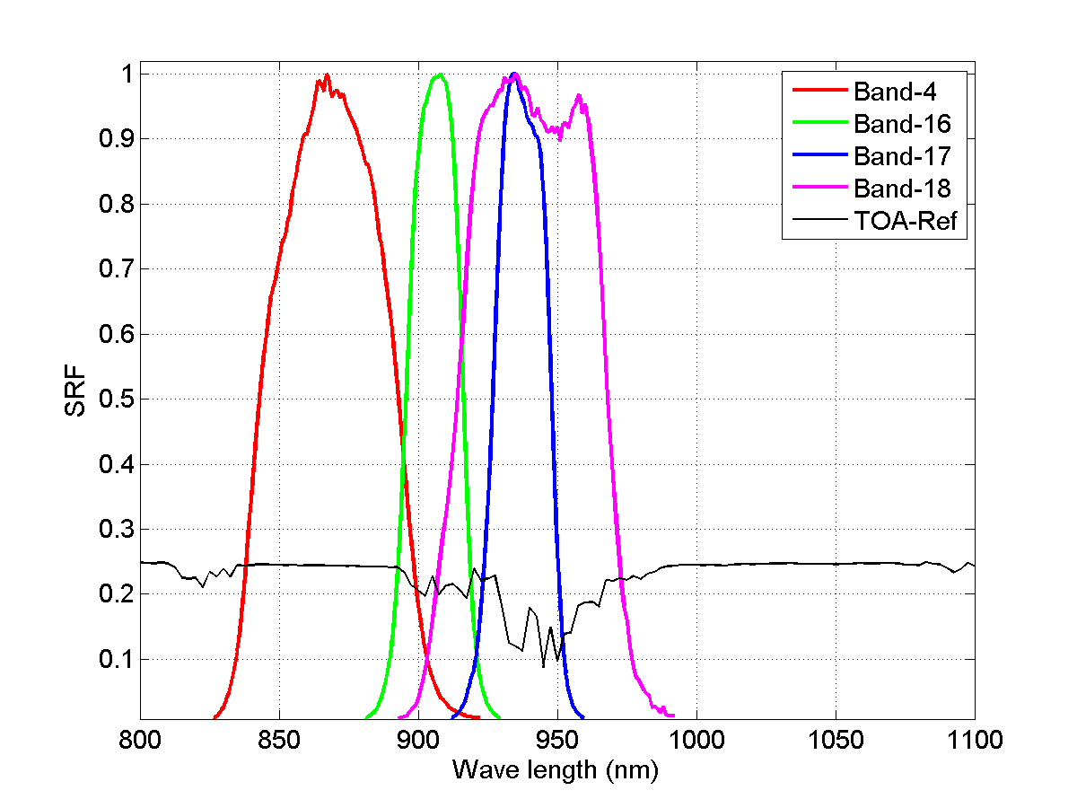
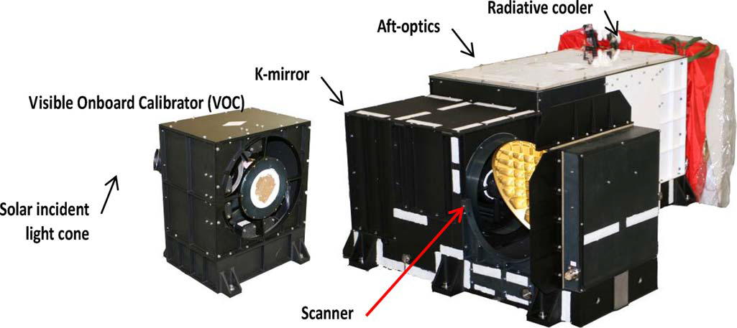
MERSI-II Bands setting
Band 16\17\18 are vapor absorption bands
It is still hard to remove the vapor influence in the laboratory measurement
Notes:
MERSI的通道变化了
补通道光谱响应的图
另单独放大940水汽吸收线的SRF

Slide 5
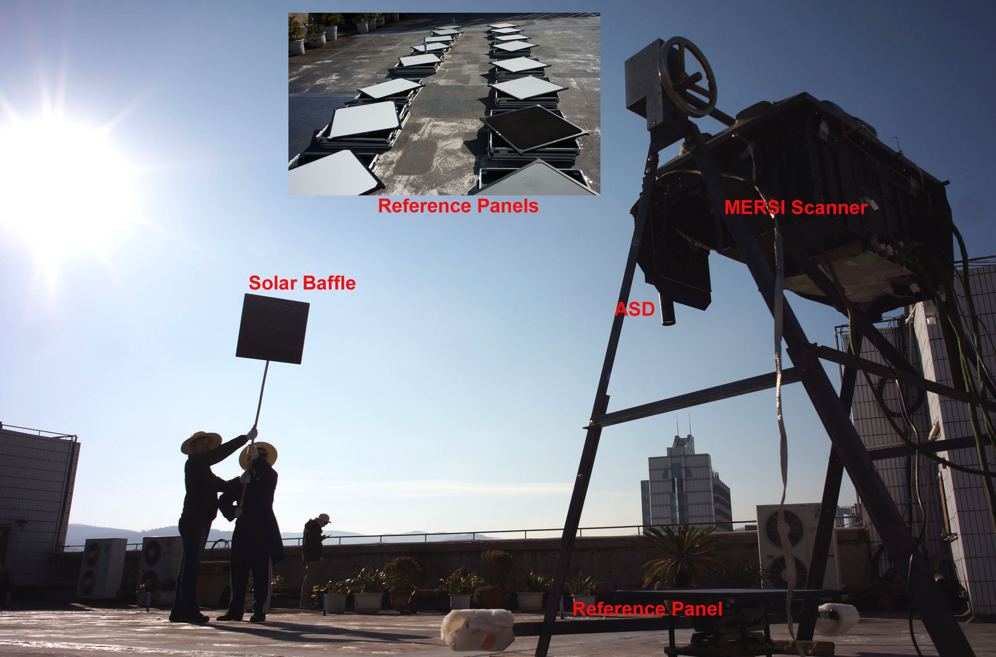
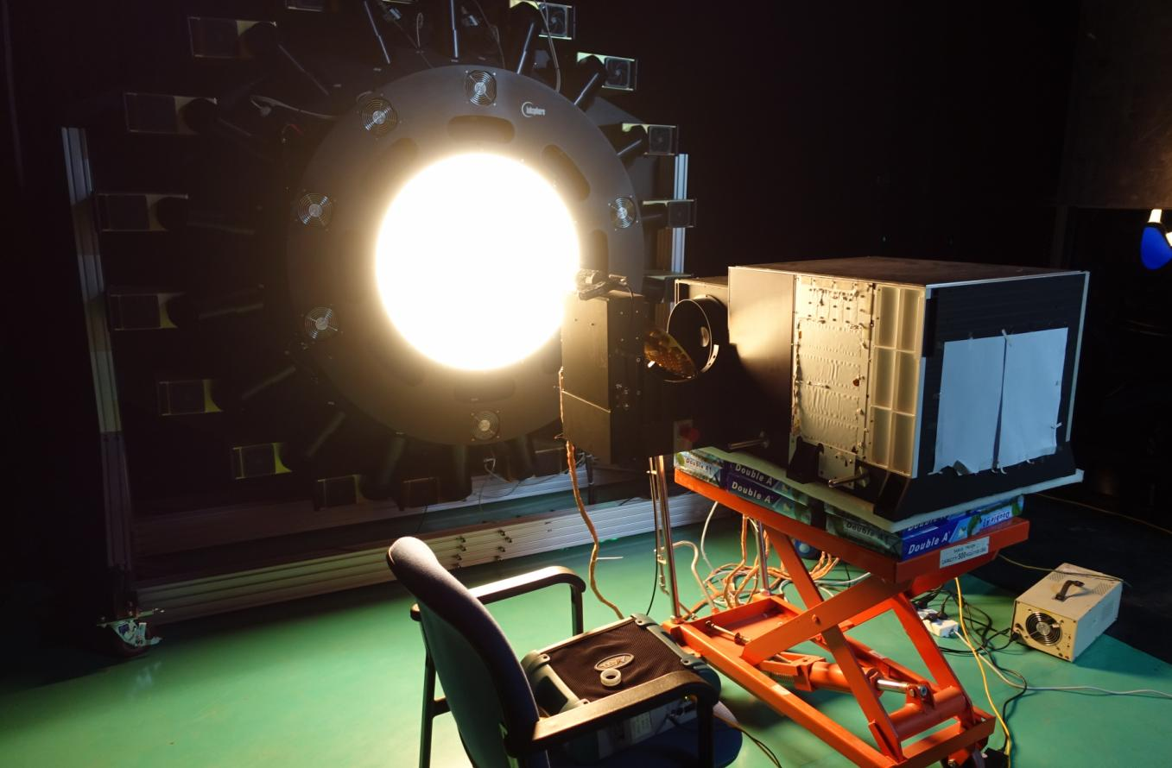
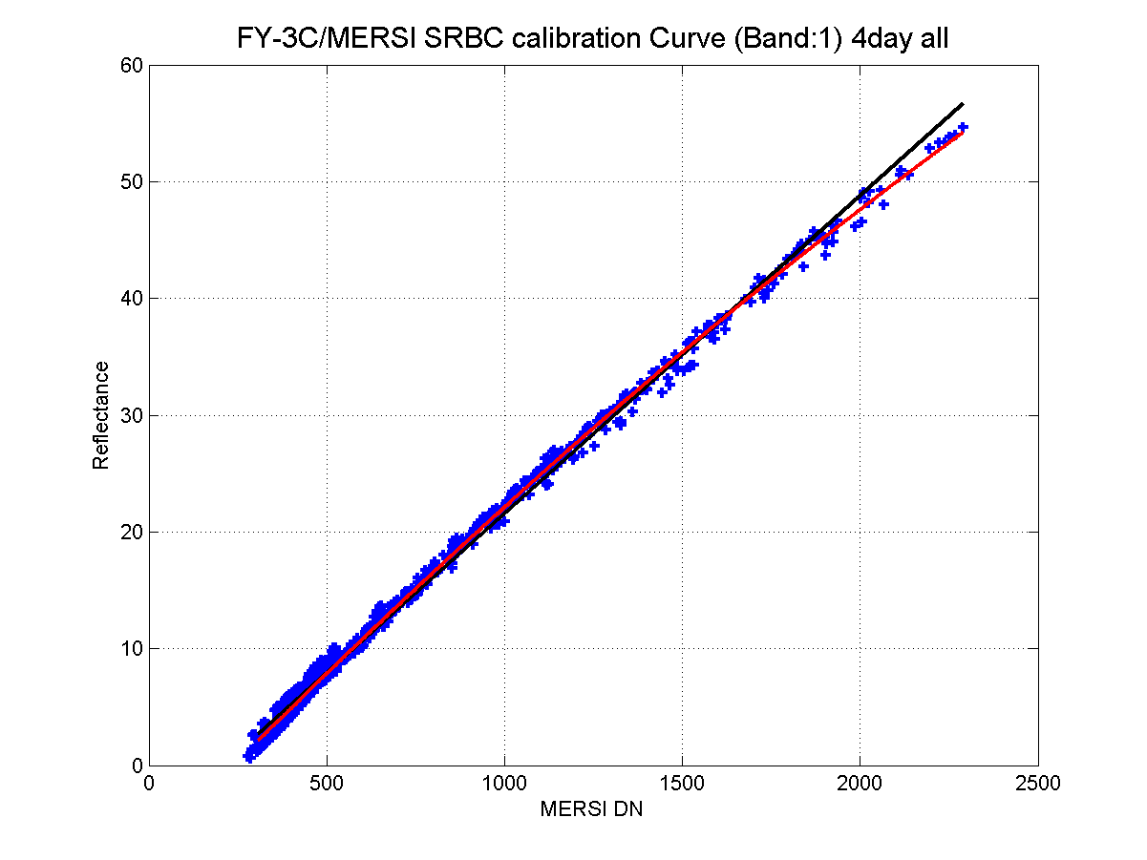
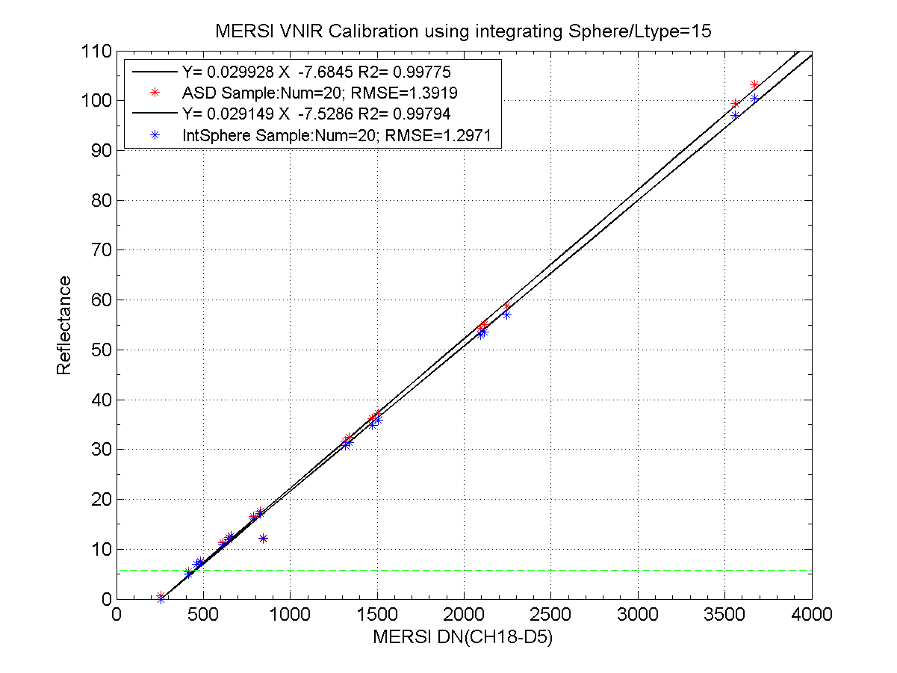
Improvement of Lunar observation performance
The photo of the pre-launch calibration for FY-3C/MERSI at Dali, on March, 2013
The photo of the pre-launch calibration for FY-3D/MERSI at Shanghai, on March, 2016
Notes:
定标变化
，发射前定标变化了—积分球性能提升，各通道实验室定标。
月亮辐照度计算
补照片：积分球图，和
Using Quadratic polynomial fitting

Slide 6
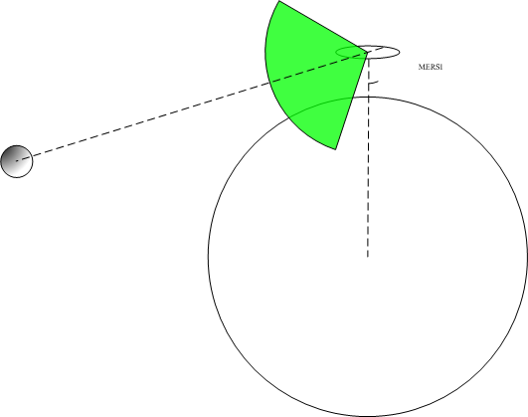
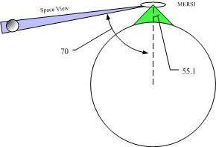
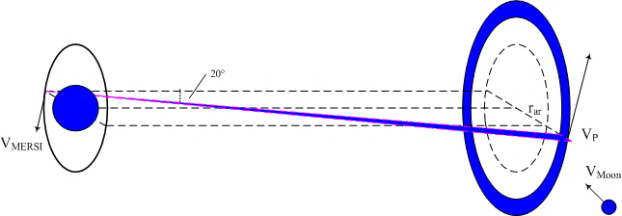
Improvement of Lunar observation performance
48 samples(@1000m), 192 samples(@250m)
2 lunar observation per month
Schedule observation by adjusting observation angle
Notes:
首先是由于增加了红外通道，地球背阳面也传输数据，所以每月会有两次对月观测：进圆环一次、出圆环一次。384400
对月观测变化了，主动被动，被动一次变两次
示意图说明，主动一次。
补：观域调整示意图

Slide 7
Improvement of Lunar observation performance
Up to 2018-2-24, there are 7 times of Un-schedule moon records and 1 schedule record
Schedule
Date | Absolutely Phase angle | Selenographic longitude (sun) | Selenographic longitude (observer) | Selenographic latitude (observer)
2017/12/29 | 78.25 | 70.02 | 3.78 | 8.36
Un-schedule
Date | Absolutely Phase angle | Selenographic longitude (sun) | Selenographic longitude (observer) | Selenographic latitude (observer)
2017/11/27 | 78.25 | 70.02 | 3.78 | 8.36
2017/11/30 | 46.31 | 38.62 | 5.77 | 7.65
2017/12/26 | 83.56 | 75.13 | 5.77 | 8.55
2017/12/29 | 45.07 | 39.60 | 6.65 | 5.28
2018/1/25 | 84.49 | 78.60 | 7.09 | 5.95
2018/1/28 | 49.70 | 44.87 | 5.10 | 4.71
2018/2/23 | 83.74 | 79.31 | 5.24 | 4.41
Notes:
目前对月观测数据时间和参数
单次定标传递结果
geometric angle
Such as
So on
And et cetera.

Slide 8
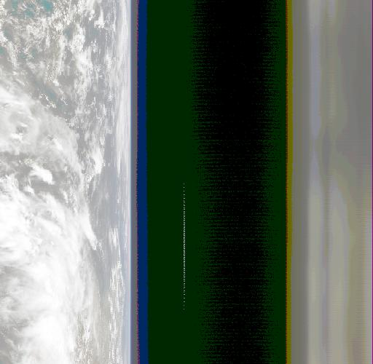
Improvement of Lunar observation performance
Notes:
对月观测图像，主动被动，同一月两次的
Using Quadratic polynomial fitting

Slide 9
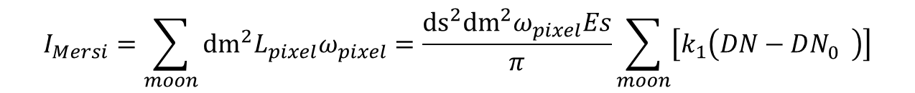
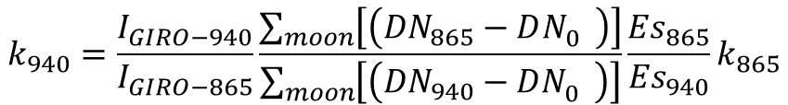
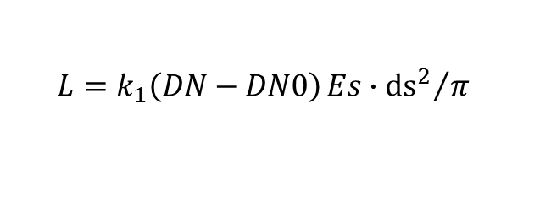

Inter-Band calibration
Irradiance from MERSI
$$L=k_{1}\left(DN−DN0\right){Es∙{ds}^{2}}/π$$
$$I_{Mersi}=\sum_{moon}{{{dm}^{2}L}_{pixel}ω_{pixel}}=\frac{{ds}^{2}{dm}^{2}ω_{pixel}Es}{π}\sum_{moon}{\left[k_{1}\left(DN−DN_{0}^{}\right)\right]}$$
Inter-band calibration
$$\frac{I_{Mersi−940}}{I_{Mersi−865}}=\frac{I_{GIRO−940}}{I_{GIRO−865}}$$
$$k_{940}=\frac{I_{GIRO−940}}{I_{GIRO−865}}\frac{\sum_{moon}{\left[\left({DN}_{865}−DN_{0}^{}\right)\right]}}{\sum_{moon}{\left[\left({DN}_{940}−DN_{0}^{}\right)\right]}}\frac{{Es}_{865}}{{Es}_{940}}k_{865}$$
Notes:
吸收通道困难，ROLO模型光谱
补充：SRF，和ROLO的单次光谱

Slide 10

Inter-Band calibration
$$R=\frac{k_{940−Moon}}{k_{940−Pre}}$$
Date | Phase | Band-16 | Band-17 | Band-18
2017/11/27 | 78.25 | 1.16 | 1.45 | 1.26
2017/12/26 | 83.56 | 1.13 | 1.42 | 1.28
2018/1/25 | 84.49 | 1.16 | 1.42 | 1.30
2018/2/23 | 83.74 | 1.17 | 1.42 | 1.29
2017/11/30 | 46.31 | 0.99 | 1.09 | 1.02
2017/12/29 | 45.07 | 1.02 | 1.10 | 1.02
2018/1/28 | 49.70 | 0.99 | 1.09 | 1.02
R shows the calibration coefficient deviation between inter-band calibration and the pre-launch.
For small phase angle:
  Band 16 and Band 18, deviation <2%
  Band 17 deviation is about 10%
  No significant change
For large phase angle:
  Band 16 deviation is about 15%
  Band 17 deviation is about 42%
  Band 18 deviation is about 28%
  No significant change
Notes:
单次定标结果

Slide 11
Inter-Band calibration
Irradiance Ratio between bands (left is RIGO, and right is MERSI )
Irradiance Ratio of MERSI is much larger than that of GIRO
reason of this is still UNKNOWN, and need to check the details of the process

Slide 12
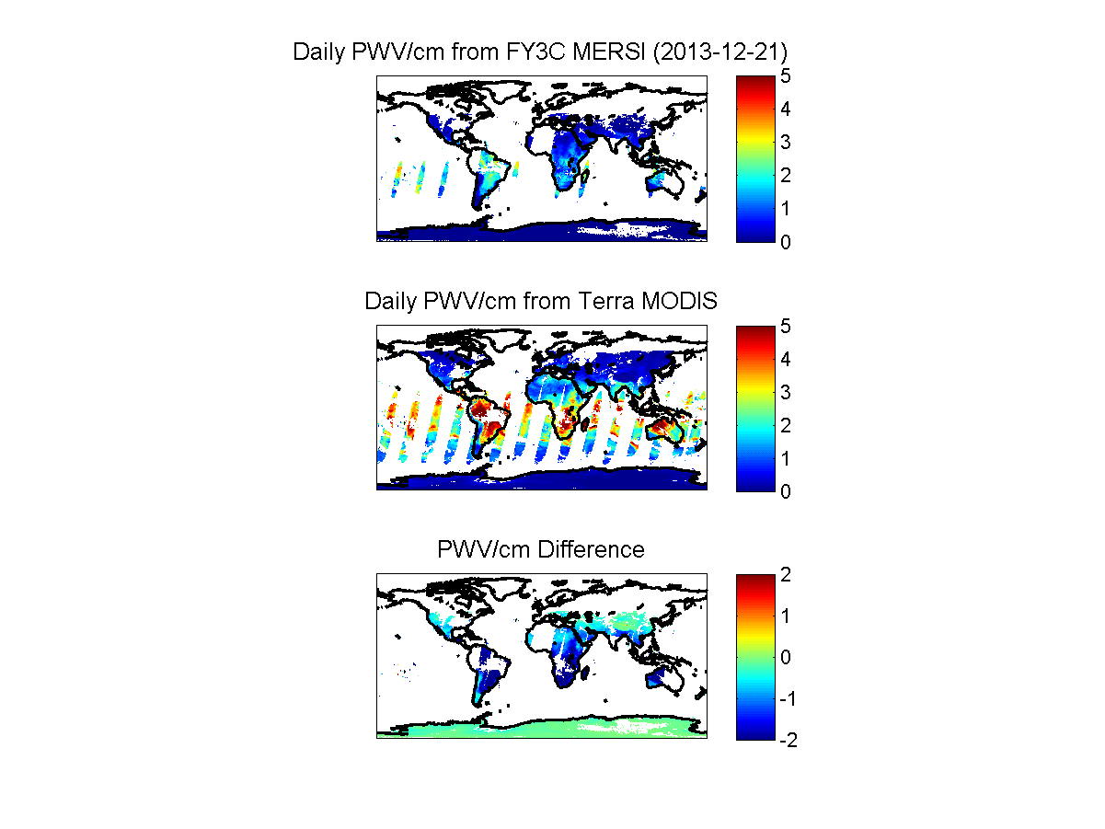
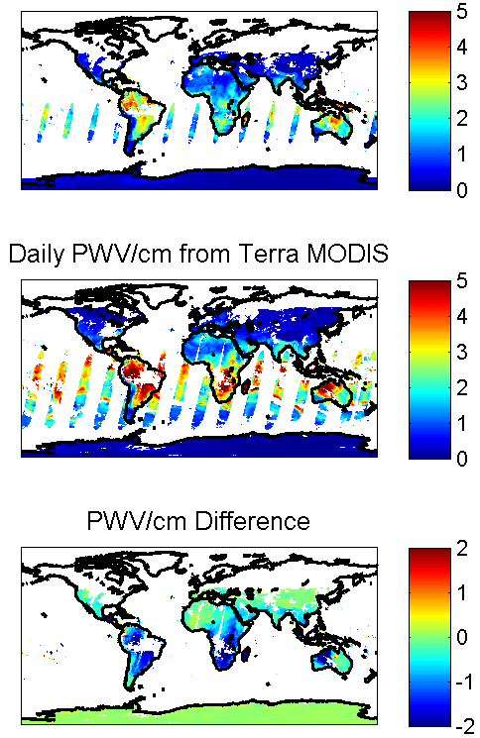
Product improvement: PWV
PWV:
Precipitable Water vapor
prelaunch
Inter-band (moon)
Notes:
3C做过的水汽产品试验
在FY3C/MERSI上，通过月亮的通道间定标系数比发射前定标系数的水汽产品结果对比。
订正后，与MODIS产品更加接近。
Equation
Formula
We can see that irradiance of all band change in a same pattern, this is caused Geometric factors influence all band in the same way.

Slide 13
Product improvement: PWV
prelaunch
MODIS
Ground base observation
Inter-band
Notes:
左侧是与MODIS产品的相关性情况；右侧是与观测站数据对比情况。
Interband定标系数改进了产品。
FY3D/MERSI-II的在轨测试还在进行中，水汽产品的情况下一步进行。

Slide 14
Summary
The total number of MERSI-II bands is up to 25, and some important adjustments are taken to the new sensor.
More lunar data will be observed, twice per month un-schedule ones and some schedule ones.
Calibration coefficient can be obtained between bands based on Lunar observation
The results shows that the vapor absorption bands coefficient did not significantly change.
Coefficient from inter-band improve the FY-3C/MERSI product(PWV )
Problem:
  For larger phase angle, the spectral shape of irradiance of MERSI is quite different from that of GIRO.
Notes:
结论
In order to Remove the Geometric influence, calculate the relative irradiance. And this is picture shows the relative irradiance time series.
We can see that most bands are stable

Slide 15
Thank you for your time!
The End
Notes:
Details

