Slide 1
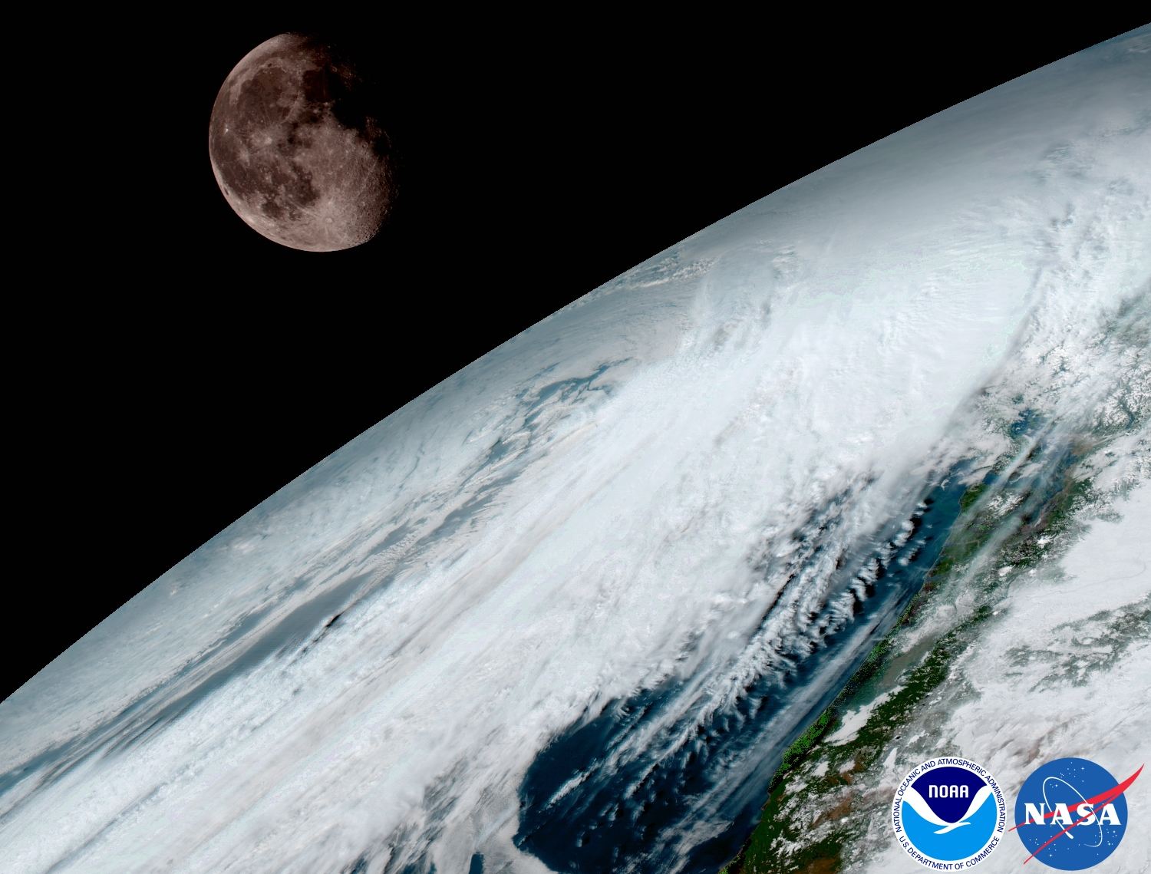
Alternative Utilities of Lunar Measurements for Satellite Instrument Calibration
Summary of the Session at the 2nd Lunar Calibration Workshop
With emphasis and update on Modulation Transfer Function (MTF)
X. Wu
2018-03-22
Acknowledgement: X. Shao, F. Yu, X. Xiong and others for help before, during, and after the meeting; X. Hu, S. Wagner, T. Stone, and others for organizing the workshop.

Slide 2
Agenda
Introduction
Stability for VNIR radiometric calibration
Knife edge and other features for additional characterization
Instrument Characterization
MTF (7)
Cross Talk (3)
Band-to-band registration
Alternative Measurements
Alternative Wavelength
Microwave
 | Topic: Alternative uses of lunar measurements
 | Chair: Fred Wu
14:10 | Fred Wu | NOAA | Introduction to the session | 5a | 00:10
14:20 | Xi (Sean) Shao | NOAA | MTF of ABI, AHI, FY-2, MI, and SEVIRI | 5b | 00:30
14:50 | Claude Ledez/Sebastien Wagner | EUMETSAT | MTF evaluation of Meteosat-9 SEVIRI using Lunar observations + results on the ABI + AHI | 5c | 00:15
15:05 | colleague/Masaya Takahashi | JMA | MTF evaluation of AHI using lunar observations | 5d | 00:15
15:20 | Lin Chen | CMA | MTF evaluation of FY-2 | 5e | 00:15
15:35 | Min Min | CMA | MTF evaluation of MERSI using Lunar observations | 5f | 00:15
15:50 | Stefan Adriaensen | VITO | MTF evaluation of Proba-V | 5g | 00:15
16:05 |  |  | Coffee break |  | 00:30
16:35 | All | All | Discussion | 5h | 00:45
17:20 | Seongick Cho | KIOST | GOCI-II MTF | 5i | 00:20
17:40 | Toru Kouyama | AIST | Lunar Observation Activities with a Small Satellite and a Planetary Exploration Satellite. | 5j | 00:20
18:00 | Lawrence Ong | NASA | TBD | ?? | 00:20
18:20 | END
Thurs am | Topic: Alternative uses of lunar measurements
 | Chair: Fred Wu
9:00 | Jack Xiong | NASA | MODIS PC bands optical leak characterisation using lunar observations | 5k | 00:20
9:20 | Wilson Truman | NASA | Electronic x-talk characterisation using lunar observations for MODIS and VIIRS | 5l | 00:20
9:40 | Fangfang Yu | NOAA | Ghost effects/ X-talk characterisation using Moon observations from ABI (?) | 5m | 00:20
10:00 | Likun Wang | NOAA | Using lunar observations from CrIS for band-to-band co-registration check and radiometric calibration stability monitoring | 5n | 00:20
10:20 |  |  | Coffee break |  | 00:30
10:50 | Songyan Gu | CMA | Lunar calibration consideration for FY-3 Microwave instruments | 5o | 00:20
11:10 | All | All | Discussion | 5p | 01:00
12:10 | Lunch Break |  |  |  | 01:00

Slide 3
Needs, Opportunity, Issues, and GSICS
Evaluate the imaging quality of satellite instrument.
In addition to radiometric, geometric, and spectral calibration.
For users, instrument vendors, calibration specialists, satellite operators, program managers, among others.
Modulation Transfer Function (MTF) of the sharp lunar edge is a nearly ideal and widely available target for such evaluation.
Results have not been comparable
Different methods for common process, e.g., LSF => ESF.
Instrument-specific idiosyncrasy, e.g., overlapping.
GSICS is the right place for such coordinated effort.

Slide 4
Step 1 (2nd Lunar Cal. Workshop)
Collect lunar image by each instruments (currently 6):
ABI on GOES-16, AHI on Himawari-8, Imager on GOES-15, MI on COMS, Imager on FY-2, SEVIRI on MSG.
Derive MTF with one method (NOAA) for all instruments
Are Imager and MI similar? ABI and AHI? Better than Imager/MI?
Derive MTF with different methods (agency) for the same instrument
Compare the differences in methods, tradeoffs, and results.

Slide 5
Expected Outcomes
Review the various methods and results.
Identify major obstacles or opportunities.
Is it feasible?
Are there better ways?
Summarize key questions for further investigation.
Plan for future – interim goals and schedule.

Slide 6
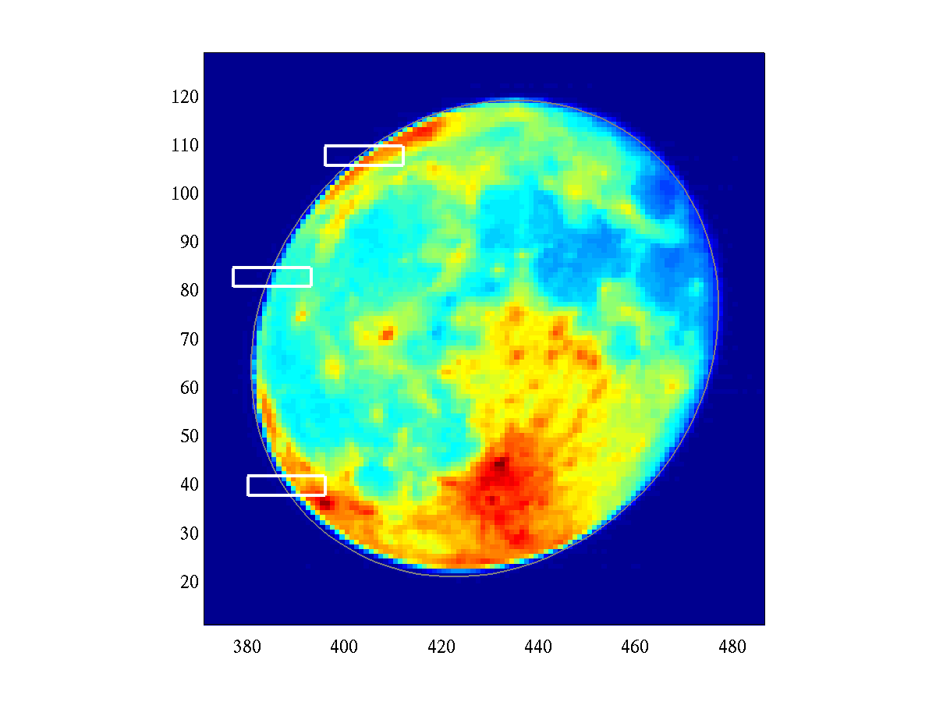
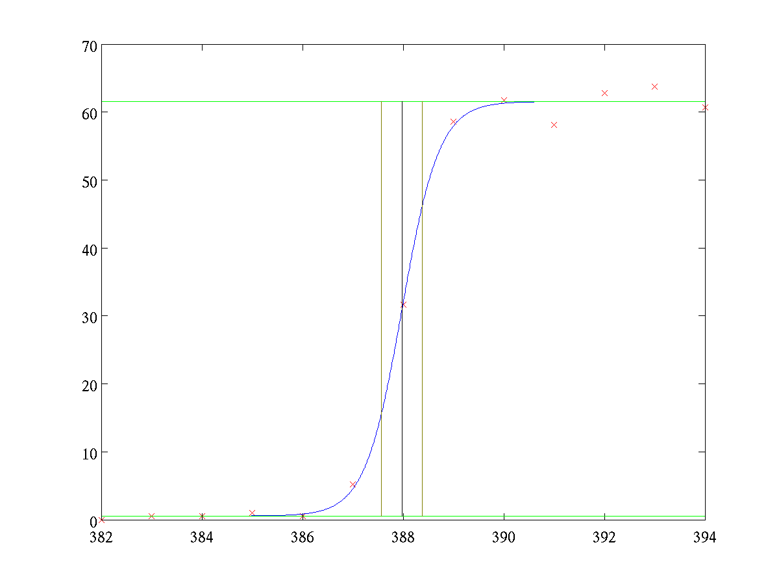
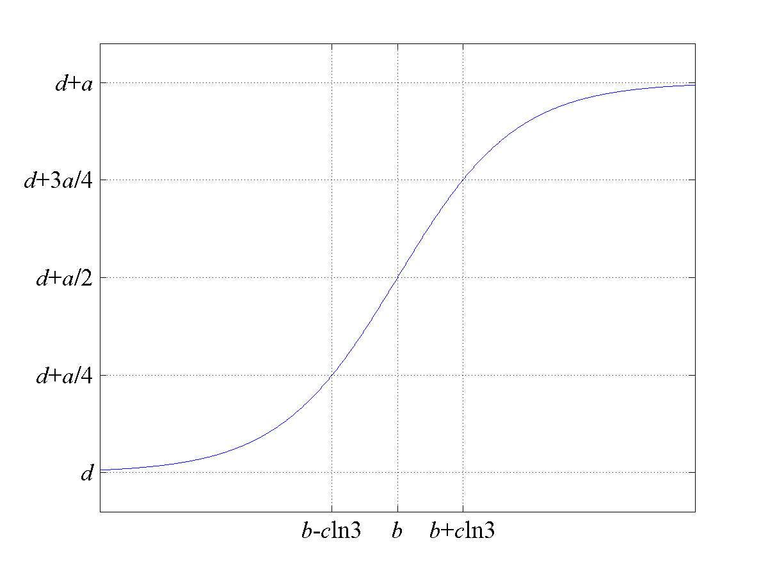
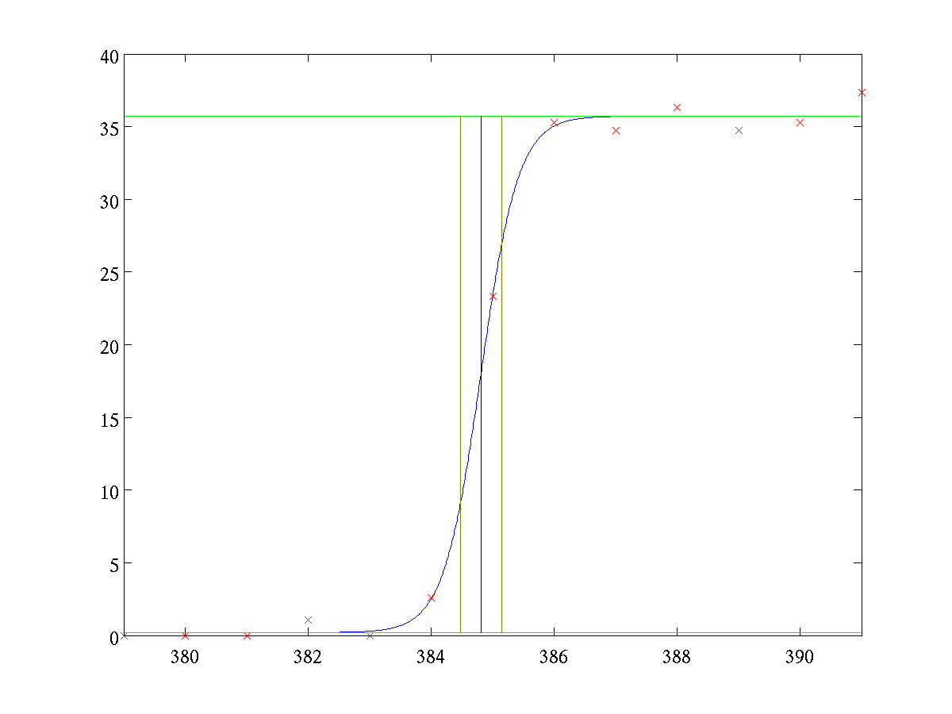
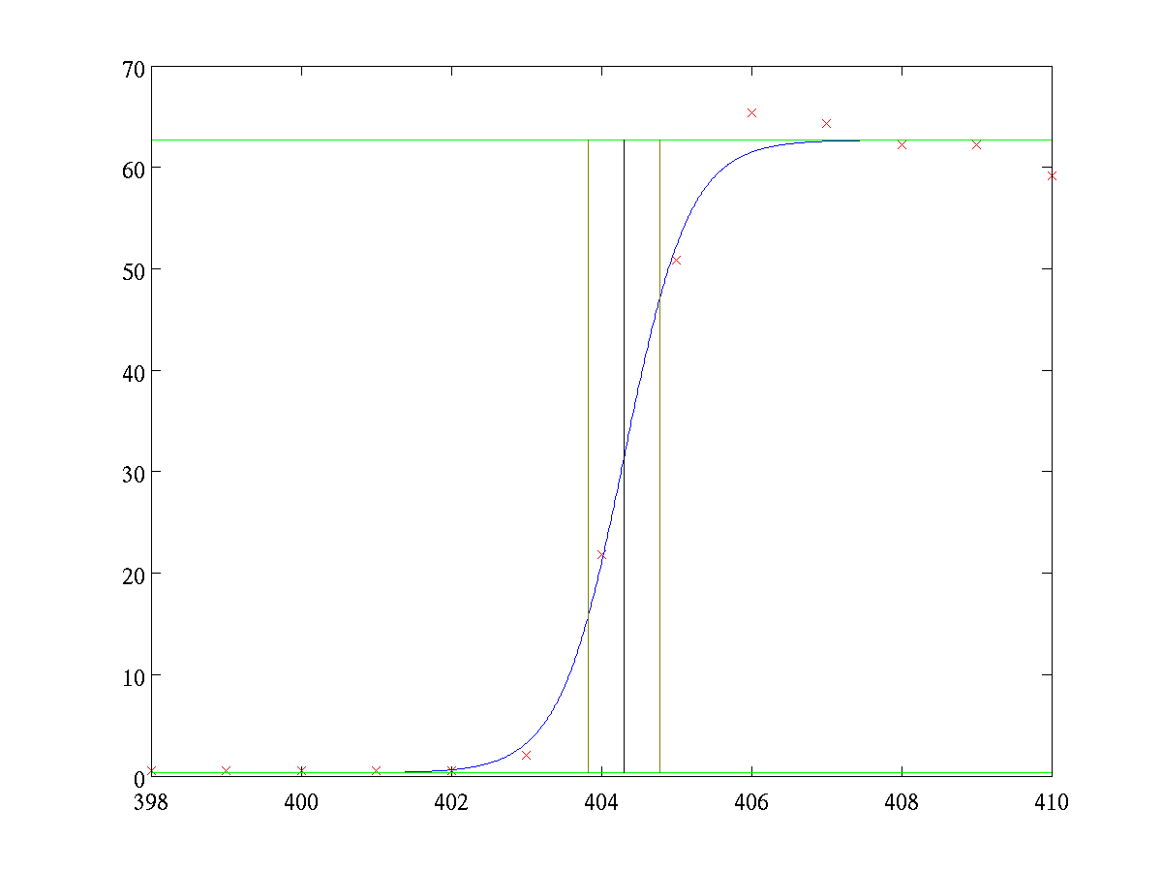
NOAA’s Method
Fit to a Fermi function (b is the edge location):
A. P. Tzannes and J. M. Mooney, 1995; Choi et al., 2014

Slide 7
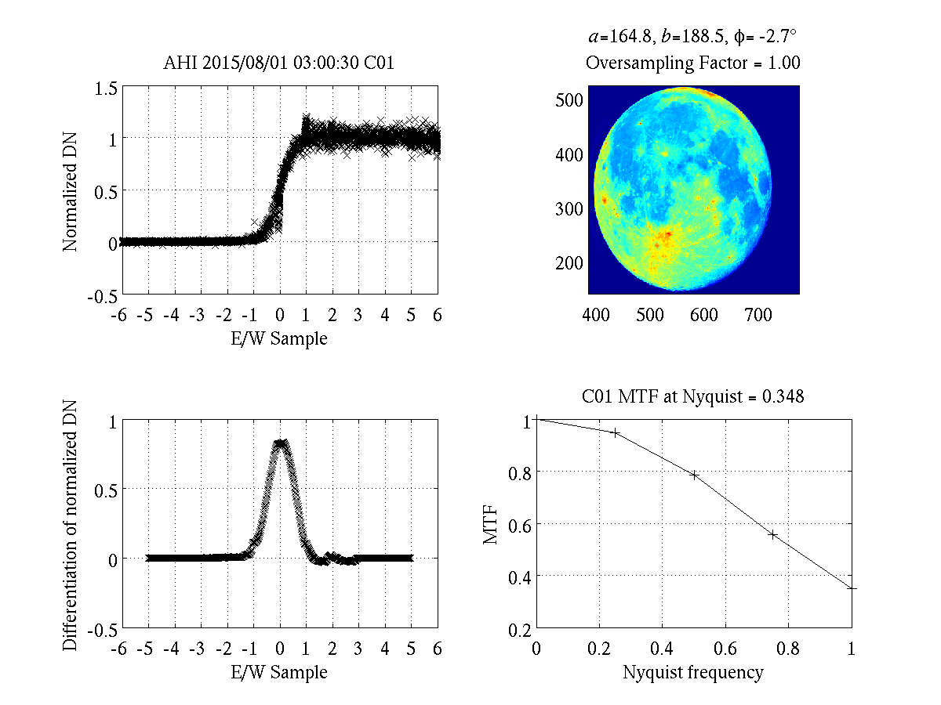
Lunar MTF Method
Normalization
Align the multiple background-to-Moon transition proﬁles at sub-pixel level along the scan-direction.
Sliding piecewise 2nd order polynomial filtering applied to ensemble of edge data
Differentiated to form the line spread function.
Apply Fourier transformation to the line spread function to derive MTF.
MTF at sub-Nyquist frequencies for imaging sensors (taking into account of Sensor specific oversampling factor)

Slide 8
Results and Discussions
Instrument | Date | Center λ(um) | Phase (deg.) | P1 | P2 | P3 | P4
AHI | 2015-08-01 03:00:30 | 0.64 | 9.85 | 0.845 | 0.600 | 0.393 | 0.198
ABI | 2017-02-11 19:12:28 | 0.64 | 9.75 | 0.939 | 0.788 | 0.590 | 0.396
KMA MI | 2016-11-13 01:13:33 | 0.675 | -22.09 | 0.926 | 0.791 | 0.607 | 0.399
GOES-15 | 2010-09-24 19:11:00 | 0.63 | 16.49 | 0.945 | 0.835 | 0.675 | 0.461
SEVIRI-9 | 2017-02-12 12:11:49 | 0.6 | 18.45 | 0.919 | 0.664 | 0.297 | 0.027
CMA FY-2G | 2015-04-03 03:01:06 | 0.5-0.75 | -15.10 | 0.734 | 0.348 | 0.148 | 0.140

Slide 9
Results and Discussions
Instrument | Date | Center λ(um) | Phase (deg.) | P1 | P2 | P3 | P4
AHI | 2015-08-01 03:00:30 | 0.64 | 9.85 | 0.845 | 0.600 | 0.393 | 0.198
ABI | 2017-02-11 19:12:28 | 0.64 | 9.75 | 0.939 | 0.788 | 0.590 | 0.396
KMA MI | 2016-11-13 01:13:33 | 0.675 | -22.09 | 0.926 | 0.791 | 0.607 | 0.399
GOES-15 | 2010-09-24 19:11:00 | 0.63 | 16.49 | 0.945 | 0.835 | 0.675 | 0.461
SEVIRI-9 | 2017-02-12 12:11:49 | 0.6 | 18.45 | 0.919 | 0.664 | 0.297 | 0.027
CMA FY-2G | 2015-04-03 03:01:06 | 0.5-0.75 | -15.10 | 0.734 | 0.348 | 0.148 | 0.140
ABI & AHI should be more similar

Slide 10
Results and Discussions
Instrument | Date | Center λ(um) | Phase (deg.) | P1 | P2 | P3 | P4
AHI | 2015-08-01 03:00:30 | 0.64 | 9.85 | 0.845 | 0.600 | 0.393 | 0.198
ABI | 2017-02-11 19:12:28 | 0.64 | 9.75 | 0.939 | 0.788 | 0.590 | 0.396
KMA MI | 2016-11-13 01:13:33 | 0.675 | -22.09 | 0.926 | 0.791 | 0.607 | 0.399
GOES-15 | 2010-09-24 19:11:00 | 0.63 | 16.49 | 0.945 | 0.835 | 0.675 | 0.461
SEVIRI-9 | 2017-02-12 12:11:49 | 0.6 | 18.45 | 0.919 | 0.664 | 0.297 | 0.027
CMA FY-2G | 2015-04-03 03:01:06 | 0.5-0.75 | -15.10 | 0.734 | 0.348 | 0.148 | 0.140
A brand new Imager vs. an aged MI

Slide 11
Results and Discussions
Instrument | Date | Center λ(um) | Phase (deg.) | P1 | P2 | P3 | P4
AHI | 2015-08-01 03:00:30 | 0.64 | 9.85 | 0.845 | 0.600 | 0.393 | 0.198
ABI | 2017-02-11 19:12:28 | 0.64 | 9.75 | 0.939 | 0.788 | 0.590 | 0.396
KMA MI | 2016-11-13 01:13:33 | 0.675 | -22.09 | 0.926 | 0.791 | 0.607 | 0.399
GOES-15 | 2010-09-24 19:11:00 | 0.63 | 16.49 | 0.945 | 0.835 | 0.675 | 0.461
SEVIRI-9 | 2017-02-12 12:11:49 | 0.6 | 18.45 | 0.919 | 0.664 | 0.297 | 0.027
CMA FY-2G | 2015-04-03 03:01:06 | 0.5-0.75 | -15.10 | 0.734 | 0.348 | 0.148 | 0.140
Difficult to compare visually.

Slide 12
Metric to Quantify Imaging Quality
SEVIRI-9
HIMAWARI-8 AHI
KMA COMS MI
FY-2G
GOES-16 ABI
GOES-15

Slide 13
Results and Discussions
Instrument | Date | Center λ(um) | Phase (deg.) | P1 | P2 | P3 | P4
AHI | 2015-08-01 03:00:30 | 0.64 | 9.85 | 0.845 | 0.600 | 0.393 | 0.198
ABI | 2017-02-11 19:12:28 | 0.64 | 9.75 | 0.939 | 0.788 | 0.590 | 0.396
KMA MI | 2016-11-13 01:13:33 | 0.675 | -22.09 | 0.926 | 0.791 | 0.607 | 0.399
GOES-15 | 2010-09-24 19:11:00 | 0.63 | 16.49 | 0.945 | 0.835 | 0.675 | 0.461
SEVIRI-9 | 2017-02-12 12:11:49 | 0.6 | 18.45 | 0.919 | 0.664 | 0.297 | 0.027
CMA FY-2G | 2015-04-03 03:01:06 | 0.5-0.75 | -15.10 | 0.734 | 0.348 | 0.148 | 0.140
Single parameter? Which one?

Slide 14
Results and Discussions
Instrument | Date | Center λ(um) | Phase (deg.) | P1 | P2 | P3 | P4
AHI | 2015-08-01 03:00:30 | 0.64 | 9.85 | 0.845 | 0.600 | 0.393 | 0.198
ABI | 2017-02-11 19:12:28 | 0.64 | 9.75 | 0.939 | 0.788 | 0.590 | 0.396
KMA MI | 2016-11-13 01:13:33 | 0.675 | -22.09 | 0.926 | 0.791 | 0.607 | 0.399
GOES-15 | 2010-09-24 19:11:00 | 0.63 | 16.49 | 0.945 | 0.835 | 0.675 | 0.461
SEVIRI-9 | 2017-02-12 12:11:49 | 0.6 | 18.45 | 0.919 | 0.664 | 0.297 | 0.027
CMA FY-2G | 2015-04-03 03:01:06 | 0.5-0.75 | -15.10 | 0.734 | 0.348 | 0.148 | 0.140
ABI & AHI should be more similar
Difficult to compare visually.
A brand new Imager vs. an aged MI
Single parameter? Which one?

Slide 15
AHI B01 (Oversampling Factor = 1)
Unintuitively, MTF for the 0.5km channel (AHI B03 & ABI B02) is worse than the 1km channel.

Slide 16
AHI B02 (Oversampling Factor = 1)
Unintuitively, MTF for the 0.5km channel (AHI B03 & ABI B02) is worse than the 1km channel.

Slide 17
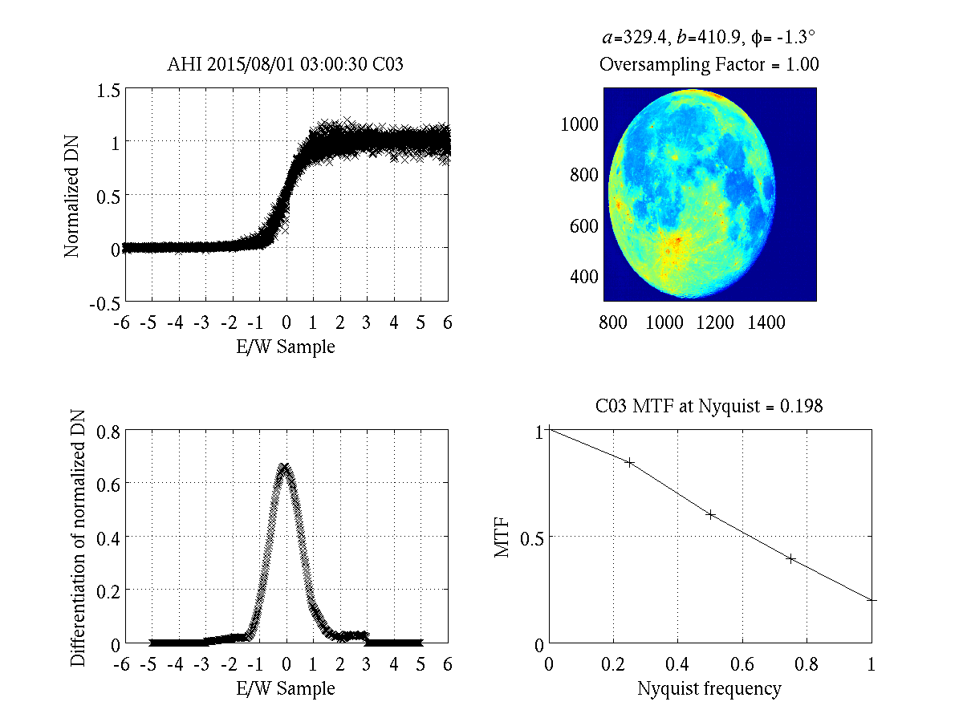
AHI B03 (Oversampling Factor = 1)
Unintuitively, MTF for the 0.5km channel (AHI B03 & ABI B02) is worse than the 1km channel.

Slide 18
ABI CH01 (2017-07-12)
Unintuitively, MTF for the 0.5km channel (AHI B03 & ABI B02) is worse than the 1km channel.

Slide 19
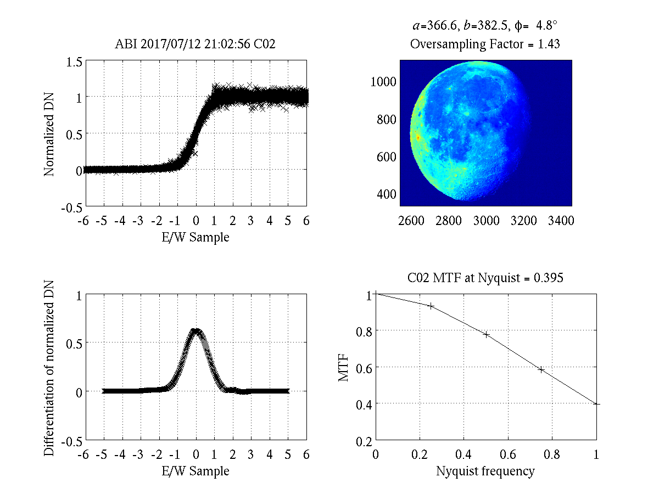
ABI CH02 (2017-07-12)
Unintuitively, MTF for the 0.5km channel (AHI B03 & ABI B02) is worse than the 1km channel.

Slide 20
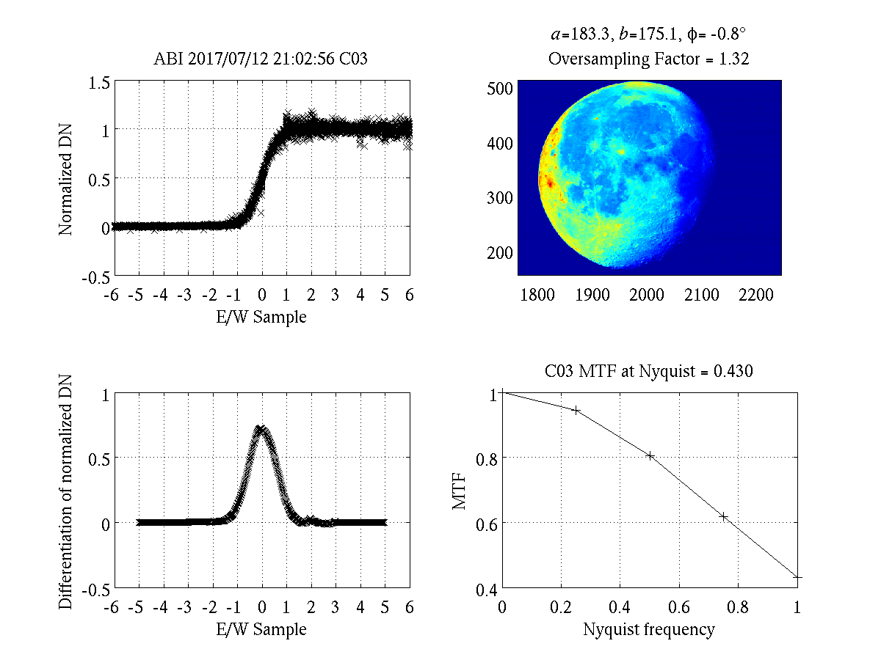
ABI CH03 (2017-07-12)
Unintuitively, MTF for the 0.5km channel (AHI B03 & ABI B02) is worse than the 1km channel.

Slide 21
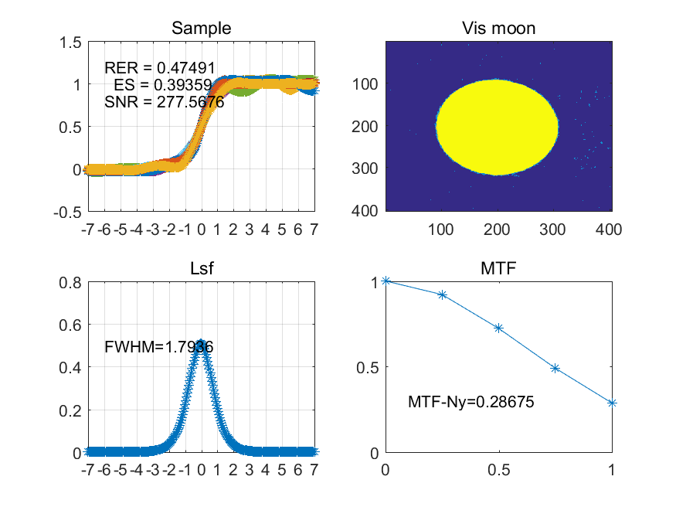
CMA Calculation on FY-2G
Have received some results.
Have not received algorithm.
Suggest other agencies to critique NOAA’s method based on their experience.

Slide 22
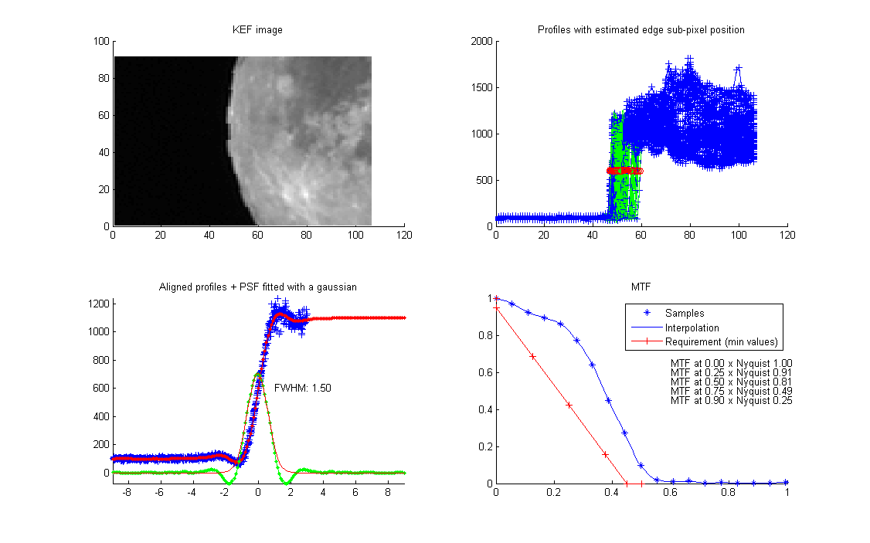
MSG-1 SEVIRI HRV in EW (by EUMETSAT)
Have received some results.
Have not received algorithm.
Suggest other agencies to critique NOAA’s method based on their experience.

Slide 23
Overall Conclusions
Meeting participants recognized the importance and expressed strong interest in evaluating the imaging quality of satellite instruments.
GSICS should recommend method(s) to compute the MTF based on lunar measurements that are applicable for all sensors and channels.
GSICS should reach out to the relevant expertise in other community such as WGCV of CEOS.

Slide 24
Path Forward (1/3)
Fundamentals: Sampling, Oversampling, and Resampling.
The algorithm should account for spatial resolution.
In addition to (or instead of) frequency relative to “sampling grids”.
Would be a more useful tool, even if no longer MTF.
Oversampling: Scaling the grid before deriving ESF.
Oversampling may have uncertainty, however it’s determined.
Its propagation to MTF should be estimated, but perhaps nearly negligible.
Resampling: Fully resample the lunar measurements before deriving ESF.

Slide 25
Path Forward (2/3)
Other Details of the Algorithm Under Development:
Coordinate acquisition on the same day?
Restrictions on lunar phase (waning/waxing) and latitude?
Fermi function?
ESF: Piecewise 2nd order polynomial etc.
LSF: Padded 0 for those 3 pixels away from edge etc.
MTF: Consideration for FFT?

Slide 26
Path Forward (3/3)
Metric to Evaluate MTF:
Single parameter is preferred.
It is desirable to cut off frequencies above the Nyquist to minimize aliasing while maintaining a reasonably flat MTF up to the Nyquist.
Some (such as AHI/ABI) does that explicitly via resampling with sinc function.
Ideally MTF near Nyquist should approach 0.
Because of other constraints and data noise etc., any algorithm is rarely optimal for every cases.
Perhaps MTF at Nyquist = 1 is neither desirable nor reliable.
Recommend MTF at Nyquist = 0.5.

Slide 27
Action Items
Action 1: Participating agency to identify Point of Contact (POC) for the GSICS lunar MTF development efforts. (POC Identified)
Action 2: NOAA to reach out to CEOS/ITOVS for knowledge and consultation of MTF experience and analysis. (Seeking suggestion in questionnaire)
Action 3: NOAA to distribute the lunar data collected from various agencies. (Distributed)
Action 4: NOAA/JMA to resolve the L1A/L1B data for MTF analysis, as well as oversampling factor. (In progress)
Action 5: NOAA to prepare the MTF questionnaires and send to the POC. (Questionnaire is under review)
Action 6: NOAA to prepare a report on lunar MTF at the workshop. (Completed).
Recommendation: POC from each agency to provide details and explanation of the algorithms/schemes.

Slide 28
Lunar MTF POC
At least one from each interested member or observer
May have more for additional instruments etc.
Current POC’s
CMA – Lin Chen
ESA – Ignacio Torralba Elipe
EUMETSAT – Claude Ledez
JMA – Masaya Takahashi
KMA – Doheong Kim
NASA – Lawrence Ong
NOAA – Xi Shao

Slide 29
Lunar MTF Questionnaire
Preliminary questionnaire for soliciting suggestions on GSICS lunar MTF development from participating agencies:
Is a standardized Lunar MTF evaluation beneficial to your instrument? Please identify the instrument and illustrate the impacts.
What is the expected GSICS Role in Lunar MTF development?
Please describe (briefly to start) the lunar MTF algorithm used or planned at your agency.
Please suggest ways to reach out for lunar MTF expertise – publications, persons, organizations (CEOS), meetings.
Please suggest steps to develop GSICS lunar MTF.

Slide 30
Summary
Review the various methods and results.
Partially fulfilled.
Revealed deficiencies (have enough to work on).
Increased interest. Confirmed feasibility.
Identify major obstacles or opportunities.
Sampling, Oversampling, and Resampling.
Many other important details.
Summarize key questions for further investigation.
Led to the Questionnaire and Path Forward
Plan for future – interim goals and schedule.
In progress.

