Slide 1
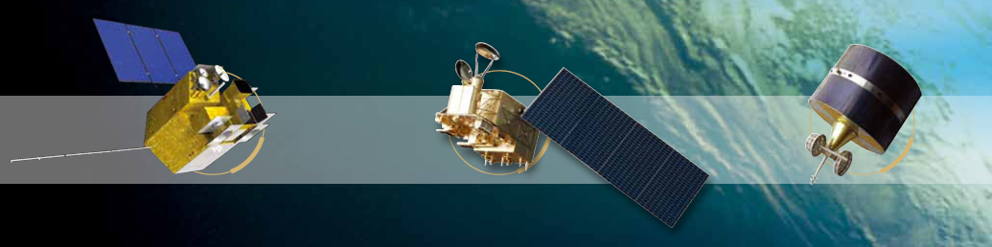

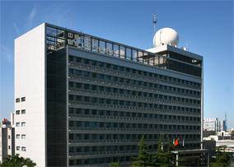


Consistent calibration of VIRR onboard FY-3A to FY-3C
Ling Wang
NSMC, CMA
2018.03.22

Slide 2
Outline
Background
Instrument and Methodology
Consistent calibration results of VIRR
Changes in VIRR calibration gain
Comparison with automatic calibration approach
Summary and future work
Notes:
[kəm'pærɪsn]

Slide 3
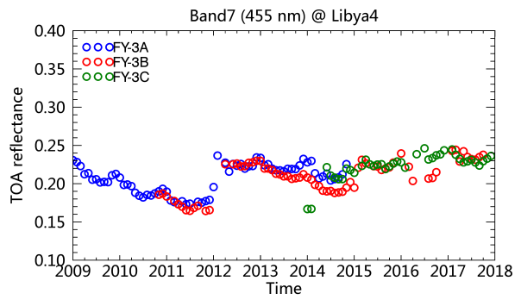
1. Background
VIRR flown on FY3 satellite series provide data nearly 10 years.
Due to lack of onboard calibration unit, in-situ calibration campaign one time a year is insufficient to correct satellite drift and make the calibration consistent.
The operational calibration of VIRR across its whole lifetime and across different FY3 satellites has jumps.
Time-series of the nadir (viewing angle < 10°) reflectance over Libya 4
Notes:
[kæm'pen]

Slide 4
2. Instrument and Methodology
VIRR introduction
  Launch Time: 2008.05 (FY-3A), 2010.11 (FY-3B), 2013.09 (FY-3C)
  Transit time: 10:30 (FY-3A), 13:30 (FY-3B), 12:00 (FY-3C)
  Scanning width: 3000 km × 1 km
  Spatial Resolution: 1 km
  Channel: 0.43 ~ 12.5 μm, including 7 RSBs, 3 IR bands
VIRR spectral band specifications
VIRR SRF over water transmittance spectrum
Band | Wavelength range (μm) | Noise (Δρ or ΔK @300K) | Dynamic (ρ or K)
1 | 0.58-0.68 | 0.1% | 0-100%
2 | 0.84-0.89 | 0.1% | 0-100%
6 | 1.55-1.64 | 0.15% | 0-90%
7 | 0.43-0.48 | 0.05% | 0-50%
8 | 0.48-0.53 | 0.05% | 0-50%
9 | 0.53-0.58 | 0.05% | 0-50%
10 | 1.325-1.395 | 0.19% | 0-90%
Notes:
micron
thermal infrared

Slide 5
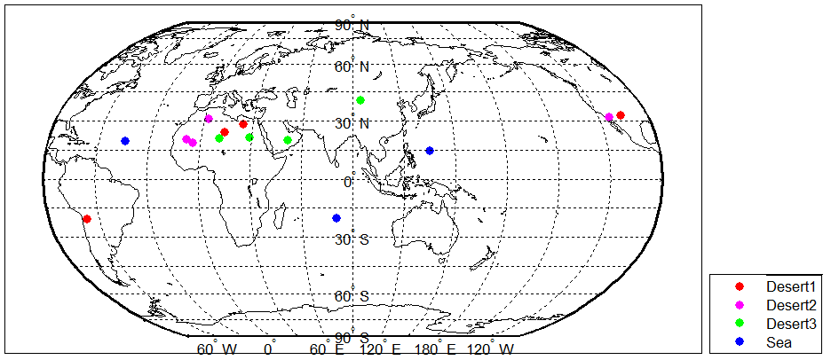
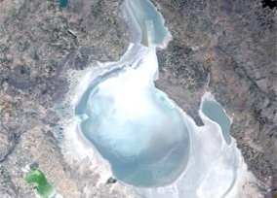
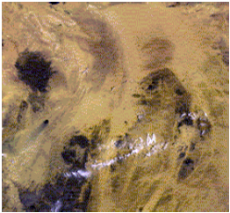

Consistent calibration methodology
Calibration Reference：calculations from 6S RTM code
Multiple stable earth targets (MST) are used, to reduce the calibration uncertainty.
  12 desert and salt lake targets
    Higher brightness: WhiteSands, Libya1, Libya4, Mali
    Moderate brightness : Algeria5, Mauritania2, Sonora, Arabia2
    Lower brightness : Niger2, Sudan1, Dunhuang
  3 dark sea targets
    AtlanticN, IndianOcean, PacificN1
Salt lake
desert
(http://calval.cr.usgs.gov/)
Deep ocean
Site location
Notes:
http://calval.cr.usgs.gov/rst-resources/sites_catalog/radiometric-sites/test-site-gallery/

Slide 6
Inputs of 6S
  VIRR L1B data->observation geometry
  MCD43C1 (0.05°×0.05°) -> surface reflectance of desert
  Deep ocean surface reflectance in 6S for ocean site
  MYD08/MOD08 (1°×1°) -> aerosol, ozone, water vapor
  NCEP (2.5°×2.5°, 6 h) -> wind speed
Desert surface reflectance corresponding to the satellite viewing geometry
fiso, fgeo, fvol are obtained from MCD43C1
Notes:
Screen secens

Slide 7
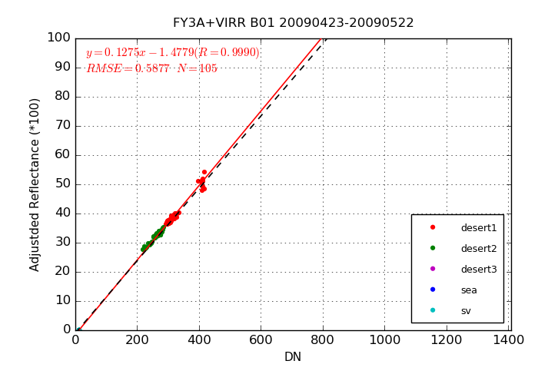
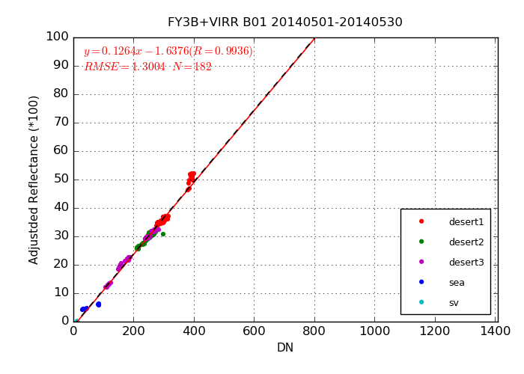
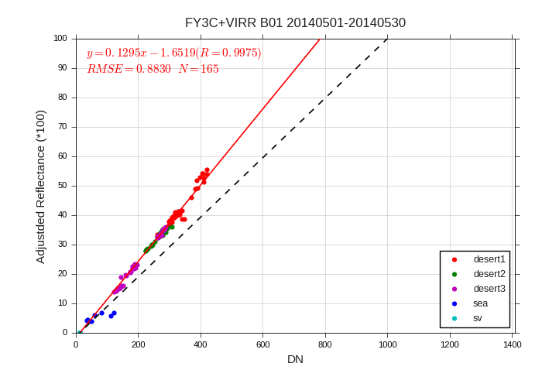
Examples of MST calibration results of FY-3X VIRR on a certain day
Samples within 30 days are used.

Slide 8
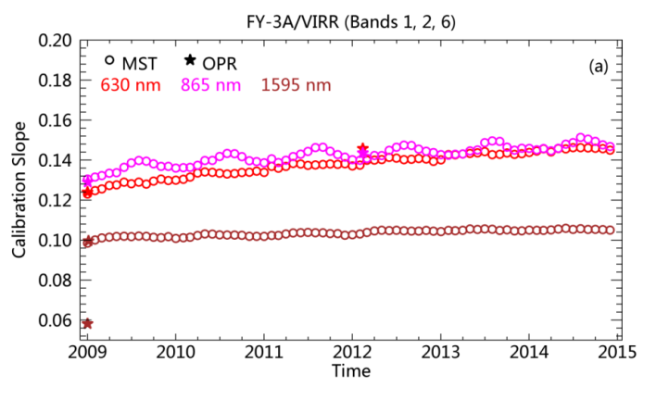
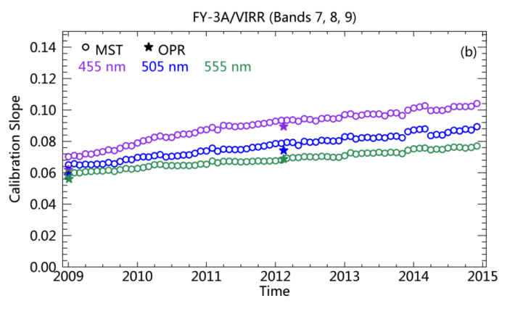
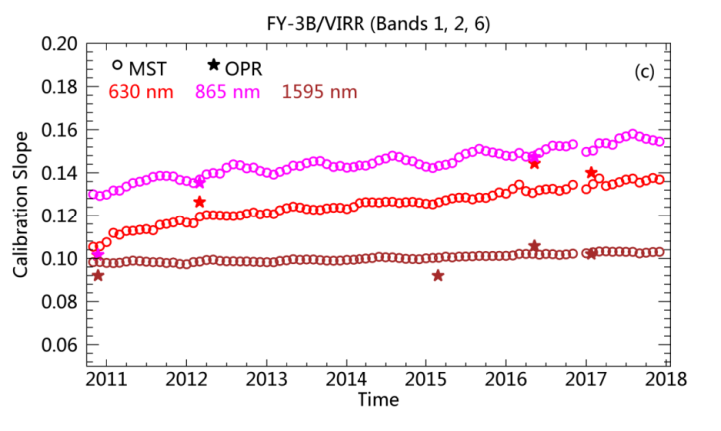
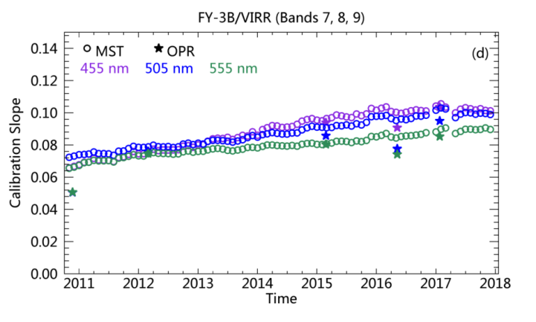
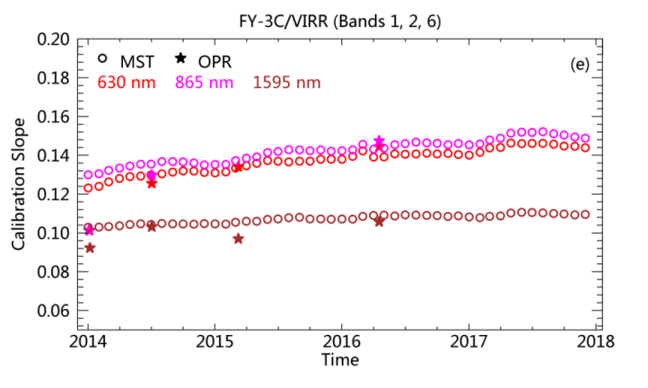
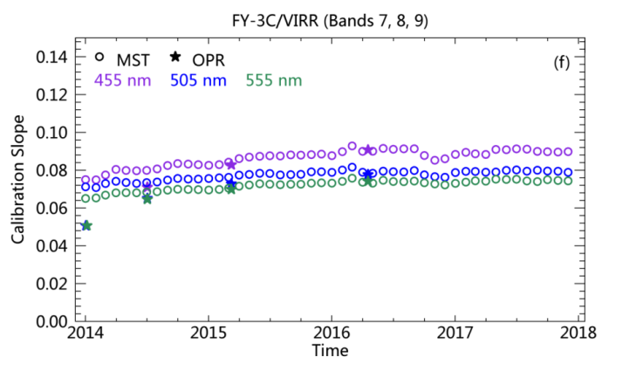
3. Consistent calibration results of VIRRs
FY-3A
Gain of VIRRs in most bands increases with time, and operational calibration update is few and is insufficient to characterize satellite drift.
The trending in the gain derived from MST agrees with the changes in operational gain.
6 years
6 years
FY-3B
7 years
7 years
FY-3C
4 years
4 years
Notes:
Fewer updates

Slide 9
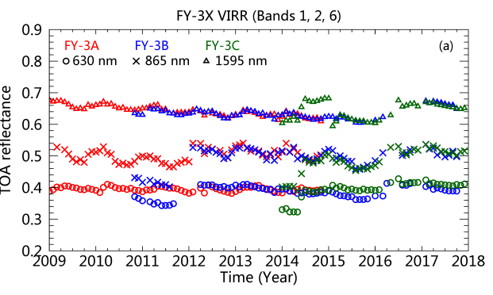
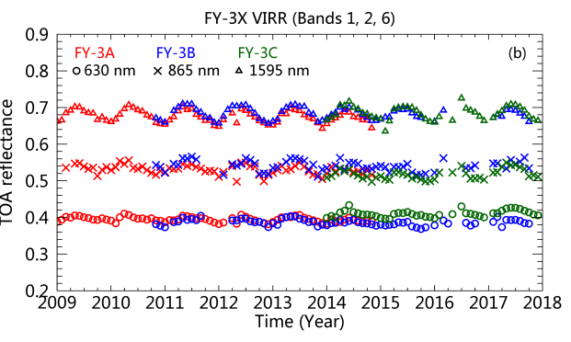
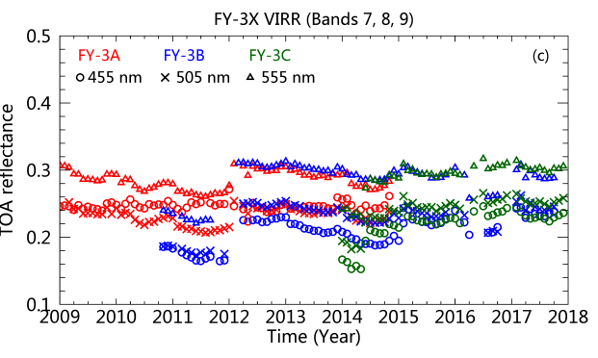
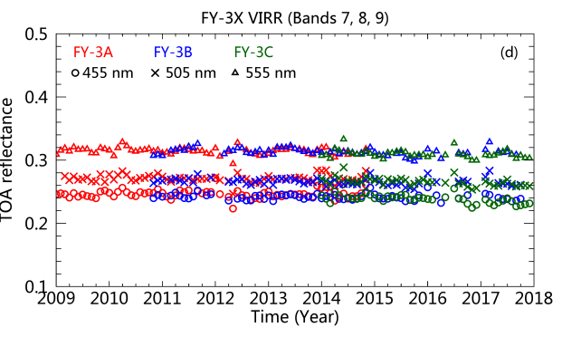
Comparison of TOA reflectance time series over Libya 4 before and after consistent calibration
Before consistent calibration
After consistent calibration
After consistent calibration the jumps in TOA reflectance are disappeared.
Notes:
TO evaluation the consistent calibration

Slide 10
Consistency comparison of VIRR TOA reflectance before and after consistent calibration
Consistency evaluation using coefficient of variation (CV):
Variation in the operational TOA reflectance is large (>5%) for most RSBs except band 6 (1595 nm).
The inconsistency increased towards shorter wavelength bands. Band 7 the shortest one, has the largest CV before recalibration.
After recalibration, the inconsistency in VIRR TOA reflectance during 9 year period is decreased to a great extent. The CV is less than 3% for all RSBs.
Period: 2009.01 ~ 2017.12, 9 years
Band No. | B1 | B2 | B6 | B7 | B8 | B9
Wavelength (nm) | 630 | 865 | 1595 | 455 | 505 | 555
Notes:
assess

Slide 11
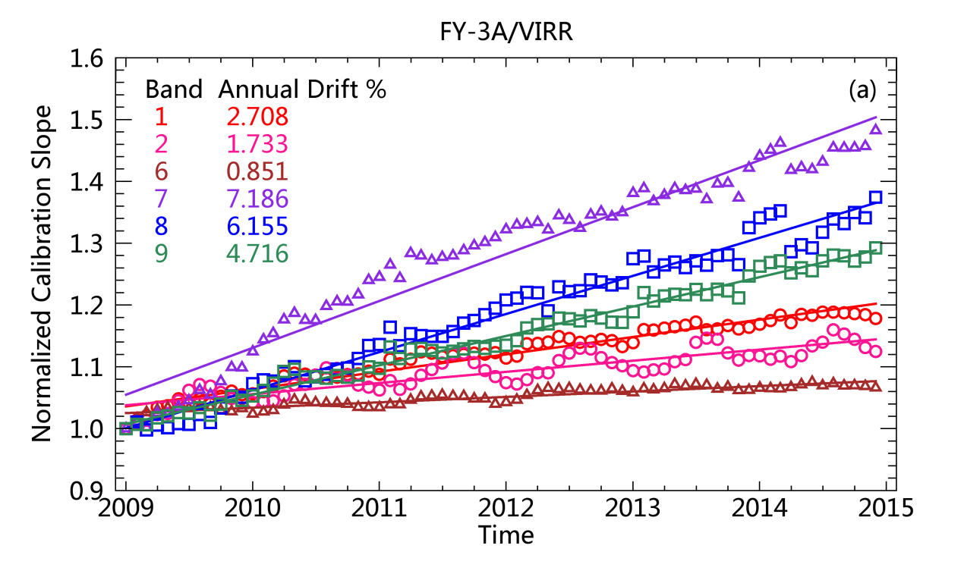
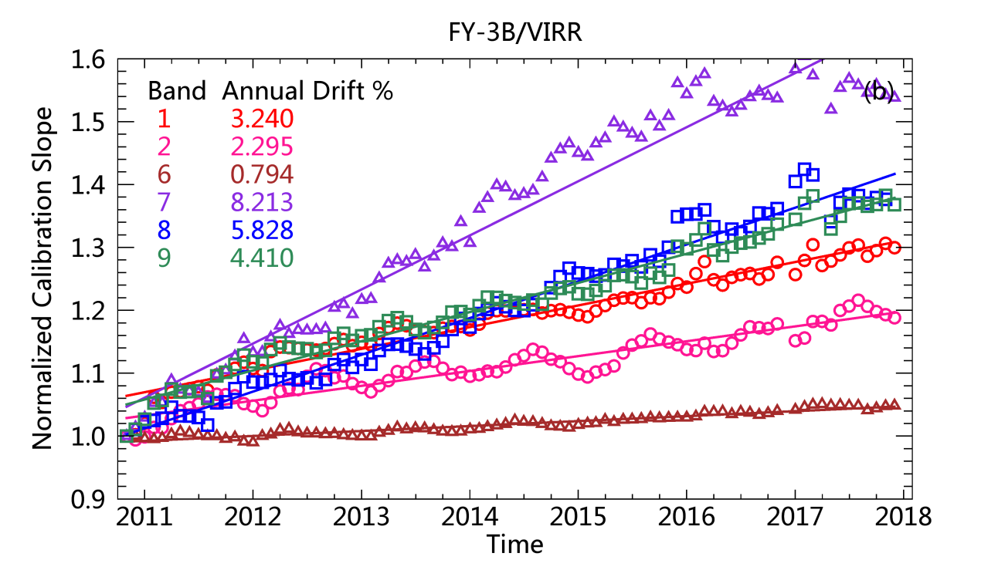
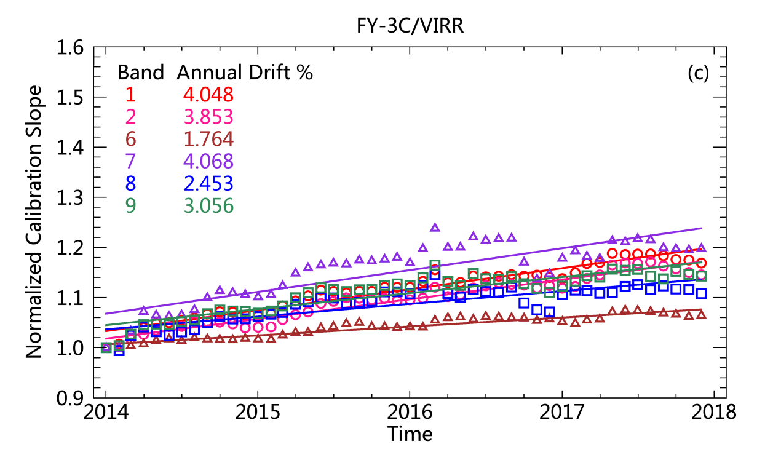
4. Changes in VIRR calibration gain
Linear fit to the normalized calibration gain to assess VIRR drift
6 years
7 years
4 years
VIRR drift is large in the short wavelength bands. The Band 6 is the most stable..
Notes:
The

Slide 12
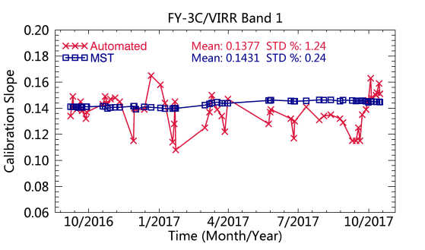
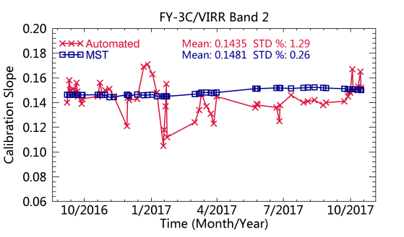
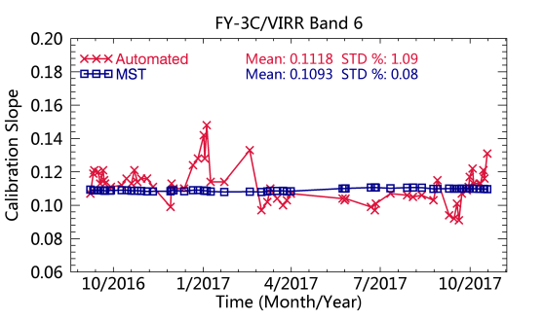
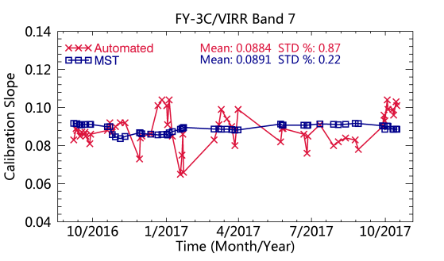
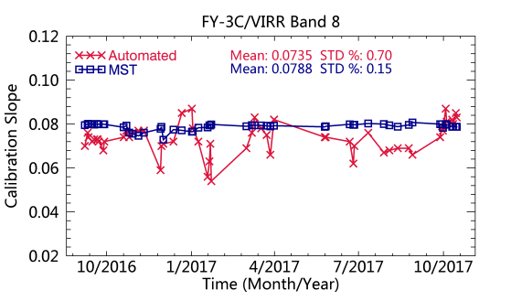
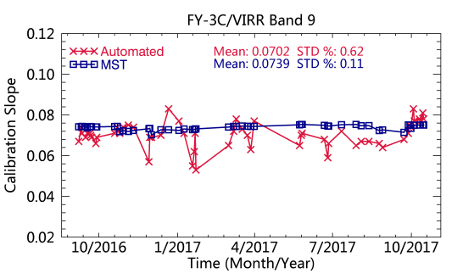
5. Compared with automatic calibration approach
Time series of calibration slope for FY-3C VIRR from 2016.09 to 2017.10
630 nm
865 nm
1595 nm
455 nm
505 nm
555 nm
MST calibration results are more smooth through time than the automatic calibration.
Notes:
Std of mst calibration coefficients is less than quarter of the automatic resulsts.

Slide 13
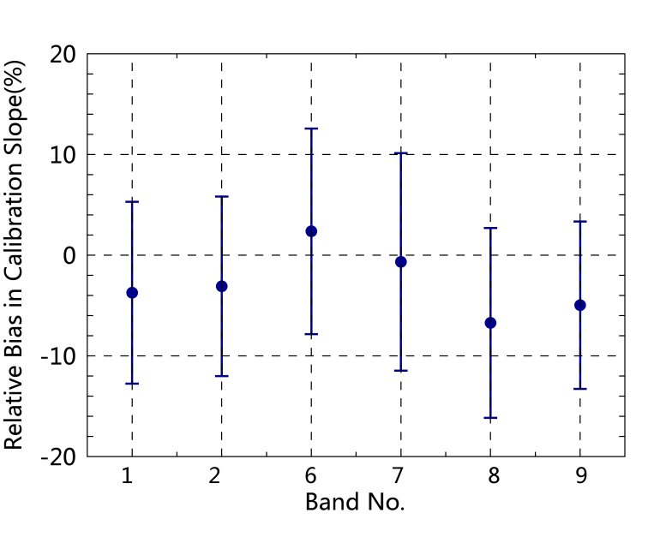
Calibration slope difference between MST and automatic calibration approach
RB = (Auto-MST)/MST * 100%
The yearly averaged calibration slope of FY-3C VIRR derived from MST are in line with automatic calibration, with relative bias less than 5% for most bands.
Notes:
Error bar represents the standard deviation

Slide 14
6. Summary and future work
VIRR operational radiometric calibration has jumps across the whole lifetime and across different FY-3 satellites.
Absolute calibration using multiple stable earth targets (MST) is developed for VIRR, which can update calibration everyday, realizing better correcting sensor drift and making the calibration consistent.
MST calibration has a good accuracy and lower temporal oscillation compared with automatic calibration operated in Dunhuang.
The VIRR drift is large in short wavelength bands (bands 7-8), with annual drift of 3~8 %. The longest wavelength, band 6 is most stable, with annual drift of <1 % for FY-3A and 3B.
Improve the current method to make calibration from different platforms more consistent and to establish vicarious calibration method which can be calibrate water vaopor absorption bands with high accuracy.
Notes:
To further investigate the seasonal pattern of TOA reflectance in Band 2 (865 nm).

Slide 15
Thanks for your attention!

