Slide 1
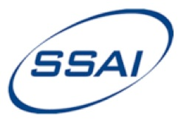
Update on the NASA-Larc SBAF tool
Benjamin Scarinoª, David R. Doelling^{b}, Arun Gopalanª, Thad Cheeª, Rajendra Bhattª, and Conor Haneyª
ªSSAI, One Enterprise Pkwy Ste 200, Hampton, VA 23666 USA
^{b}NASA Langley Research Center, 21 Langley Blvd MS 420, Hampton, VA 23681-2199 USA
Global Space-based Inter-Calibration System 2018 Annual Meeting
19 - 23 March 2018 Shanghai, China
GRWG: VIS/NIR Sub-group
Thursday, March 22th, 15:50

Slide 2
Outline
Developments summary
SBAF review
IR SBAF Example
Spectral Filtering
Summary

Slide 3
1-year Developments Summary
SCIAMACHY:
Adjustable outlier filter and data range limiters
Supports Uyuni PICS and ocean Ice/Water Cloud Earth spectra
Axis control
GOME-2:
Record expanded from 1 month to 9 years
Version 1.0.C GOME-2 (FM3) / Metop-A (M02) signal degradation correction coefficients applied
Enabled 2x-spatial resolution selection for measurements after July 2013
More PICS
Spectra plotting tool
Reflectance option added, computed from Solar Mean Reference (SMR) spectra
Hyperion:
IGBP and PICS pre-defined selection options
Cloud filtering algorithm
Spectra plotting tool with spectra range filtering and SRF convolution

Slide 4
1-year Developments Summary
IASI:
Improved Planck Function extrapolation for NIR channels
South Pole domain added
SRF+Energy weighted IR brightness temperature correction coefficients, with linear correction, for conversion from radiances† (T*)
AIRS:
AIRS SBAF tool
With T*
Miscellaneous:
Enabled spectra ASCII output on all spectra web tools
J1-VIIRS, MSU-MR, FY-4, SMS, and INSAT-3DR instrument SRFs supported
†NOAA KLM User's Guide Section 7.1.2.2

Slide 5
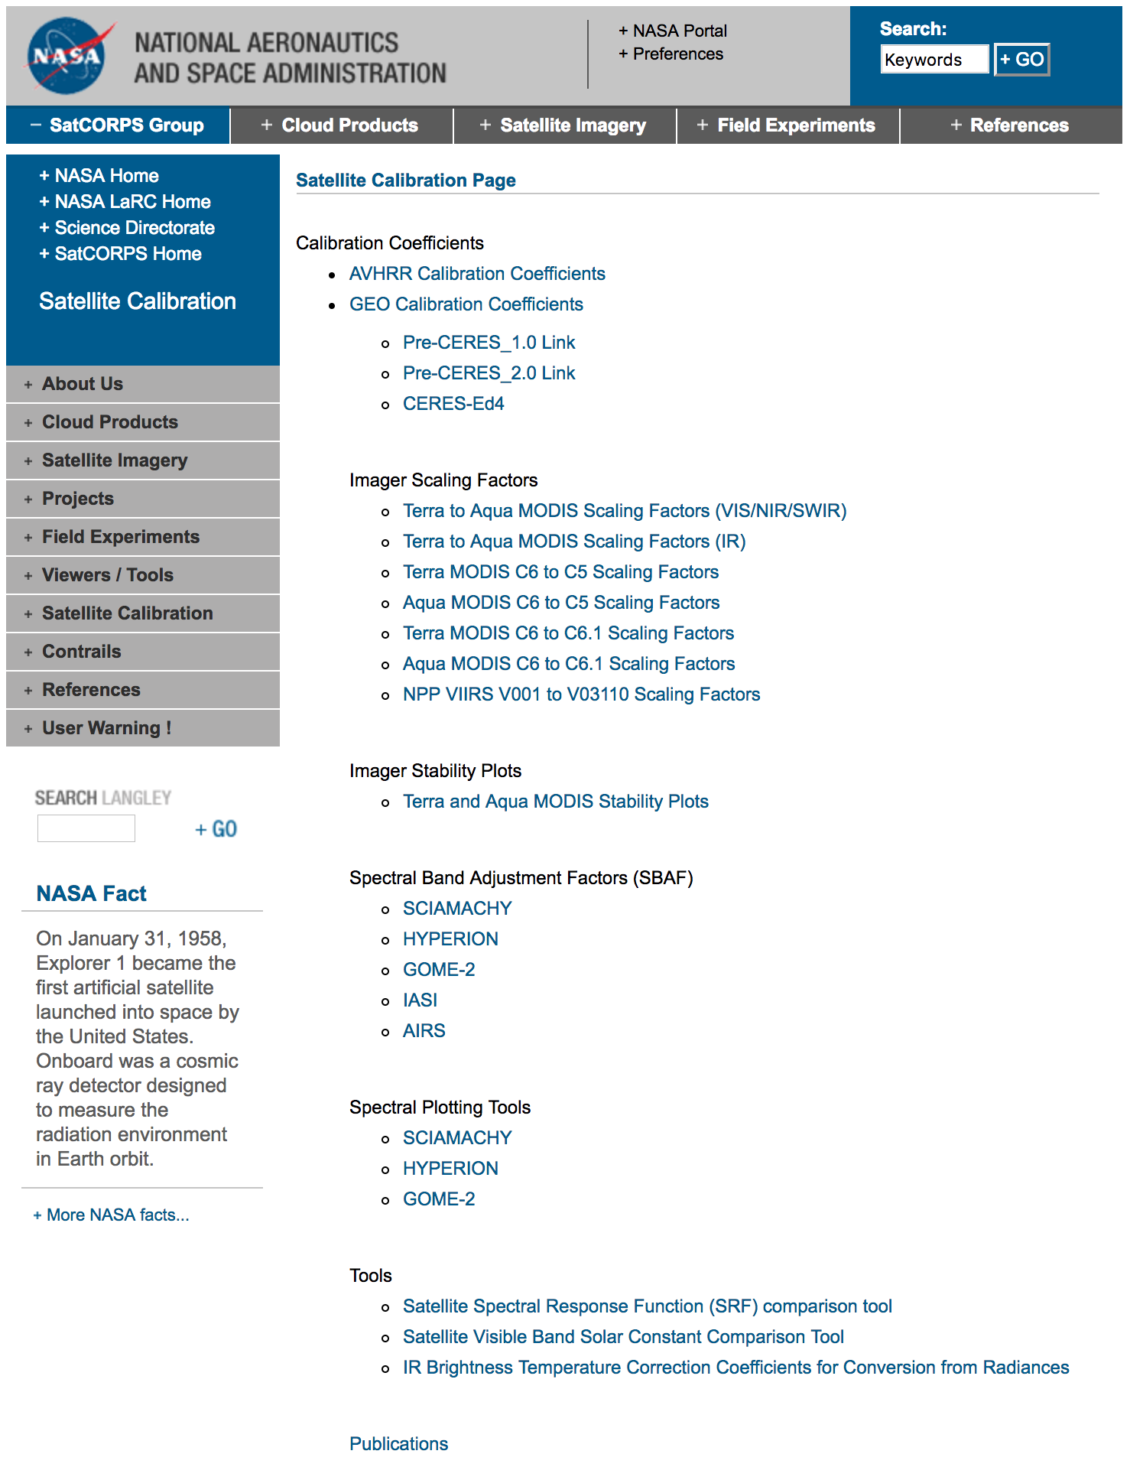
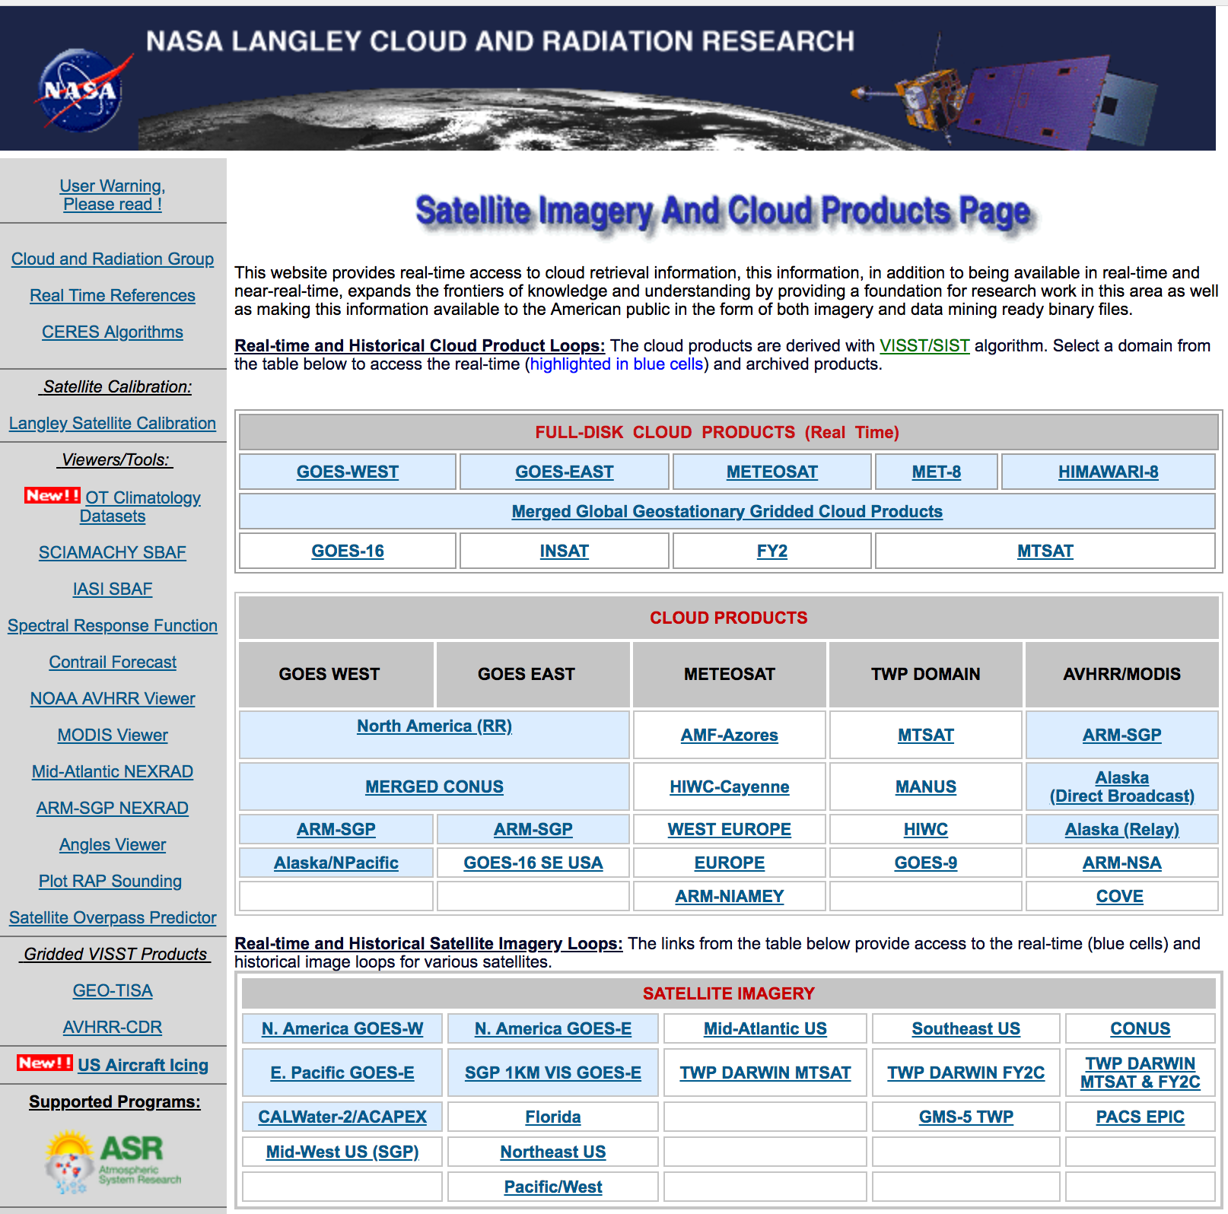
NASA Langley Satellite Calibration Webpage
satcorps.larc.nasa.gov
satcorps.larc.nasa.gov/cgi-bin/site/showdoc?mnemonic=SAT_CALIB_USER

Slide 6
NASA Langley Satellite Calibration Webpage
gsics.wmo.int
satcorps.larc.nasa.gov/cgi-bin/site/showdoc?mnemonic=SAT_CALIB_USER

Slide 7
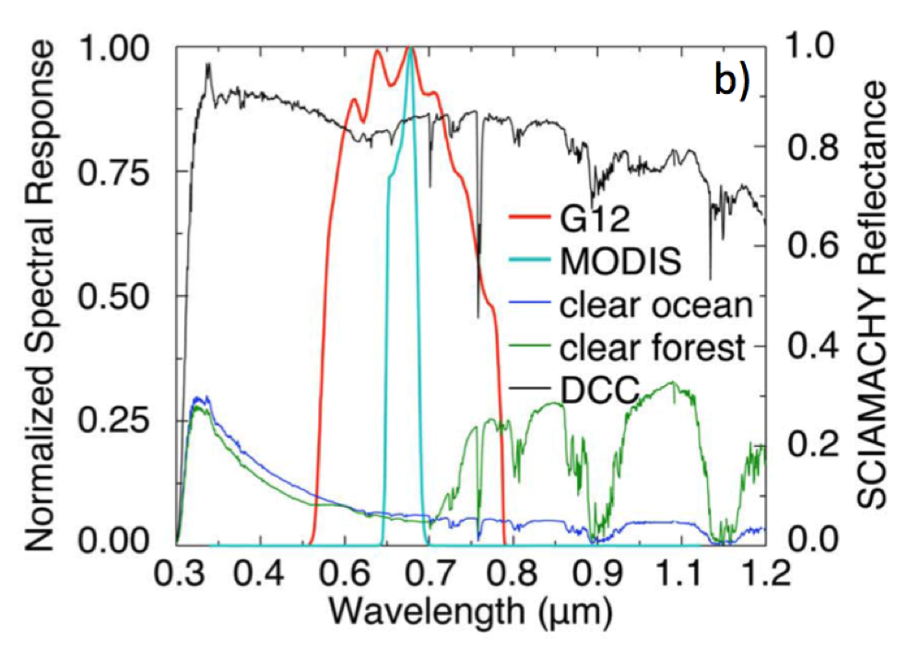
Spectral Band Adjustment Factor (SBAF)
Every Earth scene has a unique spectral reflectance signature
Derive reference- and target-sensor pseudo radiance/reflectance (L_{p}) via hyperspectral convolution over each RSR to account for band difference/out-of-band absorption
Derive reference- and target-sensor pseudo radiance/reflectance (L_{p}) via hyperspectral convolution over each RSR to account for band difference/out-of-band absorption

Slide 8
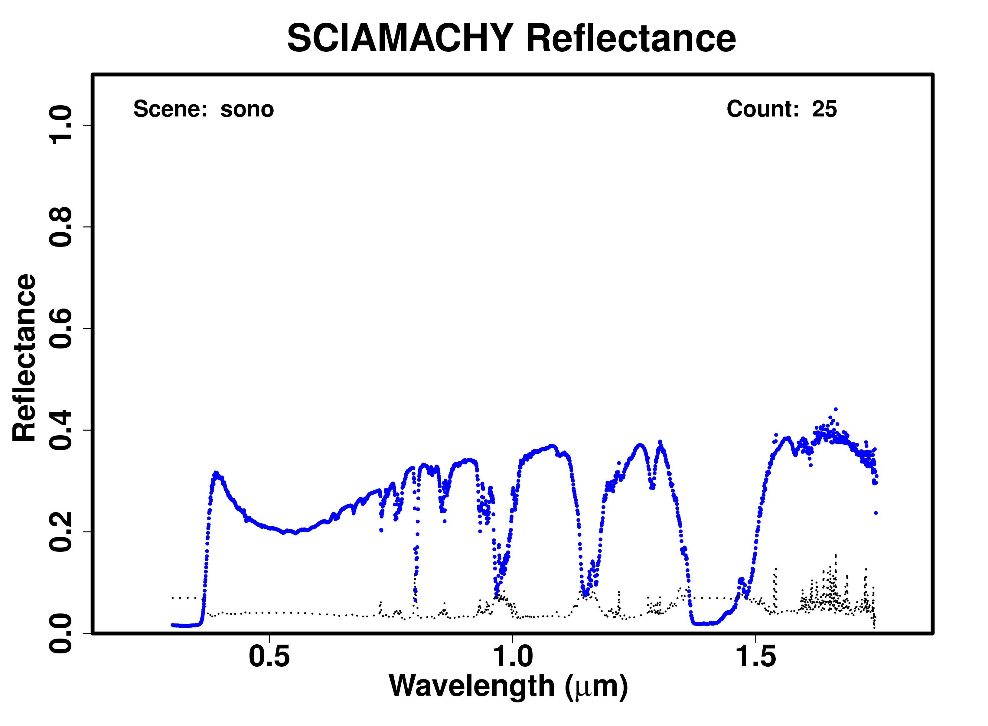
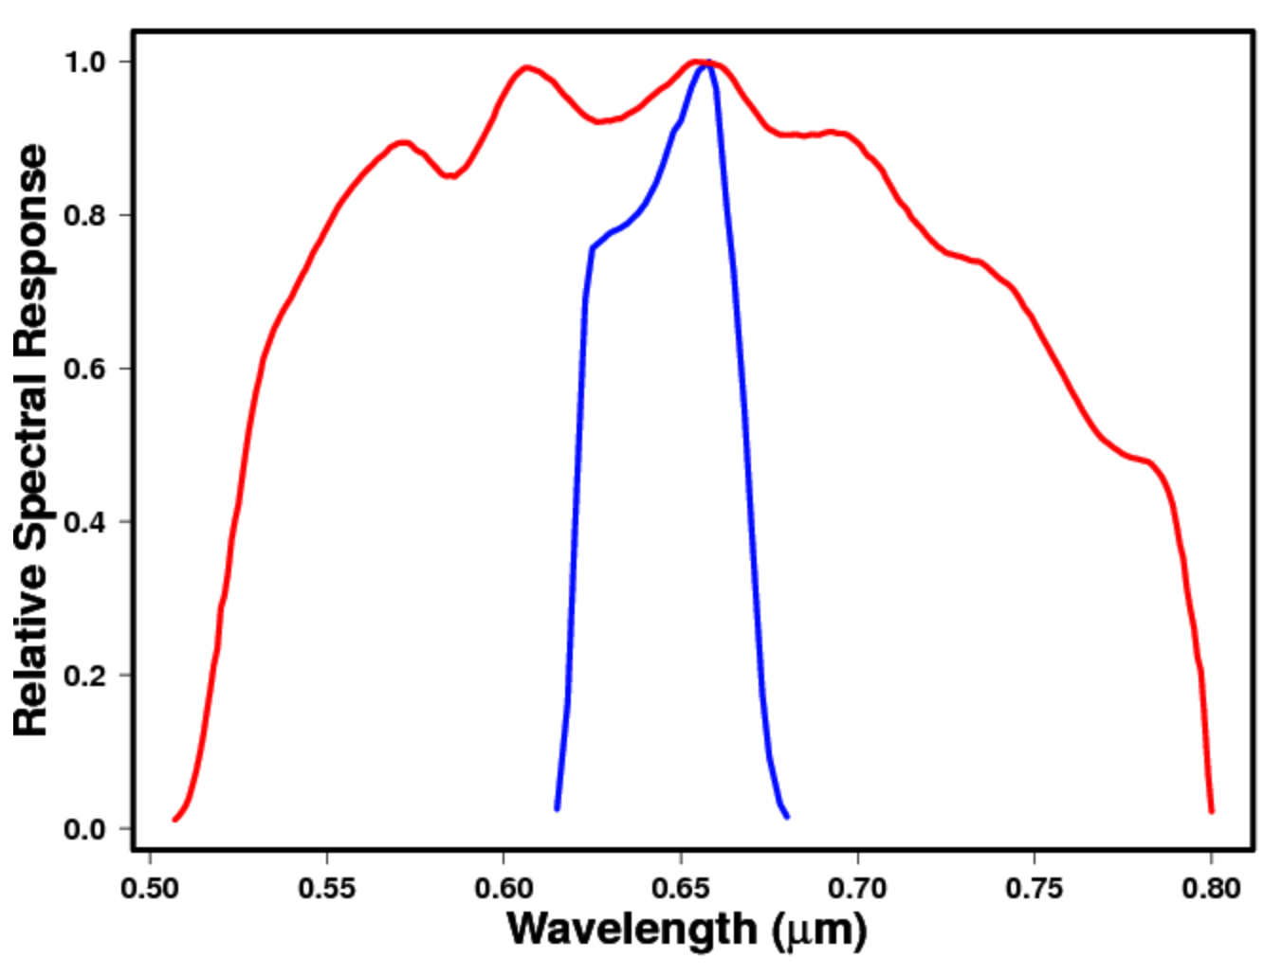
Spectral Band Adjustment Factor (SBAF)
Earth spectra plotting tool
(Sonoran Desert)
Spectral response function comparison tool
Derive Aqua-MODIS B1 and GOES-12 Ch1 pseudo radiance/reflectance (L_{p}) via SCIAMACHY convolution over each RSR to account for band difference/out-of-band absorption

Slide 9
SCIAMACHY-based Visible SBAF Tool
Regression coefficient(s) define the SBAF
L_{Met-9-equivalent,MODIS} = A2xL_{Actual,MODIS}² + A1xL_{Actual,MODIS} + A0

Slide 10
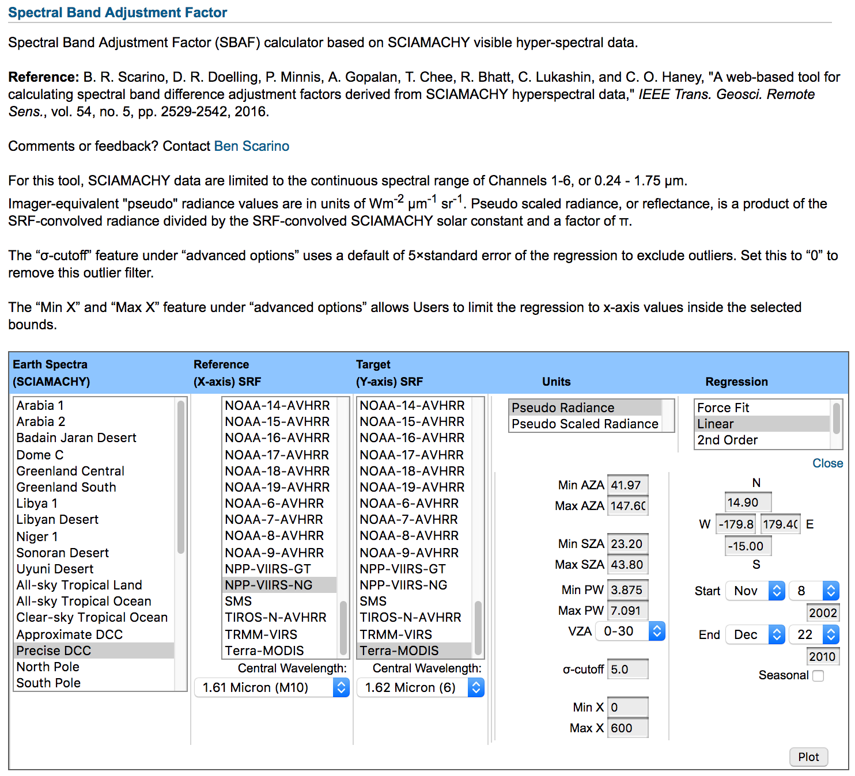
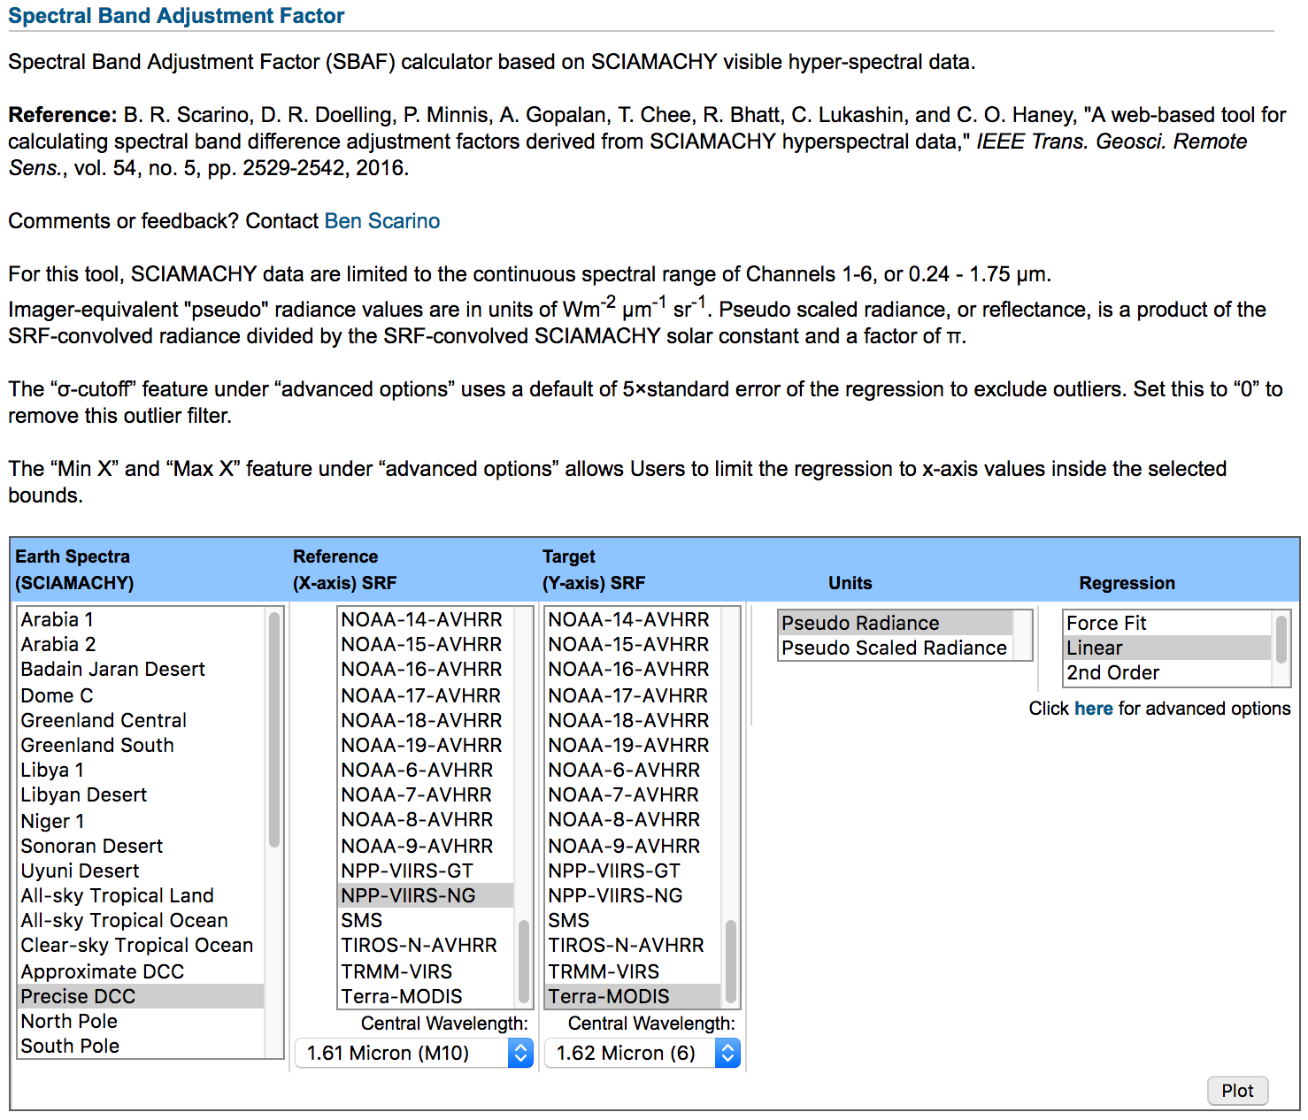
SCIAMACHY-based Visible SBAF Tool
Choose from common Earth target (e.g., desert PICS, DCC, IGBP)
Full database of instrument/channel RSRs
Units in either radiance or reflectance
Linear or non-linear characterization
SBAFs computed on the spot
Advanced subsetting options can lead to reduce SBAF uncertainty for known conditions

Slide 11
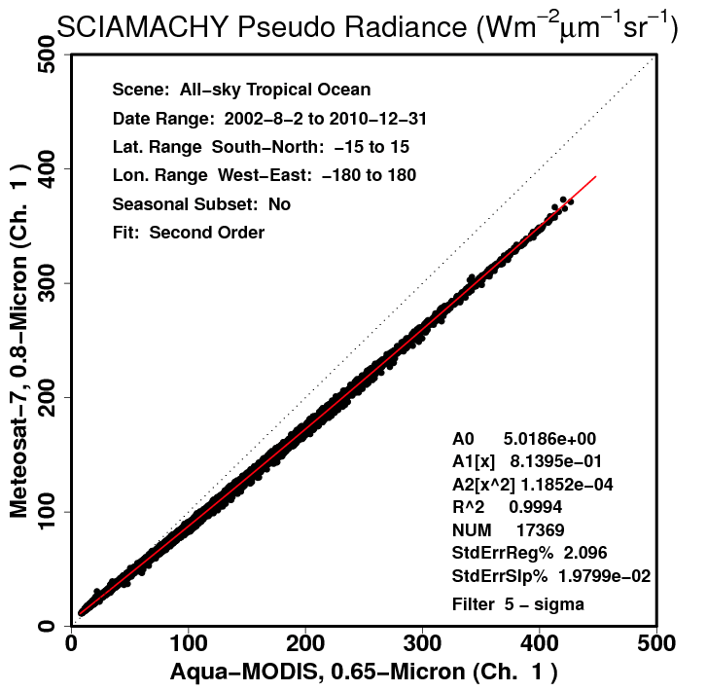
SCIAMACHY-based Visible SBAF Tool
All-sky Tropical Ocean
Met-7 pseudo radiance from convolution of Met-7 Ch. 1 SRF over the SCIAMACHY footprint spectra
Bright Clouds
Clear-sky Ocean
Regression coefficient(s) define the SBAF
L_{Met-7-equivalent,MODIS} = A2xL_{Actual,MODIS}² + A1xL_{Actual,MODIS} + A0

Slide 12
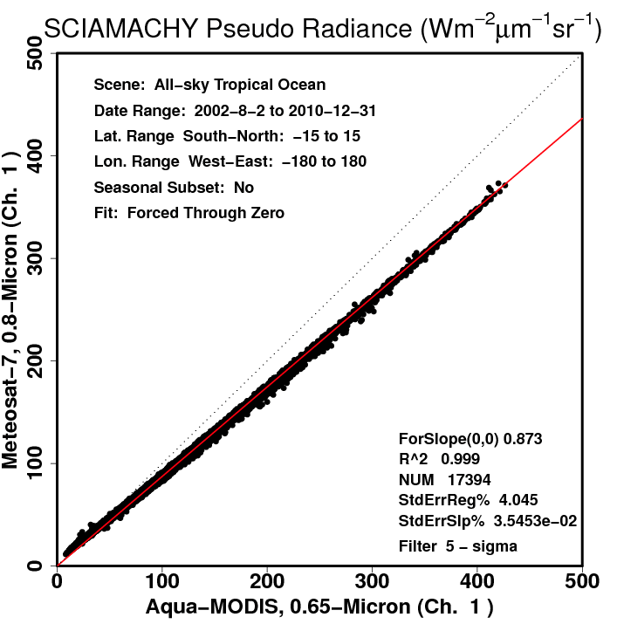
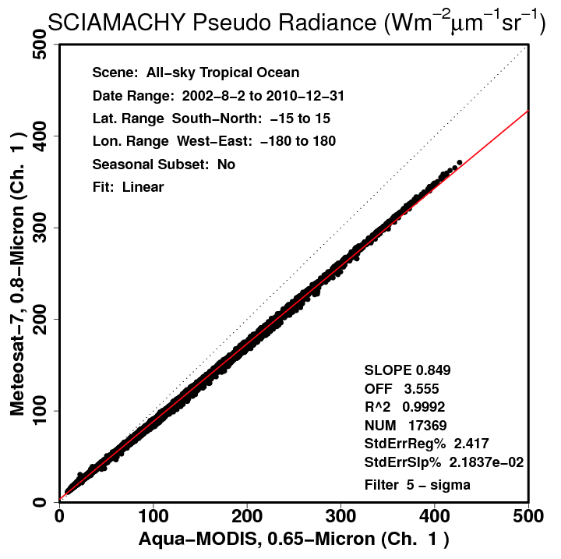
SBAF Dependency on Scene
Force Fit
Linear
2nd order
All-sky tropical ocean (ATO) SBAF is a function of scene type
Unique SBAF for clear ocean
" " for clouds
" " for thick clouds
Radiance is dependent on the scene type
2nd-order fit accurately defines an SBAF that represent the multiple scene conditions
Regression | StdErr (%)
Linear through 0 | 4.0
Linear | 2.4
2nd order | 2.10
3rd order | 2.07

Slide 13
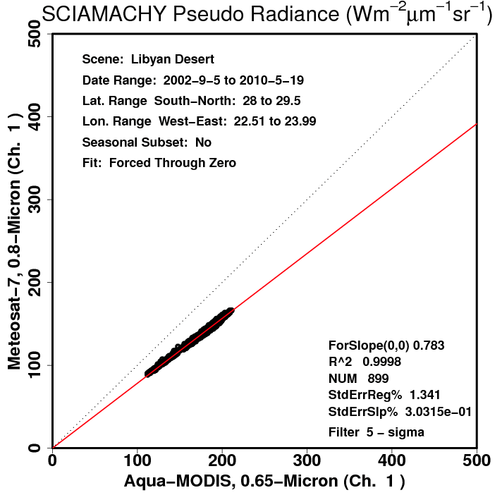
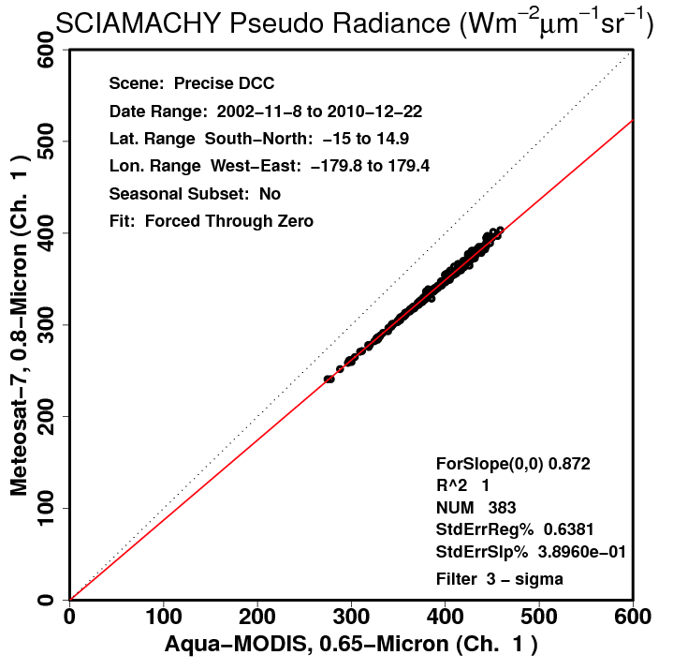
SBAF Dependency on Scene
Libyan Desert
Deep Convective Clouds
Scene Type | SBAF
Clear ocean (ATO) | 0.912
Bright cloud (ATO) | 0.880
Libyan Desert (annual) | 0.783
DCC | 0.872
Equal reflectance | 0.876
10% spectral-band-induced radiance difference between DCC and the Libyan Desert
DCC SBAF and equal reflectance (convolution over the solar constant) are similar because DCC are spectrally flat

Slide 14
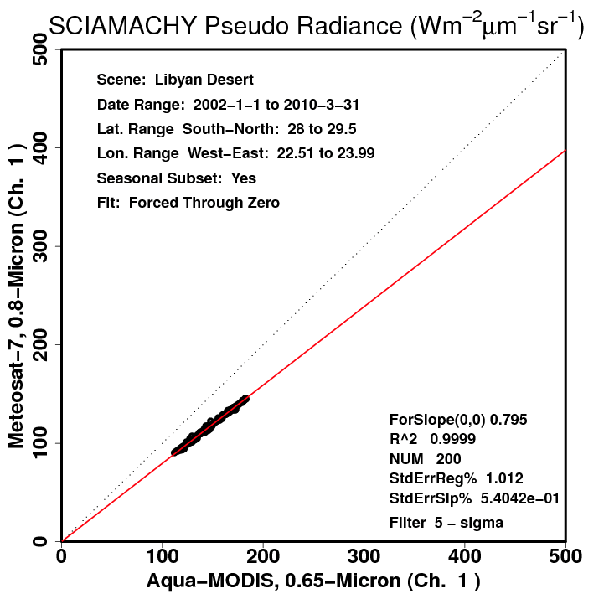
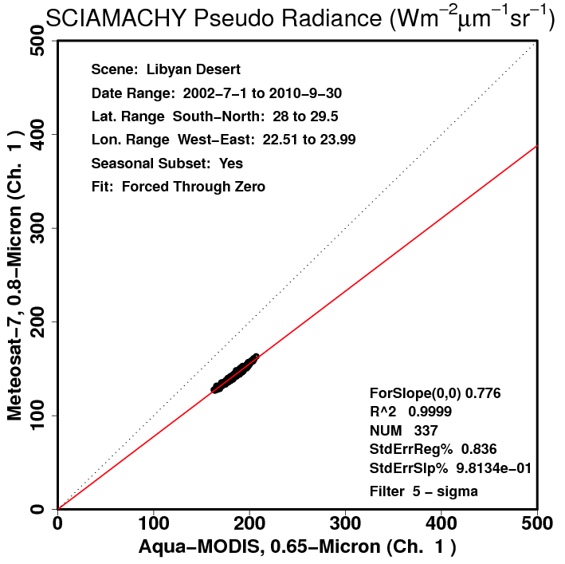
Seasonal/PW Spectral Dependency
Winter
Summer
Libya | SBAF | SE (%)
Winter | 0.795 | 1.01
Spring | 0.788 | 1.08
Summer | 0.776 | 0.84
Fall | 0.780 | 1.06
Annual | 0.783 | 1.34
Libyan Desert seasonal SBAFs have reduced uncertainty compared to annual
Likely due to the seasonal water vapor burden (highest in summer)
I.E. - 2.4% Libya-4 SBAF difference between summer and winter seasons

Slide 15
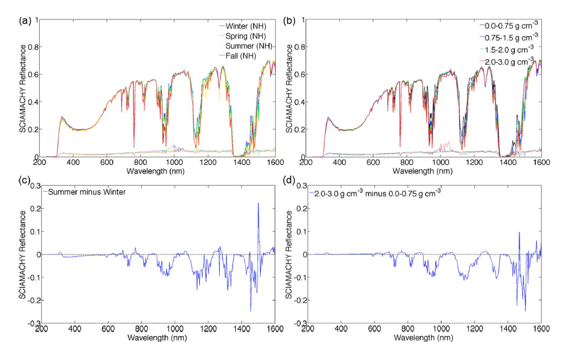
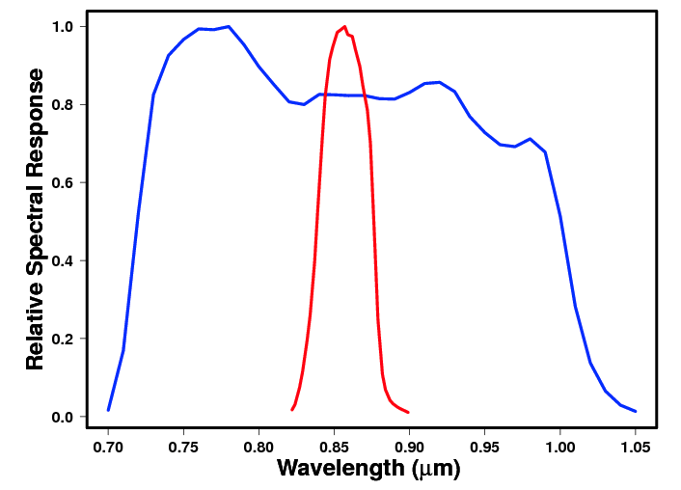
Seasonal/PW Spectral Dependency
Season
PW
Precipitable water (PW) load spectral difference follows seasonal spectral difference
Can have significant impact on SBAF for some bands (water absorption)

Slide 16
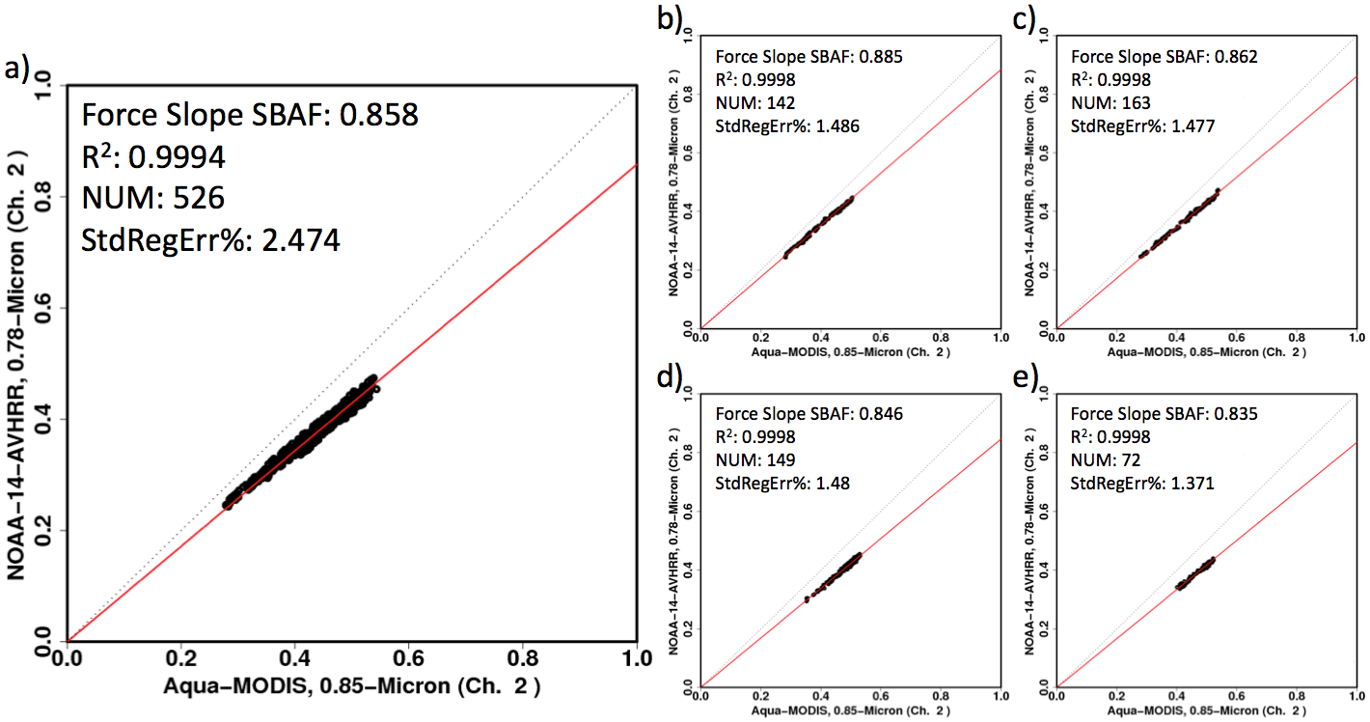
Seasonal/PW Spectral Dependency
PW: 0-0.75 g cm⁻²
PW: 0.75-1.5 g cm⁻²
PW: 0-3 g cm⁻²
PW: 1.5-2 g cm⁻²
PW: 2-3 g cm⁻²
a) Simple forced linear SBAF for Libyan Desert for a full PW range
b-e) SBAFs for specified precipitable water intervals: 6% ΔSBAF
Uncertainy for each subset less than overall uncertainty
SBAF changes systematically with adjusted precipitable water

Slide 17
Applications
0.4%
2.7%
ATO-RM
ATO-RM
SBAF reduces relative gain difference of multiple independent calibration methods over various Earth spectra

Slide 18
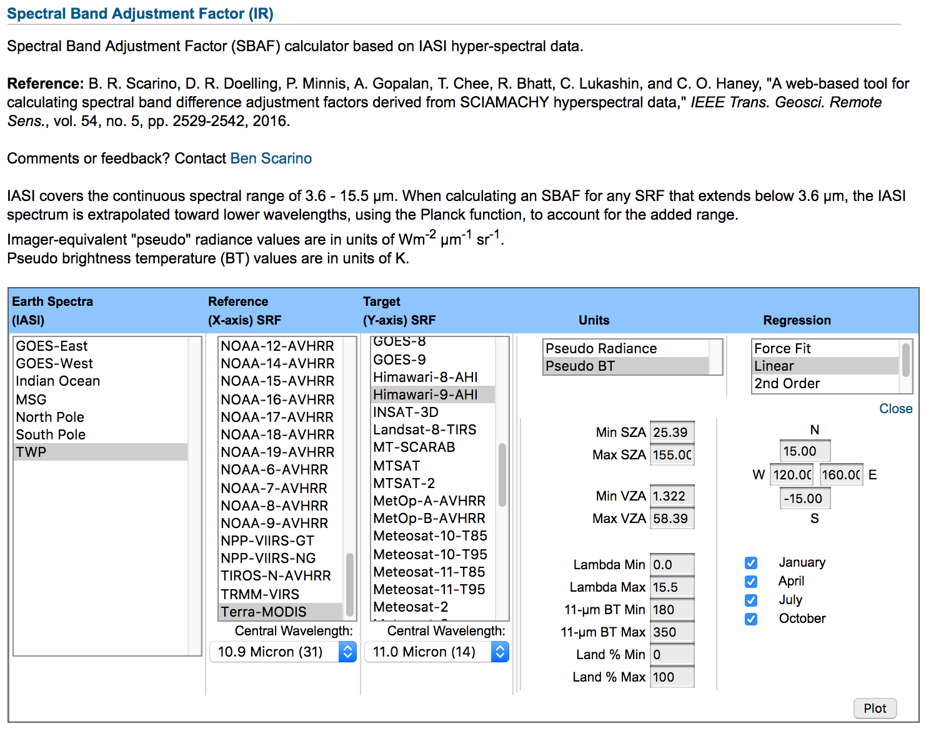
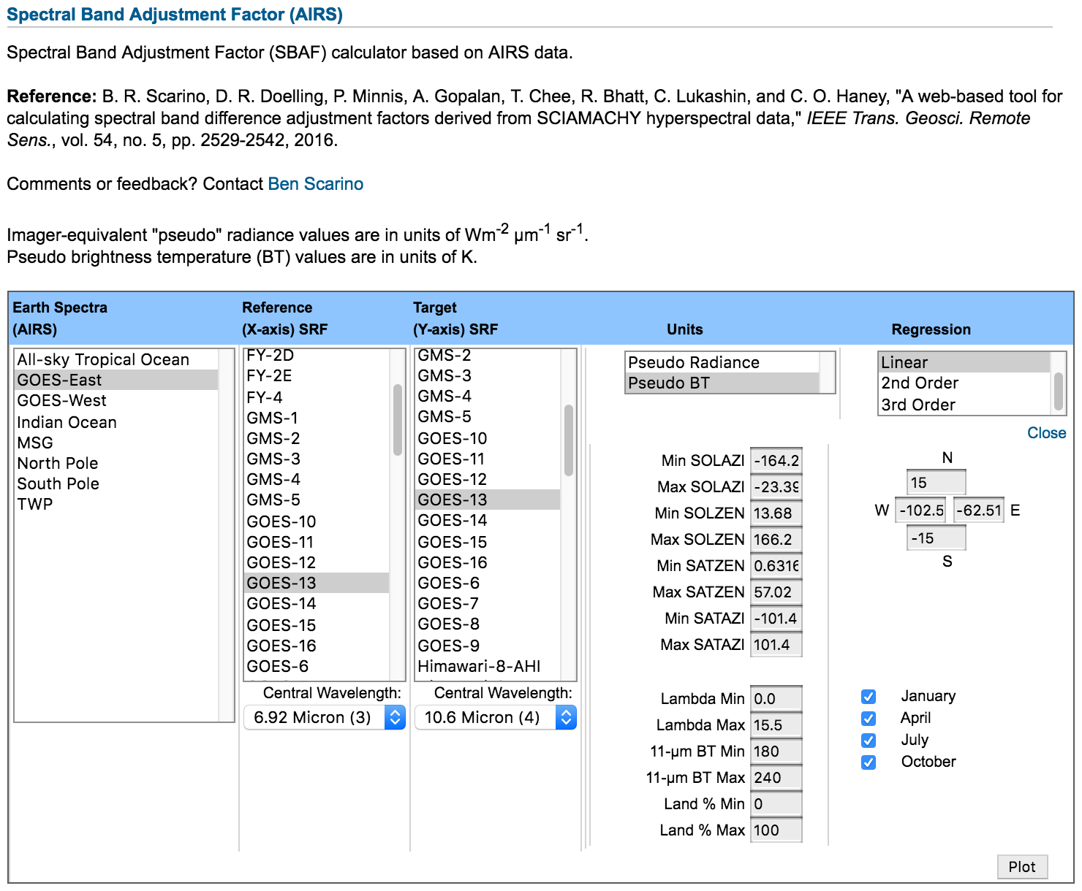
IR SBAF Example
IASI
AIRS
Spectra domains geared toward satellite coverage
SBAF available in either radiance or brightness temperature units

Slide 19
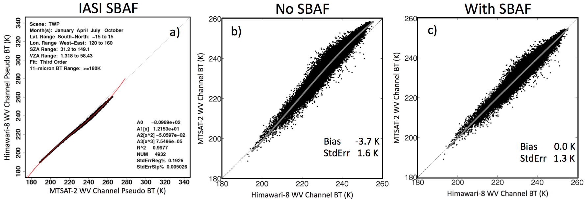
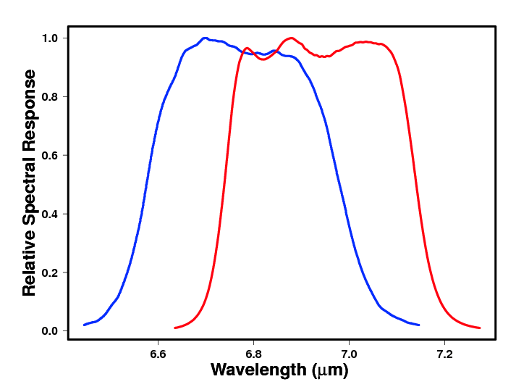
Applications
3rd-order relationship of WV channels resolved by 3rd-order SBAF application

Slide 20
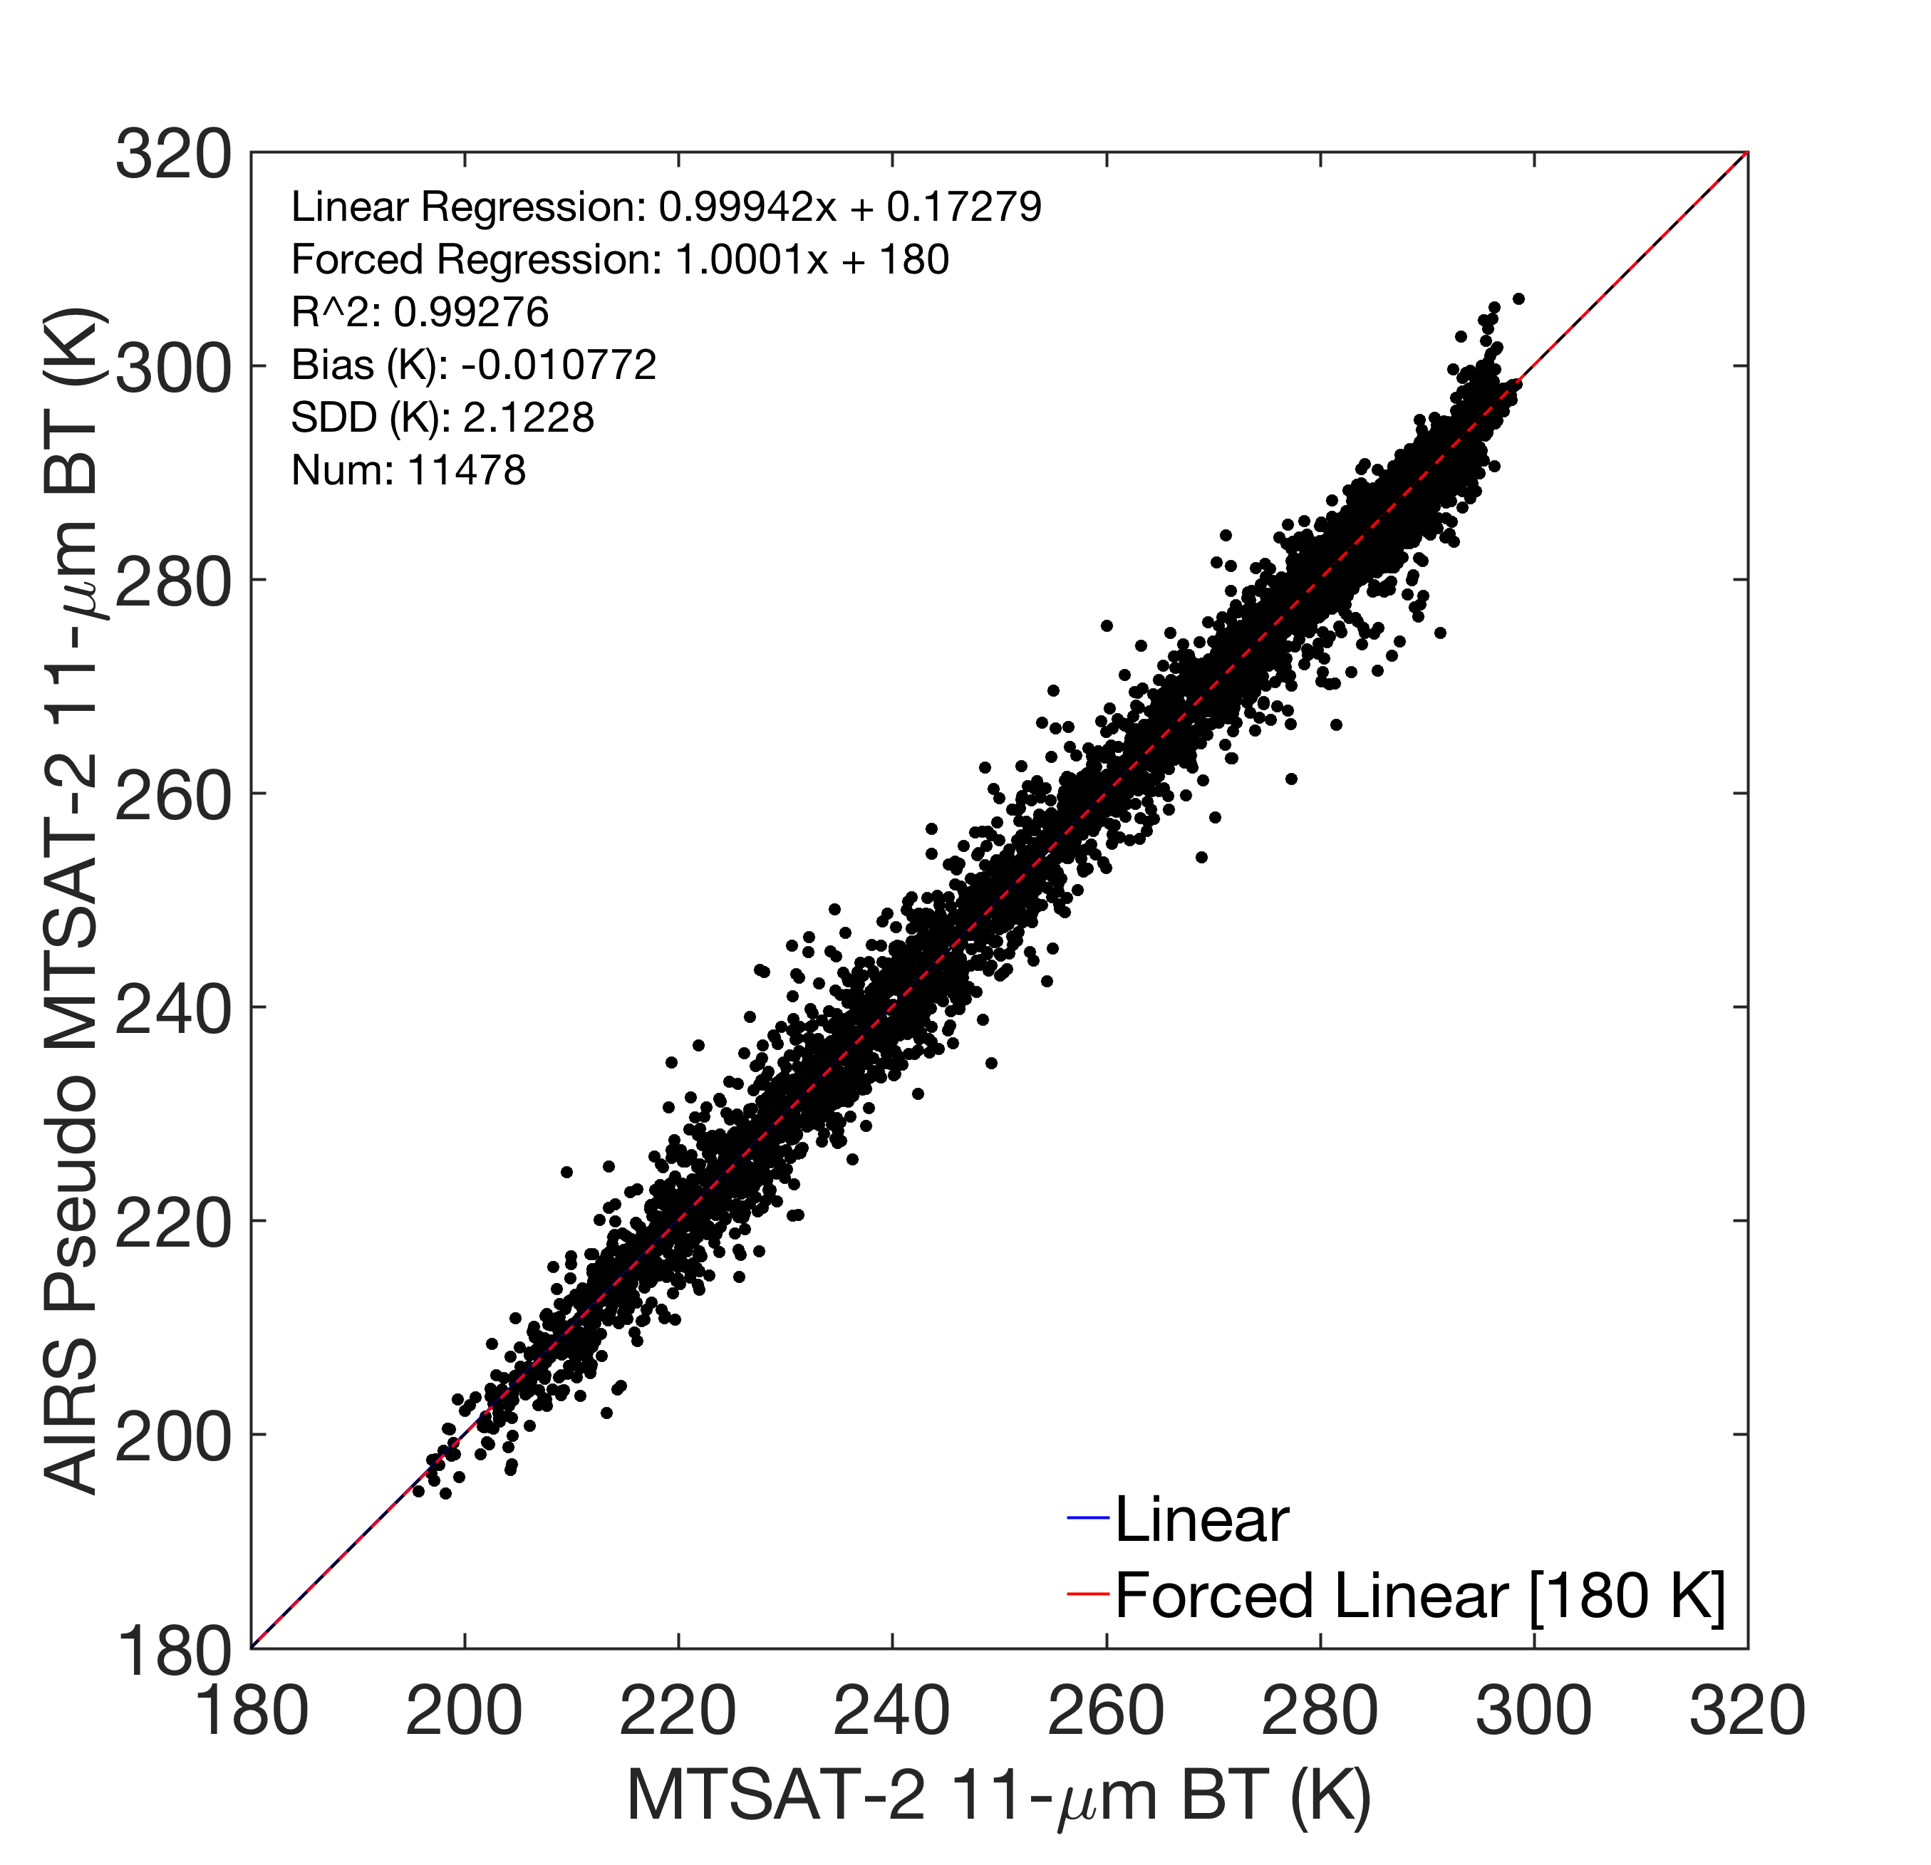
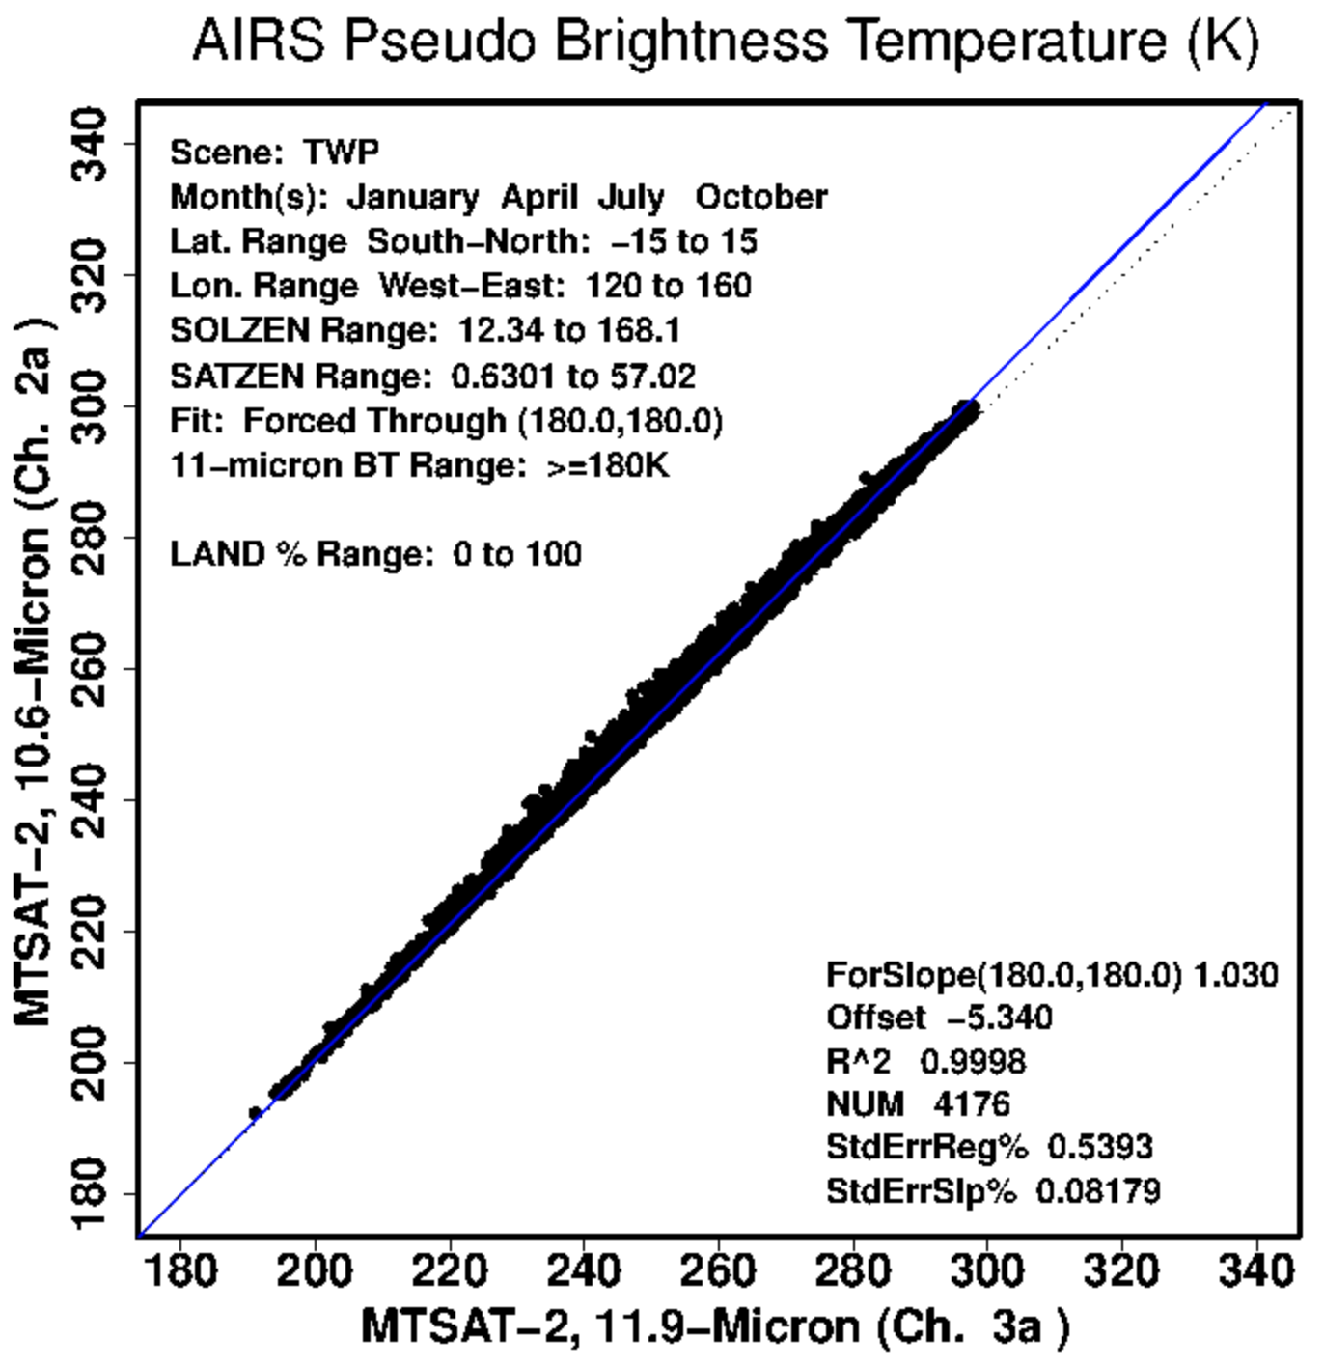
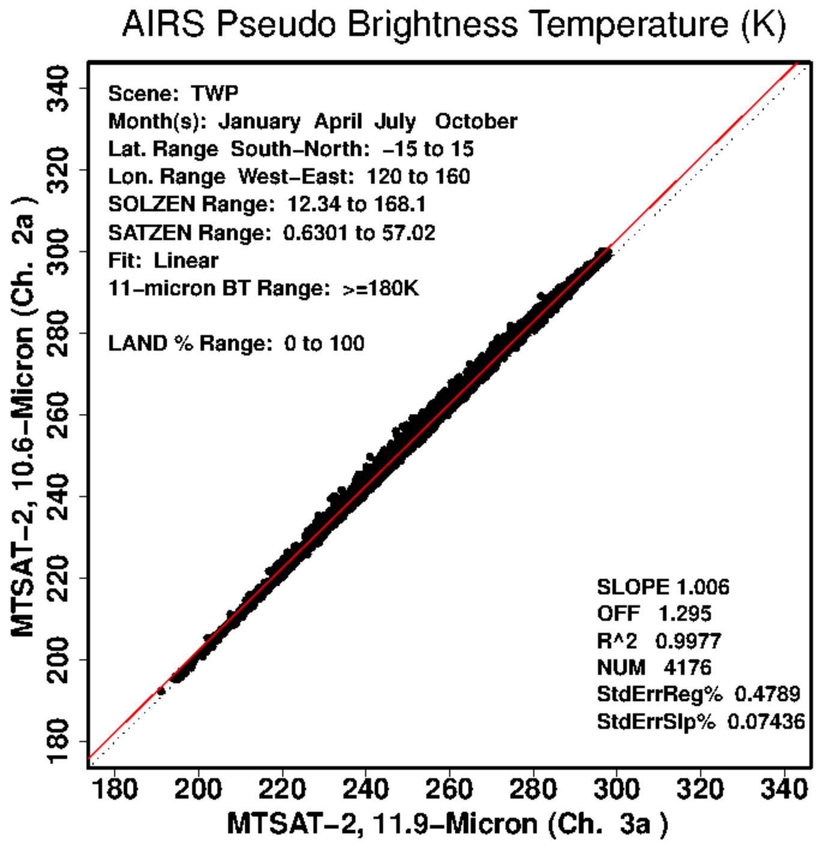
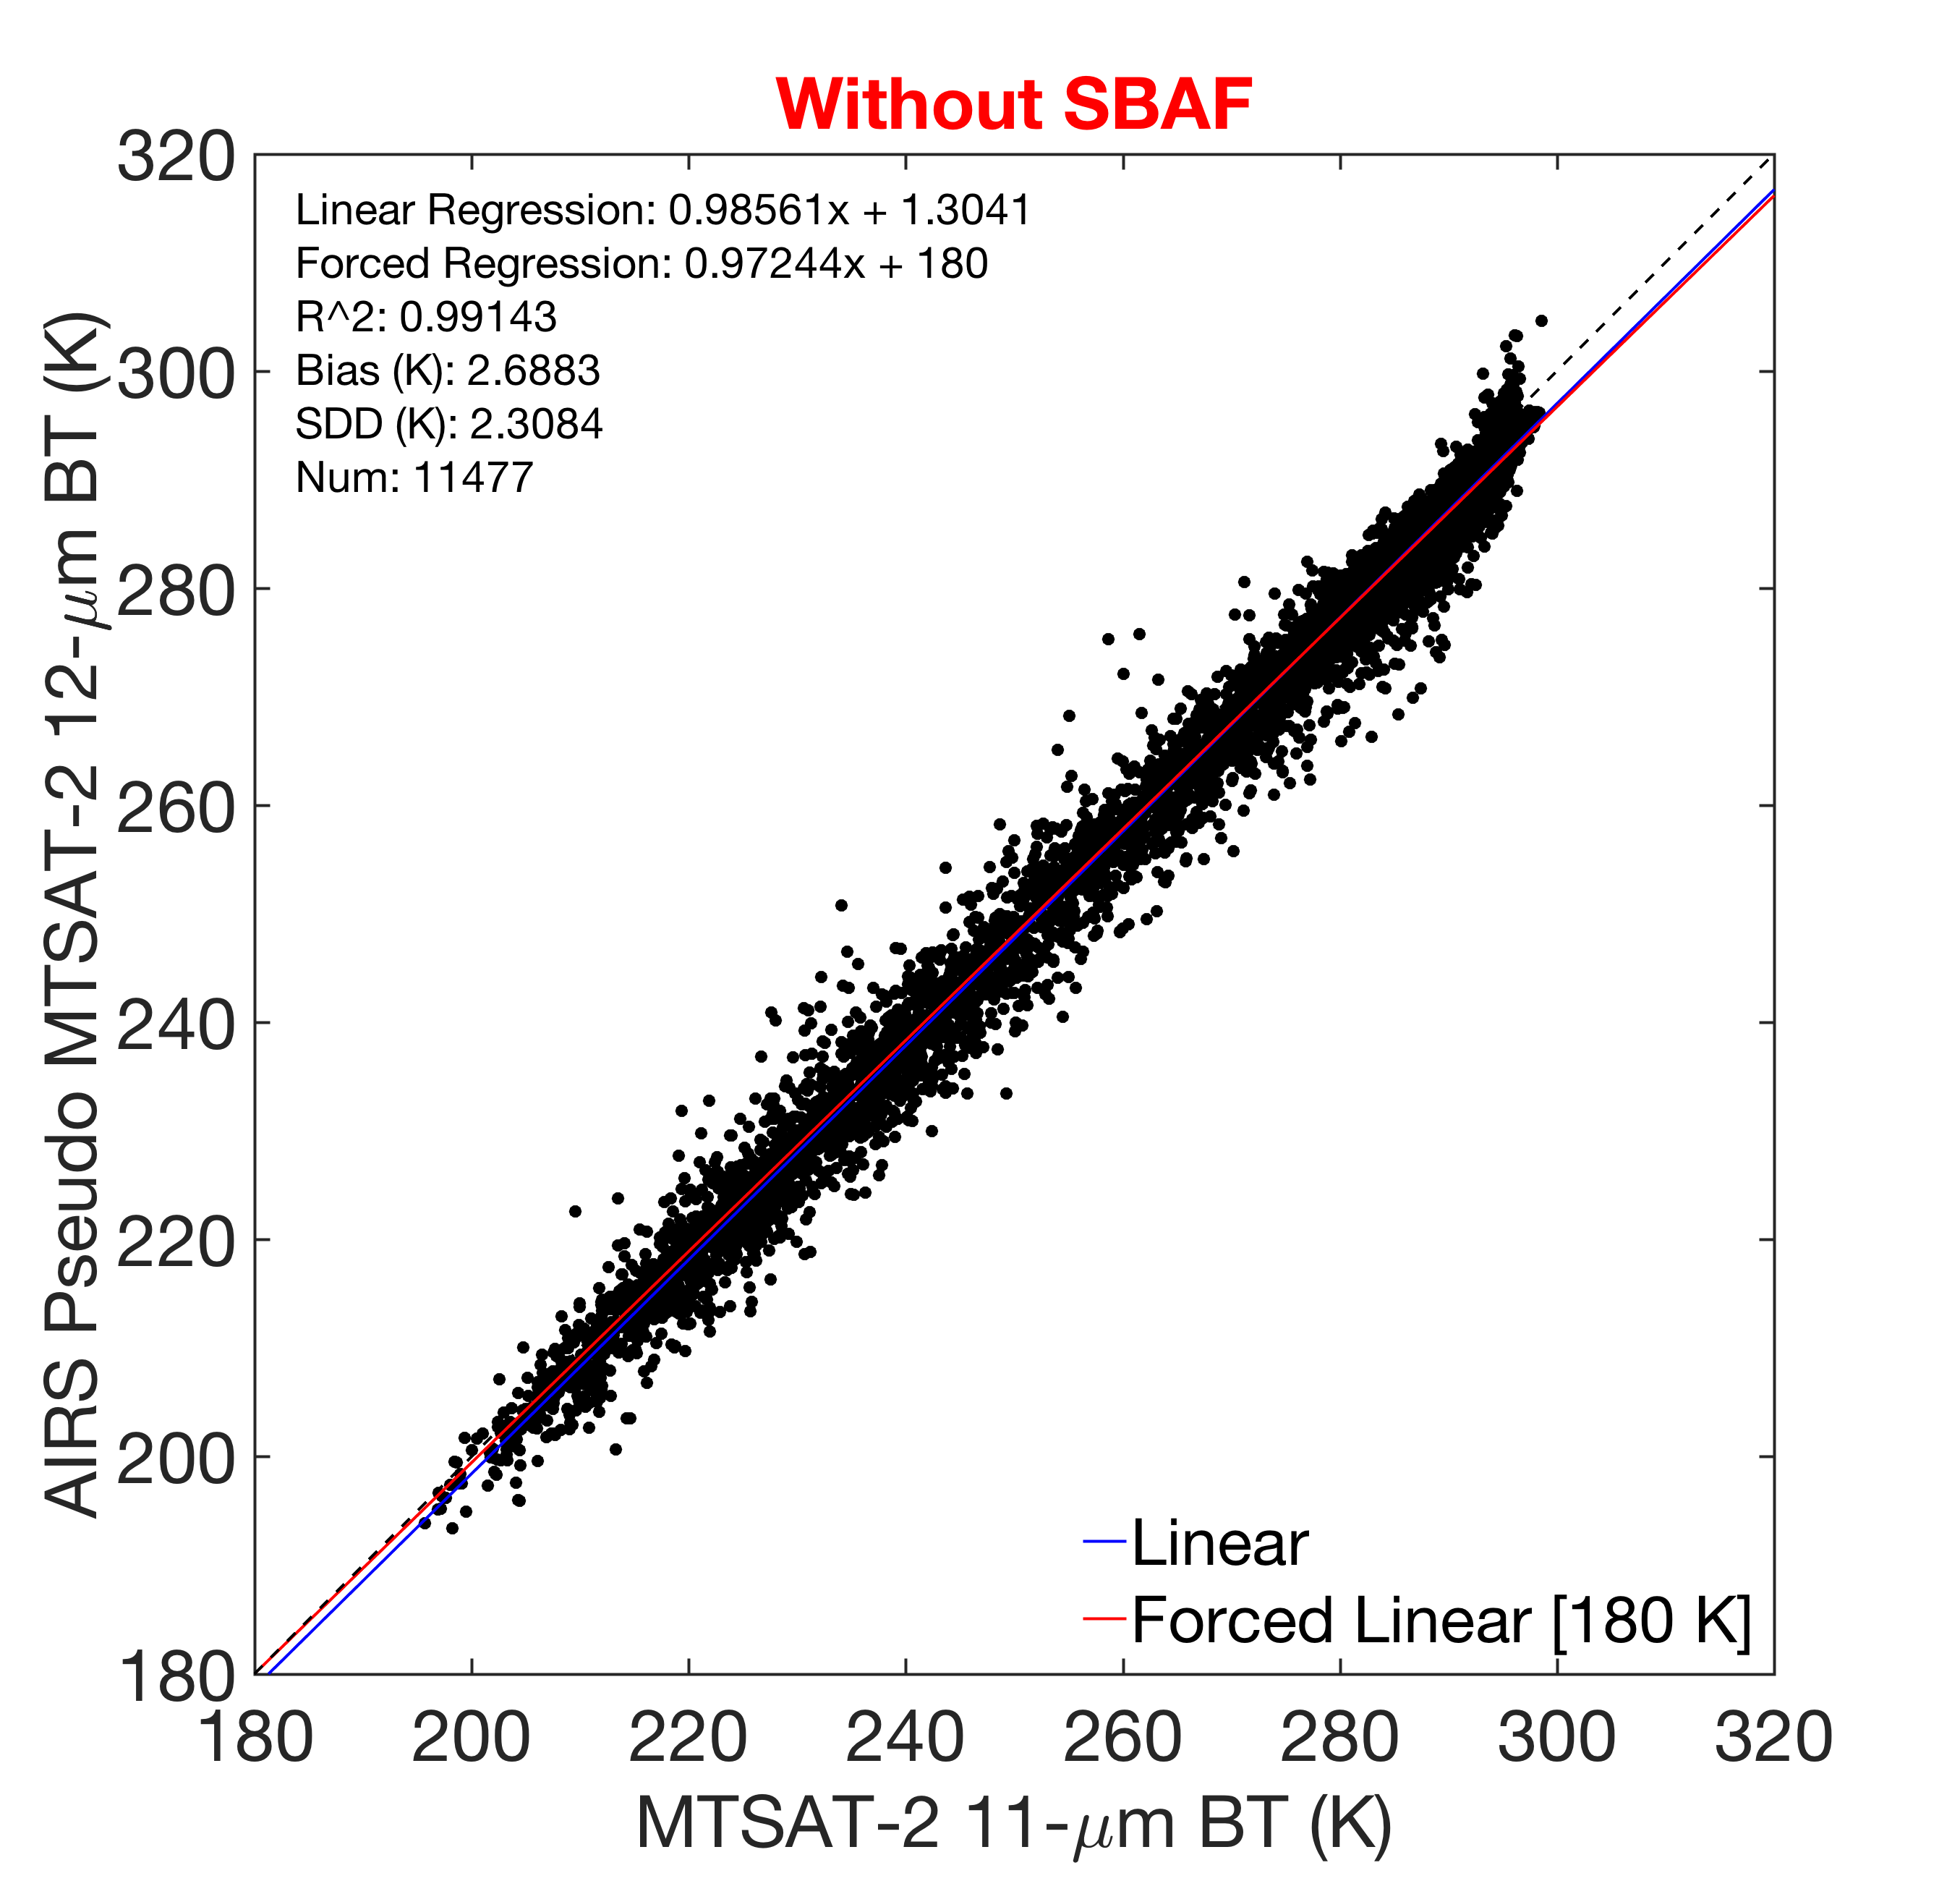
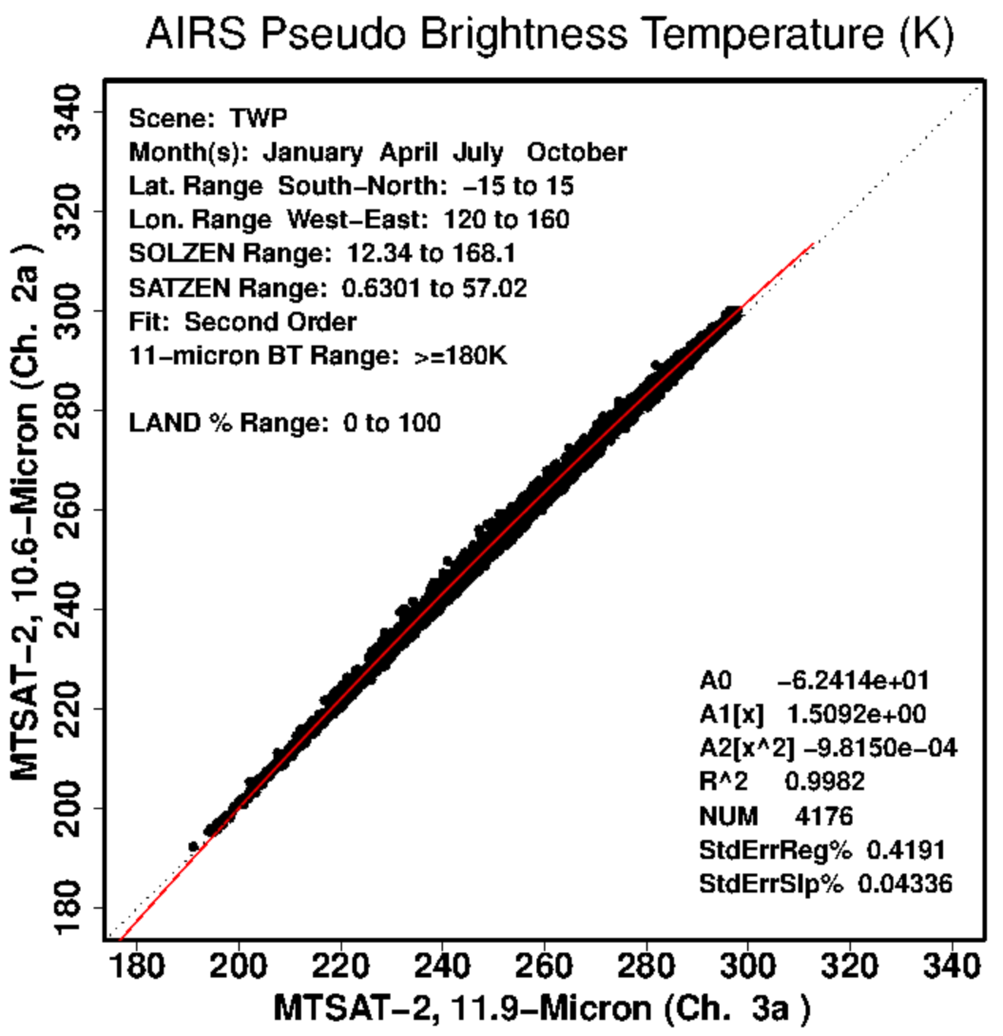
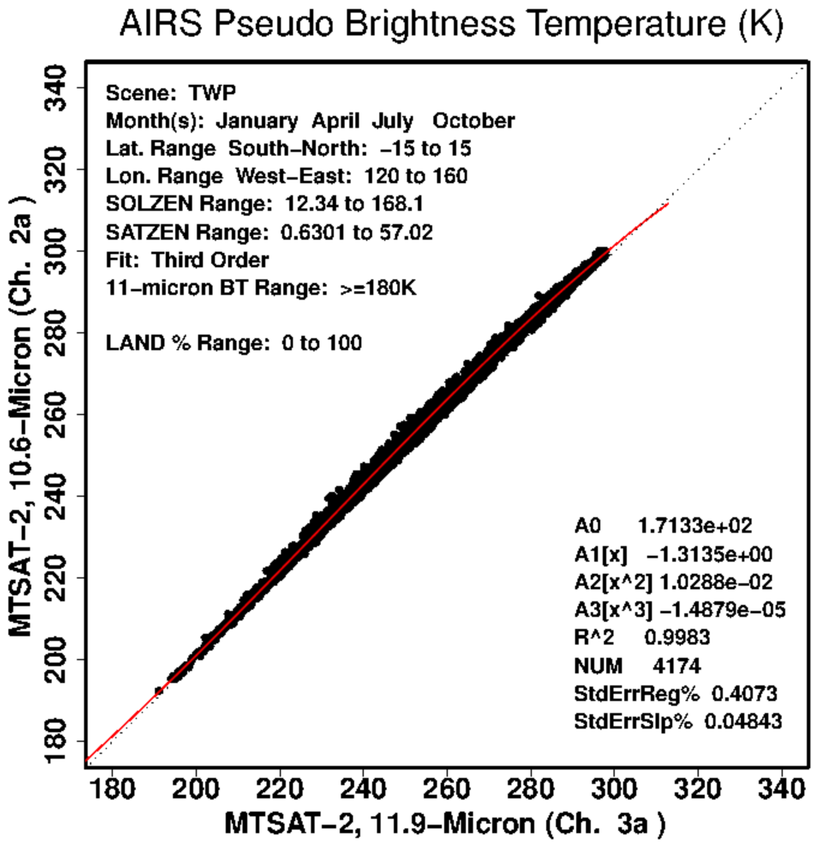
AIRS SBAF Example: 11-μm to 12-μm
Bias: -0.01 K
SDD: 2.12 K
SBAF:
1st-degree forced [180 K]
SBAF:
1st-degree
Validation:
11 μm vs. 11 μm
Bias: 2.69 K
SDD: 2.31 K
SBAF:
2nd-degree
SBAF
3rd-degree
Validation:
11 μm vs. 12 μm
Without SBAF

Slide 21
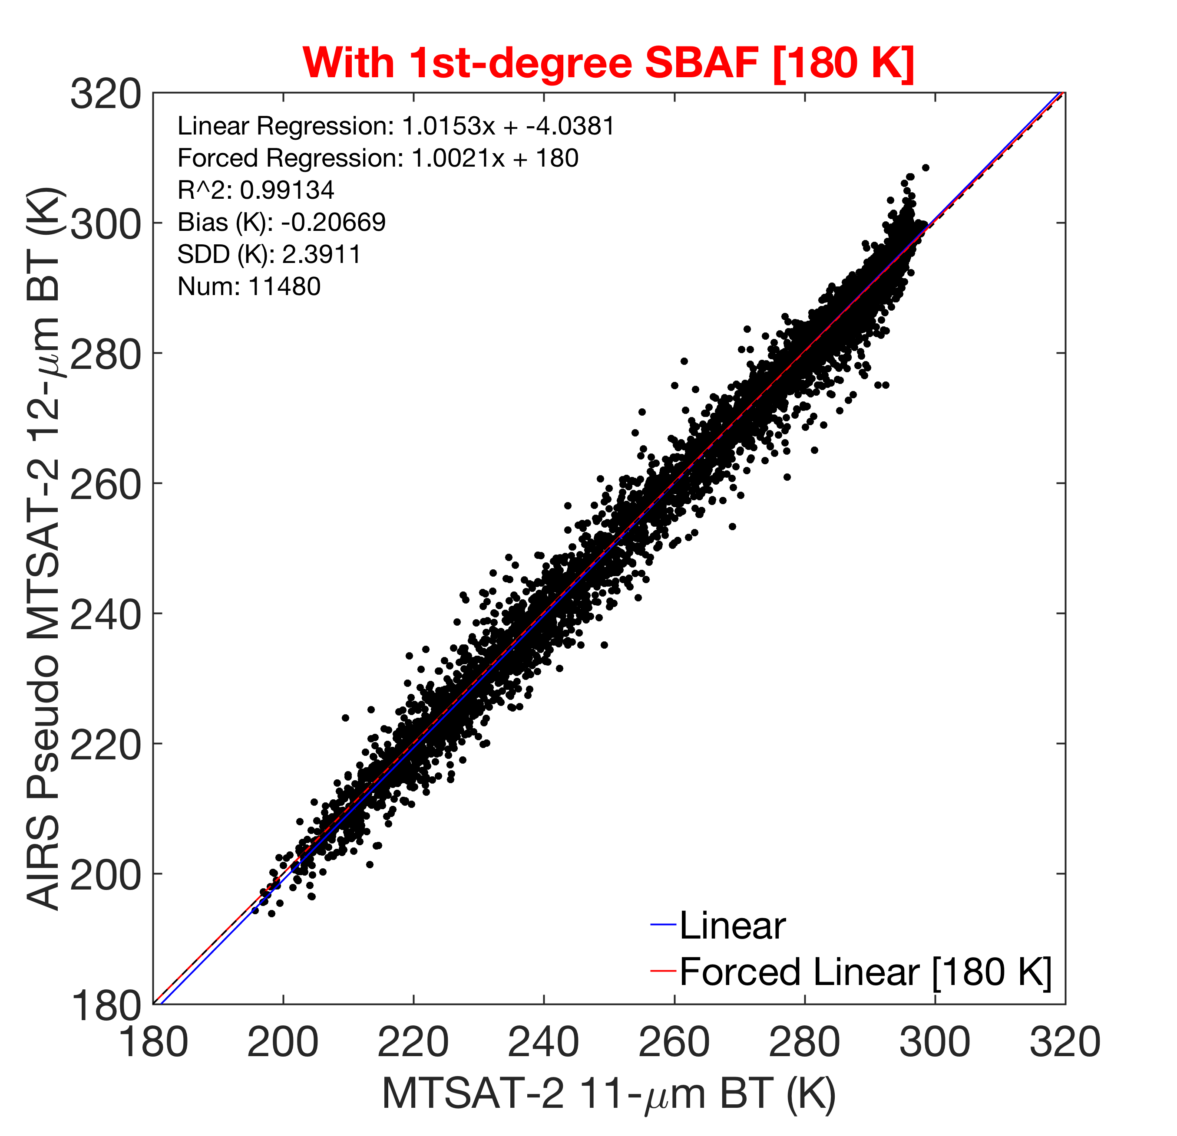
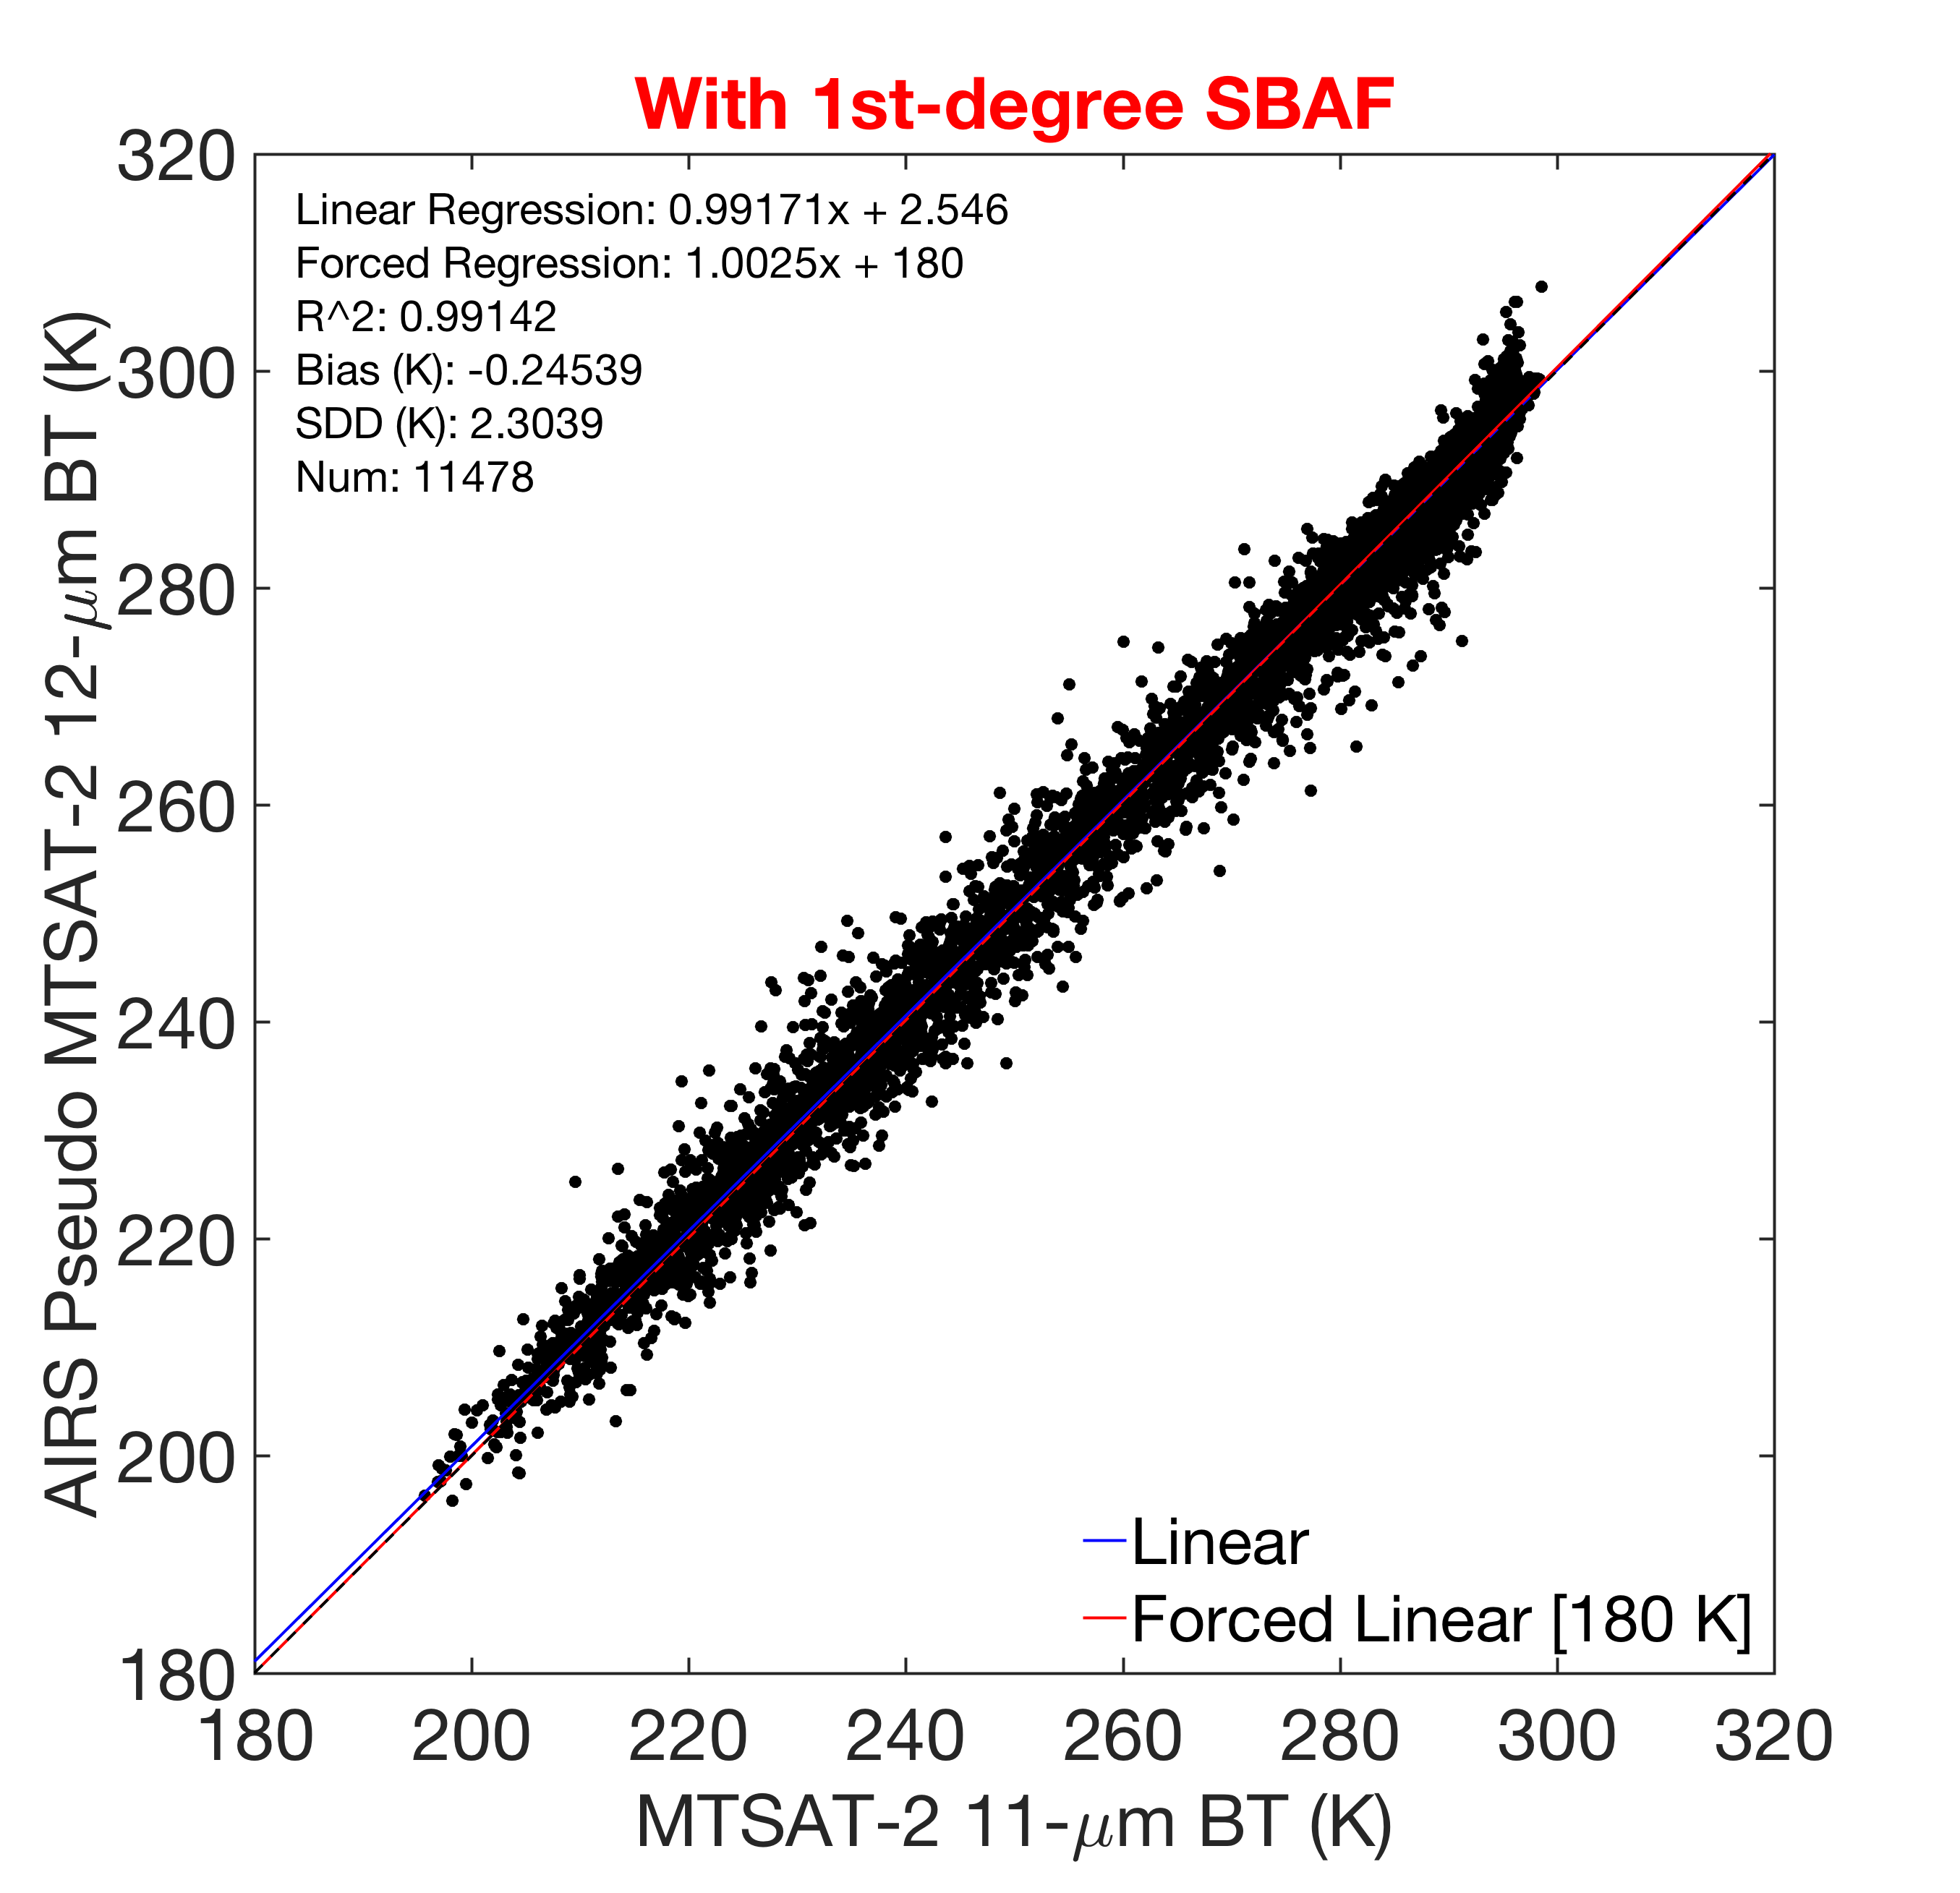
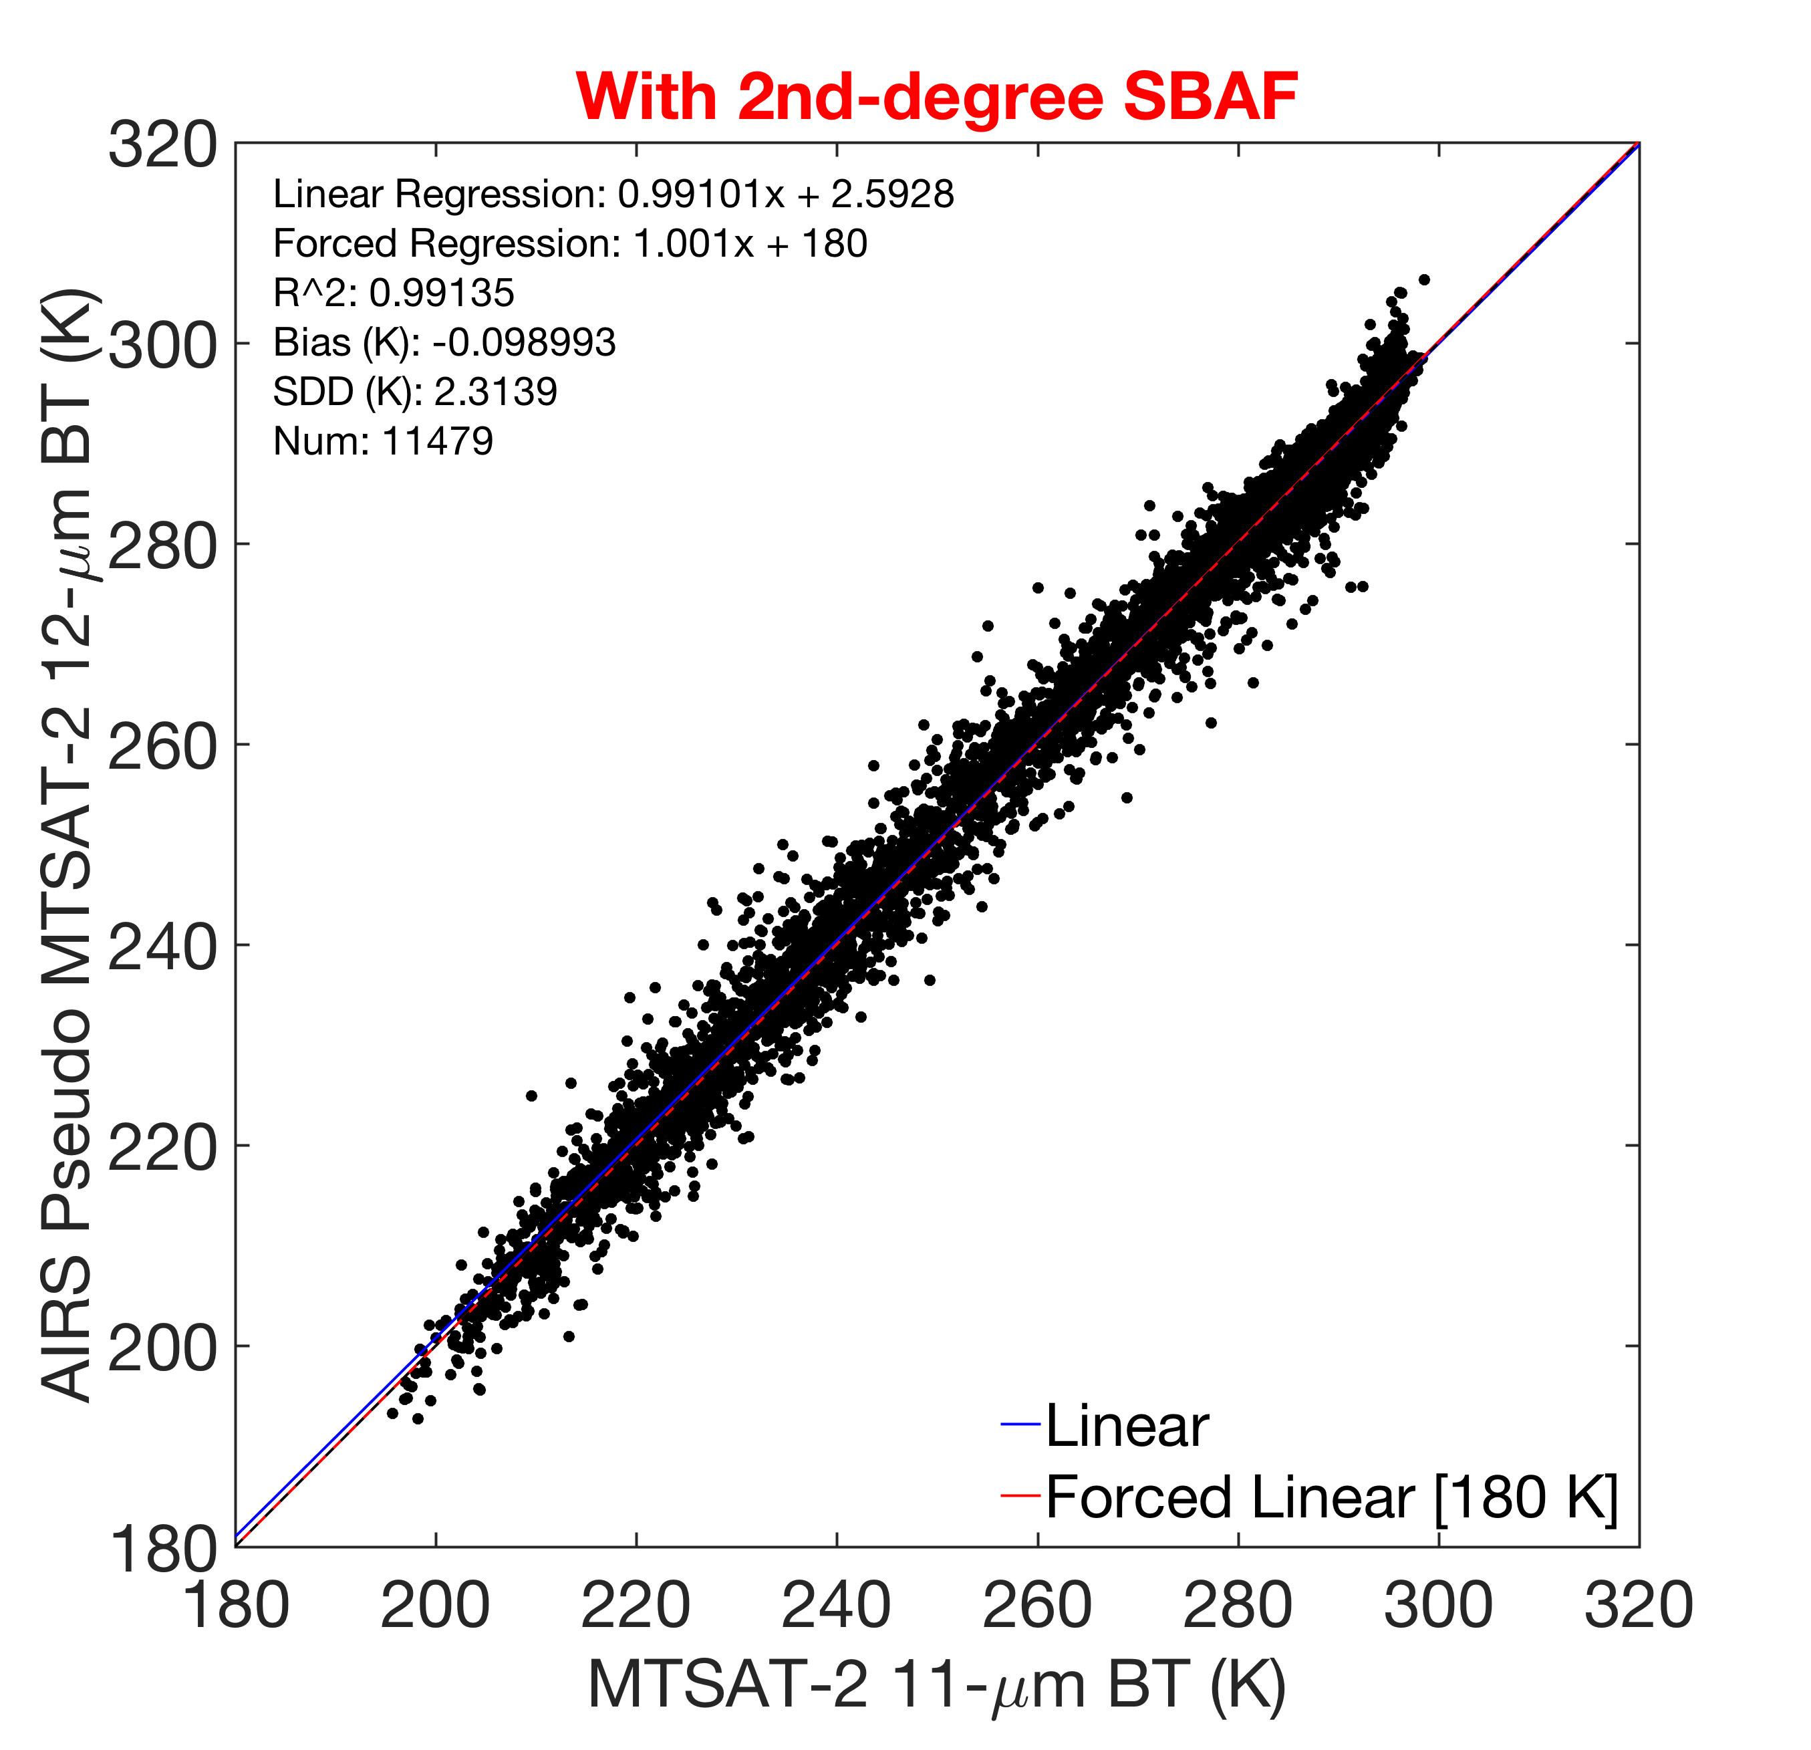
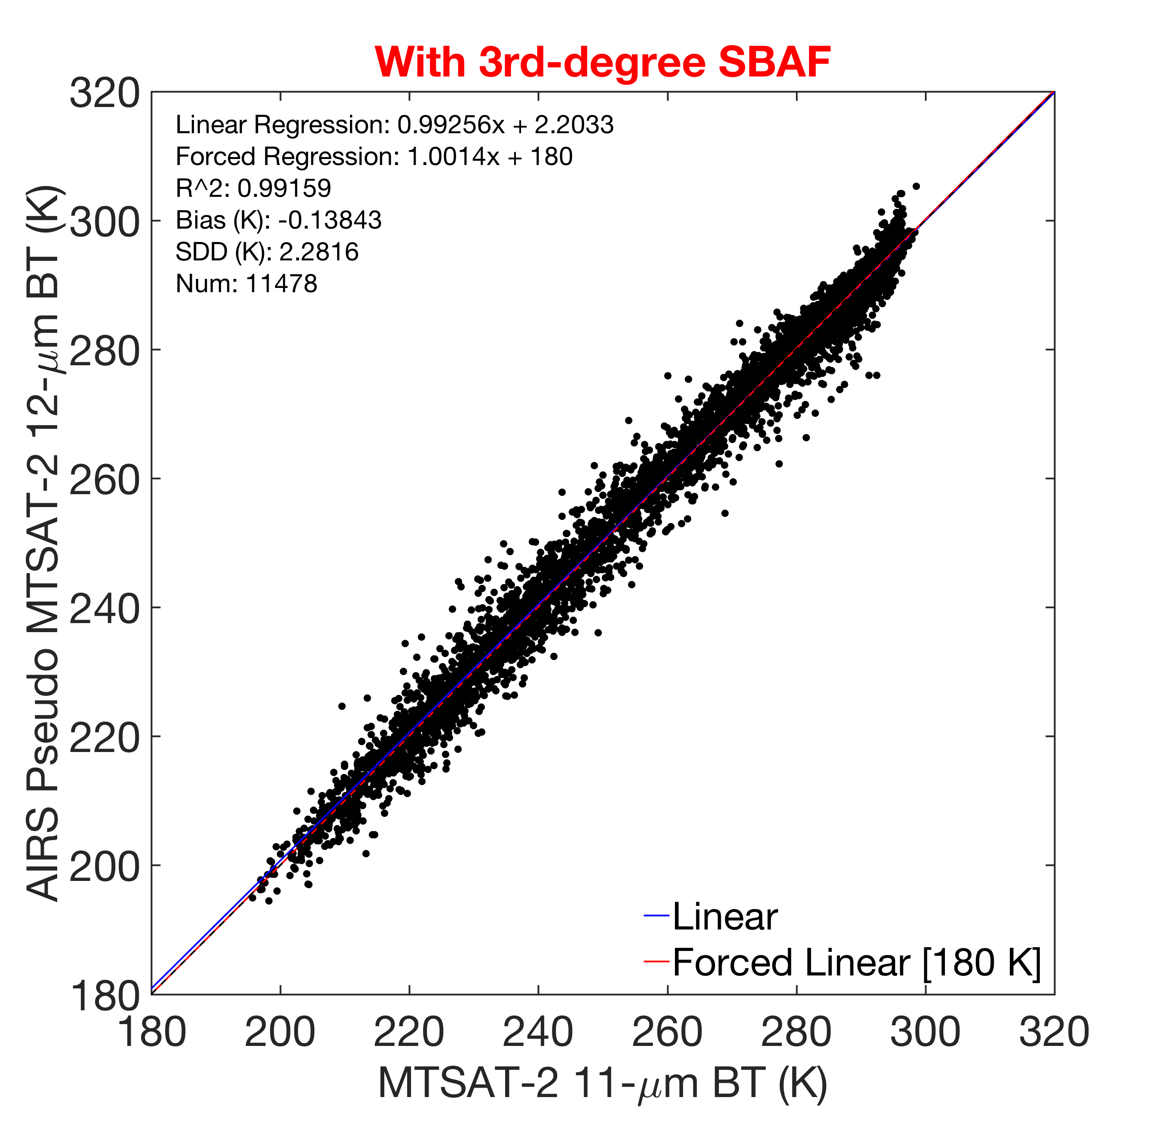
AIRS SBAF Example: 11-μm to 12-μm
Bias: -0.01 K
SDD: 2.12 K
Bias: -0.21 K
SDD: 2.39 K
Bias: -0.25 K
SDD: 2.30 K
(11-μm equivalent)
(11-μm equivalent)
Validation:
11 μm vs. 11 μm
With
1st-degree forced SBAF
With
1st-degree SBAF
Bias: 2.69 K
SDD: 2.31 K
Bias: -0.10 K
SDD: 2.31 K
Bias: -0.14 K
SDD: 2.28 K
(11-μm equivalent)
(11-μm equivalent)
Validation:
11 μm vs. 12 μm
Without SBAF
With
2nd-degree SBAF
With
3rd-degree SBAF

Slide 22
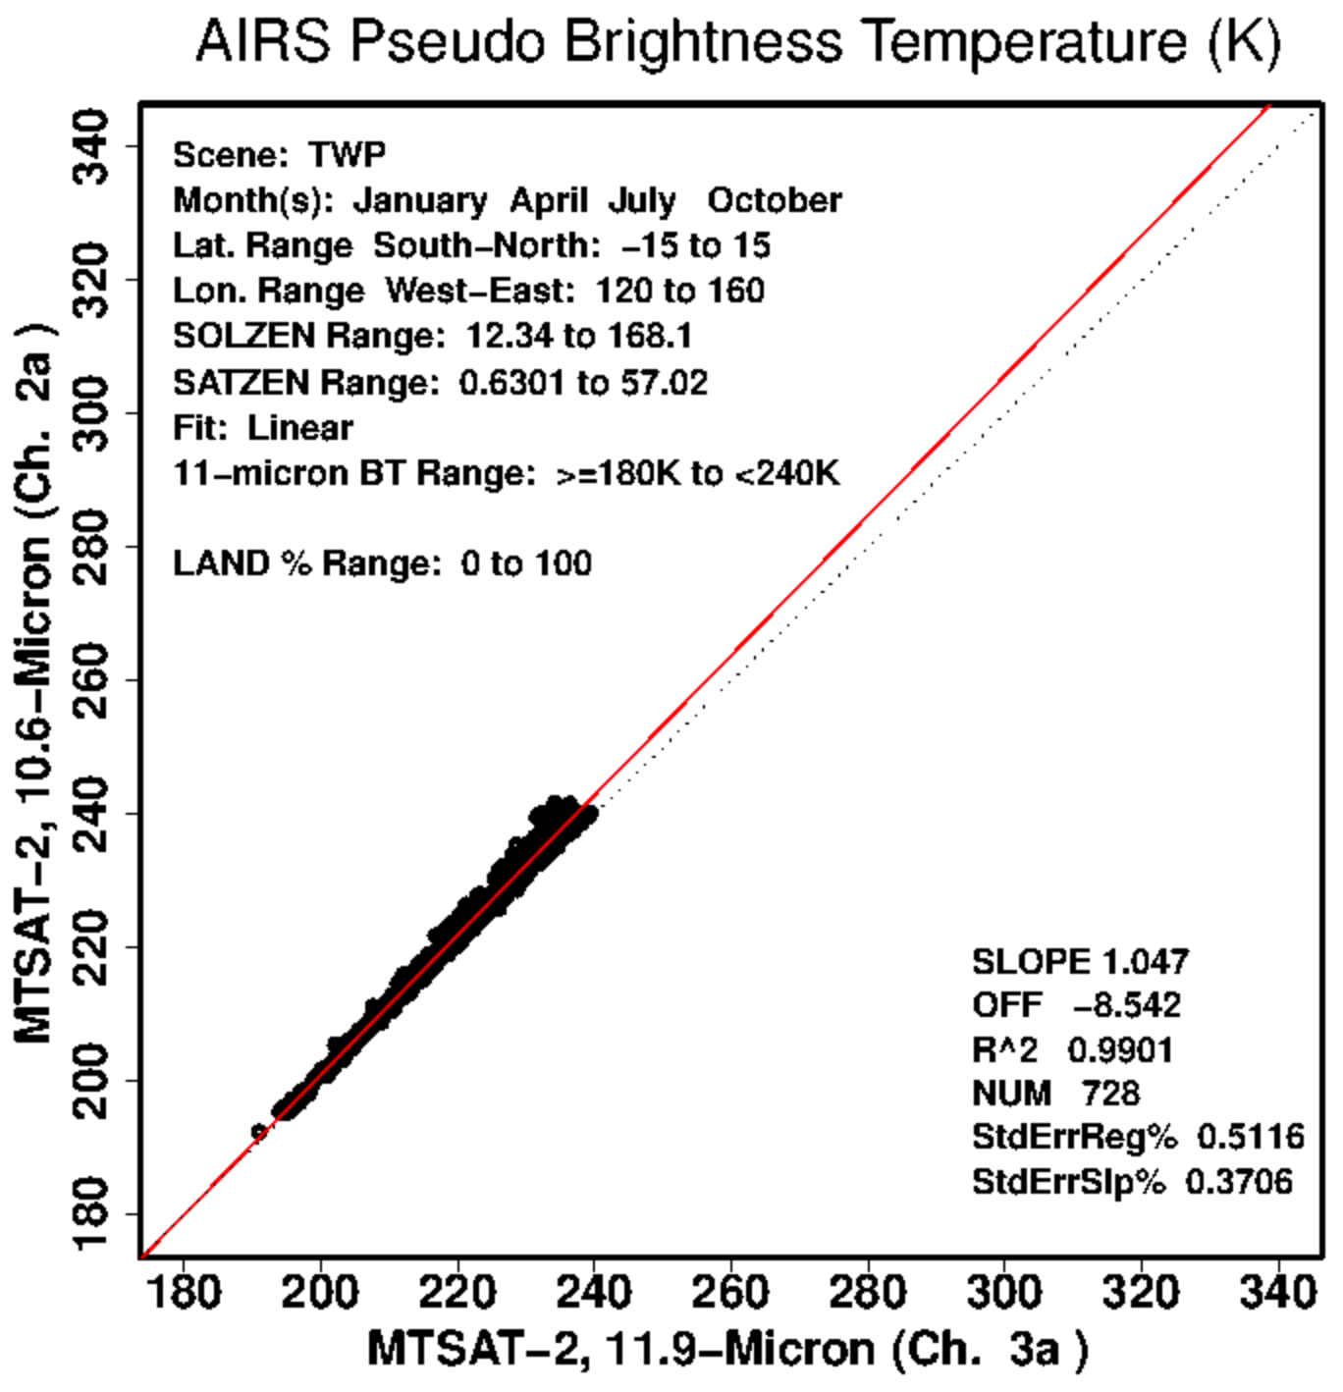
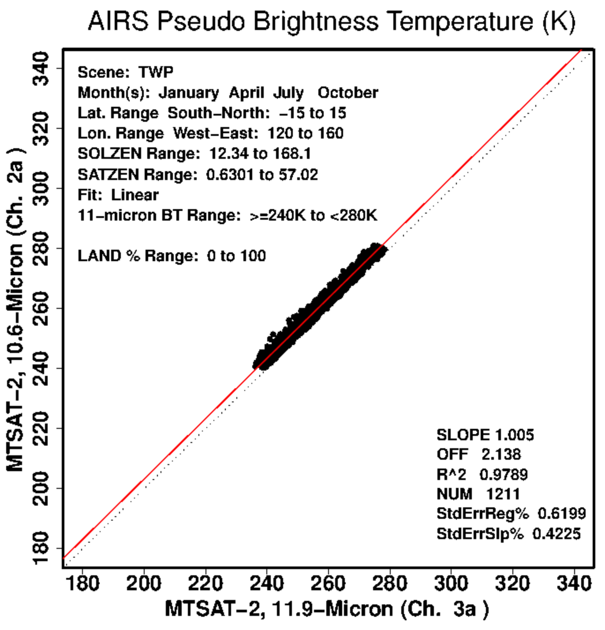
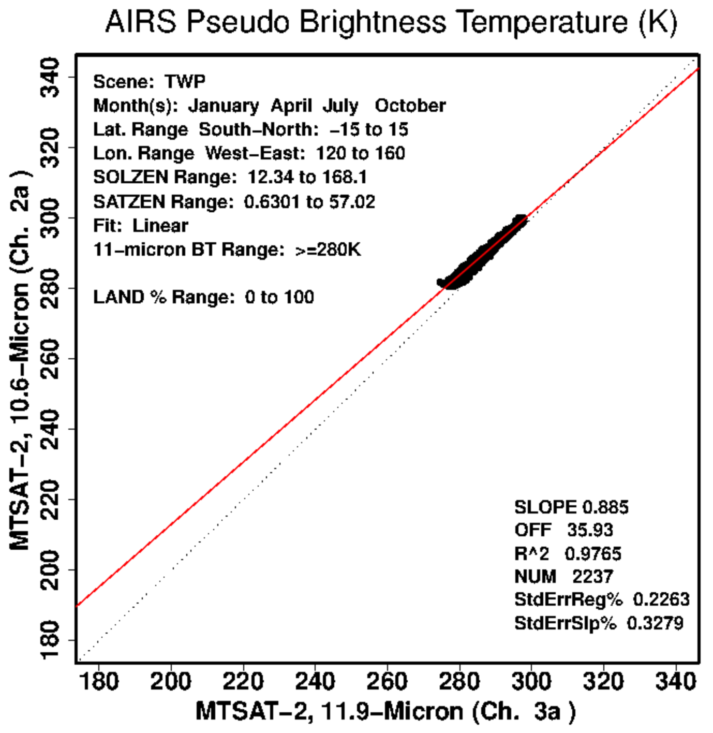
AIRS SBAF Example: 11-μm to 12-μm
Bias: -0.01 K
SDD: 2.12 K
SBAF:
Piece-wise
(1/3)
SBAF:
Piece-wise
(2/3)
Validation:
11 μm vs. 11 μm
Bias: 0.00 K
SDD: 2.27 K
SBAF:
Piece-wise
(3/3)
(11-μm equivalent)
Validation:
11 μm vs. 12 μm
With Piece-wise SBAF

Slide 23
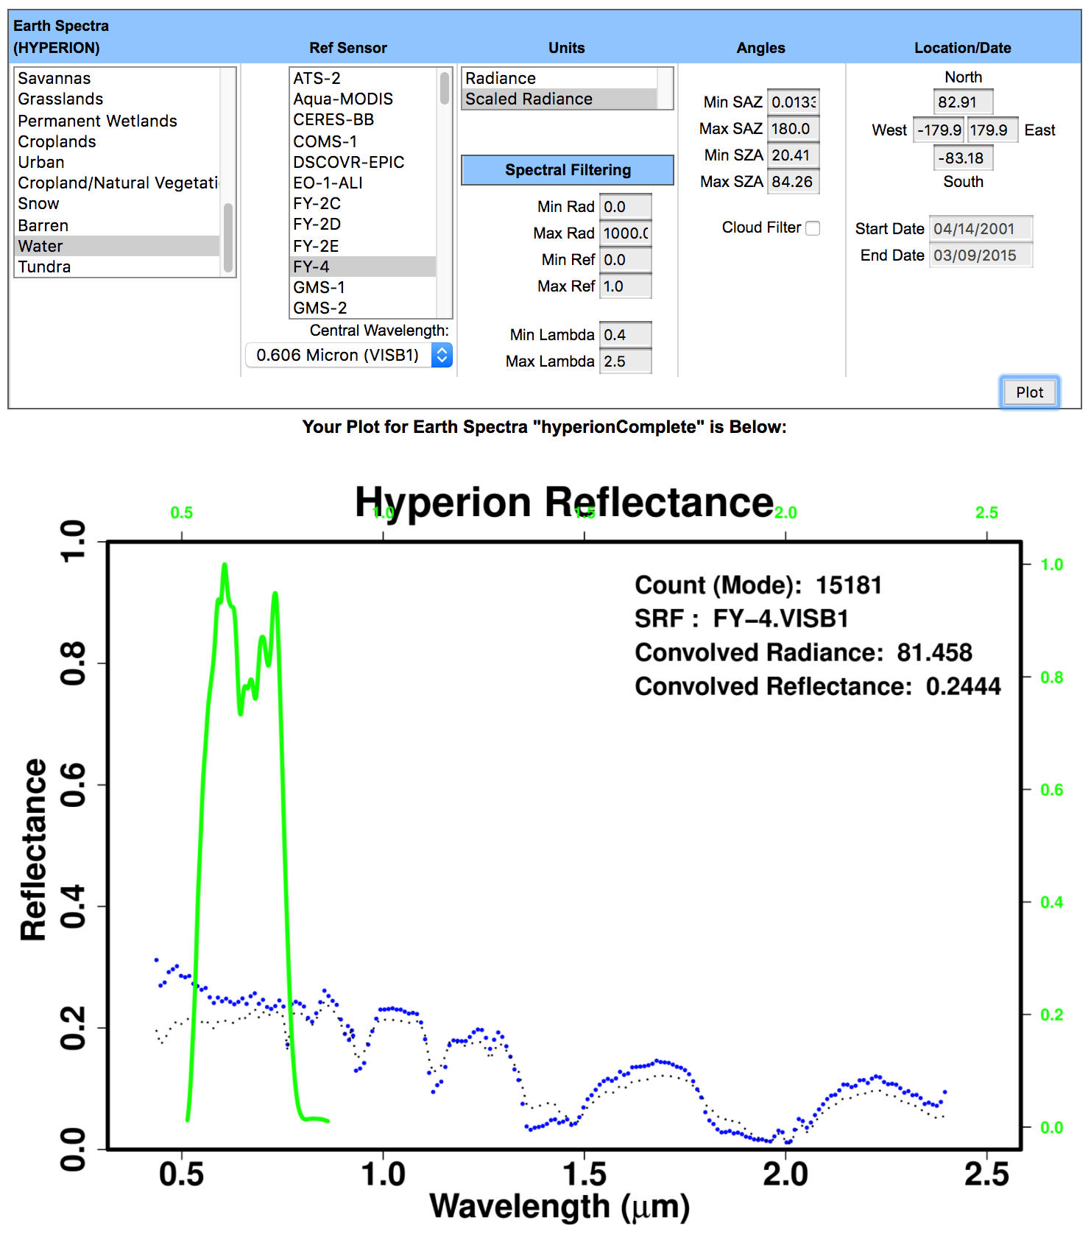
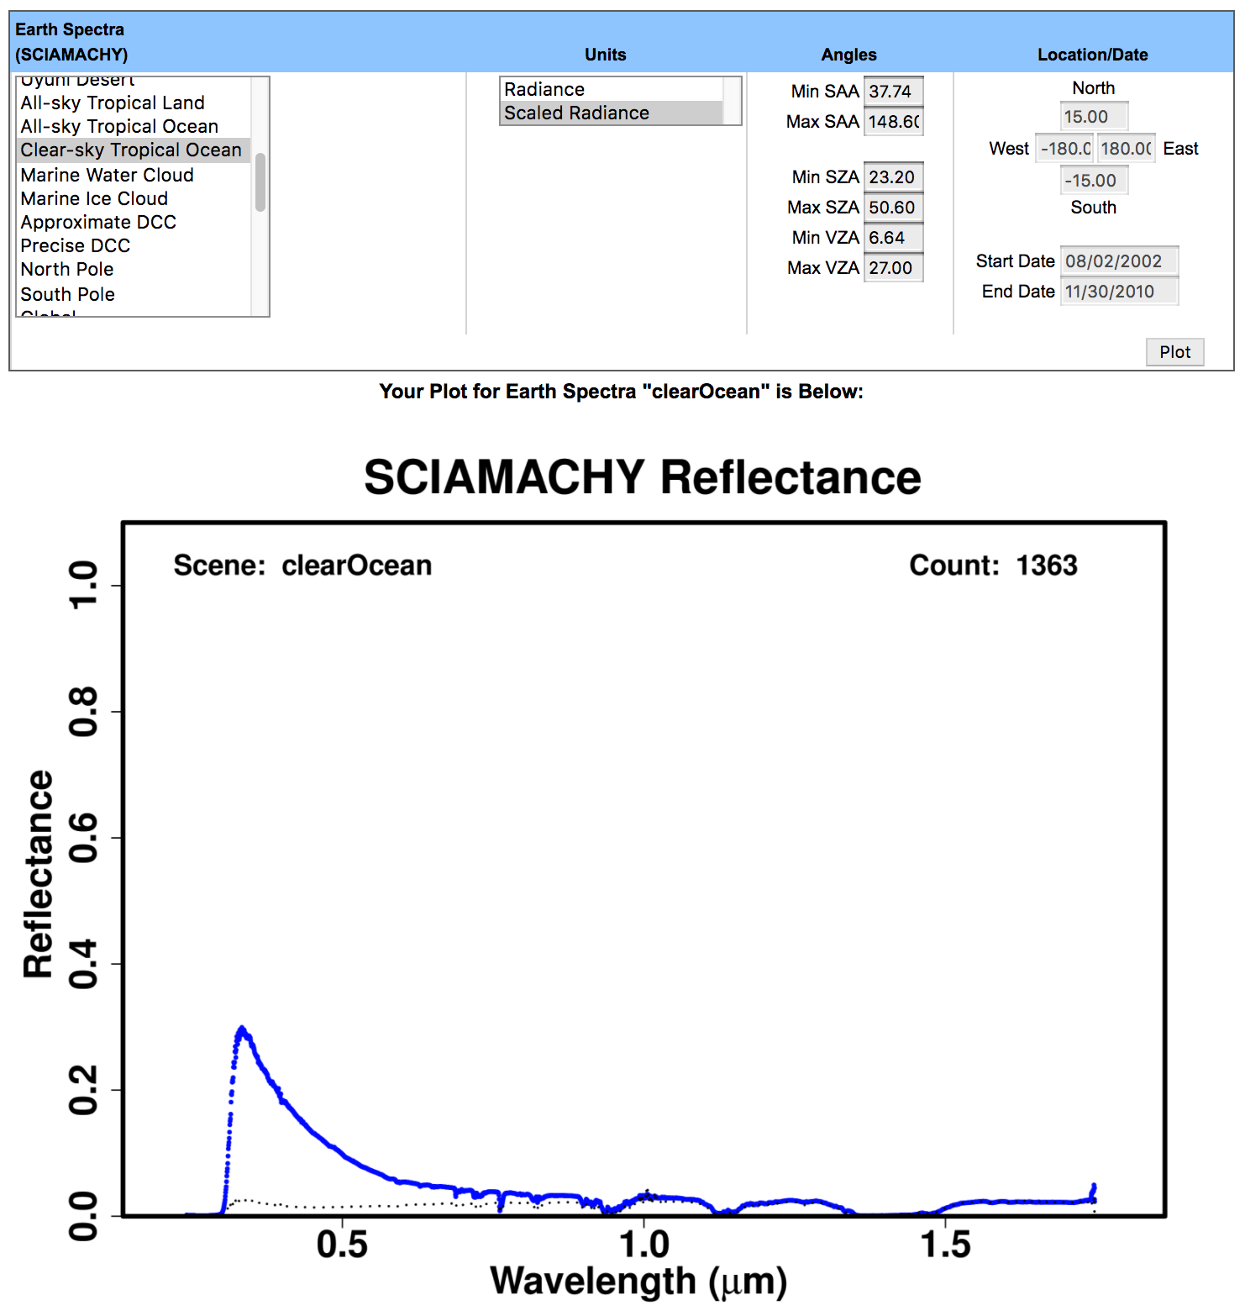
Hyperion Spectral Filtering
Hyperion “Water” Reflectance
Without Spectral Filter
SCIAMACHY “Clear-sky Topical Ocean”
Reflectance

Slide 24
Hyperion Spectral Filtering
~clear ocean
Hyperion “Water” Reflectance
With Low-Reflectance Spectral Filter
SCIAMACHY “Clear-sky Topical Ocean”
Reflectance

Slide 25
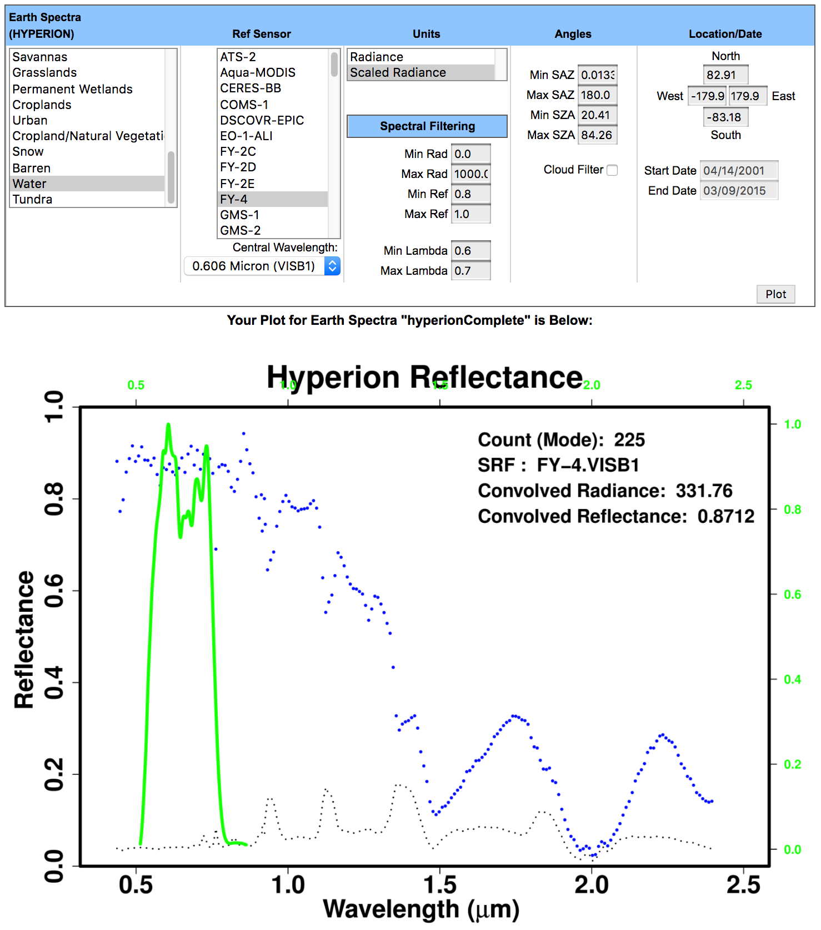
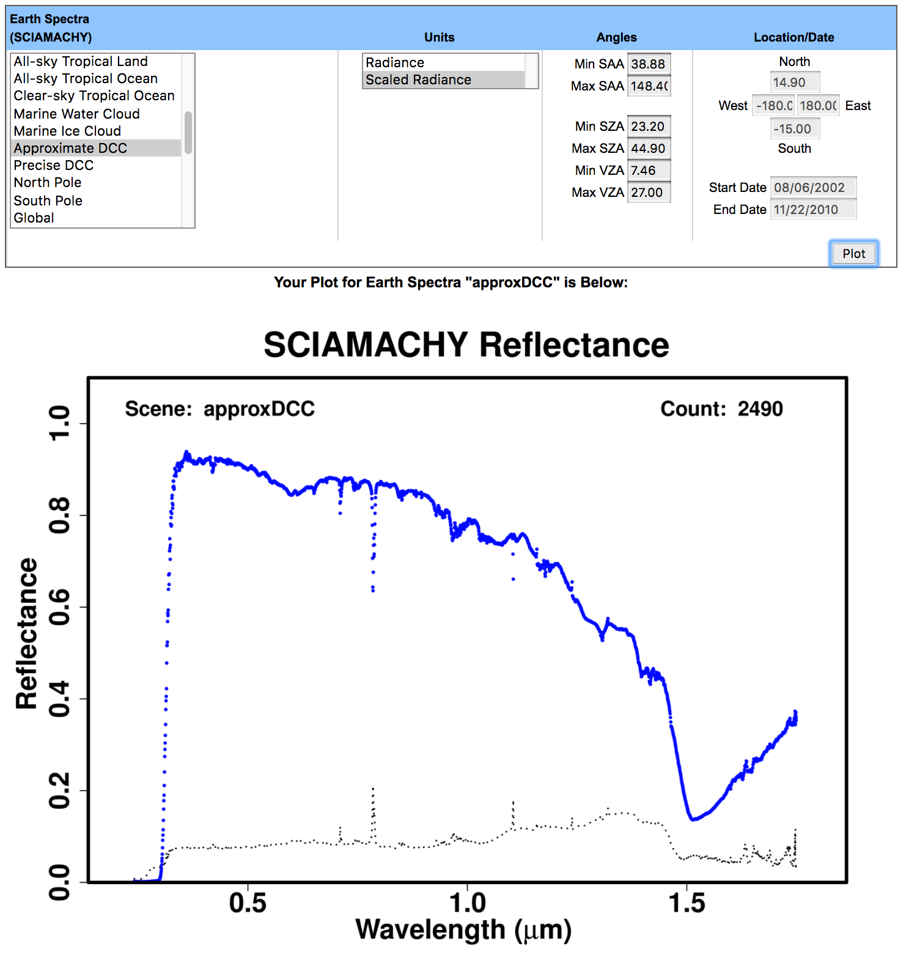
Hyperion Spectral Filtering
~bright clouds
Hyperion “Water” Reflectance
With High-Reflectance Spectral Filter
SCIAMACHY “Approximate DCC”
Reflectance

Slide 26
Summary
Active of calibration tools development in support of proposal effort and for benefit of community
Scene-specific SBAF crucial to account for spectral induced radiance differences when inter-calibrating two sensors
Subsetting for known scene conditions, angles, etc., will significantly reduce uncertainty of SBAF
Spectral filtering can isolate conditions for a certain band based on dependency of another band

Slide 27
Backup Slides

Slide 28
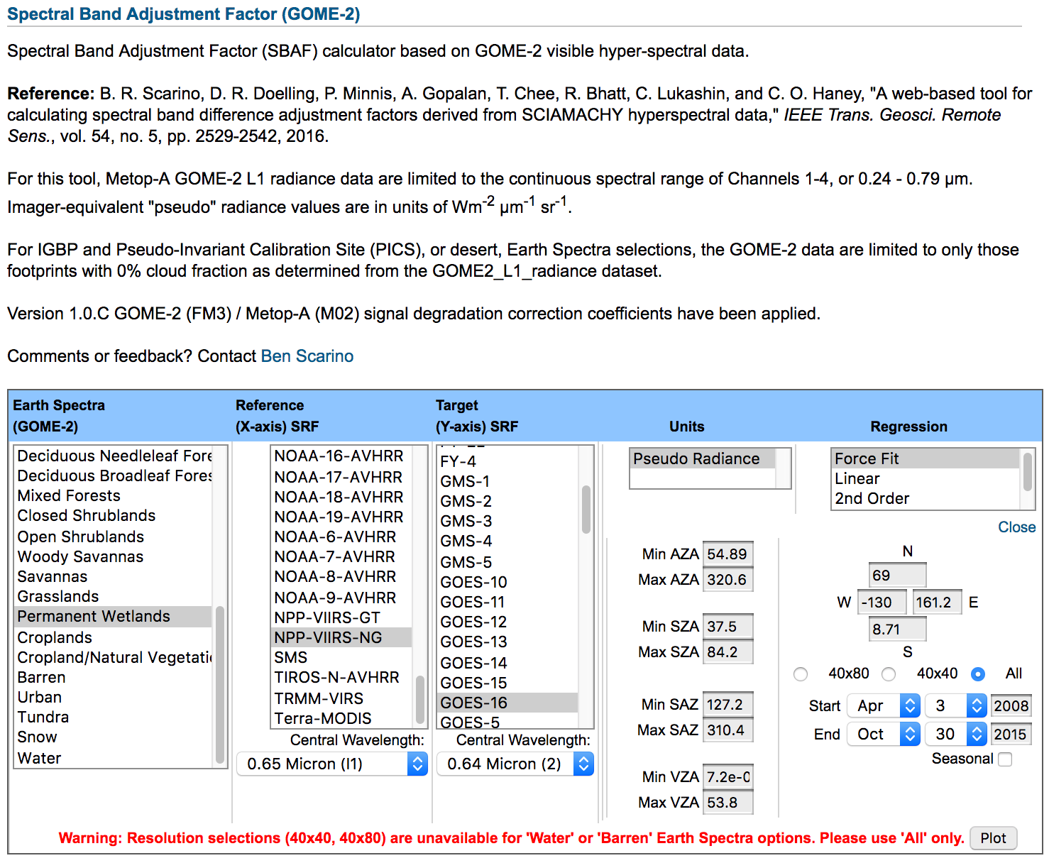
GOME-2-based Visible SBAF Tool
Currently based on 4 seasonal months from 2008 and 2015
Balance between sampling and processing time
GOME-2 SBAF based on smaller footprint than SCIAMCHY
40x80 km² before July 2013
40x40 km² after July 2013
SCIAMACHY is 30x240 km²
Homogeneity more likely in smaller footprints

Slide 29
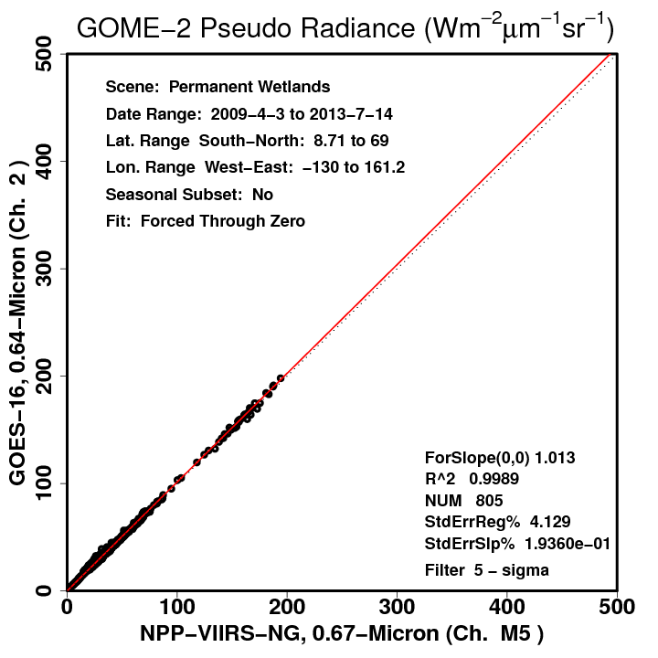
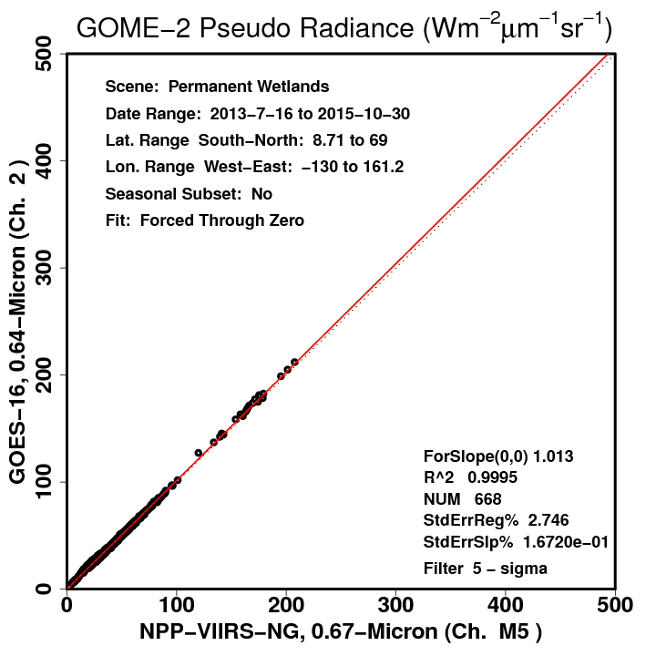
GOME-2-based Visible SBAF Tool
40x80 km²
40x80 km²
40x40 km²
40x40 km²
SBAF uncertainty 1.4% smaller using smaller footprints
SBAF does not change, however

Slide 30
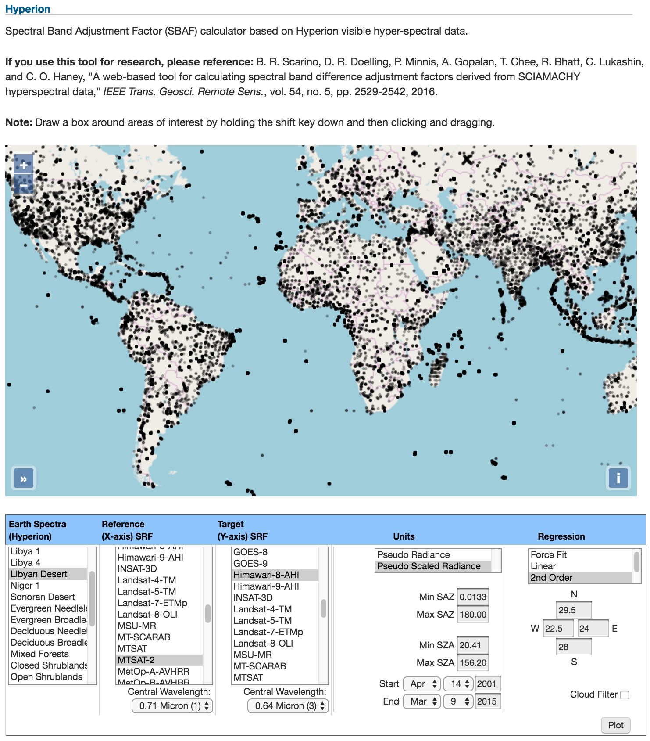
Hyperion-based Visible SBAF Tool
Map displays entire record of Hyperion ground measurements
Irregular distribution due to nature of tasked retrieval

Slide 31
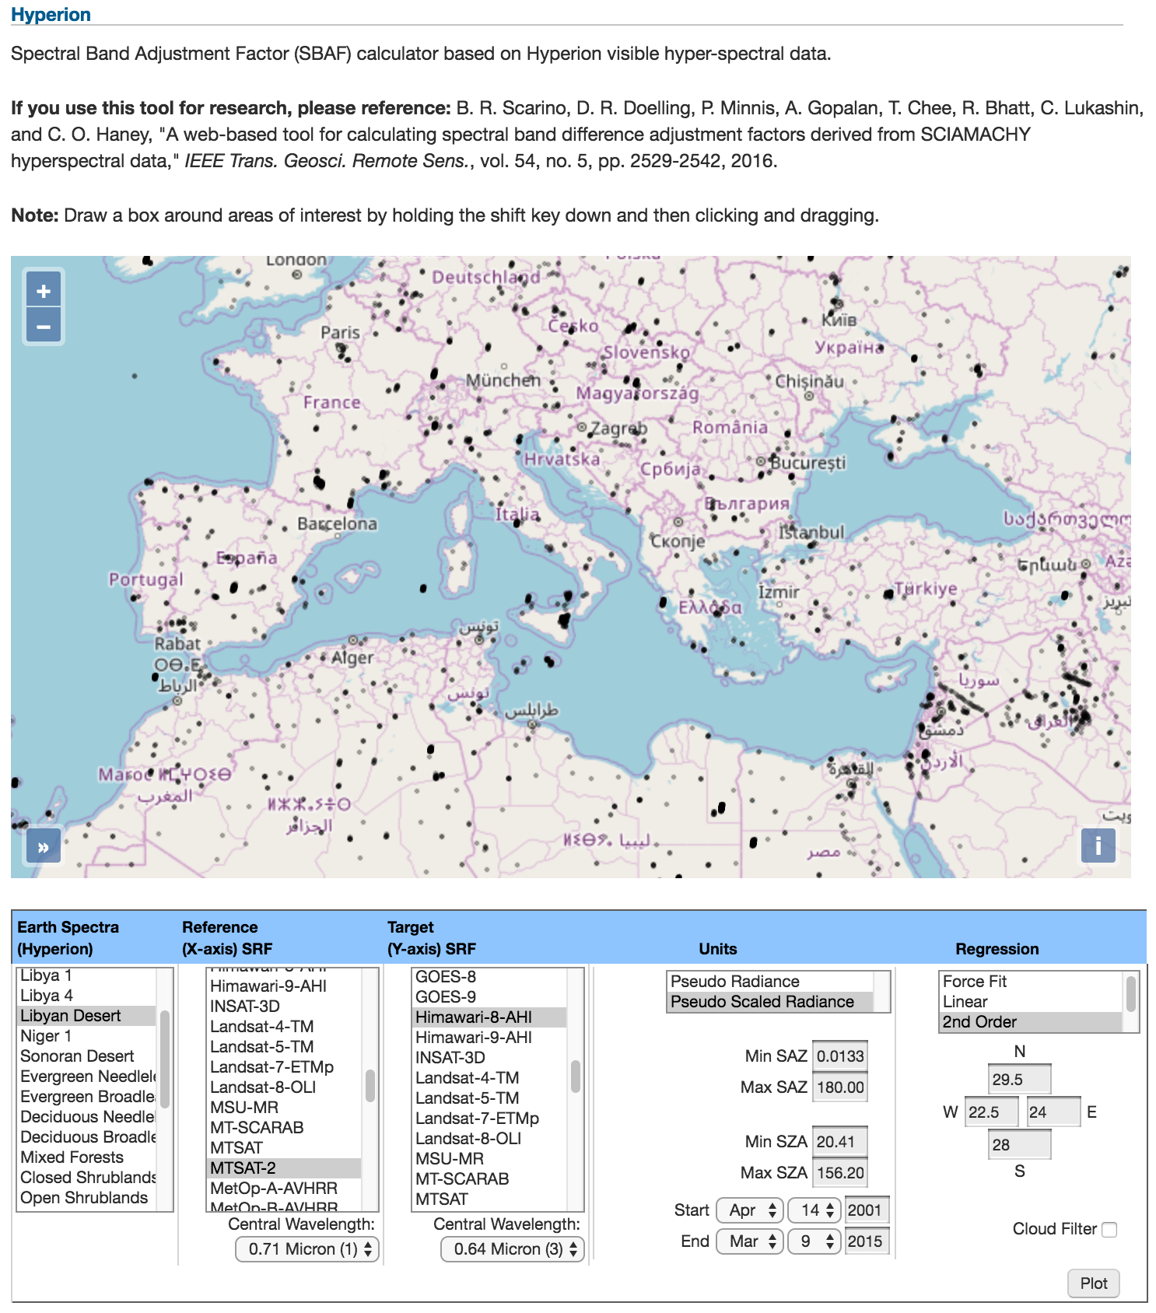
Hyperion-based Visible SBAF Tool
Map displays entire record of Hyperion ground measurements
Irregular distribution due to nature of tasked retrieval
Choose from pre-selections, enter own coordinates, or draw a box

Slide 32
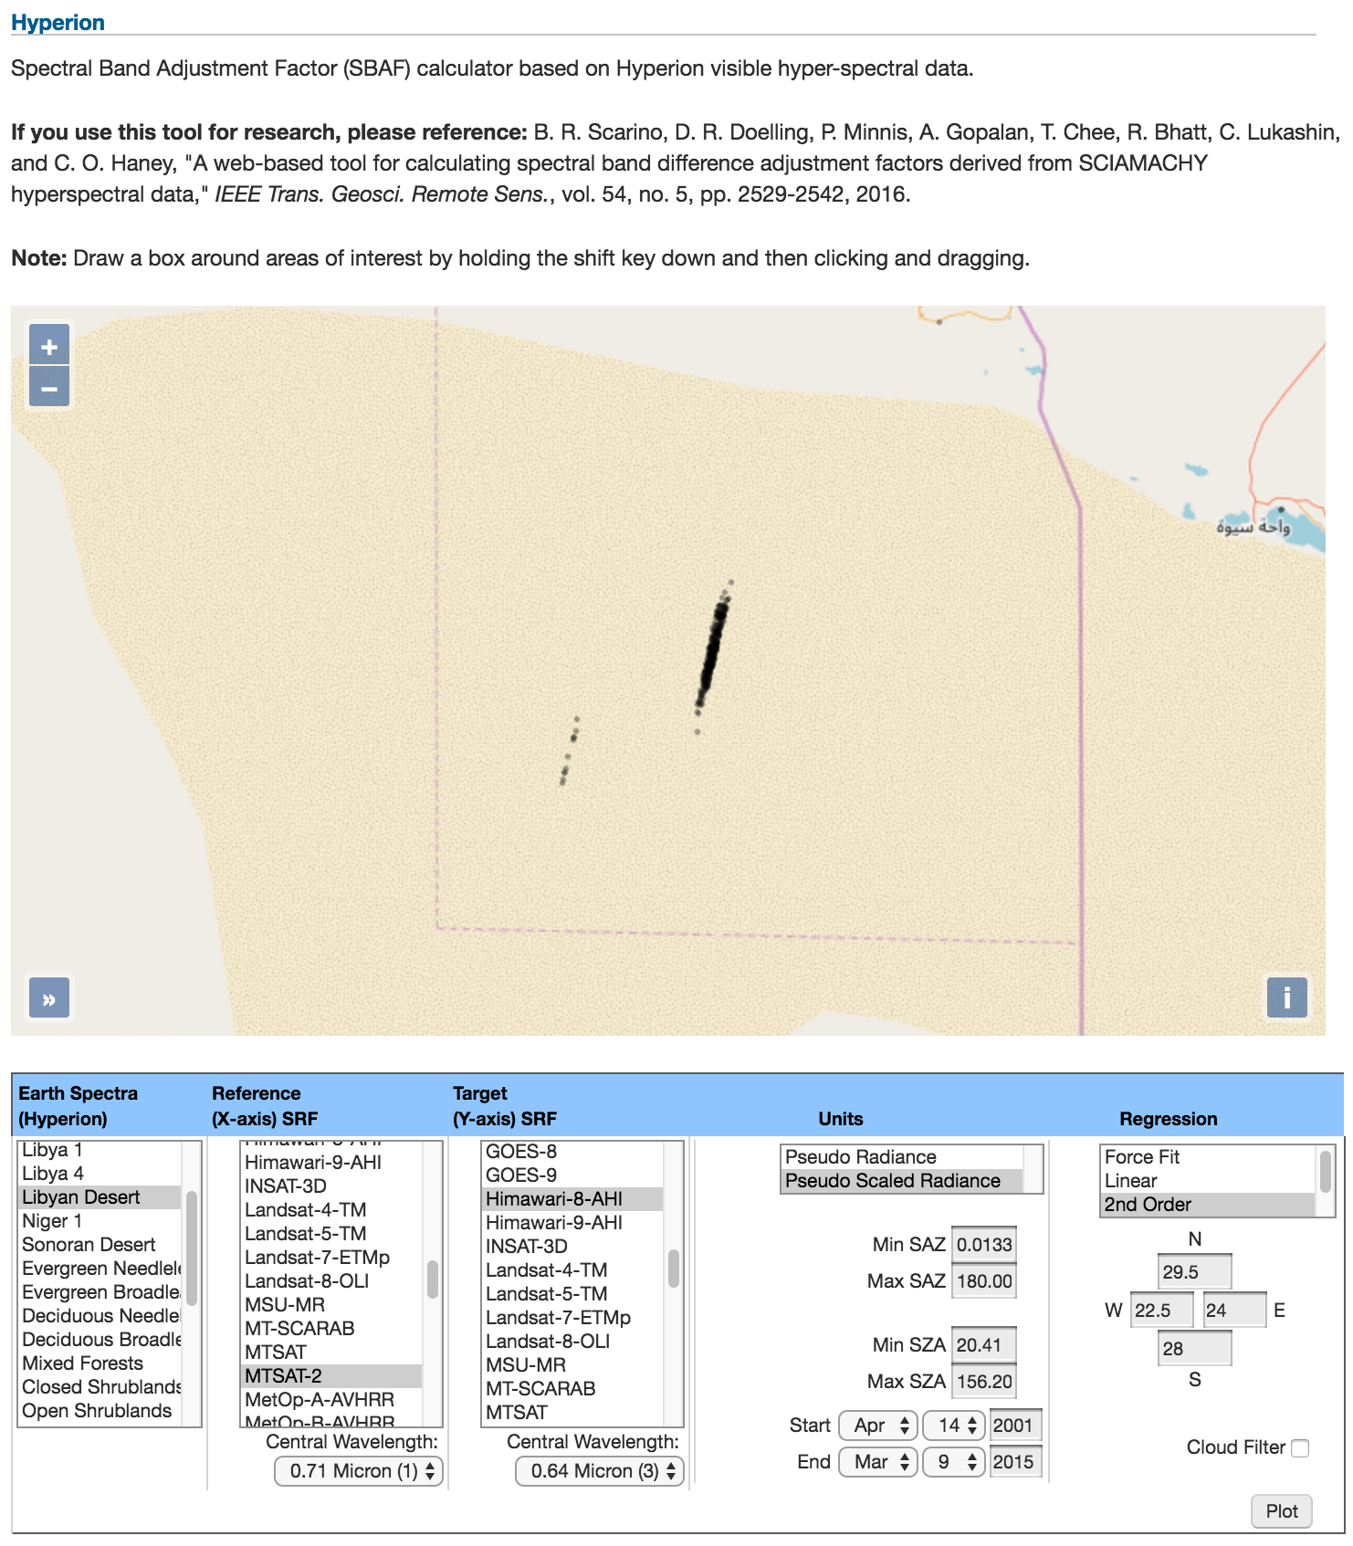
Hyperion-based Visible SBAF Tool
Map displays entire record of Hyperion ground measurements
Irregular distribution due to nature of tasked retrieval
Choose from pre-selections, enter own coordinates, or draw a box
Can be very selective

Slide 33
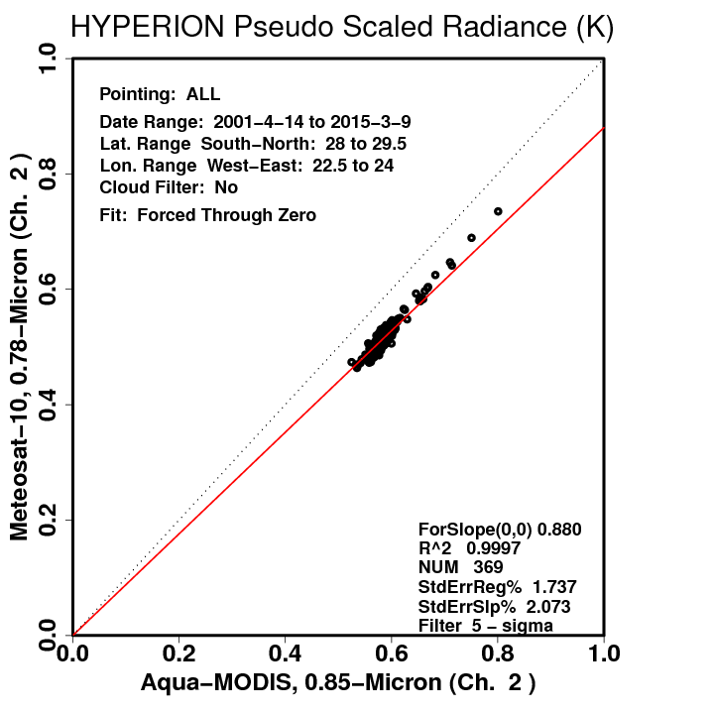
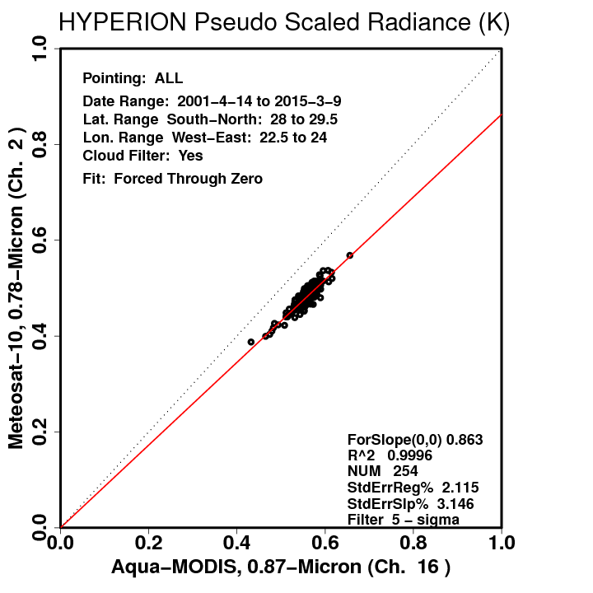
Hyperion-based Visible SBAF Tool
No Cloud Filter
No Cloud Filter
Cloud Filter
Cloud Filter
Simple cloud filter based on standard deviation thresholds across decimated Hyperion swath
Can have significant impact on derived SBAF

Slide 34
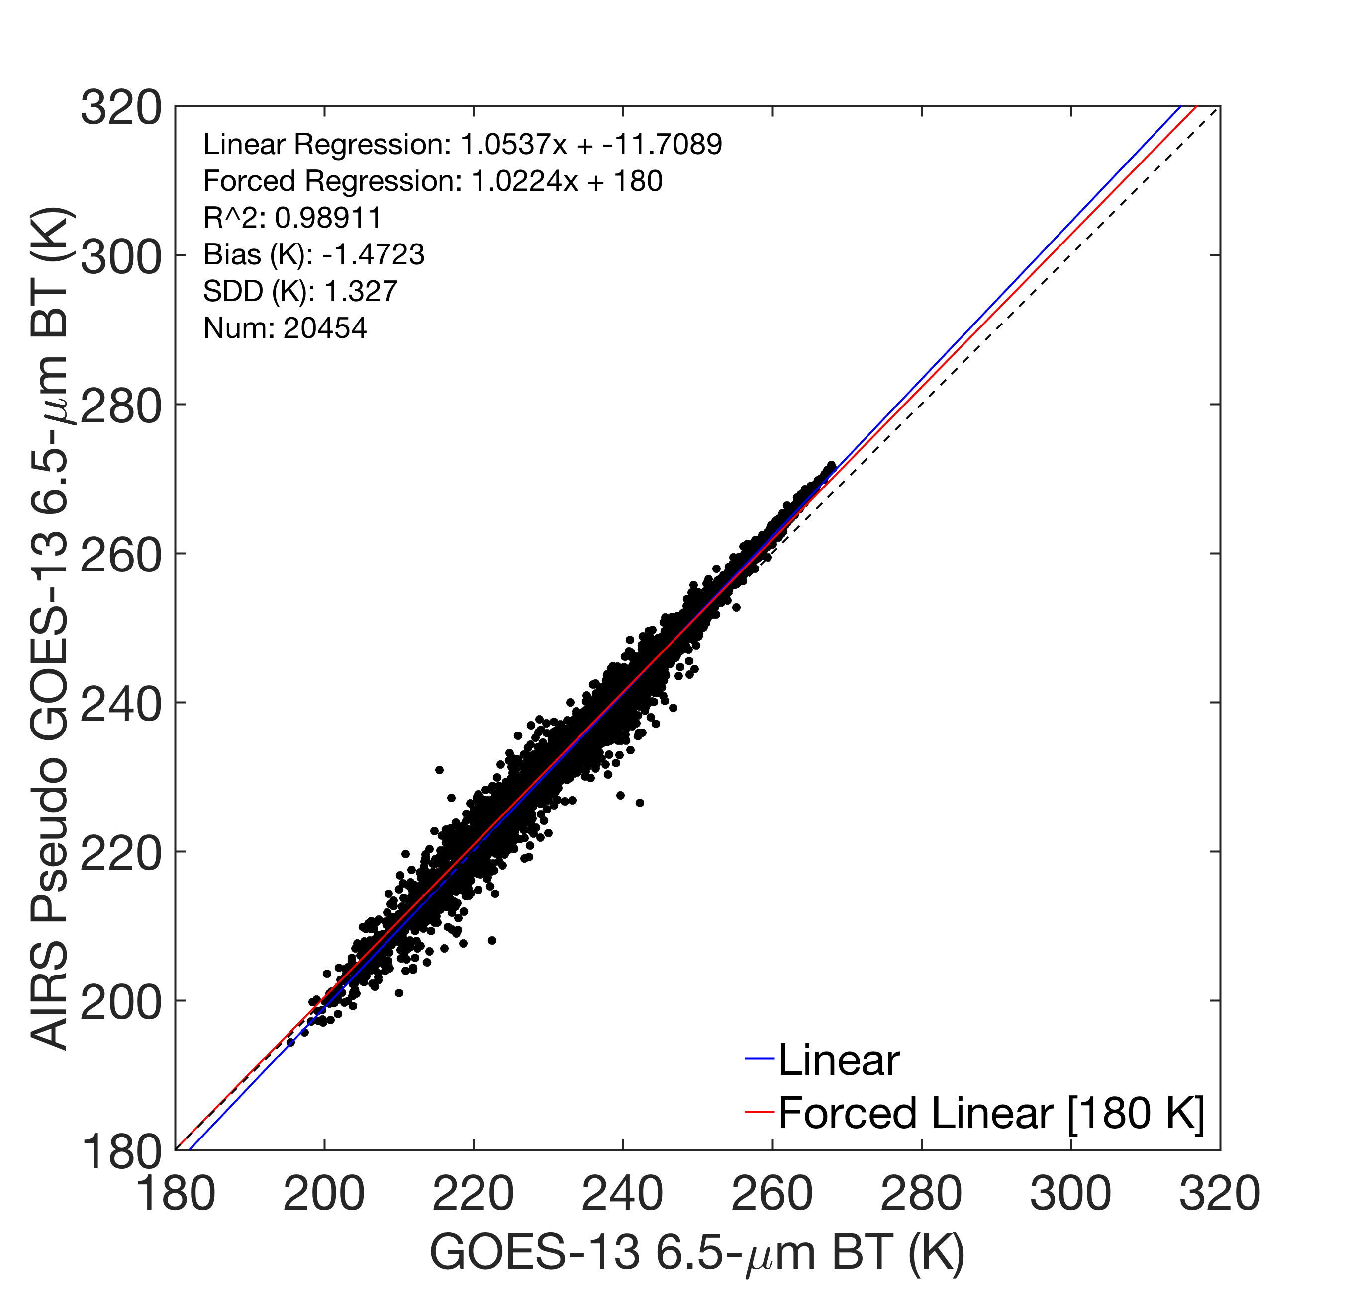
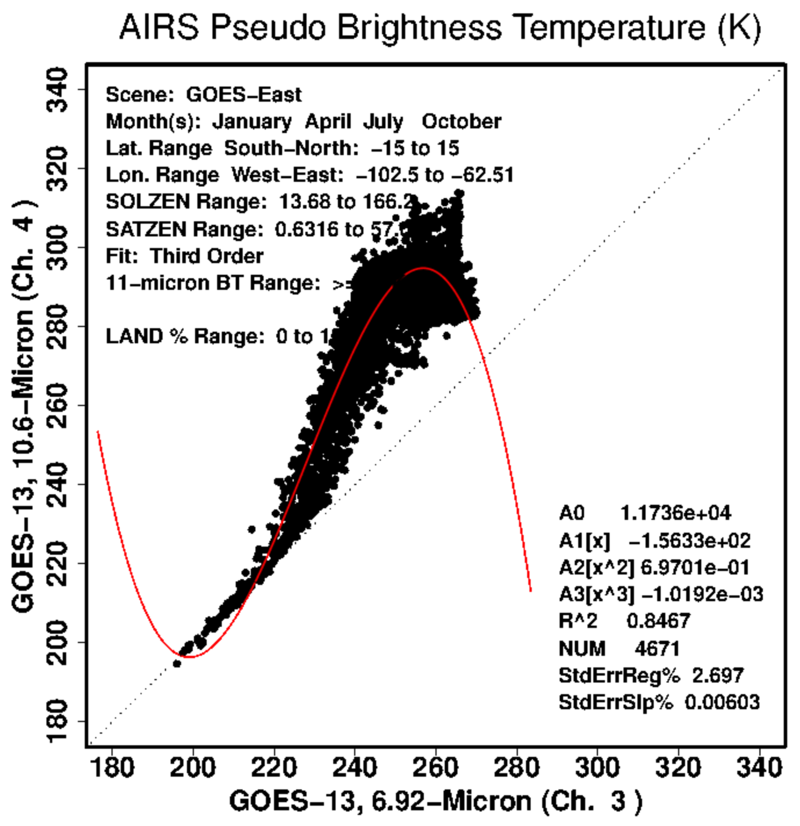
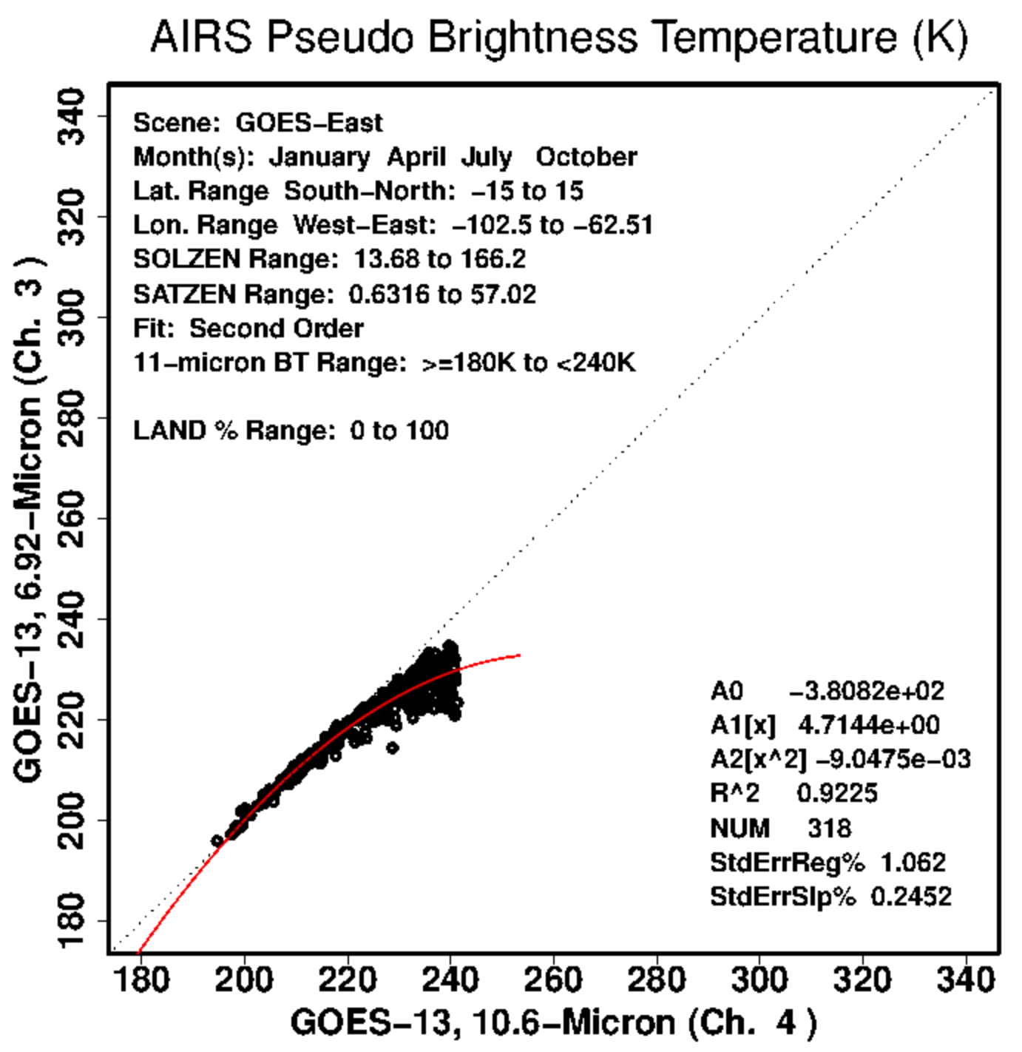
AIRS SBAF Example: 11-μm to 12-μm
Validation:
6.5 μm vs. 6.5 μm
SBAF:
3rd degree
SBAF:
Piece-wise
(1/3)
Validation:
6.5 μm vs. 11 μm
SBAF:
Piece-wise
(2/3)
SBAF
Piece-wise
(3/3)
Without SBAF

Slide 35
AIRS SBAF Example: 11-μm to 6.5-μm
Validation:
6.5 μm vs. 6.5 μm
(11-μm equivalent)
With
3rd-degree SBAF
With
3rd-degree SBAF
(6.5-μm equivalent)
Validation:
6.5 μm vs. 11 μm
Without SBAF

Slide 36
Spectral Radiance as a Function of Temperature (T*)
https://satcorps.larc.nasa.gov
https://satcorps.larc.nasa.gov/cgi-bin/site/showdoc?mnemonic=SAT_CALIB_USER

Slide 37
Spectral Radiance as a Function of Temperature (T*)

Slide 38
IASI-based IR SBAF Tool Update
Users conducting Overshooting Convective Top studies found it helpful to construct piece-wise SBAFs using limited ranges of 11-μm BT
Works for any channel SBAF, not just 11-μm

Slide 39
IASI-based IR SBAF Tool Update
A user suspected SBAF uncertainty was caused by CO₂ absorption band just beyond 4.0 μm

Slide 40
Applications
3600 – 15500 nm
3740 – 4610 nm
6200 – 8220 nm
8800 – 15400 nm
400 – 2500 nm
240 – 1750 nm
240 – 790 nm
SBAF possible for 0.24-2.50 μm via SCIAMACHY, Hyperion, and GOME-2
GOME-2 affords smaller footprint from shorter spectra range
IASI covers 3.60-15.5 μm
AIRS support grants enhanced scene selection for IR SBAFs
CLARREO Pathfinder, HySICS (??)

Slide 41
Solar Constant comparison tool
MODIS uses the MCST solar spectra to convert between reflectance and radiance
Important to use the same solar spectra when comparing multiple instruments

