Slide 1
Calibration over Rayleigh Scattering
Needs and Open Questions
Bertrand Fougnie, Sebastien Wagner, Tim Hewison

Slide 2
Summary
Introduction – Why a Rayleigh Scattering Calibration
Definition : Rayleigh versus ocean target
Which potential needs ?
Main contributors and Inputs
RTM core performance
From LEO to GEO : open questions
Definition of priorities

Slide 3
Introduction : Why a Rayleigh Scattering Calibration ?
Properties of the Rayleigh Scattering
(potentially used on the calibration after appropriate selection) :
Spectral : “blue” with (lambda)-4 decrease law
Brightness : moderate in the blue, to very dark in the red/NIR
Directionality : very smooth signature
Polarization : very significant polarized signature
3MI simulation

Slide 4
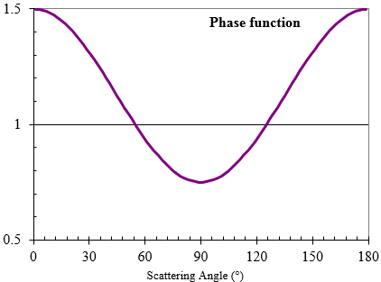
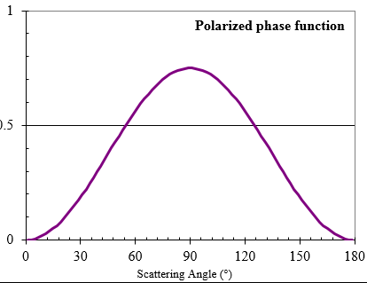
Introduction : Why a Rayleigh Scattering Calibration ?
Properties of the Rayleigh Scattering
(potentially used on the calibration after appropriate selection) :
Spectral : “blue” with (lambda)-4 decrease law
Brightness : moderate in the blue, to very dark in the red/NIR
Directionality : very smooth signature
Polarization : very significant polarized signature
Note : in single scattering approximation :
$$ρ_{toa}≈ \frac{τ_{r}.P(χ)}{4.μ_{s}.μ_{v}}$$
Geometrical range from space
Geometrical range from space

Slide 5
Definition : Rayleigh versus Ocean target
Rayleigh Scattering Calibration or Ocean Target Calibration ?
If RAY_Cal is usually performed over ocean, all oceanic targets are not suitable for “Rayleigh” calibration.
Only a limited number of oceanic targets are appropriate
The selection should avoid :
Atmospheric turbid situations
Sunglint perturbation
Cloud pollution, including sub-pixel clouds detection
Areas where the surface reflectance cannot be accurately known or predicted – this includes the marine contribution, as well as the surface whitecaps
Neighbourhood of clouds and lands (vicinity effects)
One selection stream was proposed in :
GSICS Rayleigh ATBD Web Meeting (03/07/13)
GSICS ATBD for Calibration over Rayleigh Scattering (Fougnie and Henry) 2013 (02/07/13)
After selection : ~90% of the signal is due to Rayleigh Scattering
Valid for all Visible bands (from 400 to 700nm)
Other contributions are minor, but need to be properly evaluated

Slide 6
Which Needs ?
From passed experience, the following aspects could be assessed :
Absolute calibration (= the most demanding in term of modelling)
Need an accurate modelling of every contributors
Refined selection of measurements, accurate Radiative Transfer Model, appropriate inputs
Cross-calibration (= could accommodate some approximations)
Double-difference approach : use statistics
relatively easy to derive if matchups are sufficiently similar
Direct matching with geometrical and optionally temporal constrains
limit the number of matchups + need of SBAF correction
Temporal-calibration (= could accommodate some approximations)
Less demanding in term of accuracy, but only accessible through important matchups
Depending on the aspect, the optimization would be different
IMPORTANT : The following anomalies on the radiometry impact the result : straylight, non-linearity, spectral out-of-band rejection, knowledge/evolution of the ISR, polarization sensitivity, variation of the calibration within the field-of-view…
→ RAY_cal can be seen as “vulnerable” BUT this is also a powerful checking

Slide 7
Main Contributors and Inputs
The TOA signal, to be computed and compared with the measured one, includes :
Accurate computation of the Rayleigh scattering (>85%)
Should include the polarization (single scattering assumption or fully)
Importance of the Radiative Transfer Model (RTM)
Monochromatic computation (using equivalent optical thickness) or line-by-line computation + spectral integration ?
Aerosol background (~10% in the red with AOD << 0.1) :
Selection of the best atmospherical non-turbid sites (“oceanic deserts”)
Input model assumption
or robust external source (AOD and model) – e.g. Copernicus CAMS
Surface reflectance (~10% in the blue) :
Oligotrophic (oceanic desert) & Mesotrophic waters recommended (Fougnie et al., 2010)
Climatology, sufficiently realistic – e.g. Globcolour
or external source - e.g. Copernicus CMEMS
Gas absorption :
In general minor contributors, but to be corrected

Slide 8
The RTM core performance
The Rayleigh scattering (90% of the TOA signal), must be computed with, as much as possible, a high level of accuracy
Inclusion of the polarization & multiple scattering
Specular surface contribution including coupling terms
Unified RTM Radiative Transfer Model
If a common GSICS method is agreed, a unique reference RTM or set of LUT (generated by this reference RTM) has to be adopted
If any other RTM used, they should be “traced” to this GSICS reference RTM
At least the same “Rayleigh” definition must to be considered
Computing time may be important
For NRT operational computations
LUT approach can also be easily used if critical

Slide 9
From LEO to GEO – Open questions
The method has already been extensively used for many LEO sensors
According the GSICS ATBD V1 : POLDER, VGT, MERIS, OLCI, MODIS…
Statistical results are better if a maximum of geophysical conditions can be well mixed
The generalisation to GEO sensor still has to be consolidated
Not all sites are accessible
Viewing geometries are always the same (only the solar geometry is changing)
Use of a NIR/SWIR band to constrain the aerosol content (not designed for low OC signal)
Possibility and representativeness of exogenous aerosol estimation as backup

Slide 10
Definition of priorities
The efforts to be made depend on the priorities
EUMETSAT priorities :
1/ Absolute calibration for Sentinel-3 sensors
2/ Absolute calibration for MSG/SEVIRI and MTG/FCI
3/ Cross-calibration of LEO/LEO or GEO/GEO
GSICS needs (To be discussed) – What are the common priorities ?
Cross-calibration LEO/LEO through double-difference
Cross-calibration LEO/GEO
Absolute calibration

