Slide 1
Update on Visible calibration
Special Issue of the IEEE TGRS on “Inter-Calibration of Satellite Instruments”:
Special Issue of the IEEE TGRS on “Inter-Calibration of Satellite Instruments”:
Dohyeong Kim
KMA

Slide 2
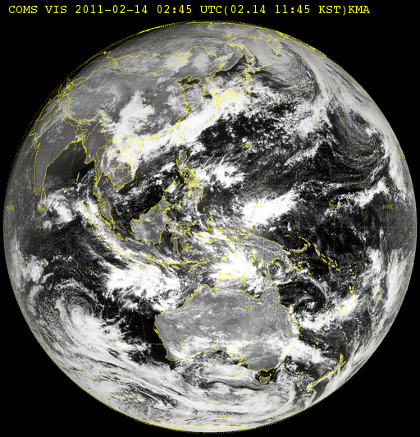
Ray Matching method (1)
일평균
COMS_Level 1B Full Disk (every 3 hour)
20°S~20°N / 108.2°E~148.2°E
MOD021KM(Level 1B) (Terra MODIS )
1km Visible (Band01, 0.62~0.67μm)
1km IR (Band31, 10.78~11.28μm)
MOD03(Level 1A)
Geolocation Data (Latitude, Longitude, SolarZA, SatelliteZA)
-1.993%/year
Temporal/spatial collocation
Time difference < 5 minute
Spatial collocation : selection of the
closest pixels

Slide 3
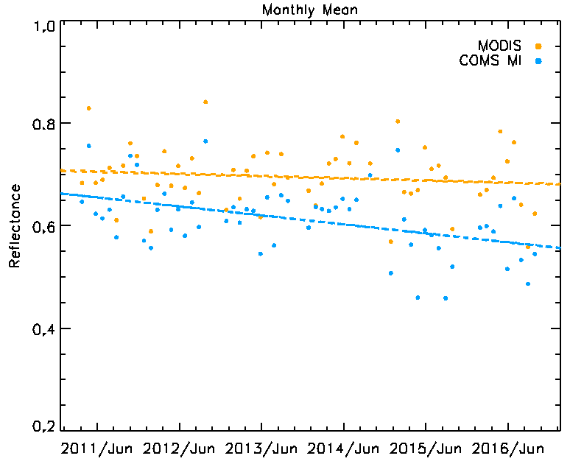
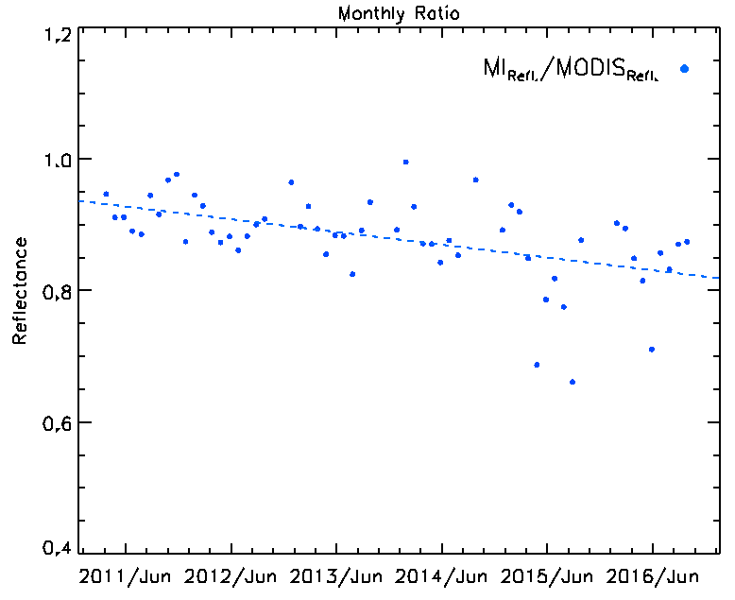
Ray Matching method (2)
일평균
Result
Period : April 2011 ~ December 2016
-1.993%/year
2011.4.1. ~ 2016.12.31.
$$\frac{MI_Refl}{MODIS_Refl}$$
= -1.93%/year

Slide 4
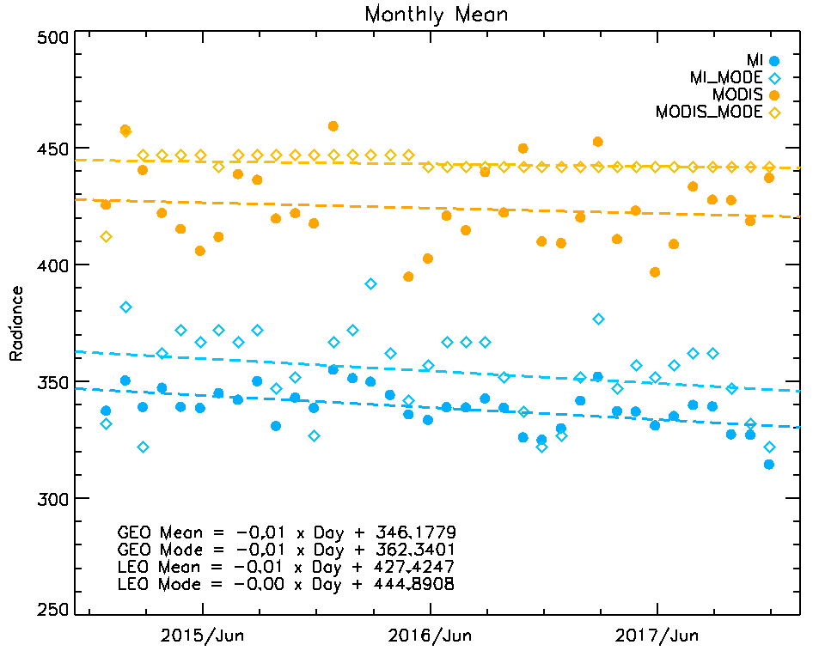
Update of DCC based on NASA algorithm
COMS Level 1B
COMS Level 1B Full Disk
Enhanced Northern Hemisphere
2015.01~2017.12
20°S~20°N, 108.2°E~148.2°E
MOD02SSH(Level 1B) Terra MODIS
5km Visible(Band01, 0.62~0.67μm)
5km IR(Band31, 10.78~11.28μm)
DCC threshold
20°S~20°N / 108.2°E~148.2°E
03:00UTC $≤$ image time $<$ 6:00UTC
SZA < 40°
VZA < 40°
BT11μm < 205°K
STD of 3x3 pixels BT11μm < 1°K
STD of 3x3 pixels visible radiance < 3%
Ref. : DCC identification based on Doelling et al. (2013)
- 1.03 %/year

Slide 5
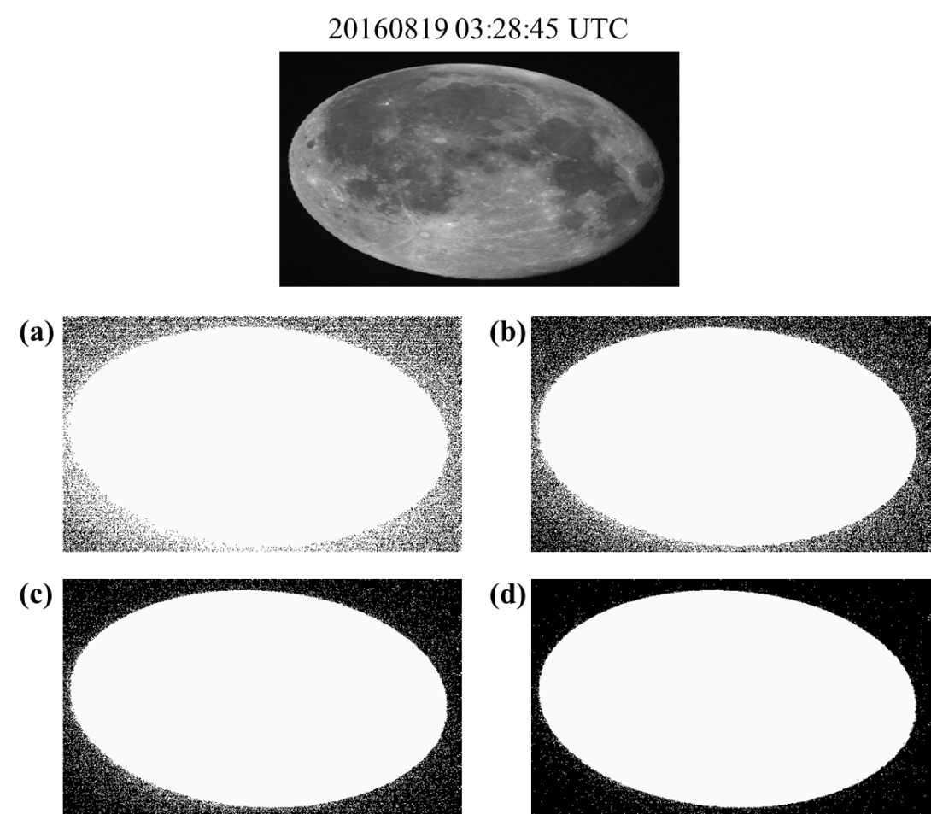
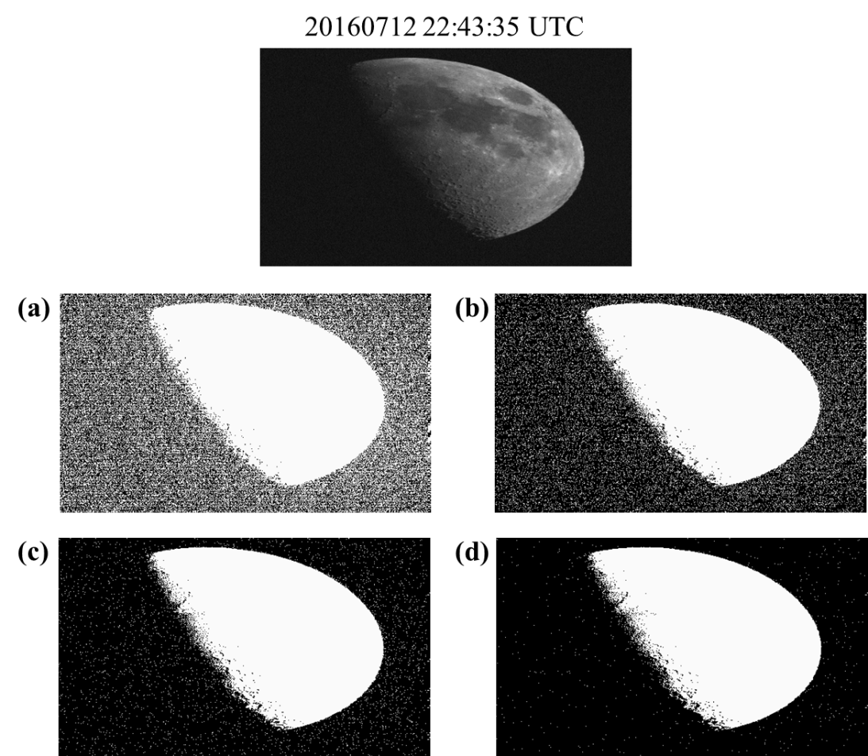
COMS VIS Degradation Trend
COMS VIS degradation trend using Moon Observation Data
Threshold test : 800, 820, 840 and 860
for all data until now
slope= 0.85
intercept= 0.02

Slide 6
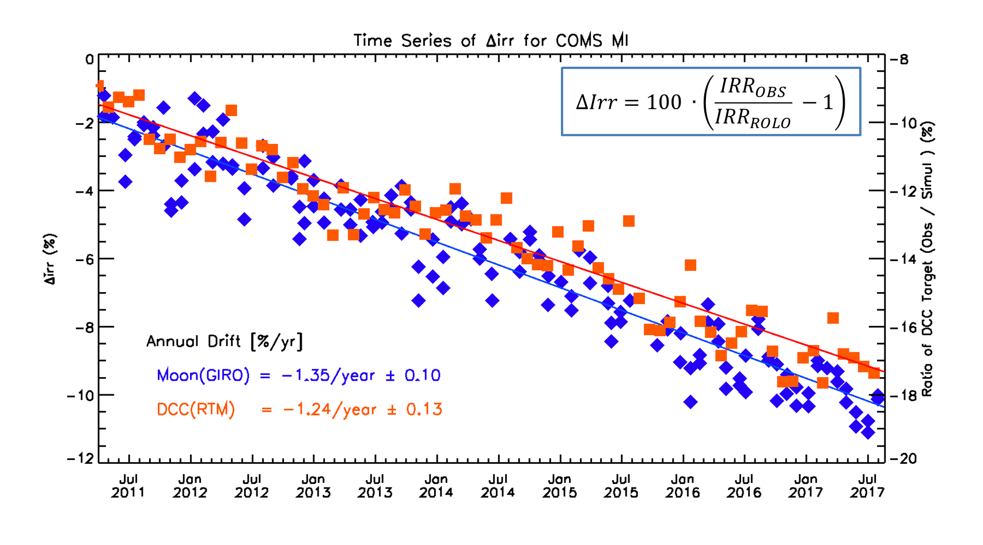
COMS VIS Degradation Trend
COMS VIS degradation trend using Moon and DCC(RTM)
Period : April 2011 ~ December 2017
for all data until now
slope= 0.85
intercept= 0.02

Slide 7
Summary
KMA/NMSC has been monitoring COMS visible channel performance using
Lunar observation data
GSICS DCC and Ray Matching Method
Earth Targets (Ocean, Desert, Water Cloud, DCC) with RTM
Method | Data period | Degradation Ratio
Ray-Matching | April 2011 ~ December 2016 | - 1.93 %/year
GSICS DCC | April 2011 ~ December 2017 | - 1.03 %/year
Lunar Observation | April 2011 ~ December 2017 | - 1.35 %/year
DCC (RTM) | April 2011 ~ December 2017 | - 1.28 %/year
Earth Target (RTM) | April 2011 ~ December 2017 | - 1.30 %/year

Slide 8
Thank you

