Slide 1
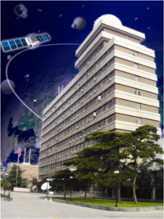
Introduction to the FENGYUN Satellite Data Services
Di Xian, Xue Li, Zhe Xu
NSMC/CMA
xiandi@cma.gov.cn

Slide 2
Outline
Introduction
Data distribution and services
Plan
National Satellite Meteorological Center ,CMA

Slide 3
1）Introduction
NSMC/CMA
CRAS
Weather RSA
Climate RSA
Environment RSA
Data Management Dep.
Data Services Dep.

Slide 4
2）Introduction
Main functions of Data Service Dep.
Data Services of FY satellites, TanSat etc.
Website Management
Remote Sensing Application System Management and support
Users benefit analysis

Slide 5
Outline
Introduction
Data distribution and services
Plan
National Satellite Meteorological Center ,CMA

Slide 6
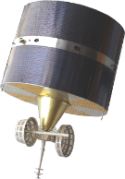
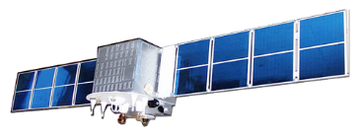
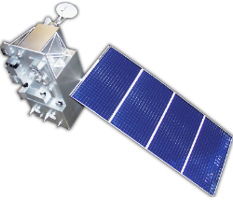
2) Data distribution and services
Data
exchange
DB
systems
FY data
processing
Fengyun-1
Fengyun-2
Fengyun-3
Fengyun-4
TanSat
EUMETCast
HY-2A
EOS/MODIS
MTSAT
NOAA
32satellites
92datasets
National Satellite Meteorological Center ,CMA

Slide 7
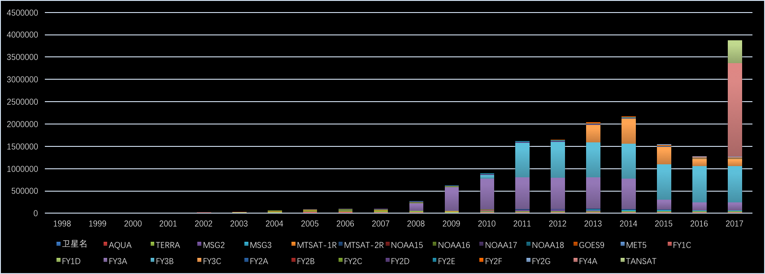
2) Data distribution and services
Data Archived in NSMC > 9.6PB，8TB/day，92 data sets，1000+products。
Daily Data Volume（MB）
Notes:
7

Slide 8
FY satellite data overview
2) Data distribution and services

Slide 9
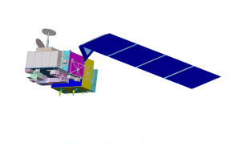
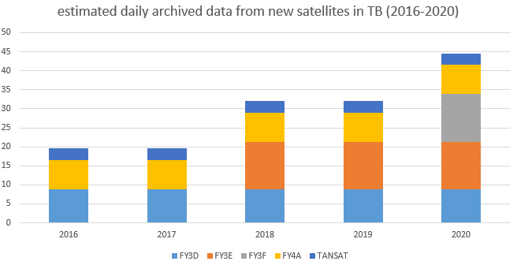
2) Data distribution and services
Overview - Planning of CMA satellite systems by year 2020
2013FY-3C(Op)
2014FY-2G(Op)
2016FY-3D(Op)
2012FY-2F(Op)
2016FY-4A (R&D)
2010FY-3B (R&D)
2017FY-2H(Op)
2008FY-2E (Op)
2018 FY-3E(Op)
2008FY-3A (R&D)
2019FY-3F(Op)
2019FY-RM(R&D)
2021 FY-3G(Op)
2020FY-4C(Op)
2018FY-4B (Op)

Slide 10
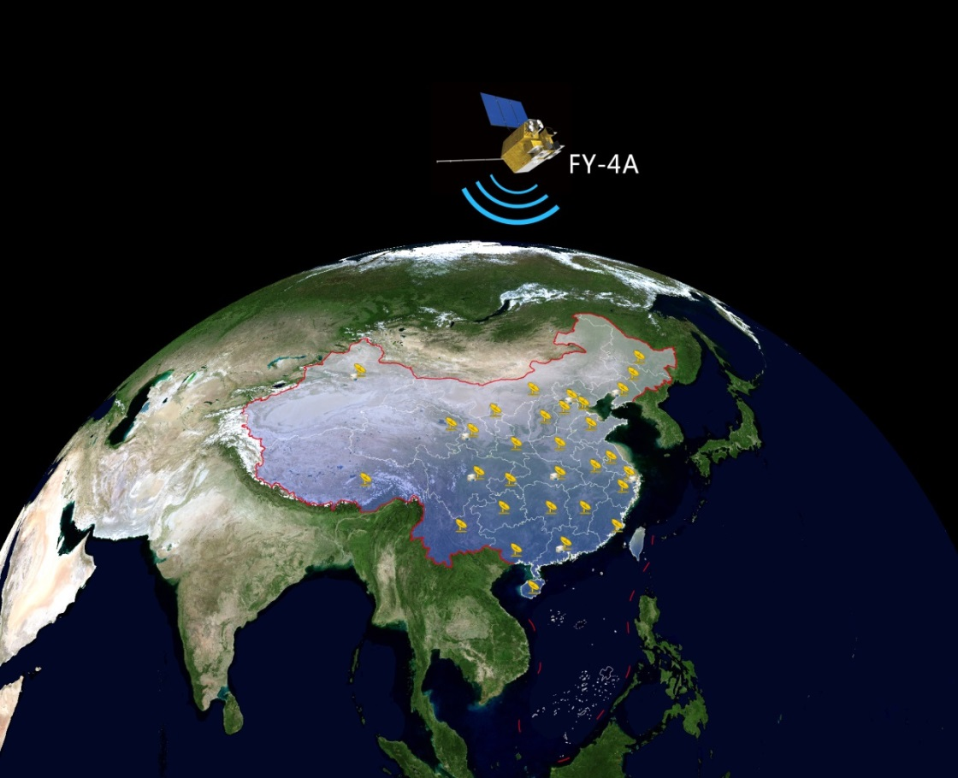
2) Data distribution and services
EUMETCast
Land Satellites
HY Satellites
Data Center
(Beijing)
CIMISS
DCPC
Data Backup Center
(Xi An)
WMO
28 FY3 Ground Stations
60+ FY4 Ground Stations
2600+ CMACast Stations
GEOSS
CHARTER

Slide 11
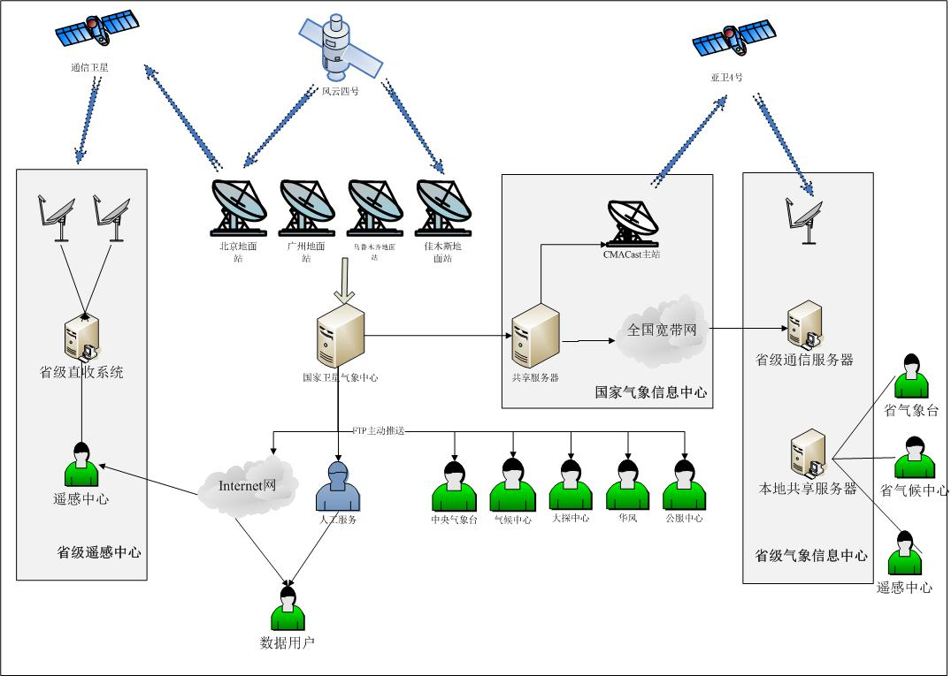
2) Data distribution and services
天地一体化的数据共享服务系统
CMACast
FENGYUN satellites
Ground Intranet
Special
Request
Internet
Direct Broadcast
Data Push
National Satellite Meteorological Center ,CMA

Slide 12
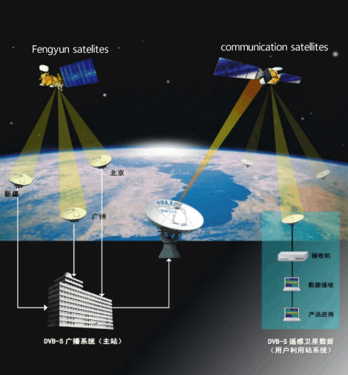
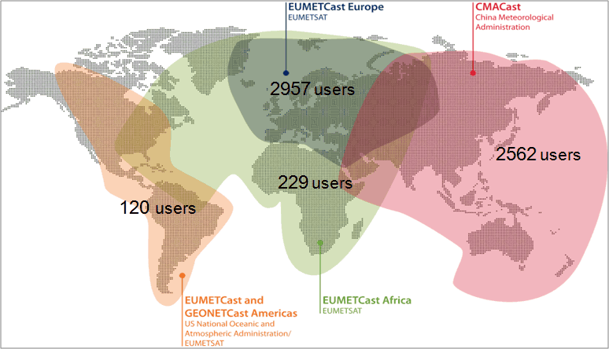
2) Data distribution and services
Real-time users
Direct Broadcast
CMACast
http://www.eumetsat.int/website/home/Data/DataDelivery/EUMETCast/GEONETCast/index.html
National Satellite Meteorological Center ,CMA
Notes:
CMACast is a newly established DVB-S2 standard satellite data broadcast system of China Meteorological Administration. It is maintained by the National Meteorological Information Centre. Users can receive FY-2 products in minutes, receive FY-3 data in 30 minutes.

Slide 13
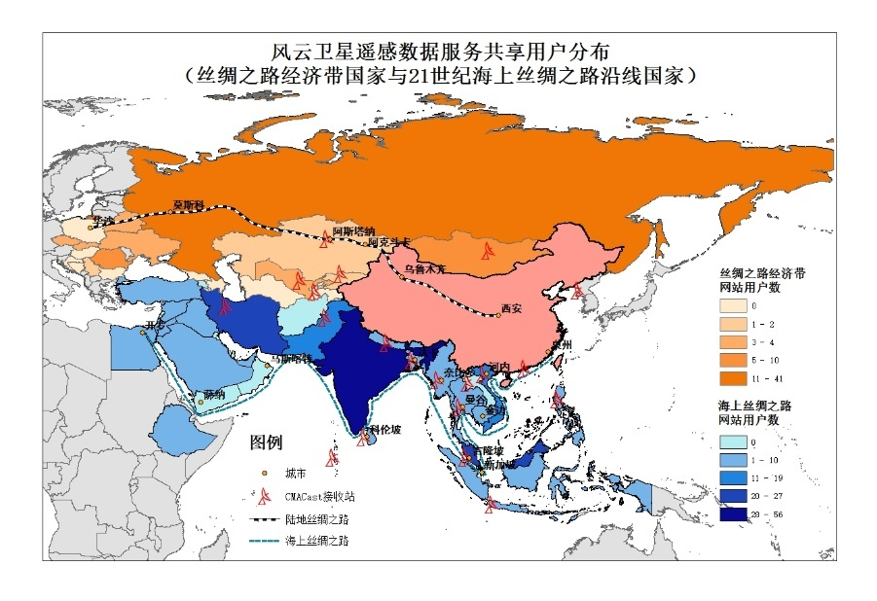
2) Data distribution and services
Fengyun Satellite Data in the Belt and Road countries

Slide 14
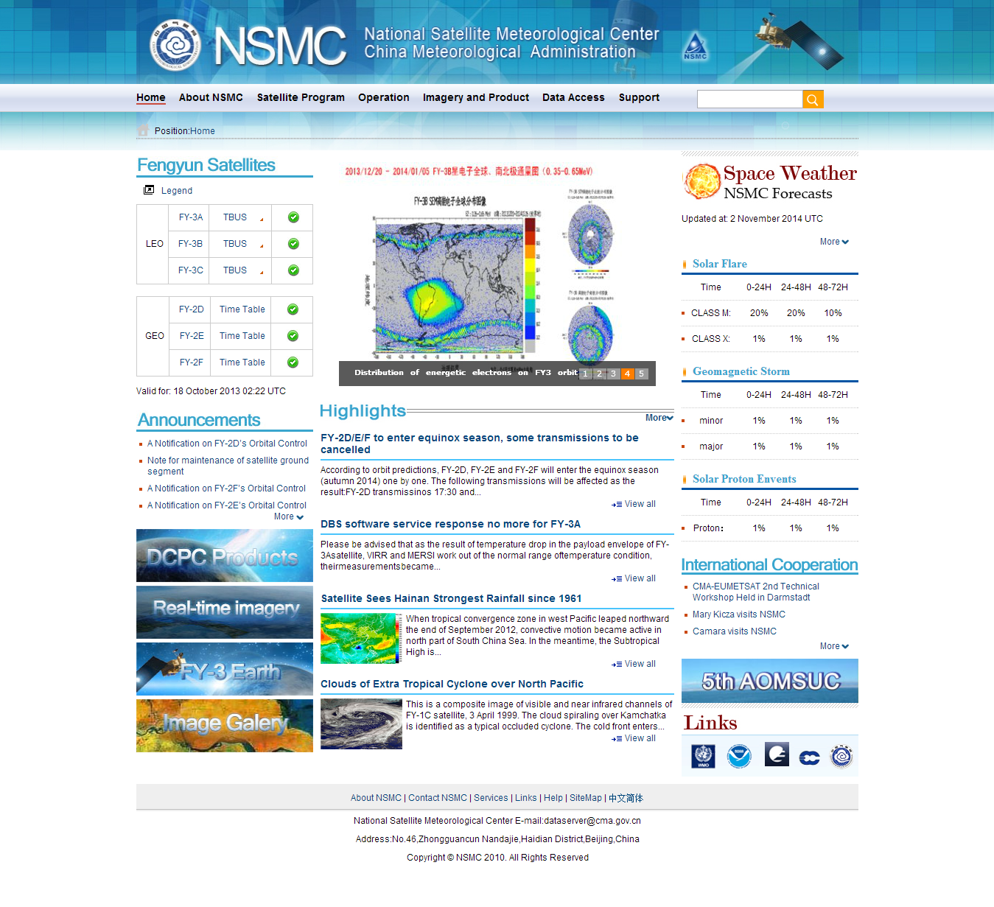
2) Data distribution and services - Website
Non real time users: NSMC Portal
http://www.nsmc.org.cn
FY Satellites’ information
Operational announcement
Space weather information
Cloud images and animation
Data access entrance
News

Slide 15
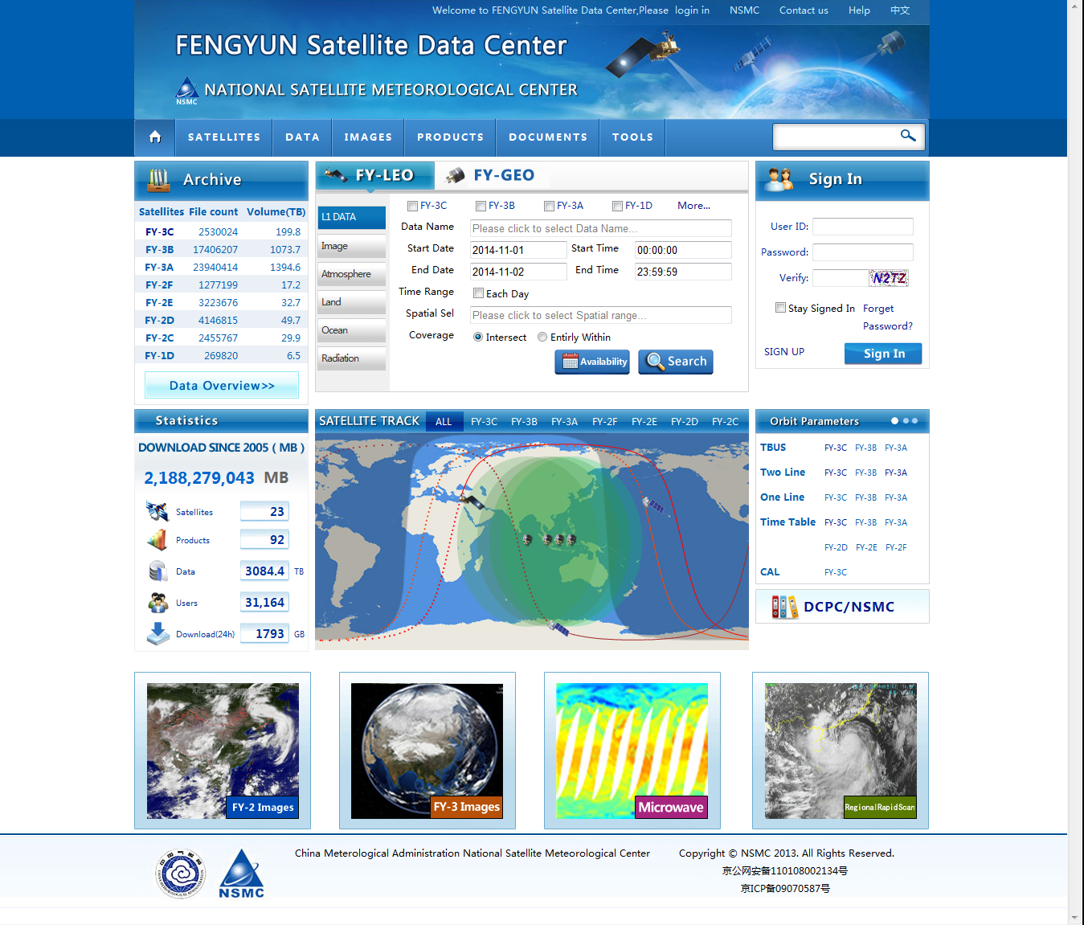
2) Data distribution and services - Website
Data Service Center
http://data.nsmc.org.cn
All archived data (real time)
Satellites’information
Daily globle browse
Documents and tools
User： freely register
Normal 500MB/day
Interest 3GB/day
Strong interest 10GB/day
National Satellite Meteorological Center ,CMA

Slide 16
2) Data distribution and services - Website
FY-3C MERSI daily globle browse

Slide 17
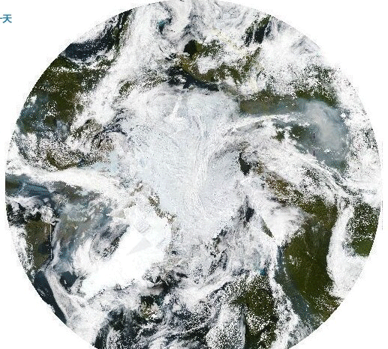
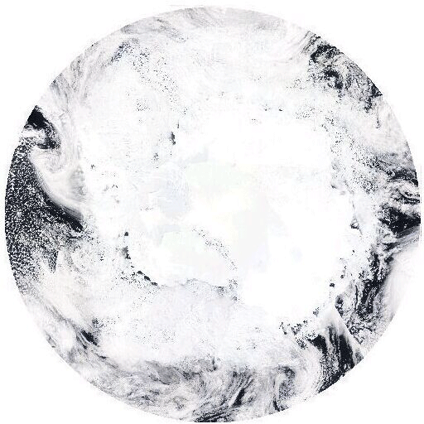
2) Data distribution and services - Website
FY-3C MERSI daily globle browse
North pole
South pole
1st -15th Augst 2014
10th -16th November 2014

Slide 18
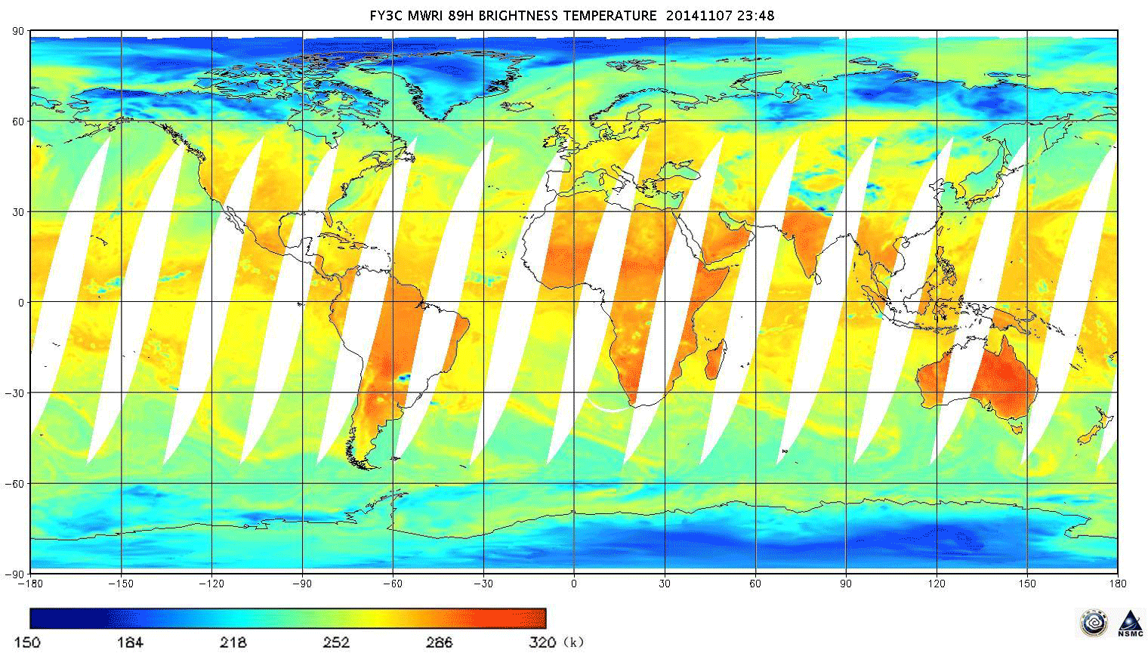
2) Data distribution and services - Website
FY-3C MWRI daily globle browse

Slide 19
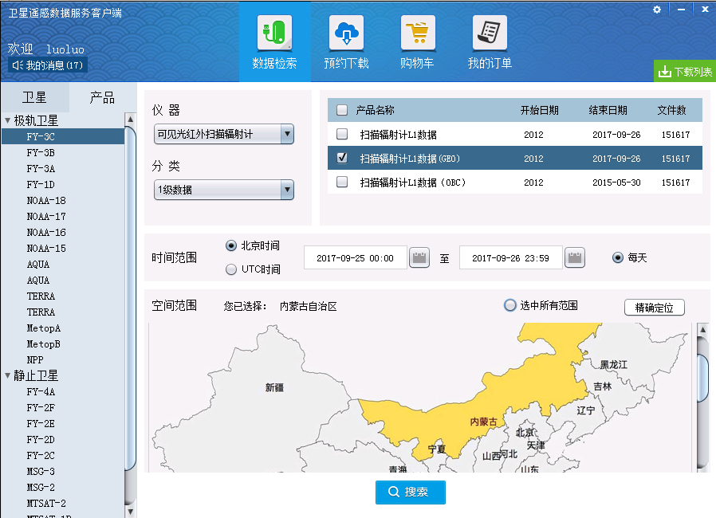
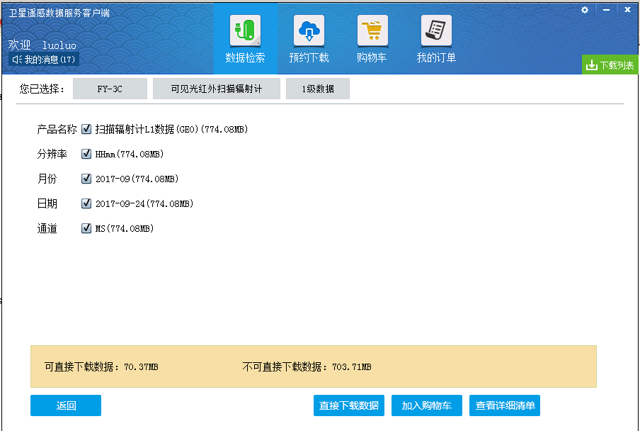
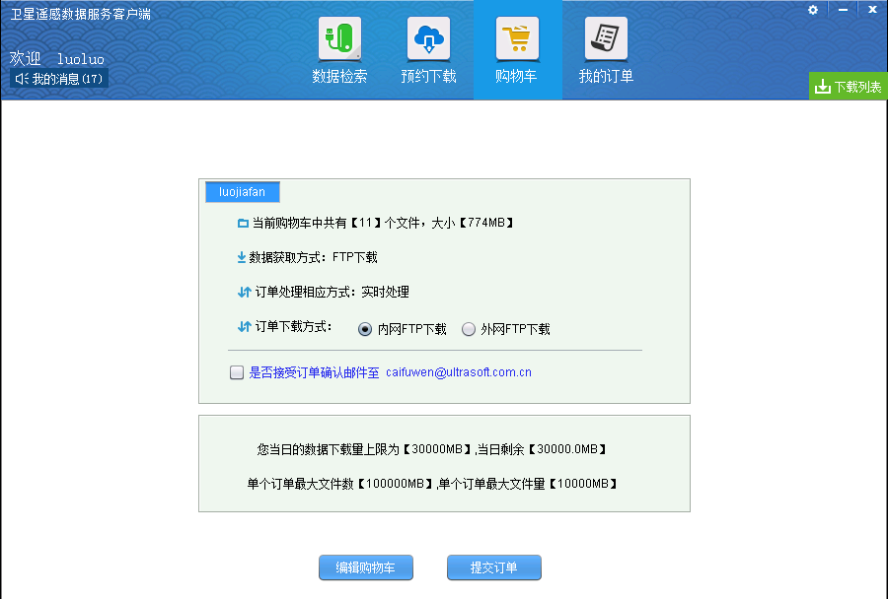
2) Data distribution and services
Data Download Client
Coming Soon……

Slide 20
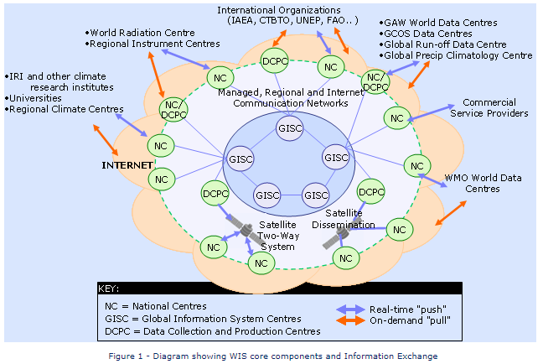
2) Data distribution and services
NSMC became a DCPC approved by WMO in June 2012
National Satellite Meteorological Center ,CMA

Slide 21
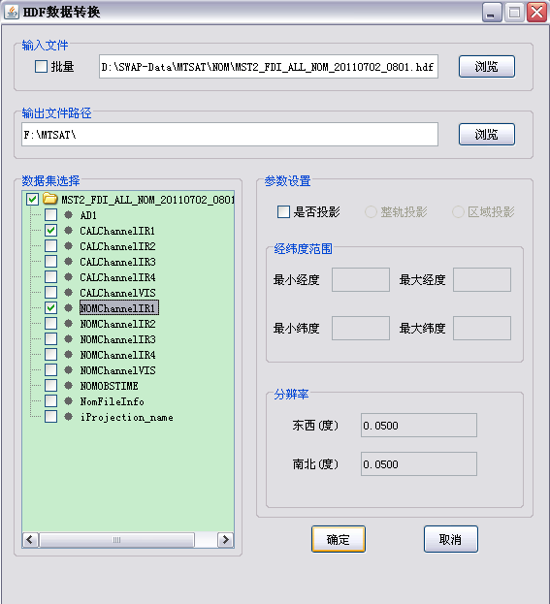
2) Data distribution and services
Softwares and tools
FENGYUN Toolkit v1.0
Support L1 HDF5.0 fromat
Lon-Lat Projection
Output Raw and JPG
Support batch processing
FY-3 Preprocessing software
packages
SMART
SWAP
National Satellite Meteorological Center ,CMA

Slide 22
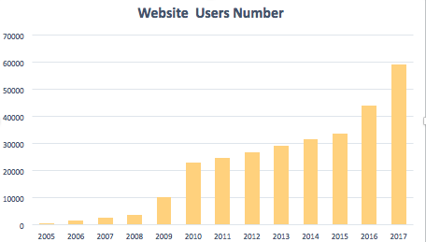
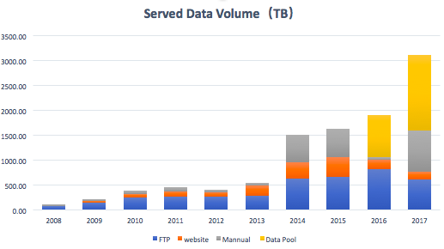
2) Data distribution and services
Search：2.86 Million/y
Download：over 3PB/y
Orders: 60000/y
Website visitor:
0.11 Million Visitors/y
0.19 Million Page Views/y
National Satellite Meteorological Center ,CMA

Slide 23
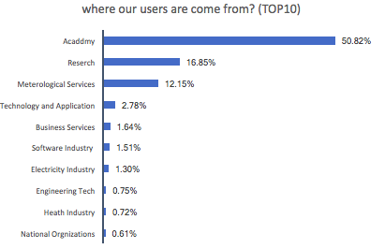
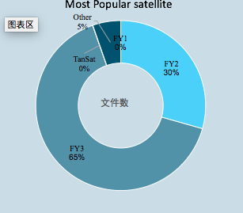
Users Analysis and survey

Slide 24
Outline
Introduction
Data distribution and services
Plan
National Satellite Meteorological Center ,CMA

Slide 25
Database Consolidation Appliance
4) New technology development
Higher efficiency
Cloud computing
Application
Training and services
New IT architecture and idea
High performance computer and storage
Virtualization
Private cloud
Public cloud
New tools
Survey and economic statistics
V-lab
Training course
Mobel devices
……
National Satellite Meteorological Center ,CMA

Slide 26
Summery
Fengyun satellite data are open to all the world.
Applications of data are still under exploring.
Information of Fengyun satellite can be found on website.
http://www.nsmc.org.cn
National Satellite Meteorological Center ,CMA

Slide 27
Thank you for attention
National Satellite Meteorological Center ,CMA

