Slide 1
DOI Overview and its Usage for EUMETSAT GSICS Objects
Peter Miu EUMETSAT
CMA, CNES, EUMETSAT, ISRO, IMD, JMA, KMA, NASA, NIST, NOAA, ROSHYDROMET, USGS, WMO

Slide 2
Overview
Digital Object Identifiers (DOIs)
Usage in the EUMETSAT
GSICS usage
Proposal for the EP

Slide 3
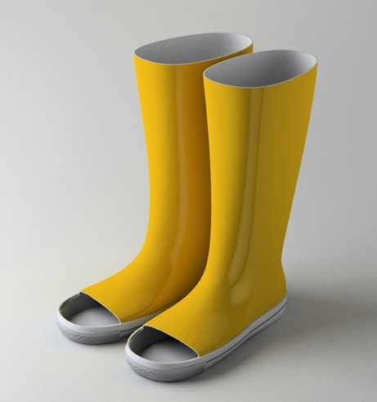
OID – Object Identifiers
Use in EUMETSAT to tag some Meteorological Products
Another method for uniquely identifying objects
User community preference is to use DOIs

Slide 4
Purpose of this Presentation
For information.
For discussion to support partner agencies to implement their own DOIs.

Slide 5
What are DOIs ?
Mechanism to uniquely identify an object.
DOIs have Metadata about the object is persistently stored in association with the identifier in another location such as a web page URL describing the object.
DOIs and their existing objects must be maintained for a minimum agreed period; 10 years.
Stable reference for Citation.
Simplifies the validation of objects used for research, etc.

Slide 6
What a DOI looks like
A DOI Name consists of a Prefix/Suffix.
Prefix is provided by a DOI management agency; this is free under certain conditions.
Suffix is an opaque string specified by the owner of the DOI prefix.
Here is EUMETSAT’s DOI Naming format:
For example, for the GEOLEOIR ATBD, we’ve specified the following DOI:
10.15770/1001.803179
This DOI uniquely identify the ATBD.
GSICS producer implementing a product as specified in the ATBD shall provide this DOI in their product.
A user of this product can cite this DOI in their work and/or papers.
Users of this work and/or paper can validate it by the URL:
http://dx.doi.org/10.15770/1001.803179

Slide 7
EUMETSAT Use of DOIs
DataCite
GSICS ATBD
http://doi.org/10.15770/1001.803179
GSICS RAC Products
http://doi.org/10.15770/1002.RAC-M8-MA-IASI
http://doi.org/10.15770/1002.RAC-M9-MA-IASI
http://doi.org/10.15770/1002.RAC-M10-MA-IASI
No DOIs for NRTC Products (GSICS EP decision)

Slide 8
Collaboration GSICS Usage?
Do other GSICS Producer want to use DOIs for their objects
If so, then
Who support the management of DOIs for GSICS i.e.
Legal aspects; act as the Data Centre managing the assigning and minting of DOIs.
This also include
Legal aspects of using DOIs, GSICS specific DOI name, specification of guidelines for the format of DOIs, where DOI landing pages are to be hosted.
Who operates DOIs for GSICS; coordinate the acquisition of DOI meta-data, coordinate the generation of a web accessible landing page, minting of the DOI, coordinating the maintenance of products with DOIs for the agreed period.
Specify guideline, conventions and standards across the members?

Slide 9
End of Presentation: Thank you for your attention

Slide 10
Managing DOIs
EUMETSAT’s Data Centre Experience:
Find a DOI “Management Agent” who can refer you to the most appropriate DOI member for your region to work with.
Once a DOI member has been found, a contract needs to be signed to agree to work as the member’s Data Centre (DC) for managing DOIs. The main requirements to become a DC:
Digital preservation and access of tagged objects (i.e. CDRs) must be guaranteed for at least 10 years.
Objects have to be worthy of citation and publication => peer review process of papers/research using the objects;
DOI name has to point to an available and maintained landing page containing meta-data information on the object.
Cost associated with becoming a DC:
150 € / year DOI admin fee; no cost for each DOI names; there a limits on the amount.
Resource needed to define the procedure for assigning and minting DOIs; can be manual or automated.
Resource needed to define the procedure for managing DOIs; can be manual or automated.

Slide 11
Minting DOIs (registering)
A DOI Name is composed of a prefix, then a “/” followed by a suffix i.e.
prefix/suffix
The prefix is fixed as this is issued by the DOI member working with the Data Centre. The DOI prefix for the EUMETSAT CDRs is:
10.15770
There are no strict rules for defining how to construct the suffix although it is recommended by the DOI members that this part should be opaque i.e. does not contain ‘metadata like human-readable’ text.
EUMETSAT CDRs do not following this recommendation as the product developers have agreed to clearly promote them as EUMETSAT products. The naming convention used is:
<DOI Prefix>/<OWNER>_<GROUP>_<ENTITY>_<NUMBER>
Example DOI:
10.1234/EUM_SEC_CLM_0005
To mint this DOI, some mandatory meta-data is required to be defined into a XML file and the creation of a landing page containing use.... A

