Slide 1
Proposed best practices for Monitoring Microwave Instruments (A Discussion)
Manik Bali¹ Cheng-Zhi Zou² and Ralph Ferraro²
¹ESSIC/CICS, ²NOAA

Slide 2
Outline
Outline
Introduction
Overarching GSICS Best Practices Approach for Calibration of Satellite Instruments
Algorithms used in producing L1 B measurements in Microwave Instruments
Proposed Pre-Launch Best Practices Matrix
Post-Launch:
Onboard Health Monitoring
Simultaneous Nadir Overpass
Re-Calibration
Post Launch: Best Practice in selecting in-orbit Microwave Reference Record
List of Best Practices Calibration Algorithms and Data sets available
Summary and Discussion

Slide 3
Introduction
In order to ensure that satellite measurements are accurate and measurement uncertainties understood it is important to make measurements traceable to international standards
Recommended process to evaluate and document measurement uncertainties is to follow internationally acceptable standards. This allows uniformity and inter- comparability of Satellite measurements.
Need Best Practices in Pre- Launch
Rec IIFS.8: Develop best practices in pre-flight characterization of MW sensors (Action Mitch Goldberg and Peng Zhang to present to GSICS).
2. Need Best Practices in Post Launch
Best Practices on Algorithms, Data Sets, Reference Records, Transfer Reference Simultaneous Nadir Overpass Algorithms
Challenges
Instruments differ in architectures and calibration mechanisms
Limits to instrument information shared by manufactures.
Our Goal
Agreement on Best Practices would help in bringing Instrument monitoring across agencies onto a single reference scale and also help in anomaly detection and root cause analysis.
We are looking for agreed upon shareable CAL/VAL Processes and algorithms.

Slide 4
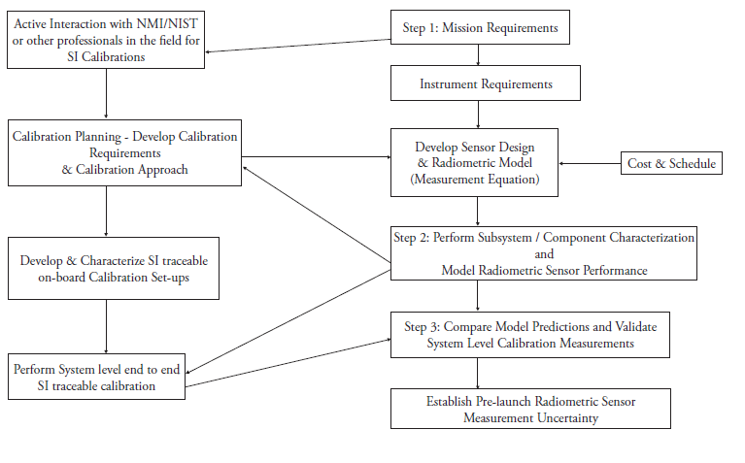
Overarching GSICS Approach for Best Practice for Characterization/Calibration of Satellite Optical Instruments
Determine Mission and Calibration Requirements
Step-2
The component and subsystem characterization and modeling the sensor performance is the
Step-3
Validate System Level Measurements
Step-1
( Datla et al, 2009)
Notes:
The pre-launch characterization and calibration of remote sensing instruments should be planned and carried out in conjunction with their design and development to meet the mission requirements. The onboard calibrators such as blackbodies and the sensors such as spectral radiometers should be characterized and calibrated using SI traceable standards. In the case of earth remote sensing, this allows intercomparison and intercalibration of different sensors in space to create global time series of climate records of high accuracy where some inevitable data gaps can be easily bridged. The recommended best practice guidelines for this pre-launch effort is presented based on experience gained at National Institute of Standards and Technology (NIST), National Aeronautics and Space Administration (NASA) and National Oceanic and Atmospheric Administration (NOAA) programs over the past two decades. The currently available radiometric standards and calibration facilities at NIST serving the remote sensing community are described. Examples of best practice calibrations and intercomparisons to build SI (international System of Units) traceable uncertainty budget in the instrumentation used for preflight satellite sensor calibration and validation are presented.

Slide 5
Pre-Launch Best Practices
Proposed Best Practice Matrix for Pre-Launch Characterization
Detector Characteristics (Freq, Side Lobe, Response)
Non Linearity -> What is your instrument’s non linearity
Antenna Pattern Correction-> How do you correct for antenna
NEdT-> What is your measure of noise .. Can we agree on one standard ?
Internal Calibration Targets are Characterized to SI Standards-> What standards do you follow.
How do you characterize the Space View at Pre-Launch
What is your absolute accuracy estimate and does it meet specs
Proposed Action: Members to share pre-launch Matrix information in the Microwave Subgroup

Slide 6
Post-Launch: Onboard Health Monitoring
Best Practice
Monitoring Array of instrument health parameters needs to be monitored on a daily basis and anomalies on websites such as the ICVS (Integrated Calibration/Validation System Long-Term Monitoring)
https://www.star.nesdis.noaa.gov/icvs/status_NPP_ATMS.php

Slide 7
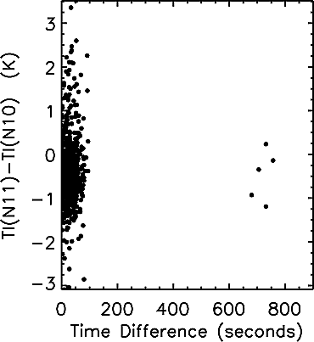
Post-Launch: Simultaneous Nadir Overpass
SNO ( Simultaneous Nadir Overpass) Algorithm identifies locations observed by two instruments under similar viewing conditions.
This algorithm is used to monitor In-orbit Microwave Instruments.
Inter-comparing MW instruments reveals biases anomalies and Trends in instruments.
SNO matchups can accurately determine the differences of the offsets as well as the nonlinear coefficients between satellite pairs, thus providing a strong constraint to link calibration coefficients of different satellites together.
MSU channel 2 brightness temperature differences of the nadir pixels between NOAA 10 and 11 versus time window for the SNO matchups. The maximum spatial distance for the SNOs is set to 111 km. Note that when the time difference is larger than about 100 s, only few SNO data pairs can be found. The brightness temperature is computed from the linear calibration algorithm equation (9).( Zou et al 2006)
e.g for Oxygen bands Best Practice for SNO
Measurements within 111 Km spatial distance
Measurements taken within a 100 Seconds of each other
Measurements taken within 1 degree of Scan Angle Difference
(Zou et al. 2006).
SNO Code from Cheng-Zhi Zou can be shared in the MW Subgroup
Proposed Action
Should we have an exercise across MW group to propose best practices may vary with window, Oxygen and Water Vapor bands

Slide 8
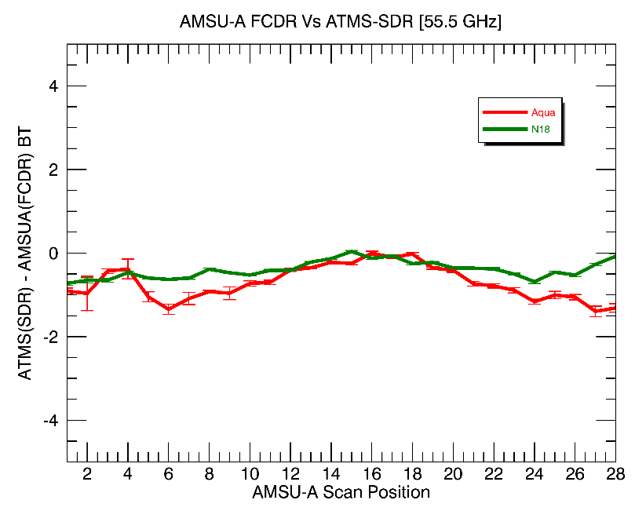
Post Launch: Best Practice in selecting in-orbit Microwave Reference Record
AMSU/MSU
FCDR
AMSR (2/E)
JAXA
SSMI
DOD
GMI
NASA
ATMS
NASA
MTVZA
ROSCOSMOS/Ukraine
MWTS-2
China
FCDR Vs ATMS interc-omparision reveals full scale of scan angle bias in ATMS. Bias is low
Best Practice for a L1B record to be used as a reference
Record to be many times over more stable than monitored instrument
Inter-satellite Biases of reference records to be better than 0.1-0.2K
Reference record to resemble a typical orbit file
Reference Record to be able to provide measurements at all scan angles
MSU/AMSU-A FCDR channels overlap with majority of MW instrument channels and has been shown to act as a an effective in-orbit reference for Microwave Instruments
Source: https://www.wmo-sat.info/oscar/instruments

Slide 9
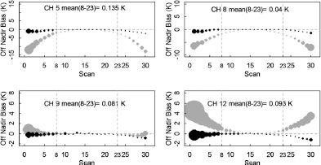
Post Launch: Best Practice in-orbit Microwave Reference Record
AMSU-A onboard six POES satellites were inter-calibrated using Integrated Microwave Inter-Calibration Approach (IMICA)
5 calibration errors were removed/minimized: nonlinearity, bias drift, frequency shift, sun-heating induced temperature variability in radiances;
Inter-satellite Biases were reduced to 0.1-0.2K
19 years of swath data
Dataset available from NCEI CDR website
AMSU-A/MSU FCDR continuously monitored in Real time
Scan Angle Dependence has been corrected
Validated with GPSRO and instruments monitored at ICVS
Typical data file resembles a native L1B data file

Slide 10
Post-Launch: Recalibration
Post-Launch: Best Practices in Recalibration
Instrument Monitoring that helps in Anomaly Detection( e.g Bias and Trends)
Understanding Root Cause of Anomaly
Update Calibration Coefficients ( e.g remove/minimize: nonlinearity, bias drift, frequency shift, sun-heating induced temperature variability in radiances; ) to permanently remove anomalies

Slide 11
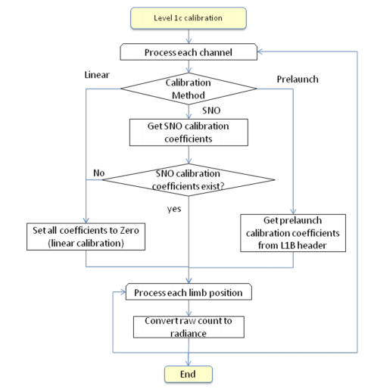
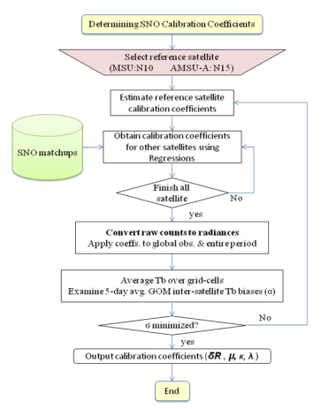
Post-Launch: Best Practices in Recalibration
Flowchart of the MSU/AMSU-A level-1c calibration.
Sequential procedure for determining MSU/AMSU-A calibration coefficients.
Flowcharts from AMSU/FCU FCDR ATBD ( Zou et al 2006) show the two main steps of Re-Calibration that can be Best Practices for Re-Calibration

Slide 12
List of Best Practices Algorithms and Data sets available on request
Simultaneous Nadir Overpass
Threshold Values for SNO
Re-Calibration and Climate Data Record Generation
Onboard Health parameters ATMS via the ICVS
In-Orbit References for AMSU/MSU Channels for 183 GHz
Framework of Re-Calibration
Lunar Reference light curves
Best Practices for GPSRO, RTM and GRUAN Sites ( Your views needed)
White paper on GPSRO-Microwave Sounder and GRUAN-MW CDR comparison is available for the community to follow

Slide 13
Summary
The GSICS Microwave Subgroup has moved ahead in identifying algorithms that it can share with the Microwave Community and can be treated as community best Practices.
The Algorithms are related to
Pre-Launch Calibration
Post Launch Calibration
In-Orbit Reference Selection
Re-Calibration
Lunar Data Sets in MW wavelength ?
We invite you to use these and contribute to sharing.
A Wiki Workspace Page has also been established for Data Sharing (http://gsics.atmos.umd.edu/bin/view/Development/MicrowaveSubGroup)

Slide 14
Thank You

Slide 15
Algorithms used in producing L1B measurements in Microwave Instruments
This is the way Frank Wenzt does it….not sure we want to use this
Broad Similarity between algorithms used in producing L1B measurements across various MW instrument architectures.
Ref: Irwin Alber and Jodha Khalsa http://qa4eo.org/docs/workshop_washington08/08May08/Alber_Implementation_08May08.pdf

Slide 16
Best Practice for Characterization/Calibration of Satellite Optical Instruments GSICS Approach
Pre-launch Preparation for Post-Launch Sensor Performance Assessments
Preparation for post launch assessments of measurements and uncertainties is part of the best practice that is to be simultaneously undertaken during pre-launch preparations. A real important aspect of pre-launch testing is determining how to prove instrument stability under on-orbit conditions
Plan for component performance reassessments
One of the lessons learned at NIST is that some of the sensor data problems on orbit could not be isolated fully because no duplicates or even samples of components were available for reexamination. Duplicates of filters, apertures, mirror samples, diffusers etc. are very valuable to have for reexamination at the metrology laboratories where high accuracy data can be obtained simulating the space environment and conditions of on-orbit operation to sort out data discrepancies.
Post-launch and pre-launch validation and SI traceability
Comparison of the modeled sensor spectral responsivity predicted from component-level characterization with the system-level end-to-end testing to establish pre-launch radiometric sensor measurement uncertainty is the last step of the best practice.

Slide 17
Specific Needs of Microwave Subgroup [Best Practices]
Real time use and/or climate use?
To understand need of Microwave Subgroup a survey was launched
Latency vs. precision?
Different spectrum has different use and requirements
Potential application areas

Slide 18
Expectation from a reference instrument

Slide 19
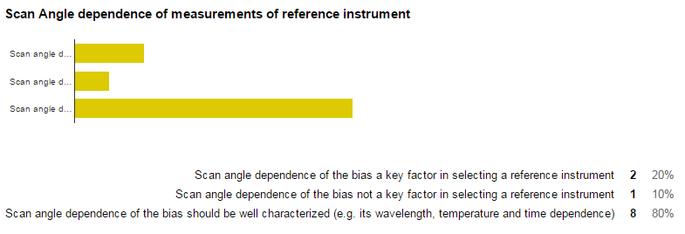
Expectation from a reference instrument
-> Split verdict

Slide 20
GSICS MW Products

Slide 21
Survey Results
GSICS MW Products
Window Channels
Average ~ 0.4 K
O₂ Channels
Average ~ 0.3 K
H₂O Channels
Average ~ 0.4 K

Slide 22
Post Launch Testing – Lessons Learned – Legacy Sensors
Moderate Resolution Imaging Spectroradiometer (MODIS)
Suomi National Polar-orbiting Partnership (SNPP) - Visible Infrared Imaging Radiometer suite (VIIRS)
Geostationary Operational Environmental Satellite (GOES) series
Global Space-based Inter-Calibration System(GSICS)

Slide 23
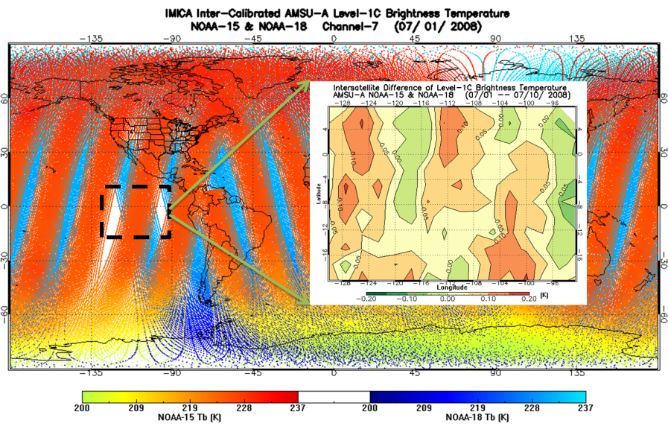
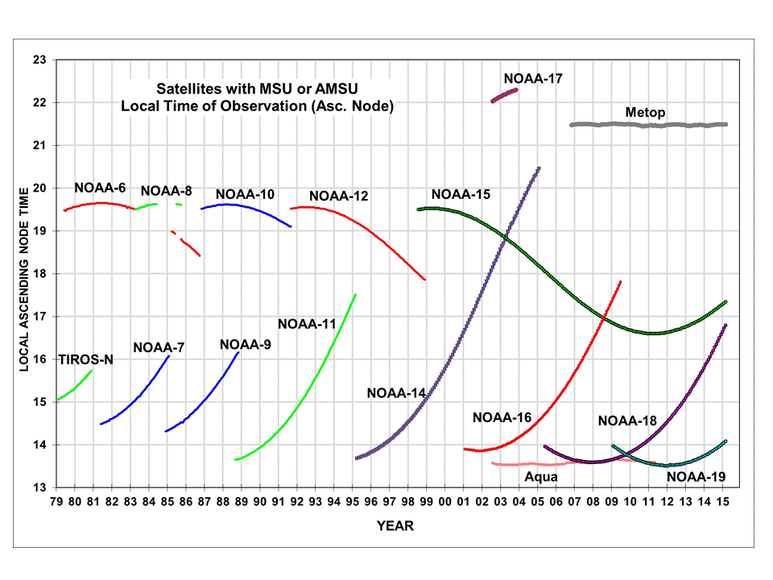
AMSU-A FCDR as a Reference for Cross-Calibration
Proposed In-Orbit Reference
AMSU-A onboard six POES satellites were inter-calibrated using Integrated Microwave Inter-Calibration Approach (IMICA)
5 calibration errors were removed/minimized: nonlinearity, bias drift, frequency shift, sun-heating induced temperature variability in radiances;
Inter-satellite Biases were reduced to 0.1-0.2K
19 years of swath data
Dataset available from NCEI CDR website
AMSU-A brightness temperature s for overlapping NOAA-15 and
NOAA-18. Their differences for randomly selected region
(e.g., within the dashed square ) are within 0.1-0.2K.
Series of MSU/AMSU-A provide a long term reference records spanning over a large range of time and full span of scan angles.

Slide 24
Post Launch MW Instrument Monitoring
Post launch MW instrument needs to be done by inter-comparing with records that are several time more stable than the target/monitored instrument.
MW sounder 1. Sensor performance stability 2. Field of view (FOV) consistency (ATMS has oversampling FOV and can be B-G to AMSU-A and MSU) 3. Error budgets (prelaunch characterization and postlaunch verification) 4. Geolocation accuracy 5. Data availability
References: AMSU/MSU FCDR

Slide 25
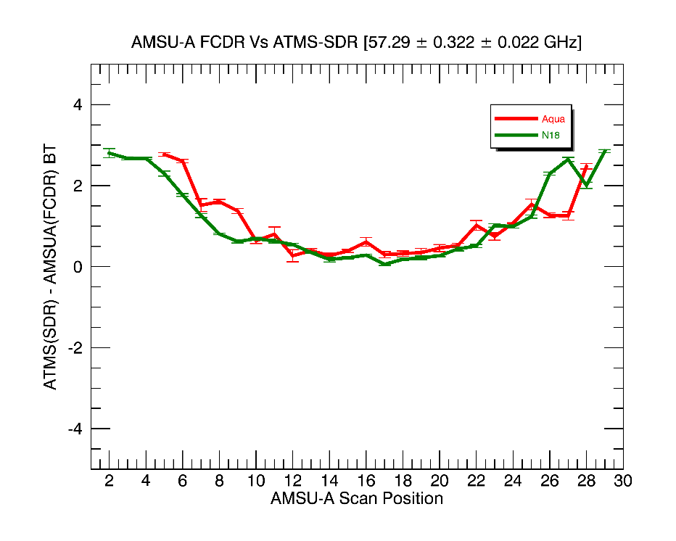

Slide 26
Summary
GSICS MW Products -Summary
Mapping time series of similar sensors but from vastly different heritage (e.g., SSMT2 to AMSU-B) together is of low priority
More precise, longer latency correction are preferred
It does appear most users would look at time series for global trends (most likely the O₂ & H₂O bands) and use to derive geophysical parameters (most likely window & H₂O bands)
The average desired accuracy of the corrections was on the order of 0.4 K (slightly less for the O₂ bands)

Slide 27
Proposed- Process to identify GSICS reference Instrument
GSICS Subgroups are the center of GSICS Cross Calibration Research and product generation.
The instrument and Channels agency wishes to monitor.
The method/s they would employ to monitor( eg. single or blended references, use transfer target , stability criterion).
May consider scoring proposed by Hewison and Reference Expectations gathered by GSICS Survey ( stated next slidse)
Demonstrated use of the instrument by member agencies and users for instrument monitoring.
Comparison of Instrument design specification ( Pre-launch testing) with In-orbit behavior.
May consider if in-orbit status of key parameters of Candidate Ref instrument are monitored and available to users ( such as . ICVS).
7. Take Info ( global coverage, eq. cross time etc) related to instrument available ( eg OSCAR) Phone: +1 301-683-3550
Process of Selection to be carried out within sub group.

Slide 28
Application of Process- Example-1
Selection Process Reference for MW
Identify a instrument and channels one wishes to monitor.
Pre-launch characterization Vs Post launch behaviour reports
Identify the method to monitor
If in-orbit status of key parameters of Candidate Ref instrument are monitored , are within specs and available to users ( via websites such as ICVS)
Consider usage of instruments for similar applications by agencies
OSCAR provides limited but critical information on instruments. (spectral, temporal and geographical coverage)
Detailed information is obtained via ATBD
Consider demonstrated use of the instrument by other agencies

Slide 29
What are we looking for in a Reference Instruments
IR sounder 1. Sensor performance stability 2. Spectral coverage/Spectral resolution 3. Error budgets (prelaunch characterization and post-launch verification) 4. Geo-location accuracy 5. Data availability
References: CrIS, AIRS IASI A/B/C can be GSICS References ( No Primary or Secondary)
References: CrIS, AIRS IASI A/B/C can be GSICS References ( No Primary or Secondary)
Hyper-spectral radiances spanning wide spectrum not available in MW
MW sounder 1. Sensor performance stability 2. Field of view (FOV) consistency (ATMS has oversampling FOV and can be B-G to AMSU-A and MSU) 3. Error budgets (prelaunch characterization and postlaunch verification) 4. Geolocation accuracy 5. Data availability
References: ATMS SDR/TDR, FCDR

Slide 30
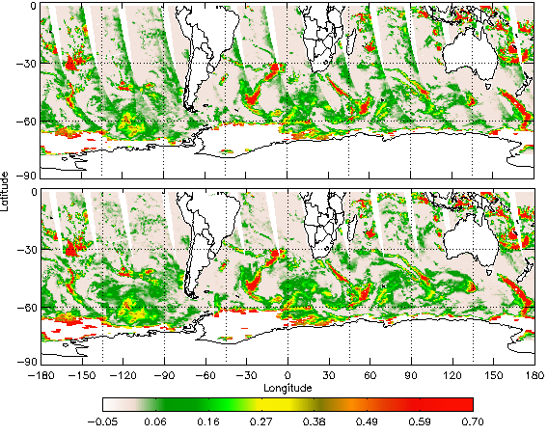
AMSU-A FCDR of Window Channels
Proposed In-Orbit Reference
AMSU-A onboard six POES satellites were inter-calibrated using Integrated Microwave Inter-Calibration Approach (IMICA) for window channels, same as sounding channels
Scan bias, nonlinearity and bias drift errors were removed/minimized;
Inter-satellite standard deviation improved by 50%, comparing to 1b data sets;
Swath data from 1998 to present
Dataset available from NCEI CDR website
As accompaniments to AMSU-A FCDR of sounding channels, the window channels cover channels 1, 2, 3 and 15 (23.8, 31.4, 50.3 and 89.0 GHz), which are widely used in many other sensors, such as SSMI, SSMIS, ATMS, GMI and etc. These channels are mainly for the input to hydrological products, and land surface products.

Slide 31
Search for a MW Reference
AMSU-A/MSU FCDR continuously monitored in Real time
Scan Angle Dependence has been corrected
Validated with GPSRO and instruments monitored at ICVS

Slide 32
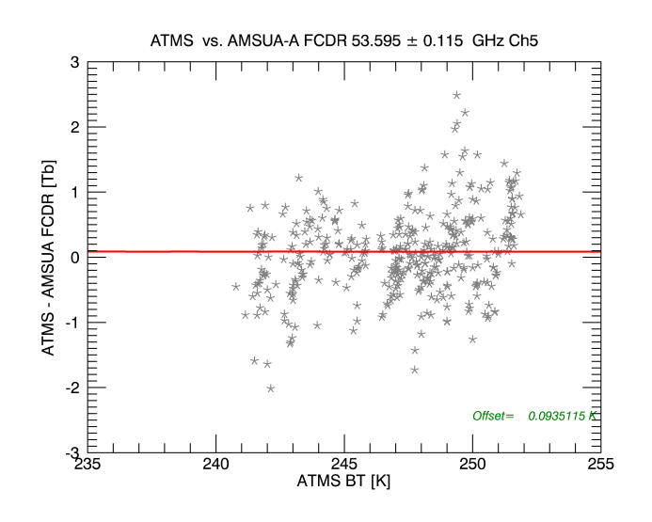
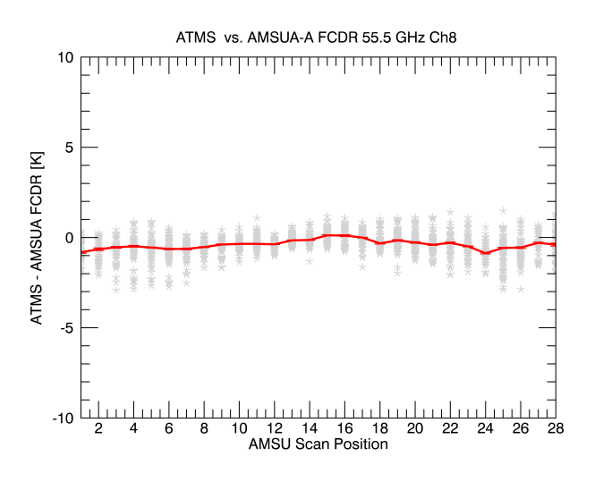
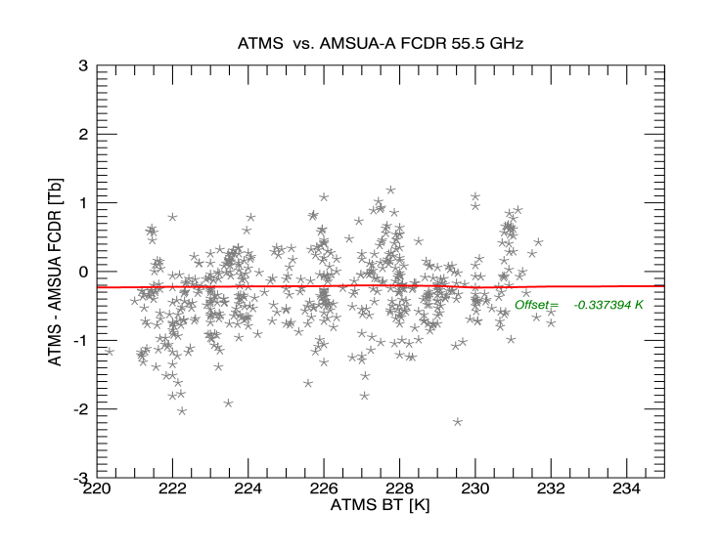
Monitoring ATMS-SDR by SNO inter- comparison with N18
Inter- comparison of ATMS-SDR with FCDR show
Low scan angle dependence of ATMS-SDR
Post launch ATMS-SDR maintains nearly pre-launch level of accuracy.

Slide 33
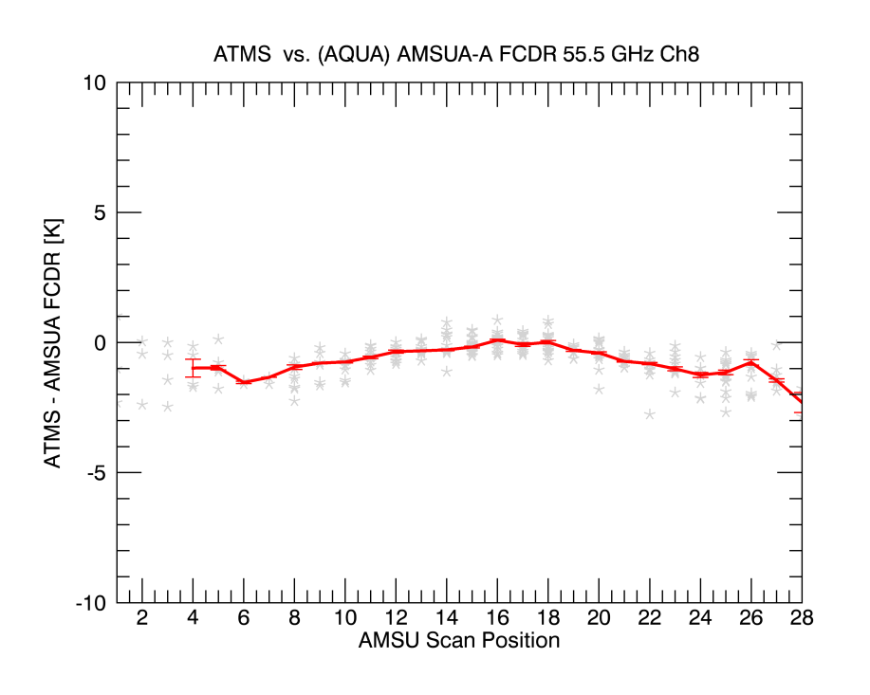
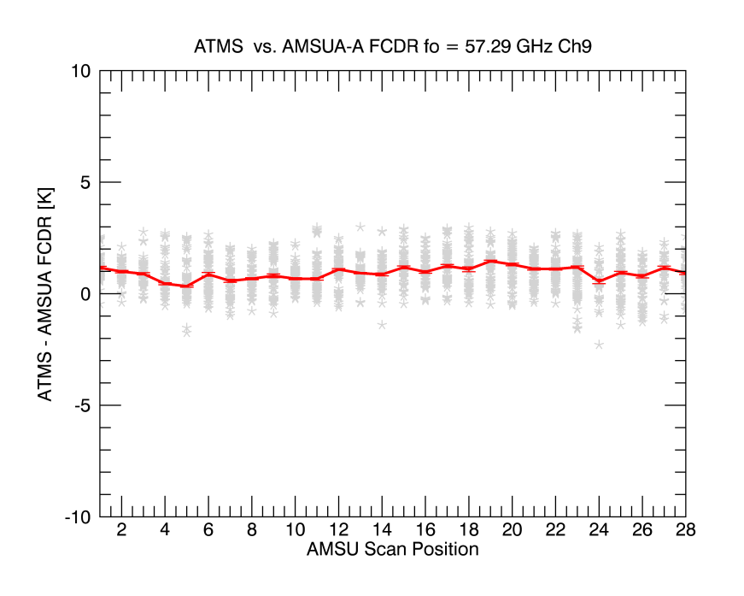
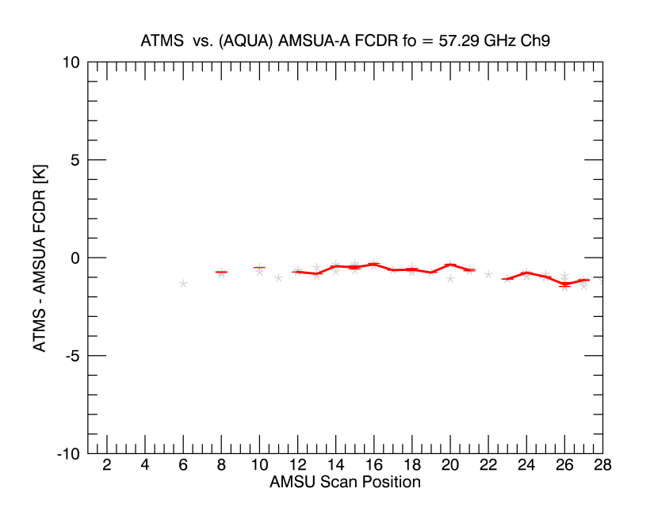
Monitoring ATMS-SDR by SNO inter- comparison with FCDR Aqua
FCDR extremely consistent as a reference → Compared to N18, Inter- comparison with AQUA-AMSU FCDR gives similar results

Slide 34
NOAA-18

