Slide 1
GRWG Microwave Sub-Group Briefing
Ralph Ferraro (and entire MW Subgroup)
NOAA/NESDIS

Slide 2
Outline
Scope of MW Subgroup
Membership
Focus for past/upcoming year
Status of Action Items
Quarterly Meetings/Highlights
MW Parallel Sessions – 2017 & 2018
Summary of Accomplishments & Ongoing Endeavors

Slide 3
Scope of Microwave
Sub-Group
Understanding the users’ requirements for inter-calibration products for microwave instruments
  Imagers + sounders – passive only (initially, but eventually consider active if there is a need…)
  Retrospective calibration (CDR’s and their components like geolocation, scan biases, inter-satellite)
  Forward looking calibration (near-real time uses)
Identifying existing products that could meet those requirements, but first….
  Need to define criteria…Reference standards (sensor(s), models, calibration methodologies….)
  And then a process that adheres to GSICS principles
We should also focus on tools/algorithms like SNO, Double Difference, RTM, etc.
  Might be something more feasible in near term?
Define data standards (jointly with GDWG)
Encourage the creators of those products to submit them to the GSICS Procedure for Product Acceptance (GPPA), once its defined for MW
  Candidates include Cheng-Zhi Zou (MSU-AMSU), Karsten Fennig (SSMI), GPM X-Cal LUT’s
Coordination with other groups (e.g., CEOS WGCV MW, GPM X-Cal) would also be required to generate standards and best practices

Slide 4
Members
Signed up as of January 2018
Over 50 members!
NOAA (and affiliates) - Ralph Ferraro (Chair), Huan Meng, Cheng-Zhi Zou, Tony Reale, Mark Liu, Manik Bali (Univ. Maryland), Isaac Moradi (Univ. Maryland), Hu (“Tiger) Yang (Univ. Maryland), Wenze Yang (Univ. Maryland), Johnny Luo (City College New York), Xailei Zou (Univ. Maryland), Lin Lin (Univ. Maryland), John Yang (Univ. Maryland)
EUMETSAT (and affiliates) – Tim Hewison, Karsten Fennig, Viju John, Jörg Ackermann, Sabatino DiMichele, Sante Laviola, Vinia Mattoli, Sreerekha Thonipparambil, Christophe Accadia, Martin Burgdorf (Hamburg Univ.), Imke Hans (Hamburg), Ralf Bennartz (Vanderbilt Univ.)
NASA (and affiliates) – Ed Kim (GSFC), Tanvir Islam (JPL), Linwood Jones (Univ. of Central Florida), Rachael Kroodsma (Univ. of Maryland), Wes Berg (Colorado State Univ.), Thomas Holmes (GSFC)
NIST – Derek Houtz, David Walker, Dazhen Gu
ECMWF – Steve English, Heather Lawrence
CMA (and affiliates) – Songyan Gu, Qifeng Lu, Lin Chen, Hu Yang, Xiaolong Dong, Shengli Wu, Xiuqing Hu
KMA (and affiliates) – Jun Park, Dong-Bin Shin (Yonsei University, South Korea), Dohyeong Kim, Minju Gu
JAXA (and affiliates) - Misako Kachi, Takashi Maeda
IISC – Ram Ratan

Slide 5
Focus Topics for 2017-2018
Defining CLEAR PATH for GSICS MW products and algorithms
  Methodologies (Jun Park, Rachel Kroodsma)
    SNO, Double difference, etc.
  Reference Standards (Manik Bali, Isaac Moradi, Derek Houtz)
    A particular sensor? Likely to be wavelength dependent (e.g., window, O₂, H₂0); A RTM?
  LUT/Correction Tables (Karsten Fennig, Cheng-Zhi Zou, Viju John)
    Near real-time and climate; they will be different
Tying together other groups/opportunities
  GPM X-Cal (Wes Berg, Rachel Kroodsma)
  CEOS MW subgroup (Cheng-Zhi, Xiaolong Dong)
  Expanding active participation (Manik Bali, Ralph Ferraro)
  GRUAN (Tony Reale, Cheng-Zhi Zou)
  FIDUCEO (Martin Burgdorf)
  GAIA-CLIM (Heather Lawrence/Steve English)
Continued participation by subgroup at meetings of relevance:
  GSICS; CEOS;CALCON, Microrad, AMS Sat. Met, EUMESAT Satellite, etc.

Slide 6
Action Items
Details in backup slides in presented Thurs MW session
Action Id | Item | Summary | Lead | What to Do | Expected Completion | Actual Completion | Deliverable Usage | Status
A.GMW.2017.6b.1 | ATMS on JPSS-1 | Priovide an update on the status after launch (currently Sept 2017) | Ed Kim | Information | 2017-12-01 | 2018-01-12 | Information | CLOSED
A.GMW.2017.6c.1 | Microwave imager CDR | Determine feasibility of extracting the inter-calibration algorithms and coefficients from the FCDR and making them a GSICS product. | Karsten Fennig | Analysis | 2018-03-01 | 2018-03-01 |  | CLOSED (see A.GMW.20170725.2)
A.GMW.2017.6d.1 | Microwave sounder CDR | Determine feasibility of extracting the inter-calibration algorithms and coefficients from the FCDR and making them a GSICS product. | Cheng-Zhi Zou | Analysis | 2018-03-01 | 2018-03-01 |  | CLOSED (see A.GMW.20170725.2)
A.GMW.2017.6f.1 | MW Sensor inventory | MW Subgroup chair to develop candidate satellite/sensor (inventory), perhaps in the form of a graphical aid, as in orbit references for specific channels (based on some predetermined set of parameters that Manik has outlined...) and note pros and cons, other attributes (publications, etc.)? It should include timelines of sensors and overlap periods. | Jun Park | Information | 2018-03-01 | 2018-03-01 | Information | CLOSED
A.GMW.2017.6f.2 | GRUAN Study | Tony Reale (NOAA) to provide a draft uncertainty analysis describing the comparison of example (microwave) instruments to GRUAN sondes. | Tony Reale | Analysis | 2018-03-01 |  |  | Open
A.GMW.2017.6g.1 | MW RTM comparison | MW co-chair to develop set of specific tasks to be performed by the Subgroup to intercompare RTM output over static references and surface models. Tasks to be identified within 6 months (Sep. 2017). | Isaac Moradi | Information | 2018-08-01 |  |  | Open
A.GMW.2017.5g.1 | MW Naming Convention/Metadata | MW subgroup would contact NOAA GDWG to get support for product creation if needed. | Ralph Ferraro | Tech Support | 2018-03-01 |  |  | Open
R.GMW.2017.6a.1 | MW Lunar Calibration | Get an update from Martin in approx. 6 months. | Martin Burgdorf | Information | 2017-09-30 | 2017-10-12 | Information | CLOSED
R.GMW.2017.6e.1 | NIST calibration reference | Get an update from Derek in approx. 6 months. | Derek Houtz | Information | 2017-09-30 | 2018-01-12 | Information | CLOSED
[EP-18.02] GRWG to assess the utilization RO for microwave instrument monitoring purposes
We have held several meetings and developed a white paper to close out this action
This will be a specific topic at the Thurs/MW subgroup meeting

Slide 7
Recent Meetings of Microwave Sub-Group
Mostly web meetings
  Max 2.5hr; try to hold in the 1100 – 1400 UTC timeframe
  Materials and minutes always posted on Wiki
22 June 2017
12 October 2017
12 January 2018
Some side-bar meetings:
  GSICS/CDR Products and best practices
  GRUAN
  GPSRO
  Sensor database/OSCAR

Slide 8
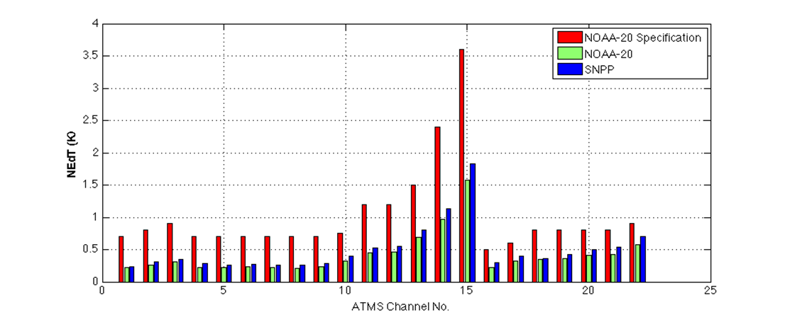
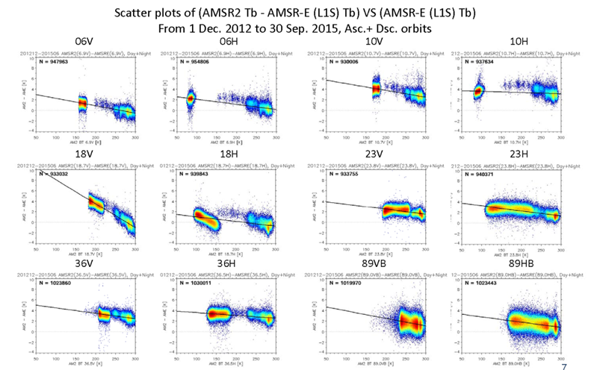
Meeting Highlights (1/3)
Mark Liu/Ed Kim, 12 Jan 2018
Misako Kachi/Takashi Maeda, 12 Oct 2017
NOAA-20 ATMS On-Orbit NEΔT Status
AMSR-2 Cross Calibration V2

Slide 9
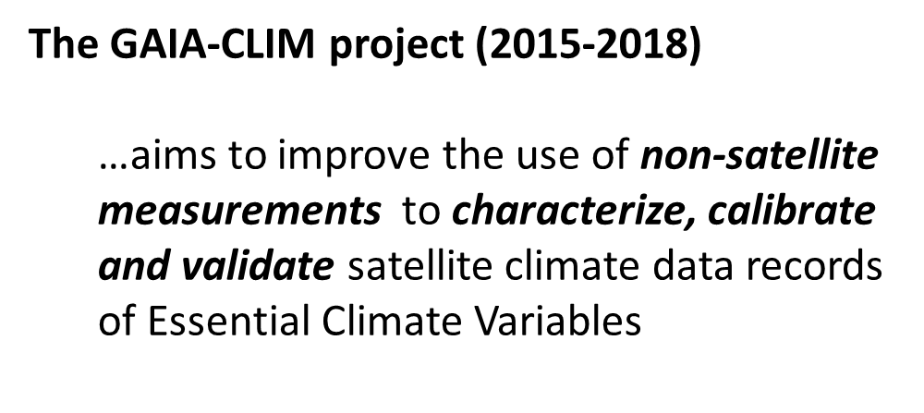
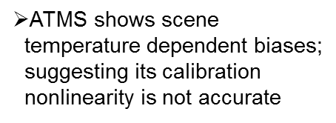
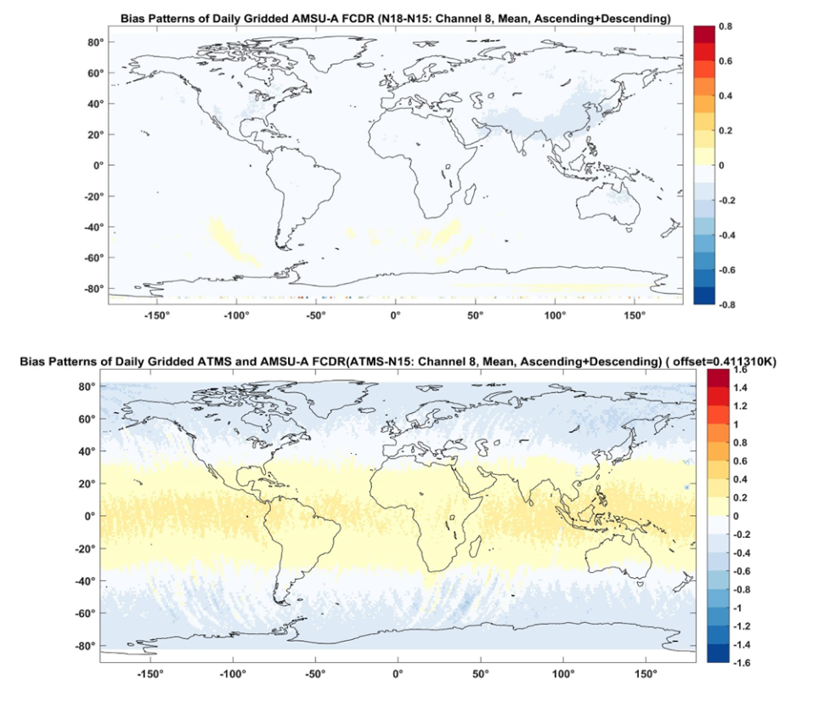
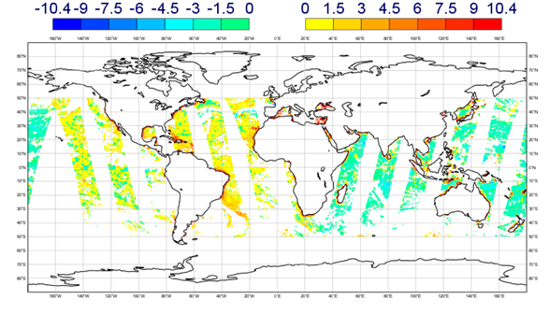
Meeting Highlights (2/3)
Cheng-Zhi Zou/Manik Bali, 12 Jan 2018
Heather Lawrence/Steve English, 22 Jun 2017
Use of MSU/AMSU CDR as Calibration Reference
ECMWF O – B minus global average – 10 H GHz

Slide 10
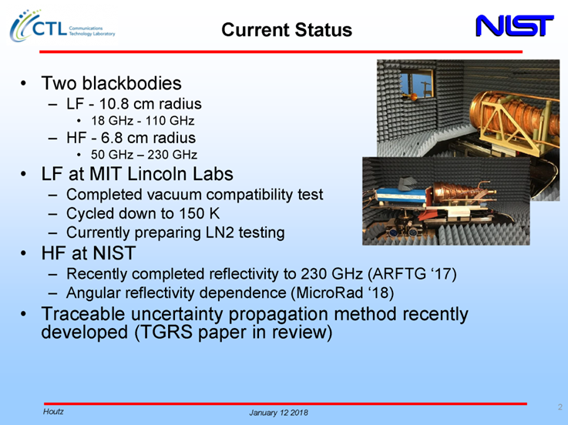
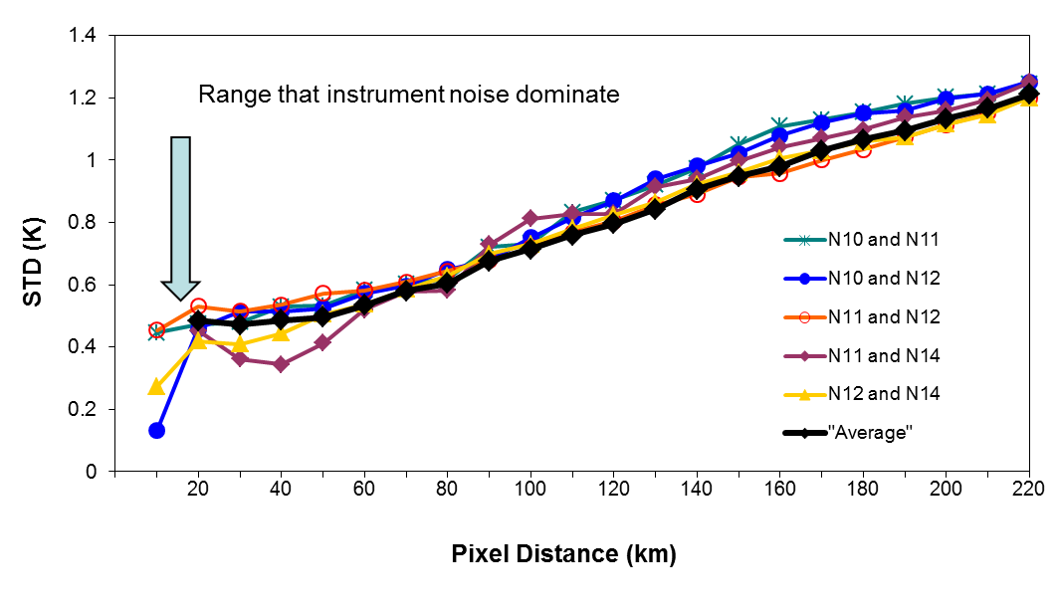
Meeting Highlights (3/3)
Derek Houtz, 12 Jan 2018
Tony Reale, 12 Oct 2017
NIST MW Calibration Reference for ATMS (JPSS-2)
Instrument noises can be used to determine the distance criteria when collecting collocated datasets between GRUAN and MW Sensors
Minimum STD = √2 *0.3K=0.42K
Maximum distance for collocated datasets ~40Km

Slide 11
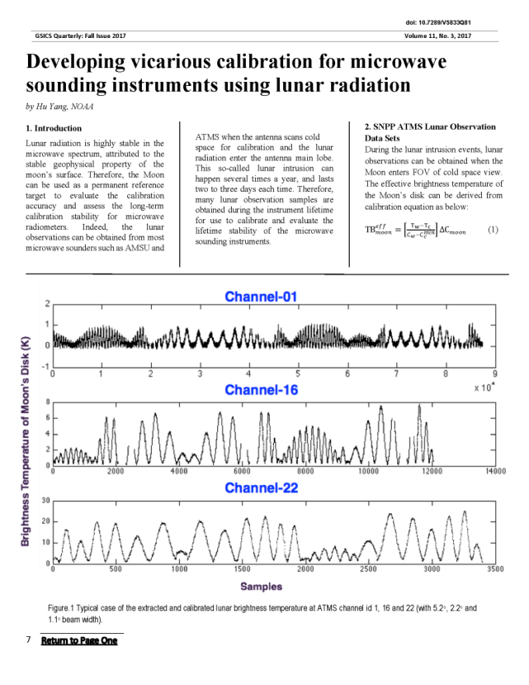
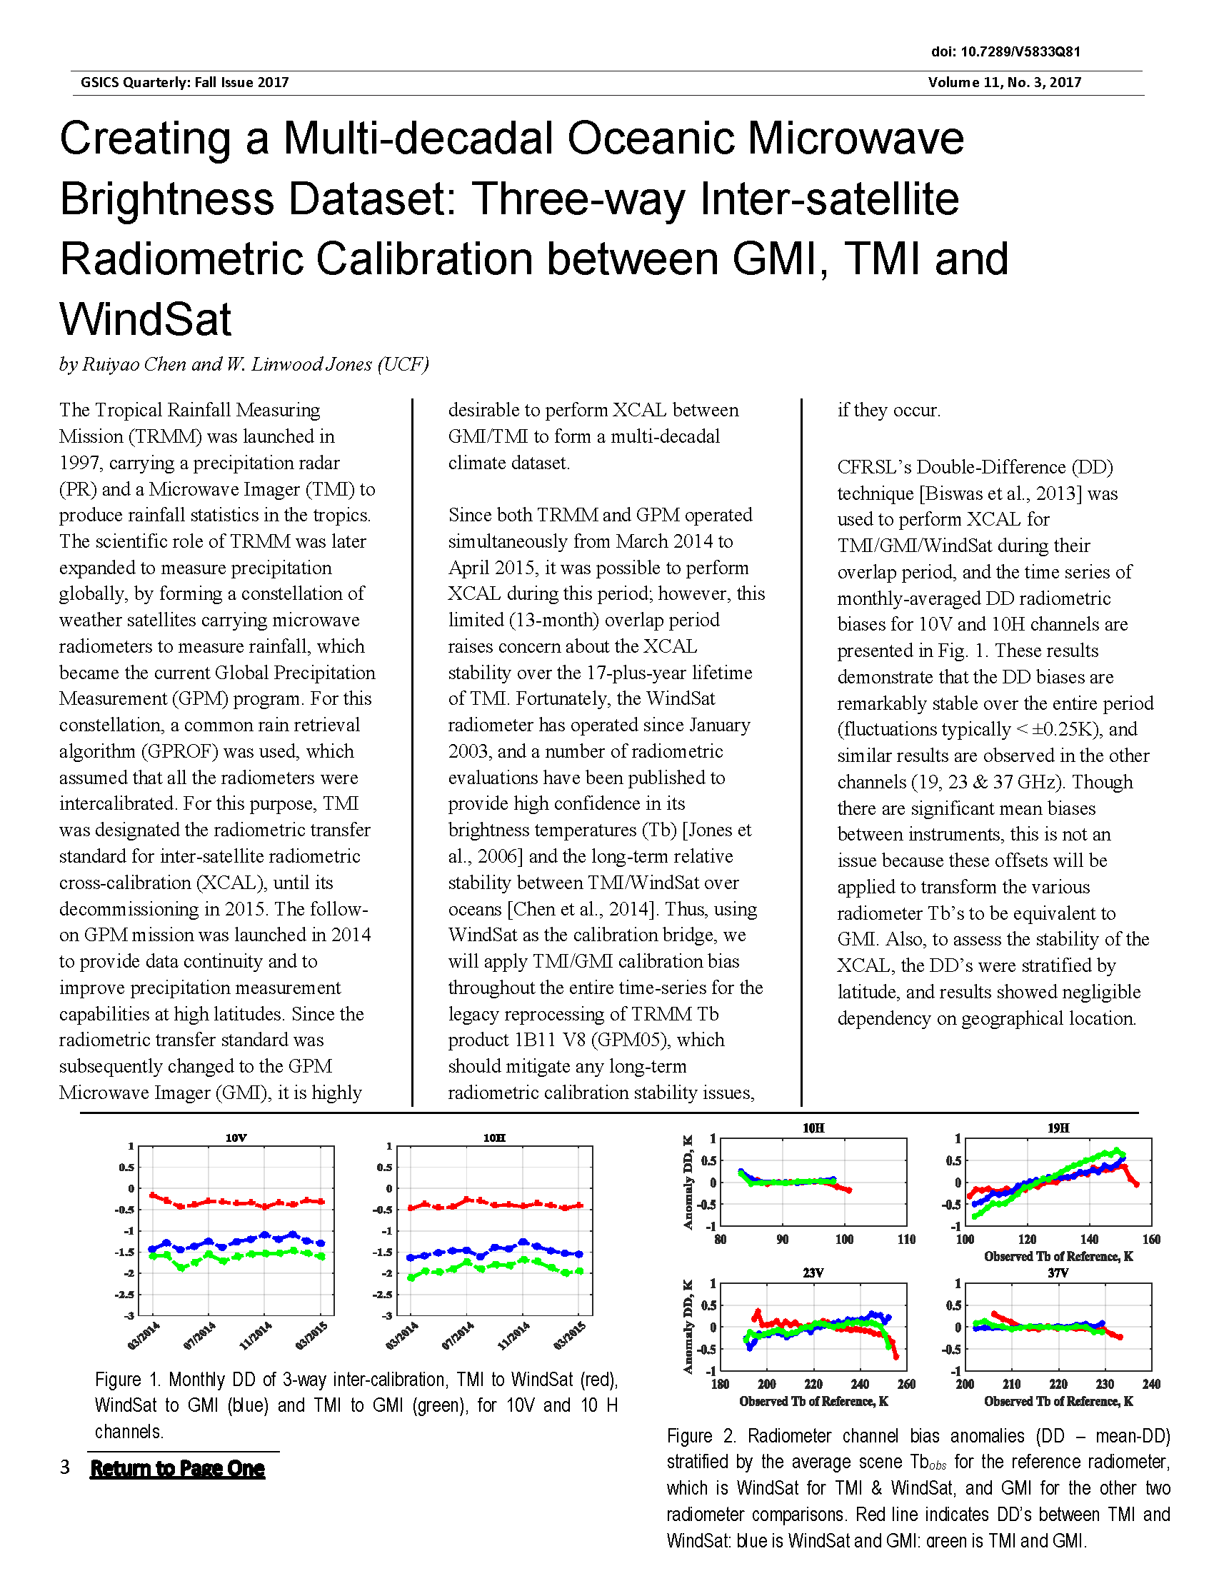
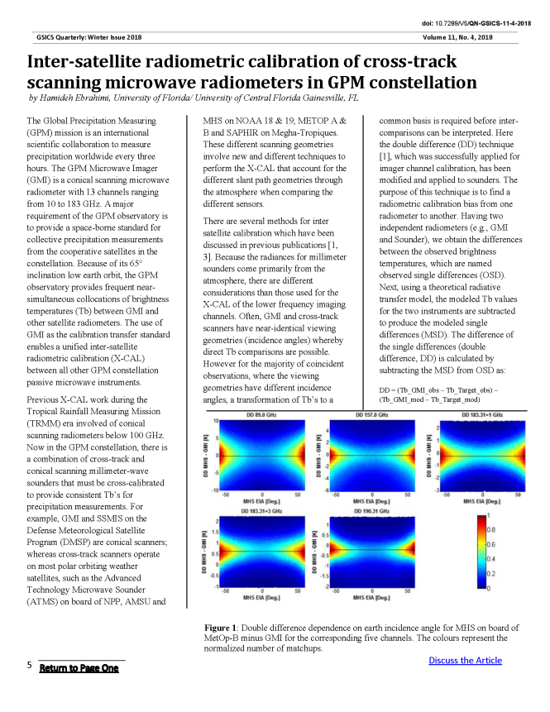
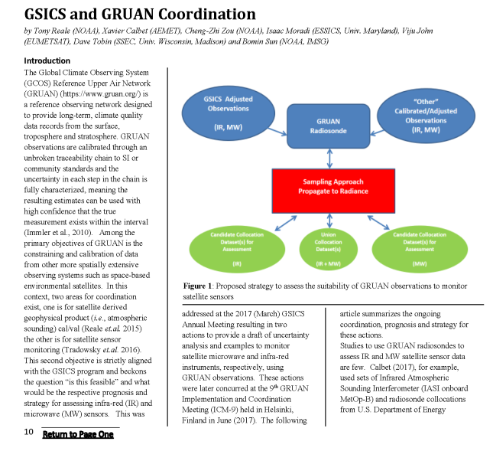
Newsletters – MW Topics

Slide 12
2017 MW Session
There were some logistical, remote participation matters that were “good lessons learned”
Were able to have some in person participation from U.S. members
  Helped stimulate closer interactions this past year
We came up with our first set of actions!

Slide 13
2018 MW Session
Thu pm | GRWG: MW Sub-Group
 | Chair : Ralph Ferraro
13:00 | Ralph Ferraro | NOAA | Introduction and Action Item/Discussion | 9a | 0:30
13:30 | Shenli Wu | CMA | Development of FY-3/MWRI Calibration on warm/cold targets and reflector emissivity | 9b | 0:20
13:50 | Yang Guo | CMA | Calibration and validation of Microwave Humidity Sounder onboard FY-3D satellite | 9c | 0:20
14:10 | Hao Liu | NSSC | Consideration of the on-board calibration of interferometric synthetic aperture microwave radiometer, | 9d | 0:20
14:30 | Xiaolong Dong | NSSC | Development and Standardization of the Guidelines for Prelaunch Calibration of Microwave Sensors - Activities of the CEOS WGCV | 9e | 0:20
14:50 | Ninghai Sun | NOAA Affiliate | ATMS SDR NOAA-20 and NPP ATMS calibration update | 9f | 0:20
15:10 | Coffee break |  |  |  | 0:20
15:30 | Ralph Ferraro | NOAA | Introduction: Radio Occultation as a MW standard/calibration source | 9g | 0:10
15:40 | Lin Lin | NOAA Affiliate | Mutual Validations of Observations between lifetime S-NPP ATMS and GPS ROs from COSMIC, MetOp and KOMPSAT (Provided by Xiaolei Zou) | 9h | 0:15
15:55 | All |  | RO Discussion | 9i | 0:30
16:25 | Scott Hu | CMA | ATMS Cal/Val evaluation using FY-3C/GNOS profile standard | 9j | 0:15
16:40 | Manik Bali | NOAA Affiliate | Proposed Best Practices | 9k | 0:30
17:10 | Ralph Ferraro | NOAA | NASA GPM X-Cal Updates (provided by Wes Berg and Rachel Kroodsma) | 9l | 0:20
17:30 | Manik Bali | NOAA Affiliate | GRUAN (Provided by Tony Reale) | 9m | 0:30

Slide 14
Summary and ongoing endeavors
Continued expansion of group
  More ideas and new collaborations
Sub-topical leads/formation
  Develop tasks, move forward with them
    References, Methods, Correction Tables….
Annual issue of Newsletter/MW Focus
First dedicated MW parallel session here…
Hope to report on “true” accomplishments in 1-year

Slide 15
Backup material

Slide 16
NOAA/NESDIS/Center for Satellite Applications and Research
Notes:
Thanks Bruce for the introduction. The title of my talk is ‘MSU/AMSU/SSU CDR development. I gave a talk three years ago in the STAR science forum about the MSU inter-calibration and trend and I kept talking this subject in the last few years in various occasions and hope people don’t get tired of it. But today I try to provide a comprehensive review of the current status and a discussion of various science issues include various bias correction, validation, inter-comparisons, web data support, and so on. I have reserved the room for two hours, but I will only talk about 45 minutes to one hour and allow plenty of time for questions. So don’t get scared about the length of the talk as suggested in the announcement.

Slide 17
GPS-RO Measurement Principle
Receivers on LEO satellites receive bented radio wave signals from the GPS transmitters
Bending angles of the radio wave can be determined precisely from the phase and speed information of satellites
Refractivity can be determined from bending angles
Temperature profiles are derived from the refractivity in dry atmospheric conditions
Plot from Kursinsky et al. 1997
Notes:
Mitch provided long time support for project from the program side, such as leveraging funding.
And Fuzhong also provides program support and coordinate the CRTM team to work with our product development team. You may notice that most of my SDS science team members are from his Branch.
I also want to thank Changyong for his long time support from scince side. I can always count on his support when I need a discussion on science. even when I need support from his team members.

Slide 18

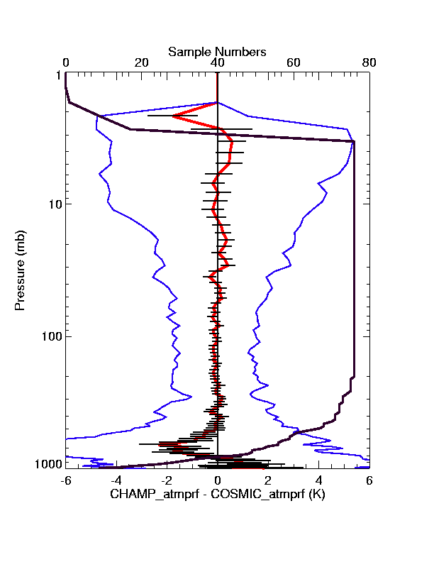
GPS-RO Accuracy
Absolute accuracy less than 1K
Precision 0.1K between ~5-25 km
RO data are treated as the ‘truth’ in the NWP data assimilation process, i.e., bending angles or refractivity are directly assimilated into NWP models and thus no bias correction is conducted before the data are assimilated into NWP models
Improved the NWP forecasting skills
Comparison statistics (mean: red; standard error of the mean: horizontal black lines superimposed on the mean; standard deviation: blue, sample number of compared soundings: solid black line) of 80 CHAMP and COSMIC profiles that were collocated within 200 km and 90 minutes between 1 Sept. and 17 Sept., 2006 (plot from Ho et al. 2009).
Notes:
Mitch provided long time support for project from the program side, such as leveraging funding.
And Fuzhong also provides program support and coordinate the CRTM team to work with our product development team. You may notice that most of my SDS science team members are from his Branch.
I also want to thank Changyong for his long time support from scince side. I can always count on his support when I need a discussion on science. even when I need support from his team members.

Slide 19
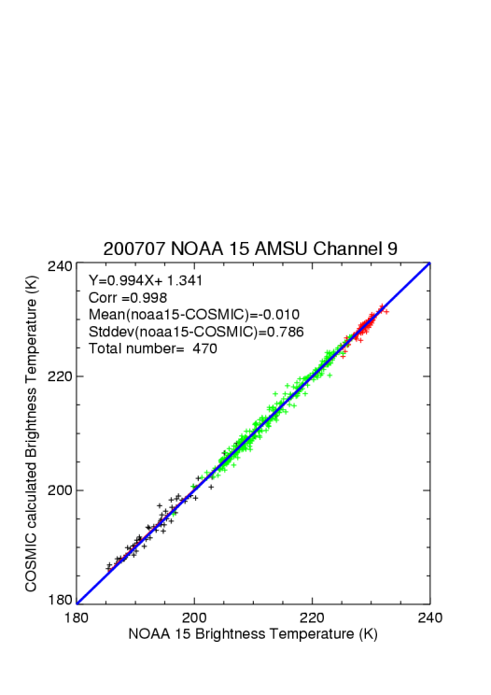
RO Data Have Been Used for Validating AMSU-A
Right figure shows a comparison between the RO temperature profiles and AMSU-A channel-9 observations
Differences between RO retrievals and the AMSU-A radiance measurements can be derived from such a comparison, such as mean and RMS difference
More in-depth information such as the scene temperature-dependent biases can also be derived
Scatter plot between the AMSU-A channel 9 brightness temperature at the 15th footprint onboard NOAA-15 and the collocated COSMIC retrievals during July 2007. The red dots represent the Arctic (60°N-90°N) data, the blue dots the Antarctic (60°S-90°S) data, and the green dots for the rest of the Earth (60°N-60°S). The AMSU-A data is from those recalibrated using IMICA approach (plot taken from Zou and Wang 2012).
Notes:
This project focus on developing MSU/AMSU atmospheric temperature CDRs. The window channels will be addressed by another NOAA group.
In summary, we work on 15 atmospheric temperature channels, involving 15 satellites, with tempral coverage from late 1978 to present.
Each channel needs to be intercalibrated seperately.
With that, let me first talk about the MSU atmospheric temperature CDR development. The MSU started from 1978 on TIROS-N and ended on NOAA-14 in May 2007. So we don’t have MSU observations now. We have already completed the MSU CDR development and gained a lot of experiences. We have developed many new techniques for various bias correction procedure. So I am going to talk with more details on this instrument.

Slide 20
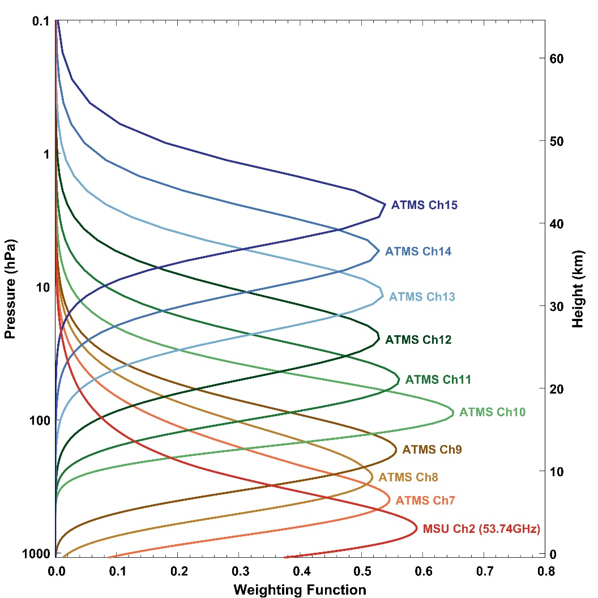
Recommendation
We recommend the use of RO data as a reference source to monitor NOAA microwave and infrared temperature sounding data (i.e L1B) for upper tropospheric and lower stratospheric channels (5-25km)
These channels include AMSU-A channels 8-11 and ATMS channels 9-12 where moisture effects and instrument noise are negligible. Best cases are for AMSU-A channels 9-10 and ATMS channels 10-11 (see right figure)
This could be established as part of the NOAA CAL/VAL plan with assistance from GSICS in the analysis of the monitoring results. The technology to perform this monitoring is already available at NOAA/STAR
This includes the capability of finding collocations between RO and NOAA satellites, assessing the RO temperature profiles and converting these profiles into channel-equivalent radiances for both microwave and infrared sounders using Community Radiative Transfer Model (CRTM) simulations
ATMS and AMSU-A weighting function
Notes:
This project focus on developing MSU/AMSU atmospheric temperature CDRs. The window channels will be addressed by another NOAA group.
In summary, we work on 15 atmospheric temperature channels, involving 15 satellites, with tempral coverage from late 1978 to present.
Each channel needs to be intercalibrated seperately.
With that, let me first talk about the MSU atmospheric temperature CDR development. The MSU started from 1978 on TIROS-N and ended on NOAA-14 in May 2007. So we don’t have MSU observations now. We have already completed the MSU CDR development and gained a lot of experiences. We have developed many new techniques for various bias correction procedure. So I am going to talk with more details on this instrument.

Slide 21
ATMS Updates for S-NPP and NOAA-20
Provided by Q. Liu/E. Kim
ATMS SDR performance is better than the requirement in J1RD.
ATMS calibration using radiance has been operational since March 08, 2017 (block 2).
Suomi NPP
ATMS is healthy.
Scan drive main motor current had been dropped down to a “normal” level.
ATMS SDR has reached “long-term monitoring validated maturity”.
NOAA-20
ATMS is good in operational normal.
ATMS TDR has reached beta maturity and pending on approval for provisional maturity.
PCT 006 converting TDR to SDR is scheduled for this January 2018.

Slide 22
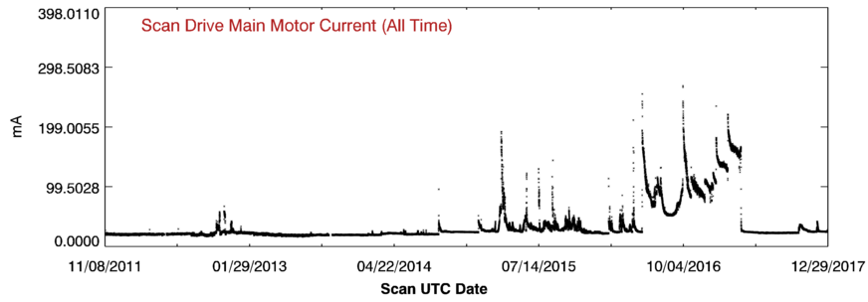
S-NPP ATMS Scan
Drive Main Motor
Provided by Q. Liu/E. Kim
S-NPP ATMS scan drive main motor experienced abnormal
(high) current beginning 2014 Summer. Mitigation used:
  Once per day scan reversal from August 2015
  Once per orbit scan reversal from July 2016
  Twice per orbit reversal from August 2016.
The scan drive main motor current has been dropped down to
a “normal” level since April 3, 2017.
normal
level

Slide 23

NOAA-20 ATMS Performance Summary
Provided by Q. Liu/E. Kim
In comparison to S-NPP ATMS TVAC data, NOAA-20 ATMS data has been demonstrated better performance.
Consistent performance between pre- (TVAC) and post-launch (onboard):
Smaller sidelobes (i.e. higher antenna efficiency)
Lower noise (i.e. NEdT)
Much smaller inter-channel noise correlation (better independent information)
Smaller ΔG/G (less striping)
Larger non-linearity. After correction, residual NL is smaller and meet requirement.
NOAA-20 ATMS On-Orbit NEΔT Status

Slide 24
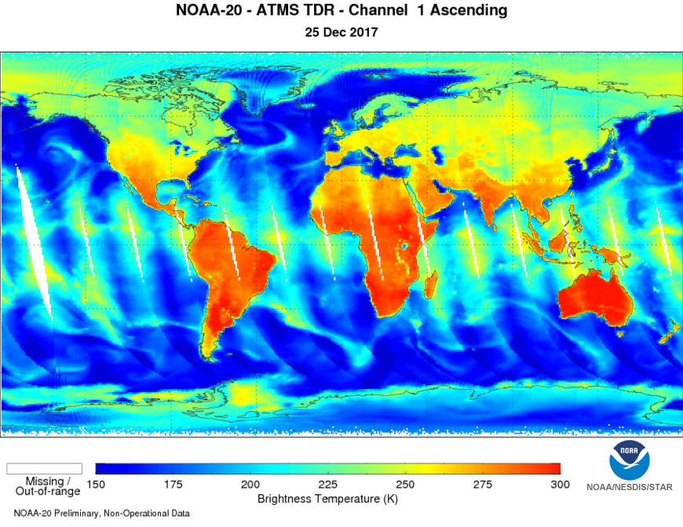
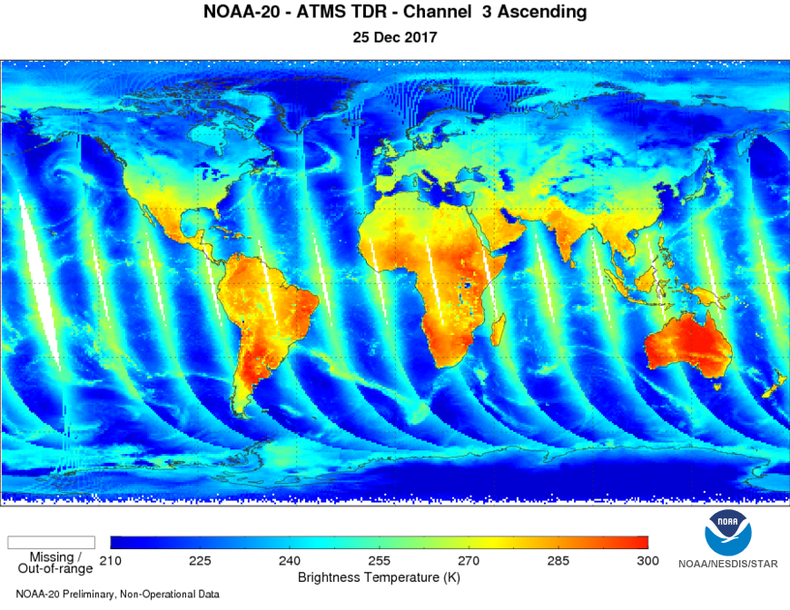
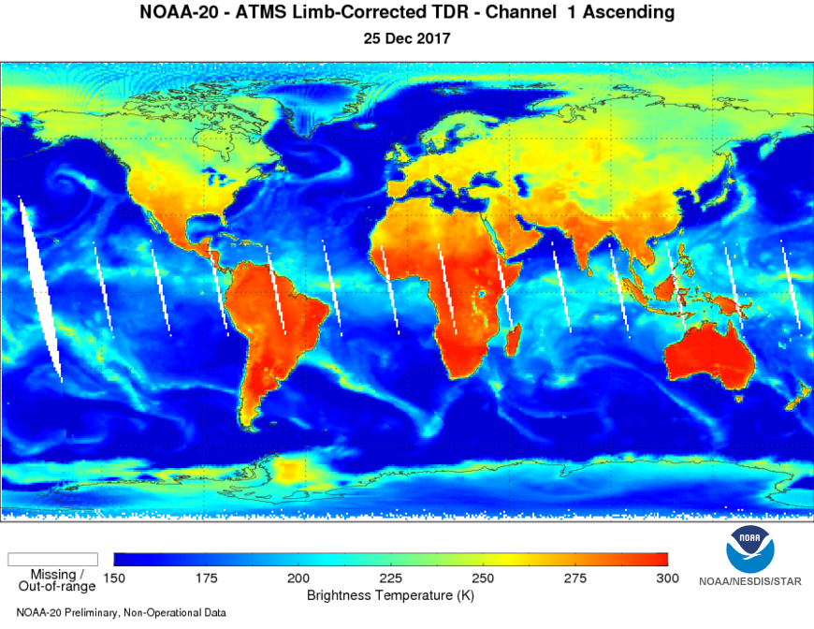
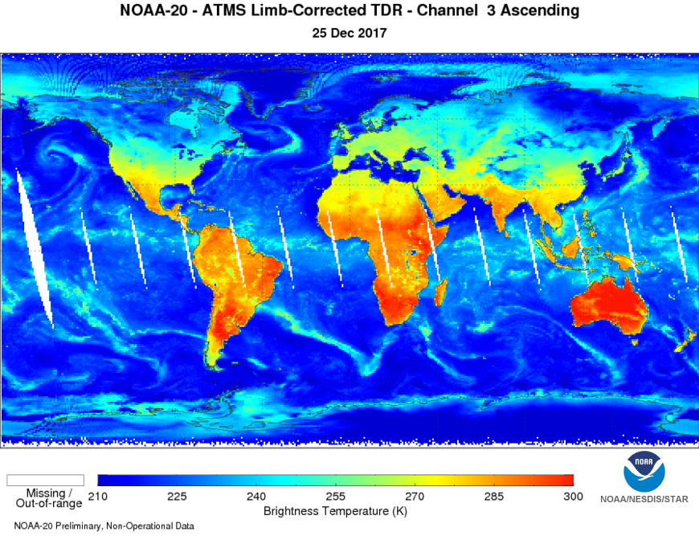
NOAA-20 ATMS TDR (upper) and limb-corrected (bottom)
Provided by Q. Liu/E. Kim

Slide 25
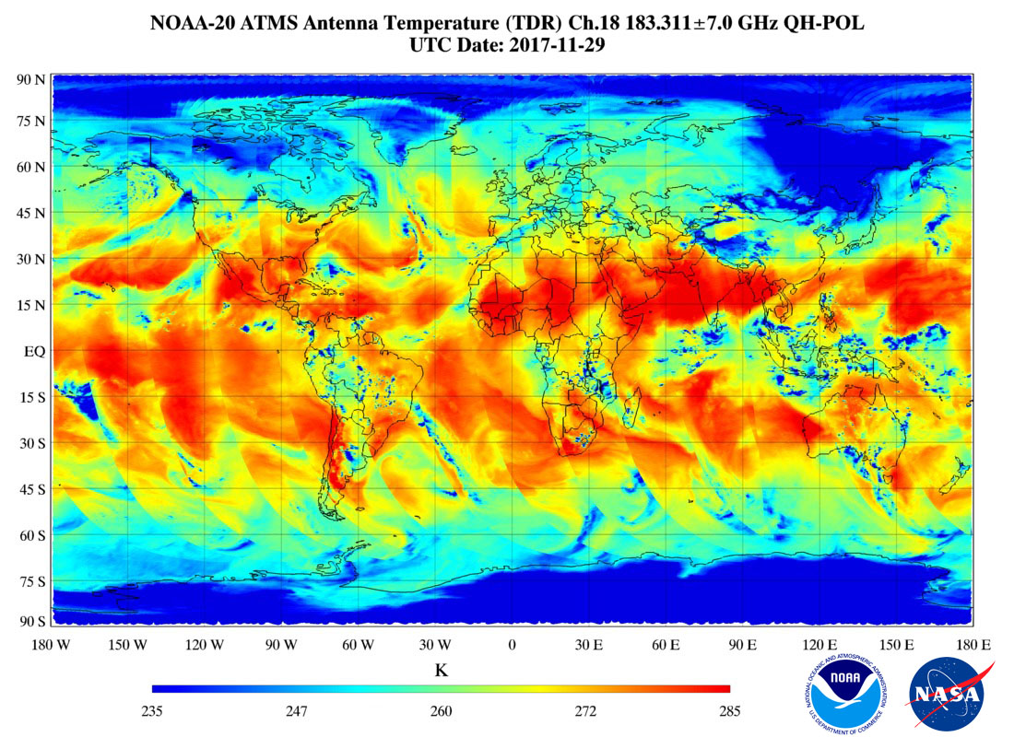
NOAA-20 ATMS First Global Image (from ICVS)

Slide 26
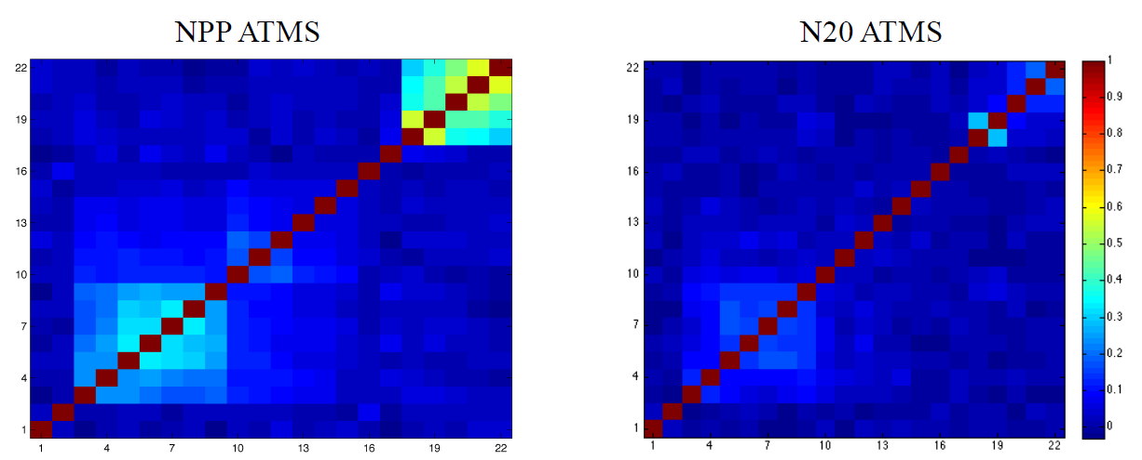
NOAA-20 ATMS Channel Correlation
One hour stable observations of warm load were calibrated
Data noise can be derived from the difference between calibrated warm load temperature and PRT temperature
Channel correlation of NOAA-20 is much smaller than that of S-NPP, especially in low V- and G-bands

Slide 27
GRUAN / GSICS
Tony Reale, Cheng-Zhi Zou …
NOAA/STAR
GRWG Microwave Sub-group
Web Meeting
Oct 12 017

Slide 28
GSICS/GRUAN Actions from
March 2017 Annual GSICS Meeting
Action: GMW.2017.6f.2: Tony Reale (NOAA) to provide a draft of uncertainty analysis examples to determine feasibility of monitoring satellite microwave instruments using GRUAN observations (radiosonde) – by the next annual meeting
Cheng-zhi Zou, Bomin Sun, Isaac Moraldi, Viju John, Vinia Mattioli, …
Action: GIR.2017.7d.1: ​ Tony Reale (NOAA) to provide a draft of uncertainty analysis examples to determine feasibility of monitoring satellite infra-red instruments using GRUAN observations (radiosonde) – by the next annual meeting
Xavier Calbet, Bomin Sun, Isaac Moraldi, Dave Tobini …

Slide 29
Guidelines for Uncertainty Measurements (GUM)
for k.le.2 … in more than 95% of cases, the uncertainties are likely to be smaller than estimated …
for k .gt. 2 … the uncertainties are likely to be larger than estimated …
If k < 1 …
from Immler (2010)

Slide 30
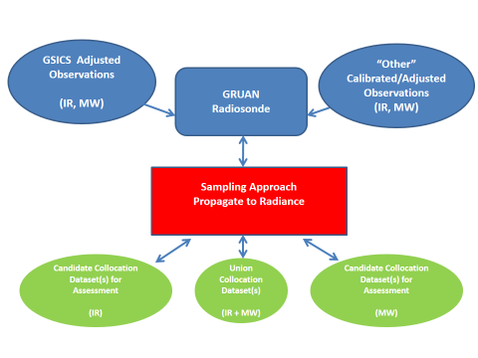
Preliminary Experiment Straw-man
Objective: Can GRUAN help verify the “accuracy/uncertainty” of GSICS adjustments

Slide 31
Instrument noises can be used to determine the distance criteria when collecting collocated datasets between GRUAN and MW Sensors
Minimum STD = √2 *0.3K=0.42K
Maximum distance for collocated datasets ~40Km

Slide 32
Progress
Article submitted to GSICS “Fall” Newsletter
Reale appointed (to be) GRUAN POC for GSICS
Xavier Calbet (AEMET) procures EUMETSAT proposal (funding) for GRUAN / GSICS assessments for IR … can something similar be done for MW?

Slide 33
GRUAN
Hi Tim
You are correct that we have much more focused on MWave (since Cheng-zhi lives here) and will (w/Bomin) have report on an initial strategy and some results ... very interesting.
With respect to IR I refer ('italic") to meeting and plans we discussed at ITSC summarized in Dec 5 email (you were included):
"I would like to summarize our meeting Friday (before lunch, ITSC-21) regarding GSICS / GRUAN activity on feasibility to monitor IR, MW satellite sensors using GRUAN data (mainly Raob at this time).
First, I attach a global distribution of GRUAN processed radiosondes collocated with MetOp-A, +/- 1hr and 50km from the NPROVS Special dataset, January 2013 thru November 2017. These are over 2000 collocations (106 were from TWP considered by Xavier) for which the IR was successfully used in level 2 retrieval. Our record for MetOp-B does not begin until around May 2014 but we maybe can re-process MetOp-B back to May 2013. I would then expect a similar number of collocations with MetOp-b as for MetOp-A, and several for which the GRUAN was collocated with both ... we now have an updated version of this dataset, however the transion to RS41 is complicating things as we have no reference processing for these ...
I (and Bomin) will coordinate with Oleksund to merge and develop a final initial dataset with SDR (from Alex) as a ground zero target achievement for the GSICS March meeting ... not yet done.
We also discussed considering HIRS, IASI and selected AMSU / MHS (Metop-A, B and maybe NOAA satellites) for initial work to identify subsets of collocations for IR, MW, respectively, that are 'suitable' for testing GRUAN in context of satellite sensor, RT model, calibration (and associated adjustment) assessment (including uncertainty) ...
For example, we mentioned analysis on the IR side to test GRUAN wrt known bias between HIRS and IR in selected spectra intervals ...
We mentioned similar work on the MW side using select 50 Ghz weighting fns in troposphere, UTLS and stratosphere and at 183 gHz to test GRUAN wrt known bias in these spectra ... this has been pursued for Mwave but in a slightly different context as will be reported at meeting (Cheng-zhi)
I am not sure how far we get before March. At this time Xavier and Cheg-zhi with assistance from Bomin and others lead this work, yes? It is good that we have some plan and goals to achieve by March and a path forward. Xavier and Cheng-zhi would present, yes?
I take the liberty to include Larrabee Strow with whom I discussed the possibility to contribute on the IR side. If there are others to append to the email list please do so. "

Slide 34
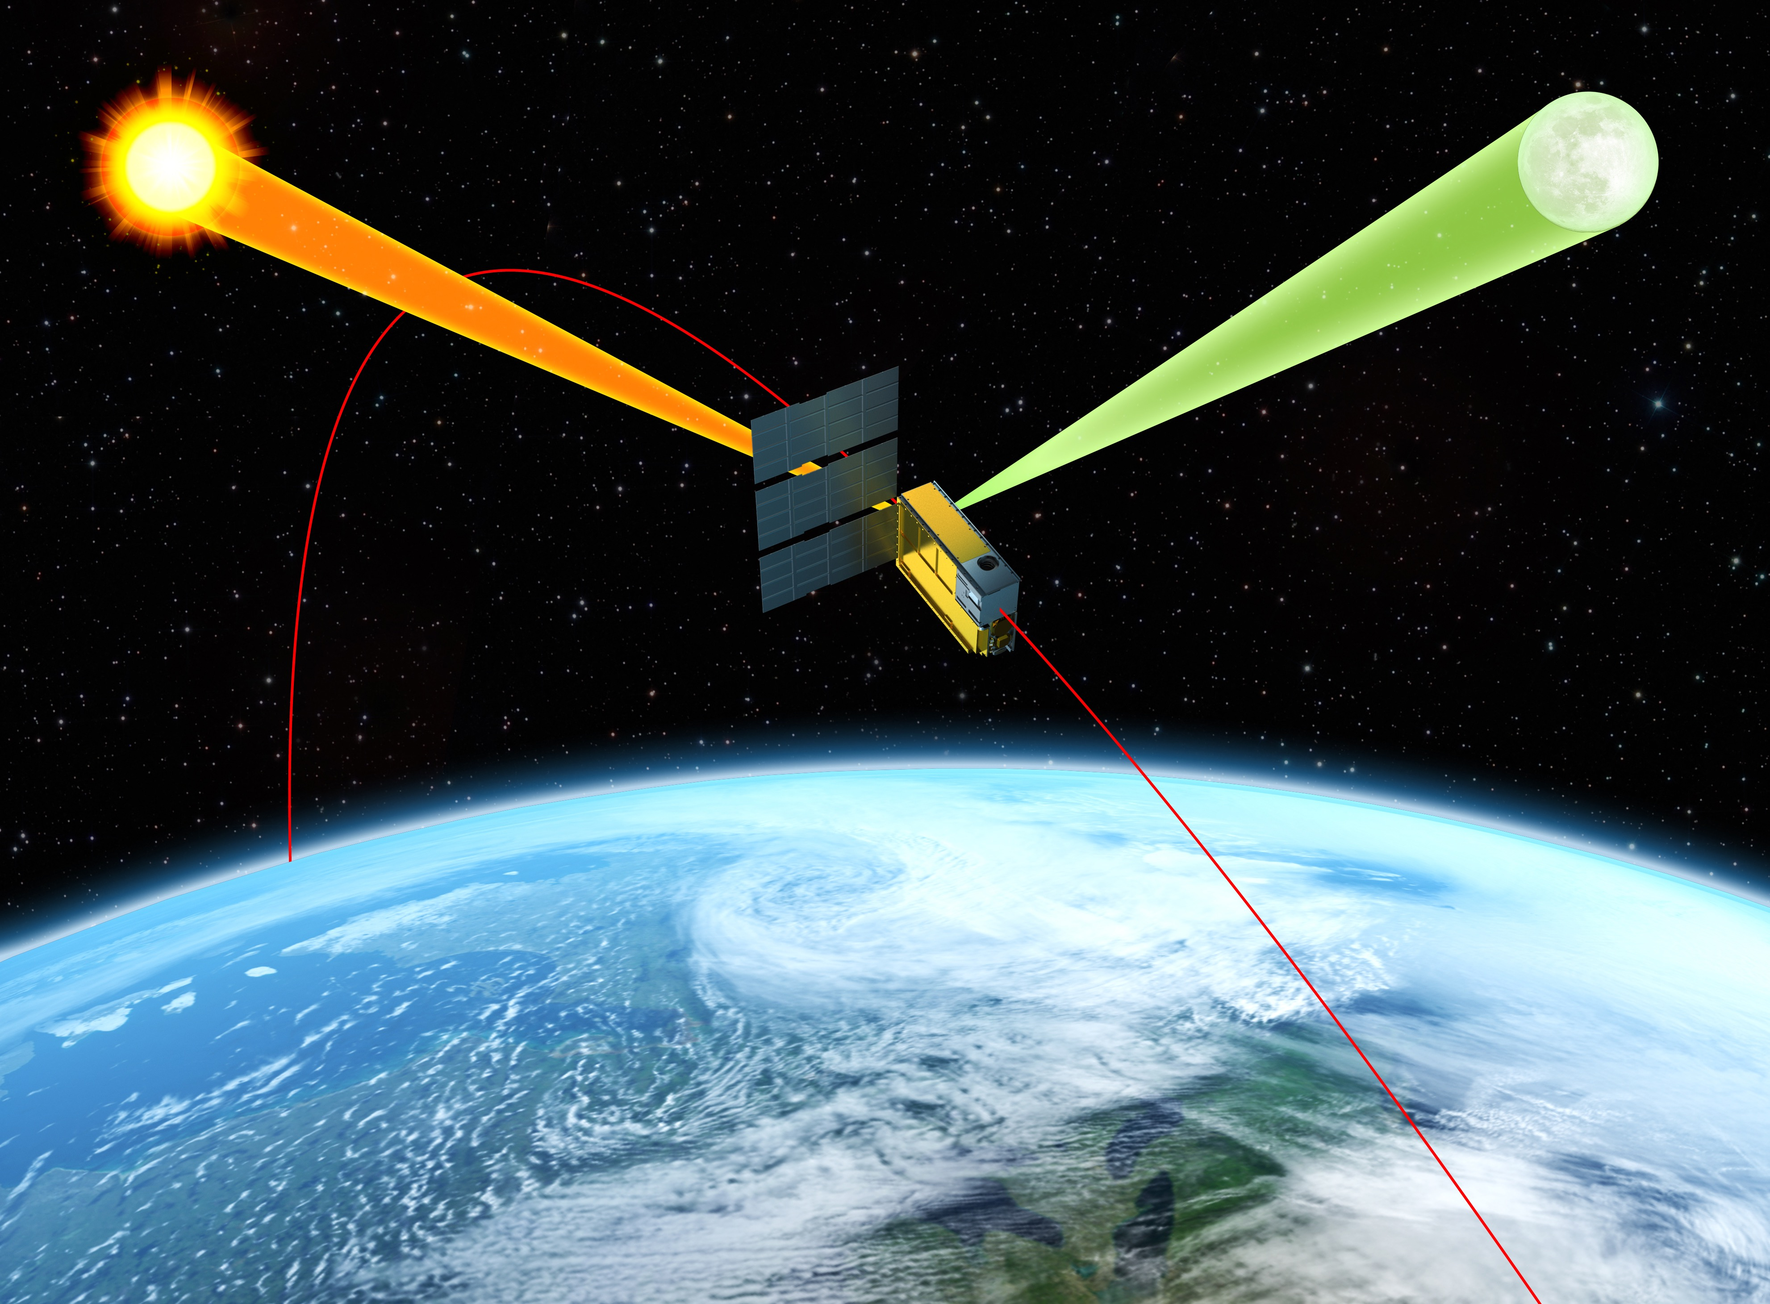
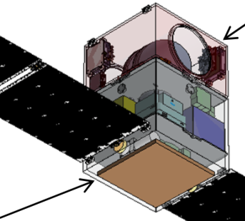
Concept of Inter-satellite Calibration using Lunar Observations
Advantages of Lunar Calibration
Lunar Calibration Scheme
Accessible for all spacecraft in cubic satellite constellation
Time and location of lunar observations are highly predictable
Highly stable radiation in microwave band
Detection of Lunar Observations
Calibration of Lunar Observations
Correction for beam pointing error
Bias evaluation for each instrument in constellation
Correction for obs. angle and solid angle of the Moon’s Disk
inter-satellite calibration for instruments in constellation

Slide 35
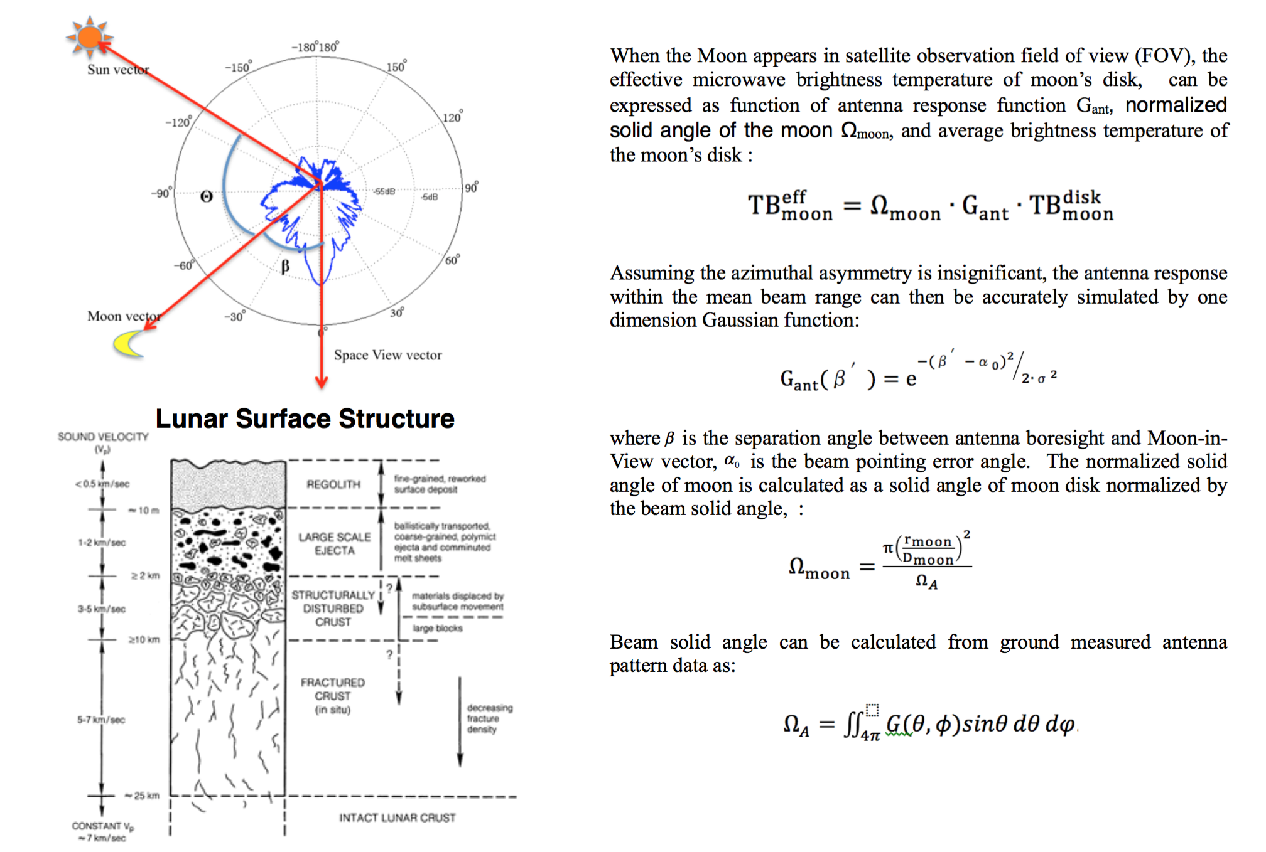
Lunar Microwave Brightness Temperature Model Development

Slide 36
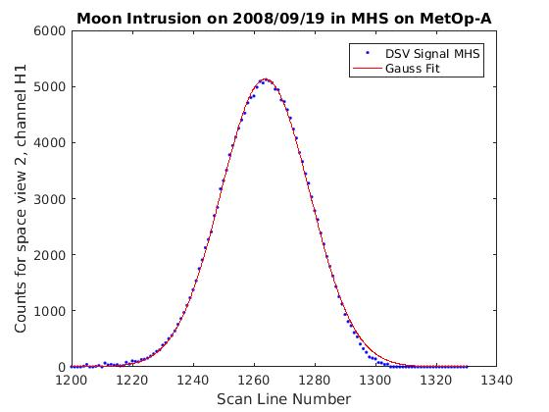
Moon in DSV of MW Sounders: Bias
Check Uniformity of Sounding Channels
“Light” Curve from Moon Intrusion has Shape of Gaussian
Radiance from Moon the same for all sounding ch.
Check uniformity with Moon intrusions
There is a bias in ch. 20 of AMSU-B on N-16, but only with Earth scenes (SNOs)
Moon flux << Earth flux
DSV correct. factor is more prominent with Moon obs.
Rule out wrong DSV correction as reason for bias => RFI more likely

Slide 37
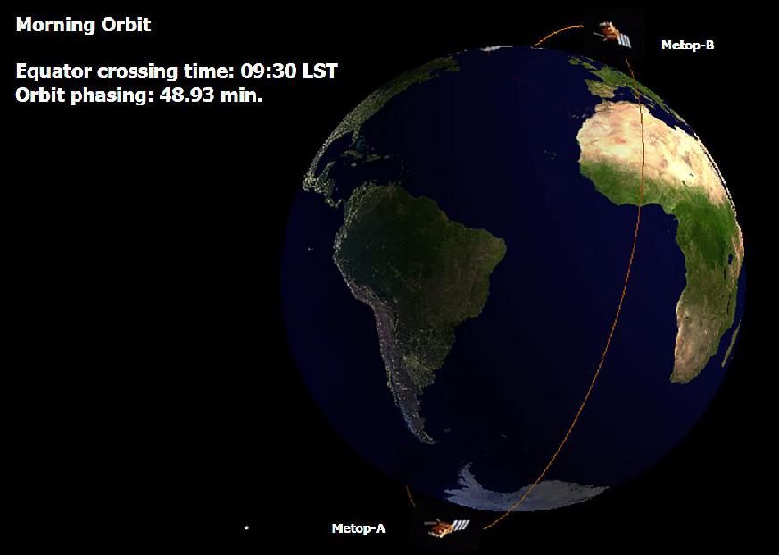
Moon in DSV of MHS: SNOs
No Simultaneous Nadir Overpasses With MetOp-A and MetOp-B
Simultaneous Observations of Moon Instead of Earth Scenes
Moon intrusions on 6/28, 2013, with MHS on Metop-A (0:15 UT) and Metop-B (1:11 UT)
Moon phase angle changes 0.5°/hour => different T_{moon} => calculate with Eq. 3 in Yang, GSICS Quarterly, 11, 3
T_{B}(Moon) from Metop-A and B agree within 2%

Slide 38
Inter-comparison of CRTM, RTTOV and a LBL Model
Era Profiles
(P, T, q, O3, Surface Variables)
Collocate Era and Satellite Observations
CRTM/RTTOV/LBL Models’ Interfaces
ATMS/CRiS observations (time, location)
Analyze the differences between model with respect to surface and atmospheric variables
Simulate ATMS/CrIS Observations Using RT Models

Slide 39
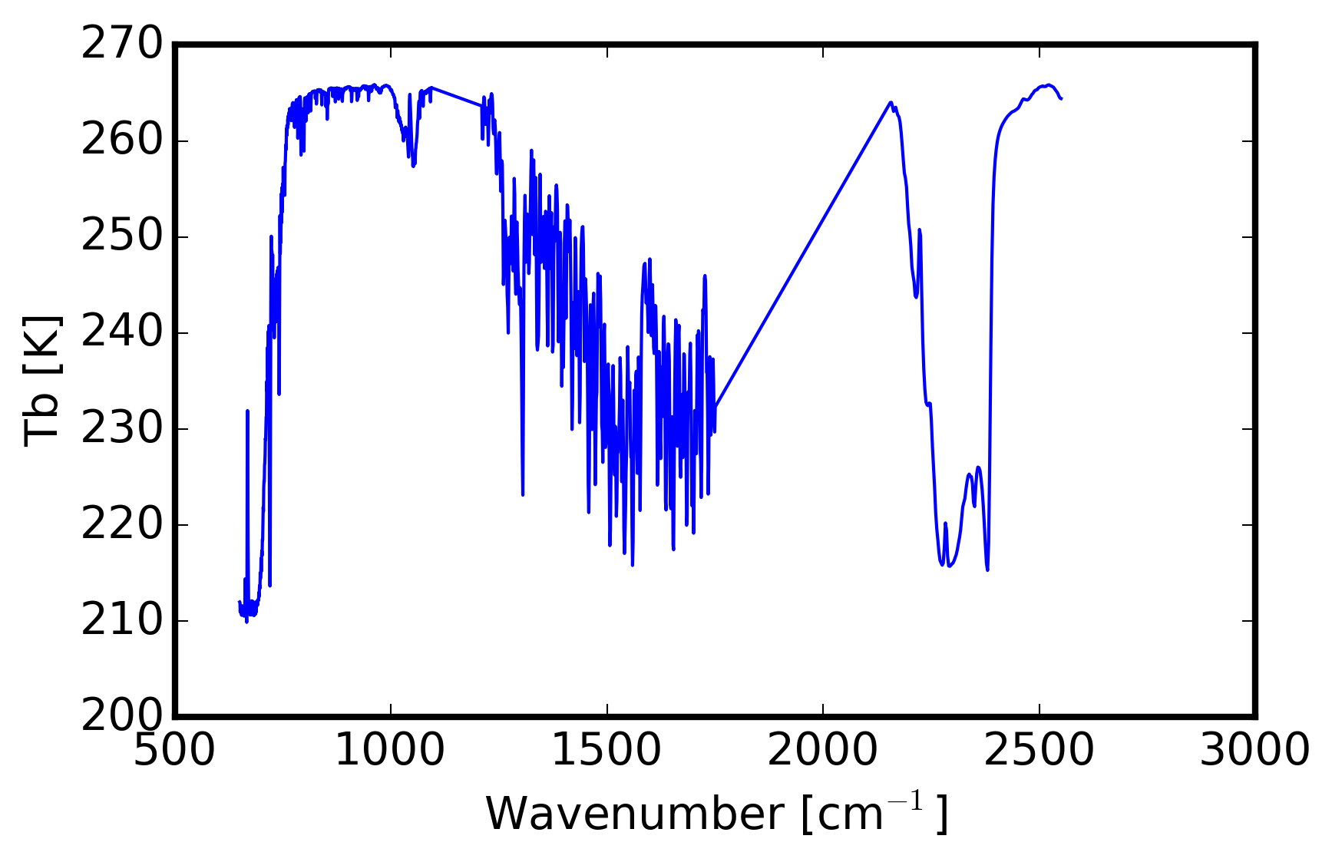
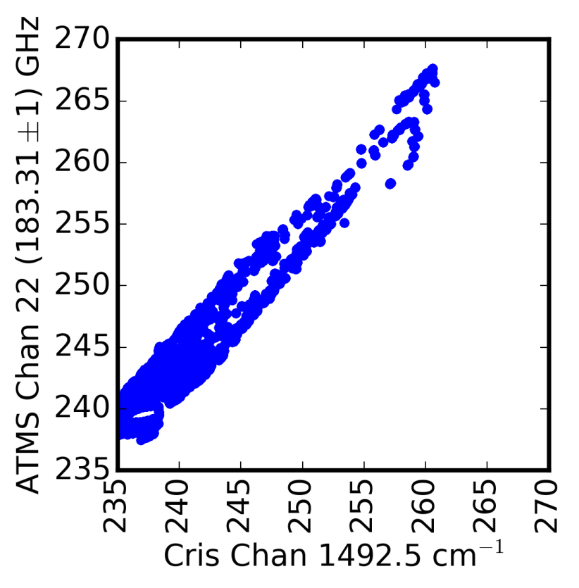
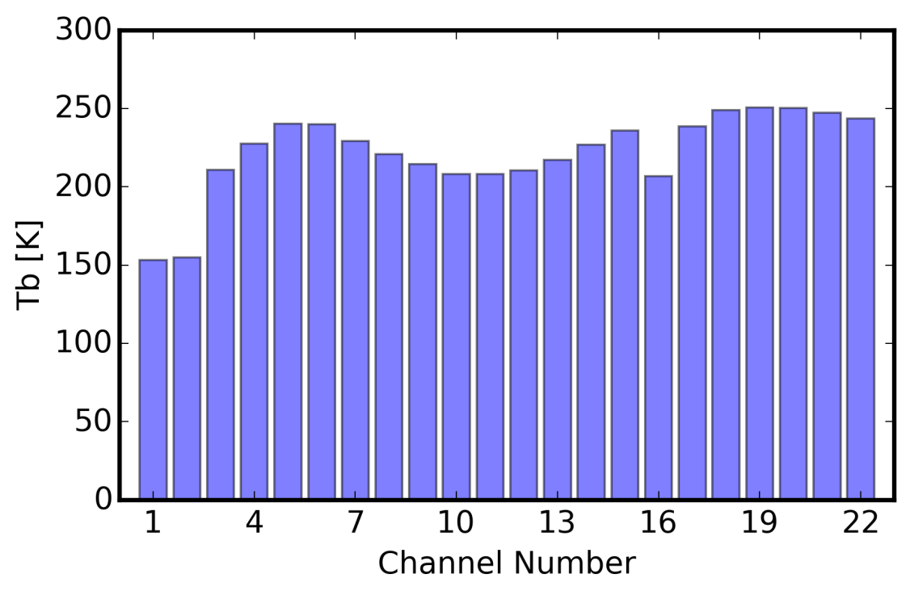
Ultimate Goal: Generating ATMS Pseudo-Observations from CrIS data

Slide 40
GSICS MW Subgroup Task to Inter-compare RTMs in MW region
collocate GRUAN and ATMS observations – include other MW instruments if necessary. Consider GRUAN uncertainties (GRUAN team?)
Run RTTOV using Collocated Datasets (EUMETSAT, UK-MetOffice?)
Run CRTM using Collocated Datasets (NOAA?)
Select an LBL model and simulate MW radiances using collocated dataset. The results would be more reliable if more than one LBLM is selected. Any suggestion for the LBL models?
Analyze the differences among the RTMs based on surface and atmospheric variables
Analyze the ATMS biases vs. GRUAN observations taking into accounts the findings from the previous step

