Slide 1
Inter-Comparison between
COMS/MI and Himawari-8/AHI
Hyeji Yang
NMSC/KMA

Slide 2
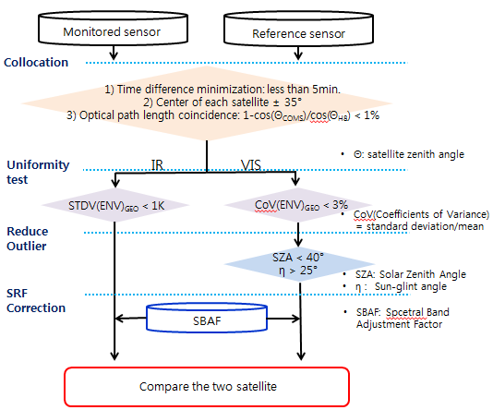
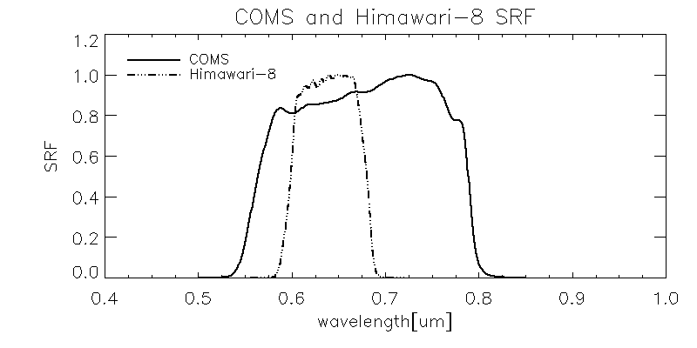
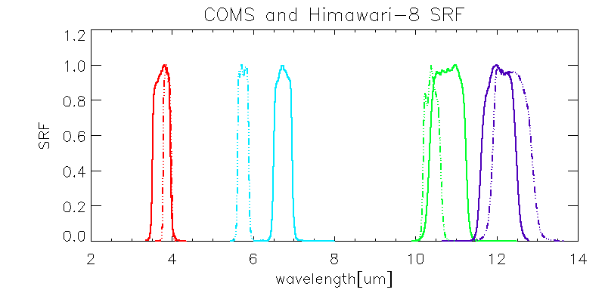
GEO-GEO Inter-comparison
Methods
Compatible Channels
COMS/MI | Himawari-8/AHI
VIS(0.67㎛) | VIS(0.64㎛)
IR1(10.79㎛) | Ch13(10.41㎛)
IR2(12.06㎛) | Ch15(12.38㎛)
WV(6.74㎛) | Ch08(6.24㎛)
SWIR(3.75㎛) | Ch07(3.89㎛)

Slide 3
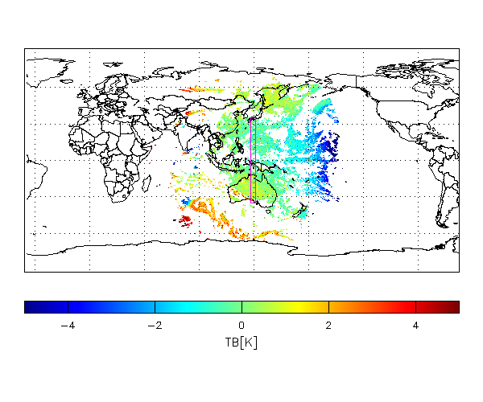
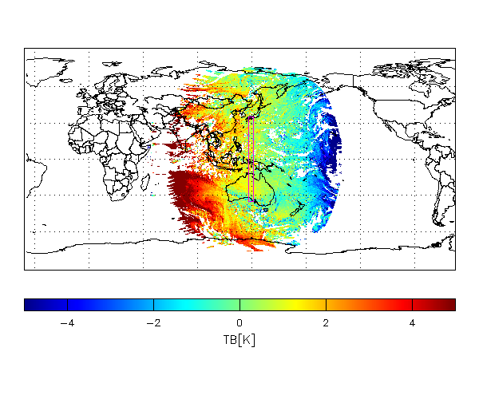
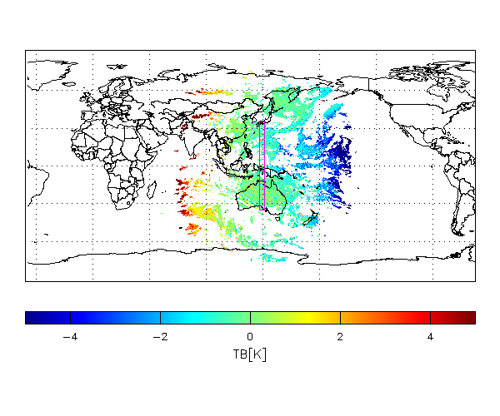
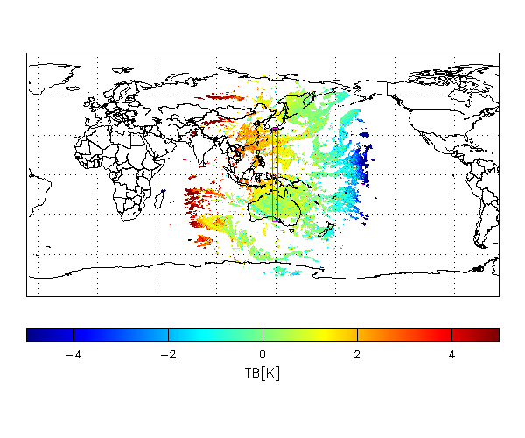
MI vs. AHI Observation Area
Common observation area of MI and AHI
Region is colored with TB bias[K] (MI-AHI) passed Uniformity test (21 July 2017 02UTC)
SWIR
WV
IR1
IR2

Slide 4
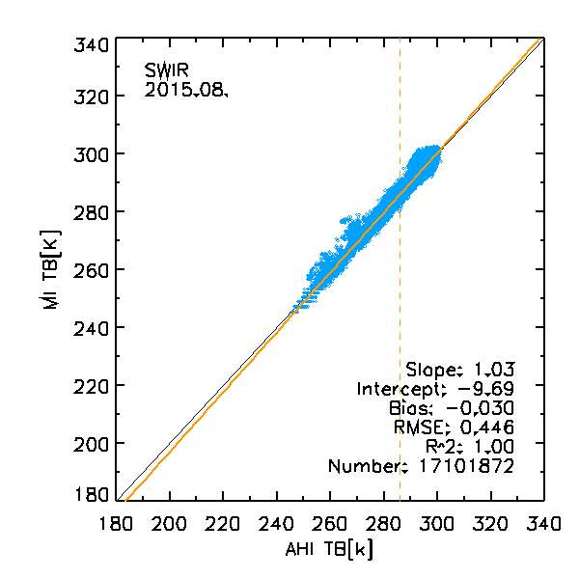
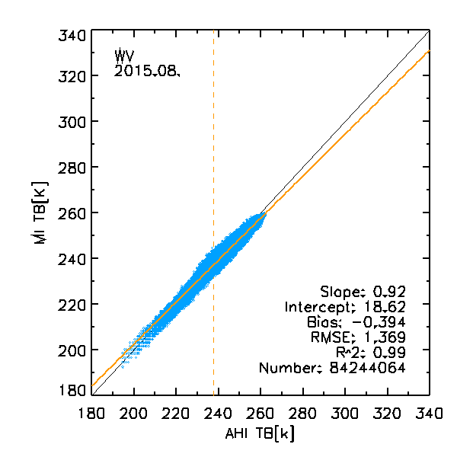
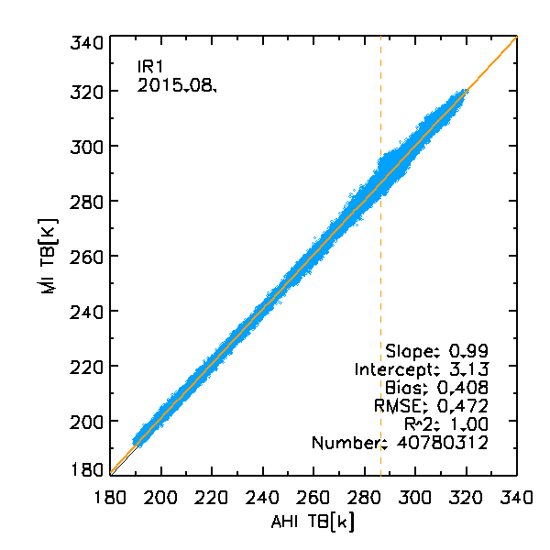
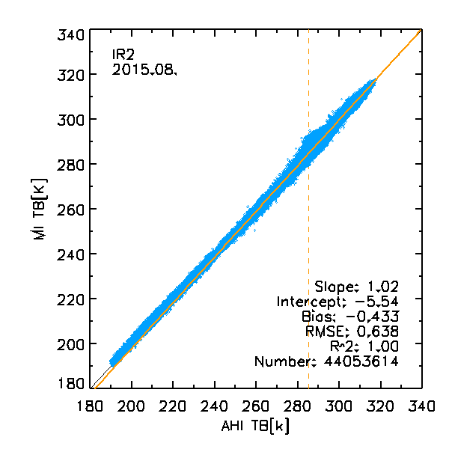
Inter-comparison of MI and AHI IR channels
Relationship between MI and AHI Tb of IR channels
Period: 1~31 Aug. 2015
 | SWIR(3.75㎛) | WV(6.74㎛)
Number | 17,101,872 | 84,244,064
Bias | -0.030 | -0.394
RMSE | 0.446 | 1.369
Slope | 1.03 | 0.92
Intercept | -9.36 | 18.62
 | IR1(10.79㎛) | IR2(12.06㎛)
Number | 40,780,312 | 44,053,614
Bias | 0.408 | -0.433
RMSE | 0.472 | 0.638
Slope | 0.99 | 1.02
Intercept | 3.13 | -5.54

Slide 5
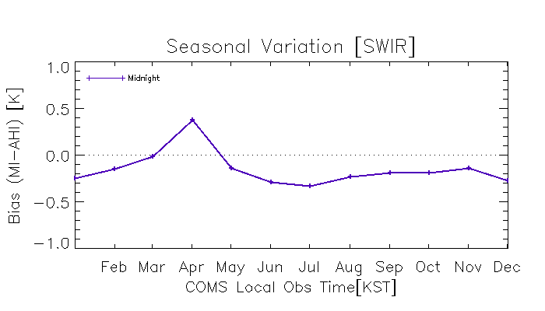
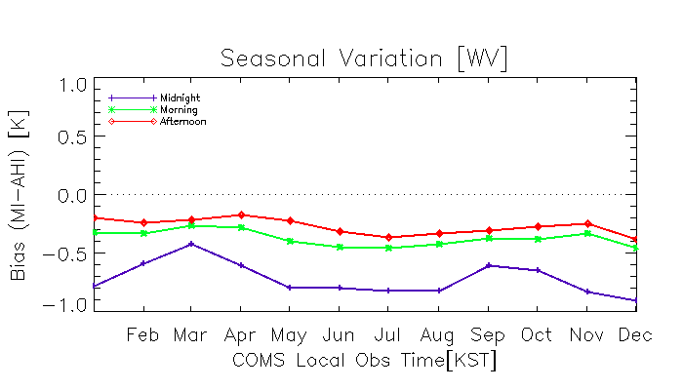
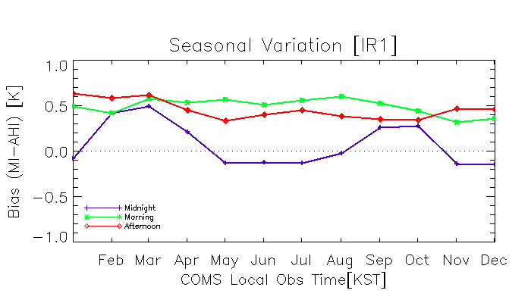
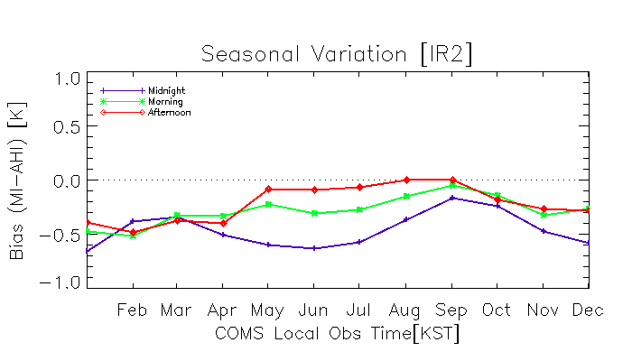
Seasonal variation of MI and AHI IR channels
Seasonal variation of Tb[K] bias (at MI standard temperature) during 2016 (1 year)
Shown by Midnight, Morning, Afternoon

Slide 6
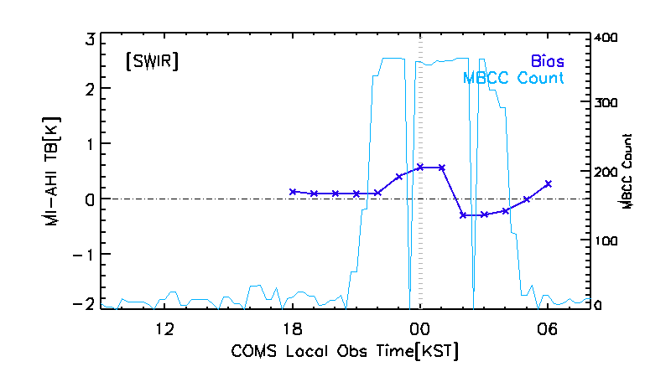
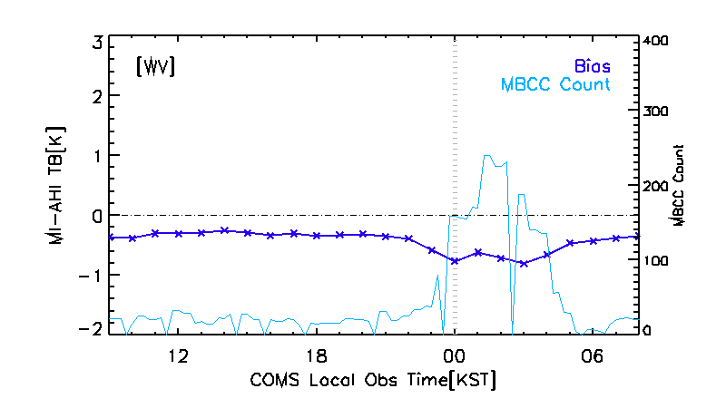
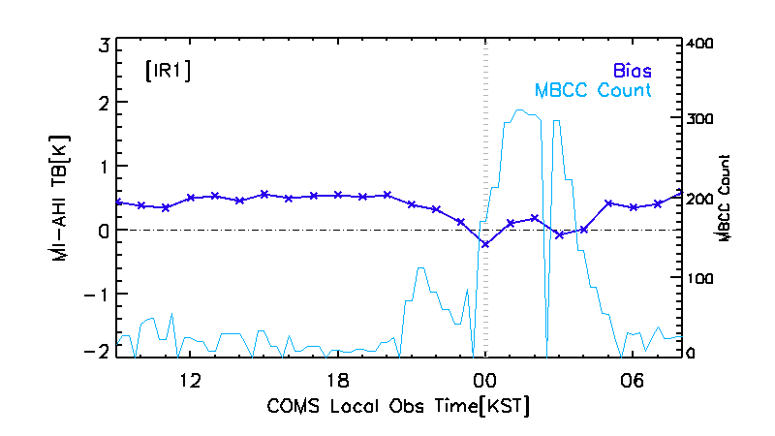
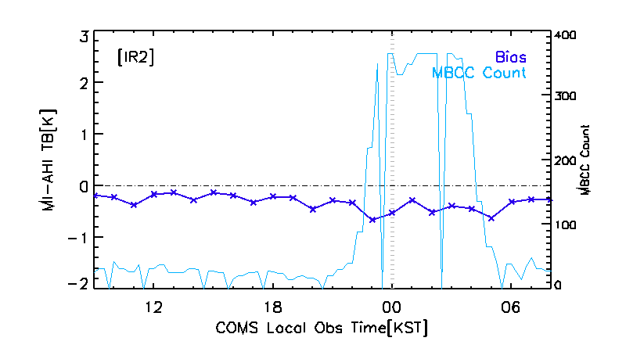
Diurnal variation of MI and AHI IR channels
Diurnal variation of Tb[K] bias (at MI standard temperature) during 2016 (1 year)

Slide 7
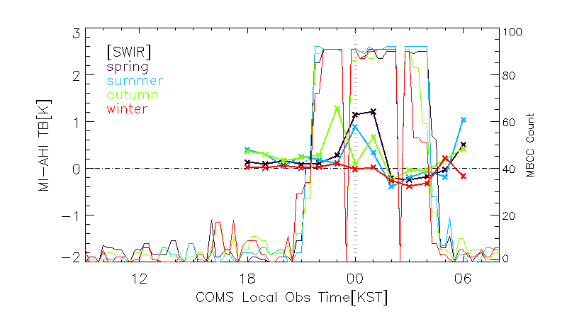
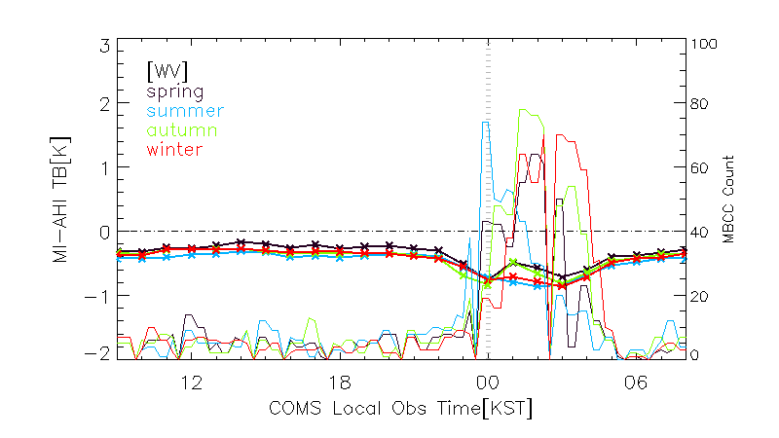
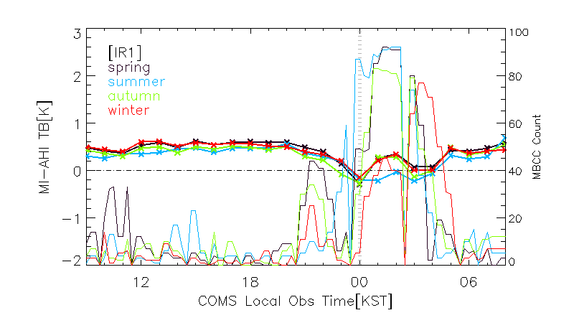
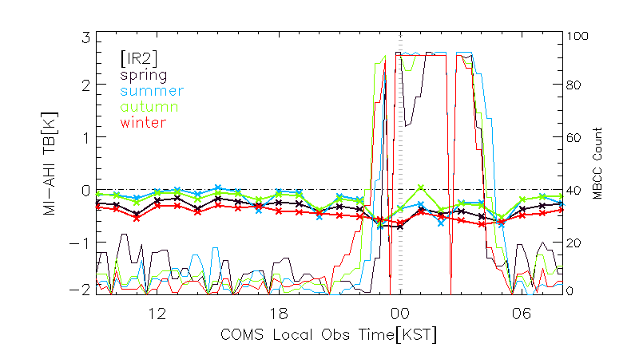
Diurnal variation of MI and AHI IR channels
Diurnal variation of Tb[K] bias (at MI standard temperature) during 2016 (1 year)
Each line means season (spring, summer, autumn, winter)

Slide 8
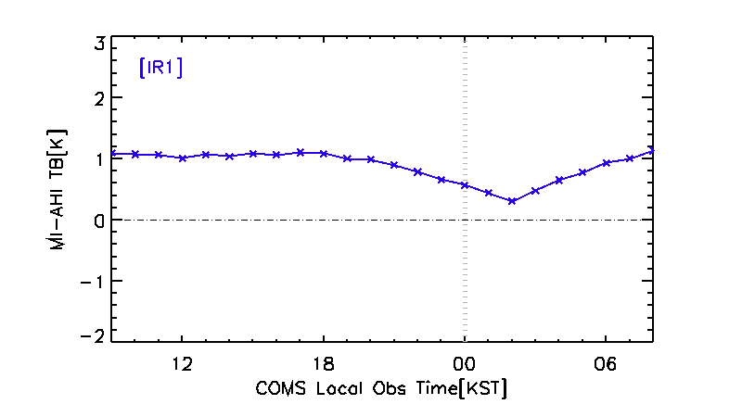
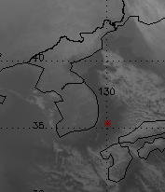
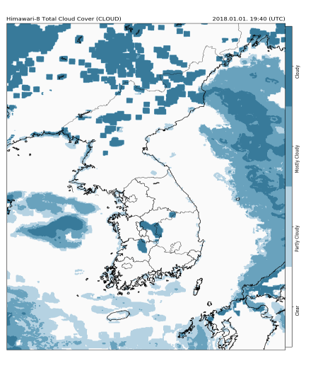
Diurnal variation on clear spot
Diurnal variation of MI and AHI IR1(10.8㎛) on clear pixels (3x3, 7x7 avg.)
Case: Jan. 2018 00~23UTC, 35.4ºN, 130.1ºE
Hour(KST) | MI | AHI | Bias
09 | 285.891 | 284.796 | 1.096
10 | 285.891 | 284.815 | 1.076
11 | 285.924 | 284.861 | 1.063
12 | 285.908 | 284.897 | 1.011
13 | 286.056 | 284.987 | 1.069
14 | 286.089 | 285.047 | 1.041
15 | 286.187 | 285.098 | 1.089
16 | 286.105 | 285.041 | 1.064
17 | 286.105 | 284.998 | 1.107
18 | 285.99 | 284.904 | 1.086
19 | 285.924 | 284.918 | 1.006
20 | 285.891 | 284.899 | 0.992
21 | 285.776 | 284.876 | 0.900
22 | 285.595 | 284.808 | 0.786
23 | 285.38 | 284.720 | 0.660
00 | 285.28 | 284.711 | 0.569
01 | 285.115 | 284.670 | 0.444
02 | 285.048 | 284.741 | 0.307
03 | 285.28 | 284.798 | 0.482
04 | 285.528 | 284.878 | 0.650
05 | 285.644 | 284.864 | 0.780
06 | 285.694 | 284.761 | 0.933
07 | 285.727 | 284.723 | 1.004
08 | 285.776 | 284.641 | 1.135
*
COMS IR1 Tb[K](‘18.1.1.02:00UTC)
Himawari-9 CA (‘18.1.1.19:40UTC)

Slide 9
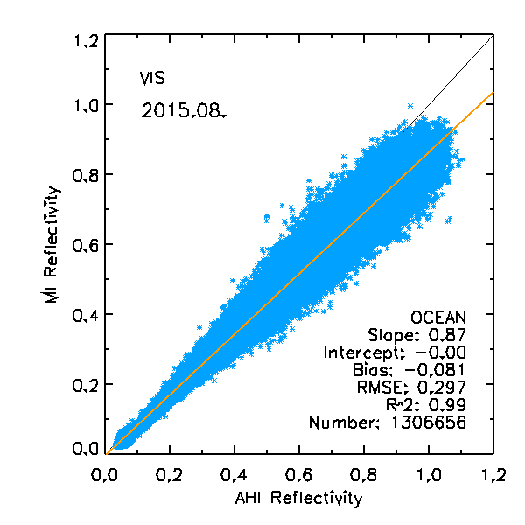
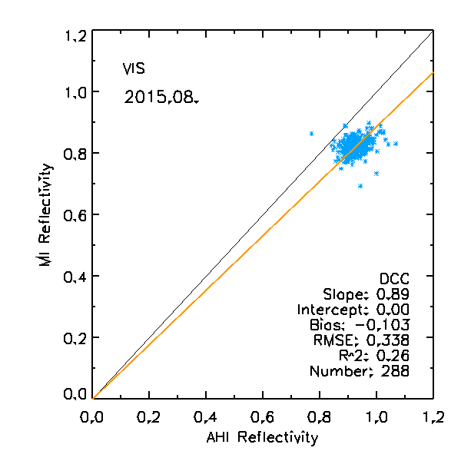
Inter-comparison between MI and AHI VIS channel
Difference of MI(0.67㎛) and AHI VIS(0.64㎛) reflectivity
SBAF calculated from the Ocean/DCC Earth spectra is applied to each ocean/DCC pixels
* Reference: http://cloudsgate2.larc.nasa.gov/SBAF (NASA Langley web-based spectral band difference correction calculator)
Ocean
DCC

Slide 10
Thank you

