Slide 1
Re-calibration of IR and WV channel onboard historical JMA’s GEO satellites -collaboration with EUMETSAT-
Tasuku TABATA
Japan Meteorological Agency / Meteorological Satellite Center

Slide 2
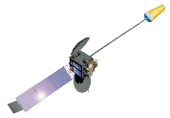
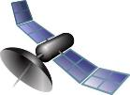
Method
Compare with spatially, temporally, and geometrically collocated data observed by a imager on low earth orbit satellite.
Fundamental idea is same as that of GSICS IR channel calibration
Imager | Satellite | Period
MVIRI/SEVIRI | METEOSAT series | 1981 -
VISSR / JAMI / IMAGER | Himawari series | 1978 -
HIRS/2 | TIROS-N NOAA-6 - NOAA-14 | 1978 – 2006
HIRS/3 | NOAA-15,16,17 | 1998 – 2013
HIRS/4 | NOAA-18,19 METOP-1,2 | 2005 -
AIRS | Aqua | 2002-
IASI | Metop-A/B | 2007-
compare data
geostationary satellite
Low earth orbit satellite
apply same method

Slide 3
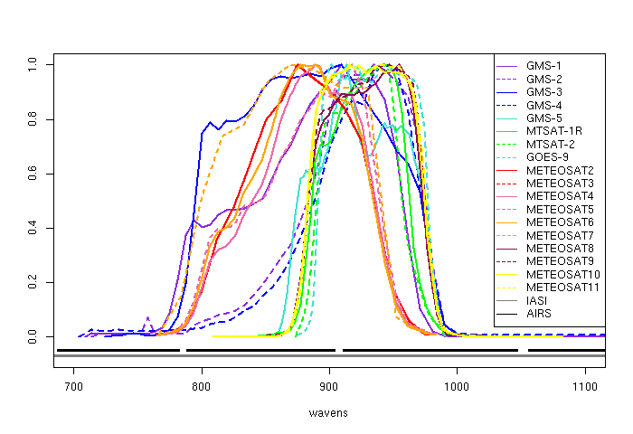
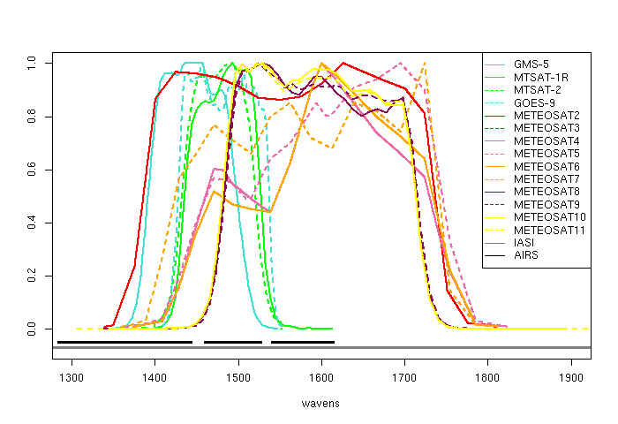
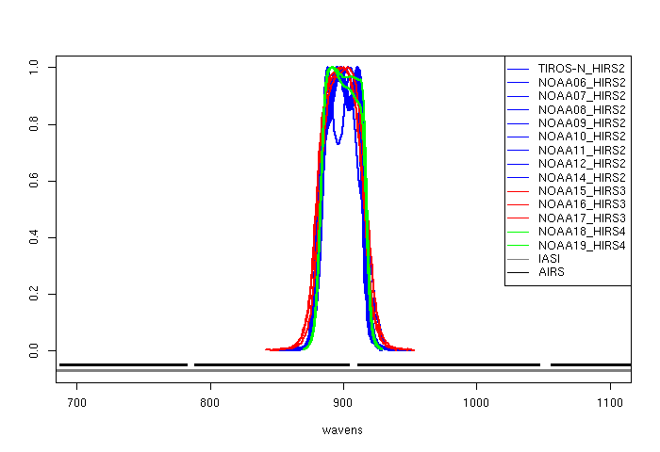
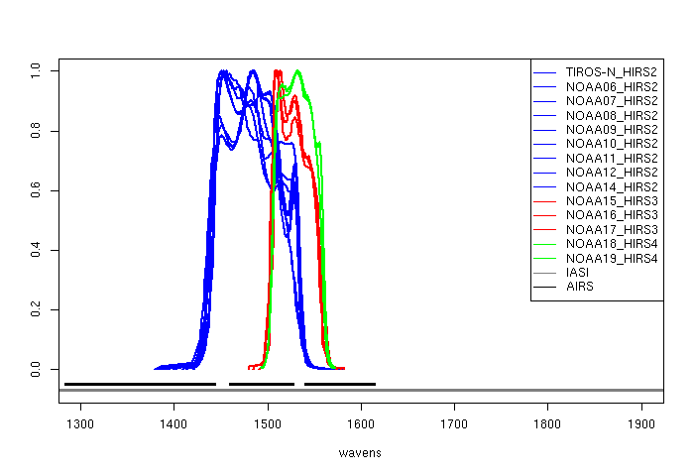
SRF of each channel
GEO IR
GEO WV
HIRS CH08
HIRS CH12
700
800
900
1000
1400
1500
1600
1700
1800
1900
wave number (cm⁻¹)

Slide 4
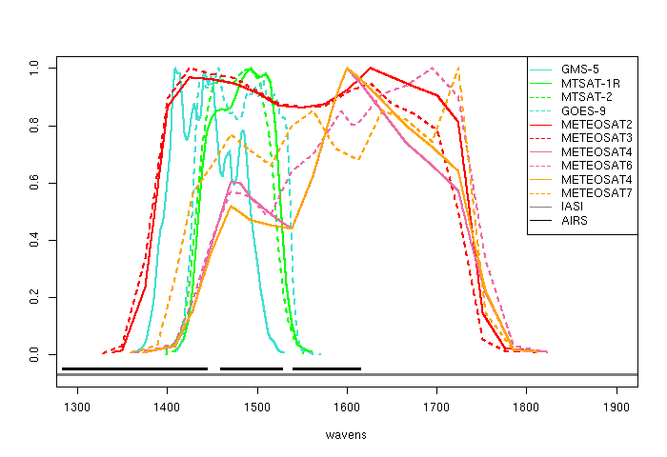
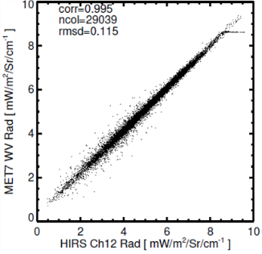
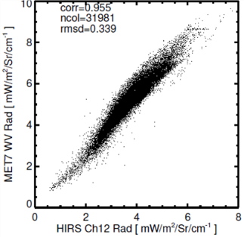
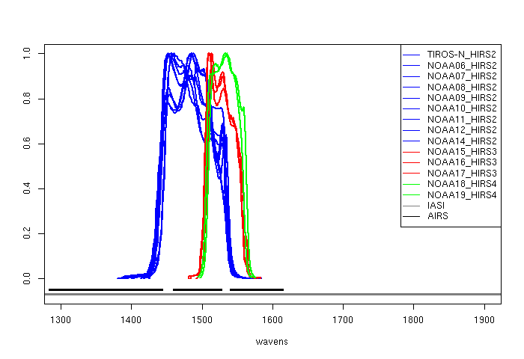
HIRS/3,4 are not suited as reference
rmsd=0.115
rmsd=0.339
LARGER!
WV channel of GEO satellite imager
HIRS/2
HIRS/3
HIRS/2
HIRS/3
HIRS/2 ch12
HIRS/3 ch12
HIRS/4 ch12
Match–up data for Metosat-7 WV channel with HIRS-2 and HIRS-3 over 0° coverage for January 2003
1300
1400
1500
1600
1700
1800
1900
Wave number (cm⁻¹)
- Start date of AIRS is earlier than end date of HIRS/2
→ Combination of HIRS/2 , AIRS and IASI covers whole GEO historical satellite observation period.

Slide 5
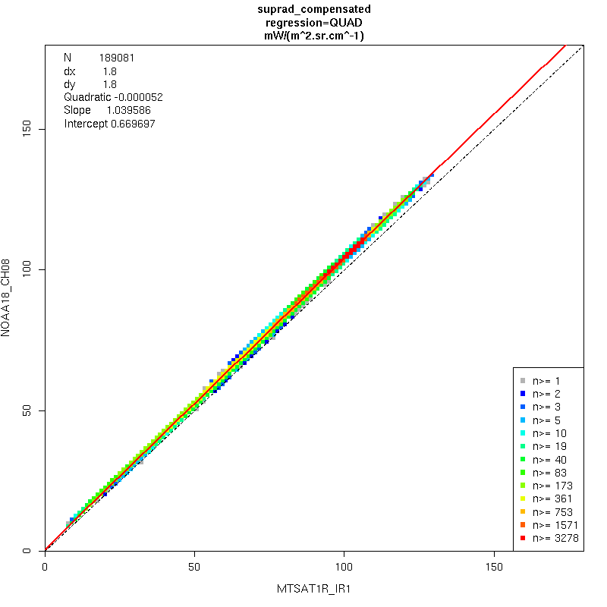
Spectral Band Adjustment Factors (SBAF)
Linear regression : y=ax+b
--> SBAF
IASI Observation Data
（actual measurement）
LEO（HIRS） pseudo-data
SBAF is the regression line of scatter plot.
( Plotting in “Radiance”: not in “Brightness Temperature”)
GEO pseudo-data
- SBAF between 2 GEO sensor can be calcurated by this method
- var(a) , var(b) and cov(a,b) are also calculated from this plot.
- Only abs(IASI_latitude) < 0 are used to calculate SBAF
- (note) module for drawing this picture is able to work on JMA’s computer

Slide 6
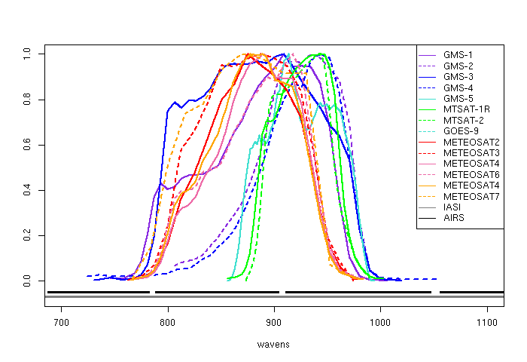
Make pseudo GEO radiance from IASI
IR
IR
IASI spectra cover all SRF range of IR and WV channels. (No gap)
Convolution method is available
$$PseudoGeoRad=\sum_{k=1}^{K}{w_{k} IasiRadObs_{k} }$$
700
800
900
1000
1100
k : IASI channel
WV
WV
Top (black): AIRS channel spectra
Bottom (gray) : IASI channel spectra
On the other hand, AIRS has gap channels.
This convolution method is not available.
1300
1400
1500
1600
1700
1800
1900

Slide 7
New method
“１” for constant term
Make pseudo GEO radiance from AIRS
# of footprint by IASI
Pseudo GEO radiance with multiple linear regression using “good” AIRS observations
A(except mask line)
1
1
1
# of AIRS channel in range of GEO SRF
$$PseudoGeoRad=c_{0}+\sum_{k=1}^{K}{c_{k} {ObsAirsRad}_{k}}$$
Pseudo AIRS radiance calculated from real IASI observation
where
Table is prepared from IASI observation in advance
$$\left\{c_{k}\right\}=argmin \sum_{i=1}^{I}{{\left\{{SimGeoRad}_{i}− \left(c_{0}+\sum_{i=1}^{I}{c_{k}{SimAirsRad}_{i,k} }\right) \right\}}^{2}}$$
observed AIRS radiance
( : known : unknown)
K : # of good airs channel in range of GEO
imager IR/WV channel spectra
I : # of actual IASI observation foot prints
mask for channels with flag in real AIRS observation
Step1 : Solve linear multiple regression (Ax=B)
for every actual AIRS foot print.
Step2 : Get pseudo GEO data at target AIRS observation footprint
from x and
(note) is not calculated.
B
Pseudo GEO radiance calculated from real IASI observation
Compensating the AIRS gap channel with thousands of observed IASI data
Uncertainty of by linear multi regression can be estimated mathematically.

Slide 8
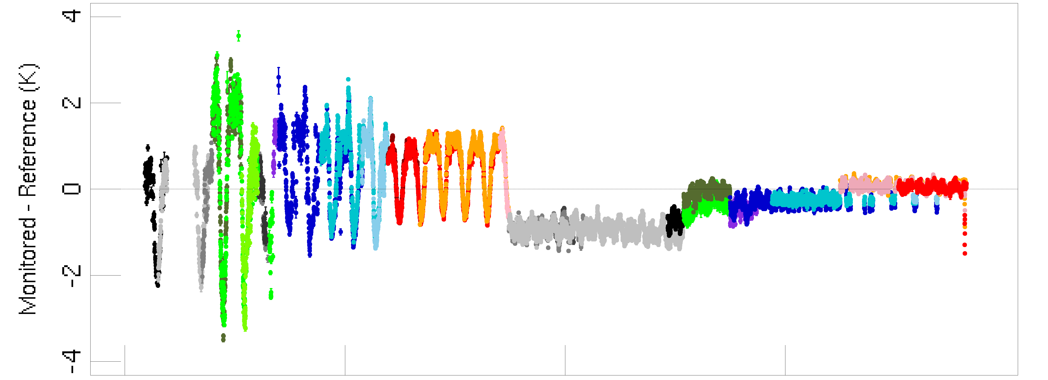
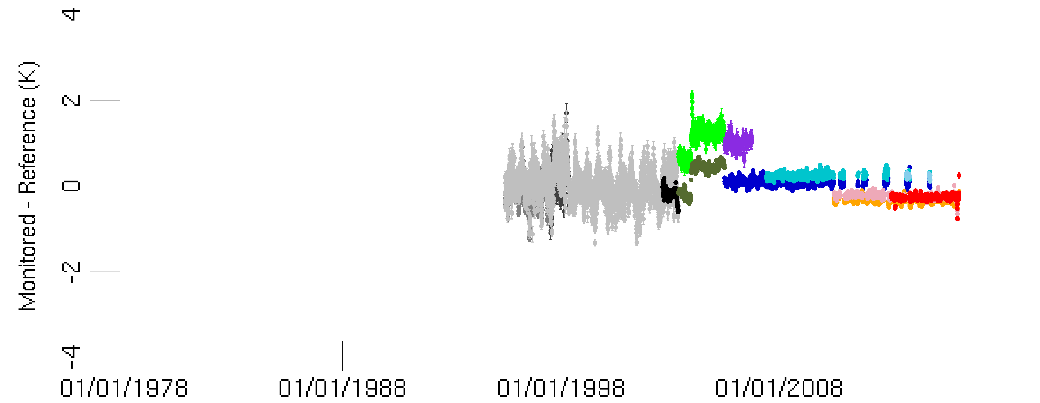
Bias of each GEO instrument against each reference @standard radiance
● GMS/VISSR vs TIROS-N/HIRS2
● GMS/VISSR vs NOAA06/HIRS2
● GMS/VISSR vs NOAA07/HIRS2
● GMS/VISSR vs NOAA08/HIRS2
● GMS-2/VISSR vs NOAA07/HIRS2
● GMS-2/VISSR vs NOAA08/HIRS2
● GMS-3/VISSR vs NOAA07/HIRS2
● GMS-3/VISSR vs NOAA09/HIRS2
● GMS-3/VISSR vs NOAA10/HIRS2
● GMS-3/VISSR vs NOAA11/HIRS2
● GMS-4/VISSR vs NOAA10/HIRS2
● GMS-4/VISSR vs NOAA11/HIRS2
● GMS-4/VISSR vs NOAA12/HIRS2
● GMS-4/VISSR vs NOAA14/HIRS2
● GMS-5/VISSR vs NOAA11/HIRS2
● GMS-5/VISSR vs NOAA12/HIRS2
● GMS-5/VISSR vs NOAA14/HIRS2
● GMS-5/VISSR vs Aqua/AIRS
● GOES-9IMAGER vs NOAA14/HIRS2
● GOES-9IMAGER vs Aqua/AIRS
● MTSAT-1R/JAMI vs NOAA14/HIRS2
● MTSAT-1R/JAMI vs Aqua/AIRS
● MTSAT-1R/JAMI vs MetOp-A/IASI
● MTSAT-1R/JAMI vs MetOp-B/IASI
● MTSAT-2/IMAGER vs Aqua/AI
● MTSAT-2/IMAGER vs MetOp-A/IASI
● MTSAT-2/IMAGER vs MetOp-B/IASI
IR
HIRS/2 seems to have bias against AIRS
We would like to overcome this bias.
WV

Slide 9
$$R=a_{0}C+b_{0}$$
← re-calibration equation derived from LEO_0 (more reliable)
$R$: radiance
$C$: GEO count
$$R=a_{1}C+b_{1}$$
← re-calibration equation derived from LEO_1
Apply linear function “$PX+Q$ “ to re-calibration equation derived from LEO_1
$$a_{0}C+b_{0}=\left(a_{1}C+b_{1}\right)P+Q$$
→ P,Q, var(P),var(Q),cov(P,Q) can be calculated with using time-series of (a0,b0,a1,b1)
New re-corrected calibration equation derived from LEO_1
$${R=A}_{1}C+B_{1}=\left(Pa_{1}\right)C+\left(Pb_{1}+Q\right)$$
$$var\left(A_{1}\right)=P^{2}var\left(a_{1}\right)+{a_{1}}^{2}var\left(P\right)$$
$$var\left(B_{1}\right)=P^{2}var\left(b_{1}\right)+{b_{1}}^{2}var\left(P\right)+var\left(Q\right)+2b_{1}cov\left(P,Q \right)$$
$$cov\left(A_{1},B_{1}\right)=P^{2}cov\left(a_{1},b_{1}\right)+a_{1}b_{1}var\left(P\right)+a_{1}cov\left(P,Q \right)$$
where,
$$cov\left(a_{1},P\right)=cov\left(b_{1},P\right)=cov\left(a_{1},Q\right)=cov\left(b_{1},Q\right)=0$$

Slide 10
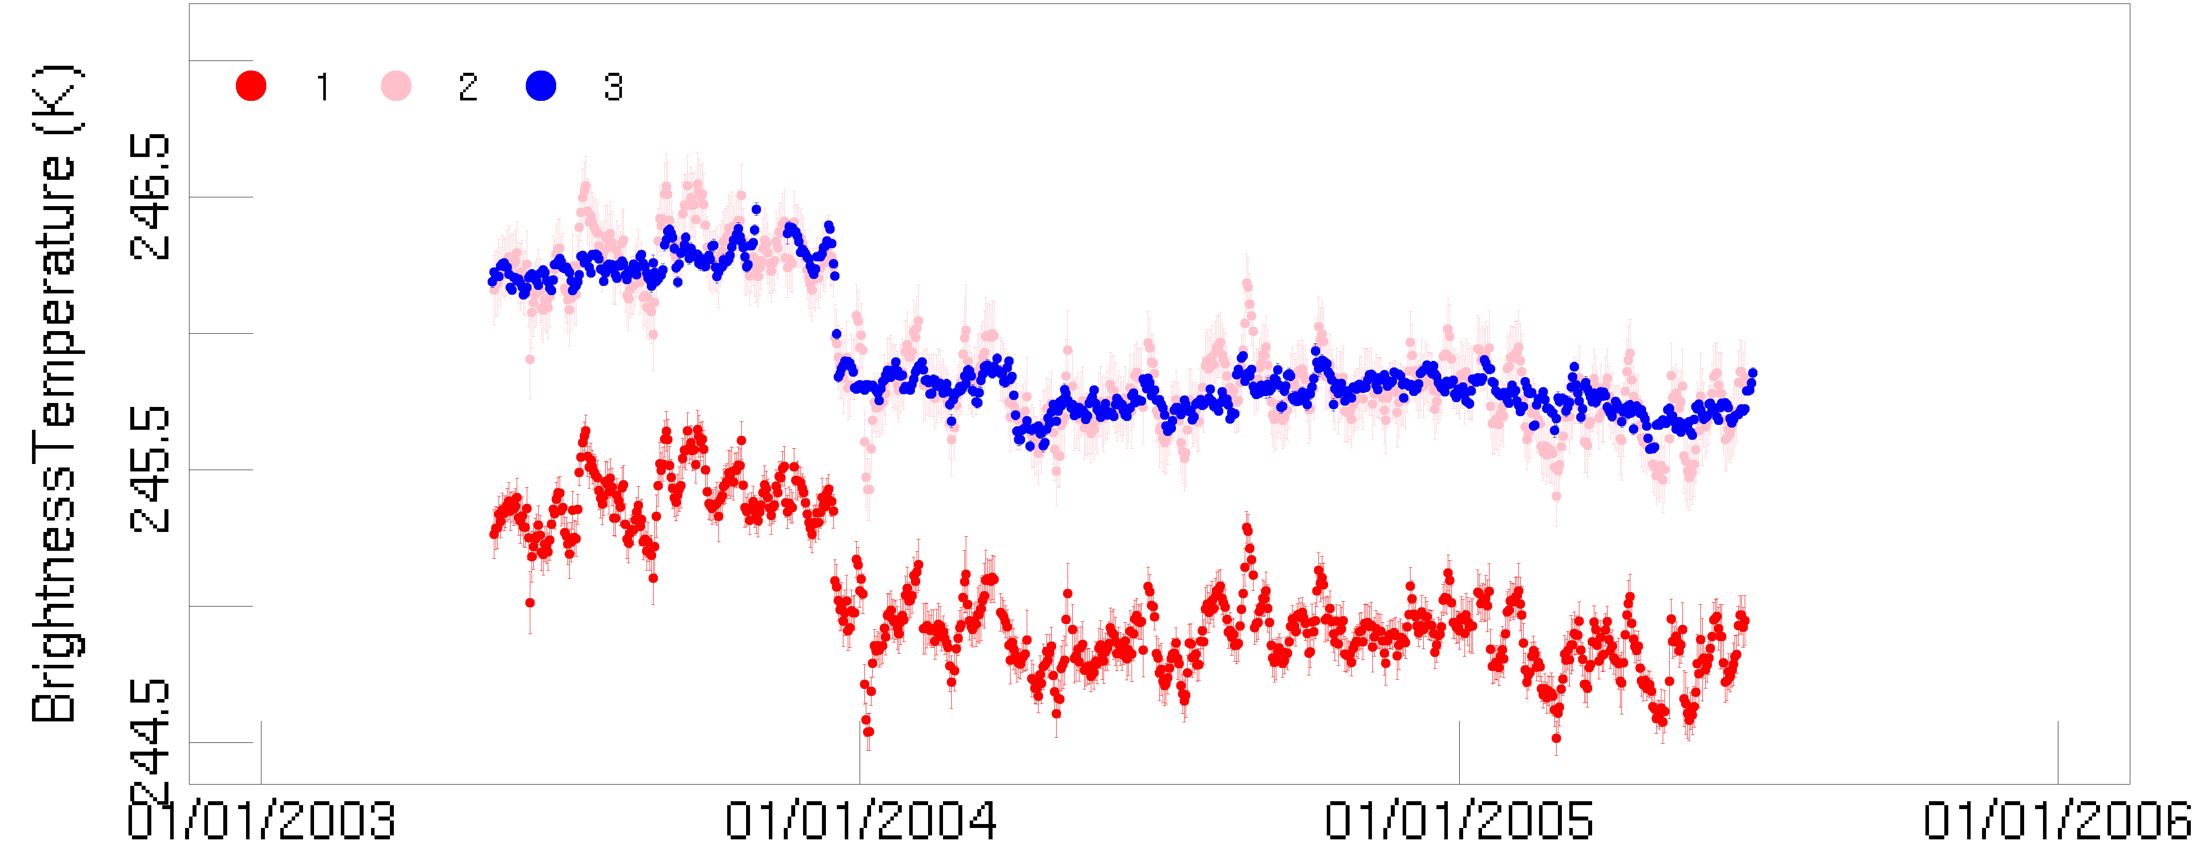
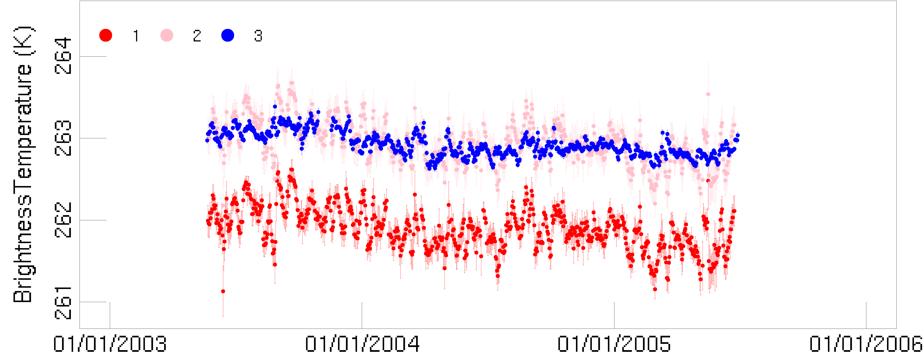
GOES-9 WV Tb at count 40
(P,Q) are estimated by data of 10% latest period
GOES-9 WV Tb at count 60
Derived from AIRS
Derived from HIRS/2
Derived from HIRS/2
( corrected by P,Q)
This method seems to work well.

Slide 11
The way to trace to MetOp/A IASI
(MetOp-A IASI is considered as prime reference )
HIRS is NOT considered as prime reference
 | MTSAT-2 | MTSAT-1R | GOES-9 | GMS-5 | GMS-4 | GMS-3 | GMS-2 | GMS-1
MetOp-B / IASI
MetOp-A / IASI
Aqua/AIRS
NOAA14/HIRS2
NOAA12/HIRS2
NOAA11/HIRS2
NOAA10/HIRS2
NOAA09/HIRS2
NOAA08/HIRS2
NOAA07/HIRS2
NOAA06/HIRS2
TIROS-N/HIRS2
SBAF
Filling LEO bias

Slide 12
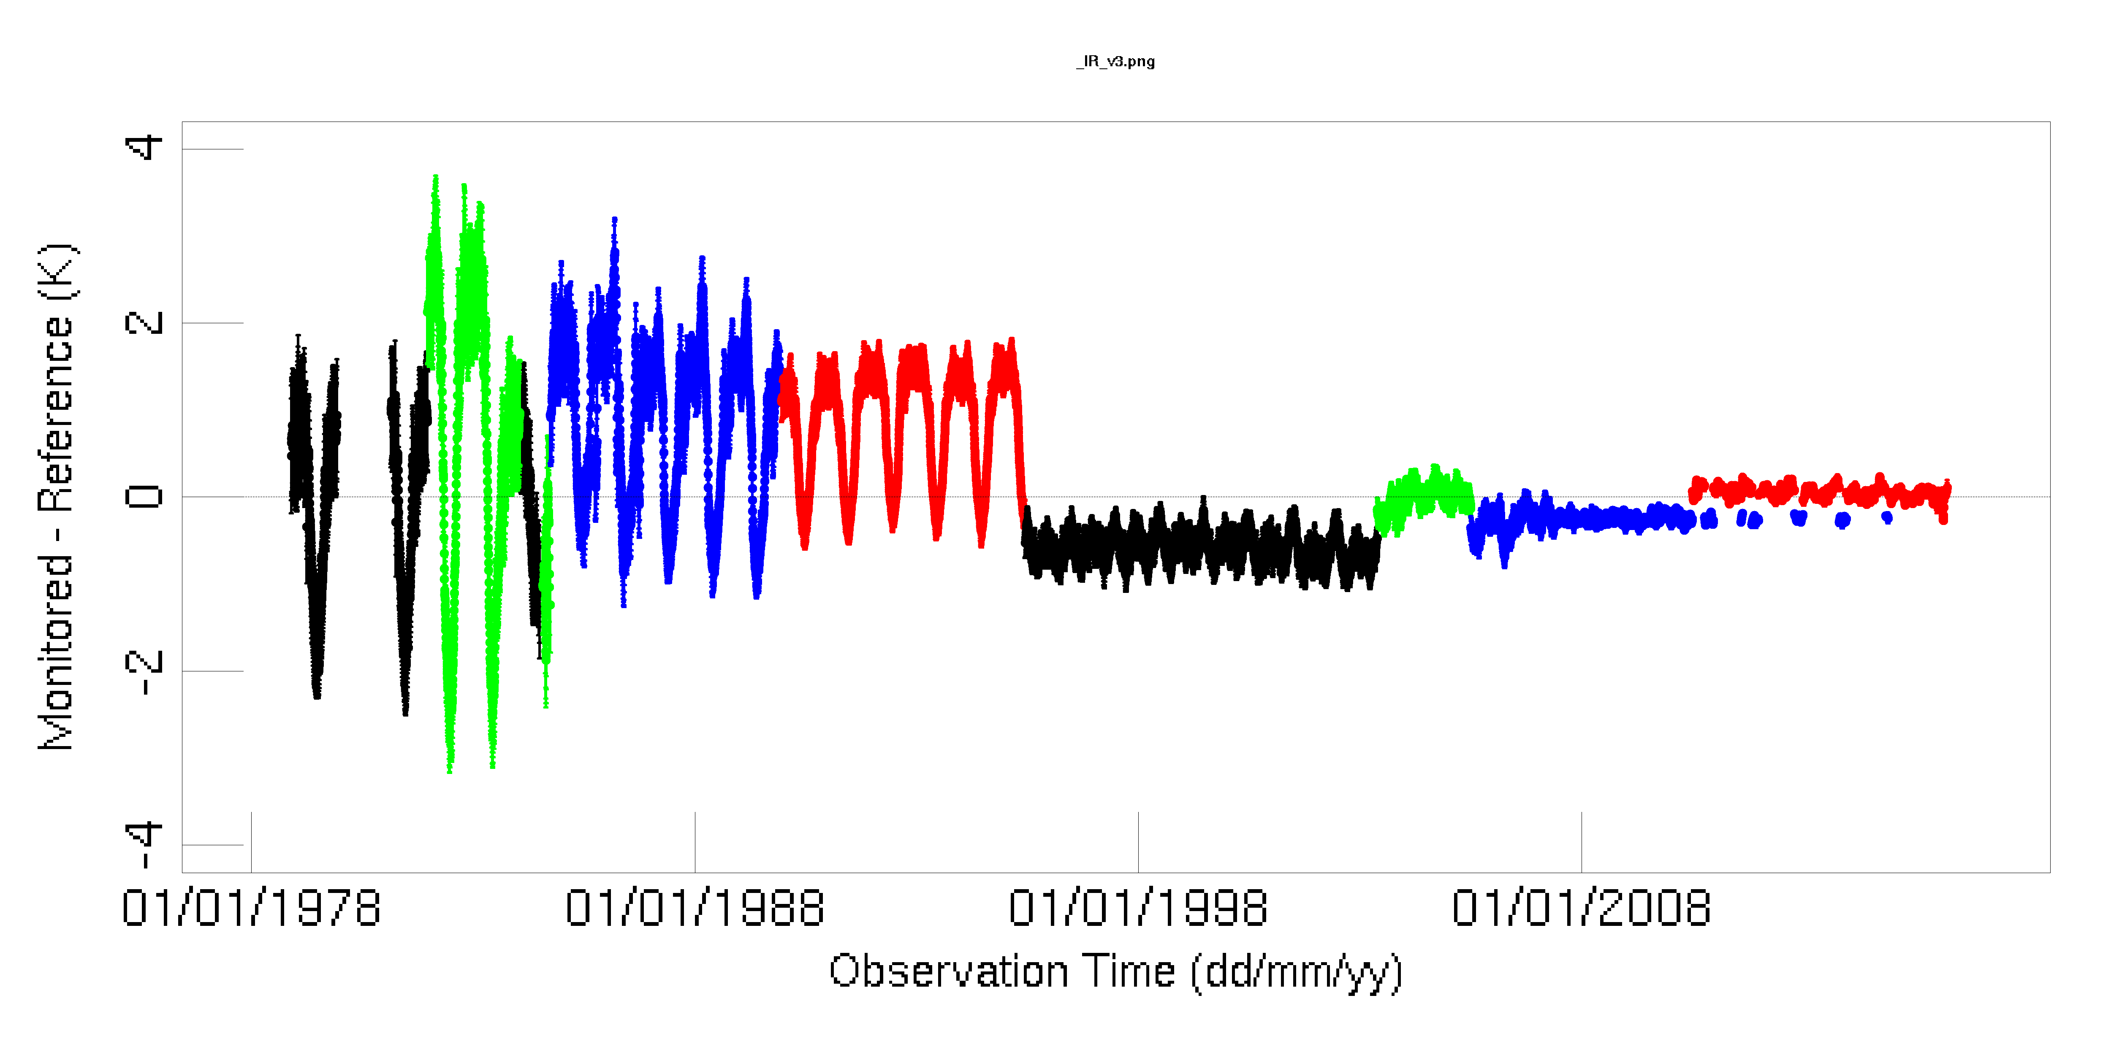
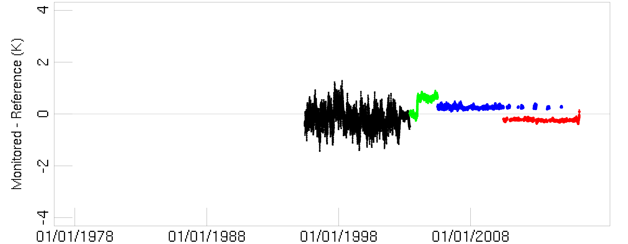
Bias of each GEO instrument (after LEO merging) @standard radiance
IR
Big uncertainty is due to mismatch GMS-5/WV channel against HIRS/2 ch12
● GMS/VISSR
● GMS-2/VISSR
● GMS-3/VISSR
● GMS-4/VISSR
● GMS-5/VISSR
● GOES-9IMAGER
● MTSAT-1R/JAMI
● MTSAT-2/IMAGER
WV

Slide 13
Average of uncertainties (K)
IR channel
GMS
GMS-2
GMS-3
GMS-4
GMS-5
GOES-9
MTSAT-1R
MTSAT-2
WV channel
GMS-5
GOES-9
MTSAT-1R
MTSAT-2
Long chain to prime reference makes big uncertainty

Slide 14
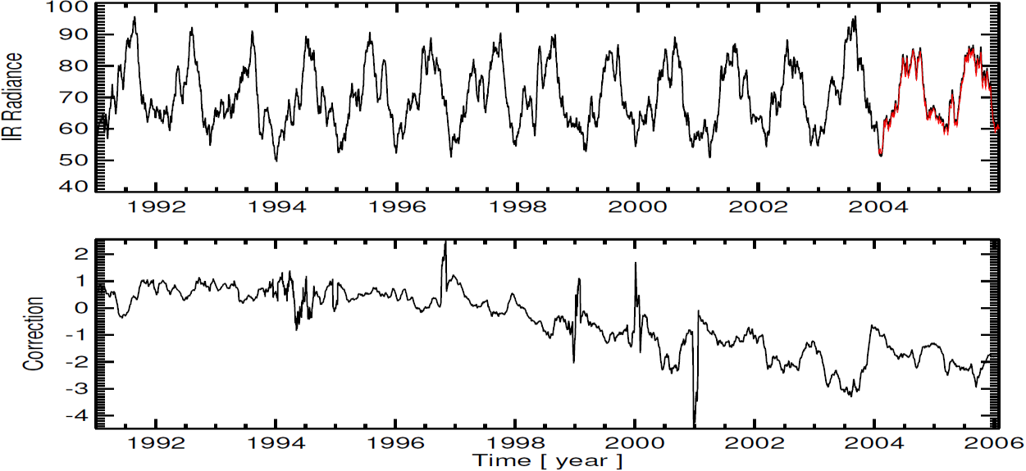
Result (EUMETSAT)
MFG
MSG
IR radiance (mW/m²/sr/cm⁻¹) over Payern, Switzerland
METEOSAT-4
METEOSAT-5
METEOSAT-6
METEOSAT-7

Slide 15
Summary
Re-calibration of IR/WV of JMA’s historical satellites
Collaboration with EUMETSAT -- > common method was applied
IASI-A is considered as prime reference.
HIRS is one of the references, but is not considered prime.
Double difference method can estimate the bias of historical HIRS data and its uncertainties against IASI-A data.

Slide 16
Back up

Slide 17
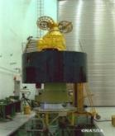
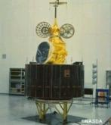
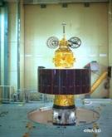
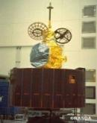
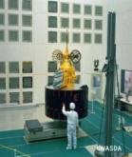
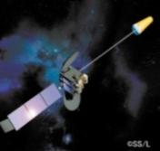
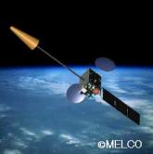
JMA geostationary satellites
GMS (Geostationary Meteorological Satellite)
Satellite | Operation period
GMS | 1978 – 1981
GMS-2 | 1981 – 1984
GMS-3 | 1984 – 1989
GMS-4 | 1989 – 1995
GMS-5 | 1995 – 2003
GOES-9 | 2003 – 2005
MTSAT-1R | 2005 – 2010
MTSAT-2 | 2010 – 2015
Himawari-8 | 2015 – 2022
Himawari-9 | 2022 – 2029
GMS
GMS-2
GMS-3
GMS-4
GMS-5
(GOES-9)
(Himawari)
(Himawari-2)
(Himawari-3)
(Himawari-4)
(Himawari-5)
Back-up operation of GMS-5 w/ GOES-9 by NOAA/NESDIS:
2003/05/22-2005/06/28
ⒸNASDA
ⒸNASDA
ⒸNASDA
ⒸNASDA
ⒸNASDA
Jul 1977
Aug 1981
Aug 1984
Sep 1989
Mar 1995
MTSAT (Multi-functional Transport SATellite )
MTSAT-1R
MTSAT-2
(Himawari-6)
(Himawari-7)
Himawari
Himawari-8
Himawari-9
2014
2016
ⒸSS/L
ⒸMELCO
Feb 2005
Feb 2006
launched on 2 November 2016
and became back up of Himawari-8 in March 2017
launched on 7 Oct. 2014
Operation started on 7 July 2015

Slide 18
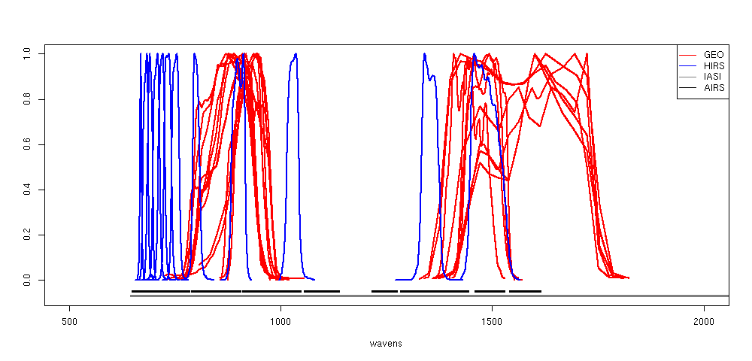
Select suitable reference channel of HIRS
IR/WV channel of imager on JMA’s and EUMETSAT’s geostationary satellite
HIRS（NOAA12）
HIRS ch08
HIRS ch12
IR
WV
500
1000
1500
2000
Wave number (cm⁻¹)

Slide 19
Purpose of re-calibration
Requirement of high quality historical geostationary meteorological satellite data for climate
Geostationary satellite observations are available for more than 40 years with high spatial and temporal coverage, which are suitable for deriving essential climate variables such as cloud properties, global radiation budget, and atmospheric motion vectors and for assimilating in climate reanalyses;
However, these historical instruments were primarily built for weather applications, but generating climate quality datasets require higher quality input data;
We attempt to generate higher quality geo-stationary radiance data by re-calibrating them using superior quality reference datasets and accounting for changes in the characteristics of the geo-stationary satellites and sensors during their operational lifetime.
Common method among satellite operation agencies
Climate studies require homogeneous dataset of whole globe;
Cooperation among satellite agencies and applying common method for qualification of all the satellite data is important.
Re-calibration of Infrared and Water-Vapor channels of imagers on EUMETSAT and JMA historical geostationary satellites
Infrared (IR) and Water-Vapor (WV) channel are considered in this study;
Re-calibration of Visible (VIS) channel is future challenge.

Slide 20
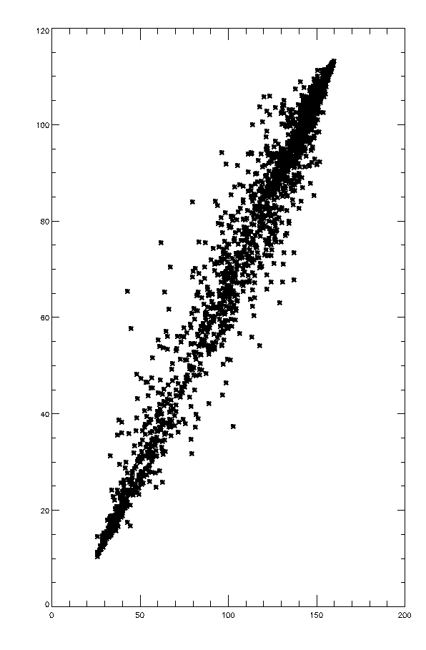
Get tentative correction coefficients
Plot GEO count and Pseudo GEO radiance
- Plot collocation data in +- 2 days
- 100 plots are minimum number for linear fitting
- We consider uncertainty of each point
- variance in x axis
variance of GEO count in FOV area.
- variance in y axis
variance from LEO NEDT
variance from SBAF (only HIRS/2)
variance from liner multi regression (only AIRS)
- temporal mismatch/ variability, etc… are not considered
- Apply linear fitting
- use fitexy (library in IDL)
this module can consider uncertainty of
uncertainty of each point in both of x and y axis
Pseudo-GEO radiance
(made from HIRS/AIRS/IAIS)
Linear fitting
This calibration is
“tentative correction coefficients”
GEO count
Each point has uncertainty
In x and y axis

Slide 21
Standard Radiance
Same condition as GSICS GEO-LEO IR
The standard radiance of AHI was calculated for each channel by RTTOV-11.2
in a 1976 US Standard Atmosphere at nadir,at night, in clear sky, and over the sea with an SST of 288.15K and a wind
speed of 7m/s.RTTOV v11
Use RTTOV-11.2 v7 predictors
his value is used for assessment of GEISCS GEOLEO-IR.
 | radiance (mW/m²/sr/cm⁻¹) |  | Brightness Temperature (K)
 | IR | WV | IR | WV
GMS-1 | 96.373 | - | 285.43 | -
GMS-2 | 91.593 | - | 285.84 | -
GMS-3 | 96.868 | - | 285.48 | -
GMS-4 | 90.551 | - | 285.51 | -
GMS-5 | 90.853 | 7.1787 | 286.14 | 243.69
GOES-9 | 89.514 | 5.0823 | 286.26 | 238.25
MTSAT-1R | 90.681 | 4.9840 | 286.17 | 237.85
MTSAT-2 | 91.497 | 5.3513 | 286.70 | 239.17

