Slide 1


Cross-track Infrared Sounder Spectral Gap Filling Accuracy Analysis
using GOES-16 ABI as Example
Hui Xu, Likun Wang, Fangfang Yu, Yong Chen and Fred Wu
GSICS IR Subgroup Webmeeting
06/05/2018
Notes:
1

Slide 2
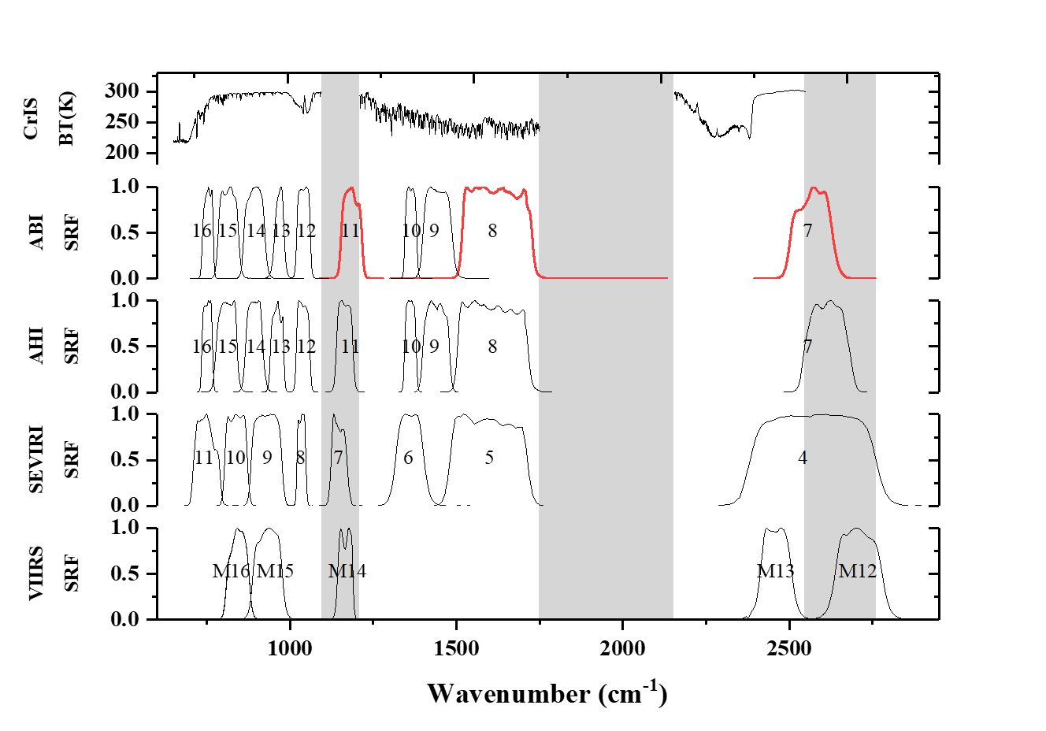
Background
The Line-By-Line Radiative Transfer Model (LBLRTM) simulated spectra of CrIS along with the channel response of ABI, AHI, SEVIRI and VIIRS. The shadow areas show the spectral regions where CrIS do not measure.

Slide 3
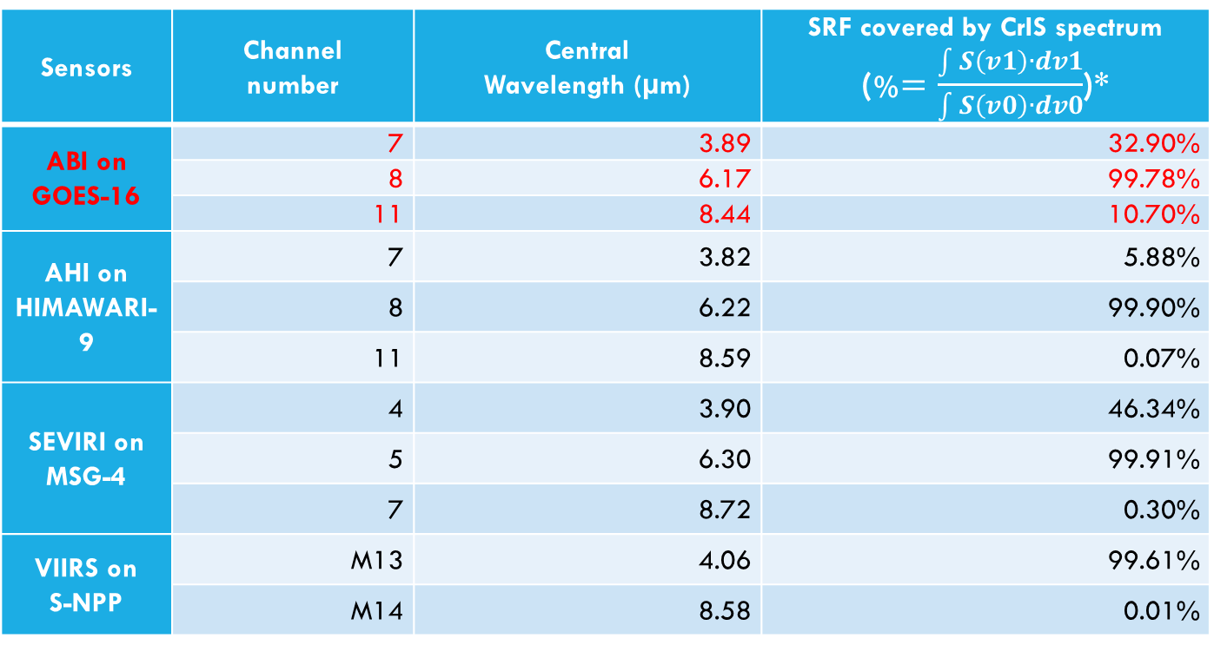
Background
Sensors | Channel number | Central Wavelength (µm) | SRF covered by CrIS spectrum (%$=\frac{\int{S\left(v1\right)∙dv1}}{\int{S\left(v0\right)∙dv0}}$)*
ABI on GOES-16 | 7 | 3.89 | 32.90%
 | 8 | 6.17 | 99.78%
 | 11 | 8.44 | 10.70%
AHI on HIMAWARI-9 | 7 | 3.82 | 5.88%
 | 8 | 6.22 | 99.90%
 | 11 | 8.59 | 0.07%
SEVIRI on MSG-4 | 4 | 3.90 | 46.34%
 | 5 | 6.30 | 99.91%
 | 7 | 8.72 | 0.30%
VIIRS on S-NPP | M13 | 4.06 | 99.61%
 | M14 | 8.58 | 0.01%
Table 1. CrIS spectral band coverage for broadband channels of ABI, AHI, SEVIRI and VIIRS. Only the channels that are not fully covered by CrIS are listed.
* v0 and S are wavenumber and spectral response of the broad band instrument, and v1 is wavenumber of the broad band instrument that only covered by CrIS.

Slide 4
Background
GSICS 2018 annual meeting actions and suggestions:
A.GIR.2018.4d.1: Xu Na (CMA) and NOAA to compare with the NOAA and JMA gap filling methods. To report at the next Web meeting in 2-3 months.
Suggestions from Mitchel: Evaluate the NOAA proposed gap filling method with IASI data. “To pretend IASI has gaps and fill them with this method and check it with real IASI data. That would be the best validation.”
A.GIR.2018.4d.3: Hui Xu to apply gap-filling method to IASI following to previous comment.
The detailed NOAA proposed gap filling methods can be found in our previous presentation at GSICS website:
http://gsics.atmos.umd.edu/pub/Development/20180319/4d_2018_GSICS_HUIXU.pptx

Slide 5
Outline
The evaluation of NOAA proposed gap filling method with
Initial comparison between JMA and NOAA’s gap filling methods
Conclusions and future works
IASI simulated Proxy Collocation Data
GEO-ABI and IASI Collocation Data
Notes:
5

Slide 6
The evaluation of NOAA proposed gap filling method
with IASI simulated Proxy Collocation Data
FullCrIS Spectra
(0.625 cm-1, 650~2755 cm-1, continuously)
GOES-ABI SRF
FullCrIS-ABI
(Regarded as truth)
Step1. Conversion to
CrIS(gapfilled) Spectra
IASI Spectra
(Globally, All FORs and FOVs)
Step2. Convolve with GOES-ABI
Advantages of Proxy data
(Global Scale, no collocation, spatial average ... uncertainties)
Proxy Collocation data
CrIS measured channels
(0.625 cm-1, 650~1095, 1210~1750, 2155~2550 cm-1)
Gap Filling
CrIS gap channels
(0.625 cm-1, 1095~1210, 1750~2155, 2550~2755 cm-1)
CrIS(gapfilled)-ABI
The flow chart of the evaluation of gap filling method with proxy collocation data
The difference between CrIS(gapfilled)-ABI and FullCrIS-ABI can be regarded as the gap filling uncertainty which is mainly caused by the following two parts:
fitting error of the gap filling method, e.g., the linear assumption between the CrIS measured and gap channels which will induce small bias if they are nonlinearly correlated;
the original IASI instrument noise can hardly be predicted, e.g., IASI is supposed to have a larger noise over the cold scene.
Dataset and quality control: The dataset used here is selected from the full orbit of IASI/B spectra on 30 Oct 2016. Moreover, the spectra with channel radiances less than zero are considered as invalid data with large noise and removed from the dataset.

Slide 7
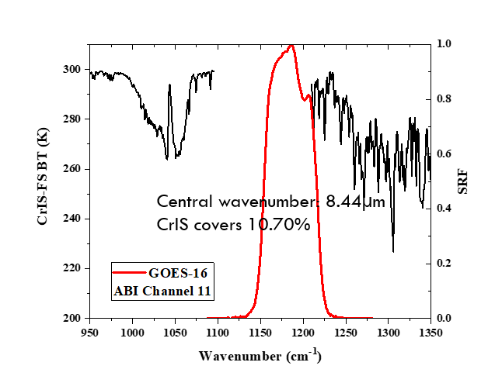
The evaluation of NOAA proposed gap filling method
with IASI simulated Proxy Collocation Data
CrIS(gapfilled)-ABI minus FullCrIS-ABI in Channel 11
Channel 11 is a window channel, the observed radiances are mainly emitted from underlying surfaces
CrIS covers around 10% of the ABI channel SRF
In general, the differences between CrIS(gapfilled)-ABI and FullCrIS-ABI over channel 11 are very small with a mean of 1.4e-6 and standard deviation of 0.065K Globally.
Mostly less than 0.25K

Slide 8
The evaluation of NOAA proposed gap filling method
with IASI simulated Proxy Collocation Data
CrIS(gapfilled)-ABI minus FullCrIS-ABI in Channel 11
Scene dependent
NOT observed
Similar
Angle dependent
NOT observed
Scene and scan angle dependences are hardly found between CrIS(gapfilled)-ABI and FullCrIS-ABI over channel 11, and the daytime data shows a slightly larger value in Stddev.

Slide 9
The evaluation of NOAA proposed gap filling method
with IASI simulated Proxy Collocation Data
CrIS(gapfilled)-ABI minus FullCrIS-ABI in Channel 11
Descending (day)
Ascending (night)
Spatial distribution maps of their BTD (K) in Channel 11
Their differences tend to be larger over desert areas (takes 2% of the total observations, and possibly due to the surface and airborne dust emissivity are too complex to be predicted)

Slide 10
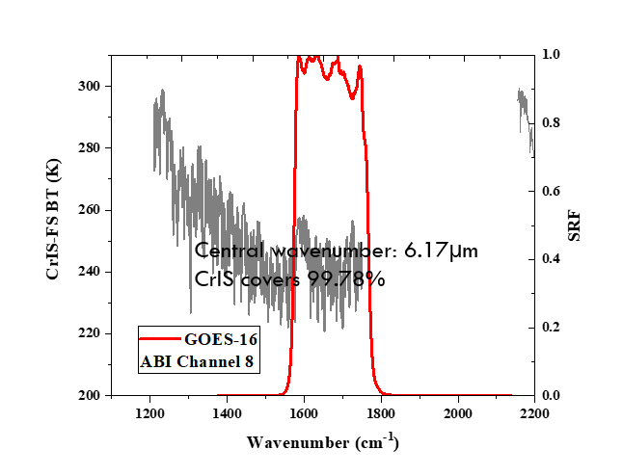
The evaluation of NOAA proposed gap filling method
with IASI simulated Proxy Collocation Data
CrIS(gapfilled)-ABI minus FullCrIS-ABI in Channel 8
Channel 8 is a water vapor channel, the radiances are mainly from atmosphere
Mostly less than 0.0005K
Scene dependent
Angle dependent
Similar
NOT observed
NOT observed

Slide 11
The evaluation of NOAA proposed gap filling method
with IASI simulated Proxy Collocation Data
CrIS(gapfilled)-ABI minus FullCrIS-ABI in Channel 8
Descending (day)
Ascending (night)
Spatial distribution maps of their BTD (K) in Channel 8
Channel 8 BTD ZOOM IN
Channel 8 BT
The anomaly areas are overlapped with the very cold scenes (DCC? Machine learning method will helpful on this ?).

Slide 12
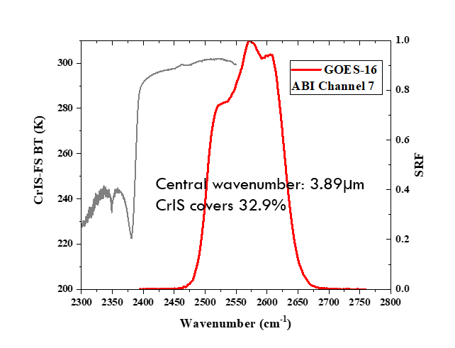
The evaluation of NOAA proposed gap filling method
with IASI simulated Proxy Collocation Data
CrIS(gapfilled)-ABI minus FullCrIS-ABI in Channel 7
Channel 7 is also a window channel. Only nighttime data are analyzed to remove the uncertainties caused by solar reflectivity.
Mostly less than 0.5K
Scene dependent
Angle dependent
NOT observed
NOT observed

Slide 13
The evaluation of NOAA proposed gap filling method
with IASI simulated Proxy Collocation Data
CrIS(gapfilled)-ABI minus FullCrIS-ABI in Channel 7
Spatial distribution map of their BTD (K) in Channel 8
Spatial distribution maps of the channel BT (K)
Their difference are generally larger in the cold scenes, such as the areas near the polar regions.
The instrument noises of the original IASI SW observations are relatively larger over the cold scene.

Slide 14
The evaluation of NOAA proposed gap filling method
with GEO-ABI and IASI Collocation Data
The data is collected from 1 Mar. 2018 to 6 Mar. 2018, and the collocation criteria are:
Closest pixel center: <2 KM
Time difference: <5 minutes
Viewing zenith angle difference: Abs[cos(Geo_zen)/cos(Leo_zen) -1]<1%
There are totally 20218 FOVs are collocated together between IASI/B and GOES-16 ABI with 9840 FOVs are selected from nighttime. The full disk collocation dataset is provided by the GOES ABI SDR Science Team.
The inhomogeneous scenes are further filtered in each channel with:
  Geo_env_std/Geo_env_mean<5%
  Geo_fov_std/Geo_fov_mean<1%
to reduce the uncertainties caused by collocation method.

Slide 15
The evaluation of NOAA proposed gap filling method
with GEO-ABI and IASI Collocation Data
Ray-matching Collocation data
(Full disk)
GOES-ABI SRF
IASI-ABI
(regarded as the IASI reference)
convolve with ABI SRF
IASI Spectra
CrIS(gapfilled) Spectra
GOES-ABI compare with
both of the two references to check the performance of the gap filling method
GOES-ABI
CrIS measured channels
(0.625 cm-1, 650~1095, 1210~1750, 2155~2550 cm-1)
Compare
convolve with ABI SRF
Gap Filling
CrIS(gapfilled)-ABI
(regarded as the CrIS reference)
CrIS gap channels
(0.625 cm-1, 1095~1210, 1750~2155, 2550~2755 cm-1)
The flow chart of the evaluation of gap filling method with IASI and ABI collocation data

Slide 16
The evaluation of NOAA proposed gap filling method
with GEO-ABI and IASI Collocation Data
GOES-ABI minus LEO-ABI in channel 11
The scene, angle, spatio-temporal patterns between them are quite similar.

Slide 17
The evaluation of NOAA proposed gap filling method
with GEO-ABI and IASI Collocation Data
Bias caused by gap filling method
The differences caused by the gap filling method are generally less than 0.1 K (within the green dish line) over a large area, and the scene, angle, spatio-temporal dependences are not obvious.

Slide 18
The evaluation of NOAA proposed gap filling method
with GEO-ABI and IASI Collocation Data
GOES-ABI minus LEO-ABI in channel 8
Since the spectral gap is very small, the differences can be neglected after the gap was filled.

Slide 19
The evaluation of NOAA proposed gap filling method
with GEO-ABI and IASI Collocation Data
Bias caused by gap filling method
The differences are less than 0.005 K (within the green dish line), and the scene, angle, spatio-temporal dependences are hardly observed.

Slide 20
The evaluation of NOAA proposed gap filling method
with GEO-ABI and IASI Collocation Data
GOES-ABI minus LEO-ABI in channel 7
Similarly, most of their differences are overlapped together.

Slide 21
The evaluation of NOAA proposed gap filling method
with GEO-ABI and IASI Collocation Data
Bias caused by gap filling method
Similar to the LW channel 11, the uncertainty induced by gap filling are less than 0.1 K in SW channel 7.

Slide 22
Initial Comparison between different gap filling methods
JMA’s gap filling method are currently used in GSICS community and works well for small gaps, such as the AIRS bad channels.
JMA’s method
8 typical spectra simulated from LBLRTM
narrow channels only within broad channels are used
The coefficients need to be regressed at each channels and observations
NOAA’s method
4 Days global real spectra measured from IASI in different season,
Leading PCs (spectral information) are used
All the coefficients have no channel, observation dependences…
We have to mention that the comparison here is only for discussion not the final result. (It would be better if JMA could do a further investigation on this)

Slide 23
Initial Comparison between different gap filling methods
Comparison using IASI simulated proxy collocation data
The performance of both JMA and NOAA proposed gap filling methods are firstly compared with previous mentioned Global Proxy CrIS and ABI collocation data simulated from IASI.
CrIS(JMA)–ABI: IASI convert to CrIS and convolve with ABI SRF after the gap was filled with JMA’s method
CrIS(NOAA)–ABI: IASI convert to CrIS and convolve with ABI SRF after the gap was filled with NOAA’s method
MINUS
FullCrIS–ABI: IASI convert to FullCrIS and convolve with ABI SRF (regarded as the truth)
Less than +- 0.5K
Less than +- 0.2K
Less than +- 0.0005K
Less than +- 2.5K
Less than +- 0.4K
Less than +- 0.002K
NOAA proposed gap filling method results in a lower difference with the FullCrIS-ABI.

Slide 24
Initial Comparison between different gap filling methods
Comparison using GSICS Ray-matching collocation data
The GSICS IASI/ABI Ray-matching collocation data are also used in the comparison of the two gap filling methods:
CrIS(JMA)–ABI: IASI convert to CrIS and convolve with ABI’s SRF after the gap was filled with JMA’s method
IASI–ABI: IASI directly convolve with ABI’s SRF
CrIS(NOAA)–ABI: IASI convert to CrIS and convolve with ABI’s SRF after the gap was filled with NOAA’s method
MINUS
GOES–ABI: observations measured by GOES ABI (regarded as the truth)
Both NOAA and JMA’s gap filling methods work well for this channel.
Comparable
Departure from others
JMA’s gap filling results have a larger uncertainty.
Their differences should be neglected for small gaps.
NOAA’s gap filling method could get comparable inter-comparison results (red) with real IASI observation (blue).
JMA’s gap filling results are a little departure from the other two.

Slide 25
Summary and Future work
Summary
Scene, angle, and spatiotemporal dependences are not obviously found in NOAA’s gap filling results, even though anomalies are found in extreme scenes.
The NOAA proposed gap filling results are comparable with real IASI in the inter-comparison studies.
Overall, the NOAA’s gap filling method could be an alternative way to choose in the GSICS community, and it can be easily embedded into the current GSICS operational software.
Future work
More extreme scenes will be in included in the training dataset to see if this will reduce the anomalies. Furthermore, a machine learning based neutral network gap filling method is under investigated now to see if this could solve these issues and finally improve the gap filling accuracy.
Following Tim’s suggestions on this issue, we are now trying to work with Xu Liu and Wan Wu together to see if we could use the PCRTM data to predict out the channels beyond 2760 cm-1.

Slide 26
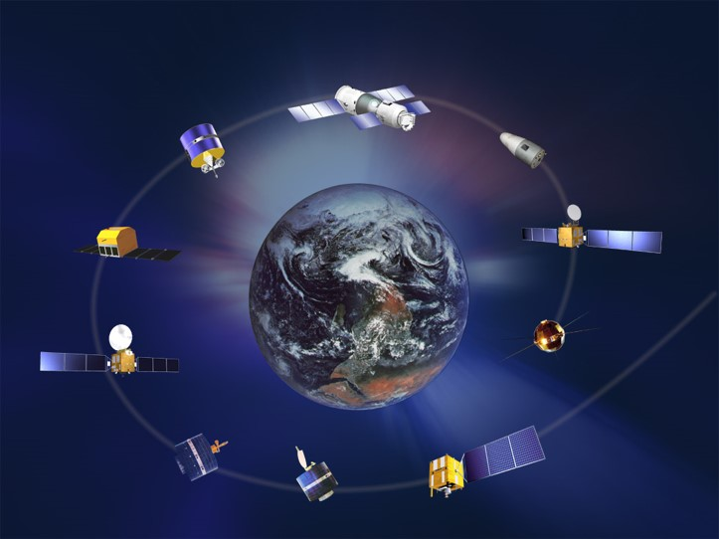
Thanks
Hui Xu
(CICS/ESSIC/Univ. of Maryland, College Park, MD)
Email: huixu@umd.edu

