Slide 1
Review of Spectral Filling Methods - History, Challenges, and Prospects
Likun Wang
Univ. of Maryland, College Park, MD; wlikun@umd.edu
2018 GSICS Annual meeting, Shanghai, China; March 20 2018

Slide 2
Actions from 2018 GSICS Meeting
A.GIR.2018.4d.2: Likun Wang (NOAA) to set up web meeting to discuss comparisons of gap-filling methods and plan way forward by June 2018.
A.GIR.2018.4d.1: Na (CMA) to compare with the JMA gap filling methods. To report at the next web meeting in 2-3 months.
A.GIR.2018.4d.3: Hui Xu to apply gap-filling method to IASI following to previous comment (two IASI data wt/wo gap).

Slide 3
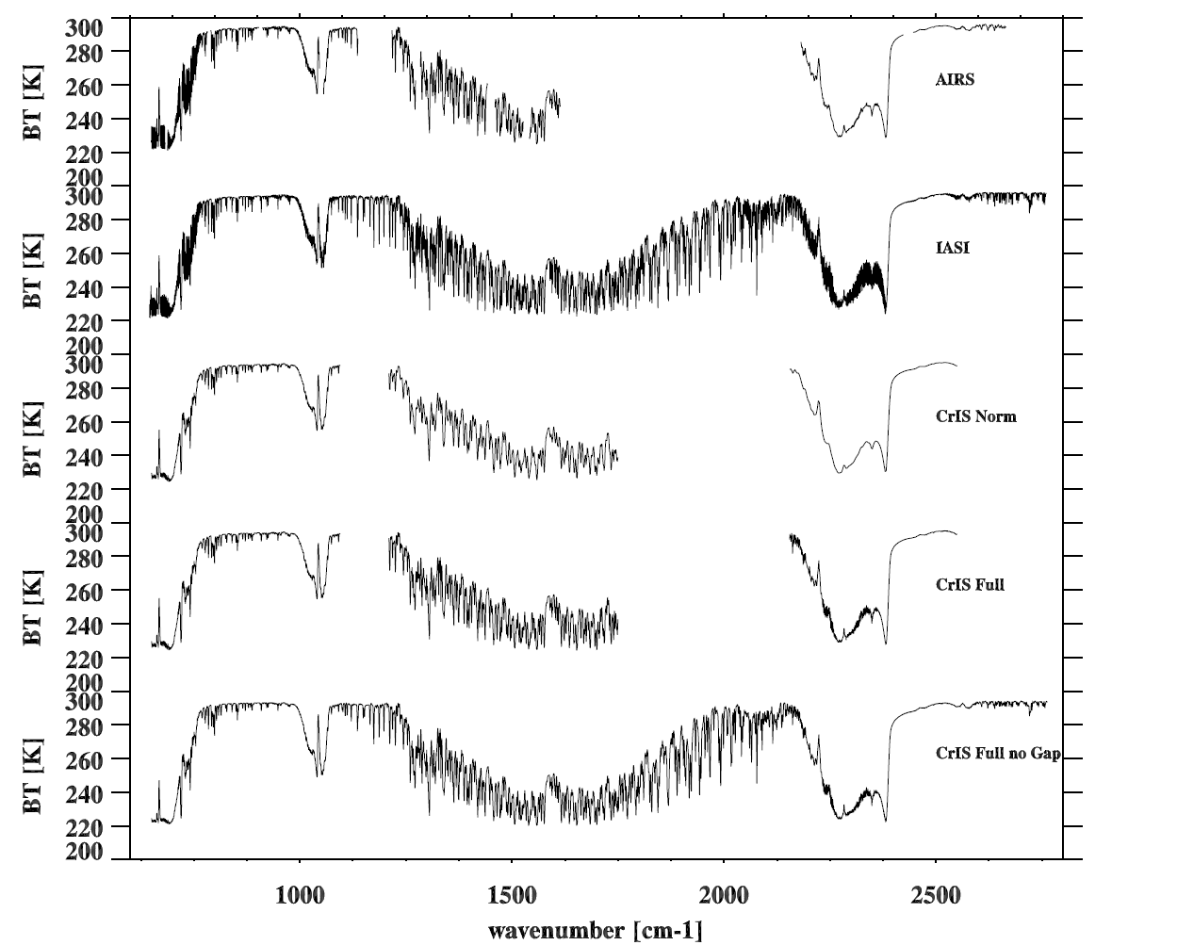
AIRS, IASI, and CrIS Spectra for inter-calibration
AIRS bad or missing channels
IASI channels beyond 2760 cm-1
CrIS Spectral Gaps

Slide 4
References
Tobin, D. C., et al, 2006: Use of atmospheric infrared sounder high-spectral resolution spectra to assess the calibration of Moderate resolution Imaging Spectroradiometer on EOS Aqua. J. Geophys. Res., 111, D09S05. doi:10.1029/2005JD006095.
Tahara, Y., and K. Kato, 2008: New spectral compensation method for intercalibration with high spectral resolution sounder. Japan Meteorological Agency Meteorological Satellite Center Tech. Note 52, 37 pp.
Wu, W., et al., 2018: An accurate method for correcting spectral convolution errors in inter-calibration of broadband and hyper-spectral sensors. J. Geophys. Res. (Under Review).
Xu, H, Y. Chen, and L. Wang 2018: Cross-track Infrared Sounder Spectral Gap Filling toward Improving Inter-calibration Accuracy, IEEE TRANSACTIONS ON GEOSCIENCE AND REMOTE SENSING (Under Review).

Slide 5
Spectral Gap Methods
Authors | Training Datasets | Method | Implementation(before or after convolution) | AIRS Gap | IASI SW Gap | CrIS Gaps Between bands
Tobin et al. (2006) | 6 kCARTA Spectra from Standard Atmospheric Profiles (clear sky) | Mean Values | After | ✓ | ✗ | ✗
Tahara and Kato (2008) | 9 LBLRTM Spectra from Different Atmospheric Profiles (clear sky+ cloudy) | Multiple Linear Regression | Before | ✓ | ✗ | ✗
Wu et al. (2018) | 14600 LBLRTM Spectra from PCRTM databases (clear sky+ cloudy) | Multiple Linear Regression | After | ✓ | ? | ✓
Xu et al (2018) | IASI four day’s spectra in different seasons (clear sky+ cloudy) | PCA Regression | Before | ✗ | ✗ | ✓

