Slide 1
CrIS Spectral filling method test on FY-3D MERSI 8.55μm band
Na XU Hanlie XU Xiuqing HU
CMA, 2018-06-05

Slide 2
Outline
Spectral Coverage Comparsion
Application testing based on SNO intercalibration
  MERSI-CrIS
  MERSI-HIRAS
Summary

Slide 3
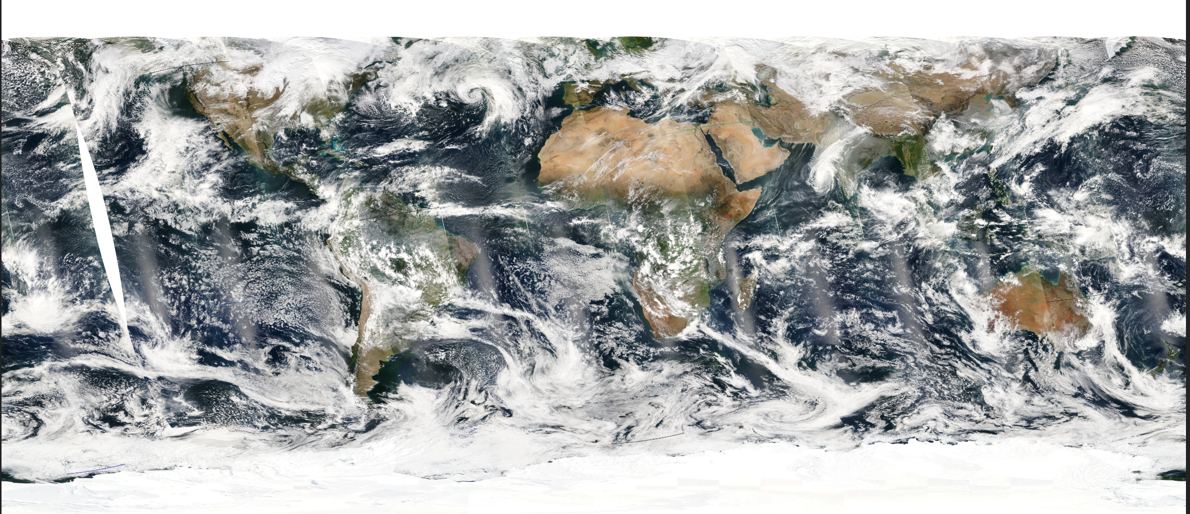
Instrument—MERSI-II
Band | FY-3D MERSI-II | FY-3A/B/C MERSI
1 | 0.470 | 0.470
2 | 0.550 | 0.550
3 | 0.650 | 0.650
4 | 0.865 | 0.865
5 | 1.38 | 11.25
6 | 1.64 | 1.640
7 | 2.13 | 2.130
8 | 0.412 | 0.412
9 | 0.443 | 0.443
10 | 0.490 | 0.490
11 | 0.555 | 0.520
12 | 0.670 | 0.565
13 | 0.709 | 0.650
14 | 0.746 | 0.685
15 | 0.865 | 0.765
16 | 0.905 | 0.865
17 | 0.936 | 0.905
18 | 0.940 | 0.940
19 | 1.03 | 0.980
20 | 3.8 | 1.030
21 | 4.05
22 | 7.2
23 | 8.550
24 | 10.8
25 | 12.0
MERSI-II Improvements:
Cover all bands in FY-3A/B/C MERSI and VIRR
Five more IR bands
Cirrus cloud band 1.38μm
Water vapor bands In NIR and 7.2μm
Two IR split windows with 250m spatial resolution
Higher accuracy from onboard calibration
Lunar Calibration capability
250 m
1000 m

Slide 4
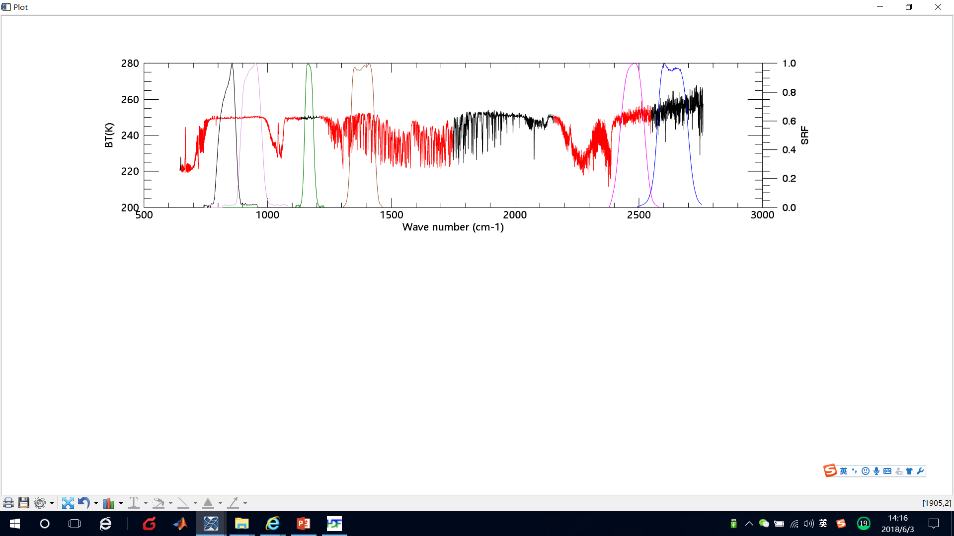
Instruments Spectral Coverage
MERSI SRF & IASI、HIRAS spectral coverage
CH25
CH24
CH23
CH22
Spectral Gap of HIRAS
CH21
CH20
MERSI |  | HIRAS | CrIS | IASI
Band number | Wavelength Center | Spectral channel coverage (cm⁻¹)
CH25 | 12μm (833cm⁻¹) | 650-1135 | 650-1095 | 645-1210
CH24 | 10.8μm (926cm⁻¹)
CH23 | 8.55μm (1169cm⁻¹) | Gap | Gap
CH22 | 7.2μm (1389cm⁻¹) | 1210-1750 | 1210-1750 | 1210-2000
CH21 | 4.05μm (2469cm⁻¹) | 2155-2550 (A little bit gap) | 2155-2550 (A little bit gap) | 2000-2762 (A little bit gap)
CH20 | 3.8μm (2631cm⁻¹) | Gap | Gap

Slide 5









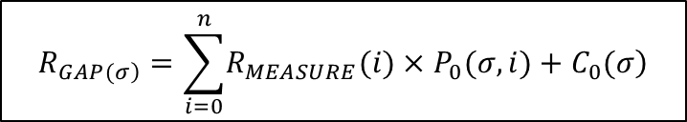
Gap filling Coefficients
From Hui Xu
huixu@umd.edu
Methodology:Principal Component Regression (PCR) based spectral gap prediction
Usage : There are 3 datasets inside the H5 file
P0：is gap-filling coefficient matrix with a dimension of 1158(col) ×2211(row)
C0：is gap-filling constant vector with a length of 1158
GAP_NUM: has 3 values which are 183, 647 and 328 representing the number of gap channels (totally are 1158=183+647+328) in LW[1095.625~1209.375], MW [1750.625~2154.375] and SW [2550.625~2755] spectral regions respectively.
The use of the H5 file
$$R_{\left.GAP(σ\right)}=\sum_{i=0}^{n}{\left.R_{MEASURE}(i)×P_{0}(σ,i)+C_{0}(σ\right)}$$
2211 measured radiances
1158 gap channels
1158 gap radiances
CrIS-FS
measured spectra
CrIS-FS
gap spectra
1158 gap channels
2211 coefficients
t observations
t observations

Slide 6
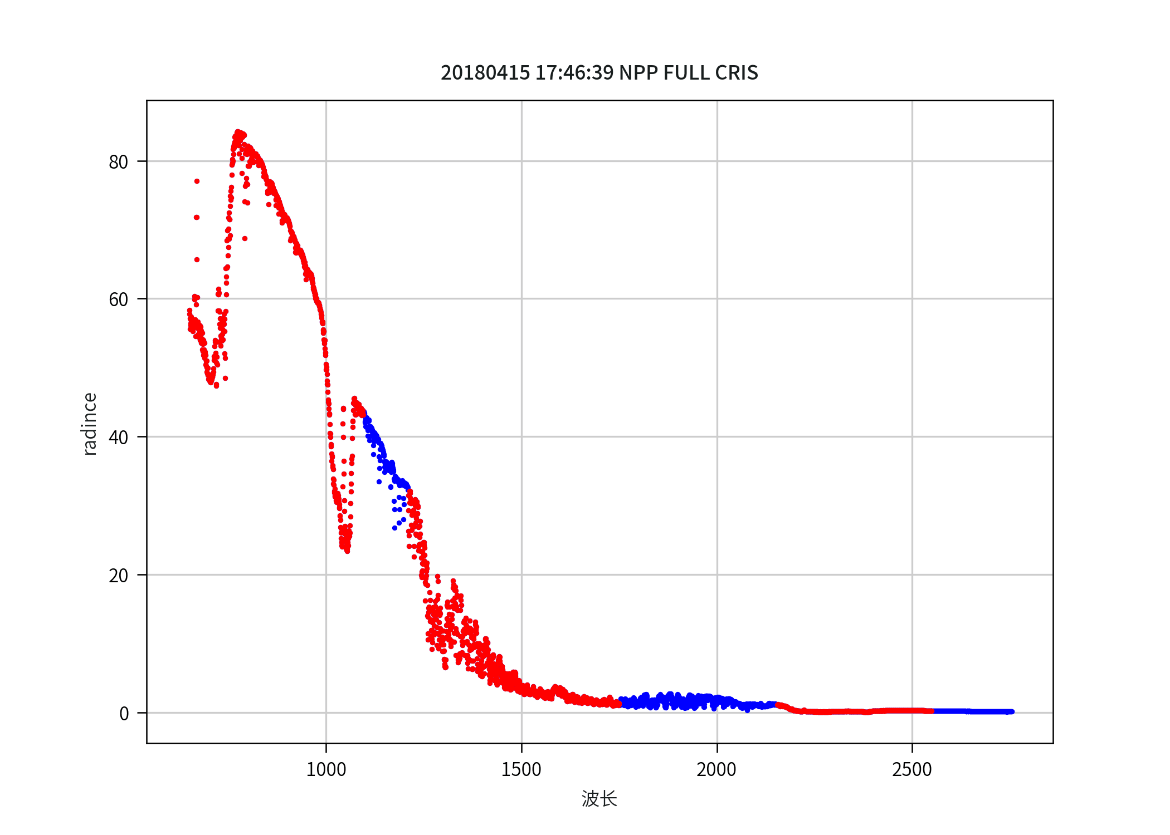
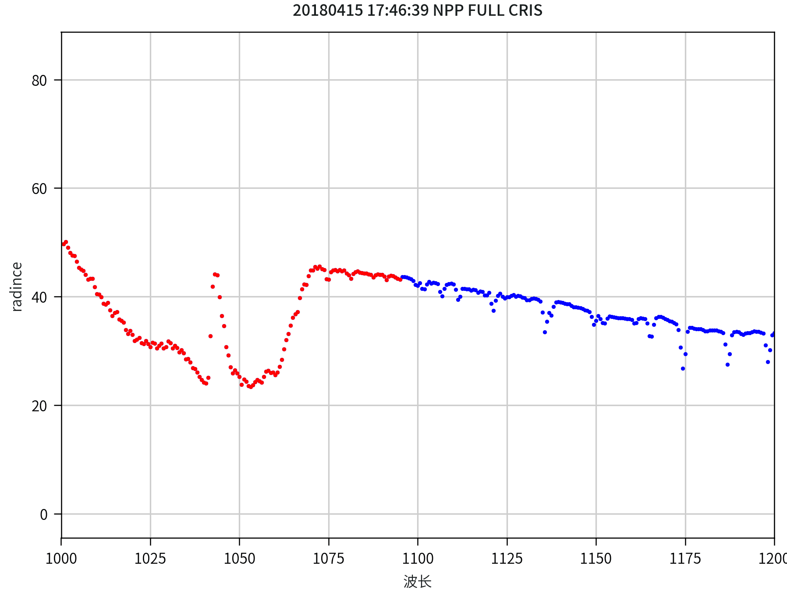
Radiance Spectra after gap filling
Application Testing: MERSI-CrIS
Red ：Orignal Spectra
Blue：Gap filling Spectra

Slide 7
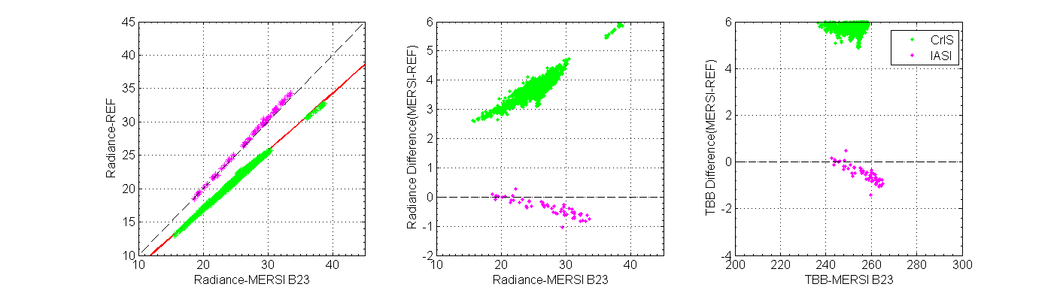
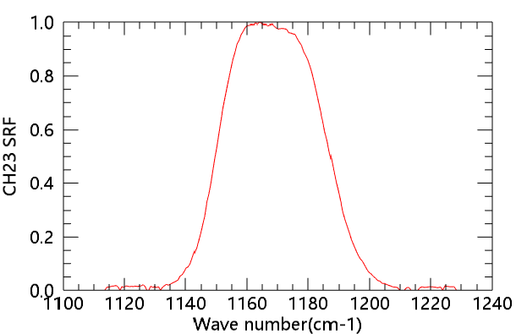
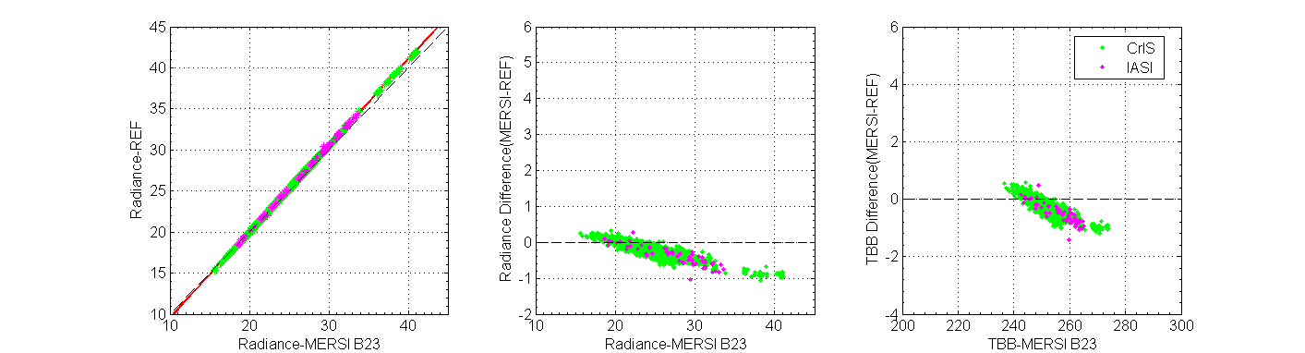
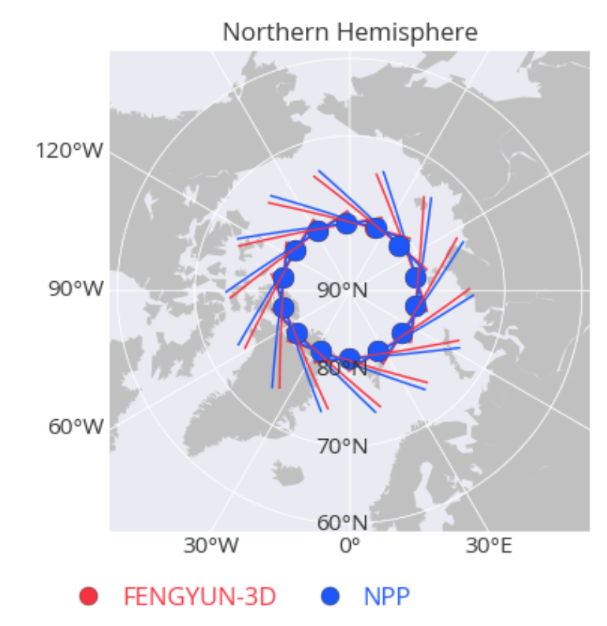
SNO Intercalibration Regression based on IASI and CRIS for MERSI Band 8.55μm
Application Testing: MERSI-CrIS
S
Before
MERSI SRF
CrIS Spectral Gap
After
SNO track selection
Bias@250K=-0.39K
Bias@250K=-0.45K

Slide 8
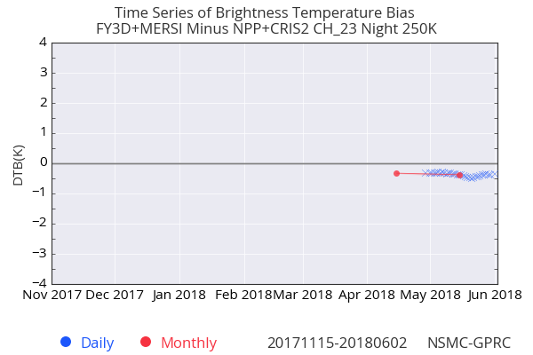
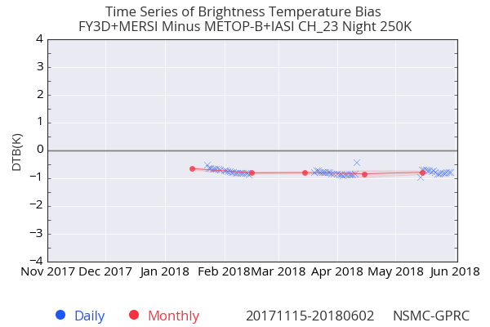
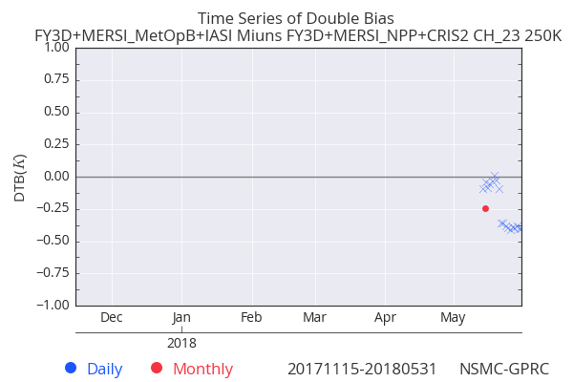
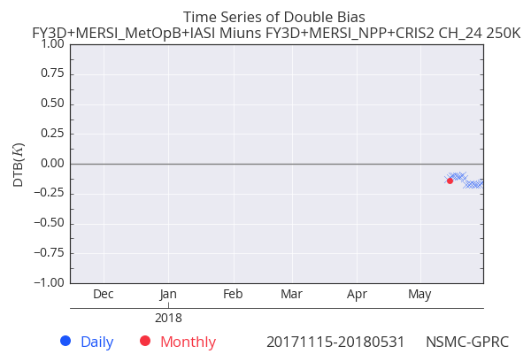
Time series variation
TBB Bias
CRIS
IASI-B
Double difference (CrIS&IASI-B)
8.55μm
10.8μm

Slide 9
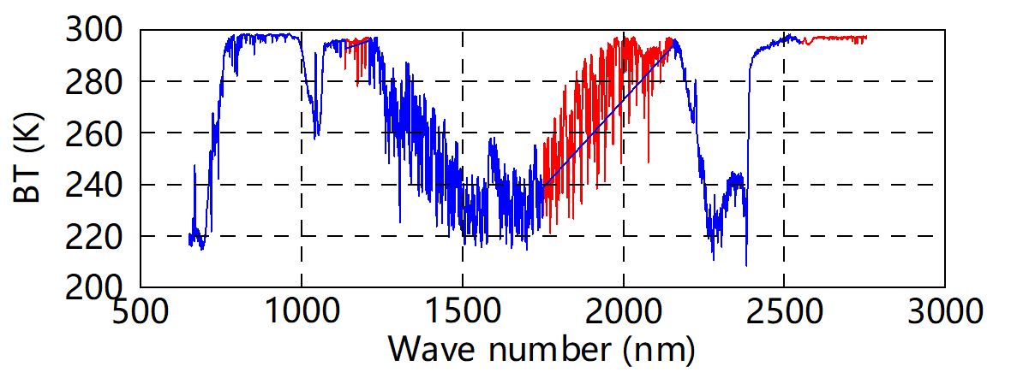
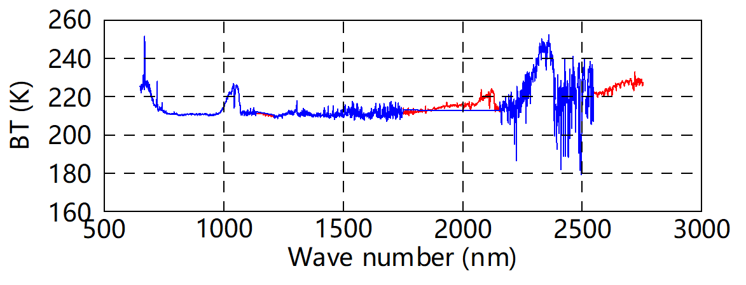
Application Testing: MERSI-HIRAS
Radiance Spectra after gapfilling
20180601-0820
Blue：Orignal Spectra
Red ：Gap filling Spectra
Warm Scene
Cold Scene

Slide 10
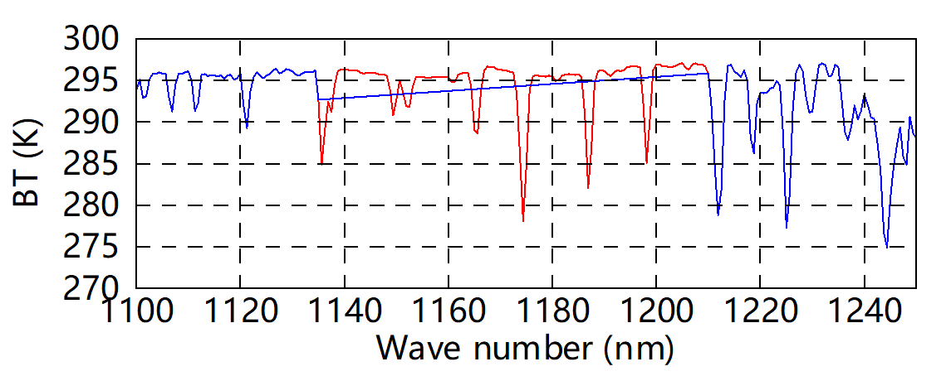
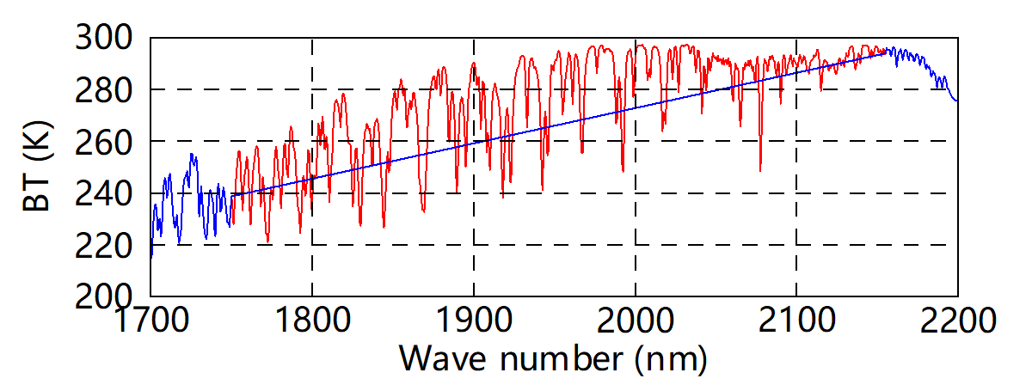
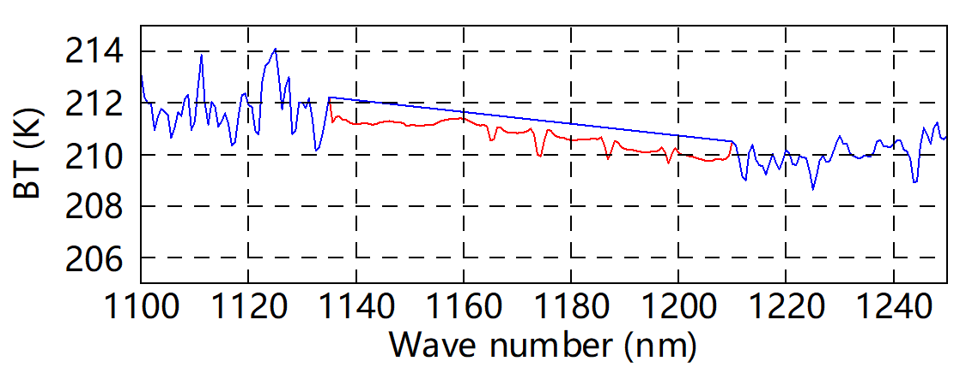
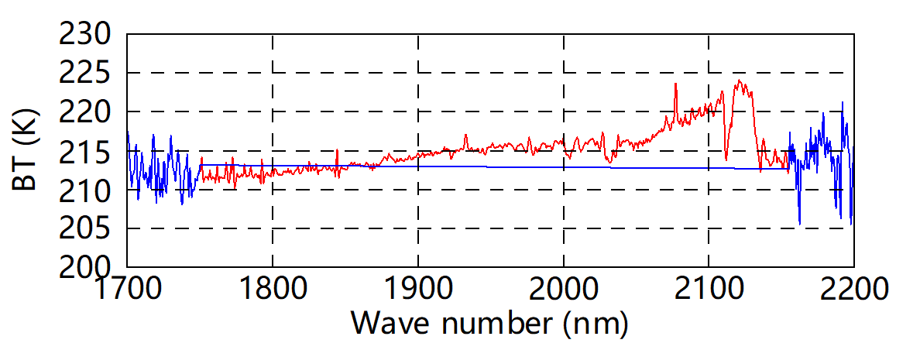
Details spectra
Warm Scene
Cold Scene

Slide 11
SNO Intercalibration Regression based on CrIS and HIRAS for MERSI Band 8.55μm
MERSI SRF
CrIS Gap
HIRAS Gap

Slide 12
Summary
Testing results of CrIS Spectral filling method on FY-3D MERSI 8.55μm band show the new spectra after gap filling is reliable, and can be used as reference for inter-calibration for this broadband channel.
MERSI 8.55μm band is found a litter nonlinear response feature, which maybe has a little influence on double difference comparison.

Slide 13
Thank for your attention

