Slide 1
Development of inter-comparison method for 3.7µm channel of SLSTR-IASI
Tim Hewison
Alessandro Burini
(EUMETSAT)

Slide 2
Problem #1
S7 band extends beyond IASI’s short-wave limit 2760cm⁻¹ = 3.623µm
Missing from IASI spectra
From S3-RP-RAL-SL-102

Slide 3
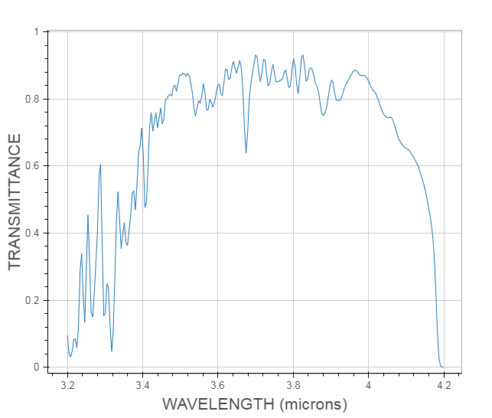
Assumption
S7 band extends beyond IASI’s short-wave limit 2760cm⁻¹ = 3.623µm
Hypothesis:
Missing signal can be predicted from observed spectra
Assumption:
No significant spectral features of different atmospheric species or surface emissivity
http://modtran.spectral.com/modtran_home

Slide 4
Problem #2
Representative radiance spectra to train gap-filling
Need to cover full range of atmospheric conditions
Temperature profiles
Surface types/temperatures
Water vapour burdens
Cloud amounts (low, mid-level, high, …)
CH4, CO2, …
Need to cover full spectrum of monitored channel
IASI doesn’t help here!
At sufficient spectral resolution
Whatever that means…
Over full range of viewing angles
Can we use modelled radiance spectra?

Slide 5
Idea #1a – Use SEVIRI/IR3.9 with RTTOV+SBAF tool
Use RTM to define SBAF to a channel that can be synthesised:
Get a big dataset of atmospheric profiles
(e.g. Chevallier, SLSTR data!)
Over different surfaces
Add cloud at different levels
Use RTTOV to simulate TOA radiances
for these profiles at different view angles
for monitored channel (SLSTR/S7) and SEVIRI/IR3.9
or any other real channel around here fully covered by IASI
Which? Want real instrument with full SRF coverage by IASI
Compare these to generate SBAF
Convolve collocated IASI spectra with SEVIRI/IR3.9 SRF
➔Pseudo-SEVIRI radiances
Apply SBAF to pseudo-SEVIRI radiances
➔Pseudo-SLSTR radiances

Slide 6
Idea #1b – Use SEVIRI/IR3.9 with NASA SBAF tool
NASA SBAF tool is based on IASI observations ☹
Need to re-train with modelled spectra covering full SRF
Get a big dataset of atmospheric profiles
Over different surfaces
Add cloud at different levels
and line-by-line RTM to simulate TOA radiance spectra
Over full spectrum 3-15µm
Over full range of viewing angles
Compare these to generate “SBAF” to convert IR3.9 to S7
Is this a generally useful thing to do? If so, how?
Is this a plausible thing to do?
Convolve collocated IASI spectra with SEVIRI/IR3.9 SRF
➔Pseudo-SEVIRI radiances
Apply SBAFs to pseudo-SEVIRI radiances
➔Pseudo-SLSTR radiances

Slide 7
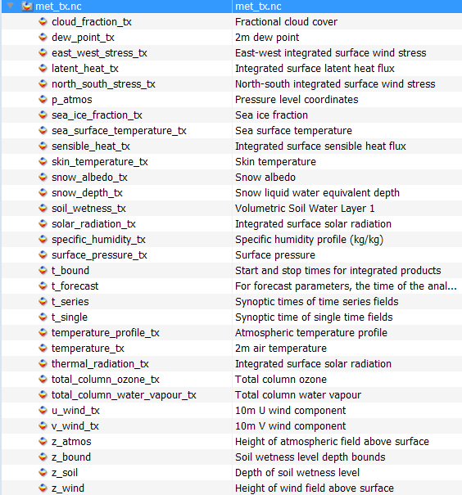
But …
SLSTR L1 data comes with a bonus!
ECMWF model fields per scan line/ every ~12 pixel across track

Slide 8
Idea #1c – Use SEVIRI/IR3.9 with SBAF tool
Use RTM to define SBAF to a channel that can be synthesised
Use ECMWF data included in SLSTR L1 data(!)
Over land/sea
Add cloud at different levels
how?
Use RTTOV to simulate TOA radiances
for monitored channel (SLSTR/S7) and SEVIRI/IR3.9
for each collocation
Compare these to generate customised SBAF
Convolve collocated IASI spectra with SEVIRI/IR3.9 SRF
➔Pseudo-SEVIRI radiances
Apply SBAFs to pseudo-SEVIRI radiances
➔Pseudo-SLSTR radiances
- Equivalent to double differencing (SLSTR-RTM(ECMWF)) – (SEVIRI-RTM(ECMWF))

Slide 9
Idea #2 – Use Gap Filling Tool
Use Gap-filling tool
Based on large dataset of profiles
Add cloud at different levels
and line-by-line RTM to simulate TOA radiance spectra
Over full spectrum 3-15µm
Over full range of viewing angles
Compare these to generate “SBAF” to convert IR3.9 to S7
Convolve collocated IASI spectra with SEVIRI/IR3.9 SRF
➔Pseudo-SEVIRI radiances
Apply SBAF to pseudo-SEVIRI radiances
➔Pseudo-SLSTR radiances
How good could it be? – Hui Xu’s analysis from 2018 GRWG…

Slide 10
Prediction results validation
Fitting accuracy analysis
One-day IASI/B data which are different from the training dataset, are selected and converted into Full-CrIS spectra.
The measured channels of the Full-CrIS are used as predictors, while the gap channels of the Full-CrIS are used as the truth to check the prediction accuracy.
Less than 0.5 K
Less than 0.2 K
Less than 1.0 K

Slide 11
Discussion
Ideas?
Suggestions?
Plans?

Slide 12
Discussion
Comments from Dave Doelling:
First there are probably multiple scene conditions where the convolved S7 modeled hyper-spectral radiances are the same. Under these conditions there is no unique relationship between S7 and modelled radiances.
The best approach would be to define scene conditions, that the SLSTR imager can easily identify and create modeled LUTs, where there is a unique relationship between S7 and modelled radiances.
The validation of the approach is to identify several scene types and get similar S7 observed radiances and modeled convolved S7 radiances.
That is by carefully selecting the scene conditions and not using all of the observed radiances, using several scene conditions to get the complete radiance range.
You could test this approach by limiting the 12.0µm band width and seeing how well you can predict the radiance.
The most difficult part of this is to accurately identify the scene type using SLSTR imager input. This could involve using other IR and visible channels, such as window and water vapor channel.
Response
Could use SLSTR/IASI cloud mask
Or ECMWF model data
Or collocated cloud products
To add clouds in profile input to RTM
At different the relevant level
Good idea to test it on a band where we do have full coverage.
We could also use the IR13.4 channel as a test, as that has more spectral content and is also on the edge of a CO2 band.

