Slide 1
Using VIIRS I or M band as the calibration reference
June 29, 2018
David Doelling

Slide 2
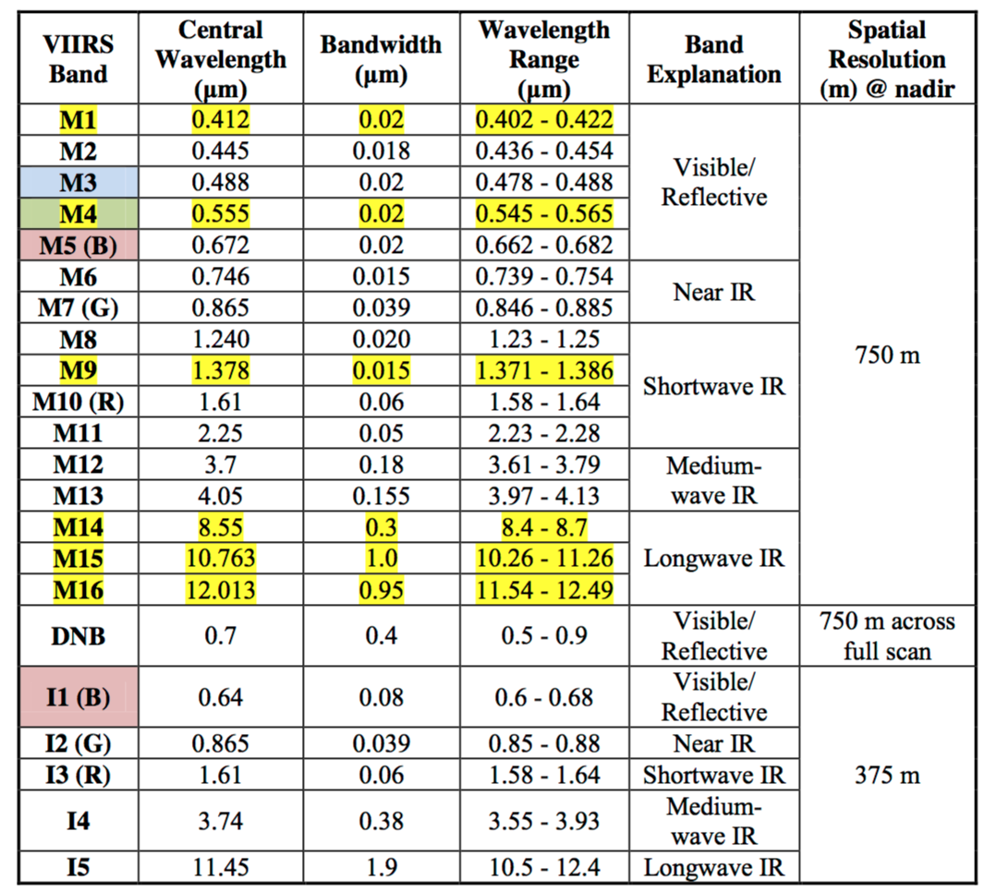
Introduction, VIIRS I and M band differences
• Some VIIRS bands have both an I or M band
• The 0.65µm, 0.87µm, and 1.6µm bands in the reflective solar bands
• The M bands have a larger spatial pixels and should have less radiometric noise than the I bands,
• If the 4 I band pixel radiances are averaged is that the equivalent noise of the M band?
• The 0.87µm and 1.6µm I and M bands have very similar spectral response functions
• The 0.65µm I and M bands have differing spectral response functions. This increases the SBAF uncertainty when scaling the radiometric calibration from one sensor to another.

Slide 3
Selection Criteria for the 0.65µm I or M band as the calibration reference
 | M band | I Band
Radiometric noise | M band has lower radiometric noise due to its larger pixel size | I band has a higher radiometric noise, but when averaged should have the same noise as the M band
Spectral response function | The M band spectral response is very narrow and does not match the newer GEOs and MODIS B1 | The I band spectral response is very similar to the newer GEOs and similar to the MODIS B1
SBAF uncertainty | Increased SBAF uncertainty when transferring the VIIRS calibration reference | Small SBAF uncertainty
Dataset ease of use | Just need to order the M band data and is less volume than the I band data | May cause extra programming to handle both M and I band
NPP VIIRS M5 and I1 calibration difference | The NPP M5 band is 1.5% brighter than the I1 band, The NOAA-20 M5 band, and Aqua-MODIS B1

Slide 4
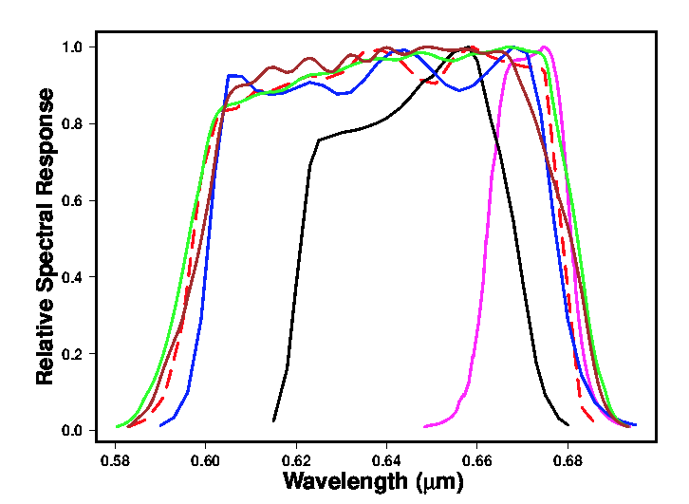
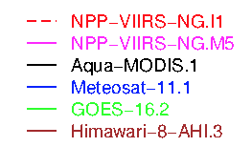
VIIRS I1 and M5 0.65µm spectral response

Slide 5
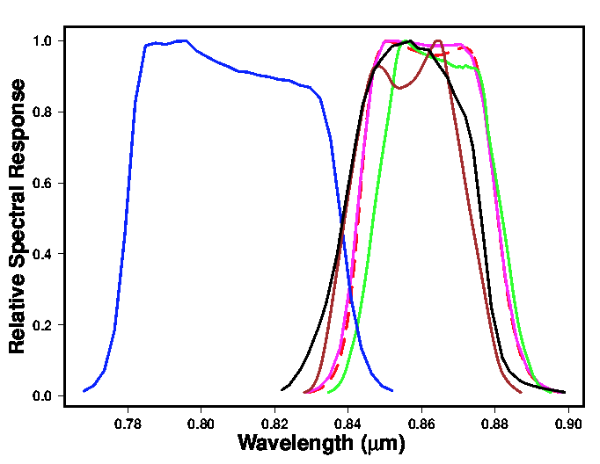
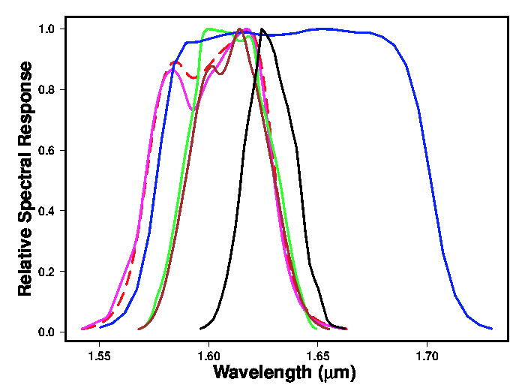
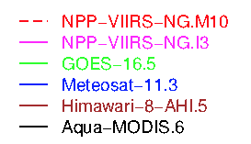
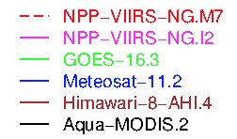
VIIRS I2/M7 and I3/M10 spectral response
0.86µm bands
1.6µm bands

Slide 6
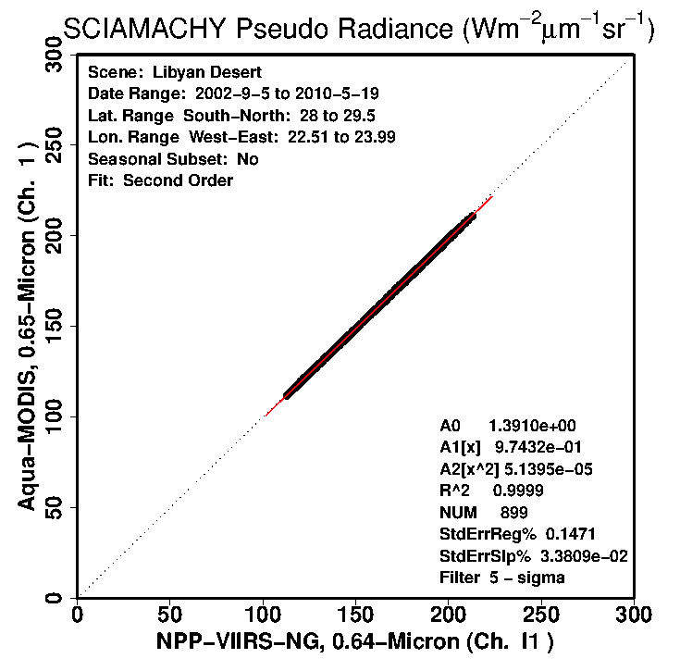
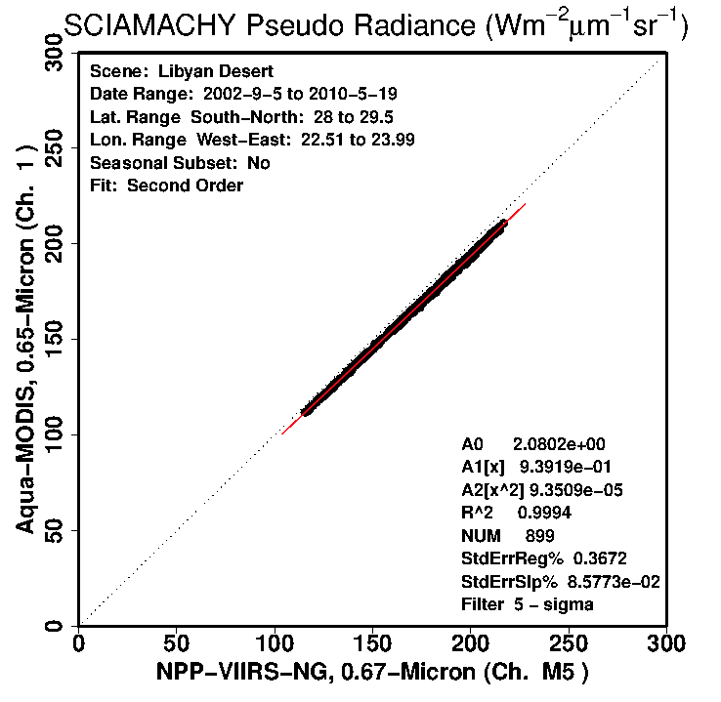
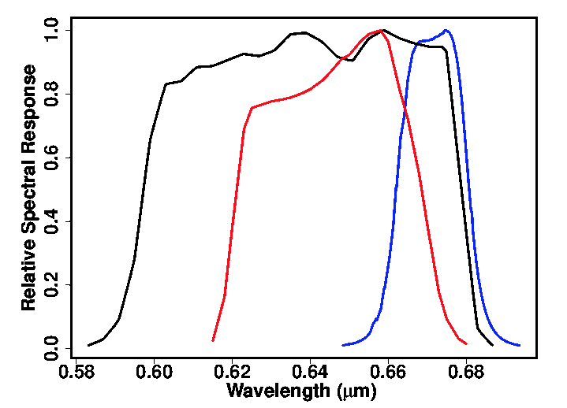
VIIRS I1 and M5 and MODIS B1 SBAF uncertainty
Aqua-MODIS B1
Libya-4, I1
Libya-4, M5
SBAF sigma (%) | I1 | M5
Libya-4 | 0.15 | 0.37
DCC | 0.06 | 0.21
Tropical Ocean | 0.24 | 0.97
Polar intersects | 0.52 | 1.41

Slide 7
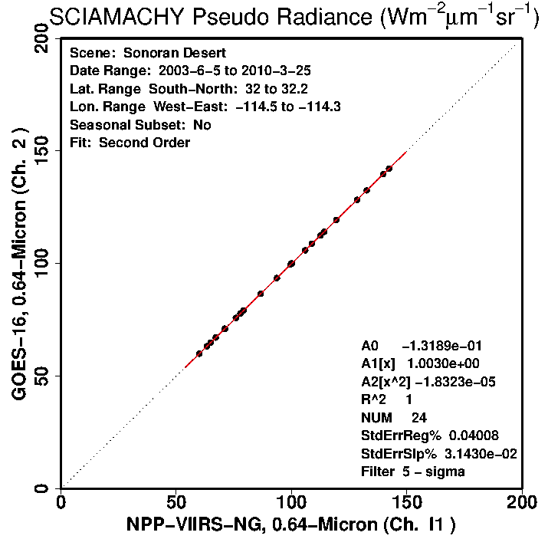
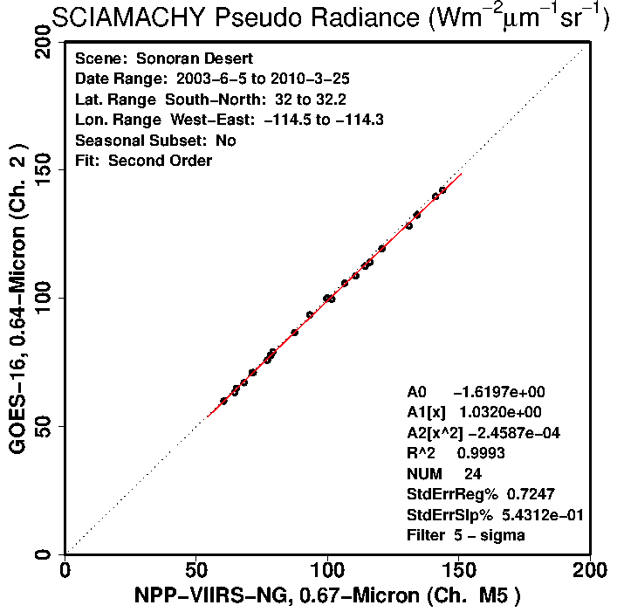
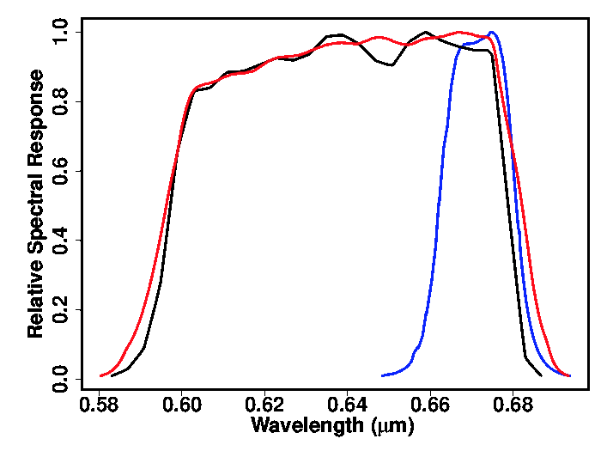
VIIRS I1 and M5 and GOES-16 B2, SBAF uncertainty
Met 8-11, GOES-16/Him-8
Sonoran, I1
Sonoran, M5
SBAF sigma (%) | I1 | M5
Libya-4 | 0.03 | 0.34
DCC | 0.02 | 0.19
Tropical Ocean | 0.06 | 0.87
Sonoran | 0.04 | 0.72

Slide 8
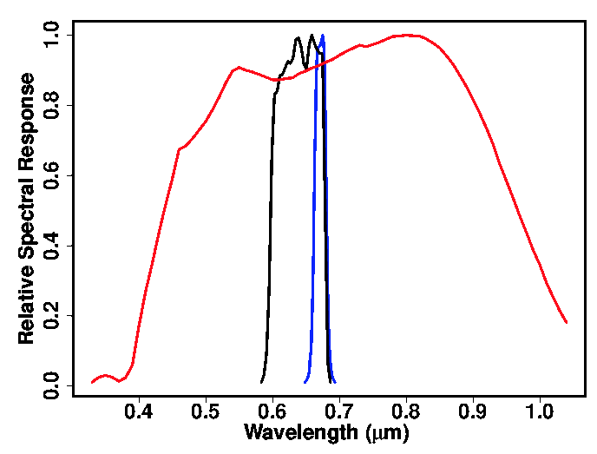
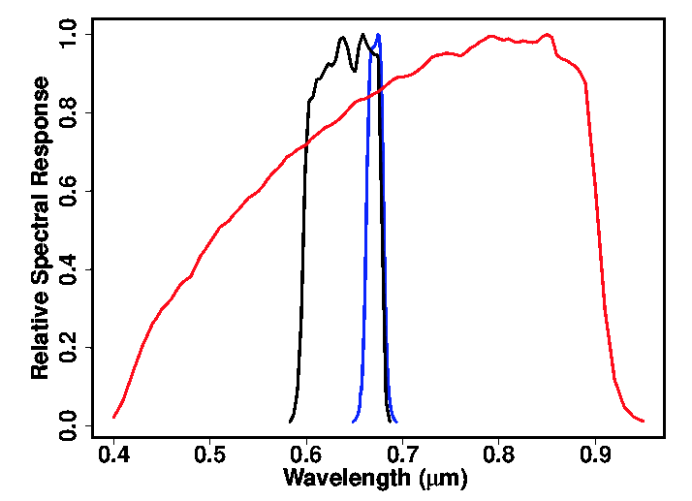
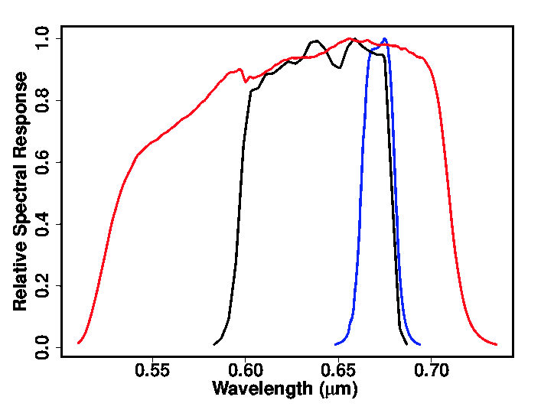
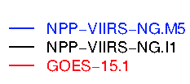
VIIRS I1 and M5 and GEO, SBAF uncertainty
Meteosat-7
FY-2E
GOES-15
SBAF sigma (%) | I1 | M5
Libya-4 | 1.33 | 1.67
DCC | 0.83 | 0.92
Tropical Ocean | 2.12 | 2.81
Arabia-1 | 1.29 | 1.67
SBAF sigma (%) | I1 | M5
Libya-4 | 0.94 | 1.15
DCC | 0.58 | 0.57
Tropical Ocean | 1.49 | 2.12
Badain | 1.17 | 1.12
SBAF sigma (%) | I1 | M5
Libya-4 | 0.38 | 0.67
DCC | 0.20 | 0.25
Tropical Ocean | 0.86 | 1.46
Sonoran | 0.70 | 1.37

Slide 9
Conclusions
Select the M bands, since they have larger pixels and therefor have less radiometric uncertainty if the spectral response is the same
For I1 and M5 bands, the spectral response differs. Most of the concurrent GEO and MODIS imagers have spectral responses more similar to M5 than I1.
The I1 band SBAF uncertainty is less for the concurrent GEO and MODIS imagers. If the GEO imagers have very broad SRF than the SBAFs are similar
But the I1 radiometric noise is larger. If 4 I1 pixels are averaged the radiometric noise should be similar
Most also consider data availability and programming ease.

